Slide 1
Seminar 1 International Finance
Michala Moravcova
Department of Finance, Masaryk University

Slide 2
Refinitiv – Thomson Reuters
About the software
Thomson Reuters vs. Bloomberg
Our users shared that Thomson Eikon (Refinitiv) is the newer, more affordable platform while Bloomberg is the industry leader with its advantage being its chat functionality that is widely used across the street (source).

Slide 3
Access the broadest and deepest coverage
LEVERAGE APPLIED LEARNING USING REAL-WORLD DATA AND STATISTICS
40 BILLION Daily market data updates | 92.5 MILLION Company financial data | 51 MILLION Estimates and KPIs | 52.8 MILLION Research pages per year from 1,300 firms | 9.5 MILLION Economic time series | 1.3 MILLION Equity quotes from 325 exchanges
Market data and pricing The widest available range of cross-asset data through low-latency, real-time and bulk-content delivery systems. |  |  |  | Company data Comprehensive and timely information to inform in-depth, bottom-up analyses. The leading provider of detailed company data. |  | Reference data Data to support security master and enterprise data management and asset set-up. Index constituents & weightings Industry classifications Symbology Terms and conditions
Indices Benchmarks Lipper Fund data Equities Derivatives & options | Derivatives & options Exchange-traded funds Evaluated pricing Fixed income Foreign exchange – FX and interest rate polls |  | Futures Loan pricing Municipal bonds New issues Real-time pricing | Bond holdings Business classifications Credit (CDS) Company news Corporate actions Debt new issues Entity risk (corporate structures) ESG data (ranking and ratings) Estimates Equity new issues Events & transcripts Fundamentals | Investment research Mergers and acquisitions People data Ownership Private company data Shareholder activism Intelligence Shareholding disclosures Syndicate loans and project finance Venture capital and private equity data
 |  |  |  |  |  | Analytics Unique data sets support idea generation, due diligence and decisions. Deal analytics StarMine® quantitative analytics and models
Economic data The largest collection of global economic time series content in the industry. Global key indicators National sources and calendars International historical sources Forward-looking economic indicators |  | News and insight Extensive coverage from the world’s leading financial news organization. Reuters News Third-party news sources and news wires Thomson Reuters news Analytics and MarketPsych Indices |  |  |  | Analytics Unique data sets support idea generation, due diligence and decisions. Deal analytics StarMine® quantitative analytics and models

Slide 4
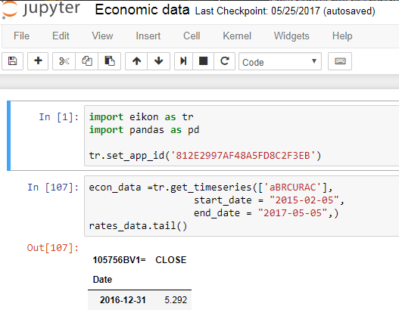
Bringing financial intelligence to academic institutions
Enhanced multi-platform experience
Students can continue their research seamlessly even away from university by accessing Workspace from their personal desktops or tablet via workspace.refinitiv.com/web
Open and agile
Students can conduct deeper data modeling and analysis with modern APIs and popular languages like Python, helping them broaden their knowledge of the markets.
They can also access the raw data, extract it, build it into models and applications – open access to our data – to drive innovation and your research.

Slide 5
News

Slide 6
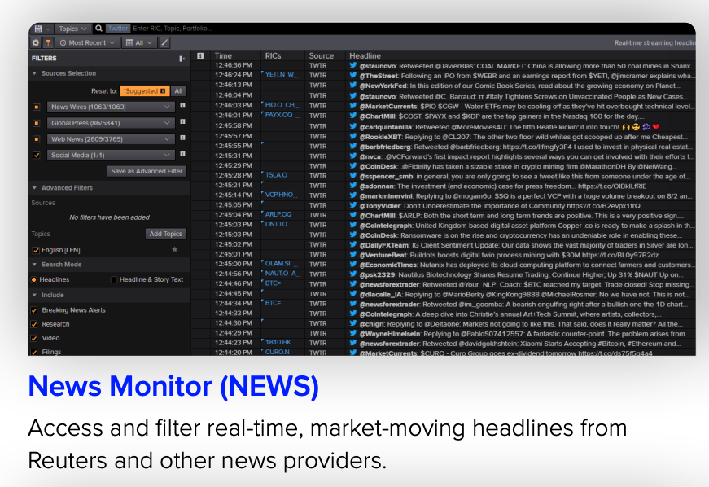

Slide 11
Financial news
cnbc.com
finance.yahoo.com
bloomberg.com (limited content)
reuters.com
wsj.com
marketwatch.com
tradingview.com
investing.com

