Slide 1
Gartner Magic Quadrant Tool
J.Skorkovský , KPH

Slide 2
Agenda related to MQ Matrix
Positioning Technology Players Within a Specific Market
Giving you a wide-angle view of the relative positions of the market's competitors
Helps to digest how well technology providers are executing against their stated vision

Slide 3
MQ Matrix
Challengers
Leaders
Ability to execute
Niche=Market gap
Niche players (gap in the market)
Visionaries
Completeness of vision

Slide 4
MQ Matrix explanation
Leaders execute well against their current vision and are well positioned for tomorrow (make money now and in the future - TOC statement).
Visionaries understand where the market is going or have a vision for changing market rules, but do not yet execute well.
Niche Players focus successfully on a small segment, or are unfocused and do not out-innovate or outperform others
Challengers execute well today or may dominate a large segment, but do not demonstrate an understanding of market direction.

Slide 5
MQ Matrix „A“ better than „B“ and „B“ Better than“C“
Challengers
Leaders
Ability to execute
A
B
Niche players
C
Visionaries
Completeness of vision

Slide 6
MQ Matrix Using colors in order to show progress (Red =bad, Green = good)
Challengers
Leaders
B
A
Ability to execute
B
A
Niche players
C
Visionaries
Completeness of vision

Slide 7
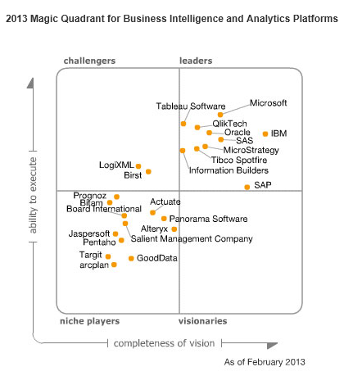
MQ for BI

Slide 8
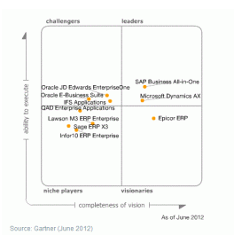
MQ for ERP

Slide 9
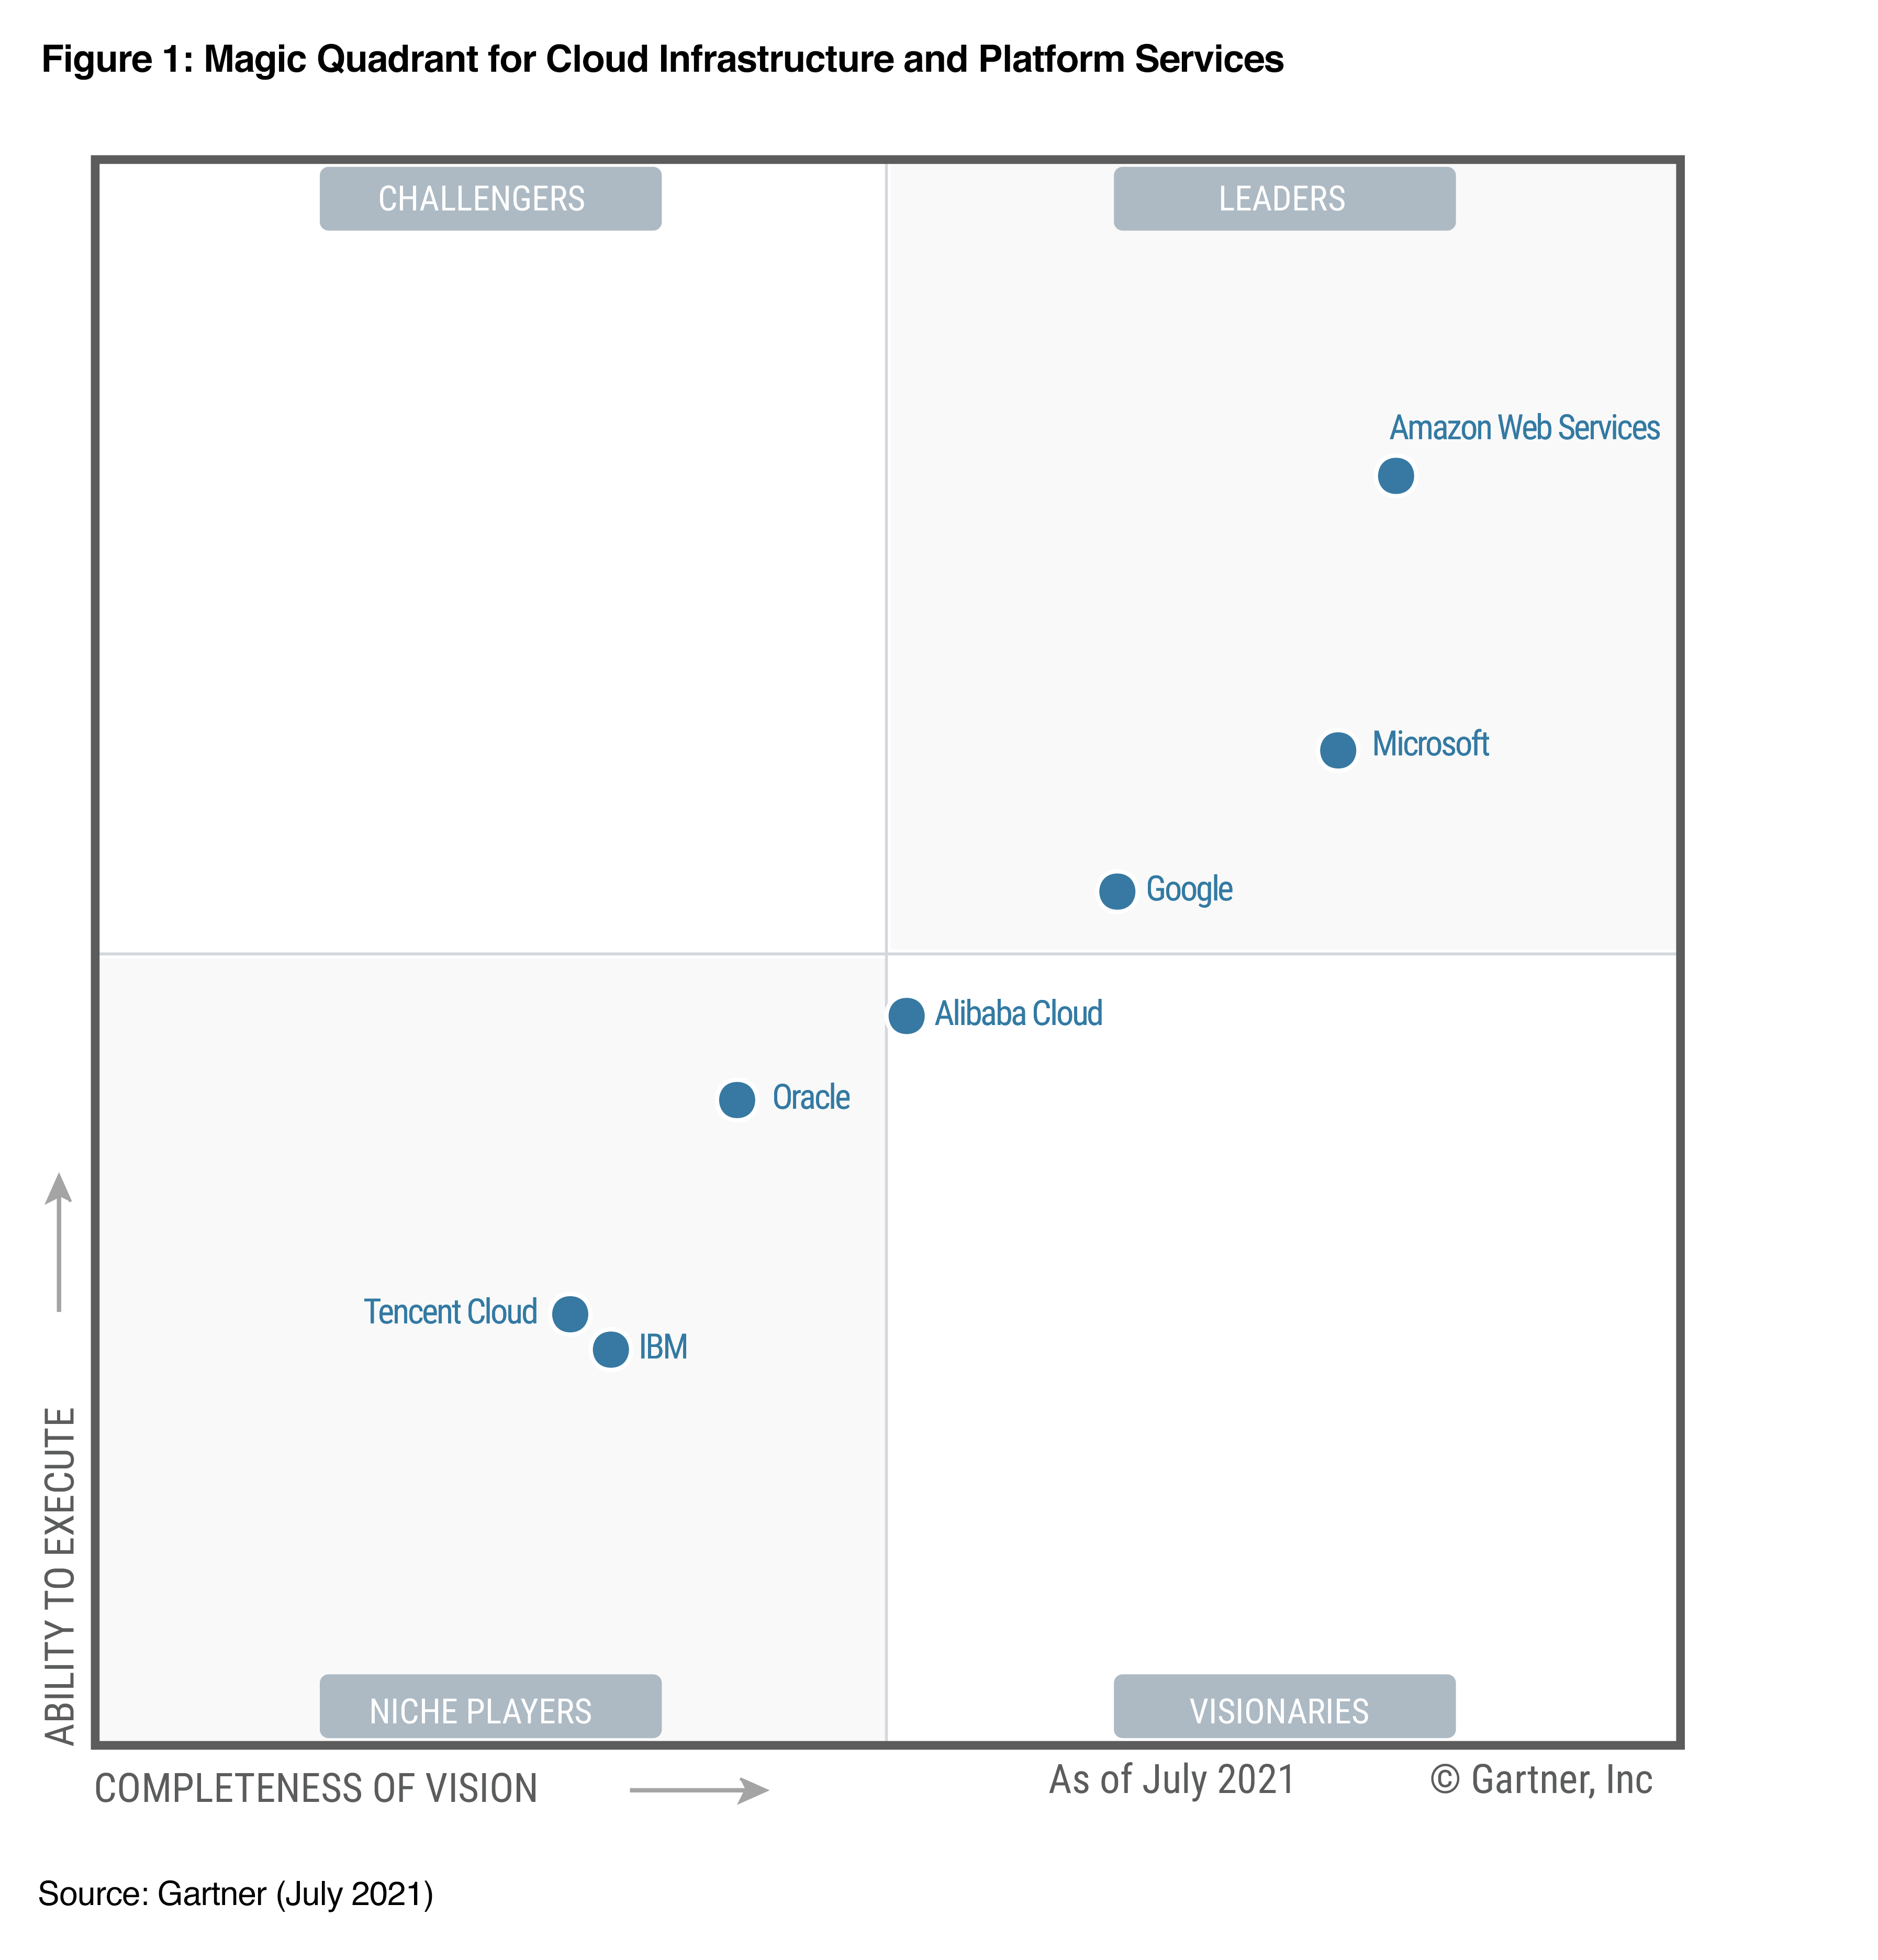
MQ for DMS for Cloud

Slide 10
MQ for DMS for Analytics
Resource : Daniel Souza
Senior Data Engineer - Open Banking & Finance and Payments

Slide 11
Example of evaluations, reviews and templates
EASE –OF – USE
Pros - Once you are comfortable working in NAV it is very easy to navigate
Cons
FUNCTIONALITY
Pros - It overs a large horizon of functions necessary for process control, so the adaptation of ESP to a branch solution is not demanding
Cons
PRODUCT QUALITY
Pros Thanks to tens of thousands of implementations and a large number of comments from customers all over the world, the system is extremely high quality
Cons
CUSTOMER SUPPORT
Pros Excellent training materials and teaching methods enable quality and trained consultants to deliver excellent service
Cons
VALUE FOR MONEY
Pros
- Cons -Often bad advice is received, where the NAV consultants don't even know how their own system works (Example)

