Slide 1
Product mixture
Ing.J.Skorkovský, CSc,
Department of Corporate Economy
FACULTY OF ECONOMICS AND ADMINISTRATION
Masaryk University Brno
Czech Republic

Slide 2
Parameters
TOC Company produces two products, Y and Z that are processed in four departments, A, B, C and D. Product Y requires three types of materials, M1, M2 and M4. Product Z requires two types of materials, M2 and M3. The company's production process is illustrated in the following graphic (see following picture)

Slide 3
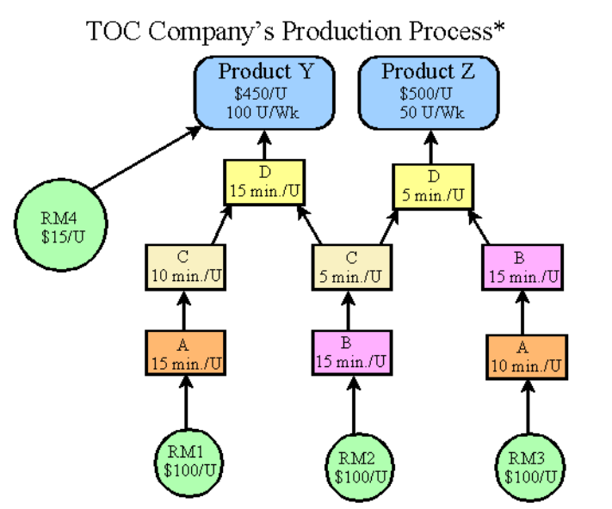
TOC company
In the production of product Z it is required to operate machine B two times
RM =Raw Material
U=Unit
U/W= Unit per Week

Slide 4
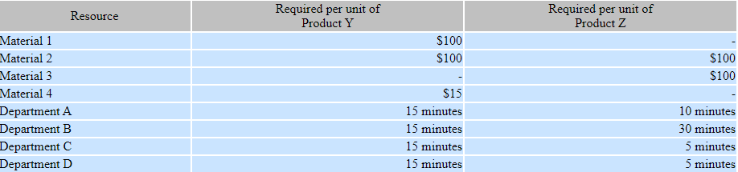
Parameters
Constraint 1: Each department has 2,400 minutes of available time per week.
Constraint 2: The Company's operating expenses are $30,000 per week (upper limit).
Constraint 3: Based on current demand, the company can sell 100 units of product Y per week.
Constraint 4: Based on the current demand the company can sell 50 units of product Z per week.
Sales prices are $450 for product Y and $500 for product Z.
All four materials are available in sufficient quantities.
The needed workers are also available.

Slide 5
Questions
1. Determine the company's constraint (bottleneck)
2. Determine the throughput (T) per unit for each product.
3. Determine the throughput (T) per minute of the constrained resource for each product.
4 Determine the product mix needed to maximize throughput (T), i.e., the number of units of Y and Z
that should be produced per week.
5. Determine the maximum Net Income per week for TOC Company.
6. Suppose the company broke the current constraint by doubling the capacity of that resource.
What would become the new constraint?

Slide 6
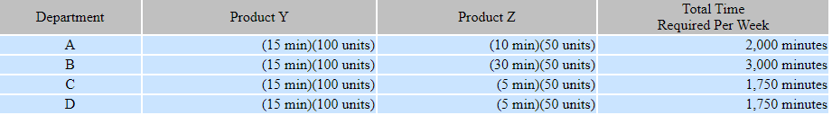
Company constraints
Time requirements to meet demand for each department are calculated as follows:
Each machine center has only 2,400 minutes of available time per week. B is the constraint because
it does not have enough capacity to process 100 units of Y and 50 units of Z per week.
15 min *100 units +30 min *50 units = 3000 minutes

Slide 7
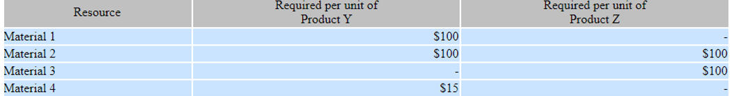

Determine the throughput per unit for each product.
Throughput per unit for each product is needed so that we can determine how to use the constraint to maximize throughput. Throughput per unit is as follows:
215=100+100+15
200= 100+100
Determine the throughput per minute of the constrained resource for each product.
Determine the product mix needed to maximize throughput, i.e., the number of units of Y and Z that should be produced per week.
Maximizing throughput requires producing as much of the product with the highest throughput per minute of the constrained resource as needed to meet demand.
The company should produce 100 units of product Y. This requires (100 units)(15 minutes) = 1,500 minutes of time in the constraint department B and leaves 2,400 - 1,500 = 900 minutes for the production of 30 units of product Z, i.e., 900 minutes ÷ 30 minutes per unit = 30 units of Z.

Slide 8
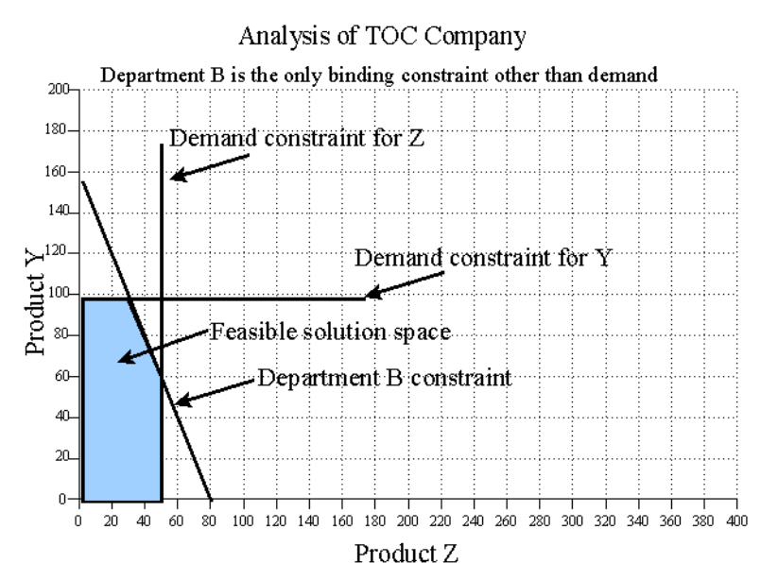
Graphic analysis I.
The following graphic analysis provides a general approach for solving simple product mix problems that is also applicable when there are overlapping constraints.
First, plot the constraints to find the feasible solution space. The B constraint is 15Y + 30Z = 2,400 so Department B could produce 160 Y's (i.e., 2,400/15) or 80 Z's (i.e., 2,400/30), or some combination of Y and Z indicated by the constraint line connecting those two points on the graph. The department B constraint and demand constraints define the feasible solution space indicated by the blue colored area on the graph.
An explanation of the equation of a line in the space X -Y
The company should produce 100 units of product Y. This requires (100 units)(15 minutes) = 1,500 minutes of time in the constraint department B and leaves 2,400 - 1,500 = 900 minutes for the production of 30 units of product Z, i.e., 900 minutes ÷ 30 minutes per unit = 30 units of Z.
1500 /100 = 15
900 /30 = 30
15Y + 30Z = 2,400
If Y=0 the Z=2400/30=80 and If Z=0 then Y=2400/15=160
Corner points

Slide 9
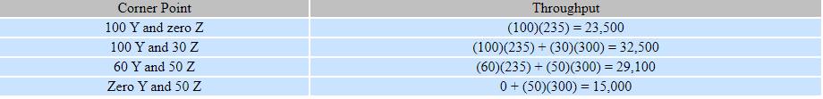
Graphic analysis II.
Check the solution at each corner point, or plot the objective function and move it to the right as far as possible in the feasible solution space. The objective function is to maximize throughput where Throughput = 235Y + 300Z. Checking the corner points we find that 100 Y and 30 Z provides the greatest amount of throughput.
If we plot the objective function 235/300 (i.e., it takes 0.7833 of a Z to produce as much throughput as 1 Y),
we can locate the solution by moving it to the outer most point in the feasible solution space as illustrated
on the next slide. The first objective function shows that 100 Ys would produce the same throughput as 78.3333
Zs. This is so called iso-throughput line indicating that any point on the line represents a combination of Y and Z that
produces $32,500 of throughput. The point indicated by 100 Y and 30 Z is the last point the objective
function touches in the feasible solution space as we move it up and to the right.
This point indicates the solution to our product mix problem.

Slide 10
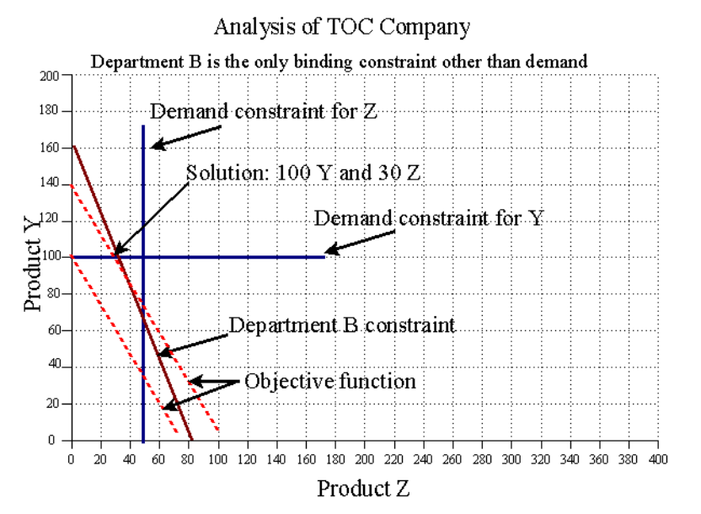
Graphic analysis III.

Slide 11
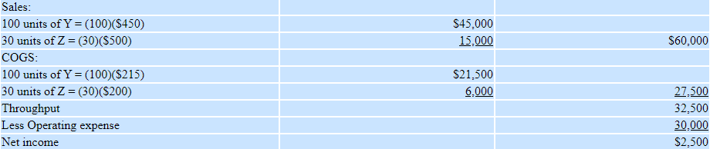
Maximum net income per week for TOC Company.
45000+1500
Note: An assumption in this illustration is that there are no beginning or ending inventories
of work in process or finished goods.
COGS = Cost of Goods Sold
215= Production cost (raw material)
200= Production cost (raw material)

Slide 12


