Slide 1
The Lean Canvas

Slide 2
The Lean Canvas
perfect one-page format for brainstorming possible business models
the blocks guide you through logical steps starting with your customer problems right through to your unfair advantage (often the hardest block to answer)

Slide 3
Problem
Each customer segment (CS) you are thinking to work with will have a set of problems that they need solving. Try listing the one to three high priority problems that you CS has.
Customer Segments
The problem and Customer Segments can be viewed as intrinsically connected — without a CS in mind you can’t think of their problems, and visa versa.
Unique Value Proposition
A promise of value to be delivered. It’s the primary reason a prospect should buy from you. A way to get your head around this is to think about why are you different and why should your CS buy/invest time in you

Slide 4
Solution
Finding a solution to the problem is the golden egg! You’re not going to get this right off the first bat — it’s OK, as that’s what Lean is all about. So go interview your customer segment, ask them questions, and take those learnings.
ways for you to reach your CS. And remember that in the initial stages it’s important not to think about scale but to focus on learning. With that in mind try to think about which channels will give you enough access to your CS at the same time give you enough learning. Channels can be email, social, ads, blogs, articles, trade shows, radio & TV, webinars

Slide 5
Revenue Streams
How you price your business will depend on the type of model it is, however, it’s quite common for startups to lower their cost, even offer it for free to gain traction, however, this can pose a few problems. The key being it actually delays/avoids validation. Getting people to sign up for something for free is a lot different than asking them to pay. There is also the idea of perceived value.
Cost Structure
Here you should list all the operational costs for taking this business to market.

Slide 6
Key Metrics
Every business, no matter what industry or size, will have some key metrics that are used to monitor performance. The best way to help with this is to visualise a funnel top down that flows from the large open top, through multiple stages to the narrow end
Unfair Advantage
“The only real competitive advantage is that which cannot be copied and cannot be bought.” — Jason Cohen (insider information, a dream team, getting expert endorsements, existing customers etc.)

Slide 7
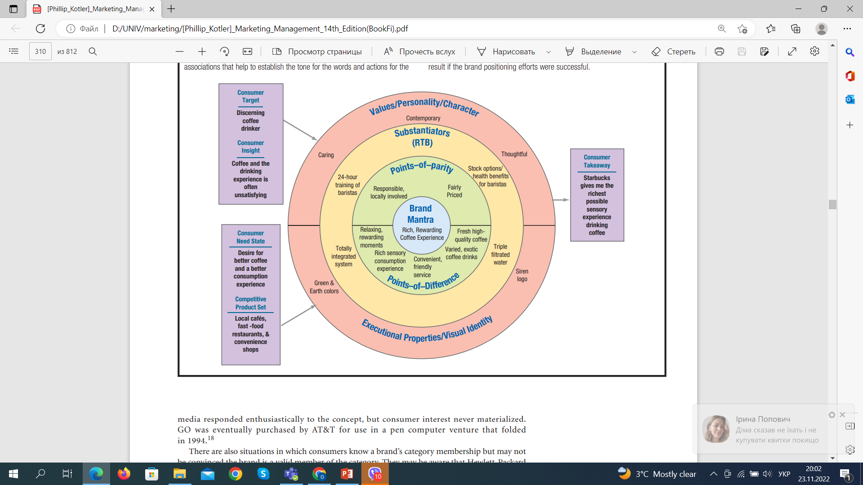
Brand positioning Bull’s eye

Slide 8
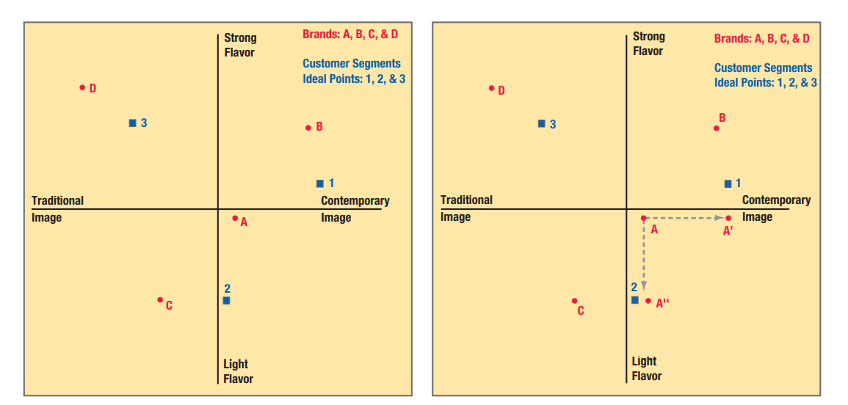
Positioning map

