Slide 1
Financing Healthcare
Public Finance 2

Slide 2
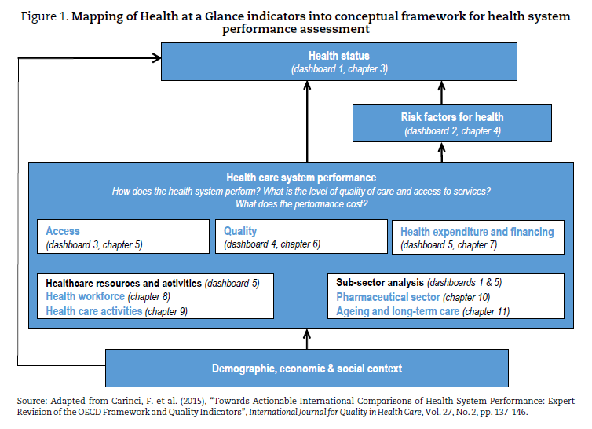
Source: OECD: Health at Glance, 2019

Slide 3
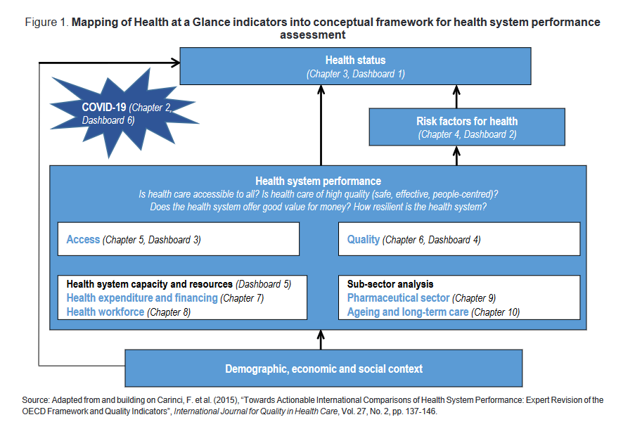
Source: OECD: Health at Glance, 2021

Slide 4
Definitions and concepts
citizens x healthcare
ageing x technology
public x private
solidarity x free market (benefits x drawbacks)
state (government, regional authority) x employers x insurance companies x healthcare providers x citizens
drugs

Slide 5
Factors that influence healthcare financing
legislature
new technology and development of new drugs
population health
demographic changes – ageing
international migration – insurance conditions for foreigners
economic a financial situation of the country – cost of healthcare in the country and in neighboring countries

Slide 6
The models of financing healthcare
public insurance – payroll tax x state insured x cost of labor
financing of healthcare through taxis (from state budget)
private insurance, private payments for treatment or drugs x responsibility of the people for their health
Diagnosis-related group (DRG) financing – comparison of treatment by different group

Slide 7
The problems of financing healthcare
healthcare standards and „quality“ of life
the role of insurance companies – what is paid and why? cream skimming – what is it?
regulatory fees – participation of patients – they have to pay some amount for treatment
private physicians and clinics – their role and financing
high consumption of drugs, the cost of the hospital stay – the tendency for corruption
salaries of medical staff (doctor, nurse etc.)

Slide 8
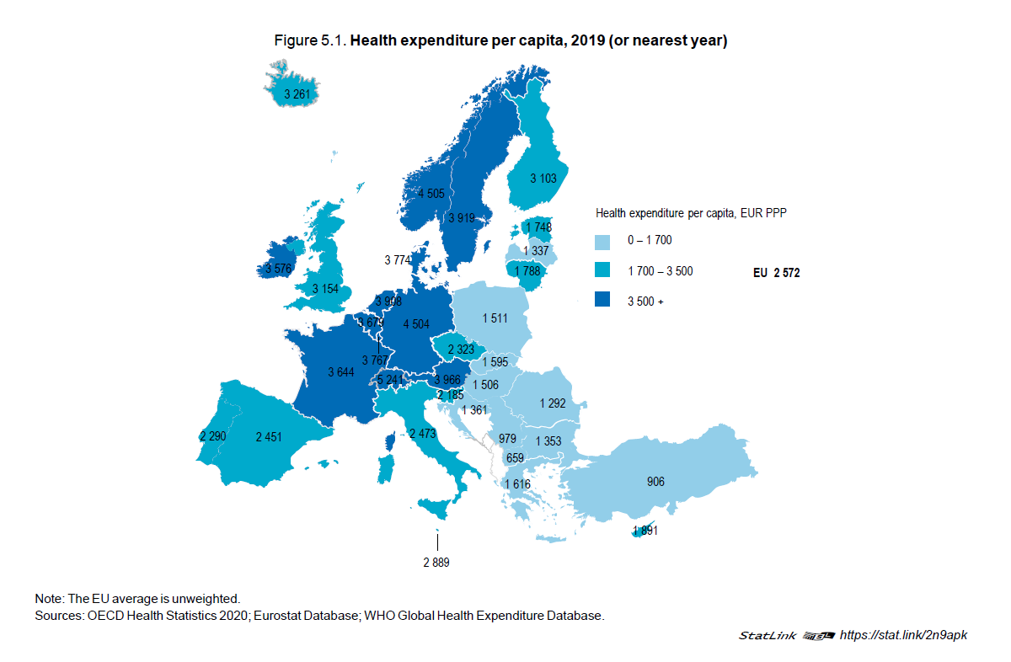

Slide 9
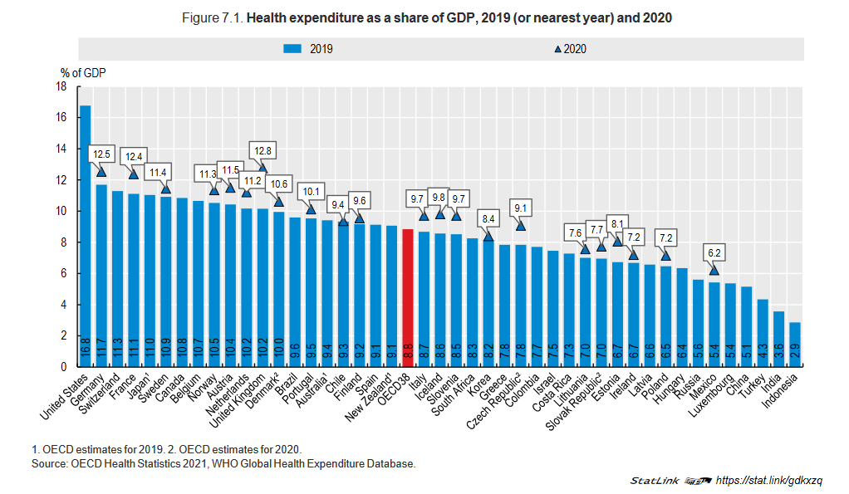
Source: OECD: Health at Glance, 2021

Slide 10
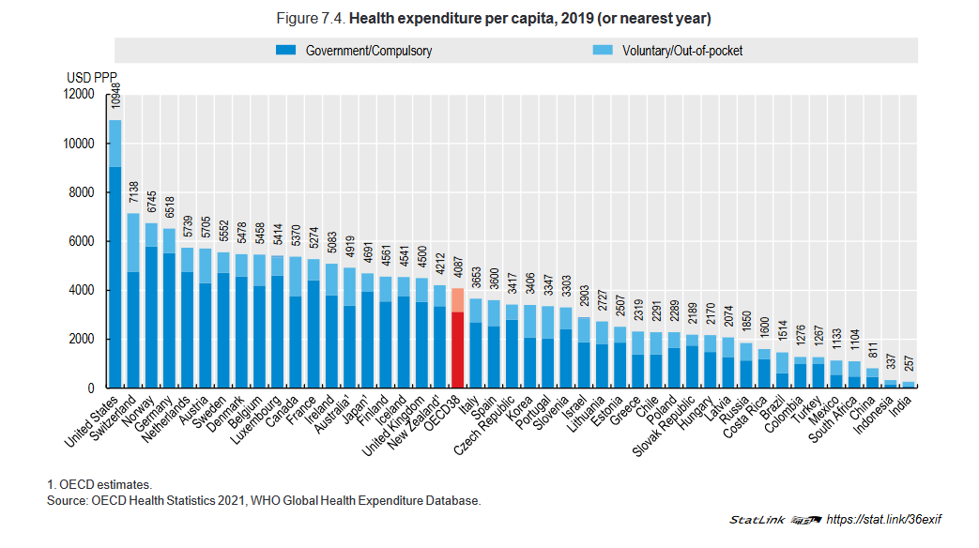
Source: OECD: Health at Glance, 2021

Slide 11
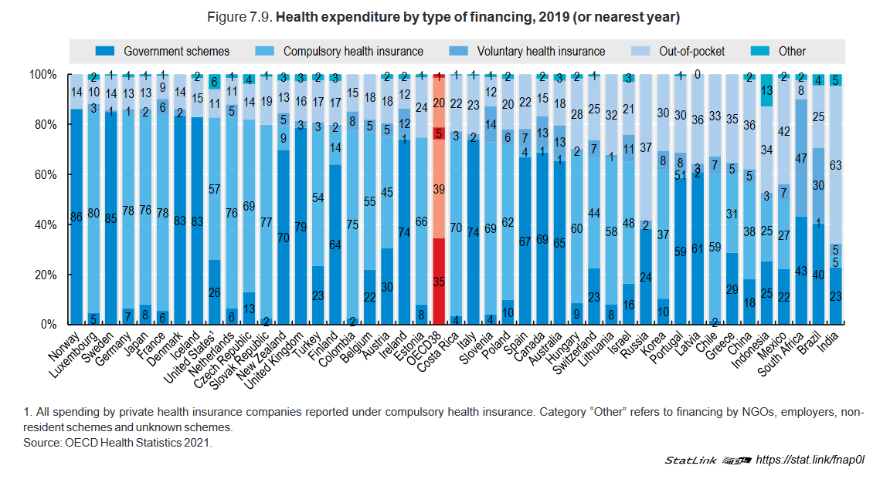
Source: OECD: Health at Glance, 2021

Slide 12
Sources
Health at a Glance 2021
https://www.oecd-ilibrary.org/social-issues-migration-health/health-at-a-glance-2021_ae3016b9-en
OECD Health Statistics 2021
http://www.oecd.org/els/health-systems/health-data.htm

Slide 13
Qaly
What does this concept mean?
Calculating QALYs, comparing QALY and DALY calculations:
http://heapol.oxfordjournals.org/content/21/5/402.full

Slide 14
Q & A

