Slide 2
Oracle Netsuite introduction
Pavel Hembera
ERP Product Manager
Oracle NetSuite
October 31, 2023
Notes:
Growth isn’t easy and when it comes to growing and scaling a company, its harder and harder to do. As the world’s most widely deployed Cloud ERP solution with thousands of clients who are successfully growing their business, we’ve learned a few things. I wanted to share some of those words to grow by.

Slide 3
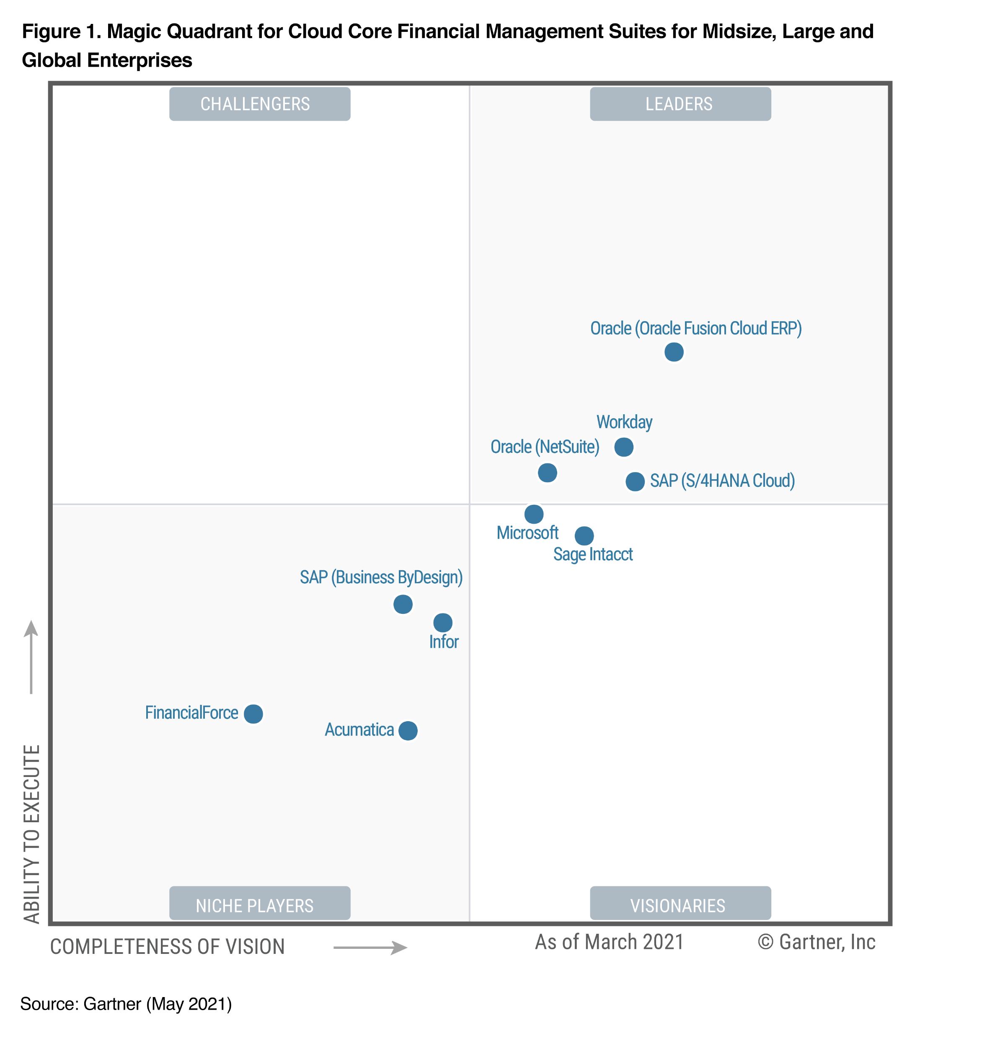
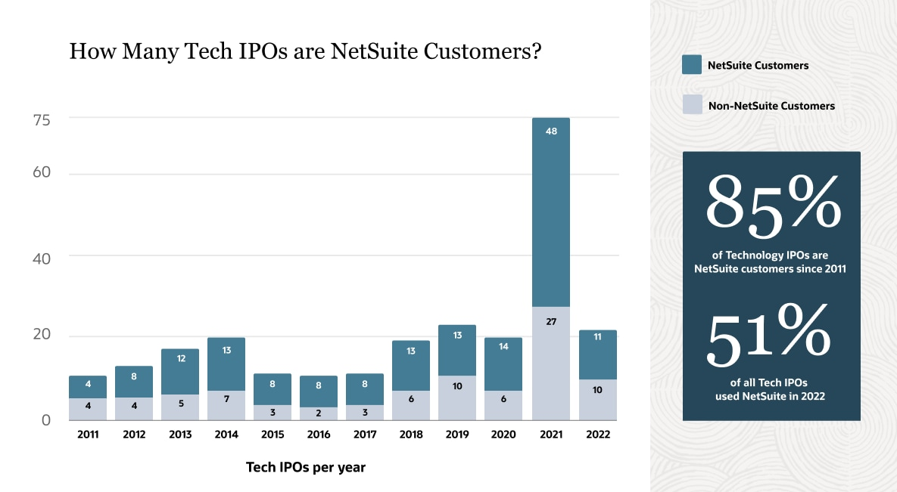
Why #1 Cloud ERP?
25 years on market
NetSuite is leader in cloud ERPs according to Gartner
85% of technology IPOs since 2011 are NetSuite customers
84% of companies in Forbes cloud 100 list are NetSuite customers
Notes:
And that’s what NetSuite is designed to address:
First and Foremost is our philosophy’ we were born in the cloud, and designed to address an entire business.
NetSuite is Cloud first and Cloud only. Meaning it has all of the tenants you would associate with a real cloud solution. Access using any device, anytime anywhere. Consumer oriented- easy for anyone to pick up and use without extensive training. Fit for purpose and always up to date
Built to run a business – most other cloud products out there were not built to run a business. They started off built to run something else, an HR department, a finance department, a shopfloor, a sales team. Meaning that when other capabilities were added they seemed like a bolt on. NetSuite knew from day one every function within a company needed a solution as though it was designed for them. That’s why it has all the key business functions represented equally; Finance, Sales, Product, Service, People etc. Ensuring that when users access the system it looks as though it has been specifically written for their role.
Built on a single data source: Our Unified Data modelis the key to being able to enable BI the way companies need it today. Our unified data model allows you to report and analyze your entire business end to end. It’s all real-time with no need to build complex data warehouses with multiple moving parts that many other products require as they have multiple products on multiple platforms. NetSuite’s unified data model delivers unrivalled analytical capabilities on day one. The Unified Data Model allows customers to define who is able to view, analyze and transact what across the enterprise. Managing security by functional area, fields, companies, subsidiaries and sites. In most other solutions managing security means trying to coordinate rights across multiple platforms and environments. In NetSuite our customers just get it.
All of this is built on the SuiteCloud platform.
NetSuite’s SuiteCloud platform offers unrivalled levels of personalization, customization and development. All within a framework that ensures security, scalability, globalization and built in capability of being kept up to date with the latest versions of the software.
It enables a vibrant Ecosystem of developers who know that they only have one version to worry about and all customers have access to their solutions. It enables developers to use industry-standard technology.
SuiteCloud is one of the most powerful well used PaaS’s available, with 1000’s of developers providing real solutions that are being used every day.
NetSuite provides the functionality that every business needs to be successful, HR, CoreFinancials, SCM, CRM, Ecommerce and coupled with our Built for NetSuite program, our partners are building on top of our platform to ensure companies have what is needed to be successful.
And through all of this NetSuite IS Global. Every business is becoming more global and will need these capabilities in order to compete. This means not only being able to transact in different countries but to be able to run on a platform that is available 24x7x365, is secure, scalable and always updated with the latest requirements.
We are able to handle the difficult task of going global with multi-book, multi-language, multi-currency and multi-country tax compliance.
And last but not least is that its built for your industry. We make sure that NetSuite has what is needed across Software, Services, Advertising Media and Publishing, Non Profit, Manufacturing, Wholesale Distribution and Retail to name a few.

Slide 4
Oracle NetSuite
10,000+
The first cloud company
Employees globally
Global Business Unit
37,000+
300+ Partners
Customers worldwide
Customers in over 203 Countries and Territories
4,500+
New customers in the last 12 months
Notes:
NetSuite’s scale and ability to execute are unsurpassed. We have over 18,000 customers all running on the SAME version of the product. With support for emerging companies to some of the largest global enterprises, NetSuite remains the fastest growing financial management platform in the world. We are an especially trusted partner to public companies, with over a 1/3 of ipos last year running on our platform—what a testament to innovation!
Growth is not new to us. In fact, everyone else is trying to catch up. Our proven, reliable and scalable success is what caught the attention of Oracle and led to our acquisition back in late 2016. So rest assured that our tried and true experience and unparalleled support for our customers continues as NetSuite grows to new heights. And we had record 2018 growth with over a 3,000 new customers that signed up with us in the last twelve months.

Slide 5
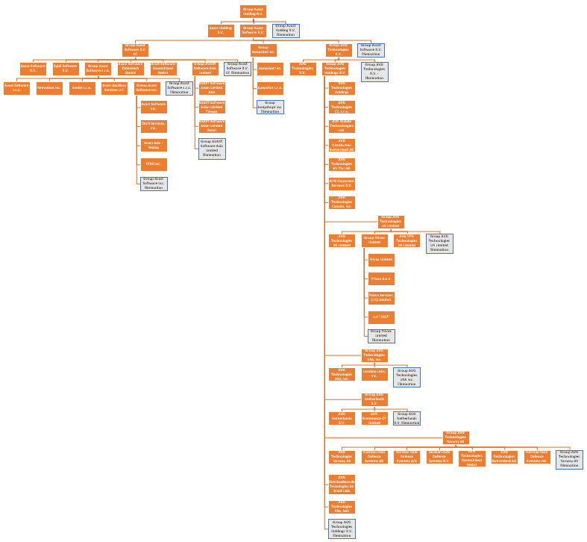
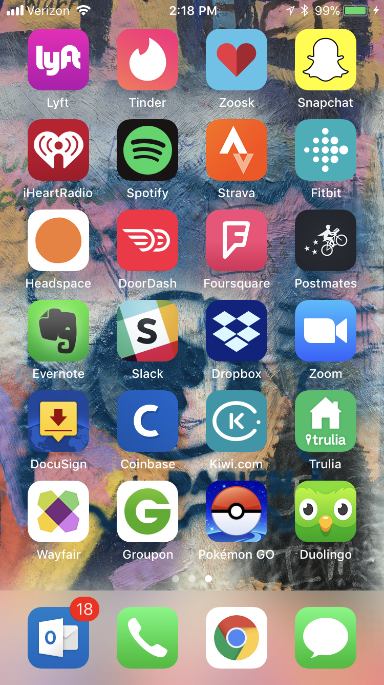
Our customers
Small to enterprise size companies
Key markets
US
EMEA
JAPAC
Key industries
Software
Services
Manufacturing
Wholesale
Retail
Notes:
And that’s what NetSuite is designed to address:
First and Foremost is our philosophy’ we were born in the cloud, and designed to address an entire business.
NetSuite is Cloud first and Cloud only. Meaning it has all of the tenants you would associate with a real cloud solution. Access using any device, anytime anywhere. Consumer oriented- easy for anyone to pick up and use without extensive training. Fit for purpose and always up to date
Built to run a business – most other cloud products out there were not built to run a business. They started off built to run something else, an HR department, a finance department, a shopfloor, a sales team. Meaning that when other capabilities were added they seemed like a bolt on. NetSuite knew from day one every function within a company needed a solution as though it was designed for them. That’s why it has all the key business functions represented equally; Finance, Sales, Product, Service, People etc. Ensuring that when users access the system it looks as though it has been specifically written for their role.
Built on a single data source: Our Unified Data modelis the key to being able to enable BI the way companies need it today. Our unified data model allows you to report and analyze your entire business end to end. It’s all real-time with no need to build complex data warehouses with multiple moving parts that many other products require as they have multiple products on multiple platforms. NetSuite’s unified data model delivers unrivalled analytical capabilities on day one. The Unified Data Model allows customers to define who is able to view, analyze and transact what across the enterprise. Managing security by functional area, fields, companies, subsidiaries and sites. In most other solutions managing security means trying to coordinate rights across multiple platforms and environments. In NetSuite our customers just get it.
All of this is built on the SuiteCloud platform.
NetSuite’s SuiteCloud platform offers unrivalled levels of personalization, customization and development. All within a framework that ensures security, scalability, globalization and built in capability of being kept up to date with the latest versions of the software.
It enables a vibrant Ecosystem of developers who know that they only have one version to worry about and all customers have access to their solutions. It enables developers to use industry-standard technology.
SuiteCloud is one of the most powerful well used PaaS’s available, with 1000’s of developers providing real solutions that are being used every day.
NetSuite provides the functionality that every business needs to be successful, HR, CoreFinancials, SCM, CRM, Ecommerce and coupled with our Built for NetSuite program, our partners are building on top of our platform to ensure companies have what is needed to be successful.
And through all of this NetSuite IS Global. Every business is becoming more global and will need these capabilities in order to compete. This means not only being able to transact in different countries but to be able to run on a platform that is available 24x7x365, is secure, scalable and always updated with the latest requirements.
We are able to handle the difficult task of going global with multi-book, multi-language, multi-currency and multi-country tax compliance.
And last but not least is that its built for your industry. We make sure that NetSuite has what is needed across Software, Services, Advertising Media and Publishing, Non Profit, Manufacturing, Wholesale Distribution and Retail to name a few.

Slide 6
My career path
ESF MU graduate – Economic Policy and Administration
15 years experience in Consulting
Microsoft Dynamics NAV
SAP
NetSuite
Current position: ERP Product Manager

Slide 7
What to focus on
Ability to learn new things
Excellent communication skills
Languages
Willingness to travel
Enthusiasm
Basic accounting knowledge
Understanding of business processes
Technical skills (Java, .NET, PHP, JavaScript, HTML)
Basic knowledge of databases (data types and structures)
Basic knowledge of software engineering
Work experience
Notes:
And that’s what NetSuite is designed to address:
First and Foremost is our philosophy’ we were born in the cloud, and designed to address an entire business.
NetSuite is Cloud first and Cloud only. Meaning it has all of the tenants you would associate with a real cloud solution. Access using any device, anytime anywhere. Consumer oriented- easy for anyone to pick up and use without extensive training. Fit for purpose and always up to date
Built to run a business – most other cloud products out there were not built to run a business. They started off built to run something else, an HR department, a finance department, a shopfloor, a sales team. Meaning that when other capabilities were added they seemed like a bolt on. NetSuite knew from day one every function within a company needed a solution as though it was designed for them. That’s why it has all the key business functions represented equally; Finance, Sales, Product, Service, People etc. Ensuring that when users access the system it looks as though it has been specifically written for their role.
Built on a single data source: Our Unified Data modelis the key to being able to enable BI the way companies need it today. Our unified data model allows you to report and analyze your entire business end to end. It’s all real-time with no need to build complex data warehouses with multiple moving parts that many other products require as they have multiple products on multiple platforms. NetSuite’s unified data model delivers unrivalled analytical capabilities on day one. The Unified Data Model allows customers to define who is able to view, analyze and transact what across the enterprise. Managing security by functional area, fields, companies, subsidiaries and sites. In most other solutions managing security means trying to coordinate rights across multiple platforms and environments. In NetSuite our customers just get it.
All of this is built on the SuiteCloud platform.
NetSuite’s SuiteCloud platform offers unrivalled levels of personalization, customization and development. All within a framework that ensures security, scalability, globalization and built in capability of being kept up to date with the latest versions of the software.
It enables a vibrant Ecosystem of developers who know that they only have one version to worry about and all customers have access to their solutions. It enables developers to use industry-standard technology.
SuiteCloud is one of the most powerful well used PaaS’s available, with 1000’s of developers providing real solutions that are being used every day.
NetSuite provides the functionality that every business needs to be successful, HR, CoreFinancials, SCM, CRM, Ecommerce and coupled with our Built for NetSuite program, our partners are building on top of our platform to ensure companies have what is needed to be successful.
And through all of this NetSuite IS Global. Every business is becoming more global and will need these capabilities in order to compete. This means not only being able to transact in different countries but to be able to run on a platform that is available 24x7x365, is secure, scalable and always updated with the latest requirements.
We are able to handle the difficult task of going global with multi-book, multi-language, multi-currency and multi-country tax compliance.
And last but not least is that its built for your industry. We make sure that NetSuite has what is needed across Software, Services, Advertising Media and Publishing, Non Profit, Manufacturing, Wholesale Distribution and Retail to name a few.

Slide 8
Thank you

