Slide 1
Articles, quantifiers and determiners
The presentation is divided into three levels:
= Lower-intermediate/Intermediate
= Upper-intermediate

Slide 2

countability
Articles, quantifiers and determiners
Look at the nouns:
BOX, DOG, CUSTOMER
1 box, 2 boxes, 3 boxes …
1 dog, 2 dogs, 3 dogs …
1 customer, 2 customers, 3 customers …
If you can count them (they are individuals), they are COUNT NOUNS.
MILK, SNOW, LOVE
1 milk, 2 milks, 3 milks,...
1 snow, 2 snows, 3 snows, ...
1 love, 2 loves, 3 loves,...
If you can’t count them (they are part of a mass or are abstract nouns), they are NON-COUNT NOUNS.
Lower-intermediate/Intermediate level

Slide 3
countability
Articles, quantifiers and determiners
Which nouns are count and which are non-count?
ADVERTISEMENT, ADVICE, COMPLAINT, DEPARTMENT, EMPLOYEE, EQUIPMENT, EXPERIENCE, INFORMATION, MONEY, OFFICE, SERVICE, STAFF
*‘Experiences’ can be used in plural, but then it means “zážitky”
COUNT | NON-COUNT
ADVERTISEMENT / ADVERTISEMENTS
COMPLAINT / COMPLAINTS
DEPARTMENT / DEPARTMENTS
EMPLOYEE / EMPLOYEES
OFFICE / OFFICES
SERVICE / SERVICES
ADVICE / ADVICES
EQUIPMENT / EQUIPMENTS
EXPERIENCE / EXPERIENCES*
INFORMATION / INFORMATIONS
MONEY / MONEYS
STAFF / STAFFS
Lower-intermediate/Intermediate level

Slide 4
much, many, few, little
Articles, quantifiers and determiners
Read the questions and answers:
How many customers came to the party?
Only a few customers came.
There were fewer customers than last time.
There were the fewest customers that have ever come to our parties.
Use many → more → the most and few → fewer → the fewest with COUNT NOUNS.
How much snow was there in the Alps last year?
There was really little snow.
There was less snow than the year before.
There was the least snow in history.
Use much → more → the most and little → less → the least with NON-COUNT NOUNS.
Lower-intermediate/Intermediate level

Slide 5


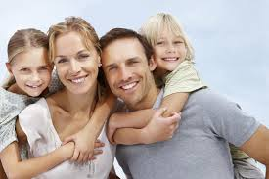
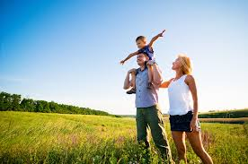
this, that, these, those
Articles, quantifiers and determiners
This person is happy.
That person is happy.
(singular, close to the speaker)
(singular, far from the speaker)
These people are happy.
Those people are happy.
(plural, close to the speaker)
(plural, far from the speaker)
Lower-intermediate/Intermediate level

Slide 6
the indefinite article
Articles, quantifiers and determiners
A/AN
A dog
‘A’ is used with consonants (b, d, f, m, etc.).
An apple
‘An’ is used with vowels (a, e, i, o, u).
Pronunciation matters!
A university [ˌjuːnɪˈvɜːsəti]
An hour [ˈaʊər]
Lower-intermediate/Intermediate level

Slide 7
the definite article
Articles, quantifiers and determiners
THE
the dog
[ðə] with consonants
the apple
[ði, ðiː] with vowels
Spelling doesn’t change, but pronunciation does.
Lower-intermediate/Intermediate level

Slide 8
use of articles – singular
Articles, quantifiers and determiners
Look at the sentences:
A customer bought shoes in our shop.
We don’t know yet who the person is specifically.
We use the indefinite article for unspecified or unknown people/things that are count and singular.
The customer paid by credit card.
We already know who the person is (= the one who bought shoes in our shop).
We use the definite article for specific or known people/things that are count and singular.
Singular count nouns always need either a definite or an indefinite article.
Lower-intermediate/Intermediate level

Slide 9
use of articles – plural
Articles, quantifiers and determiners
Look at the sentences:
Customers buy shoes in our shop.
We mean a group of people, customers in general => no article (the zero article).
We don’t use an article for unspecified or unknown people/things that are count and plural.
The customers are always satisfied.
We mean the specific customers who buy shoes in our shop.
We use the definite article for specific or known people/things that are count and plural.
Ø
Lower-intermediate/Intermediate level

Slide 10
use of articles – non-count nouns
Articles, quantifiers and determiners
Look at the sentences:
Milk is good for your bones.
We mean all milk in general => no article.
We don’t use an article for unspecified or unknown substances/ideas which are non-count.
You can drink the milk I bought today – it’s in the fridge.
We mean specific milk (which I bought today).
We use the definite article for specific or known substances/ideas which are non-count.
Ø
Lower-intermediate/Intermediate level

Slide 11
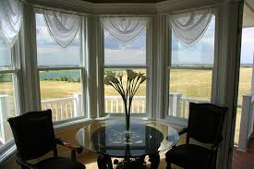
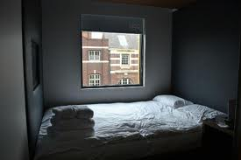
use of articles
Articles, quantifiers and determiners
For singular count nouns:
Open a window.
Using the indefinite article means that there are more windows and you can open any one of them.
Open the window.
Using the definite article means that there is only one window and it is clear which the speaker wants you to open.
Lower-intermediate/Intermediate level

Slide 12
use of articles
Articles, quantifiers and determiners
For plural count nouns (also applies to non-count nouns):
Open the windows.
Using the definite article means that there are more windows, and the speaker wants you to open all of them.
Open some windows.
Using “some” means that there are more windows, and it doesn’t matter how many or which ones you decide to open.
Lower-intermediate/Intermediate level

Slide 13
indefinite article – summary
Articles, quantifiers and determiners
Basic rules for using the indefinite article:
The indefinite article a/an is used with an unspecified (or indefinite) member of a group or category (count, singular).
a window
a boy
a nice day
(one of all windows in the world, in a room, in a building…)
(one of all boys in the world, in a classroom…)
(one of all nice days in history)
Lower-intermediate/Intermediate level

Slide 14
definite article – summary
Articles, quantifiers and determiners
Basic rules for using the definite article:
The definite article the is used with a specified (or definite) member or specified members of a group or category (count, singular or plural) and with specified non-count nouns.
the workers in our team
the snow in our garden
The is also used with a unique person/thing – everyone knows which one we talk about because there is only one.
the sun
the sky
the floor
the top
the president
(the solar system only has one sun)
(our planet only has one sky)
(a room only has one floor)
(a page/a box/etc. only have one top)
(a country only has one president)
BUT with names: Ø President Obama, Ø Queen Victoria…
Lower-intermediate/Intermediate level

Slide 15
no article – summary
Articles, quantifiers and determiners
Basic rules for using no article:
We don’t use any article if we talk about all members of a group or category (count, plural), or if we talk about unspecified non-count nouns.
Ø Consumers like Ø low prices.
Ø Vegetarians don’t eat Ø meat.
(all consumers in the world, all low prices)
(all vegetarians, all kinds of meat)
Lower-intermediate/Intermediate level

Slide 16
practice
Articles, quantifiers and determiners
Read the text and decide which articles to use to complete it.
I met ___ client in ___ restaurant yesterday. ___ restaurant was full
of ___ people, so there weren’t enough tables. He joined me and we drank
___ red wine with our dinner. ___ wine was extremely delicious. Then we
wanted to pay, so I talked to ___ waiter, but it wasn’t ___ waiter who took
care of us during ___ evening. After we paid, we took ___ walk and
watched ___ moon move across ___ sky.
a
a
The
client and restaurant are mentioned for the first time
the restaurant was mentioned before
Ø
people in plural and in general, not a specific group
Ø
The
non-count, mentioned for the first time
we already know which wine
a
the
one of the waiters, not a specific one
the specific waiter
the
a
the specific evening when the story happened
mentioned for the first time
the
the
there is only one moon
there is only one sky
Lower-intermediate/Intermediate level

Slide 17
the indefinite article
Articles, quantifiers and determiners
Look at the sentences:
She’s an accountant.
He’s a systems analyst.
Use the indefinite article with jobs (in singular).
He won a million dollars.
I found a euro on the ground.
Use the indefinite article instead of “one”.
She can write twenty pages a day.
The car went 220 km an hour.
Use the indefinite article instead of “per”.
= He won one million dollars.
= I found one euro on the ground.
= She can write twenty pages per day.
= The car went 220 km per hour.
Upper-intermediate level

Slide 18
the indefinite article
Articles, quantifiers and determiners
Look at the sentences:
She’s an American.
He’s a German.
Use the indefinite article with nationalities (in singular).
(1) He’s a Frenchman.
(2) She’s a Spaniard.
If the nationality adjective ends in –ish, –ch or –ese, it cannot be used by itself as a noun representing a person. –man, –woman or –person has to be added (1), or a special word is used (2).
(a person from Spain)
Upper-intermediate level

Slide 19
the indefinite article
Articles, quantifiers and determiners
Look at the sentences:
I drink a lot of Ø coffee.
Non-count nouns are used without an article if we talk about the substance in general.
I have a coffee every morning.
We can use an indefinite article with non-count nouns if we want to talk about one container (glass/box/mug/bottle...).
That man is Ø Mr Smith.
Names are usually used without an article.
There’s a Mr Smith waiting for you.
We can use an indefinite article with names if we want to express that we know the name of the person, but the person themselves is unknown to us.
= I have one cup of coffee.
Upper-intermediate level

Slide 20
the definite article
Articles, quantifiers and determiners
Look at the sentences:
This is the best cafe in the town.
Use the definite article with superlatives (there is always only one superlative thing/person).
This is the first time I’ve been to Brighton.
Use the definite article with ordinal numbers (the first, the second, the hundredth... => there is always only one in that place).
She plays the drums.
Use the definite article with musical instruments.
The police are looking for a missing girl.
Germany is a member of the EU.
Use the definite article with organisations and institutions.
Upper-intermediate level

Slide 21
the definite article
Articles, quantifiers and determiners
Look at the sentences:
I’m going to the United Kingdom for a holiday.
I really love the Netherlands.
Use the definite article with countries with state, kingdom or republic in the name, or with country names in plural.
She would like to climb in the Himalayas.
I spent last summer in the Bahamas.
Never swim in the Nile!
Use the definite article with geographical names: mountain ranges, groups of islands, rivers, seas, oceans, and canals.
Upper-intermediate level

Slide 22
the definite article
Articles, quantifiers and determiners
Look at the sentences:
Let’s go see the Mona Lisa at the Louvre.
Use the definite article with well-known buildings or works of art.
We’re staying at the Ritz.
They have great beer in the King’s Head.
Use the definite article with hotels, pubs, and restaurants.
I read the Washington Post every morning.
Use the definite article with newspapers.
Upper-intermediate level

Slide 23
the definite article
Articles, quantifiers and determiners
Look at the sentences:
“I saw George Clooney in the street.”
“The George Clooney?”
‘The’ in the second sentence conveys the meaning of ‘the real one’. It is usually pronounced [ði/ ðiː] for emphasis even if the first sound is a consonant.
The rich should give up some of their wealth to help the poor.
The combination ‘the + adjective’ is used to describe a group of people with that characteristic.
The Jacksons always invite the Tooleys to spend Thanksgiving with them.
The definite article is used with family names in plural to describe the whole family.
Upper-intermediate level

Slide 24
the zero article
Articles, quantifiers and determiners
Look at the sentences:
Ø Berlin is the capital of Ø Germany.
Don’t use an article with cities and countries (exception: the Hague).
Ø Lake Ontario is the smallest of the Great Lakes.
Archeologists are trying to uncover the mystery of Ø Easter Island.
Ø Mount Everest is an attractive tourist destination.
Don’t use an article with individual lakes, islands, and mountains (exception: the Matterhorn).
Where is the boundary between Ø Europe and Ø Asia?
Don’t use an article with continents (exception: the Americas, meaning North America + South America).
Upper-intermediate level

Slide 25
the zero article
Articles, quantifiers and determiners
Look at the sentences:
I was never good at Ø chemistry when I was at school.
Can you play Ø tennis?
Don’t use an article with subjects at school and sports.
Do you speak Ø Chinese?
Ø Italians are such enthusiastic people.
Don’t use an article with languages and plural nationalities (general meaning).
Ø Spanish people like to have a siesta in the afternoon.
The Spanish like to have a siesta in the afternoon.
If you want to talk about people whose nationality adjectives end in -ch,
-ish, or -ese, use either Ø + adjective + people, or the + adjective.
Upper-intermediate level

Slide 26
the zero article
Articles, quantifiers and determiners
Look at the sentences:
Have you visited Ø Southern France?
Estonia is located in Ø Northern Europe.
Don’t use an article with geographical names containing adjectives made from south, north, east, and west.
Ø IBM is a good employer.
Did you send the application to Ø Google?
Don’t use an article with names of companies.
(Exception: the definite article has to be used if it is a part of the official name of the company, e.g. ‘Ø Coca Cola’ vs ‘The Coca Cola Company’, ‘Ø Ford’ vs ‘The Ford Motor Company’.)
BUT the south of France
BUT the north of Europe
Upper-intermediate level

Slide 27
practice
Articles, quantifiers and determiners
Read the text and decide which articles to use to complete it.
I work as ___ sales representative. I am currently ___ third highest
performer in the company because for last 6 months I have been selling
200 products ___ month. I got ___ hundred dollars as a reward. ___ best
employee got a trip to ___ Philippines. I’m thinking of learning to speak
___ German to be able to make sales in ___ Germany and ___ Austria and
improve my position.
a
the
job
ordinal number
a
a
The
per month
one hundred
superlative
the
country name in plural
Ø
Ø
Ø
language
countries
Upper-intermediate level

Slide 28
determiners: another, other, the other
Articles, quantifiers and determiners
Look at the sentences:
Would you like another cup of coffee?
Another is used with singular nouns to express “one more”.
There were many other recruiters visiting the job fair besides us.
Other is used with plural nouns or non-count nouns to express “additional” or “different ones”.
Half of the staff kept the deadline. The other half needed an extension.
I ate my lunch in my office. The other managers went out to eat.
The other with a singular noun is used to express “the second of the two”.
The other with a plural noun or non-count noun is used to express “the rest of a specific group”.
Upper-intermediate level

Slide 29
determiners: the others, others
Articles, quantifiers and determiners
Look at the sentences:
Some of our clients like discounts. The other clients prefer good customer service.
The other clients means the rest of the group of our clients: those who are not impressed by discounts.
Some of our clients like discounts. The others prefer good customer service.
To talk about the rest of the group without repeating the noun, the others can be used.
Some clients like discounts. Other clients prefer good customer service.
Other clients is less specific, the sentence is a general statement.
Some clients like discounts. Others prefer good customer service.
Other clients can be substituted by others, which means “the rest of an unspecified group of clients” (which is usually all clients in the world).
Upper-intermediate level

Slide 30
practice
Articles, quantifiers and determiners
Read the sentences and decide which of the determiners below to use to complete them.
ANOTHER, OTHER, THE OTHER, THE OTHERS
I can’t make the deadline. I need ________ day.
He is very uncooperative, but ________ team members are easy to work with.
This pen stopped writing. Can I have _________________ one?
You can find deadline dates and ________ information in this document.
Only two members of the team showed up for work; __________ were all off sick.
________ websites seem boring compared to our excitingly designed e-shop.
another
the other
another
/ the other
(one more, additional)
(if there’s a choice of 2)
other
the others
Other
Upper-intermediate level

Slide 31
quantifiers: little, a little, few, a few
Articles, quantifiers and determiners
Look at the sentences:
He has a little experience, so he will need little supervision.
“Little” used with the indefinite article has a positive meaning.
“Little” used without the indefinite article has a negative meaning.
A few employees stay at work until 8 pm, but few do any actual work.
“Few” used with the indefinite article has a positive meaning.
“Few” used without the indefinite article has a negative meaning.
little/few = málo
some, a small amount
not much, almost none
a little = trochu
a few = několik, pár
some, a small number
not many, almost none
Upper-intermediate level

Slide 32
practice
Articles, quantifiers and determiners
Read the sentences and decide which of the quantifiers LITTLE, A LITTLE, FEW, A FEW to use to complete them.
The brainstorming wasn’t very successful, but we did come up with _______ ideas.
It’s always work, work, work – I have _______ time to do anything else.
All you need to quit your job is _______ courage.
_______ people are prepared to work hard for a low salary.
a few
little
a little
Few
Upper-intermediate level

Slide 33
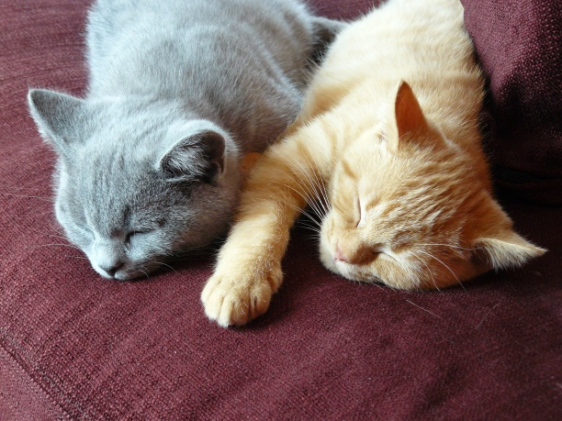
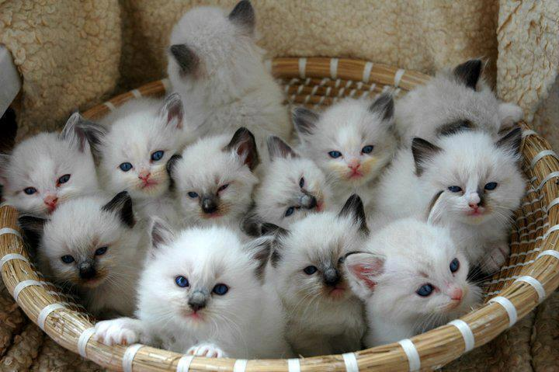
quantifiers: both, neither, either, all, no, any
Articles, quantifiers and determiners
Both (the) cats are asleep.
(one and also the other – plural, used with plural verb)
Neither cat is awake.
(not one nor the other – singular, used with singular verb)
Either cat can wake up any second.
(one or the other – singular, used with singular verb)
All (the) cats in the basket are kittens.
(every member of the group – plural, used with plural verb)
No cat in the basket is an adult.
(not one member of the group – singular, used with singular verb)
Any cat in the basket can become your pet.
(one member of the group, doesn’t matter which one – singular, used with singular verb)
Upper-intermediate level

Slide 34
practice
Articles, quantifiers and determiners
Read the sentences and decide which of the quantifiers BOTH, EITHER, NEITHER, ALL, NO, ANY to use to complete them.
________ colleague can help you if you ask; everyone is really nice here.
I bought ________ products because I couldn’t decide between the two of them.
We are happy to say that ________ client complained about our products.
Buses number 44 and 52 leave from this stop. ________ bus will take you to the city centre.
I interviewed two applicants. ________ candidate had the proper qualifications, so we had to keep looking.
________ employees got a bonus this month. There were no exceptions.
Any
both
no
Either
Neither
All
Upper-intermediate level

Slide 35
quantifiers as nouns and with ‘of’
Articles, quantifiers and determiners
Look at the sentences:
We have two IT specialists.
Either IT specialist can help you with your software problem.
Either can help you with your software problem.
Either of the IT specialists can help you with your software problem.
Either of them can help you with your software problem.
The same rules apply to both, neither, all, and any.
We have three projects to finish, and we don’t have time.
No project will be finished on time.
None will be finished on time.
None of the projects will be finished on time.
None of them will be finished on time.
If you want to express the idea of ‘not one member of the group (of three or more)’ as a noun, use none.
=> used as an adjective with a noun
=> used as a noun by itself
=> used as a noun with ‘of’ + a specific group of people/things in plural
=> used as a noun with ‘of’ and a personal pronoun
=> ‘no’ is used as an adjective with a noun
=> ‘none’ is used as a noun by itself (with verb in singular or plural)
=> ‘none’ is used as a noun with ‘of’ + a specific group of people/things in plural
=> ‘none’ is used as a noun with ‘of’ and a personal pronoun
Upper-intermediate level

Slide 36
quantifiers: all, every, each
Articles, quantifiers and determiners
Look at the sentences:
I spent all morning preparing the presentation.
I give a presentation every morning.
Every CEO wants to make a profit.
Each manager supervises a team of 20 people.
Each supervises a team of 20 people.
Each of them supervises a team of 20 people.
He held a file in each hand.
Every and each are always used with verbs in singular form.
=> ‘all’ = the whole
=> ‘every’ is used with time expressions to show how often something happens
=> CEOs seen as a group
=> managers seen as single individuals
=> ‘each’ can also be used as a noun
=> ‘each’ can be used with ‘of’ + specific group in plural /personal pronoun
=> ‘each’ is used with two to mean “(in) one and also (in) the other”: the noun is in singular, but
the meaning is “He held one file in one hand and another one in the other hand.”
Upper-intermediate level

Slide 37
practice
Articles, quantifiers and determiners
Read the sentences and decide which of the quantifiers ALL, EVERY, EACH, NONE to use to complete them.
_____________ team member has to work towards the common goal.
We bought a uniform for ______ of our employees.
We have to invest in language courses, as from all the managers, ______ can speak English.
We didn’t get any sleep yesterday because we worked ______ day and night to keep the deadline.
There is a motivational meeting ______ morning in this company.
______ of what he said was true; they were all lies.
The team members got a task: ______ has to interview 5 people about their buying preferences.
Every
/ Each
Every => all of them, as a group
/ Each => the members individually
each
none
all
every
None
each
Upper-intermediate level

Slide 38
quantifying non-count nouns
Articles, quantifiers and determiners
Look at the sentences:
If you want Ø advice, talk to your supervisor.
‘Advice’ is an example of a non-count noun. It doesn’t have a plural, and you can’t count it.
He gave me some advice.
If you want to talk about unspecified advice, use some.
The advice he gave me really helped.
If you want to talk about specific advice, use the.
Let me give you a piece of advice/one piece of advice.
He gave me three pieces of advice, and none of them helped me.
If you want to quantify advice (make it countable) despite it being non-count, you can use a countable expression, which will enable you to express quantity or plural.
Other examples of countable expressions: an article of clothing, an item of news, a bar of chocolate, an act of kindness…
Upper-intermediate level

Slide 39
count/non-count nouns
Articles, quantifiers and determiners
Look at the sentences:
We do a lot of business with Asian countries.
She owns a successful business.
He has too much work these days.
I love the works of Shakespeare.
The candidate didn’t have sufficient experience.
He talked about his experiences from World War 2.
Some non-count nouns can be used as count ones with a change in meaning.
(‘business’ = trading activities)
(‘a business’ = a company)
(‘work’ = what one does in one’s job)
(‘a work’ = a piece of art)
(‘experience’ = the skill one gained through practice)
(‘an experience’ = an event or activity in one’s life)
Upper-intermediate level

Slide 40
making generalisations
Articles, quantifiers and determiners
There are several options of article use if you want to say something about all the things/people referred to by a noun.
A wolf is not really a dangerous animal.
The wolf is not really a dangerous animal.
Wolves are not really dangerous animals.
These can be used interchangeably without a significant change in meaning.
Upper-intermediate level

Slide 41
article tips for Czech speakers
Articles, quantifiers and determiners
Although Czech doesn’t have articles, there are expressions that are used to convey the same meaning.
She bought a handbag.
Whenever you would use “nějaký”, “nějaká”, “nějaké” with a noun in Czech, use a/an in English.
(Be careful: “nějaký” in singular is expressed by a/an; “nějaký” in plural is expressed by some. Never mix them!)
The handbag fell apart after a week.
Whenever you would use “ten”, “ta”, “to” with a noun in Czech, use the in English.
=> Koupila si nějakou kabelku.
=> Ta kabelka se po týdnu rozpadla.
Upper-intermediate level

Slide 42
sources
Articles, quantifiers and determiners
Pictures:
this person: http://contactglenda.com/category/thoughts-2/
that person: http://fitgirlprettyworld.com/category/motivation/
those people: http://www.priotime.com/happy-people-prioritize/
these people: http://www.gaba-supplement.com/tag/gaba-vitamin/
window: http://www.tripadvisor.co.uk/LocationPhotoDirectLink-g186402-d2054151-i42031352-Bloc_Hotel_Birmingham-Birmingham_West_Midlands_England.html
windows: http://homedecorphotos.com/page/399/
cats: http://funzypics.funnypicturesutopia.com/board/pins/271/7341
Phonological transcription:
http://www.oxfordlearnersdictionaries.com/

