Slide 1
7. REGULATION AND OWNERSHIP

Slide 2
Introduction
This lecture is concerned with control →by relevant authorities on the levels and behaviour of transport users and operators under their authority
It concerns not only public transport, but all areas of transport, whether that be public, private or freight

Slide 3
Government control
Government control of transport markets can be achieved through one of two measures:
Ownership – the transport authority can own the assets and the means of production. The market is brought into public sector and thus it does not have to operate along market principles
Regulation - control through command; i.e. telling operators what to do

Slide 4
Forms of regulation
Qualitative regulation
Specify the price to be charged
Specify the maximum increase in price allowed
Regulate the (final) price through the tax charged on the good or service
Specify the rate of return (profit) to be gained
Through introducing yardstick competition
Specify a minimum frequency
Limit market entry

Slide 5
1) Qualitative regulation
Qualitative regulation occurs when the regulatory authority intervenes in the market in order to specify minimum criteria that regulate behaviour within the market
Speed limits for all road users
Minimum criteria applied to driver behaviour and vehicle conditions (public transport, road haulage)

Slide 6
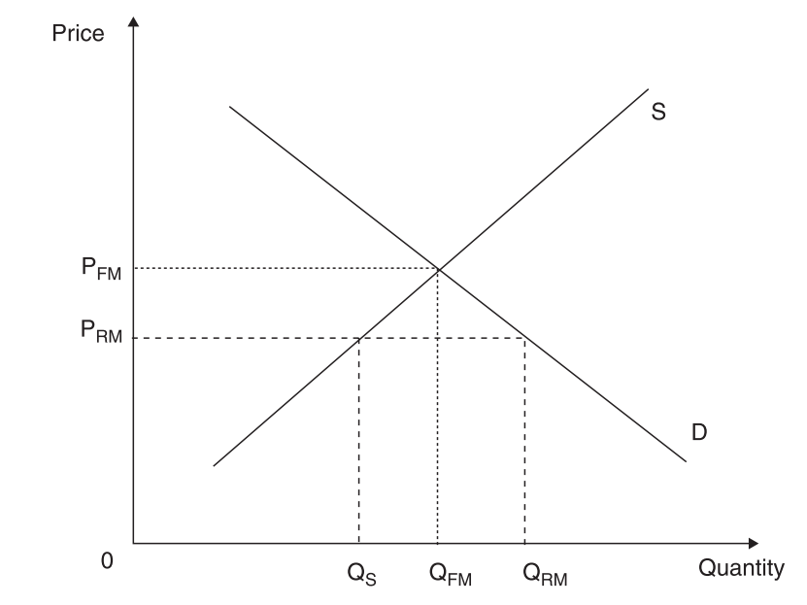
2) Specify the price to be charged

Slide 7
3) Specify the maximum increase in prices allowed
Rather than state a specific price, the authority limits the extent to which the operator can increase the prices over time
In the UK this has normally been done by RPI – X% formula (RPI = rate of inflation)
The measure is intended to motivate efficiency improvements, as it is only through reducing costs, and not increasing prices that operators can maintain or increase profitability

Slide 8
4) Regulate the price through the tax
Varying tax levels can be used to regulate the price in the market
General VAT imposed on all goods and services
Additional or specific taxes may be imposed to regulate the price on the market → fuel tax, Pigouvian taxes (to correct negative externalities)

Slide 9
5) Specify the rate of return to be gained
Prices charged by transport operators can be regulated based upon the level of profits to be gained
A „reasonable“ rate of return may be set and then prices regulated accordingly to achieve this rate of return
Can be applied when we know demand precisely and the only variation in revenues will be due to change in prices
How to deal with efficiency gains? → if they are not taken into account, there will be higher rates of profit
Example: Case – Network Rail

Slide 10
6) Through introducing yardstick competition
Yardstick competition exists where direct competition in the market is not feasible but is introduced indirectly, and is normally used to control price levels
This is achieved by linking the performance of different firms in different markets to each other
Benchmark competition → the performance of each firm in the industry is benchmarked against each other

Slide 11
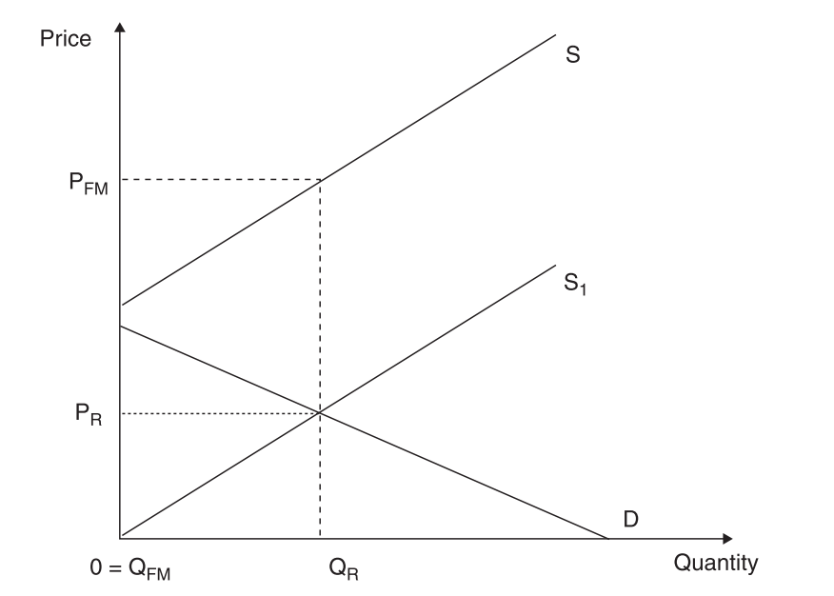
7) Specify minimum frequency

Slide 12
8) Limit market entry
Legal control of market entry = barrier to entry
Can be used as the form of capacity regulation
Limits on the number of operating firms
To avoid competition in the provision of public transport
Regulation of taxi services – to avoid street congestion

Slide 13
The rationale for the regulation (1)
To overcome the market failure or imperfect/asymmetric information → the minimum standards of vehicles and drivers/pilots
The market can no longer regulate itself → most transport industries tend towards anti-competitive market structures
To correct for externalities → the market may still not produce the right modal splits or maximization of economic welfare

Slide 14
The rationale for the regulation (2)
To ensure the quality of the service provided → local or national authority wants to specify minimum quality or minimum level of service or the requirement for the new rolling stock
To provide a transport service where none existed before → rather than to leave them to free market, authorities may decide to intervene → e.g. to restrict entry to profitable routes in exchange for the protected operator to provide services on unprofitable routes (cross – subsidization)
To improve efficiency within the industry → regulatory framework can be used in to bring about the efficiency improvements

Slide 15
The drawbacks of economic regulation (1)
Limits free enterprise → it is against laissez faire ideology → it limits consumer sovereignty → it may limit innovations → it dampens free enterprise spirit → because there are clear limitations imposed
Inefficient, second best solution → the best efficiency solution is always when market regulates itself → regulation creates additional administrative costs → there is also usually time gap because the reaction of regulation is usually slower than market response
Cumbersome regulatory procedures make avoidance of regulatory measures possible → when regulation fails to regulate actions of behaviour that it is designed to regulate through avoidance (see Railtrack)

Slide 16
The drawbacks of economic regulation (2)
Asymmetry of information → to regulate efficiently, the regulator needs information to plan and control operations → however, the operator unsurprisingly knows more about its own business than the regulator → it may be in the interest of the operator to withhold information if they believe it may be used against them
Regulatory capture → Stiegler (1971) → the regulator, not as tough on the industry as they should be → the regulator better serves the interest of the industry than the interest of the consumers → regulator is dominated by the vested interest in the industry → or even become the protector of the industry

Slide 17
Case: The practicalities of industry regulation – regulating the British railway infrastructure provider

Slide 18
Introduction
Theory may appear straightforward, the practice is almost always more complicated
This case study illustrate it through the examination of regulatory mechanism surrounding the former British railway infrastructure provider, the private sector company Railtrack

Slide 19
British rail reform
British Rail divided into 104 separate companies → to introduce competition at all levels → not only between train operating companies → but also among rolling stock leasing companies and infrastructure maintenance companies
The only exception was the infrastructure provider → advantages of single network outweighed the drawbacks of geographical separation → Railtrack was created and was floated on the stock exchange
Railtrack was supposed to operate on commercial basis → access charges were set on full costs basis → profit was expected and no subsidies intended (except to assist the funding of rail investment)

Slide 20
Regulation
Railtrack was in monopoly position → access charges needed to be regulated → to avoid the abuse of monopoly position → The Office of the Rail Regulator (ORR) was established
ORR regulated charges, network access and Railtrack financial framework → dilemma between high charges (profit for shareholders, investment for network) and low charges (for train operating companies) → for lower fares for customers and lower subsidies for TOC

Slide 21
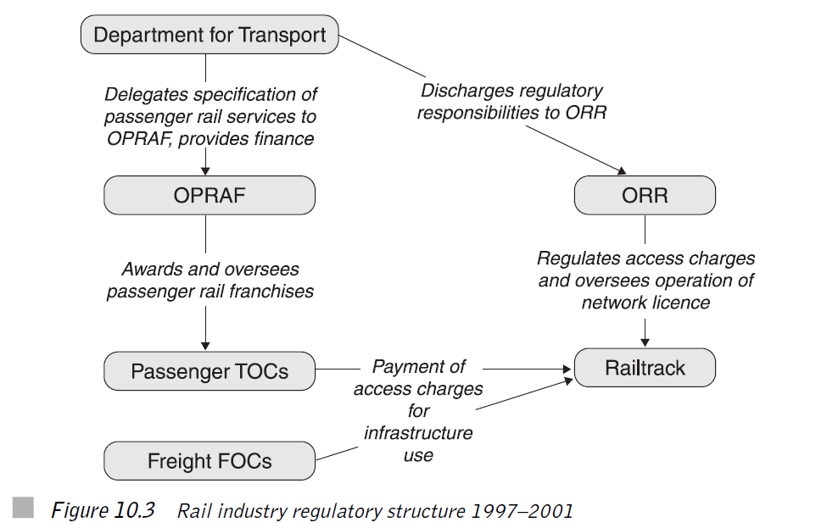

Slide 22
Regulatory challenges
The key was to set the access charges right → to raise revenue to cover all Railtrack's costs + depreciation charges + 8% rate of return → how to calculate asset base from which to calculate depreciation and rate of return?
How to deal with investment needs and how to divide profits into dividends and investment?
How to push Railtrack into efficiency gains and how to measure them and account for them?

Slide 23
Problems
Railtrack had effectively little control over its own costs → subcontractors carried out all of maintenance and renewals → loss of engineering expertise at Railtrack
Train derailed at Hatfield → 4 fatalities and 70 injuries → because of broken rail → Railtrack panicked and introduced severe speed limits over the whole network → then had to pay to TOC more than 500m GBP as compensations
Major cost overruns on the major infrastructure project → West Coast mainline → from 2b to 8b GBP
Railtrack went bancrupt in October 2001

Slide 24
Lessons
Industry regulation is not easy
Was the failure of Railtrack a regulatory failure? → Did Railtrack fail due to failure of regulator to sufficiently protect it and enable it to continue in profitable operations?
Regulatory capture → who is in charge of regulation?
Agenda selection → certain aspects of regulation were neglected (with dire consequences)
British rail reform was extraordinary complex

Slide 25
OWNERSHIP

Slide 26
Discussion question – to heat up
What do you see as the main advantages and disadvantages of public ownership in transport markets?
What do you see as the main advantages and disadvantages of involving the private sector in the provision of public transport services?
What are benefits and risks of privatization?

Slide 27
Reasons for the public ownership of transport assets (1)
Eradicate wasteful competition → where two or more services exist when one would be sufficient → however wasteful competition can be also removed through regulation
Military significance → railways during wars
Public goods → if left only to market forces, some (public) goods will not be provided
Essential to the economy → rail passenger commuting; rail coal freight

Slide 28
Reasons for the public ownership of transport assets (2)
A large employer → in certain localities and areas, certain firms may be the only major employer in the area → its collapse would have implications far beyond the direct loss of employment
Key industry → the industry that is seen to be of vital importance to the country → Example: Rolls-Royce in the UK
High project development costs → any major project requires considerable financial outgoings → high speed rail in Japan and France

Slide 29
Reasons for reform
Increasing discontent with the model of public ownership
Changing macroeconomic environment combined with social change
The desire to introduce competition into the provision of transport services

Slide 30
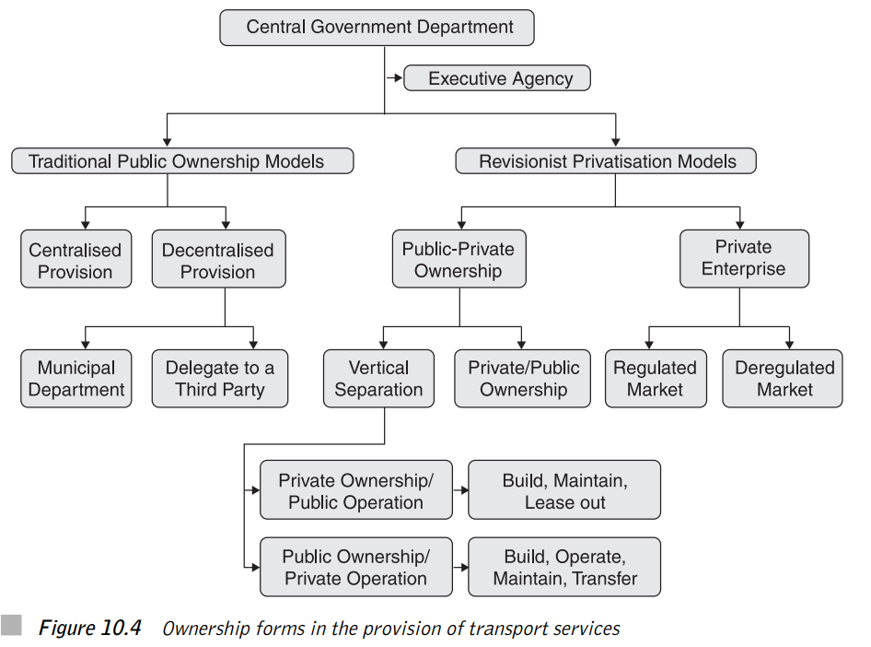

Slide 31
Case: The move away from control through ownership to control through regulation in public transit markets
Regulatory reform is often seen as a road paved by good intentions, but leading to policy hell
In lecture 6, we have observed British bus reform
We will now add three other examples: London, Helsinki and Swedish rail

Slide 32
London
Before reform, all transport services planned and operated by public London Transport
After reform (1984): planning and operation divided and separated → planning and strategyin Transport for London (TfL) → services tendered under fare levels and services specified by TfL
Contracts on operational basis → tender is for the costs of operation and all revenue is returned to the authority
TfL also lay down other service specifications → standards of vehicles to be used → importantly in case of London all buses are red!

Slide 33
London (2)
London Underground remains in public ownership and it is a subsidiary of TfL
Like the private bus companies, London Underground runs services to patterns specified by TfL
In 2003 responsibility for maintenance of trains and stations transferred to two private sector companies
All urban public transport services within London are under direct control of TfL → integrated ticket scheme is operated → tickets valid on all services as well as some rail services → Oyster card

Slide 34
Helsinki
City transport → bus, tram, two ferry services, rail and underground → Helsinki City Transport (HKL) used to operate them all (except rail)
Reform: Bus privatised and HKL only specifies services → trams, metro and underground are still owned and operated by HKL → cost based contracts with revenues back to HKL
Public transport services to outlying areas of Helsinki are overseen by the regional transport authority → electronic integrated ticketing is used

Slide 35
Swedish rail (1)
Late 1980s → vertical separation of infrastructure and services
Infrastructure manager (Banverket) → responsible for maintenance and development of rail network → it receives budget form government → access charges based on MC (not full costs) and paid by TOC directly to government
Services → responsibility of Swedish State Railway (SJ) → divided into commercial (intercity) and contract (local and interregional) sector
SJ used to have monopoly in commercial sector → now is challenged on Stockholm-Gothenburg line by open-access competition

Slide 36
Swedish rail (2)
On the contract side → services are run under contract to regional government contracts → gross costs contracts on regional and local lines→ net cost contracts (revenues – costs) on interregional contracts → usually for five years
Freight was privatized
Problems: overoptimistic bids, disruptions in services, ticket integration among competing operators, rise in ticket prices
Successes: rise in passenger numbers, decrease in subsidies
Biggest risk: disruption of services as result of company failure → easier to solve in case of buses than trains

Slide 37
Rail privatization (1):
Japan
Thompson, L. (2003). Changing railway structure and ownership: is anything working?. Transport Reviews, 23(3), 311-355.

Slide 38
Japan rail
Passenger traffic dominant
Freight rail marginal – due to sea traffic
HSR Shinkansen – starting from 1964 on Tokyo-Osaka line; Highly successful – leading to build up of further lines with lower commercial potential
1980s – high indebtness of JNR , overemployment

Slide 39
1986 Reform
Sack of management
Horizontal separation (JR Freight)
Geographical separation (JR East, JR Central a JR West - commercialization, JR Hokkaido, JR Shikoku a JR Kyushu - subsidies)
Yardstick competition – competition on the edges only
Indebtness solution – partial bail-out, partial transfer to JR East, Central and West
Privatization of JR East, Central and West in 1990s

Slide 40
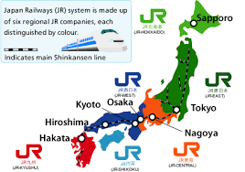
Geographical separation and yardstick competition

Slide 41
Results
Between 1987-1991: traffic + 20%; employment down from 280.000 to 160.000
Labor productivity: +68% between 1985-88 and another +25% between 1988-98
JR East, Central and West – profitable +3 bn income taxes per year (5 bn subsidies to JNR before reform)
JR Freight and JR Hokkaido, JR Shikoku a JR Kyushu – stable traffic, operational subsides
Better quality and responsiveness to customers

Slide 42
Assessment
Successful reform/privatization
Careful planning → expert group → sack of management
Commercialization → breaking monolith into independent market focused companies
Main goals: to decrease indebtness and bigness of JNR → stabilization was financially costly
No competition!
More effective structure and incentives

Slide 43
Rail privatization (2):
New Zealand
Laird, P. G. (2013). Government rail asset sales, and return to the public sector, in New Zealand and Tasmania. Research in Transportation Business & Management, 6, 116-122.

Slide 44
General characteristics
Rail primarily oriented towards freight traffic
In passenger traffic there is important commuting to Wellington and Auckland and a few intercity connections
Until 1993 vertically and horizontally integrated structure in state ownership
Strong intermodal competition and worsening economic results

Slide 45
1993 privatization
NZ government in 1993 sold its railway for 400 million USD to consortium of private investors
In the years after privatization, profits rose, however not enough to cover costs of capital
Freight traffic rose steadily

Slide 46
Problems
Private owners had increasing problems with operations of passenger rail transport and in 2002 sold commuter rail network back to government
Financial problems were increasing and in 2004, private owners sold back rail infrastructure to NZ state for 1 USD
NZ government agreed to infrastructure investment, however bitter disputes over the level of infra charges emerged
This led to complete purchase of remaining rail enterprise by NZ government for 690 million dollars. What was considered to be highly overpriced purchase.

Slide 47
Lessons
Very problematic privatization in New Zealand (and very similar case in Tasmania) shows dangers of rail privatization involving passenger transport
Passenger rail transport in developed countries is usually not very profitable, however politically sensitive

Slide 48
Appendix: Regulation and privatization
Based on Ch. Nash (2005) Privatization in Transport

Slide 49
History (1)
1970s – in much of the world, transport had become a largely public sector activity
Roads, railways, airports and many ports were publicly owned
Rail most bus and coach services and many air services were provided by public sector operators
The one big exception to the rule was road haulage

Slide 50
History (2)
1980s – transport policy moved progressively in the direction of the market approach and widespread privatization of transport operations and sometimes even infrastructure took place
UK under M. Thatcher – deregulation of express coach services in 1980s; deregulation and privatization of most local bus services, privatization of the major airports, ports and British Airways; privatization of rail

Slide 51
Why public ownership?
Natural monopoly argument
Transport so fundamental that it requires a degree of central planning and control
Large external benefits and costs of the transport

Slide 52
What went wrong?
Government decision taking may not always be competent (SR political advantage x LR objectives)
Publicly owned organizations lacked strong incentives to achieve high quality services at minimum cost
Transport sector has heavy requirements for investment

Slide 53
Is privatization the solution?
Privatization can lead to clear and explicit objectives, where operators are motivated by profits
Politicians need to make explicit arrangements, through regulation, taxes, or subsidy, to achieve their political and social objectives
Together with hard budget constraint and takeover threats should be enough to increase efficiency

Slide 54
Competition …. ?
However, privatization has most often been accompanied by action to open up the market to competition, by removing regulatory and other barriers to entry
Competition would lead to provision of services and infrastructure at minimum costs and maximum innovations

Slide 55
Potential pitfalls
Much of the transport sector was seen as a natural monopoly – competition can lead to loss of economies of density
Technical efficiency is likely to be maximized by a competitive approach, whereas revenue from asset sale is highest when the company concerned retains a monopoly

Slide 56
Solution?
Natural monopoly confined to the infrastructure, and it is perfectly possible to have competing operators over the same infrastructure.
What about the infrastructure? – privatization, cost-plus regulation, franchising?

