Slide 1
Consultancy project:
Self Assessment
By Jakub Čech & Andrej Šišolák
Notes:
Note: Please after inserting your picture, “Right Click” on the picture and “Send it to Back” to get the “Gradient” effect.

Slide 2
Our Agenda
Consultancy Project | Self Assessment
10 min
01
Actual market position
20 min
02
Current product & service portfolio
20 min
03
Organization setup
10 min
04
Financial performance
20 min
05
SWOT

Slide 3
Self Assessment
Actual Market Position
By Jakub Čech & Andrej Šišolák
Notes:
Note: Please after inserting your picture, “Right Click” on the picture and “Send it to Back” to get the “Gradient” effect.

Slide 4
Targets of Analysis
Self Assessment | Actual Market Position
Market Share
Profitability
Growth Trends
To compare the company’s sales with the potential in the selected market segments.
The main target is to understand the sales distribution compared to the potential distribution among the various market segments.
To compare the profitability of the company’s sales to the defined market segments.
The following factors usually influence the profitability of sales to the various segments:
Product mix
Volume and average net sales price
Cost of the goods sold
Marketing cost
Transportation cost
Sales & Admin Cost
To compare the company’s sales growth (or declination) development with the potential growth (or decline) development.
The main target is to understand the company’s position in the segments with the promising future.

Slide 5
Market Position by Segments
Self Assessment | Actual Market Position

Slide 6
Growth Trends Analysis
Self Assessment | Actual Market Position
CAGR
0.48%
CAGR
9.89%
VS
Potential
Sales
Estimated growth rate for the next 3 years is 2%
Market share is 36% with profit of 16% of the Net Sales

Slide 7
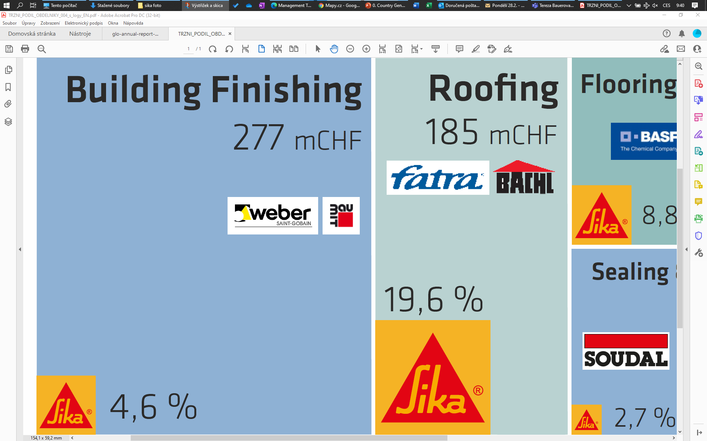
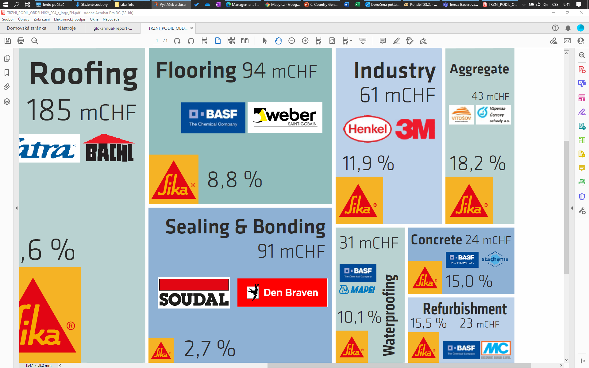
Market Position by Segments
Self Assessment | Actual Market Position

Slide 8
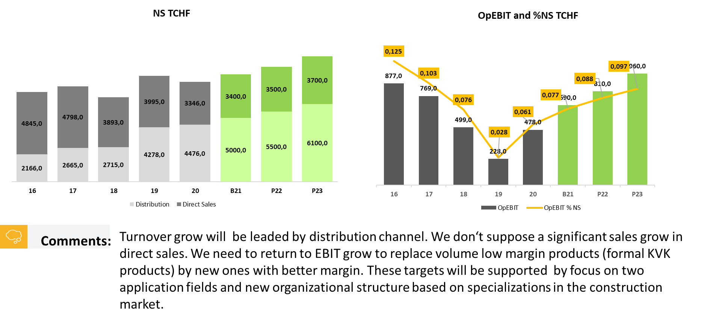
Profitability by Segment
Self Assessment | Actual Market Position

Slide 9
Self Assessment
Product & Service Portfolio
By Jakub Čech & Andrej Šišolák
Notes:
Note: Please after inserting your picture, “Right Click” on the picture and “Send it to Back” to get the “Gradient” effect.

Slide 10
Targets of Analysis
Self Assessment | Actual Market Position
Range
Quality & Performance
Price & Value
To compare the current company’s product range with the customers’ typical product basket within the selected market segment.
The main target is understanding how the company’s product portfolio matches the customers’ needs and recognize possible gaps or opportunities.
To compare the most important technical parameters of the selected products with the customers’ requirements and competitors’ products.
The targets of analysis is following:
understanding what features of products are important for the customers and how the company’s products match them
comparison of company’s products features with the relevant competitors’ products
To compare the company’s value proposition for the customers in the selected with their needs
To compare the company’s value proposition with the major competitors within the selected market segment
.

Slide 11
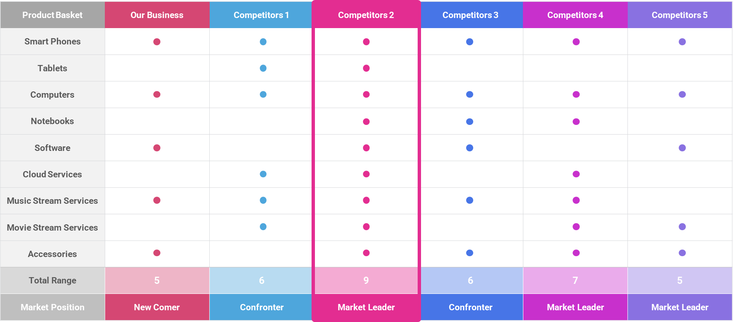
Product Range Analysis
Consultancy Project | Self Assessment

Slide 12
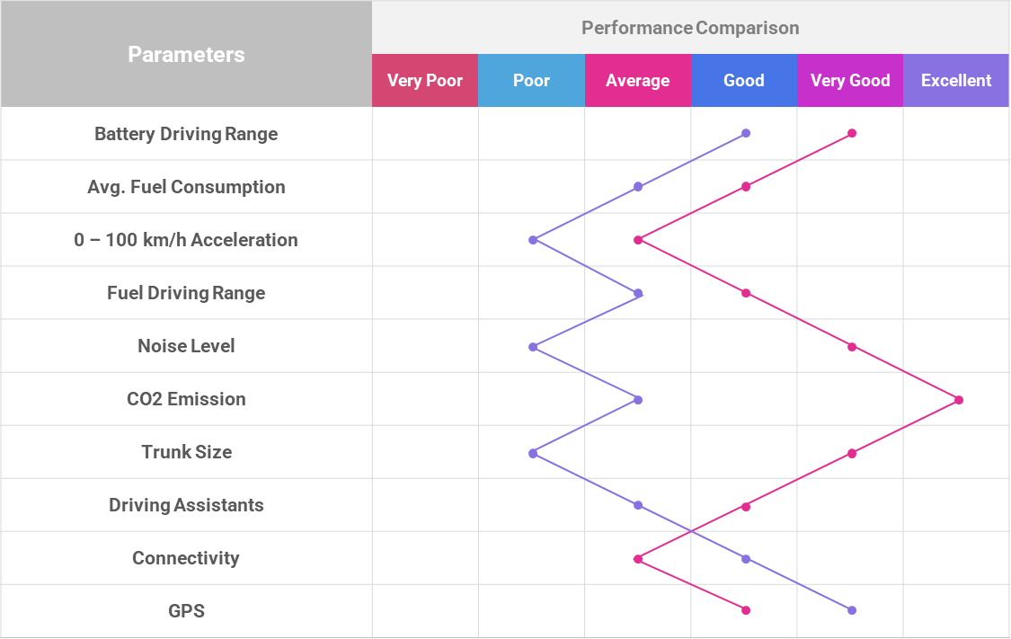
Product Range Analysis
Consultancy Project | Self Assessment
Customer
Company

Slide 13
Product Range Analysis
Consultancy Project | Self Assessment
High
High
Competitor
#3
Company
Competitor
#4
Price
Customer
Expectation
Competitor
#2
Competitor
#1
Low
High
Performance

Slide 14
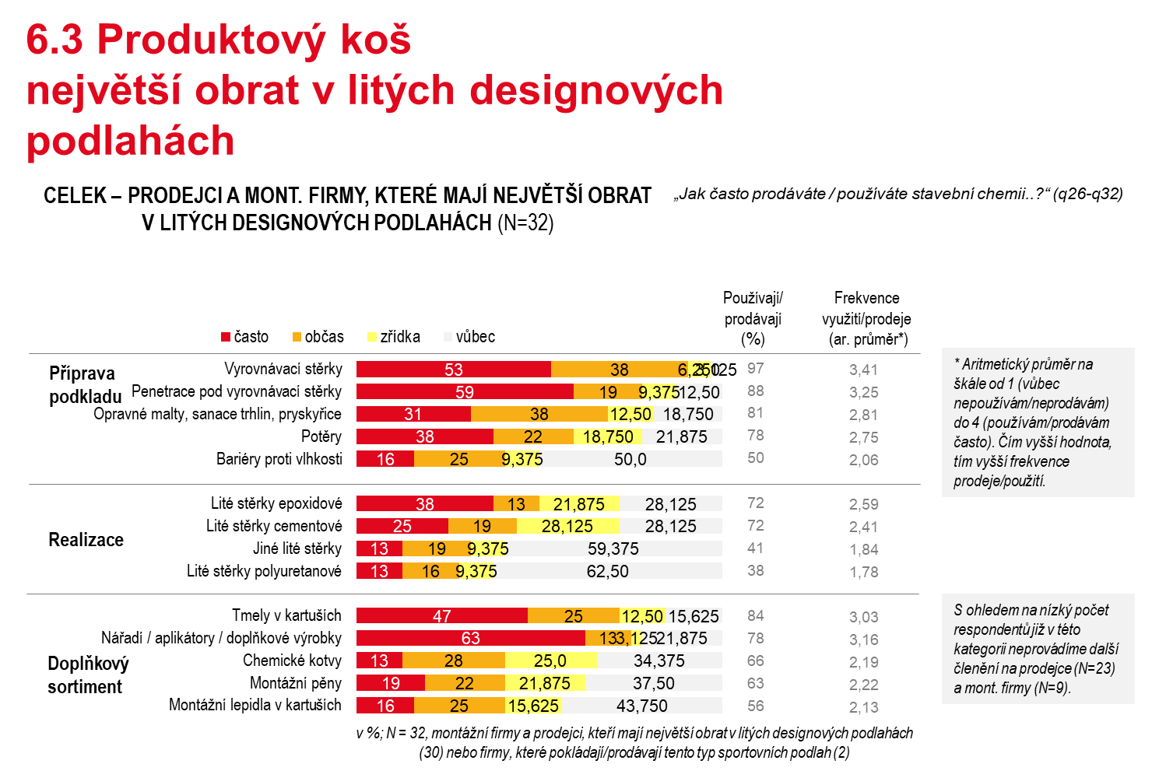
Product Range Analysis
Consultancy Project | Self Assessment

Slide 15
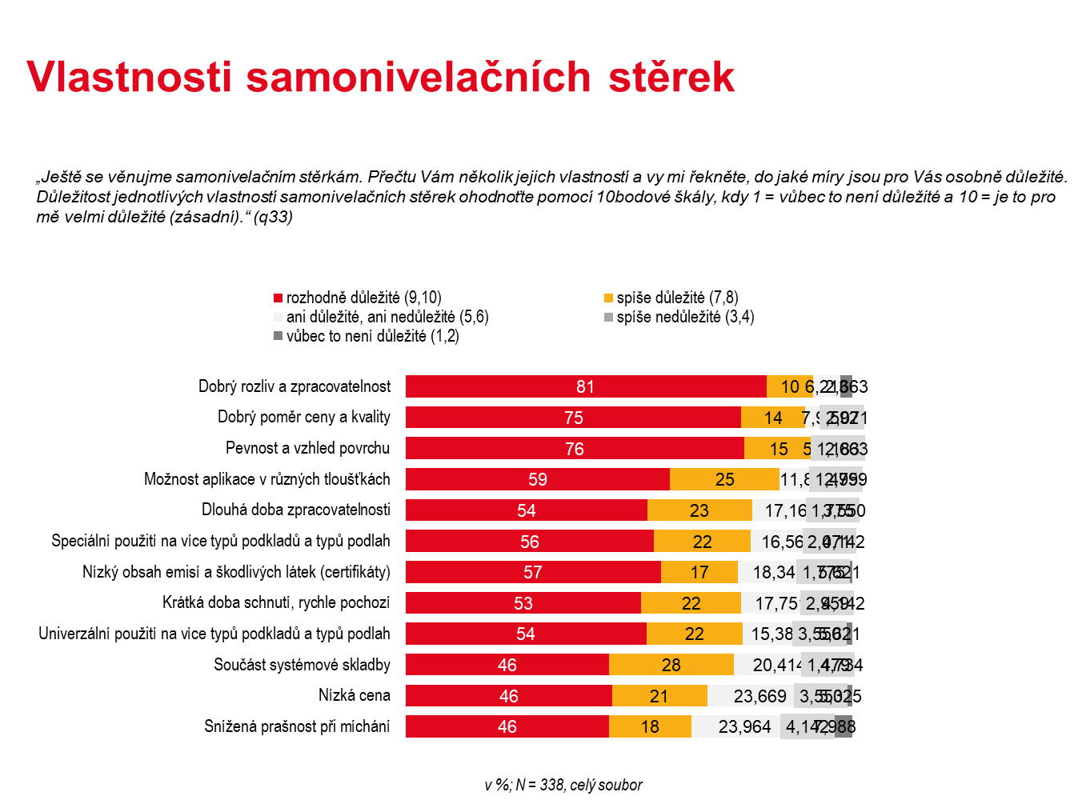
Product Range Analysis
Consultancy Project | Self Assessment

Slide 16
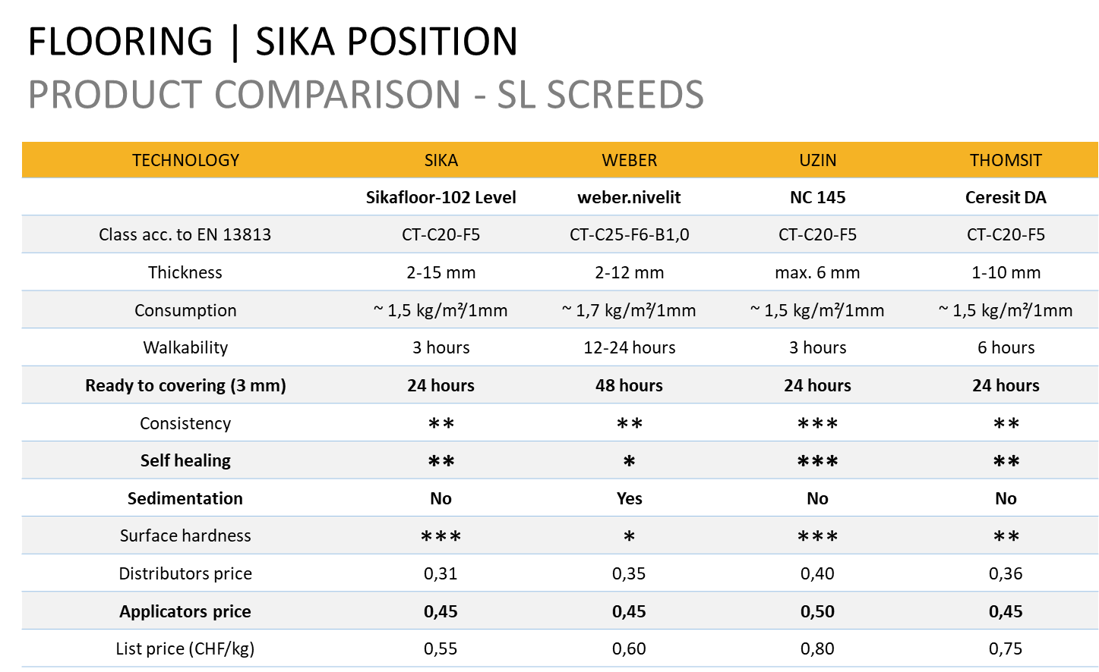
Product Range Analysis
Consultancy Project | Self Assessment

Slide 17
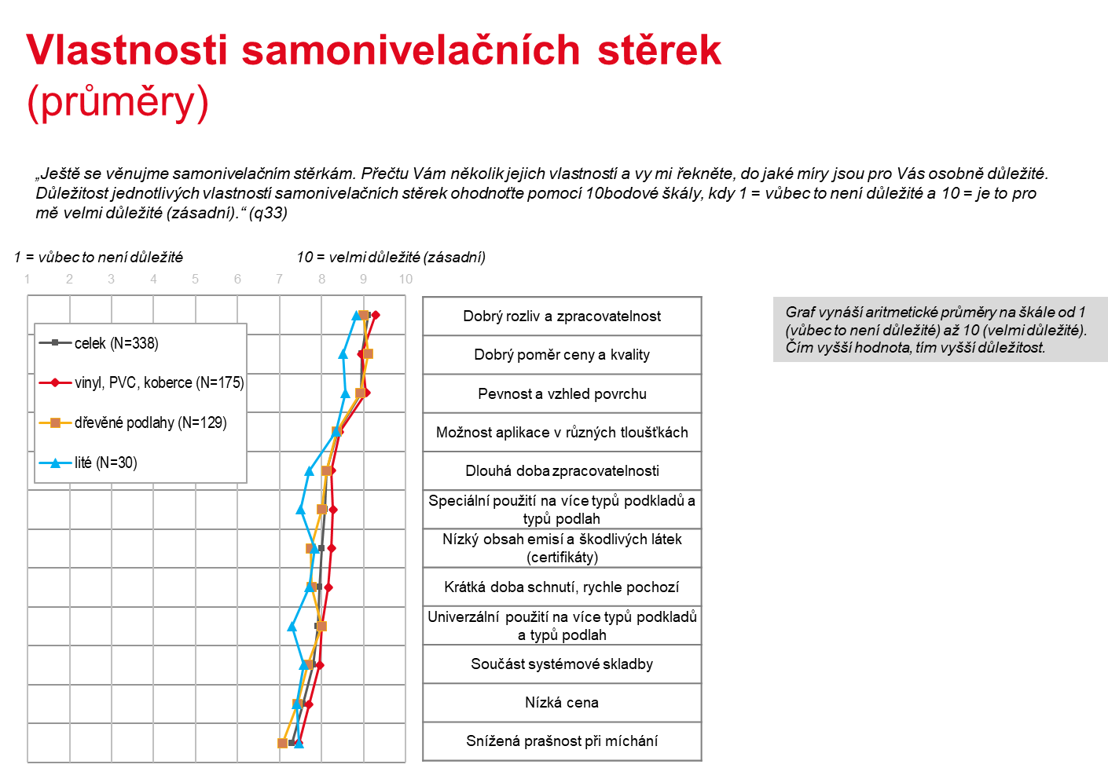
Product Range Analysis
Consultancy Project | Self Assessment

Slide 18
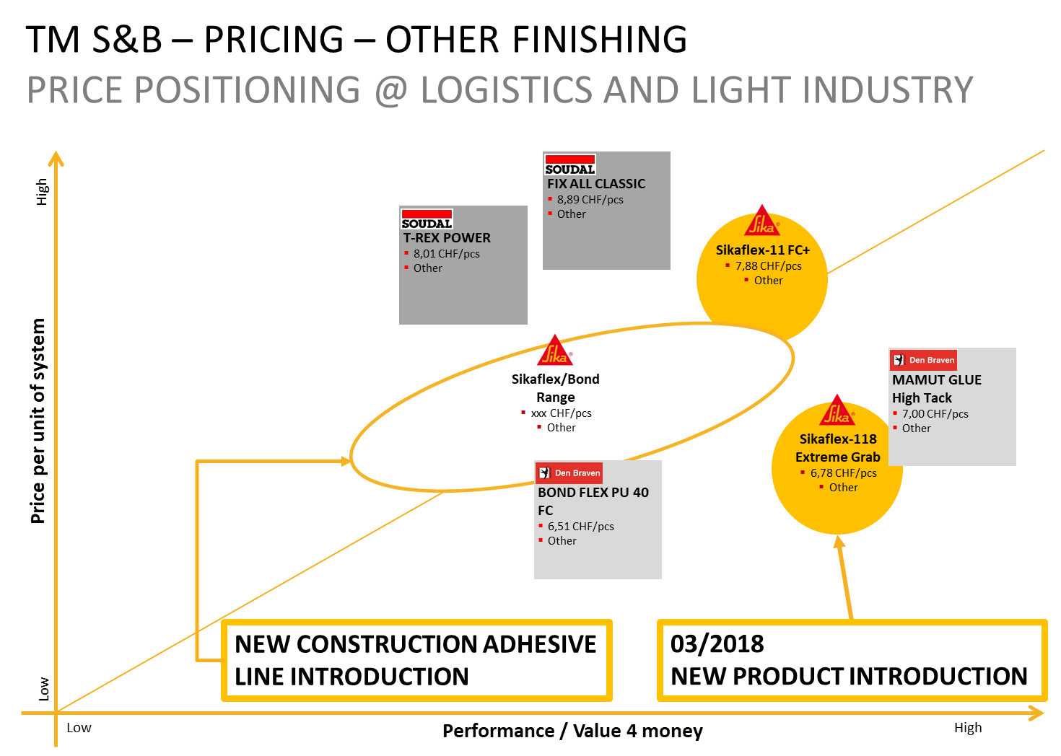
Product Range Analysis
Consultancy Project | Self Assessment

Slide 19
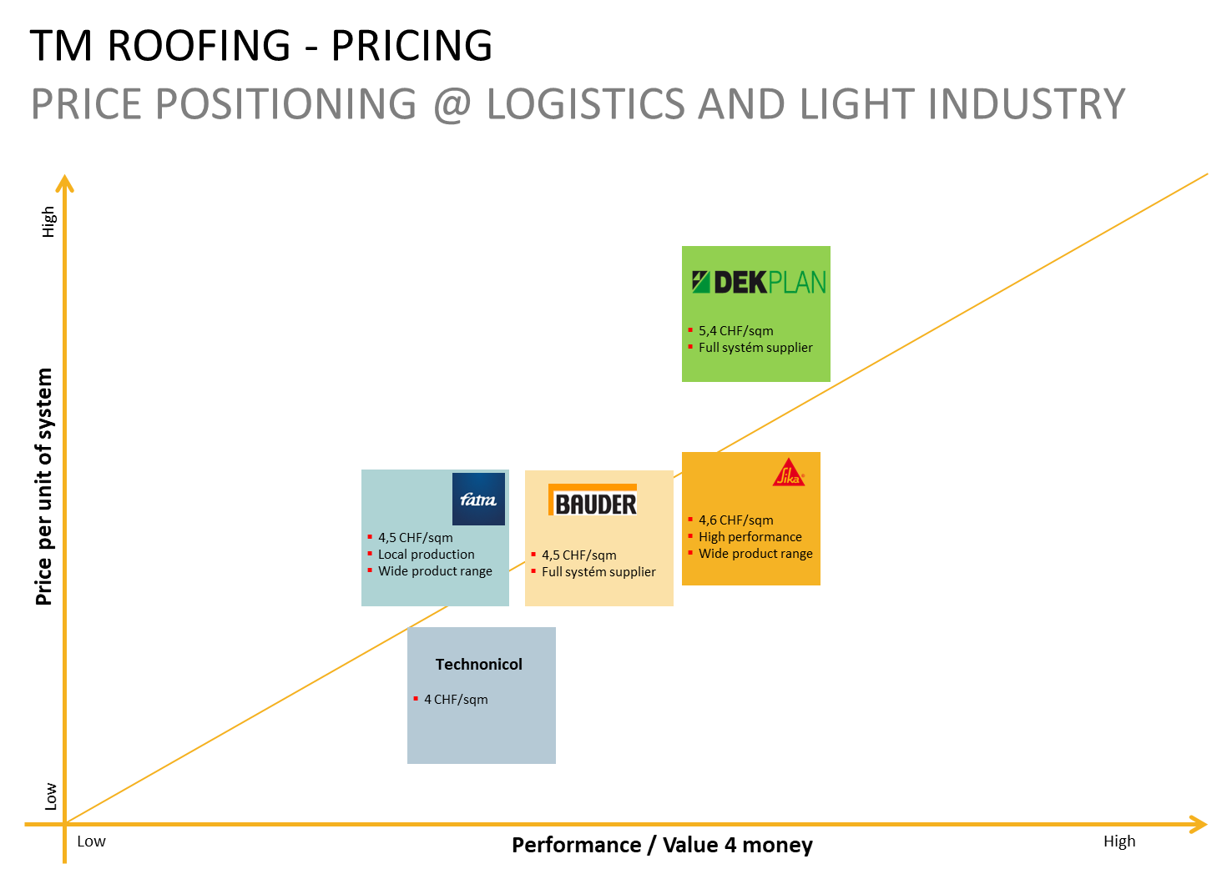
Product Range Analysis
Consultancy Project | Self Assessment

Slide 20
Self Assessment
Organization Setup
By Jakub Čech & Andrej Šišolák
Notes:
Note: Please after inserting your picture, “Right Click” on the picture and “Send it to Back” to get the “Gradient” effect.

Slide 21
Targets of Analysis
Self Assessment | Organization Setup
Current Allocation of Workforce
Potential Allocation of the Workforce
Trends of Future Influence
To map actual allocation of the employees to different departments and geographical regions.
The main target is understanding if the current organization structure provides proper efficiency and flexibility and does allow the company to deliver desired results.
To map an actual allocation of the market potential to the defined segments and geographical regions
The main target is to understand how the future organization structure should look like:
the size of the market potential within defined market segments and regions
number of the potential customers in the most attractive segments
prevailing way of sales, technical customer & delivery service in the most attractive segments
production & supply chain setup
To map and understand all major trends with the possible influence on future workforce structure in the industry such as:
automation
digitalization
demographical development
future technological and safety standards
environmental standards
ESG legislation
employment legislation
regional set up and infrastructure

Slide 22
Organization Mirror
Self Assessment | Organization Setup
Market Segment | Criteria | Unit | Importance | Comparison & Rating
 |  |  |  | Company |  |  |  | Competitor 1 |  |  |  | Competitor 2 |  |  |  | Competitor 3
 |  |  | Weight | # | Low | Mid | High | # | Low | Mid | High | # | Low | Mid | High | # | Low | Mid | High
 |  |  |  |  | 0,1 | 0,5 | 1 |  | 0,1 | 0,5 | 1 |  | 0,1 | 0,5 | 1 |  | 0,1 | 0,5 | 1
 | Number of Sales Point | FTE | 30% | 250 | 3,0% |  |  | 540 |  |  | 30,0% | 480 |  | 15,0% |  | 760 |  |  | 30,0%
 | Number of Sales Reps | FTE | 10% | 25 | 1,0% |  |  | 50 |  |  | 10,0% | 46 |  | 5,0% |  | 65 |  |  | 10,0%
 | Number of Technical Advisors | FTE | 5% | 10 |  |  | 5,0% | 5 |  | 2,5% |  | 2 | 0,5% |  |  | 12 |  |  | 5,0%
 | Number of Customer Service Reps | FTE | 10% | 10 | 1,0% |  |  | 20 |  |  | 10,0% | 15 |  | 5,0% |  | 25 |  |  | 10,0%
 | Number of Factories | lines | 5% | 3 | 0,5% |  |  | 5 |  |  | 5,0% | 3 | 0,5% |  |  | 5 |  |  | 5,0%
 | Number of Warehouses | locations | 5% | 3 | 0,5% |  |  | 5 |  | 2,5% |  | 3 | 0,5% |  |  | 8 |  |  | 5,0%
 | Number of Merchandisers | FTE | 5% | 0 | 0,5% |  |  | 5 | 0,5% |  |  | 5 | 0,5% |  |  | 10 |  |  | 5,0%
 | Average Delivery Terms | days | 30% | 3 | 3,0% |  |  | 3 | 3,0% |  |  | 2 |  | 15,0% |  | 1 |  |  | 30,0%
 | Subtotal |  |  |  | 9,5% | 0 | 5,0% |  | 4% | 5% | 55% |  | 2% | 40% | 0% |  | 0% | 0% | 100%
 | Market Segment Total |  | 100% |  | 14,5% |  |  |  | 63,5% |  |  |  | 42,0% |  |  |  | 100,0%
 | Company's level of organisational complexity on the market segment |  |  |  | 14,5% |  |  |  | Standard level of organisational complexity on the market segment |  |  |  |  |  |  |  | 68,5%
 | Company's sales to the market segment |  |  |  | mEUR 10 |  |  |  | Total potential on the market segment |  |  |  |  |  |  |  | mEUR 350

Slide 23
Organization Mirror
Self Assessment | Organization Setup
High
Market
Segment
#1
Market
Segment
#3
Market
Segment
#3
Company
Market
0%
100%
Organization Fit
Organization Advantage | Oversize
Company Segment
#1
Company
Segment
#2
Company
Segment
#3
Company
Organization Gap
Organization Complexity Level

Slide 24
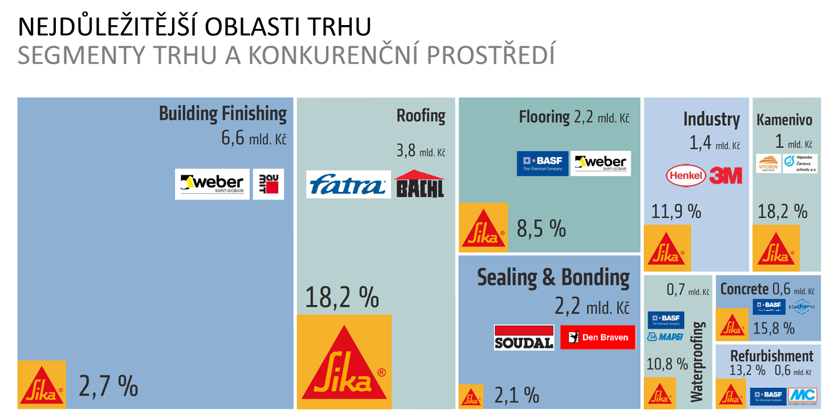
Organization Development
Self Assessment | Organization Setup

Slide 25
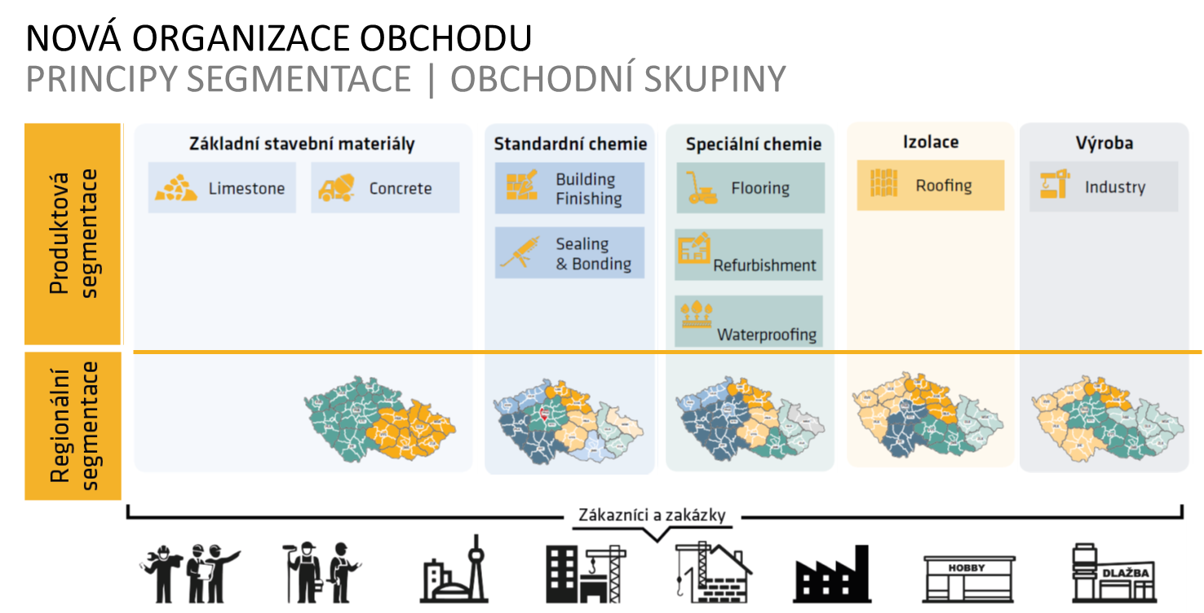
Organization Development
Self Assessment | Organization Setup

Slide 26
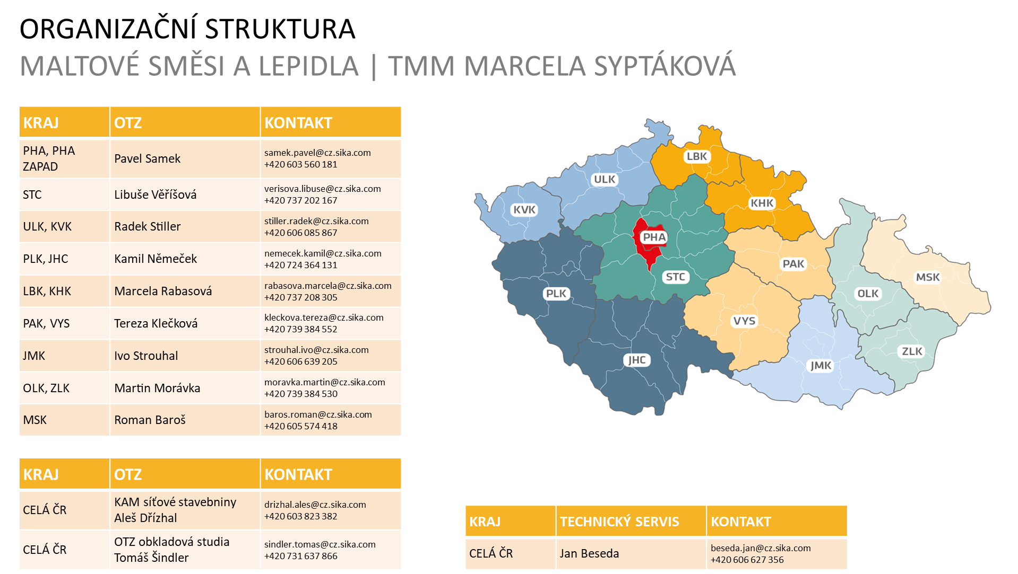
Organization Development
Self Assessment | Organization Setup

Slide 27
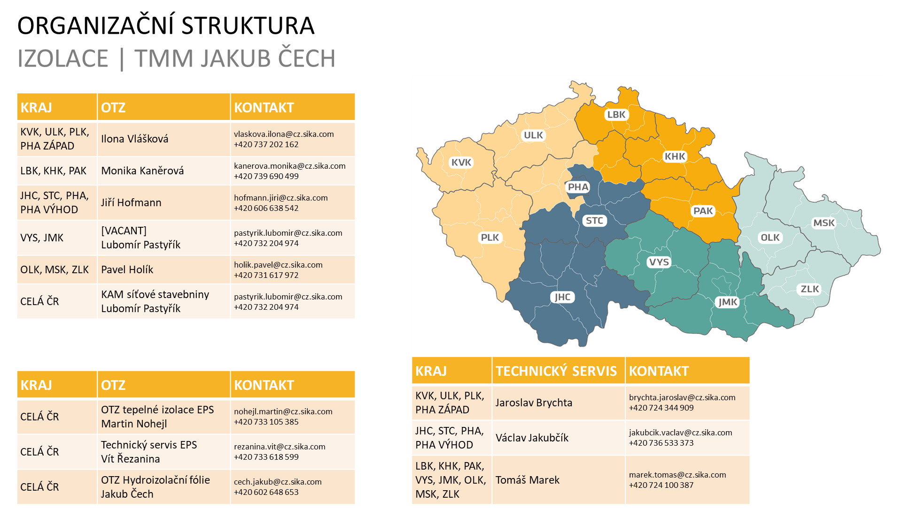
Organization Development
Self Assessment | Organization Setup

Slide 28
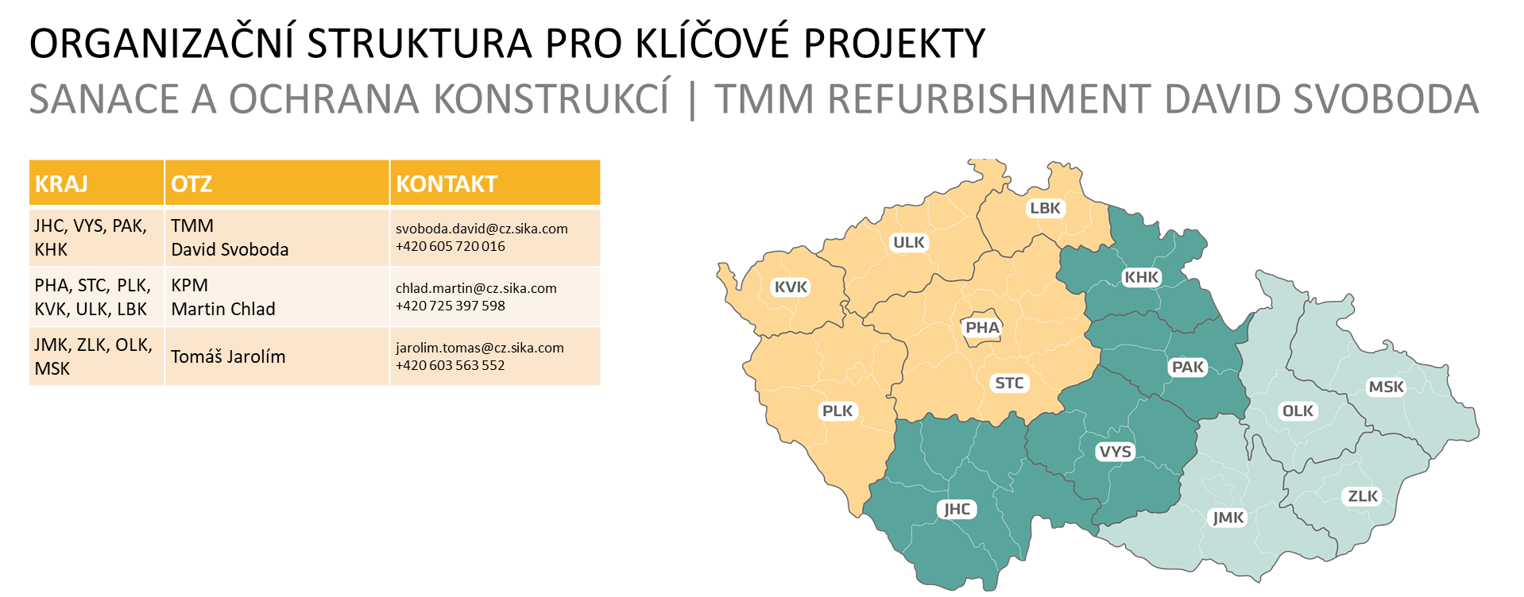
Organization Development
Self Assessment | Organization Setup

Slide 29
Self Assessment
Financial performance
By Jakub Čech & Andrej Šišolák
Notes:
Note: Please after inserting your picture, “Right Click” on the picture and “Send it to Back” to get the “Gradient” effect.

Slide 30
Targets of Analysis
Self Assessment | Financial performance
Balance sheet
Profit & Loss
Cash flow
A balance sheet is a financial statement which shows relationship between assets, liabilities and shareholer´s equity.
A balance sheets shows what company owns and how these asets are financed. It shows the general financial status of a company.
Profit & Loss statement is the financial statement, which calculates the revenues, cost and all other expenses. It shows the ability of the company to generate profit.
Main target of the companies is to increase their profits by revenue increase, cost cutting or both.
Cash flow is the amount of cash that comes in and goes out of a company. The companies take in money from sales as revenues and spend money on expenses.

Slide 31
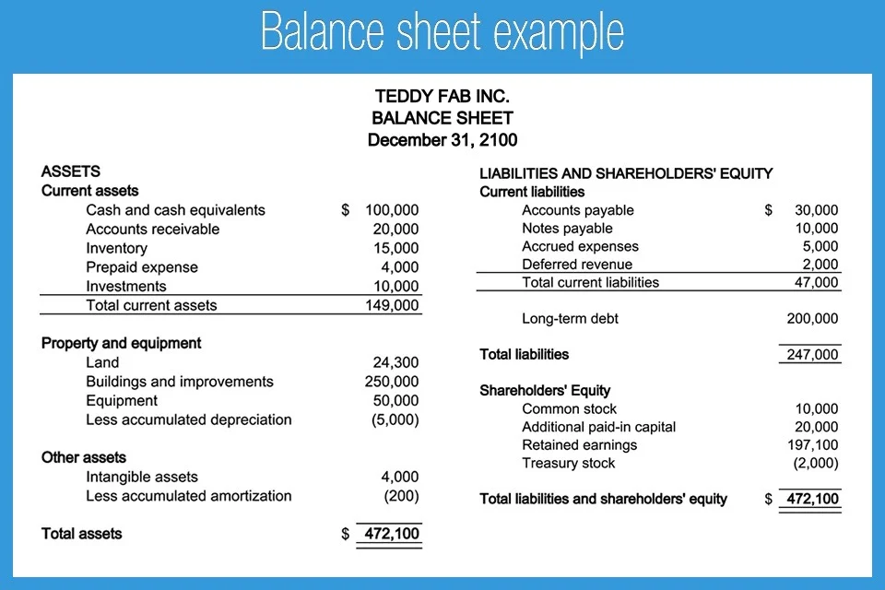
Balance Sheet
Self Assessment | Financial performance

Slide 32
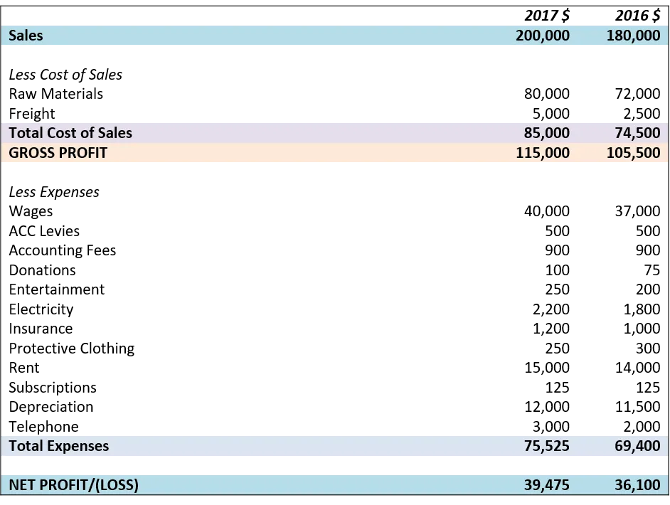
Profit & Loss
Self Assessment | Financial performance

Slide 33
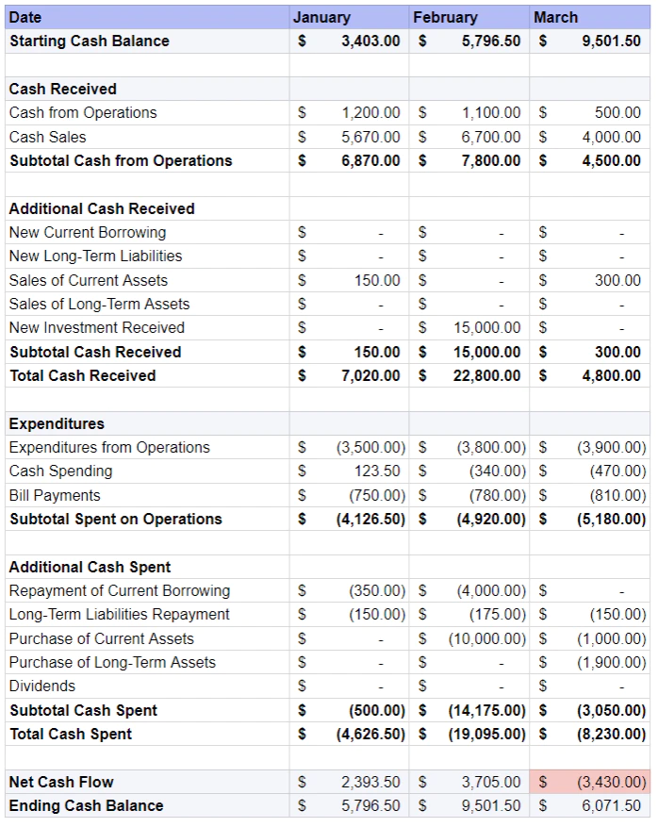
Cash Flow
Self Assessment | Financial performance

Slide 34
Self Assessment
SWOT analysis
By Jakub Čech & Andrej Šišolák
Notes:
Note: Please after inserting your picture, “Right Click” on the picture and “Send it to Back” to get the “Gradient” effect.

Slide 35
Targets of Analysis
Self Assessment | SWOT analysis
Internal environment
External environment
So what?
First half of the analysis is focused on internal environment. The main purpose is to understand the competencies of your company.
The result of this part are the definitions of our positives, Strenghts, and negatives, Weaknesses
Second half of this analysis is the opposite, focused on external environment. The main purpose is to identify the potential for business growth.
The result of this part are the definitions of our Opportunutities on the market and the Threats which can we meet there.
Description of all this factors is not enough. SWOT analysis helps us to define particulat actions. Based on the strenghts with understanding the weaknesses to use possible opportunities to grow the company business. All these with awareness of threats.

Slide 36
SWOT Analysis Model
Consultancy Project | Self Assessment
Strengths
Weaknesses
All aspects of our company, which have a positive impact to our business and helps to strenghten our market position. Where are we better than competition?
So what?
How can we use it?
All aspects which reduce the company value, skills, resources etc. The company goal is to reduce the weaknesses or to be aware of it.
So what?
How to prevent from doing this?
Internal Analysis
„can be influenced“
S
W
Threats
Opportunities
T
O
Possible risks which can negatively impact the company´s goals. The target is to identify these and eliminate if possible.
So what?
Which part of the business can be affected? How to avoid it?
Potential external opportunities to grow the business and strnghten the market position. These opportunities can bring bigger demand, customer satisfaction etc.
So what?
What new business will this bring us?
External Analysis
can´t be influenced

Slide 37
SWOT Analysis Example
Consultancy Project | Self Assessment
STRENGTHS | WEAKNESSES
We are leaders in our business We have products/services ready Proven quality and know-how We provide solutions Stable team – low fluctuation rate Long term partner | Complex order handling procedures Slow reaction to the customers Organizational structure Internal competition between divisions Lower warehouse capacity Longer delivery times
OPPORTUNITIES | THREATS
Legistation support to the sustainable solutions Innovations supported Increasing demand for additional services Quality services valued by the customers Growth strategy of our main partners Sales synergies focused on growth | Non stable Exchange rate Negative impact to imported products Upcoming economical crisis Negative market trends – buying decisions delayed Lack of labor force Missing employees within the industry

Slide 38
Thank You
For Your Watching
Jakub & Andrej

