Slide 1
International Trade
Sylva Žáková Talpová, Ph.D.
Sylva.zakova.talpova@econ.muni.cz

Slide 2

Why international trade?

Slide 3
About the course
What to expect?
What are you expected to know?
What to do to pass the course?
  Seminars compulsory
  Seminar work/essay
  Final exam

Slide 4
What this course can bring to you, really?

Slide 5
Essay, presentation and brief
Choose a topic in IS
Prepare an ESSAY on a selected topic (7-10 pages max. incl. sources)
Please upload your seminar work to IS until Tuesday 11 a.m. prior to your presentation (Thursday)
Prepare a PRESENTATION and present your mayor findings during seminar (10 minutes) (no need to upload); include 4-6 review questions!
Prepare a BRIEF (incl. Infographics – optional) according to instructions in IS (upload HERE)

Slide 6
Essay - content
Try to include most recent data and information
Upload your essay in IS
At the beginning of your essay, formulate questions that you want to answer (and make sure you answer them in the end☺)
Follow formatting and citation guidelines (webpages ESF MU)
It is an essay – do not a copy&paste from other sources; your input is necessary (ideas, comparison, advocating, discussion, etc.)

Slide 7
Final assessment
Grading:
50 and more.....A
49-46.......B
45-40.......C
39-35.......D
34-30.......E
29-0.........F
Final grade
Seminar work = Essay + presentation + brief
Exam
Additional points (news)
max. 20 points
max. 30 points
need 60% to pass!
max. 10 points

Slide 8
Essay assessment
CONTENT 60%
  Clear structure
  Correct and relevant information
  Adequate work with resources (comparison, discussion, etc.)
  Well-founded conclusions
FORMAL REQUIREMENTS 10%
  Correct citations, formatting
  Text flow, understandable, readable, illustrations (graphs)
PRESENTATION 20%
BRIEF 10%

Slide 9
Final test
To pass the final test, you need to reach 60% in the test. Multiple-choice questions focused on the main principles of international trade and open questions to show the ability to understand, apply and assess issues in international trade.

Slide 10
Additional points
You can get additional points by adding interesting international trade news to a course dashboard. These posts need to be brief, informative, clear, including external links.

Slide 11
Schedule
5.10. | SEMINAR: Introduction to international trade and organization of the course
12.10. | Basic Models of international trade
19.10. | SEMINAR
26.10. | Political economy of trade policy & International trade agreements (dr. Šafrová Drášilová)
2.11. | SEMINAR
16.11. | SEMINAR
23.11. | Legal Aspects of international trade (JUDr. Kyselovská)
30.11. | SEMINAR
7.12 | The instruments of trade policy
14.12. | SEMINAR
21.12. | MNC in international trade

Slide 12
Literature
Krugman, P. R. (2009). International economics: Theory and policy (8th ed.). Boston: Pearson/Addison Wesley. (library code EKV-1049)
Lecture notes
Articles! (databases: EBSCO, ProQuest, JSTOR etc.)

Slide 13

Please communicate ☺

Slide 14

Ready to start?

Slide 15
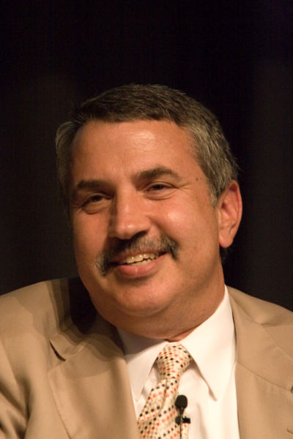

Is today´s economy global?
Pankaj Ghemawat
Thomas Friedman, American journalist, author of a book called „The world is flat“

Slide 16
Globalisation
Challenges
Benefits
Backlash against capitalism and rekindling of nationalism
Increased protectionism of high-demand resources
Need to develop top managers with international understanding and experience
Access to more markets
Growth of developing economies
Opportunities for flexibility and efficiency
Opportunities for small and medium-sized enterprises (SMEs)

Slide 17
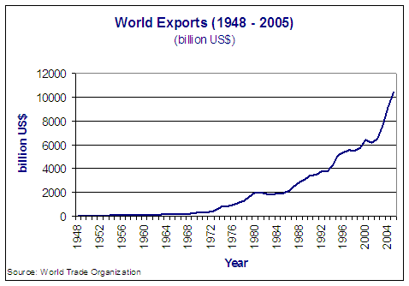
International trade development
Newer data (check trends)

Slide 18
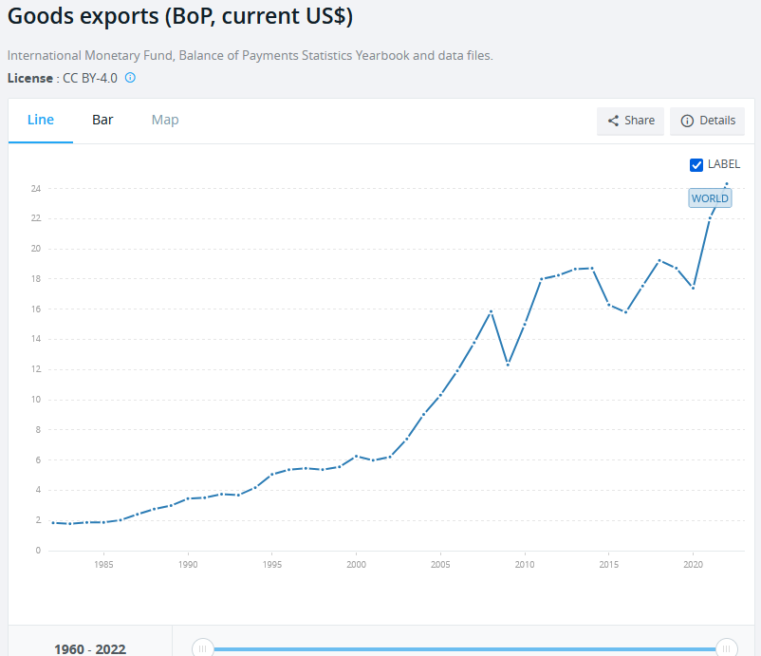
Data source here

Slide 19
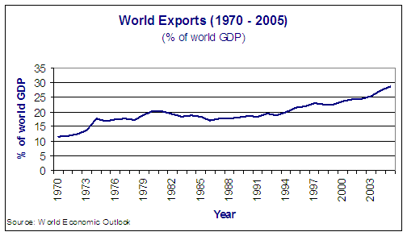
International trade development

Slide 20
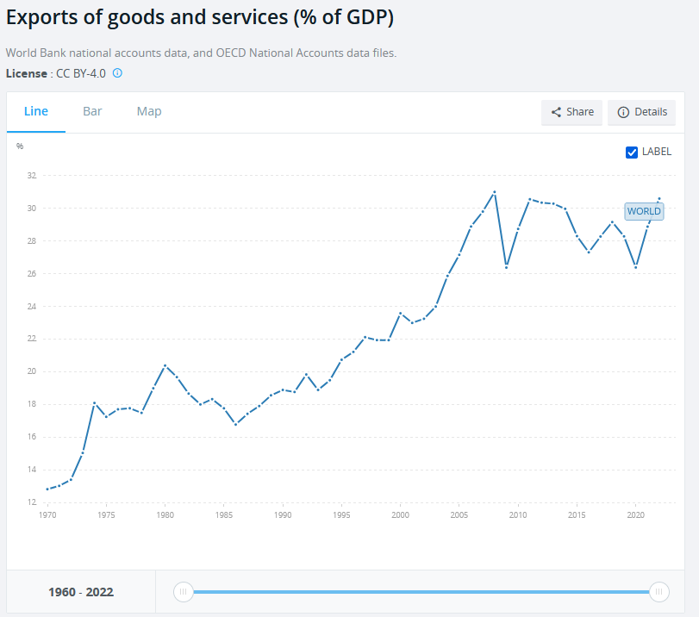
Data source here

Slide 21
Measuring international trade
Import
Export
Trade compared with GDP (trade = (import+export)/2)
Shortcomings?

Slide 22
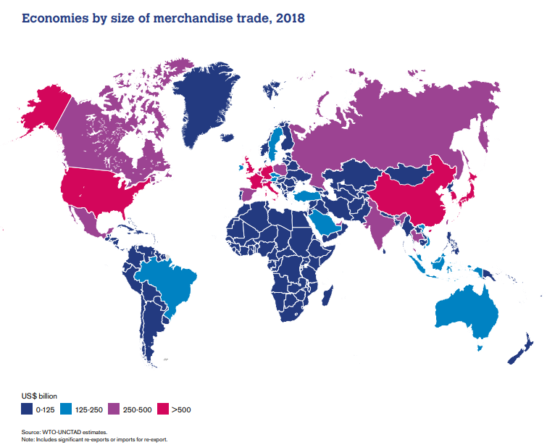

Slide 23
Key recent trends
the economic growth of many developing countries
the growing integration of global production through supply chains
the higher prices for agricultural goods and natural resources
increasing interdependence of the world economy, which causes shocks to reverberate more quickly and globally

Slide 24
Quiz!
When you look at world exports as a percentage of world GDP for the years 1970 to 2005, you can see:
steady increase
sharp increase
steady decline

Slide 25
Global integration
  Theoretical approach
  Competitive advantage
  Comparative advantage
  Examples of comparative advantage:
  Slovakia /Germany
  France/Netherlands
  Finland/Poland
  Czech Republic/Italy

Slide 26
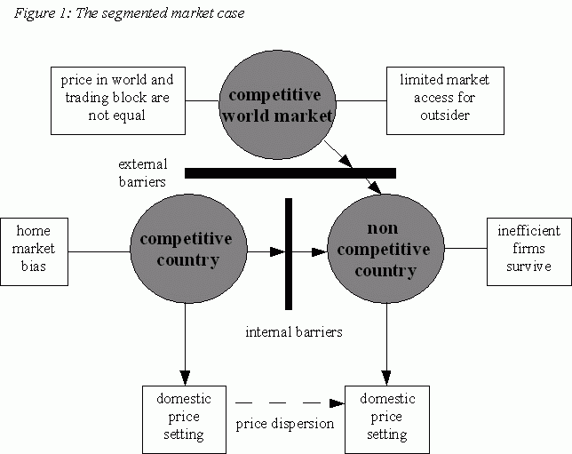
Segmented markets

Slide 27
Consequences
  Price dispersion
  Home bias
  Access to markets

Slide 28
Integration within trading block
The dominance of the US is already over. What is emerging is a world economy of blocs represented by the North American Free Trade Agreement, the EU, and the Association of Southeast Nations. There´s no one center in this world economy.
Peter Drucker

Slide 29
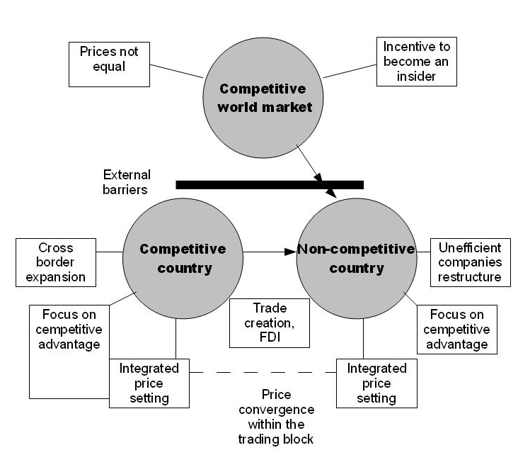
Integration within trading block

Slide 30
Consequences
  Price convergence within trading block
  Expansion of efficient firms
  Focus on their competitive advantage
  Relation between specialization of firms according to competitive advantage and the specialization of a country according to comparative advantage
  Attractivity of successful regional trading blocks

Slide 31
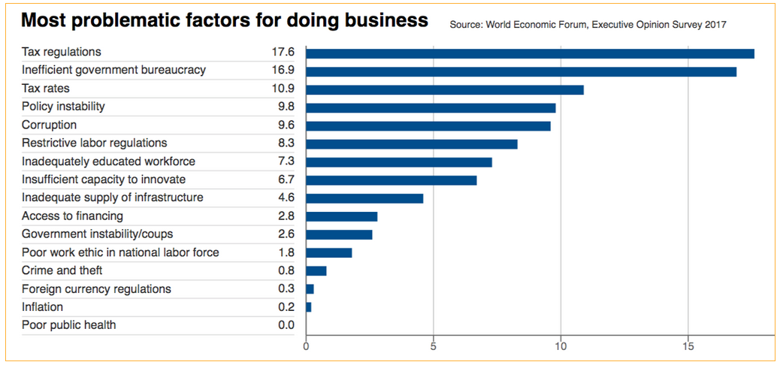
The Czech Republic ranking
Data source here

Slide 32
Quiz!
TRUE OR FALSE???
“Asia accounts for one half of world exports”

Slide 33
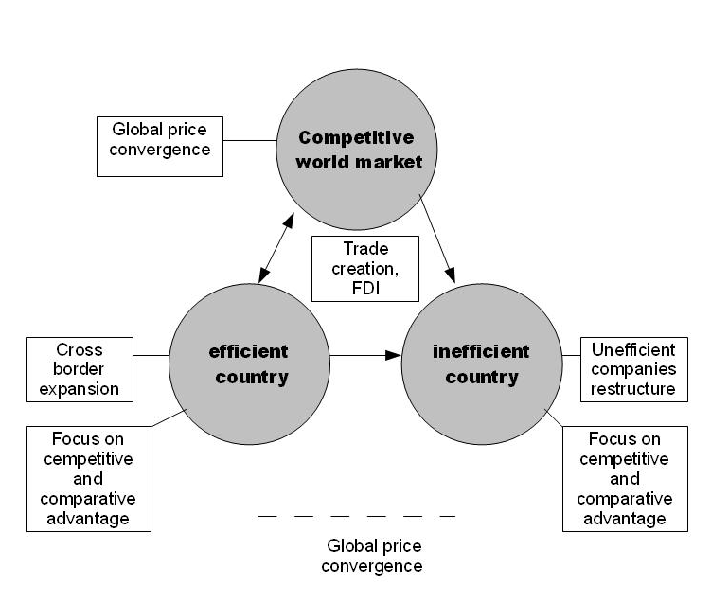
Global integration
Source: Filip Abraham, Internalization and globalization

Slide 34
Consequences
  Global price convergence
  Home market bias disappears
  Efficient firms prevail
  Firms focus on their competitive advantage, countries specialize according to their comparative advantage

Slide 35
From theory to practice
  Price convergence
  Home market bias
  Turning to corporate specialization due to integration
  Relation between integration and comparative advantage of countries

Slide 36
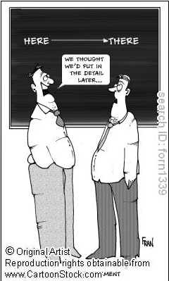
Thank you for attention!

