Slide 1
International trade
Ricardian model

Slide 2
History
Merkantilism
18th/19th century – classic theory (Smith, Ricardo, Mill)
20th century – dynamic theory of comparative advantage (Heckscher, Ohlin, Samuelson and many more)
Limitations of theories – turbulent and changing environment

Slide 3
World trade development
From 1890 until WW1 – golden age of international trade
Great depression (1929) – Smooth-Hawley tarrifs
Reaction of other countries
      Dramatic fall in world trade in interwar period
      Large costs to the US and the world economy

Slide 4
World trade development
After WW2 - second „golden age“ of trade
post World War II era - the General Agreement on Tariffs and Trade (GATT, 1948) was an agreement that prompted regular negotiations among a growing body of members to reduce tariffs (import taxes) on imported goods on a reciprocal basis
1995 WTO
Regional free trade agreements

Slide 5
Approach to International Trade
Active vs. passive approach to IT in a country economy (free trade x autarky)
Support of export
    various national institutions (CzechTrade)
    laws, certificates, advisors, etc.
    media (Japan – competitions – best exporter)

Slide 6

1,34 milions of snowboards imported to US

Slide 7
Reasons for Trade
Technology differences
Different amount of resources
Different costs of outsourcing
Proximity of countries

Slide 8
Models of International Trade
  The Ricardian model examines differences in the productivity of labor (due to differences in technology) between countries.
  The Heckscher-Ohlin model examines differences in labor, labor skills, physical capital, land, or other factors of production between countries.

Slide 9
Opportunity cost
The opportunity cost of producing something measures the cost of not being able to produce something else with the resources used
For example, a limited number of workers could produce either roses or computers
  The opportunity cost of producing computers is the amount of roses not produced.
  The opportunity cost of producing roses is the amount of computers not produced.

Slide 10
Opportunity Cost - Example
Suppose that in the US 10 milion roses can be produced with the same resources as 100 000 computers.
Suppose that in Colombia 10 milion roses can be produced with the same resources as 30 000 computers.
What is the opportunity cost of roses and computer in both countries?

Slide 11
Comparative Advantage
A country has a comparative advantage in producing a good if the opportunity cost of producing that good is lower in the country than in other countries.
Back to the case with roses and computers, which country has the comparative advantage?

Slide 12
Suppose initially that Colombia produces computers (30 000) and the United States produces roses (10 milion), and that both countries want to consume computers and roses.
Can both countries be made better off?

Slide 13
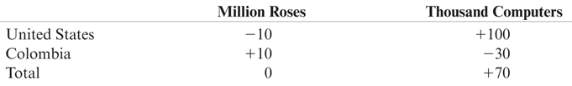
Hypothetical Changes in Production – intuition behind Ricardian model
In the US 10 milion roses can be produced with the same resources as 100 000 computers.
In Colombia 10 milion roses can be produced with the same resources as 30 000 computers.

Slide 14
A One-Factor Ricardian Model
Assumptions:
Labor is the only factor of production.
Labor productivity varies across countries due to differences in technology, but labor productivity in each country is constant.
The supply of labor in each country is constant.
Two goods: wine and cheese.
Competition allows workers to be paid a wage equal to the value of what they produce, and allows them to work in the industry that pays the highest wage.
Two countries: home and foreign.

Slide 15

A One-Factor Ricardian Model
A unit labor requirement indicates the constant number of hours of labor required to produce one unit of output.
a_{LC} is the unit labor requirement for cheese in the home country
a_{LW} is the unit labor requirement for wine in the home country.
A high unit labor requirement means low labor productivity.

Slide 16
A One-Factor Ricardian Model
Labor supply L indicates the total number of hours worked in the home country (a constant number).
Cheese production Q_{C} indicates how many pounds of cheese are produced.
Wine production Q_{W} indicates how many gallons of wine are produced.

Slide 17

Production Possibilities
The production possibility frontier (PPF) of an economy shows the maximum amount of a goods that can be produced for a fixed amount of resources.
The production possibility frontier of the home economy is:
a_{LC}Q_{C} + a_{LW}Q_{W} ≤ L
What is the maximum home cheese production?
What is the maximum home wine production?

Slide 18
Production Possibilities - Example
Suppose that the economy´s labor supply is 1000 hours.
1 hour of labor produces one pound of cheese.
2 hours of labor produce one gallon of wine.
1. What is the PPF equation?
2. What is maximum cheese production?
3. What is maximum wine production?

Slide 19
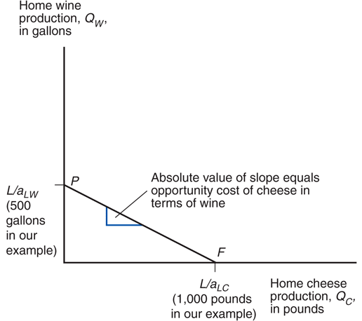
Home’s Production Possibility Frontier

Slide 20
Production Possibilities
The opportunity cost of cheese is how many gallons of wine Home must stop producing in order to make one more pound of cheese:
    a_{LC} /a_{LW}
This cost is constant because the unit labor requirements are both constant
The opportunity cost of cheese appears as the absolute value of the slope of the PPF
  Q_{W} = L/a_{LW} – (a_{LC} /a_{LW} )Q_{C}

Slide 21
Relative Prices, Wages, and Supply
Let P_{C} be the price of cheese and P_{W} be the price of wine.
Due to competition,
  hourly wages of cheese makers equal the value of the cheese produced in an hour: P_{C} /a_{LC}
  hourly wages of wine makers equal the value of the wine produced in an hour: P_{W} /a_{LW}
Workers will choose to work in the industry that pays the higher wage.

Slide 22
Example
Suppose that cheese sells for $4/pound and wine for $7/gallon
Wage paid in cheese industry?
Wage paid in wine industry?
What will workers do?

Slide 23
Relative Prices, Wages, and Supply
  The relative price of cheese 4/7 exceeds the opportunity cost of cheese of ½
If the price of cheese relative to the price of wine exceeds the opportunity cost of producing cheese
P_{C} /P_{W} > a_{LC} /a_{LW} ,
  then the wage in cheese will exceed the wage in wine
  w_{C} =P_{C} /a_{LC} > P_{W} /a_{LW} =w_{W}
  so workers will make only cheese (the economy specializes in cheese production).
  w_{C} =4 > 3,5=w_{W}

Slide 24
  What if the price of cheese drops to $3/pound?

Slide 25
Production, Prices, and Wages
If the home country wants to consume both wine and cheese (in the absence of international trade), relative prices must adjust so that wages are equal in the wine and cheese industries.
  If P_{C} / a_{LC} = P_{W} / a_{LW} workers will not care whether they work in the cheese industry or the wine industry, so that production of both goods can occur.
  Production (and consumption) of both goods occurs when the relative price of a good equals the opportunity cost of producing that good:
  P_{C} /P_{W} = a_{LC} /a_{LW}

Slide 26
Trade in the Ricardian Model
If the home country is more efficient in wine and cheese production, then it has an absolute advantage in all production:
  its unit labor requirements for wine and cheese production are lower than those in the foreign country
  a_{LC} < a*_{LC} and a_{LW} < a*_{LW}
  where “*” notates foreign country variables.

Slide 27
Trade in the Ricardian Model
A country can be more efficient in producing both goods, but it will have a comparative advantage in only one good.
    Even if a country is the most (or least) efficient producer of all goods, it still can benefit from trade.

Slide 28
Trade in the Ricardian Model
Before any trade occurs, the relative price of cheese to wine reflects the opportunity cost of cheese in terms of wine in each country.
In the absence of any trade, the relative price of cheese to wine will be higher in Foreign than in Home if Foreign has the higher opportunity cost of cheese.
It will be profitable to ship cheese from Home to Foreign (and wine from Foreign to Home)

Slide 29
Gains from Trade
Consumption possibilities expand beyond the production possibility frontier when trade is allowed.
With trade, consumption in each country is expanded because world production is expanded when each country specializes in producing the good in which it has a comparative advantage.

Slide 30
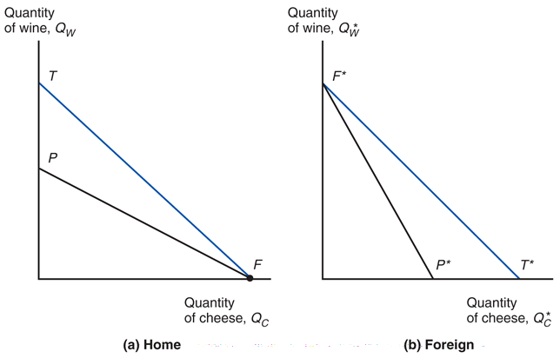
Trade expands consumption possibilities in both countries

Slide 31
Example
Unit labor requirements for home and foreign countries
 | Cheese | Wine
Home | a_{LC} = 1 hour/lb | a_{LW} = 2 hours/gallon
Foreign | a*_{LC} = 6 hours/lb | a*_{LW} = 3 hours/gallon
What is the home country’s opportunity cost of producing cheese?

Slide 32
Example
The home country is more efficient in both industries, but has a comparative advantage only in cheese production.
1/2 = a_{LC} /a_{LW} < a*_{LC} /a*_{LW} = 2
The foreign country is less efficient in both industries, but has a comparative advantage in wine production!

Slide 33
Example
With trade, the equilibrium relative price of cheese to wine settles between the two opportunity costs of cheese.
Suppose that the intersection of RS and RD occurs at P_{C} /P_{W} = 1 so one pound of cheese trades for one gallon of wine.
Trade causes the relative price of cheese to rise in the home country and fall in foreign.

Slide 34
Example
With trade, the foreign country can buy one pound of cheese for P_{C} /P_{W} = one gallon of wine,
  instead of stopping production of a*_{LC} /a*_{LW} = 2 gallons of wine to free up enough labor to produce one pound of cheese in the absence of trade.
Suppose L* = 3,000. The foreign country can trade its 1,000 gallons maximum production of wine for 1,000 pounds of cheese, instead of the 500 pounds of cheese it could produce itself.

Slide 35
Example
With trade, the home country can buy one gallon of wine for P_{W} /P_{C} = one pound of cheese,
  instead of stopping production of a_{LW} /a_{LC} = 2 pounds of cheese to free up enough labor to produce one gallon of wine in the absence of trade.
The home country can trade its _____ pounds maximum production of cheese for _____ gallons of wine, instead of the ____ gallons of wine it could produce itself.

Slide 36
Relative Wages
Relative wages are the wages of the home country relative to the wages in the foreign country.
Productivity (technological) differences determine relative wage differences across countries.
The home wage relative to the foreign wage will settle in between the ratio of how much better Home is at making cheese and how much better it is at making wine compared to Foreign.
Relative wages cause Home to have a cost advantage in only cheese and Foreign to have a cost advantage in only wine.

Slide 37
Relative Wages
Suppose that P_{C} = $12/pound and P_{W} = $12/gallon.
Since domestic workers specialize in cheese production after trade, their hourly wages will be
P_{C}/a_{LC} = $12 /1= $12
Since foreign workers specialize in wine production after trade, their hourly wages will be
P_{W}/a*_{LW} = $12/3 = $4
The relative wage of domestic workers is therefore $12/$4 = 3

Slide 38
Relative Wages
The relative wage lies between the ratio of the productivities in each industry.
  The home country is 6/1 = 6 times as productive in cheese production, but only 3/2 = 1.5 times as productive in wine production.
  The home country has a wage 3 times higher than the foreign country.

Slide 39
Relative Wages
These relationships imply that both countries have a cost advantage in production.
    High wages can be offset by high productivity.
    Low productivity can be offset by low wages.
In the home economy, producing one pound of cheese costs $12 (one worker paid $12/hr) but would have cost $24 (six paid $4/hr) in Foreign.
In the foreign economy, producing one gallon of wine costs $12 (three workers paid $4/hr) but would have cost $24 (two paid $12/hr) in Home.

Slide 40
Relative Wages
Because foreign workers have a wage that is only 1/3 the wage of domestic workers, they are able to attain a cost advantage in wine production, despite low productivity.
Because domestic workers have a productivity that is 6 times that of foreign workers in cheese production, they are able to attain a cost advantage in cheese production, despite high wages.

Slide 41
Do wages really reflect productivity?
Do relative wages reflect relative productivities of the two countries?
Evidence shows that low wages are associated with low productivity.
Other evidence shows that wages rise as productivity rises.

Slide 42
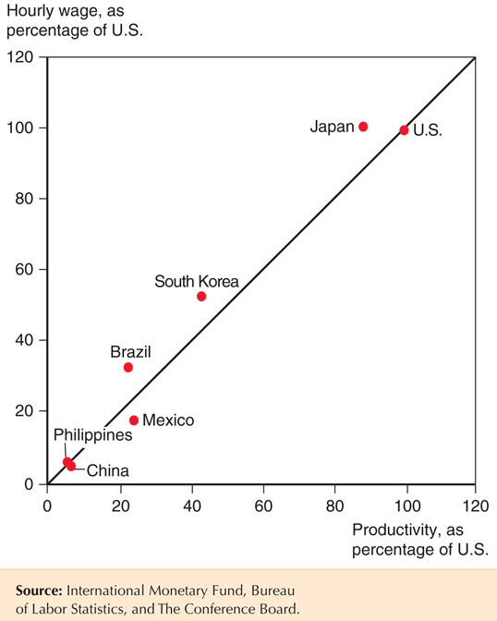

Slide 43
Everything clear? ☺

Slide 44
Misconceptions about Comparative Advantage
Free trade is beneficial only if a country is more productive than foreign countries.

Slide 45
Misconceptions about Comparative Advantage
Free trade with countries that pay low wages hurts high wage countries.
  While trade may reduce wages for some workers, thereby affecting the distribution of income within a country, trade benefits consumers and other workers.
  Consumers benefit because they can purchase goods more cheaply.
  Producers/workers benefit by earning a higher income in the industries that use resources more efficiently, allowing them to earn higher prices and wages.

Slide 46
Misconceptions about Comparative Advantage
Free trade exploits less productive countries whose workers make low wages.
  While labor standards in some countries are less than exemplary compared to Western standards, they are so with or without trade.
  Are high wages and safe labor practices alternatives to trade? Deeper poverty and exploitation may result without export production.
  Consumers benefit from free trade by having access to cheaply (efficiently) produced goods.
  Producers/workers benefit from having higher profits/wages—higher compared to the alternative.

Slide 47
Transportation Costs and
Non-traded Goods
The Ricardian model predicts that countries completely specialize in production.
But this rarely happens for three main reasons:
  More than one factor of production reduces the tendency of specialization
  Protectionism
  Transportation costs reduce or prevent trade, which may cause each country to produce the same good or service.
Nontraded goods and services (e.g. haircuts and auto repairs) exist due to high transport costs.

Slide 48
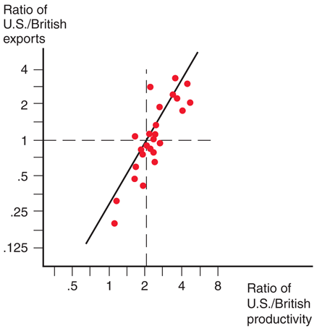
Empirical Evidence
Do countries export those goods in which their productivity is relatively high?

Slide 49
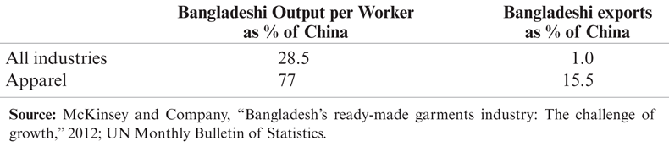
Empirical Evidence
A very poor country like Bangladesh can have comparative advantage in clothing despite being less productive in clothing than other countries such as China because it is even less productive compared to China in other sectors.

Slide 50
Key points
The main implications of the Ricardian model are well supported by empirical evidence:
  productivity differences play an important role in international trade
  comparative advantage (not absolute advantage) matters for trade

Slide 51
Questions?

