Slide 1

Strategic partnerships
Eva Švandová

Slide 2
“We all do better when we work together. Our differences do matter, but our common humanity matters more.” (Bill Clinton)
“If you want to make peace with your enemy, you have to work with your enemy. Then he becomes your partner. (Nelson Mandela)
“Alone we can do so little; together we can do so much” (Helen Keller)

Slide 3
Road map
What are strategic partnerships
Types and areas of strategic partnerships
Why are enteprises partnering
Theories explaining cooperation
Basics steps of strategic partnership creation
Keys to successful cooperation
Partnering in the Czech Republic

Slide 4
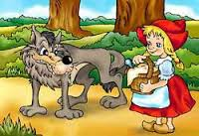
What is strategic partnership
A relationship formed by two or more organizations that share (proprietary), participate in joint investments, and develop linked and common processes to increase the performance of both companies. Source: http://www.apics.org/
A Strategic alliance is a partnership between two or more companies to pursue a set of agreed upon goals while remaining independent organizations. Strategic alliances come in all shapes and sizes, and include a wide range of cooperation, from contractual to equity forms. Source: Encyclopedia, Wikipedia, http://en.wikipedia.org/wiki/Strategic_alliance
TO SUM UP:
  agreements with „open“ end (ASAP)
  between separated independent companies
  sharing common interests or goals
  mutually beneficial
Notes:
The question is, can wolf and the red girl create a partnership for the puprose visitng the grandmother?

Slide 5
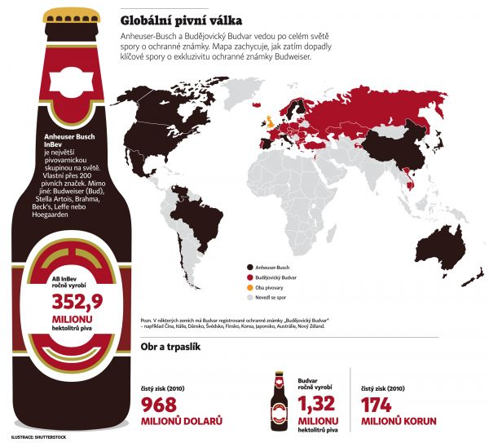
Even competitors can cooperate
Notes:
Lawsiut between Anheuser Busch and Budvar concernig the trademark Budweiser. They were coopertatin from 2007 to 2012. Anheuser Busch Inbev was a sole supplier of budvar name Czechwar in USA market. They were importing distributing and marketing it. Bud in 2008 nwe partner Inbev entered ANB and the business conception hase changed. They wanted to offer thexr small trademarks in the amrecian market. ABI wanted to utilize growing demand for imported beers in USA, co they started to cooperatce. US beverages

Slide 6
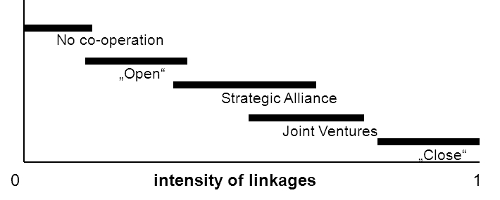
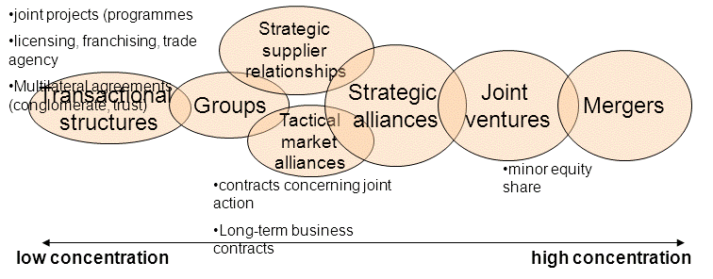
What is strategic partnership

Slide 7
Typology of strategic partnership
  „salient“ informal agreements
  informal collaboration with information sharing
    handshake agreement
  licensing
  franchising
  preferred suppliers and buyers
  joint ventures
  „close“ form of co-operation ???
    merger
    acquisition
risk, resources, costs
SA

Slide 8
Informal collaboration with information sharing
Sharing of information which are interesting for the both sides (supplier and subscriber)
The partners can share the experience and other data resources concerning the market conditions, experience with other partners, computer programs
Handshake agreements
Question of trust – it can be problem in the CR

Slide 9

Preferred suppliers and buyers
Agreements connected with the special position of the partners
Long-term co-operation
Enteprises tend to have fewer suppliers and to create with them longer relationship based on the trust
ŠKODA Auto Mladá Boleslav

Slide 10

Sole agency
Adjusted by New Civil Code (no. 89/2012 Sb.)
agreement closed between agent and the company to be the only one representative (entity) of repsesented company or to sell a product in a particular area on behalf of represented company
Zepellin CZ a Caterpillar
Anheuser Busch Inbev and Budvar
Notes:
Společnost Zeppelin CZ s.r.o., výhradní prodejce stavebních strojů a zařízení Cat® pro Českou republiku, dodává na český trh širokou škálu stavebních, zemních, zemědělských a důlních strojů amerického výrobce Caterpillar. Je také dodavatelem komplexních energetických řešení a systémů od stejnojmenného výrobce. Kromě prodejních a servisních služeb se společnost zabývá půjčováním stavebních strojů a malé mechanizace - autorizovaná půjčovna The Cat Rental Store má pobočky na 11 místech České republiky. Ve spolupráci se společností Caterpillar Financial Services ČR, s.r.o., zajišťuje zákazníkům komplexní finanční servis, spojený s nákupem strojů a služeb. Zeppelin CZ s.r.o. je součástí koncernu ZEPPELIN GmbH, který provozuje 190 poboček ve 30 zemích světa. Aktivity koncernu jsou v globálním měřítku velmi široké a jsou rozdělené do pěti „strategických obchodních jednotek“ (SBU = Strategic Busines Unit). Na území České republiky je společnost Zeppelin CZ aktivní v rámci těchto tří skupin: Stavební stroje EU, Energetické systémy a Půjčovna strojů (The Cat Rental Store).

Slide 11

Licensing
the process of leasing a legally protected (that is, trademarked or copyrighted) entity - a name, likeness, logo, trademark, graphic design, slogan, signature, character, or a combination of several of these elements.
Franchising is a special type of licensing
http://bcove.me/0m0xx9bi
Notes:
Licensing is the process of leasing a legally protected (that is, trademarked or copyrighted) entity
Mitas a coontinetal. Mitas vyrábí pneumatiky v licenci Continentalui. 3 výrobní závody v CR, v Srbsku 1 a v USA. Zahraniční pobočky atd. Výrobce mimosilničních pneumatik. a name, likeness, logo, trademark, graphic design, slogan, signature, character, or a combination of several of these elements. The entity, known as the property or intellectual property, is then used in conjunction with a product. Many major companies and the media consider licensing a significant marketing tool. vlastní obchodní značkou Mitas a Cultor a licencovanou značkou Continental

Slide 12



Franchising
franchisor provides its franchisees a claim to provide brand, trade marks, know-how, design, bussines and technology systems, procedural systems and other industrial or intellectual property rights, marketing support , but it is also the obligation of franchisee to operate in accordance with the concept of franchising.
Franchisee pays a fee
Czech franchising association (ČAF) - http://www.czech-franchise.cz
Notes:
Active in 20 countries, jumping on small trampoline, founded in 2000. (14 european countries, also canada, emirates…)
CAF . Support of existing franchising concepots, create conditions fore the next developmetn, established in 1993

Slide 13
Joint ventures
An agreement between two or more firms to undertake the same business strategy and plan of action
It has its legal form
Two companies want to co-operate (share knowledge, markets, and profits) and they decide to create another company together – JOINT VENTURE
In the CR typical for the enterprises with foreign capital
Notes:
Barum a Continental
From 40 to 60 % of JV underperformed their potential

Slide 14

Barum Continental
tires producer
JV partner – German company CONTINENTAL – 1992
Barum – part of Continental Group
Notes:
Company with long history, traditional company, tires produced since the 30 in the 20th centruy in Baťas plants. After war the BRAND Barum was created. In 70th, BARUM was exporting their tires into the world and they were popular, because in1971 nwe plant was build and the factory was very uptodate. Change started in 1989, the conditions in the world rubber industry changed and it was very difficult for the company to keep its position in the worls. There wer 8 big manufacturers. Privatiozation started, it was necessary – goodyear, michelin, bridgestone pirelli Sunimoto have showen interest to buy the company, finally Continental won. V roce 1993 tak vznikla společnost Barum Continental, s. r. o.. V letošní roce došlo k přejmenování na Continental Barum, s. r. o.

Slide 15
Close form of cooperation
merger
acquisition
Acquisitions – key success factor:
  ability to integrate the company (85)
  synergies (84)
  competitive position of the company acquired (81)
  evaluation of acquisition candidate (80)
  management abilities of company acquired (77)
  prior experience making acquisitions (69)
  market growth of the company acquired (69)
  technology position of the company acquired (68)
  compatibility of management styles (67)
  price paid (64)
  aid from public authorities
Wall Street Journal/Booz-Allen &Hamilton Survey 2002

Slide 16
Popularity of cooperation in the CR
Informal agreement without written contract
Long-term subcontracts
Joint venture
Business cooperation based on long-term contracts (import/export)
Equity capital
Strategic alliances
Licences/franchising
Other forms of cooperation

Slide 17
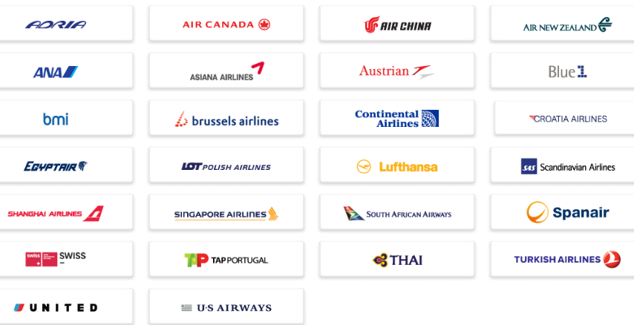
Marketing / distribution/ service agreements
Agreements concerning the collective solution and implementation of external processes
The external processes can be presented by mutually coordinated marketing, assembly and servicing of complicated equipments, commen distribution
Cooperation of airlines – Sky Team, Star Alliance
Alliance of automobile manufacturers
Notes:
Cost reductions come from sharing operation facilities (e.g. catering or computer systems), operation staff (e.g. ground handling personnel, at check-in and boarding desks), investments and purchases (e.g. in order to negotiate extra volume discounts). Traveller benefits can include lower prices due to lowered operational costs for a given route, different times to choose from, more destinations within easy reach, shorter travel times, More options of airport lounges shared with alliance members, fast track access on all alliance members if having frequent flyer status, faster mileage rewards by earning miles for a single account on several different carriers, round-the-world tickets, enabling travellers to fly over the world for a relatively low price.
Airline alliances may also create disadvantages for the traveller, such as higher prices when competition is erased on a certain route or less frequent flights; for instance, if two airlines separately fly three and two times a day respectively on a shared route, their alliance might fly less than 5 (3+2) times a day on the same route. This might be especially true between hub cities for each airline. e.g., flights between Detroit Metropolitan Wayne County Airport (a Delta Air Lines fortress hub) and Amsterdam Airport Schiphol (a KLM fortress hub).

Slide 18

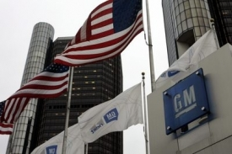


Production / assembly / buy back agreements/ purchasing/ RaD
The participating companies are trying to exploit the advantages coming from the economies of scale
Co-operation connected with fluently recovery of the capital equipment and later with buy back by the supplier of the equipment
Notes:
New United Motor Manufacturing, Inc. (NUMMI) was an American automobile manufacturing company in Fremont, California, jointly owned by General Motors and Toyota that opened in 1984 and closed in 2010. After the plant was closed by its owners, the facility was sold to Tesla, Inc. and reopened as a 100% Tesla-owned production facility in October 2010, becoming known as the Tesla Factory.^{[1]} considered the worst workforce in the automobile industry in the United States,"

Slide 19
Area of cooperation
Procurement/supply
Joint production
Consultancy/experience exchange
Marketing/acquiring of customers
Joint selling
HRM/training and development
Other
Product development/innovation/RaD
Joint financing

Slide 20
The process of strategic alliance creation
advanteges
disadvantages
Strategy
Goals
Search
Evaluation
Idefinition of
occasions
Setting
competencies
cooperation
plan
implementation
Alliance negotiation
Alliance management
Assesment and termination
interested
groups
Partner assessment and selection

Slide 21
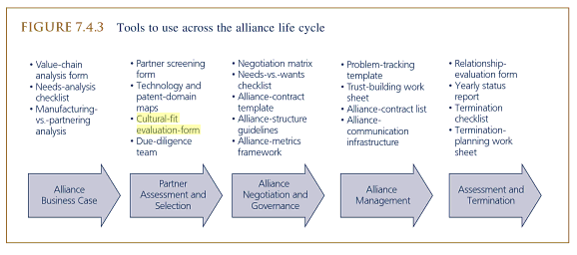
Wit, B., Meyer, R. (2010. Strategy: Process, Content, Context : an International Perspective. Cengage learning EMEA

Slide 22

DCH merger
started in 1998, in 2000 german management started taking over the whole´s company management, 2007 Chrysler division sold.
a lot of red tape x no red tape
Long almost endless reports x discussions and reports based on the minimum necessary
Detailed plan and precise implementation x trial- and –error method to come to solution
Methodical decision making x creativity in decision making
Authority, bureaucracy centralized DM x equal rights among all staff
Hierarchies and top-down management flat structures
Low salaries x high salaries

Slide 23
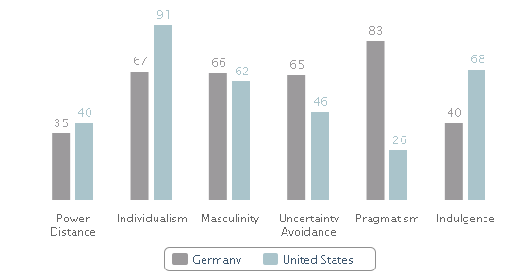
Cultural clashes: DaimlerChrysler

Slide 24
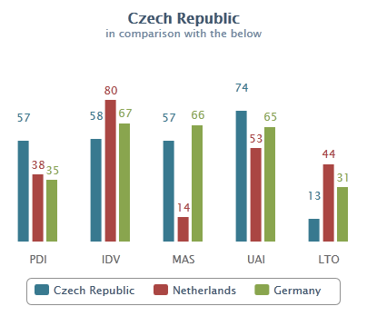
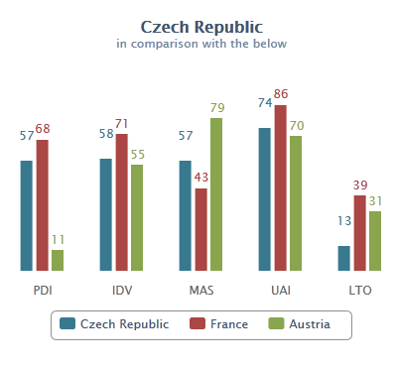
Cultural clashes
http://geert-hofstede.com/czech-republic.html
http://www.businessinfo.cz/cs/clanky/organizacni-kultura-a-narodni-kultura-7699.html

Slide 25
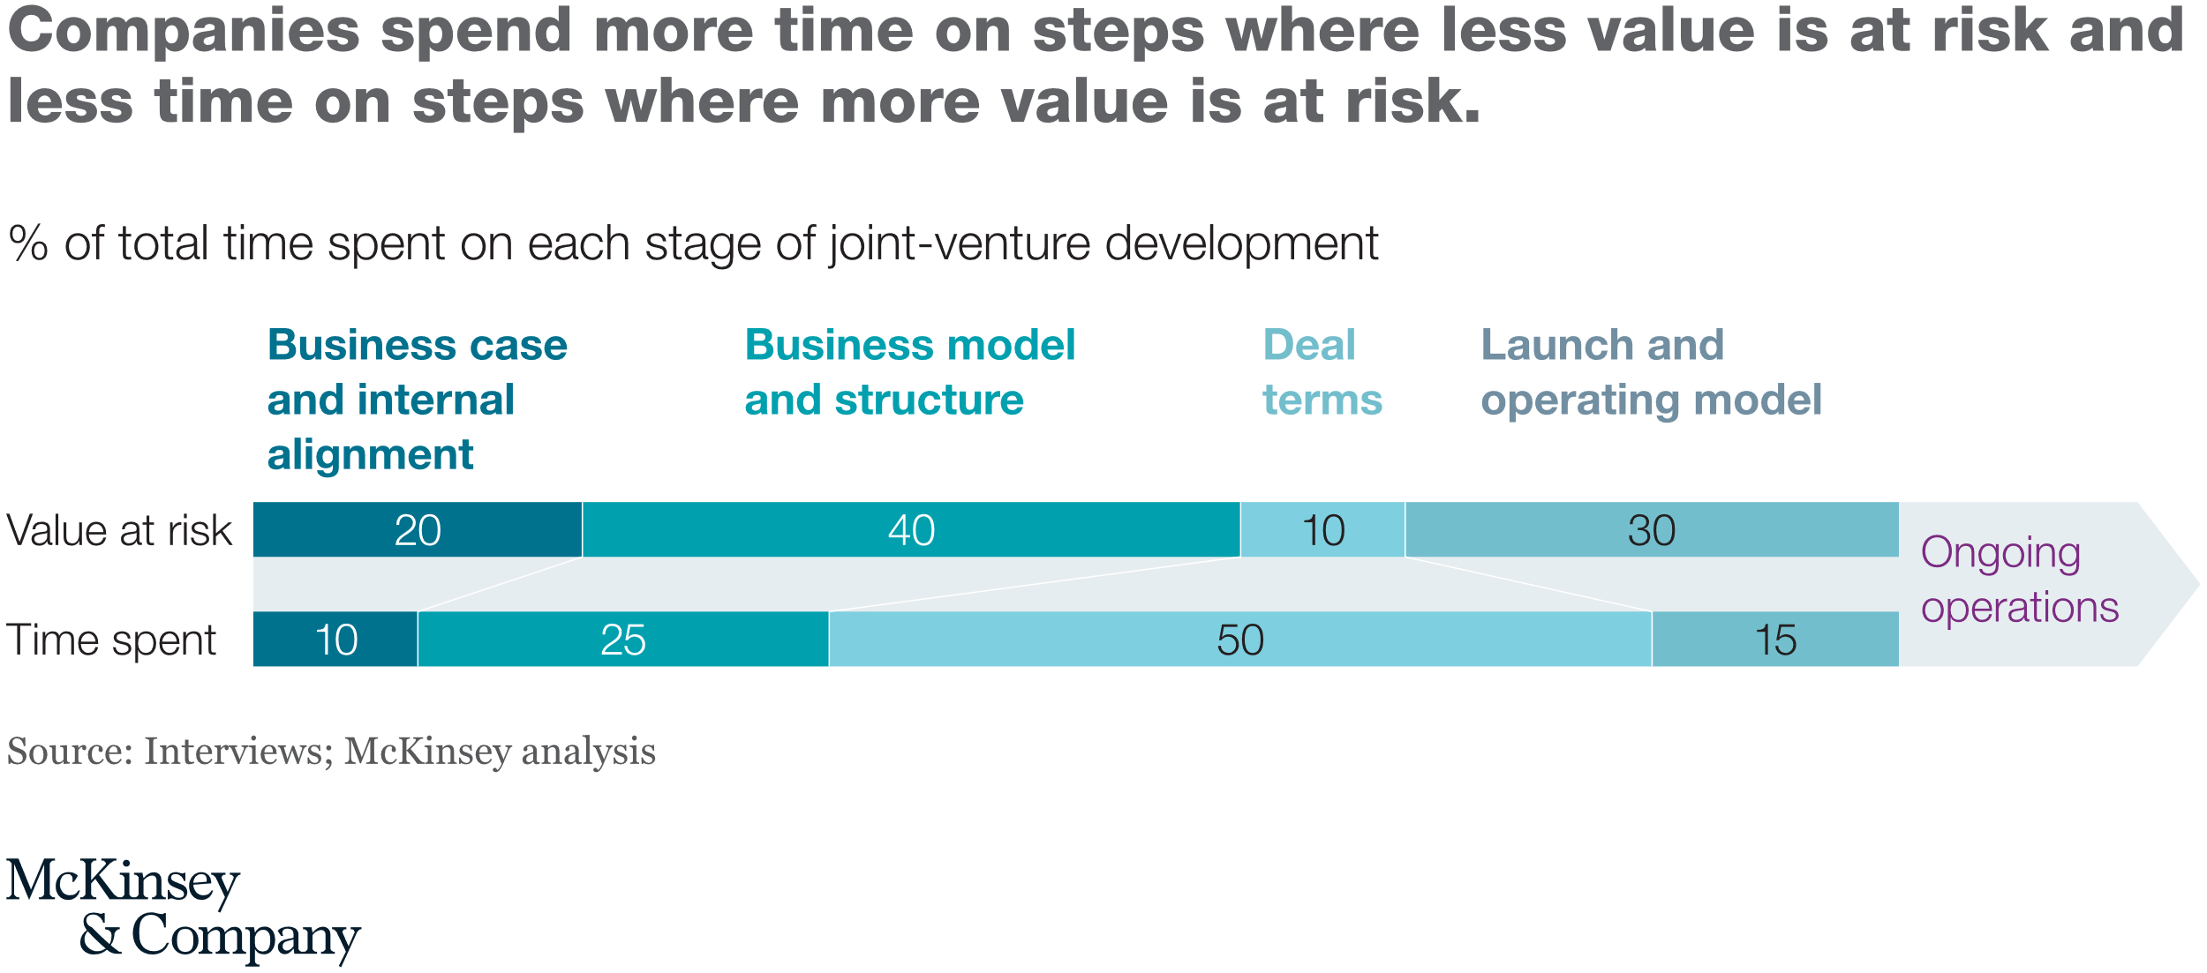

Slide 26
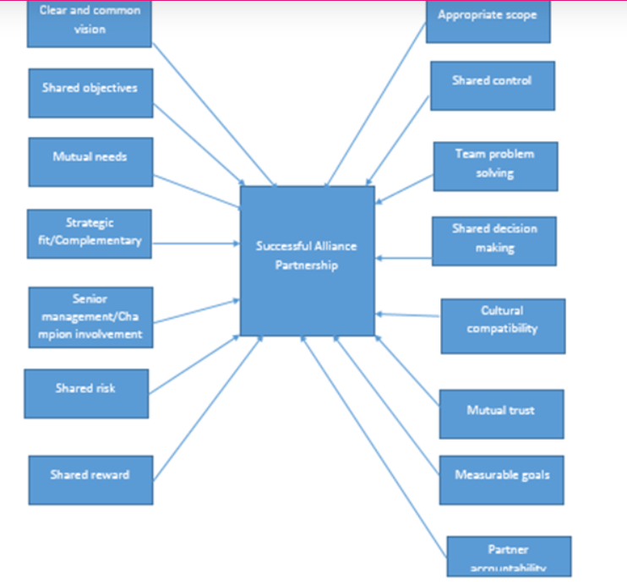
Critical success factors of SA (Biggs, 2006)

Slide 27
Why strategic partnership
SME
limited possibility of financing (this disadvantage causes other secondary problems)
higher interest rates at the bank
underutilization of production machines
employees motivation
Access to the resources
Large companies
Prevent competition (cheaper acquistion)
Access to technology, expertise, innovation
Competitive advantage
Decrease time to market
Notes:
Funding, reputation
Plans to become big company
Market validation
Dostribution channel

Slide 28
Main purposes of the alliances
activities and resources shared between partners – co specialization
competition battle reduction – co-option. coopetition
knowledge creation, transmition and utilization – co-learning, learning and internalization
power shift (change in bargaining power), image and trustworthiness shift
cost reduction

Slide 29
Motives to cooperate (MBV)

Slide 30
Motives to cooperate (RBV)

Slide 31
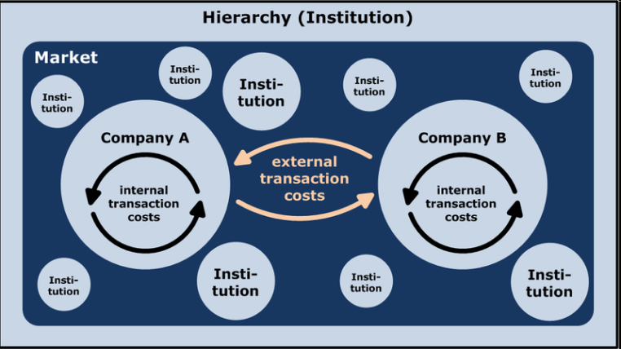
Theories of cooperation
Resource dependance theory
  Formalized by The External Control of Organizations: A Resource Dependence Perspective (Pfeffer and Salancik 1978)
Transactional cost theory
  R.Coase in 1937
Social network theory
  Sociometry, Moreno, Milgram, Granovetter, Burt
Strategic management

Slide 32
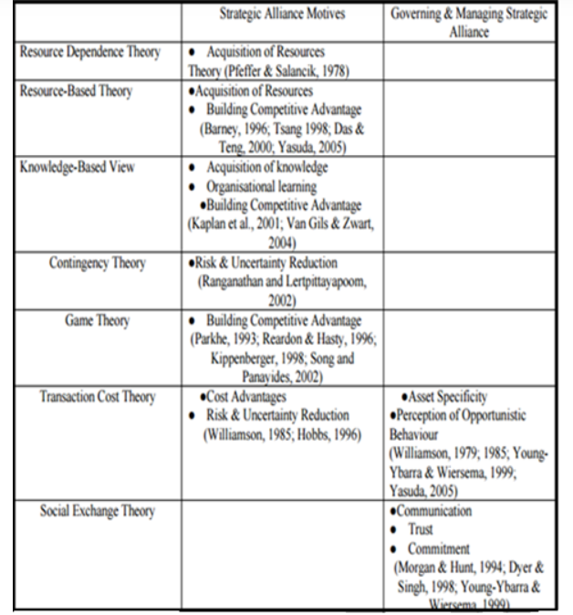

Slide 33
Facts representing cooperation
volume of direct foreign investment exceeded 9 billion EUR in 2010
173 000 Czech firms are supported by foreign capital (2012), 70 % of exports are made by these firms
99,8% of all the Czech companies in the CR belongs to SME
CaE Europe is the most atractive region fore investros (Ernst&Young, 2009, European Atractiveness survey)
87 % of Czechs speak at least one foreign language
One of the highest mobile telephone penetration (105 %)
Educated staff
Good transportation infrastructure

Slide 34
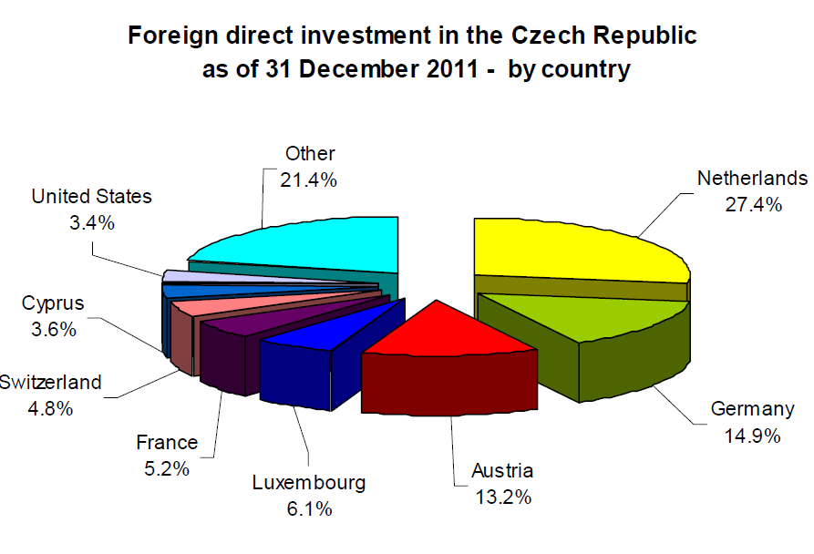
Volume of direct foreign investment inflows
Czech Republic: Inward Foreign Direct Investment, 1993–2012 (in mil. EUR)
Notes:
31.12.1995 31.12.1996 31.12.1997 31.12.1998 31.12.1999 31.12.2000 31.12.2001 31.12.2002 31.12.2003 31.12.2004 31.12.2005 31.12.2006 31.12.2007 31.12.2008 31.12.2009 30.6.2010
5 741,0 6 909,9 8 367,4 12 254,6 17 478,7 23 323,2 30 717,2 36 883,8 35 852,0 42 035,0 51 424,4 60 620,5 76 337,8 81 301,7 84 614,9 90 299,2

Slide 35
Cooperation in the CR
Problem with trust between the Czech companies being competitors, if they are going to co-operate (the Moravia Silesia Cluster) – problem especially of the co-operation supported by public authority
Foreign partners are trying to produce for cheap in the Czech Republic
Foreign partners want to expand and don´t know the Czech market
Cooperation between Czech firms in the sphere of research and development (24 of innovative research parks in the CR)
Expansion of outsourcing
Barriers of cooperation – different wage and cost level, different attitude to work and mentality, low knowledge of the language, bureaucratic and legal obstacles,

Slide 36
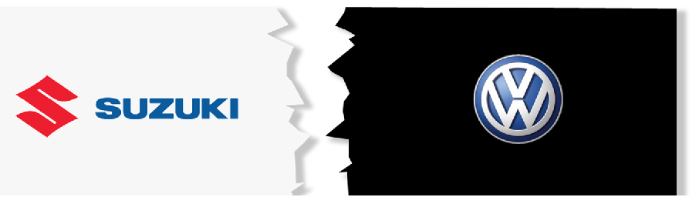
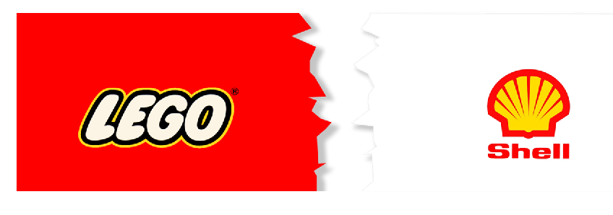
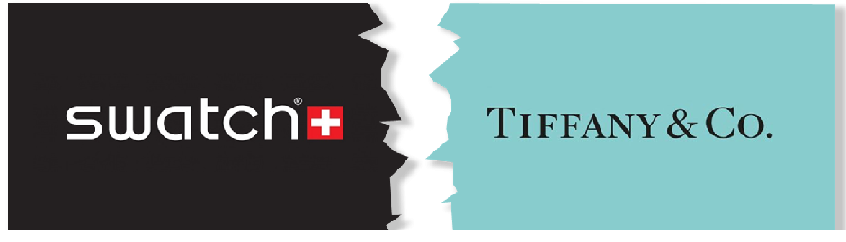

Slide 37
Don’t give your brand away, carve out provisions for adequate creative control
  “We signed a partnership thinking it was going to work perfectly, and it failed dramatically. To be successful today you have to be true to your DNA, and there’s no way an external company can take care of that as you do. You don’t just give away your brand to someone who might have completely different objectives.” (Nicola Andreatta, Vice President and General Manager of Tiffany & Co Swiss Watches)
Don’t underestimate the importance of compatibility from a core value perspective
  “Lego are a company all about all about children, the future of children and being environmentally sustainable. If you make those kinds of claims as values of your company then it is really important that you examine the relationships that you have with other companies who clearly don’t have the same values” (Charlie Kronick, Senior Climate Advisor at Greenpeace)
Make sure you establish and practice trust, be clear on what you plan to share, and then share it
  “Volkswagen AG did not allow Suzuki access to Volkswagen AG’s core technology and it also became clear that there were differences between Suzuki and Volkswagen in the understanding of ‘independence’. Suzuki could not therefore establish a relationship of mutual trust which is the basis for collaboration between the two parties.” (Spokesperson, Suzuki )

Slide 38
Thank you

