Slide 1
Operation Management (OM) Introduction
Ing.J.Skorkovský, CSc,
Department of Business Management
FACULTY OF ECONOMICS AND ADMINISTRATION
Masaryk University Brno
Czech Republic

Slide 2
Coordinates (will be part of OM Introduction as well)
Lecturer : Ing.Jaromír Skorkovský, CSc.
  Department of Business Management (5th floor)
  jaromir.skorkovsky@econ.muni.cz
  +420 731113517
Study material : will be updated regularly after every lesson (is.muni.cz and Interactive Syllabus )
So far there is a lot of material there but mind you that nearly every part will be slightly or more heavily modified every year. So the correct material will have at the end of its name specification …20YY mmdd meaning 20YYMMDD if not specified otherwise in advance (e.g. 20230919)
Attendance : seminar and lectures are obligatory – see subject specification (is.muni.cz) – first vital condition to be admitted to exam !!!!) – see letter send after this class.
Excuses : if serious reason emerges - only written form is accepted
Seminar work : will be assigned after some important theory will be presented. Accepted seminar work is the second condition to be admitted to an exam. Assign time: 13.11.2023
Tuition plan : at the end of this slide show
Name of the tuition plan file : Tuition plan for AOPR_2023mmdd
For the case of normal contact teaching : AOPR: P312 (308)- every Monday on 16:00 and VT206 and every Wednesday on 12:00
In case of online teaching during an unexpected events : MS TEAMS

Slide 3
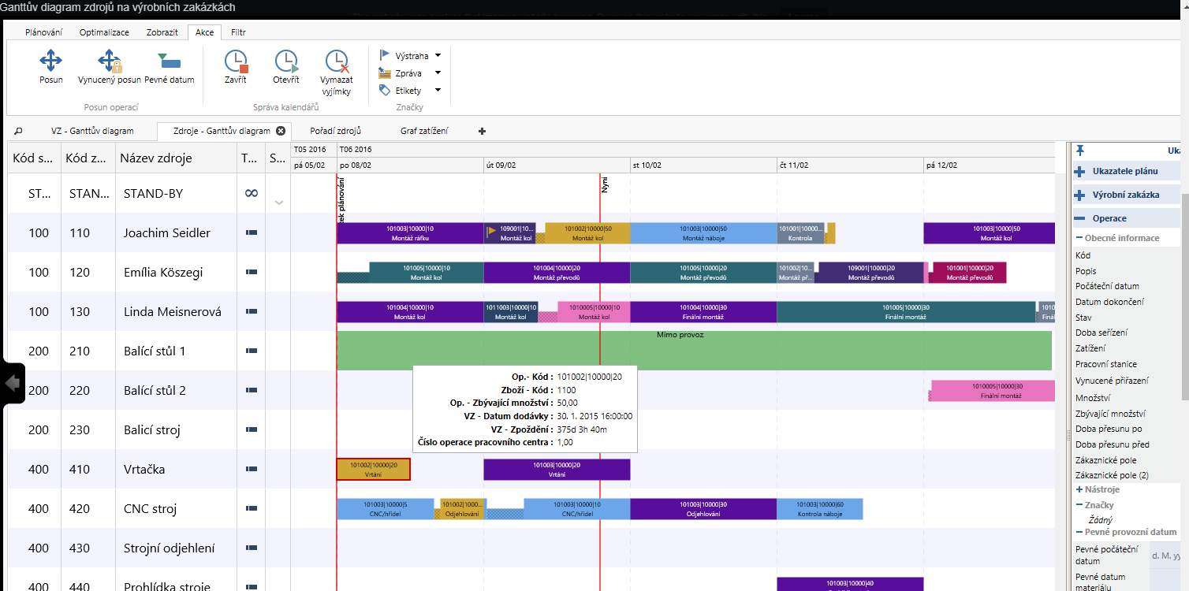
Tutor experiences from latest projects
ITEC Johannesburg
Peter Paper Johannesburg (https://www.peterspapers.co.za/)
Training of personel for Navertica South Africa (120 hours in 2023)
SW localisations
  Boltrics (Warehouse Management)
  Planner One (Ortems)
  Implementation of BC (ESF)

Slide 4
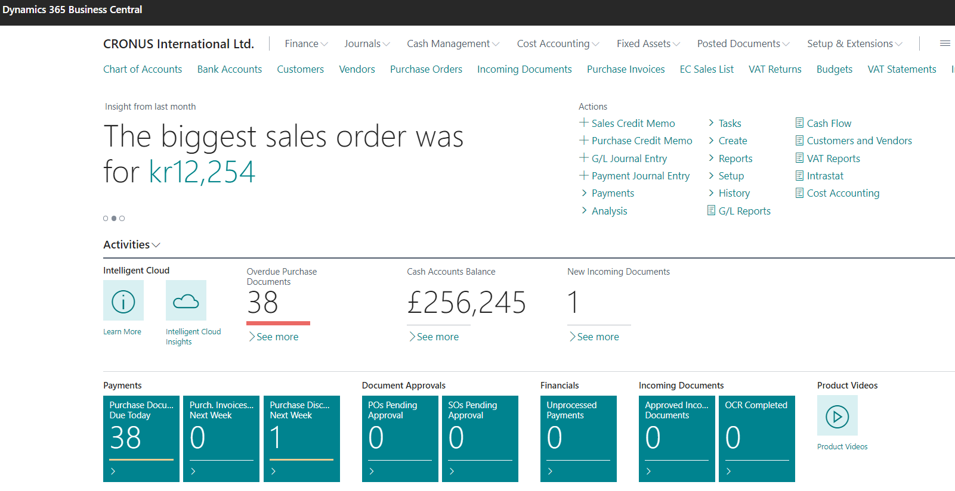

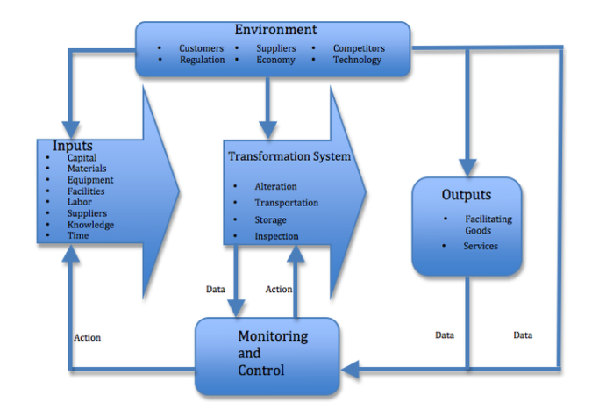
Principles
Data
Management philosophy (processes)
Information technology
MS Dynamics 365 Business Central)
Feedbacks

Slide 5
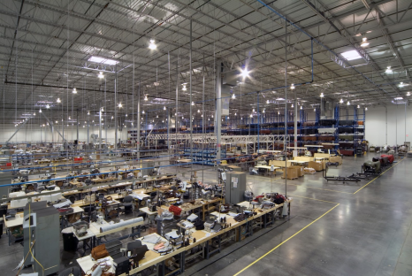
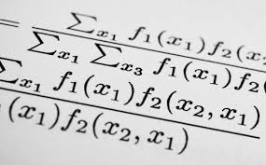
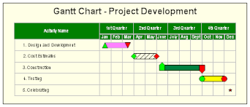
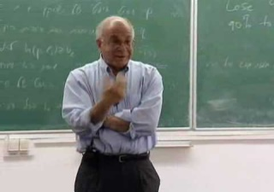
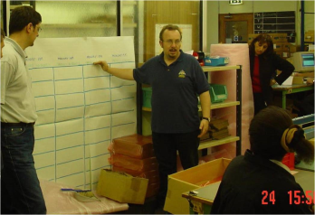
What is going on ?
Use of Operations Management (OM) in external environment
(main target)
General knowledge of OM methods acquired at university and long-standing experience
Knowledge of methods and experience from research and literature - teachers
Knowledge of methods and experience from outside world – consultants, managers, …
Extent of knowledge
Extent of knowledge
Synergy and put OM into practice

Slide 6
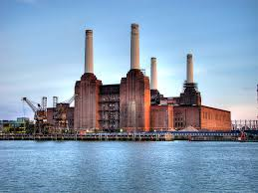
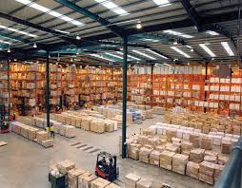


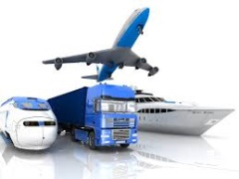

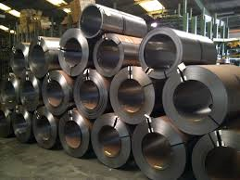
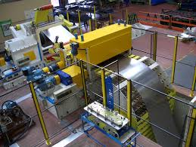
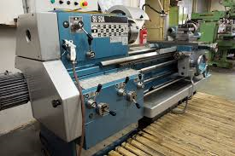
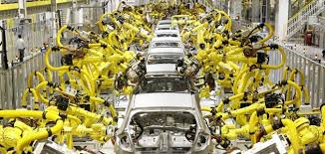
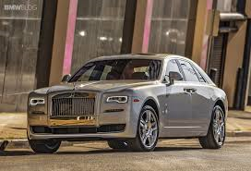
OM all around us
OM is the management of all processes used to design, supply, produce, and deliver valuable goods and services to customers
INBOUND
Processing-transformation
OUTBOUND
TQM = Total Quality Management,Six Sigma,…
ERP: Logistics, Transportation ,
MRP, JIT, APS, Lean Manufacturing, Little´s law
ERP: Marketing, Selling, Invoicing, Payment,….

Slide 7
Selected OM methods, which will be kicked around as time will move on
Theory of Constraints (TOC) -(AOPR)
Balanced Scorecard -(AOPR)
Project Management methods (Critical Chain) -( AOPR)
Material Requirement Planning (MRP) and Just-in-Time principles
- (more in detail live in ERP MS Dynamics 365 Business Central )
. Six Sigma – quality management -(AOPR- reason -> JIT introduction)
Boston matrix and PLC, SWOT and Magic Quadrant Matrices -(AOPR)
Little´s Law (relations between WIP, Throughput and Cycle time) -(AOPR)
Linear programming – optimization prinicples- (AOPR)
Yield Management - (AOPR)
Kepner-Tregoe (support of decision making) - (AOPR)
Decision trees -(AOPR)
WIP=Work in Progress, PLC=Product Life Cycle

Slide 8

Some tools which have to be used
ERP-Enterprise Resource Planning : MS Dynamics 365 Business Central)
  Necessary installation, handling, and system setup-prinicples
  Inventory – Items – Transports –Availability of Components (Items)
  Purchase –dealing with Suppliers (SCM)- > Payables
  Selling – dealing with Customers -> Reveivables
  Payment – Bank operations
  Accounting basics
  CRM- Customer Relationship Management
  Manufacturing Basics– Planning and Shop Floor Control->WIP, COGS,…
  Budgets
  Reporting
SCM=Supply Chain Management, COGS=Cost of Good Sold
ERP serves as the magnifying glass to processes…

Slide 9
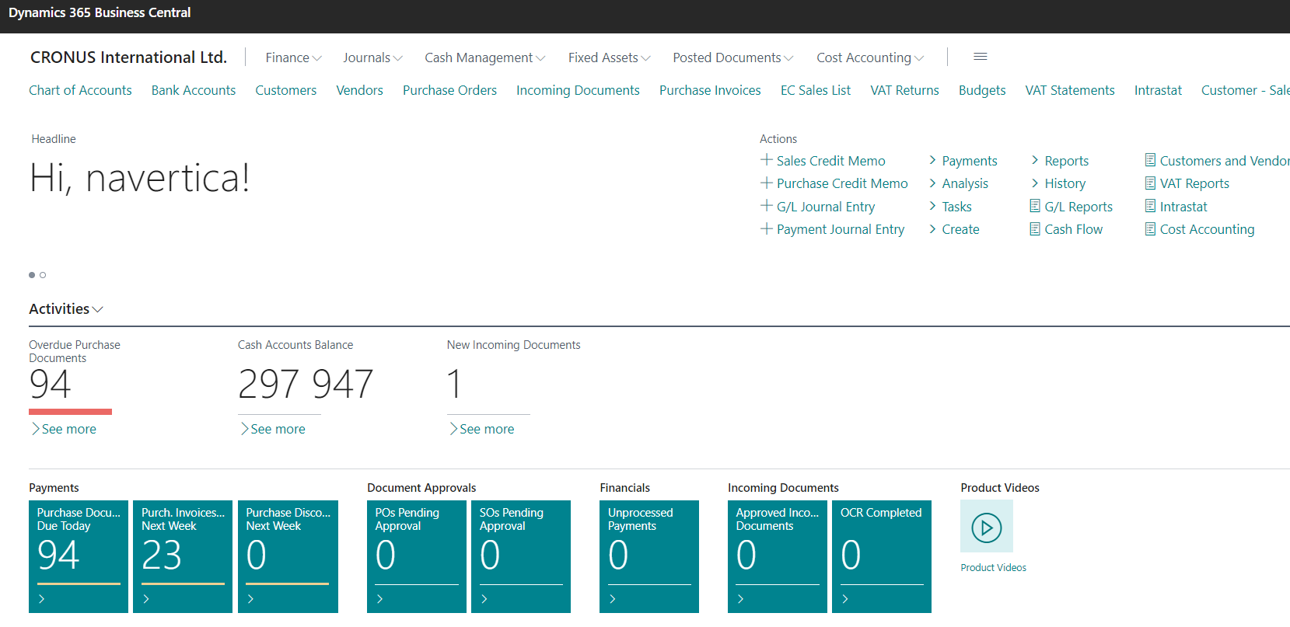
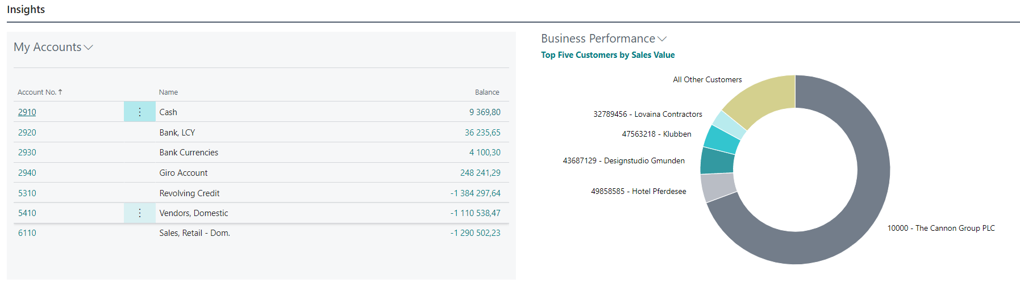
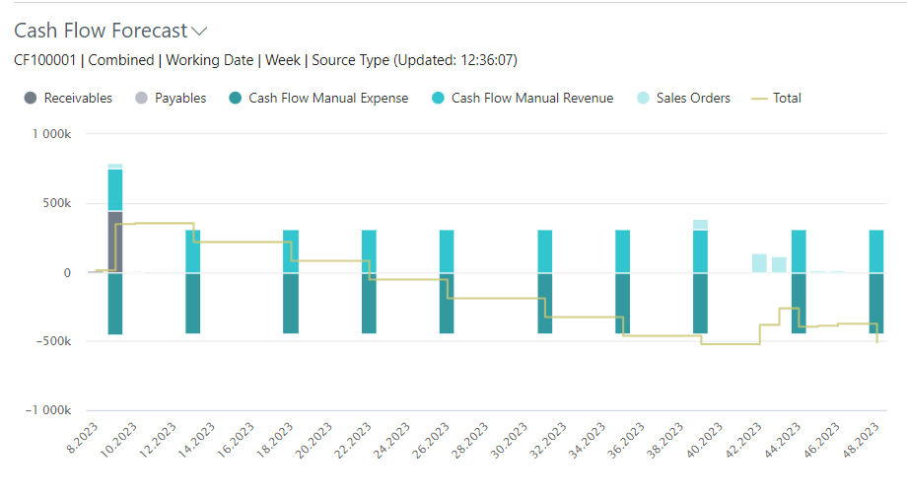
Business Central

Slide 10
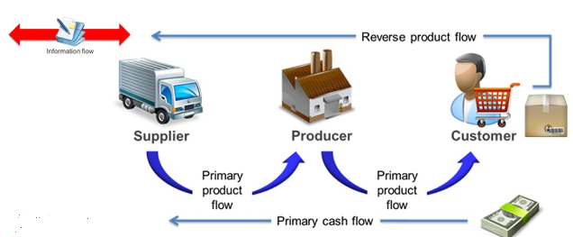
Controlling processes in Supply Chain Management (SCM)
Supply | Production | Orders
 | Operation Strategies and Innovations , R&D
Forecasts, Blank Orders | Long term planning | Marketing
Logistic operations | Routing control, TQM | Packaging , Transportation
MRP, Replenishment | MRP_II ; JIT, Capacities | Cash flow
Planning levels
Strategic
Demand Planning
Tactical
Operational
Operational
Used abbreviations : R&D –Research and Development; TQM-Total Quality Management; JIT- Just –In-Time; MRP_II-Manufacturing and Resource Planning
Used abbreviations (slide number 3 ): : ERP - Enterprise Resource Planning ; APS – Advanced Planning and Scheduling , MRP-Material Requirement Planning

Slide 11
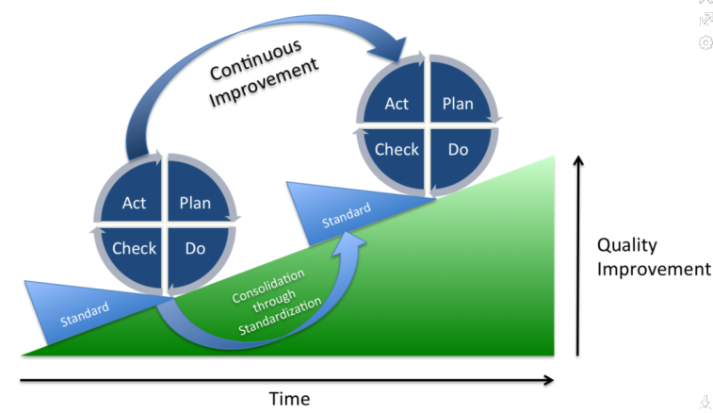
Deming cycle PDCA (based on process periodicity)
Plan: Define the problem to be addressed, collect relevant data, and ascertain the problem's root cause (meaning by use of TOC=Theory of Constraint).
Do: Develop and implement a solution; decide upon a measurement to assess its effectiveness.
Check: Confirm the results through before-and-after data comparison.
Act: Document the results, inform others about process changes, and make recommendations for the problem to be addressed in the next PDCA cycle.
Used abbreviations : TOC – Theory of Constraints

Slide 12

Another PDCA angle of view
Project management
Theory of constraints
Production
Linear programming
Total quality
management
Product postitioning
Business Intelligence
Workflow
Critical chain
Drum –Buffer-Rope
MRP-MRP-II,JIT,APS
Cutting, blending
Pareto, ishikawa
Boston Matrix
Gartner QM
Decision
Making -trees
SCRUM
CONWIP
Logistics
Pareto, Ishikawa
Product Life Cycle
Kepner-Tregoe
EOQ
Six Sigma
Yield management
Hurwitz
ABC
Prospect Theory
LEAN
Function block Logistic more in detail
will be presented later in this show
Little´s law
Used abbreviations : QM– Quadrant Matrix; CONWIP – Constant Work in Progress; EOQ – Economic Order Quantity ; MRP - Material Requirement Planning

Slide 13
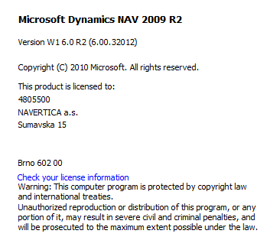
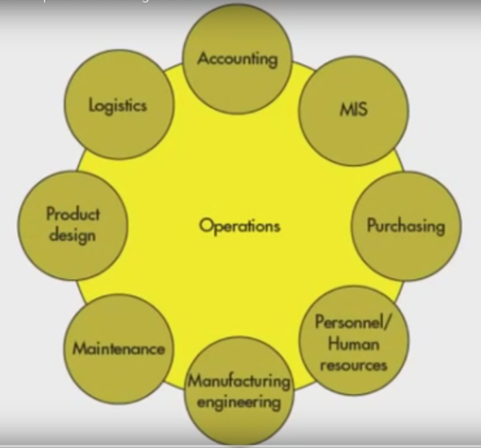
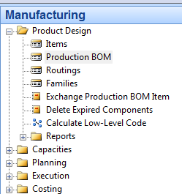
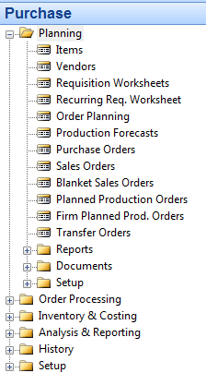
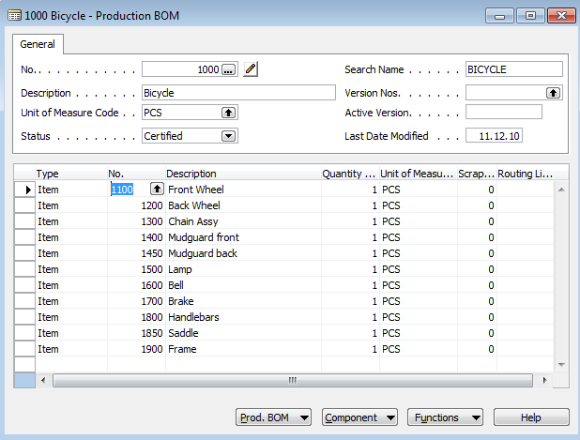
A subset of ERP-driven operations
See next slide
Bill of Material

Slide 14
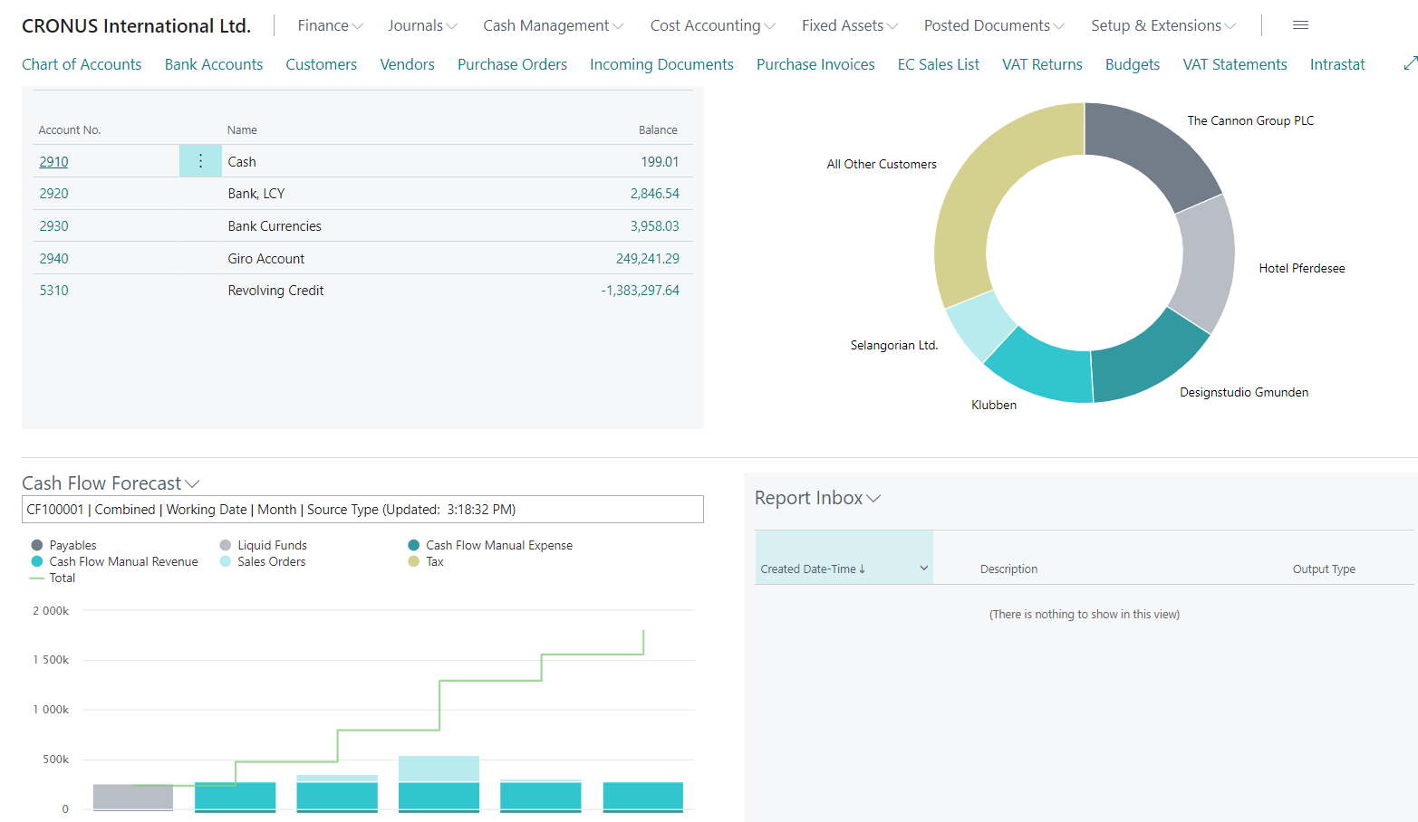
MS Dynamics 365 Business Central

Slide 15
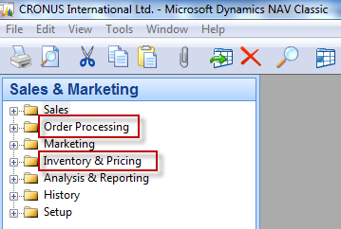
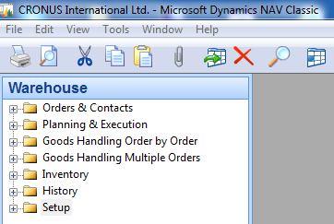
Function block Logistic- very simplified
Inventory Management
Orders (Dependent demand)
Inventory Costing
Warehouse Management
Forecasts based on Independent demand
Transportation
Will be part of our course regarding ERP system MS Dynamics BC

Slide 16
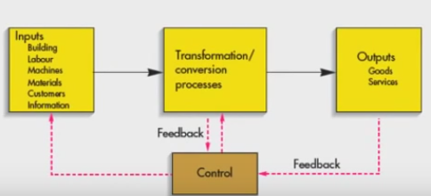
Procedures-simplified (feedback control)
Color agenda used later
Input
Transformation
Output
When managing the processes, you will not be able to do without the use of feedback.
Resource (modified) : dowtsx

Slide 17
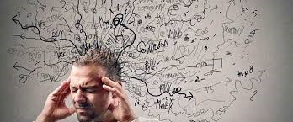
Processing (not organised set of processes, will be presented also as a introduction to project management PWP presentation later)
Load-despatch
Purchase Order
Reporting
Statistics
Consumption registration
Production Output registration
Inventory value
calculation
Output check
(Quality control)
Delivery
Production Planning
Sales Order
Component replenishment
Process flow ?
Transfer
to
Production
Put-away
Cross-docking
Input check
Finished
goods to
Inventory
Picking from
Inventory
Invoicing
Payment
Resource : Skorkovský

Slide 18
Your main task (to organize processes based on business logic)
Sales Order
(demand)
Production Planning
Component replenishment
Purchase Order
Input check
Consumption registration
Transfer
to
Production
Picking from
Inventory
Inventory value
calculation
Put-away
Production Output registration
Inventory value
calculation
Cross-docking
Finished
goods to
Inventory
Load-despatch
Payment to
Vendor
Inventory value
calculation
Shipment
Invoicing
Output check
Payment from
Customer
Reporting
Statistics
Transformation
Output
Agenda
Input
Control
Logistics
Resource : Skorkovský

Slide 19


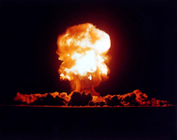
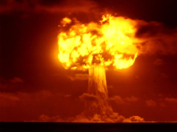
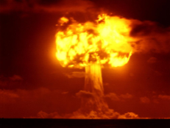
Your main task (possible problems, bottlenecks, undesirable effects..)
Sales Order
Production Planning
Component replenishment
Purchase Order
Input check
Consumption registration
Transfer
to
Production
Picking from
Inventory
Inventory value
calculation
Put-away
Production Output registration
Inventory value
calculation
Cross-docking
Finished
goods to
Inventory
Load-despatch
Priorities ?
Payment to
Vendor
Inventory value
calculation
Shipment
Invoicing
Output check
Payment from
Customer
Reporting
Statistics
Application of TOC ->thinking tools->Current Reality Tree – first stage
Resource : Skorkovský

Slide 20

Your main task
(Search - HOW ??? Measure impacts –HOW ??? and Destroy – HOW ???)
Cause-Effect relation
Cause-Effect relation
Cause-Effect relations
Cause-Effect relation
Cause-Effect relation
Root Problem
(e.g. low profit, crippled cash flow,… )
Notes:
https://www.toc.tv/TV/video.php?id=701&open=excerpt#.V6xCP00kpFo

Slide 21

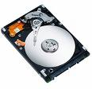
Basic problem I. (one of many)
Quantum computers ?
We have
a huge data
quantity
Moore's law is the observation that the number of transistors in a dense integrated circuits doubles approximately every two years – so -> capacity of memory is going up –>applications (SW) temporarily solve such a constraint and it is still valid after more than 50 Years !!!

Slide 22
Transistor density in chips and computer performance – home study
Density
Performance
As computer machines get more powerful, the software running on these computers will also keep growing. It does not matter what kind of software or what development model is applied to that software. The software will continually expand to match the capacity of the container it is in.
Time
MRP
Closing
loop MRP
Sales & Operation
Management
JIT
ERP
SW tools

Slide 23
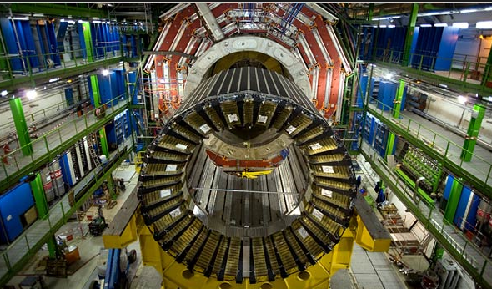
Big data and analysis problém –home study
In test and measurement applications, engineers and scientists can collect vast amounts of data every second of every day. See examples:
For every second that the Large Hadron Collider at CERN runs an experiment, the instrument can generate 40 terabytes of data.
For every 30 minutes that a Boeing jet engine runs, the system creates 10 terabytes of operations information.
For a single journey across the Atlantic Ocean, a four-engine jumbo jet can create 640 terabytes of data.
Multiply that by the more than 25,000 flights flown each day, and you get an understanding of the enormous amount of data that exists (Rogers, 2011). That’s “Big Data.”
Hardon Collider-accelerator
CERN = Conseil Européen pour la Recherche Nucléaire –Resource : https://home.cern/about

Slide 24
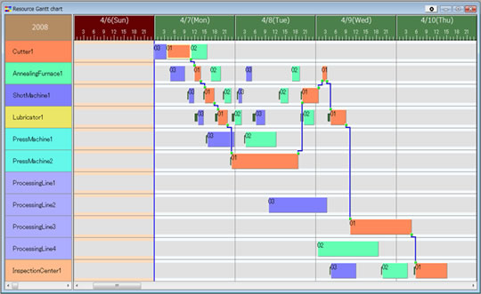
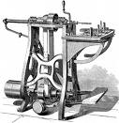

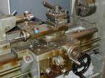
Basic problem II. (we need reliable data to control processes)
To solve it we should use Finite Capacity Scheduling (APS)
Gantt
chart
T1+T2=X
Opt=Min(X)
T2-waiting time
Op1
T2 = 0
Op1
Op2
Op2
Op3
Op3
T1 = 0
T1-waiting time

Slide 25
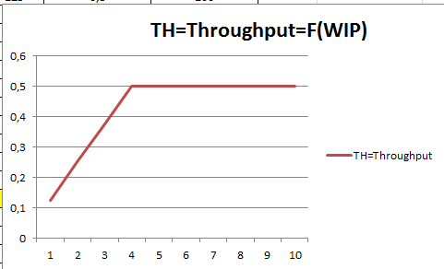
Basic problem III.
Critical WIP level
Will be explained later in Little´s law presentation (MPH_AOPR)
WIP= Work In Progress
Throughput (also known as the Flow Rate) is a measure of a business process flow rate.
Essentially, it measures the movements of inputs and outputs within
the production process. It is an important metric in the operations management of a company.

Slide 26
Throughput and Productivity
The amount of something (such as material, data, etc.)
that passes through something (such as a machine or system)
Throughput is the rate of production or the rate at which something can be processed (throughput = output / duration).
Productivity is defined as output per unit of input (productivity = output / input).

Slide 27

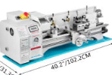
Another problem- colouring IV.
Black
White
White
Black
(Black ->White, Setup time=60 minut)
(White->Black, Setup time = 20 minut)
Main aim ->setup time minimization

Slide 28
Basic problem V-I. (availability of BOM components )
Op1
A0
20 pcs of A7 and 20 pcs of A8
A1
A2
Op2
10 pcs of A4 and 10 pcs of A5
(will be delivered in T1+X time, so too late)
A3
T0
Lead time
to produce A6
Op3
Lead time
to produce A3
A4
A5
T1
T2
A6
Op1
A7
A8
X= slack = delay
Bill Of Material=BOM
(tree structure)
Op2
T1
T1+X
Op3
For sake of simplicity we did not mentioned components A1 and A2 and possible delays having cause in delivery times of bad quality !!!
Same with capacities of machines allocated to OP1-OP2-OP3 ( due to unexpected sudden breakdowns of these machines)

Slide 29
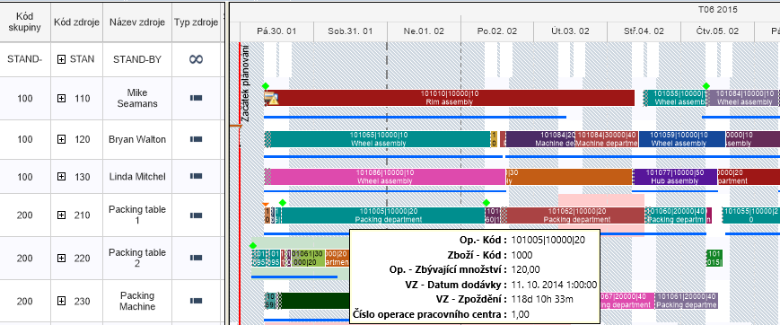
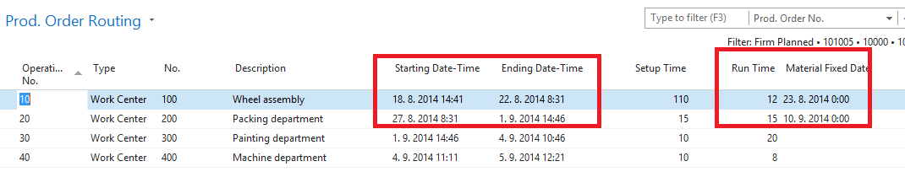
Basic problem V-II. (availability of components and capacity )
Gantt chart
APS result ->18.8.->23.8. a 27.8.->10.9
APS = Advanced Planning and Scheduling result

Slide 30
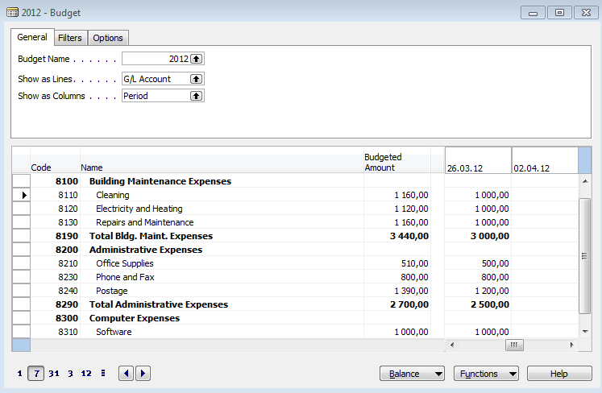
Basic problem VI-I. (budget exceeded)
We will model a very similar example in the classroom using the Business Central system

Slide 31
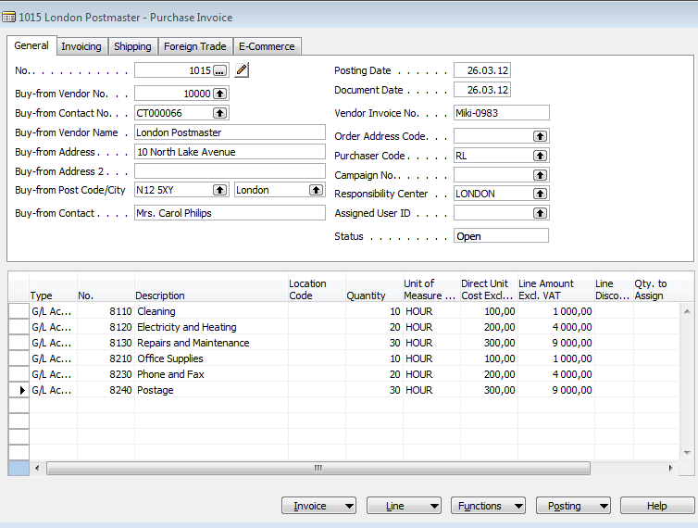
Basic problem VI-II. (budget exceeded)
Creation of the actual costs figures

Slide 32
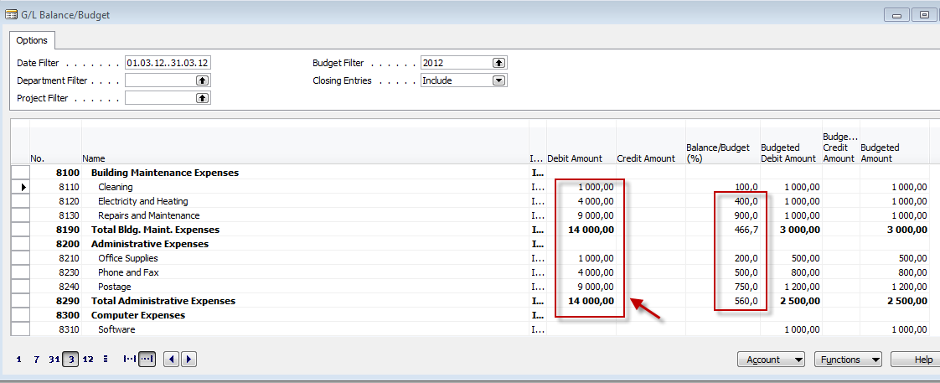
Basic problem VI-III. (budget exceeded)

Slide 33

Thanks for your attention

