Slide 1
Balanced Scorecard
Ing.J.Skorkovský,CSc.
and various listed sources
Department of Corporate Economy

Slide 2

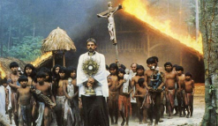



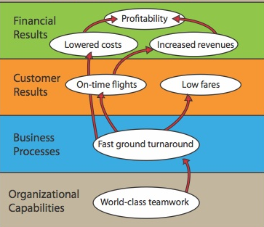
Balanced Scorecard and continuum of value I.
Balanced Scorecard is a step in the continuum describing value
and how the value is created
Mission – why we exist
Values – what is important to us
Vision – what we want to be
Strategy – our game plan
Strategy map – translate to strategy
See next show
Balanced scorecard – measure and focus

Slide 3
Mission –explanation of the term
Mission: what the company represents, what is the purpose of its existence, and what values it recognizes.
Examples:
Google: "Our mission is to organize the world's information so that everyone can access and use it„ (and make as much money as possible – tutor´s approach)
McDonald's: "We want to be the best in the world in fast service and provide customers with the best quality, service, cleanliness, and value.„ (and we don't mind that fast-food diets make people fat) – tutor´s approach)
Coca-Cola: "Refresh the world in mind, body, and spirit. Arouse moments of optimism and happiness through our brands. Create value and create the difference.„

Slide 4
Visions
Vision: what the company wants to become, what is its target state
Examples:
IKEA: "Creating a better everyday life for as many people as possible."
Harvard University: "Developing Leaders Who Will One Day Make a Global Difference"
SOS Children's Village: "A loving home for every child."

Slide 5
Step by step…
Raison d´etre of the company
Mission
Raison d´etre = why we're here
The ideal state we want to achieve
Vision
Plan how to achieve it
Strategy
Step by step procedure
Tactics

Slide 6
Balanced Scorecard and continuum of value II
Balanced Scorecard is a step in the continuum describing value
and how the value is created
Target – what WE need to do (plan, project, budget, …)
See next slide to se budget tool (model) in EPR
Personal Objectives – what I need to do
Strategic Outcomes (sub-objectives for 4 groups)
Satisfied Shareholders
Delighted Customers
Efficient and Effective Processes
Motivated and Prepared Workforce

Slide 7
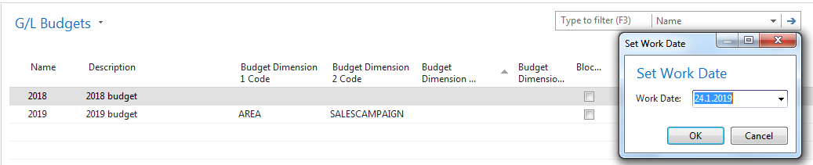
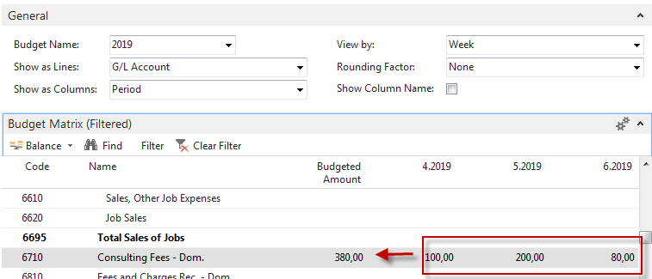
Budget model in ERP-setup
Total budgeted amount =380 =100+200+80

Slide 8
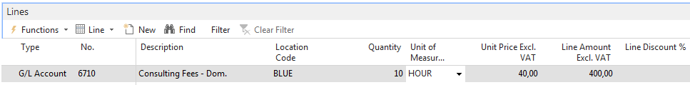
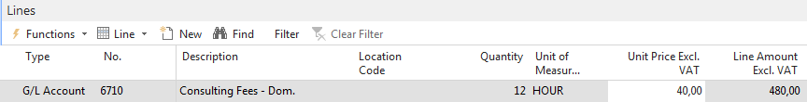
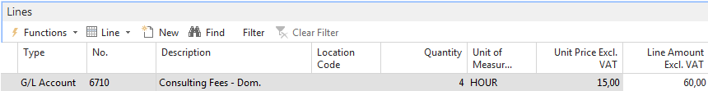
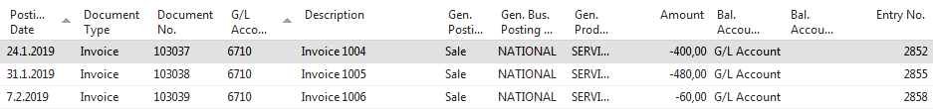
Budget model in ERP – Sales of Consulting services
Sales Line (invoice) 24.1.2019
Sales Line (invoice) 31.1.2019
Sales Line (invoice)7.2.2019
Genera Ledger Entries
400+480+60=940

Slide 9
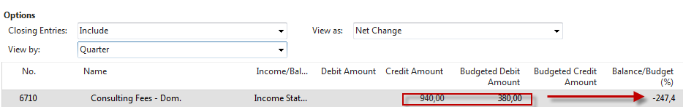
Budget- Planned-Actual results (from BC)

Slide 10




Area definitions
BSC developed by Robert Kaplan and David Norton
BSC examines a firm´s performance in four critical areas
Finances – how should we look to our shareholders ?
Customers – how should we look to our customer ?
Processes – at which business processes must we excel ?
Learning and Growing – how will we sustain our ability to change and improve ?
Resource : Operation Management, Quality and Competitiveness in Global Environment, Russel &Taylor

Slide 11
Basic strategy map (two lower BSC levels)
Processes
Production and Services
Lower cost of production
Continuous improvement (Kaizen)
Reduced cycle time (see Little´s law)
Shorter production lead times
Working capital efficiency (fin. leverage)
MRP,MRP_II
Advanced Planning and Scheduling
Good Resource Planning
Perfect way of cost calculation (actual-expected)
Application of Theory of Constraints
Linear programming- optimization
SCM-Supply Chain Management
Lower cost of transport
Better way of stock replenishment
Better delivery performance
Supplier Relationship
Lower cost of ownership
JIT delivery
TQM – High quality supply
Risk Management
Financial risks
Cash flow management
Operational risk
Technological risk
Human capital Organizational Capital Information Capital
Excellent training
of resources…
Efficient and flexible
structures and reporting
system, team work, company culture…
Analytic applications
BI, transaction processing
applications=ERP (BC)..
Resource : Operation Management, Quality and Competitiveness in Global Environment, Russel &Taylor (not the red ones)

Slide 12
Basic strategy map (two upper BSC levels)
Shareholder value
Productivity Strategy
Growth Strategy
Finance
Become industry cost leader (Gartner Magic Quadrant Matrix)
Maximize use of existing assets
Improve cost management
Strategy
Increase value of customer account
Stars and Milk Caws segments of Boston Matrix
Stable product portfolio
New resources generation (higher market share )
R&D related to current product portfolio
Competitive prices Low cost of supply Perfect Quality Deliveries in time
Processes – at which business processes must we excel (see previous slide) ?
Resource : Operation Management, Quality and Competitiveness in Global Environment, Russel &Taylor (not the red ones)

Slide 13
Some explanation of benchmarks I (home study- one of many examples)
KPI-Key Performance Indicators
  As businesses evolve, leaders need to understand how they’re performing across specific periods.
  Many businesses use key performance indicators (KPIs) to quantify metrics and standardize performance reviews.
  The fist step to implementing this process is to understand KPIs and how they can be defined for various business segments.
Example from financial area :
  Working Capital Requirement : WCR measures the financial resources required to cover the lag between outgoing and incoming payments and shows the amount of financial resources needed by a company to ensure its production cycle and its repayments of both debts and upcoming operational expenses.
  Net working capital requirement = Inventory + Accounts Receivable – Accounts Payable
Explanation : A WCR having value less than 1 signals that outgoing funds needed for operations exceeds incoming sources from business activities. Conversely, and WCR between 1.5 and 2 is a sign that the company does not need to dip into its long-term resources to satisfy short-term requirements.
Parameters related to cash flow

Slide 14
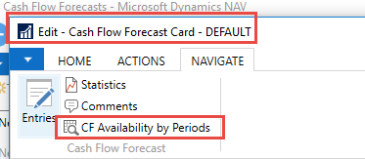
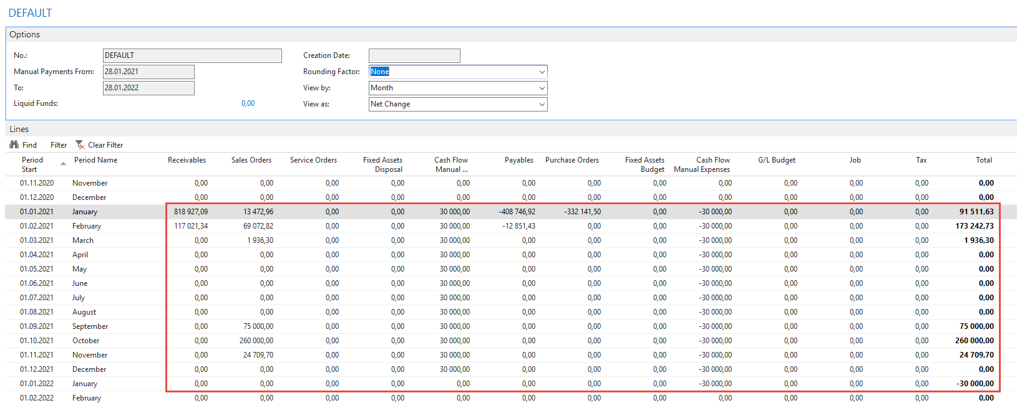
Receivables nad Payables in Business Central

Slide 15
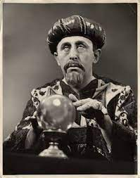
Prediction is extremely difficult,
especially in the future.

Slide 16
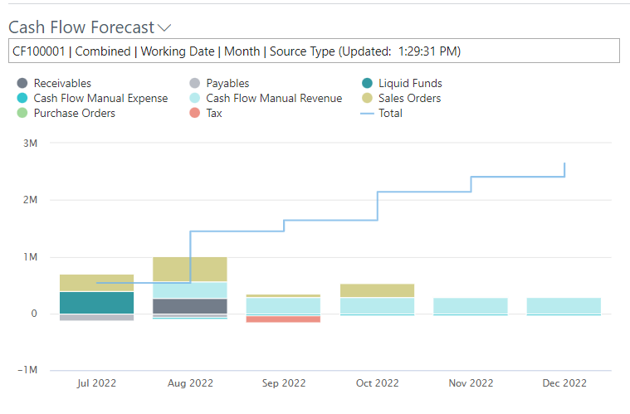
Cash flow

Slide 17
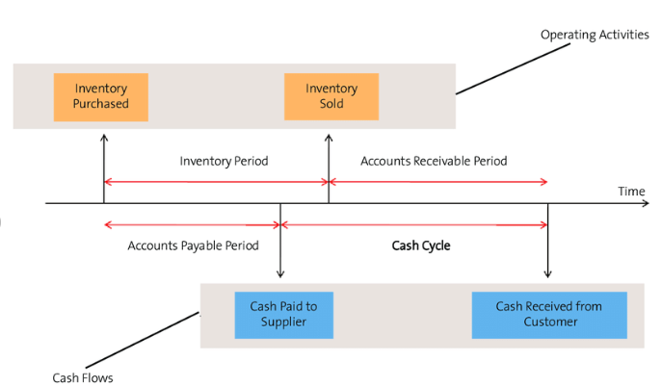
Cash cycle (Cash-to-Cash)

Slide 18
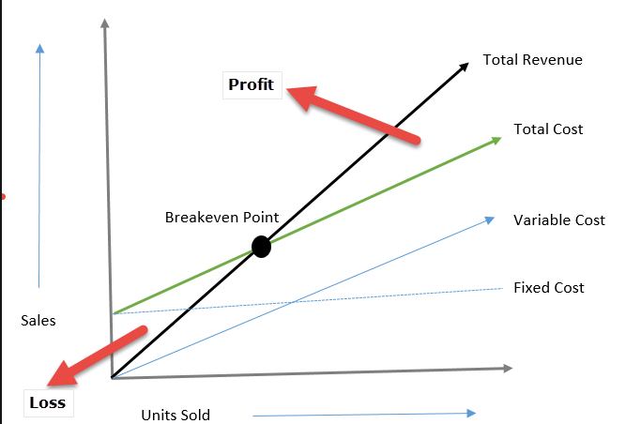
Explanation of benchmarks II (home study)
KPI-Break Even Point
Q= F/(P-VC) , where F=Fixed costs, P=Unit Cost, VC=Variable cost

Slide 19
Balanced Scorcard worksheet
(50+80)/2
Explanations : FTL-full truck load, LTL- less than truck load , SPC=statistical process control, EDI=electronic data interchange, Cycle time=time/unit=(e.g.7 min/1 customer request)
Resource : Operation Management, Quality and Competitiveness in Global Environment, Russel &Taylor

Slide 20
Some time units for measuring (home study-examples of partialy used time parameters)
Will be presented later in sections such as :
  Little´s law (WIP=Throughput *LT) – will be presented later in this course
  Theory of Constraint (througput time)
Takt Time (TT) – rhythm in which we have to produce to satisfy customer demand (demand is for instance 240 toaster ovens and we can produce these in 480 minutes ->TT= 480/240=2 ovens/minute
Lead Time (LT) – Number of minutes, hours, or days that must be allowed for the completion of an operation or process, or must elapse before a desired action takes place – see next slide

Slide 21
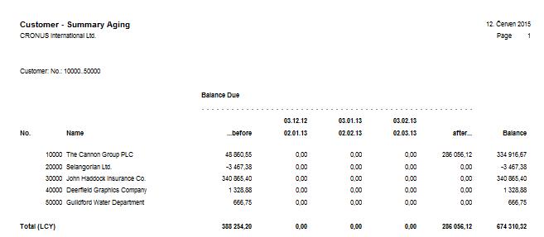
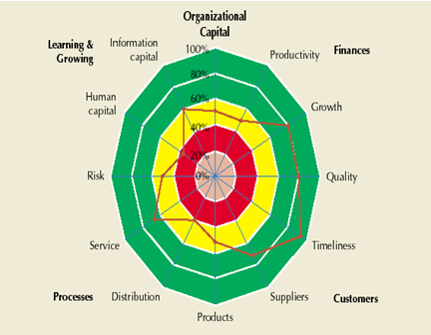
ERP outputs and BSC
Report generated from
ERP Business Central
Financial way of
reporting
BSC way of reporting
(Radar Chart)
Based on KPI estimation in % out
analysed company is excellent,
but on the other hand,
collecting money, credit limit
and overdue management
is falling behind
Resource : Operation Management, Quality and Competitiveness in Global Environment, Russel &Taylor (only radar chart)

Slide 22
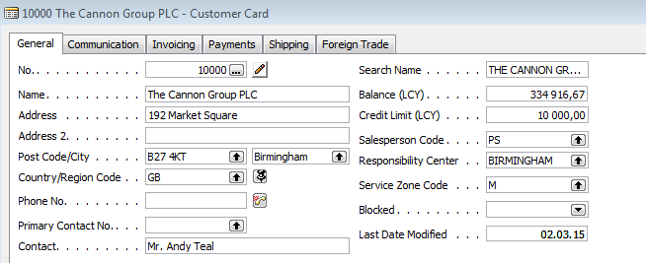
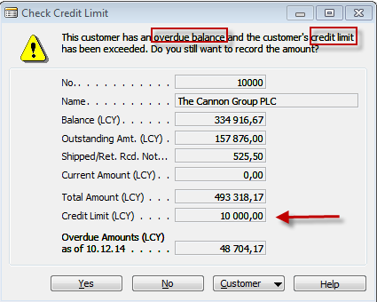
ERP forms related to customer aging report

Slide 23
BSC and OM (Processes discussed practically in Business Central are not listed here)
Finances – how should we look to our shareholders ?
Customers – how should we look to our customer ?
Processes – at which business processes must we excel ?
Learning and Growing – how will we sustain our ability to change and improve ?
Project management
Theory of constraints
Production
Linear programming
Total quality
management
Product postitioning
Business Intelligence
Workflow
Critical chain
Drum –buffer-rope
MRP-MRP-II,JIT,APS
Cutting, blending
Pareto, ishikawa
Boston Matrix
Gartner QM
Decision
making
CONWIP
Logistics
Balanced
Scorecard
Yield management
Kepner-Tregoe
EOQ, ABC
Hurviwtz
BEP analysis
Little´s law
Prospect theory
Methods related to AOPR course

Slide 24
Strategic initiatives
(two lower BSC layers have defined way : Goal-Measurement-Intent-Action Program
Satisfied shareholders
Sales growth
Profit growth
Action
program
Provided value
Better relationships
Goal
Measurement
Intent
To keep our
existing
customers
Ratio WIN/LOST
Action
sales
Ratio WIN/LOST
To enlarge
market share
Sales channel turnover
Support of
image
Number of new
customers
by 100 % - 2 years
(increase)
They arrived for the first time
Unpleasant surprise
Quantity of
problems
by50 % - 2 years
(decrease)
Programof
targeted
marketing
Marketing
skills
% of skills
% customers with
correct data
In one year 100%
In 2 years 80 %
Training
New SW
Marketing skill
Database of customers

Slide 25
Used tool (one page approach)
The least important process from the evaluators' point of view
 | Metrics
Process | Margin | Market share | Branding | Top quality | Optimized setup time | Delivery performance | Selling price
Selling | 2 | 1 | 4 | 0 | 2 | 2 | 6
Inventory Management | 0 | 1 | 2 | 3 | 1 | 4 | 2
Quality management | 2 | 3 | 4 | 8 | 1 | 3 | 2
HR sector | 0 | 1 | 2 | 1 | 0 | 2 | 2
Transport | 0 | 2 | 3 | 2 | 0 | 2 | 0
Production | 1 | 1 | 1 | 9 | 8 | 3 | 2
1+2+1+2+2=8
The numbers are chosen randomly. They represent the number of evaluators
that connect the process and a measure of the performance of that process.
The activities (processes) with the smallest number of points are not important
for the achievement of the objectives and can be suppressed.

Slide 26


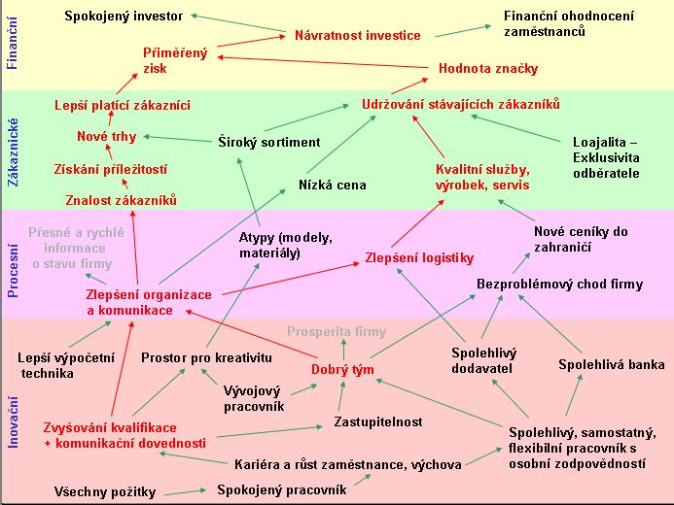
Výsledný graf po aplikaci JSS
(transpozice FRT->BSC vrstev)
Czech courses only

Slide 27
BSC and Future Reality Tree relationship
Finances
Better bottom line
Customers
Reliable deliveries
Processes
Better forecasting in stock replenishment
Learning and Growing
New Business Central

Slide 28
Strategy Map-The Simple Model of Value Creation
Strategy
Financial perspective
If we succeed, how will we look
to our shareholders ?
Customer perspective
To achieve our vision,
how must we look to our
customers?
Internal perspective
To satisfy our customer, which
processes
must we excel at ?
Learning and growth perspective
To achieve our vision,
how must our organization learn
and improve ?
Resource : Strategy Maps, Kaplan and Norton

Slide 29
Strategy map - example

Slide 30
Strategic map (BSC)
Happy shareholders
Finance
Higher market share
Profit
Customer
Revenue
Competitive
Advantage
Satisfied customer
Service delivery
Processes
Resource
Training
Testing
Trained resource
Costs
low success rate
Learning
Source selection parameters
Resource searching
Resource
profile
Compliance rate
The need for unique
resources-knowledge
Cost of resources
IQ
creativity
flexibility
TOC
CONWIP
Workflow

Slide 31
Test 1
What is the main goal of a company?
A) Obtain the highest profit
B) Find solutions that will be in the best interests of stakeholders
C) Produce as many products as possible
D) A and C
E) None of the above
Notes:
B)

Slide 32
Test 2
Which of the following is Operations Management Technology not concerned with?
A)Product & Service Technology
B)Process Technology
C) Globalization technology
D)Information Technology
E)All of the above
Notes:
C)

Slide 33
Test 3
Which of the following would be considered an input when converting inputs into outputs during the transformation process?
A) Land
B) Capital
C) Raw Materials
D) Facilities
E) All of the above
Notes:
E)

Slide 34
Test 4
Which of the following is not a key element of supply chain management ?
A)Purchasing
B) Suppliers
C) Location
D) Logistics
E) Managers decision
Notes:
E)

