Slide 1
Break-even point analysis (The basics focused also on explaining the Contribution Margin shown in the TOC PWP on slide 17)
Ing.Jaromír Skorkovský,CSc.
Department of Business Management
Masaryk University
Czech Republic

Slide 2
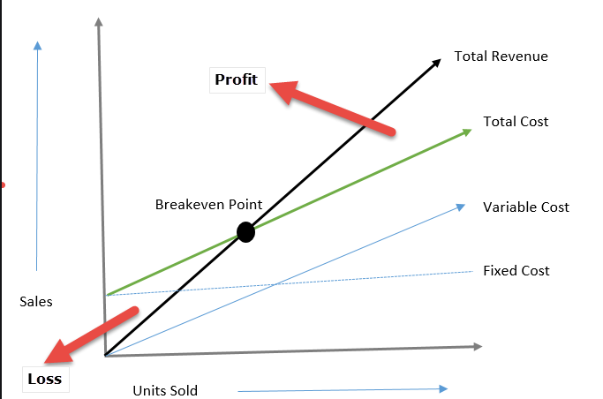
Simple Graphical representation
P x Q
F + VC = TC
VC
Costs
F

Slide 3
BEP- Basic Statements
Break-Even Point is the amount of product at which total costs are equal to total returns. From this point, the company or project begins to generate profit.
In its classic form, the break-even point tells you how much product to sell to generate profit. It is a volume indicator.
The break-even point in corresponding currency thus basically means 0.
In the next slides, we present a formula where it is also possible to incorporate the required rate of profit (in corresponding currency) into the calculation.
As a result, we will shift to the right along the X-axis (sales volume) in the graph, and the resulting Q (X pieces) will be higher than at the "classic" break-even point, where the profit is zero.

Slide 4
Calculation I.
The basic calculation of the break-even point is not complicated. All you have to do is put together the Price, Costs and possibly the Required profit.
However, the challenge is to get to these aggregated variables.
The data for partial calculations are obtained utilizing financial analysis, using data from accounting.
Good financial management considers the break-even point analysis to be an absolute must. It is not just a “lesson from microeconomics” or “theoretical exercise”

Slide 5
Calculation II.
Profit = Selling Price x Sold Products - Total Costs
Total Costs = F + VC x Q
Profit = P x Q - F- VC x Q
If BEP then Profit=0
Profit = Q x (P-VC) - F = 0
and hence -> Q= F/(P-VC)
F=Fixed costs
VC= Variable costs fro one product unit
P= Selling price – in Business Central ERP it is Unit Price
x=symbol for multiplication
BEP=Break Even Point

Slide 6
Simple example
In this screenshot we use a different colour
coding for the variables used !!!
What is the turning point in practice can be shown in a model example?
Let's imagine that you want to start confectionery production. How do you know how many cakes you have to sell to make a profit?
- Real capacity consideration - Price conditions analysis - List of all costs - Calculations and modeling Let's assume that the total input costs (fixed costs) will be 250,000 CZK. Set the selling price of the cake at 750, - CZK Variable costs for 1 cake = 300, - CZK
CZK=Czech Crown
BEP=Break-Even-Point
Q= F/(P-VC)
BEP = 555 cakes [calculation: 250.000 / (750 – 300)].

Slide 7
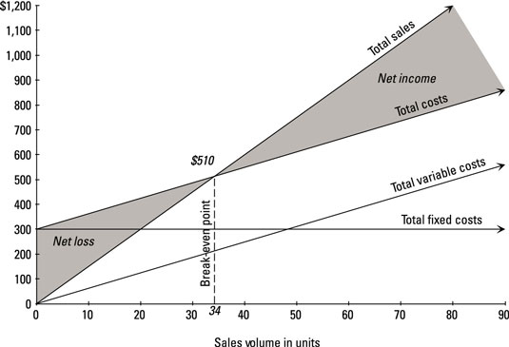
Contribution Margin
The contribution margin is computed as the selling price per unit, minus the Total variable costs
When you run a company, it’s obviously important to understand how profitable the business is. Many leaders look at profit margin, which measures the total amount by which revenue from sales exceeds costs
But if you want to understand how a specific product contributes to the company’s profit, you need to look at contribution margin.
Contribution margin = Revenue − Variable costs

