Slide 1
Kepner-Tregoe Methodology
Skorkovský
Department of business economy
KT was Developed by Charles H. Kepner and Benjamin B. Tregoe

Slide 2
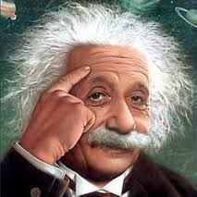
The formulation of a problem is far more essential than its solution, which may be merely a matter of mathematical or experimental skill”
- Albert Einstein

Slide 3
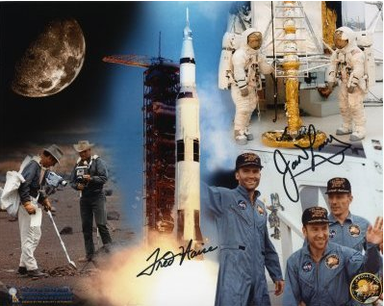
Apollo 13 – Houston, Houston, do you read me ? We have a big problem….!
The Apollo 13 team is famous for bringing back the astronauts stranded in space by solving difficult and complex problems. The teams solving the problems has used the Kepner-Tregoe (KT) methodology!

Slide 4
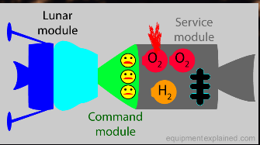
Appolo 13 – description (problem and solution)
https://spectrum.ieee.org/tech-history/space-age/apollo-13-we-have-a-solution
https://prezi.com/_ohiqi4xzcxt/tier-v-problems-and-solutions-on-apollo-13/

Slide 5
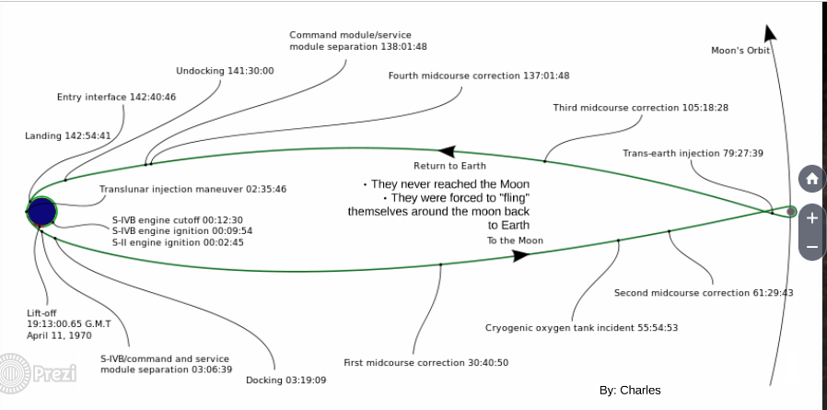
Appolo 13 – description (problem and solution)

Slide 6
What is it K-T methodology ?
Kepner -Tregoe is used for decision making (finding best possible choice)
It is a structured methodology for evaluating , gathering & prioritizing information.
It is a detailed and complex method applicable in many areas, which
is much broader than just idea selection.
It is also called a root cause analysis and decision-making method.
It is a step-by-step approach for systematically solving problems, making decisions, and analyzing potential risks.
Way of
remedy
Restore
Detection
CRT
K-T
Ishikawa + Pareto
Incident
Solved incident
Diagnosis
Repair
Remedy)
Time

Slide 7
Kepner-Tregoe spheres
Appraisal=review= assessment=evaluation
Other possible problem analysis
Decision
analysis
Assessment
(Appraisal)
Existing
problem
analysis
1. Assessment (appraisal) – priorities assigned to current situation
2. Existing Problem analysis – to find the root problem (cause)
3. Decision analysis – to select a way to react (remedy action )
4. Future (other related) problem analysis - e.g. risk analysis
Source : Kepner-Tregoe methodology

Slide 8
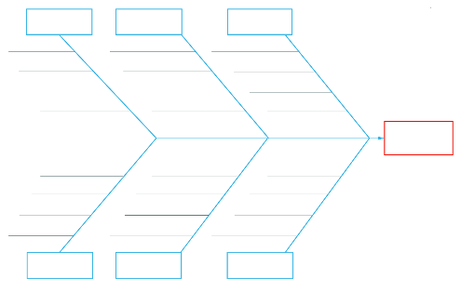
CRT-Ishikawa
12
3
1
2
4
3
7
OR
4
7
2
12
CRT
2
6
1
6
1
Root problem
3
4
Requirement
Prerequisite
 | 1 | 2 | 3 | 4 | 6 | 7
John | 8 | 7 | 4 | 3 | 5 | 6
Caroline | 9 | 5 | 7 | 8 | 5 | 6
Mean | 8,5 | 6 | 5,5 | 5,5 | 5 | 6
P1
Alternative 1
R1
1
EC
Conflict
1
= Nature (see, forest, mountains, jungle, river,..)
R2
P2
Alternative 2
2
= Hotel type
Root problem contrary
3
= Amenities (pool, golf course, wellness,.. )
4
= Period (spring, summer, fall, winter).
Alternative means how to solve problem and what kind of pay-off you will get

Slide 9
Access situation - situation appraisal
Identify concerns (problems) by listing them (detection stage)
Separate the level of concern (importance, magnitude, and level of influence) related to listed problems.
Set the priority level =importance to measure the seriousness of impacts (influence), urgency and growth potential
Decide what action to take next (step by step approach)
Plan for who is involved, what they will be doing, where they will be involved, when it happened and the extent of involvement (magnitude)

Slide 10
Used terminology
Importance=magnitude=level of influence
Priority levels (https://asana.com/resources/priority-matrix )
Step-by-step approach
Questions:
  Who
  What
  Where
  When
  Extent

Slide 11
Importance
Is it important ?
Who is concerned ?
Which core process does it restrict ?
Is it possible to find a temporary solution to work it around (not solve) the problem ?

Slide 12
Step-by-Step Approach 8-step
8-Step Problem Solving Process (one possibility)
Step 1: Define the Problem. What is the problem? ...
Step 2: Clarify the Problem. ...
Step 3: Define the Goals. ...
Step 4: Identify Root Cause of the Problem. ...
Step 5: Develop Action Plan. ...
Step 6: Execute Action Plan. ...
Step 7: Evaluate the Results. ...
Step 8: Continuously Improve
Similar to Deming cycle (see OM intro)

Slide 13
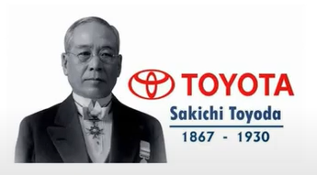
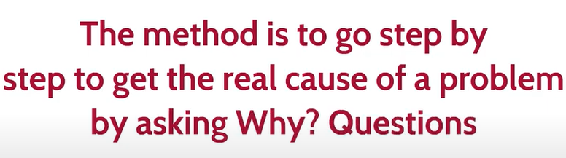
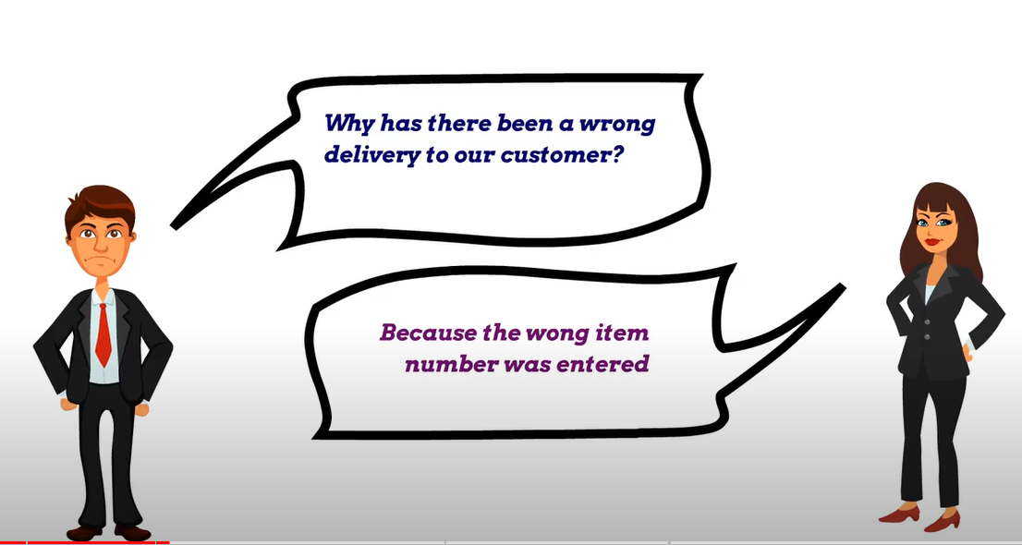
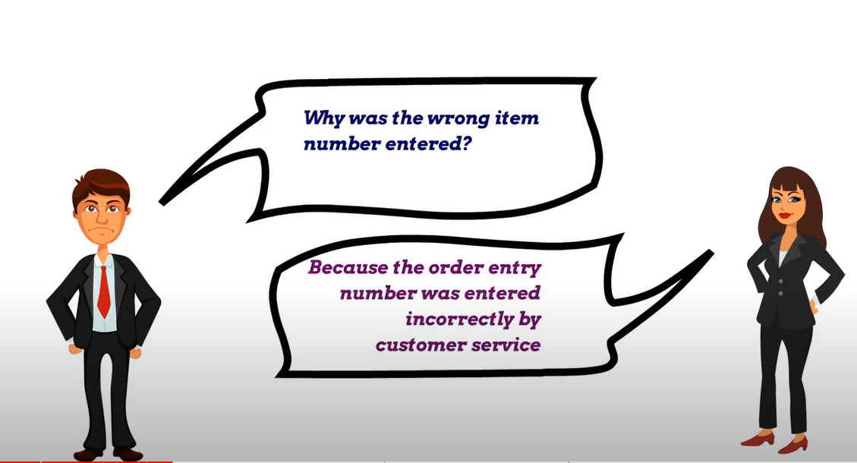
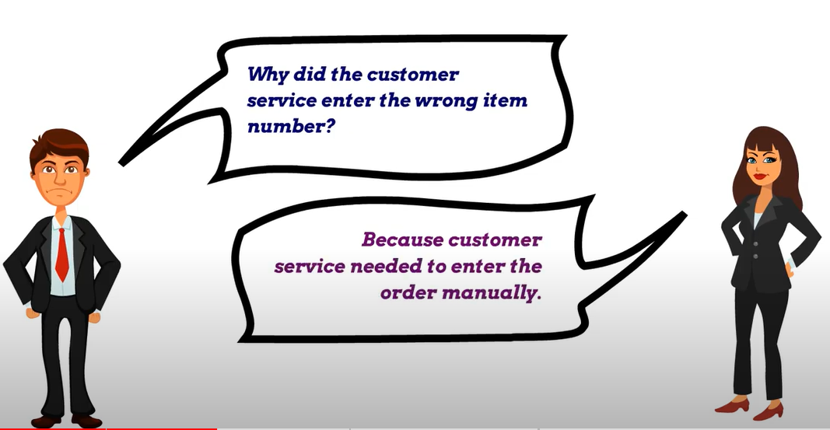
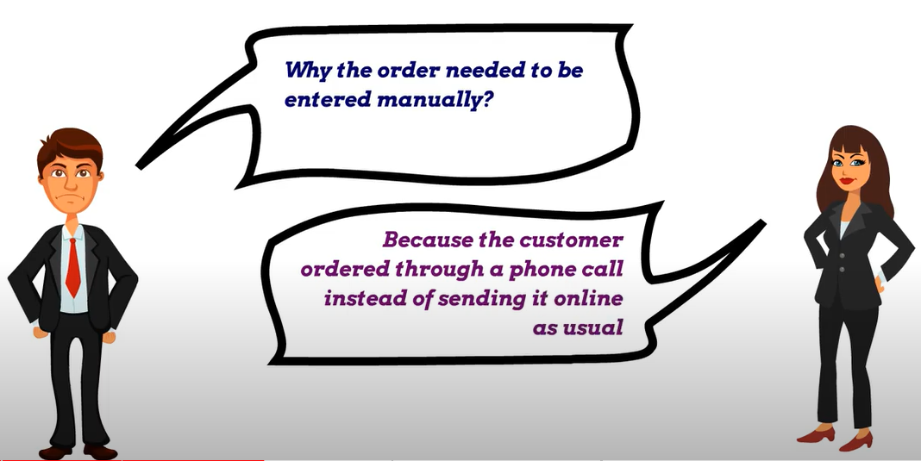
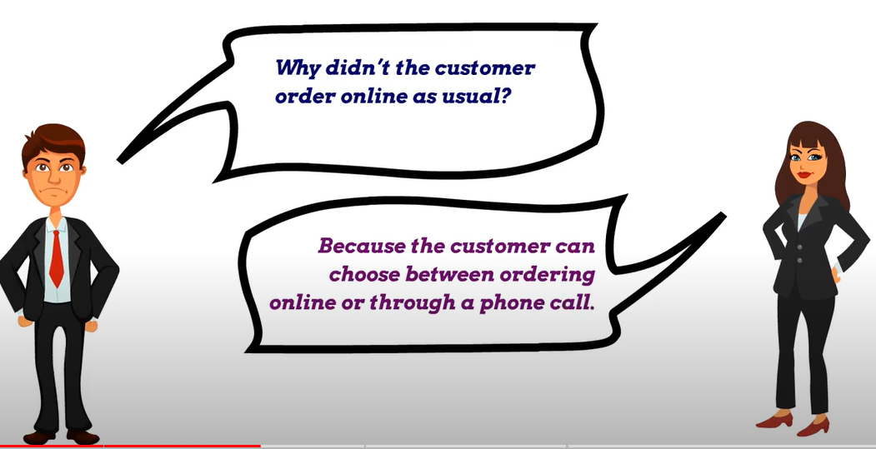
Step-by-Step Approach 5 Whys-method I.
Here is a set of the first five questions, followed by the next question to find the root cause

Slide 14
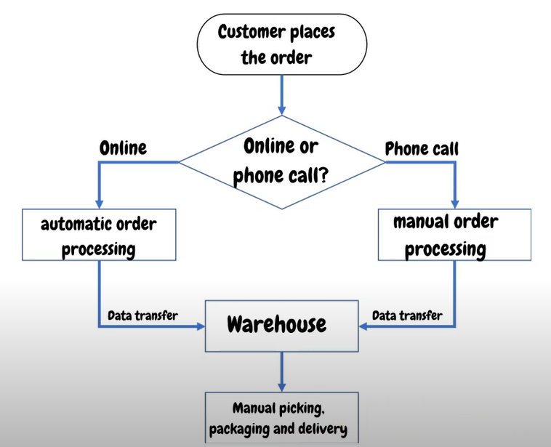
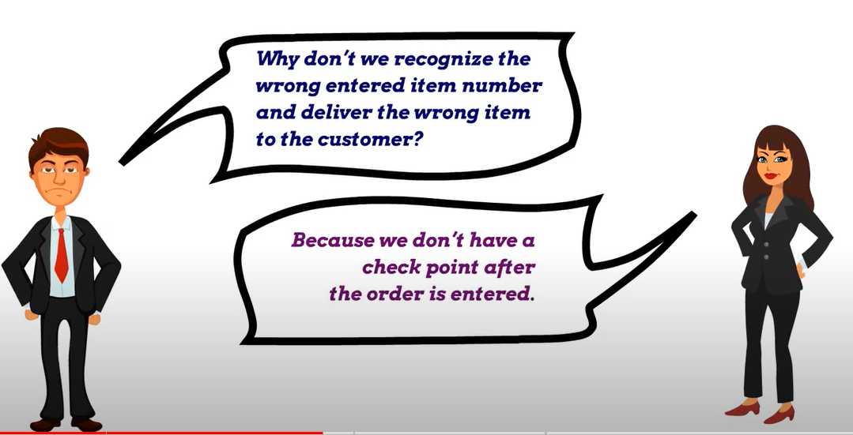
Step-by-Step Approach 5 Whys-method II.
1st question

Slide 15
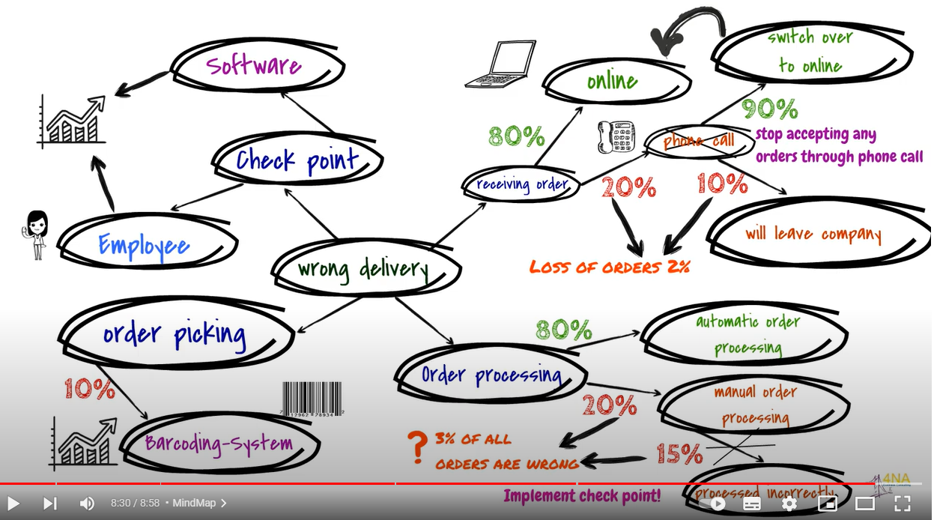
Graphical representation of the process
At the end of this KT presentation is a link to the presentation you will view as homework

Slide 16
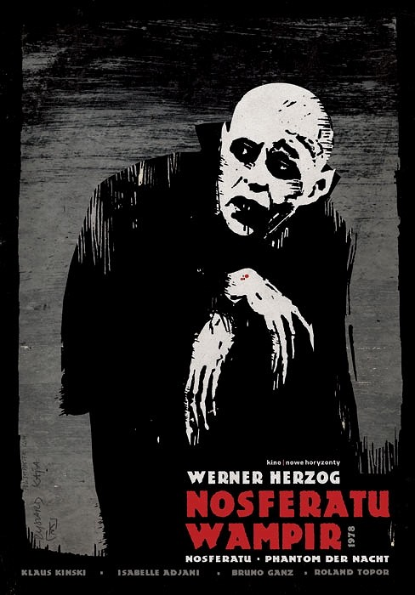
Questions and the fabulous world of the vampires
To keep this very unusual economic comparisons in your mind

Slide 17
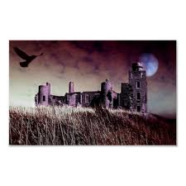
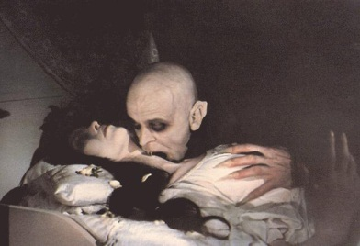
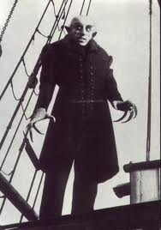
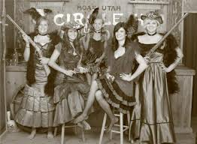

WHO WHAT WHEN WHERE EXTENT
Reverse blood
transfusion
The mysterious castle of Prince Dracula
in the Romanian Carpathians
The Vampire of Nosferatu
arrives in Hamburg on an
old Romanian sailing ship
More potential victims
of a greedy vampire
A vampire always attacks
under cover of night

Slide 18
Making decision (A choice between two or more alternatives)
Identify what is being decided (quality, used Operation Management methods)
Establish and classify objectives (main ones, minor ones,..) - goals
Separate the objectives into must (must to have) and want (nice to have) categories (we have to assign importance factors from 1-10, where 10 is the most important want objective) and assign criterion rating (weights)
Generate the alternatives - we can do it that way or we can take another way as well
Evaluate the alternatives by scoring the wants against the main (must)objective – see next slides
Review adverse (harmful) consequences of your corrective steps (risk evaluation, risk assessment,risk mitigation)
Make the best possible choice what to do
The million dollars question

Slide 19
Concise overview of the previous text
Must-to-have
Nice-to-have
Importance factor =score (10-1)=satisfaction score
  10 = the highest importance
  1 = the lowest importance
Risks
  Importance factor could be also e.g. 100-1
One of the key issues in the implementation
of ERP systems

Slide 20
Some statement of underestimation of Information Technology
I think there is a world market for maybe five computers (IBM chairman statement from the year 1943)
There is no reason anyone would want a computer in his or her home (President of Digital Equipment 1977)
I can assure you that data processing is a fad (craze),that won´t last out the year (Editor Prentice-Hall 1957)
Document management is nice-to-have, not must-to-have (Director of the company still burdened in manual business process)

Slide 21
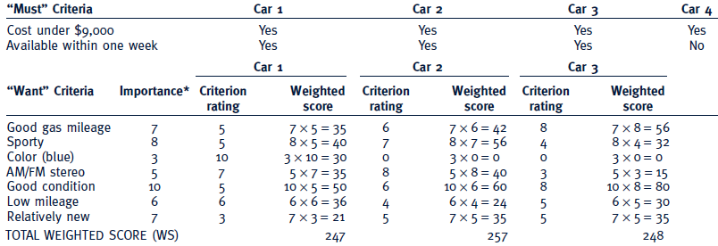
Criteria rating
See similar example on the next slide
Importance can be understood as a Satisfaction score,
meaning desirable but not essential.
Criteria rating is related to want criteria and every car property

Slide 22
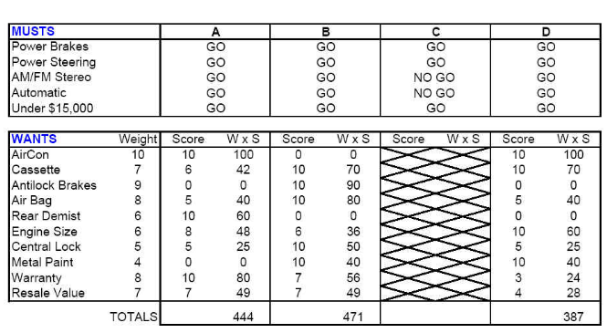
Which car to buy ?
Criterion rating
Importance score, meaning
desirable but not essential

Slide 23
Another similar problem to be solved
Step 1 Problem: Pick a replacement vehicle for the motor pool fleet
The definition of the problem dictates the requirements. As the vehicle is for a motor pool, the requirements will differ from those for a family car, for example.
Step 2 Requirements:
1. Vehicle shall be made in U. S. A.
2. Vehicle shall seat at least four adults, but no more than six adults
3. Vehicle shall cost no more than $28,000
4. Vehicle shall be new and the current model year

Slide 24
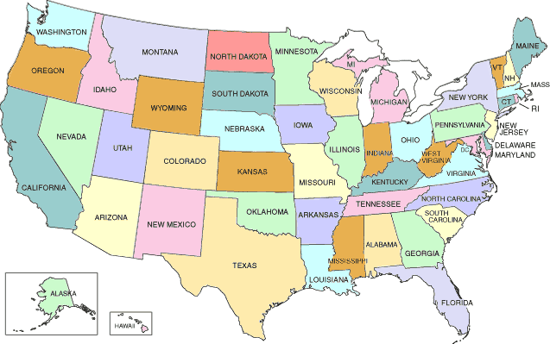
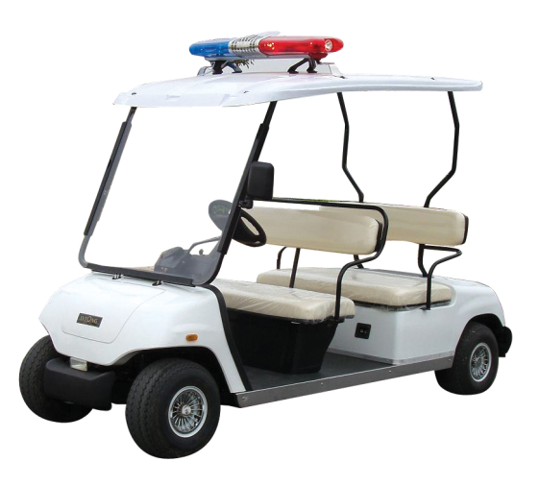
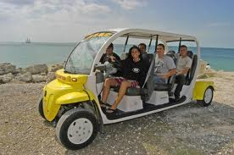

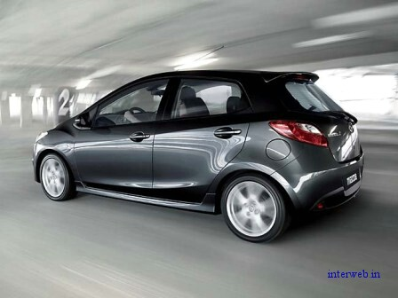
Min
Max 28000 USD
Max
New car
(current model)

Slide 25
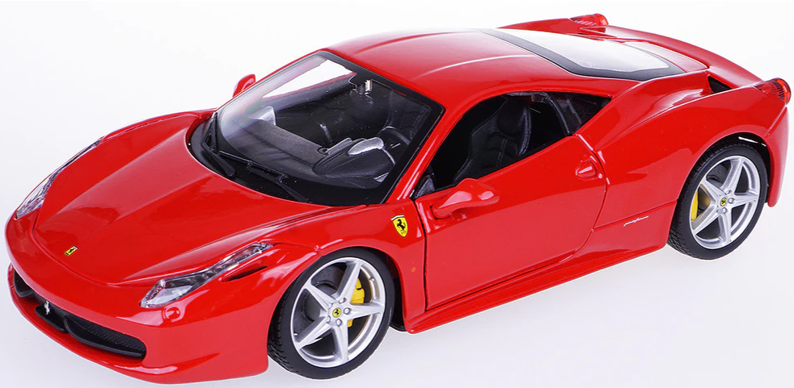
Step 3 and Step 4
Step 3 Goals:
· Maximize passenger comfort
· Maximize passenger safety
· Maximize fuel-efficiency
· Maximize reliability of the car
· Minimize investment cost
Step 4 Alternatives:
There are many alternatives but the requirements eliminate the consideration of a number of them:
Requirement 1 eliminates the products not manufactured in the USA
Requirement 2 eliminates vans, buses, and sports cars (Ferrari no !!!!)
Requirement 3 eliminates high-end luxury cars
Requirement 4 eliminates used vehicles

Slide 26
Step 5
Step 5 Criteria:
“Maximize comfort” will be based on the combined rear seat leg and shoulder room. (Note: front seat passenger leg and shoulder room was found to be too nearly the same to discriminate among the alternatives.) 5
“Maximize safety” will be based on the total number of stars awarded by the National Highway Traffic Safety Administration for head-on and side impact. 10
“Maximize fuel efficiency” will be based on the EPA fuel consumption for city driving. 7
“Maximize reliability” will be based on the reliability rating given each vehicle by a consumer product testing company. 9
“Minimize Cost” will be based on the purchase price. 10
Weighted criteria vector C(5,10,7,9,10) are values assigned by decision makers !!!!

Slide 27
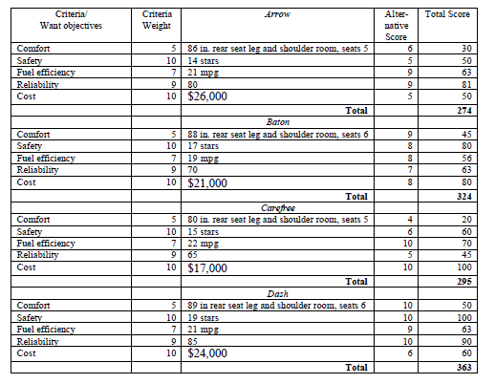
Kepner-Tregoe table
(for 4 cars : Arrow, Baton, Carefree and Dash)

Slide 28
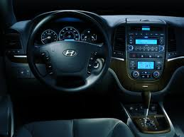
Last step – Validation (check)
Last Step Validate Solution:
The totals of the weighted scores show that the Dash most nearly meets the wants/goals (or put another way, has the most “benefits”). Dash meets all the requirements and solves the problem !!!

Slide 29
Uncover and handle problems
(problem analysis) – see step-by –step approach
State the problem (definition and description of the problem)
Specify the problem by asking what is and what is not, who is and who is not…
Develop possible causes of the problem (similar to CRT or Ishikawa FBD approaches) - > (problem detection)
Test and verify possible causes
Determine the most probable cause (root cause)
Verify any assumptions
Try the best possible solution and monitor what will be a situation after applied correctives step

Slide 30
Problem description
WHERE
and WHERE NOT
WHERE
and WHERE NOT
Priority
(urgency)
Priority
(urgency)
Description
Description
Problem 1
Problem N
Causes
Situation
Causes
Situation
Who
What
WhereWhenExtent
Who
What
WhereWhenExtent
Big
problems
Solution (corrective action) 1
Solution (corrective action) 1
Solution (corrective action) X
Solution (corrective action) Y
Problem 1´
Problem N´
Smaller
problems

Slide 31
Decomposition, priorities and causes
Sub-problem 1
Priority1
Problem 1
Sub-problem N
Priority N
Problem 1
Sub-problem 1
Cause 1
Problem 2
Sub-problem N
Cause N
Problem 2

Slide 32
Example of problem manifestation (decrease of performance)
Change
Performance
(KPI)
Planned performance
Should
Should
Unfavourable deviation
(differences)
  What do we see, hear, feel,
  taste, or smell that tells us
  there is a deviation?
  Difference between Shoud and Is
Real performance
It Is reality
Past
Present
time
Change
Final effect of the = PROBLEM (e.g. server crashed, hard disk with database crashed)
  Then we have to ask: Who, What, Where, When, How and to what Extent –Size (how much, how many)?

Slide 33
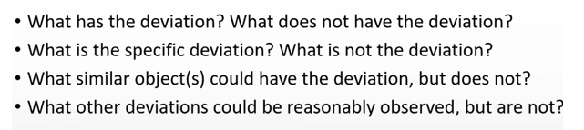
Deviation analysis - questions related to WHAT
The questions :
WHEN It is
WHERE It is
WHO It was
HOW It happened
&
WHEN
WHERE
WHO
HOW
are similar in content, so we do not include them here for sake of simlicity
It is
Is Not

Slide 34
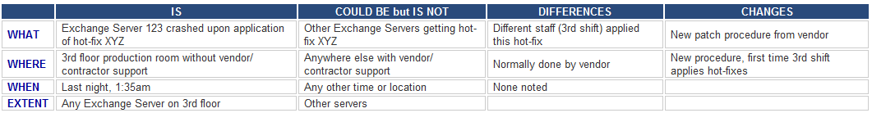
Server crashed !!!! (home study !!!)
Server crashed (this is a very poor and not clear problem definition)
The e-mail system crashed after the 3rd shift support engineer applied hot-fix XYZ to Exchange Server 123 (better definition of the problem)
Comment : WHO is not mentioned here but could be : Different staff (3 shift) – see table
History (and best practice) says that the root cause of the problem is probably due to some recent change. WHAT, WHERE, WHEN and EXTENT will be shown on next slides

Slide 35
Test the Most Probable Cause
(home study !!!)
Clarifying problem Analysis (example)
We have to ask (where Qi =QUESTION i) :
Question IS IS NOT
What (identify) Q1 Q2
Where (locate) Q3 Q4
When (timing) Q5 Q6
Extent (magnitude) Q7 Q8

Slide 36
Problem Analysis - What
Is
Is Not
What specific object(s) has the deviation?
What is the specific deviation?
What similar object(s) could have the deviation, but does not? (It did not happen)
What other deviations could be reasonably observed, but are not? (It did not happen)
Example for Is :
1. What specific object IS related to the defect?
Inventory Valuation Objects in database A
2. What specifically is the defect (deviation)?
Inventory Adjustment does not work
1-> see setup of the database and see differences
2->see algorithm used for calculation and parameter used.
You can see , that in production calculation related
algorithm is not functional
Example for Is Not :
1. What specific object IS NOT related to the defect?
Inventory Valuation Objects in database B
2. What specifically is not the defect (deviation)?
Adjustment is working – good setup in database B
1 -> Setup has another parameter ON
2-> Algorithm is also used for production where not error
occurs

Slide 37
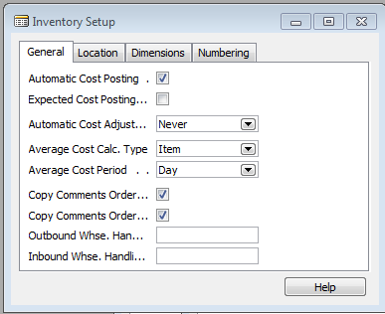
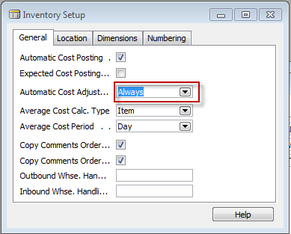
See two MS Dynamics NAV setup screens
(related to the problem specified recently)

Slide 38
Apology- we go back to strange individual habits of vampires
To keep this very unusual economic comparisons in mind

Slide 39


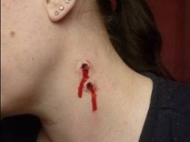


Back to vampires: Problem Analysis - What
Is
Is Not
What specific object(s) has the deviation?
What is the specific deviation? - bites on the neck
What similar object(s) could have the deviation, but does not? (It did not happen)
What could the specific deviation? but does not? (It did not happen) – bites, anemia
Example for Is :
1. Nice young girl´s neck and strange
look of anemic person
Example of Is Not :
Girl with garlic in her hands
No bites
Healthy

Slide 40
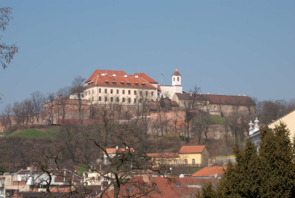


Another example for What IS and What IS NOT as well as Where IS and Where IS NOT
IS girl Sarah visited Dracula lower castle without a bunch of garlic, but IS NOT not the one (Emily) having a bunch of garlic and visiting Špilberk castle in Brno
Dracula Castle
(Where IS)
Špilberk Brno
(Where IS NOT)
Sarah
(What IS)
Emily
(What IS NOT)
garlic

Slide 41
Problem Analysis - Where
Is
Is Not
Where is the object when the deviation is observed? (geographically)
Where is the deviation on the object?
Where else could the object be when the deviation is observed, but is not?
Where else could the deviation be located on the object, but is not?
Example for IS:
The old castle in the mountains (Romania)
Where IS: Romanian Carpathian mountains
where it is very easy to meet many vampires
there
Example for IS NOT:
1. Brno Špilberk Castle
Where IS NOT possible to meet vampires
(only lovers and children and seniors)

Slide 42
Let’s Look At Some Problems!

Slide 43
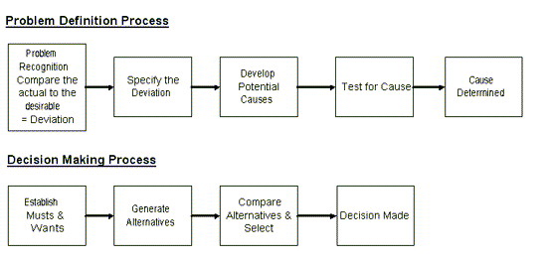
Systematic Problem Solving and Decision making Overview

Slide 44
Planning the Next Steps
Problem Analysis
    Do we have a deviation?
    Is the cause unknown?
    Is it important to know the cause to take effective action?
If the answer is YES to ALL three listed problems above, than you have a big problem, Huston!

Slide 45
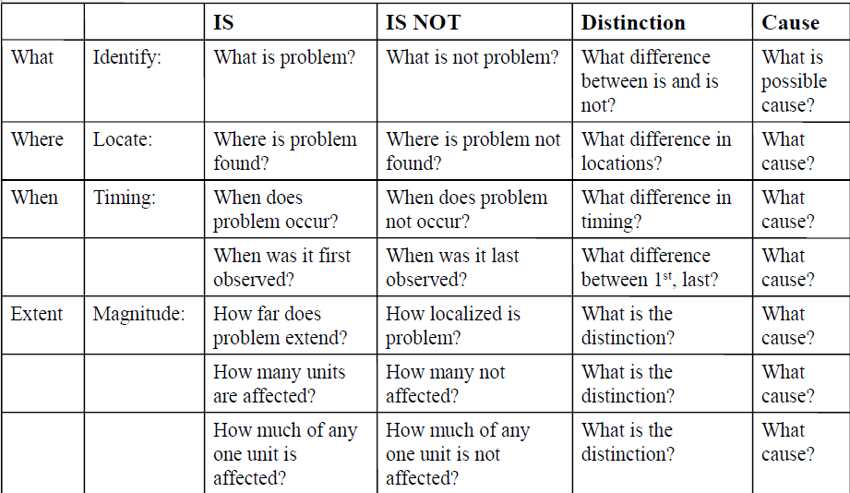
Problem analysis table template
(Home study ->the most important issue)

Slide 46
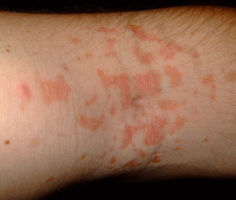
Problem description (example)
On a new model of airplane, flight attendants develop rash on arms, hands, face (only those places). It only occurs on flights over water.
Usually disappears after 24 hours. No problems on old planes over those routes.
Does not affect all attendants on these flights, but same
number of attendants get it on each flight. Those who get rash have no other ill effects.
No measurable chemicals, etc., in cabin air.
Rash arm ->

Slide 47
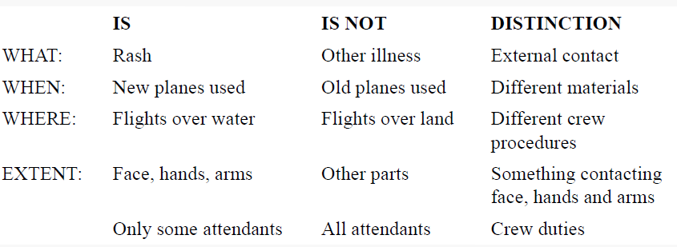
Problem analysis real table
Distinction=Difference
Comment: specification is very simplified-> all aircraft use life jackets regardless
Of the type of fly (over water or over land )

Slide 48

Results
Only a part of the cabin crew shows how a life jacket is worn over their heads.
In new airplanes, the life jackets were treated with powder chemicals
that cause a rash on contact with the skin.
Moreover, the deployment of life jackets is not presented
on-air routes outside the oceans and seas.

Slide 49
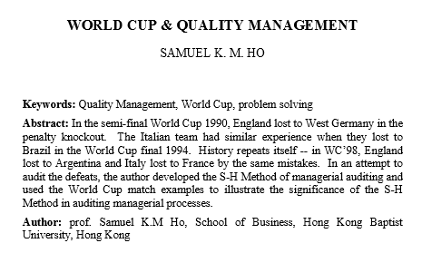
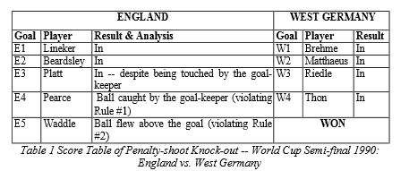

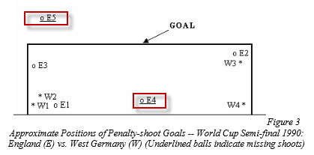


Slide 50
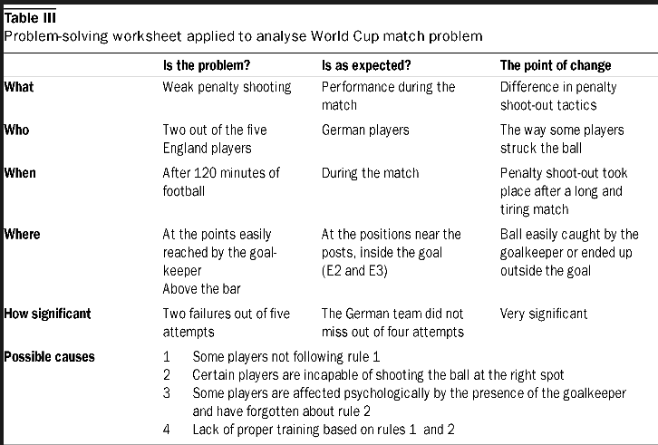
Example of analysis (only as an interesting example)

Slide 51
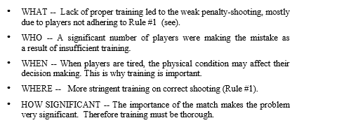

Slide 52
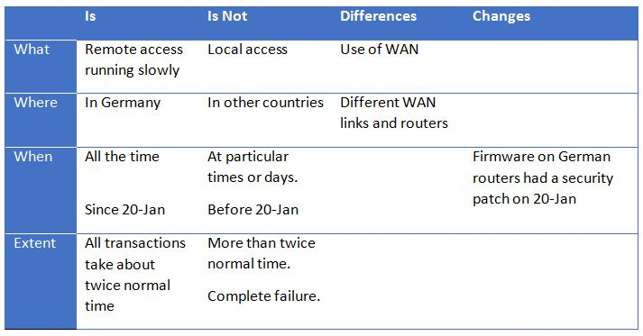
Example of K-T problem analysis
https://www.youtube.com/watch?v=dUtoOUWnJY0
https://www.youtube.com/watch?v=TEc_FZhRoro

Slide 53
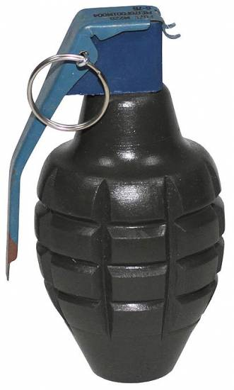
https://www.youtube.com/watch?v=S5fQrE0-kGg

Slide 54
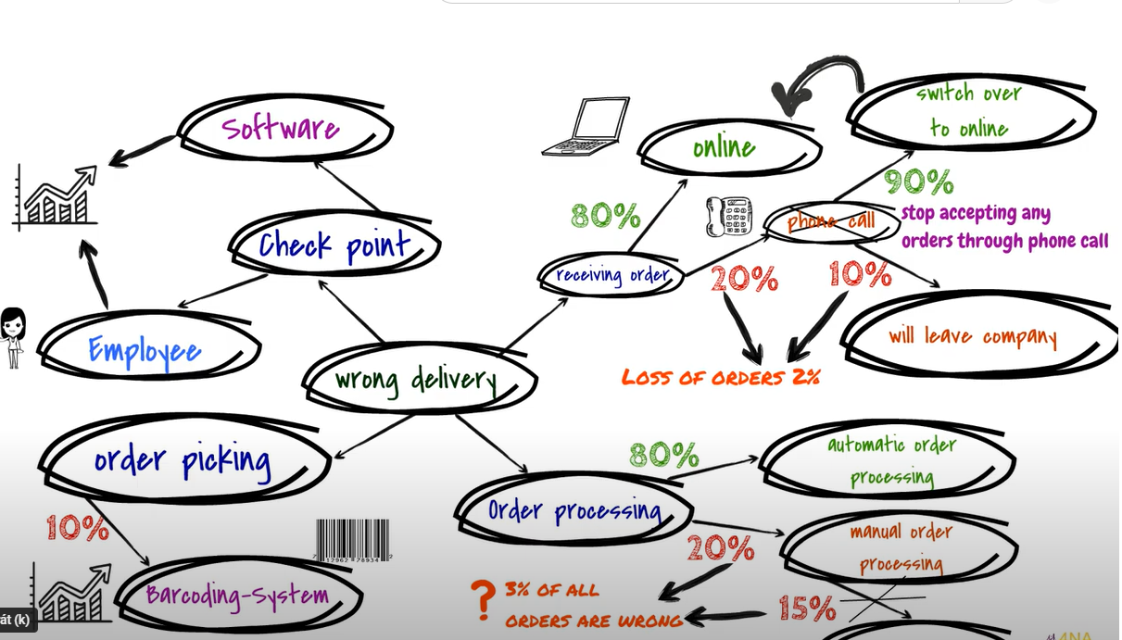
In the Ishikawa presentation, I briefly mentioned the 5 Whys methodology.
Here is an excellent example of how to analyze a selected process using this method.
(103) Problem Solving Techniques: 5-Why-Method, Flowchart, Mind-Map - YouTube

Slide 55

Thanks for Your attention

