Slide 1
Business Central Introduction Microsoft Dynamics 365 Business Solution
General Ledger and Payment Basics
Ing.J.Skorkovský, CSc,
Department of Business Management
FACULTY OF ECONOMICS AND ADMINISTRATION
Masaryk University Brno

Slide 2
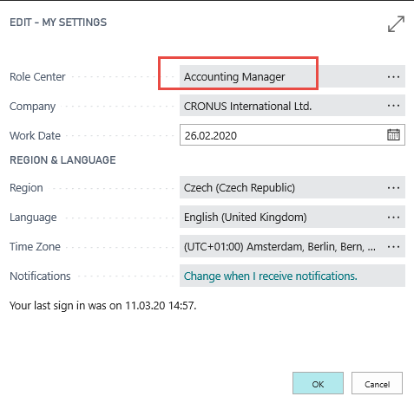
Chart of Accounts
Chosen user role
See next slide

Slide 3
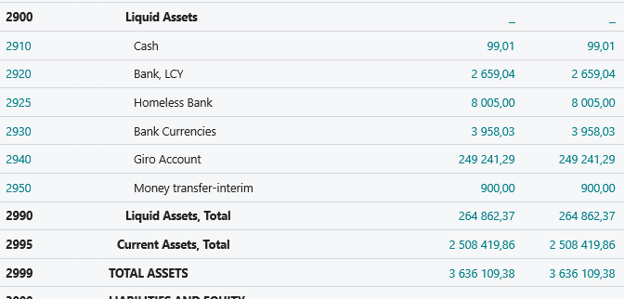
Chart of account
12
12
Amount
-12
Amount
+amount ->Debit Side and -amount ->Credit Side <- SYNTAX
12

Slide 4
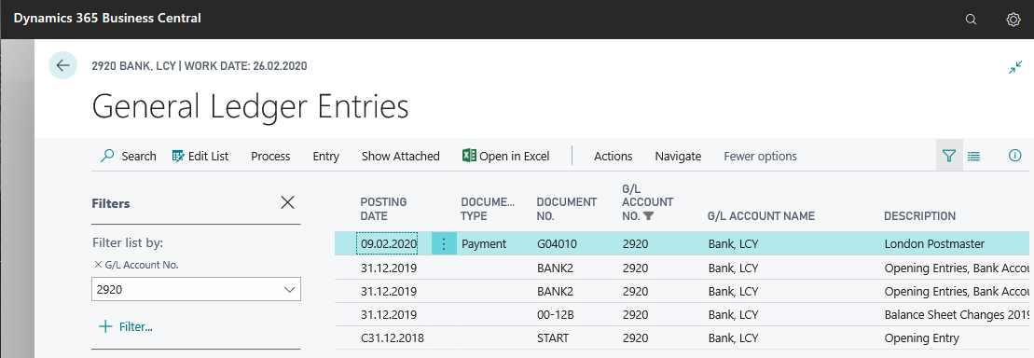
Chart of account (accounts might be nested)

Slide 5
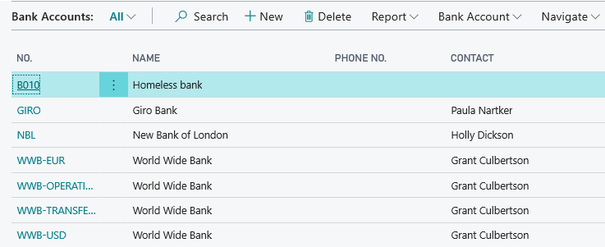
Bank Account (back account reconcilliation will be mentioned later)

Slide 6
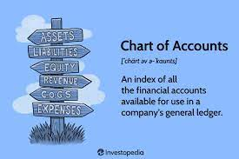
Basic pricnip General Ledger Journal The only two-way Gateway to the General Ledger (Chart of Accounts)
Bank Statements and Orders
Invoices and delivery notes
USER
Invoices and shipment notes
General Journal Structure = Gateway

Slide 7
Bank reconcilliation principle (selling)
Time
Bank account in BC
Balance=100
Bank account in Bank
Balance=000
Import bank statement in BC (GL journal)
Customer paid to bank 1000
Time + 1D + payment term code=1M
Bank account in BC
Balance=1100
Sales Order
in BC
Bank account in Bank
Balance=1000
Sales Invoice
(1000 invoiced
in BC)
The bank has sent a bank statement
Time + 1D
Customer balance =1000
Time + 1D + payment term code=1M +
+ some operational delay in bank

Slide 8
Bank account in Business Central

Slide 9
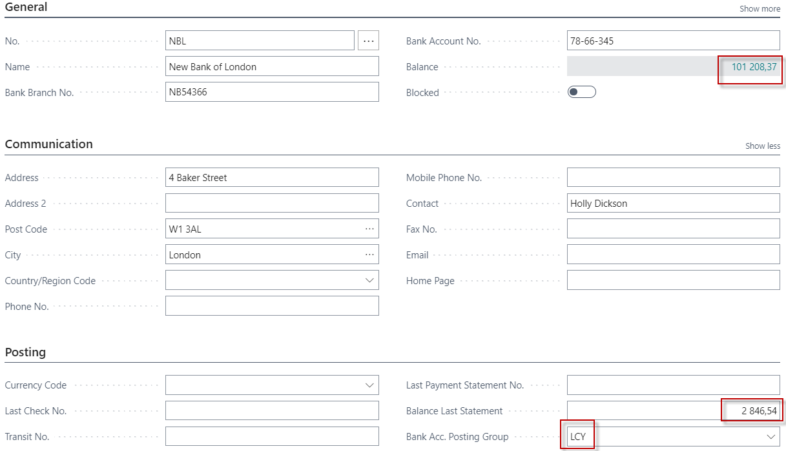
Bank account in Business Central (chosend account)

Slide 10
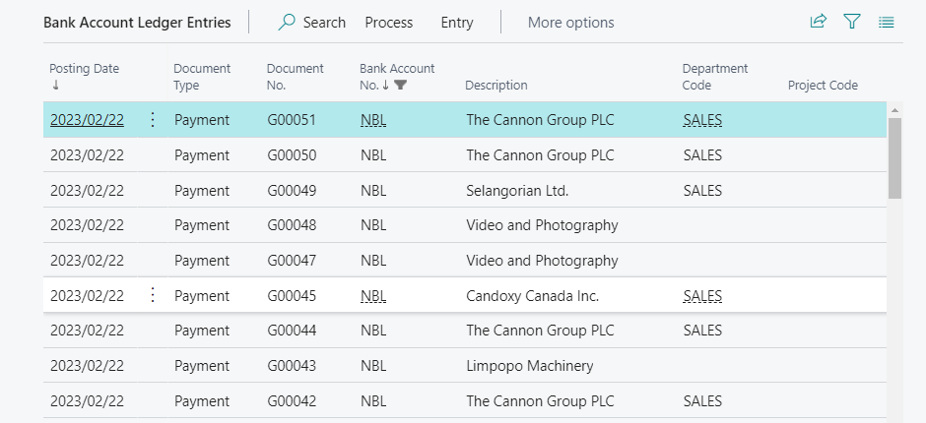
Bank account ledger entries

Slide 11
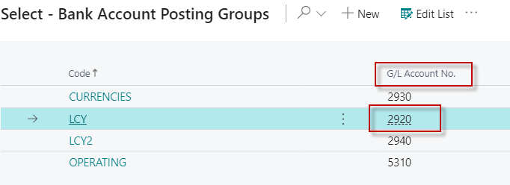
Bank account and relation to Chart of account
LCY and the linking
of this code to account number 2920

Slide 12
Payment application – basic principle
Customer Card
Customer Ledger Entry –after posting of the invoice
Sales Order Header
Sales Order Line (s)
F 9
Item Card
Posting
Sales Invoice Header
Sales Invoice line (s)

Slide 13
G/L Journal – Receivables (use of Applies to document number field)
Link to open entries (not paid so far)

Slide 14
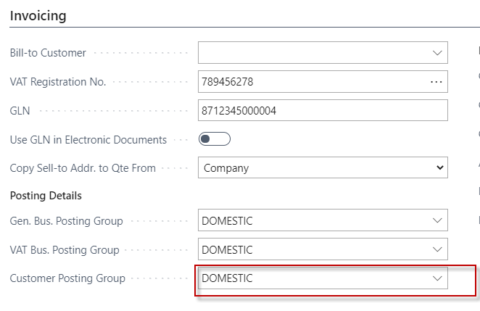
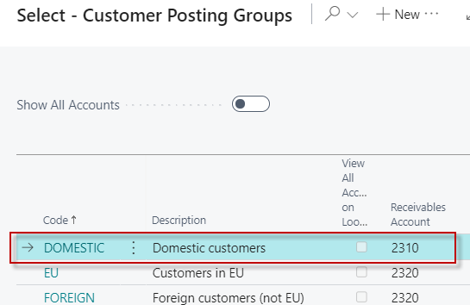
G/L Journal – Receivables (use of Applies to document number field)
Relation Number of the Customer ->G/L Account (10000->G/L Account 2310)
Invoicing tab of Customer card

Slide 15
Possible modification of the fields in G/L Journal
In our case, we already have
this field in the journal structure
To open entries (not paid so far)

Slide 16
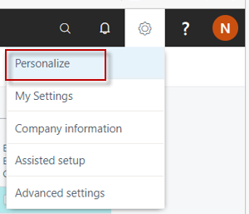
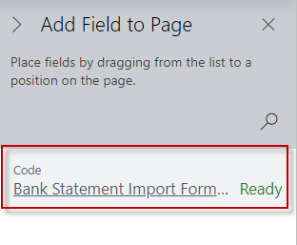
Modification of the fields (only if field Applies to documen numbe is missing in your database)
In our case we have only one field that we can display
and we move this field to the journal using the drag and drop method

Slide 17
G/L Journal – Receivables (use of Applies to document number field)
Selected invoice that is not reimbursed

Slide 18
G/L Journal – Receivables (use of Applies to document number field)
F9 - post

Slide 19
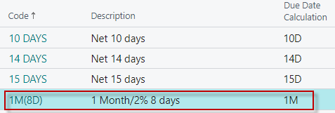
G/L Journal – Receivables (use of Applies to document number field)
Customer Ledger Entries (Payment <-> Invoice)
Payments tab of Customer card
7,2 is 2% of the invoiced amount 359,75

Slide 20
G/L accounts posting sales and payment –priciples (no payment discount presented)
2310
6110
5610
2920
120
120
100
20
120
F 9
Payment
Invoice
F9

Slide 21
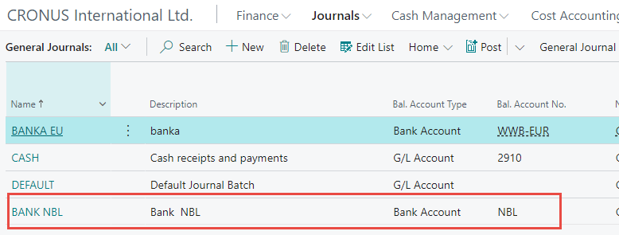
General Ledger Journal – Payables

Slide 22
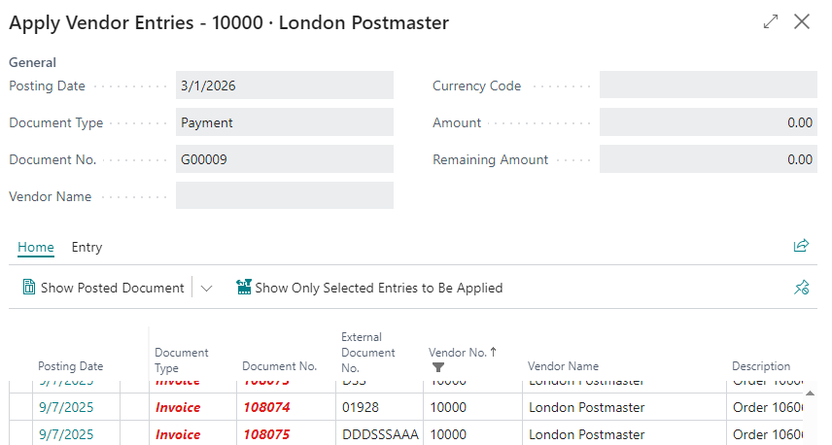
General Ledger Journal –Payables
See Apply Vendor Entries next slide

Slide 23
General Ledger Journal –Payables
Chosen entry – confirm by OK

Slide 24
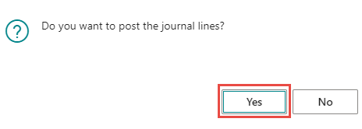
General Ledger Journal –Payables
Post by F9

Slide 25
Vendor Ledger Entries
Edit

Slide 26
Vendor Ledger Entries
Vendor Card
Ctrl-F7
Access to Vendor Ledger Entries

Slide 27
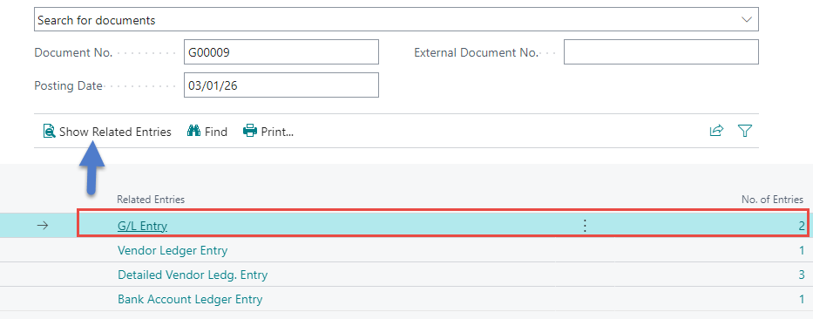
General Ledger Entries

Slide 28
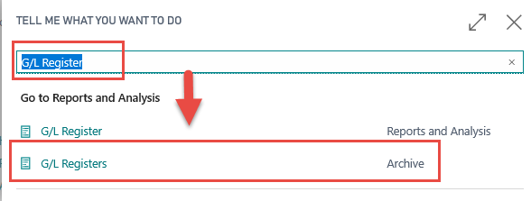
General Ledger Entries
Or by this way

Slide 29
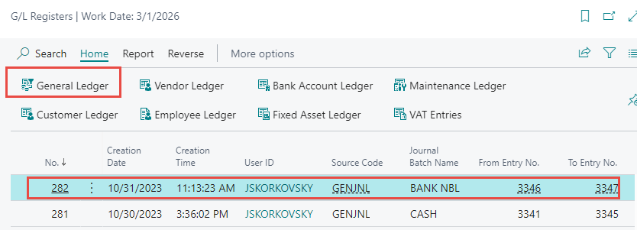
General Ledger Entries
Or by this way
See next slide

Slide 30
General Ledger Entries

Slide 31
Reversal operation (data preparation)
Transfer of amounts from the bank to the company cash office to pay for the petty cash
F9
Transfer of 100 from NBL bank account (2920)
to cash account (2910)
G/L Register Archive

Slide 32
Reversal operation (data preparation)
1- Process->Reverse Transaction
2 - Action->Functions->Others ->Reverse Transaction
A suggestion of what
a reverse operation
should look like

Slide 33
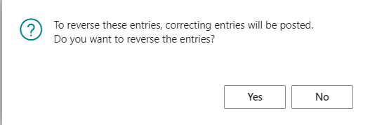
Reverse
Instructions for execution
See next slide

Slide 34
Reversal
To see the amount with a negative sign on the Debit side or vice versa on the Credit side, open a view of all fields in the table using Ctrl-Alt-F1
Cash
Bank
2910
2920
100
100
-100
-100
Reversal operations (so called red numbers)

Slide 35
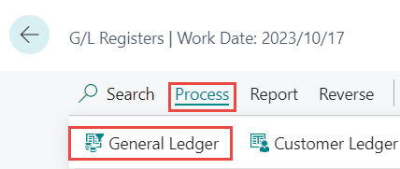
All fields (other amounts- it was created after another transaction) I.

Slide 36
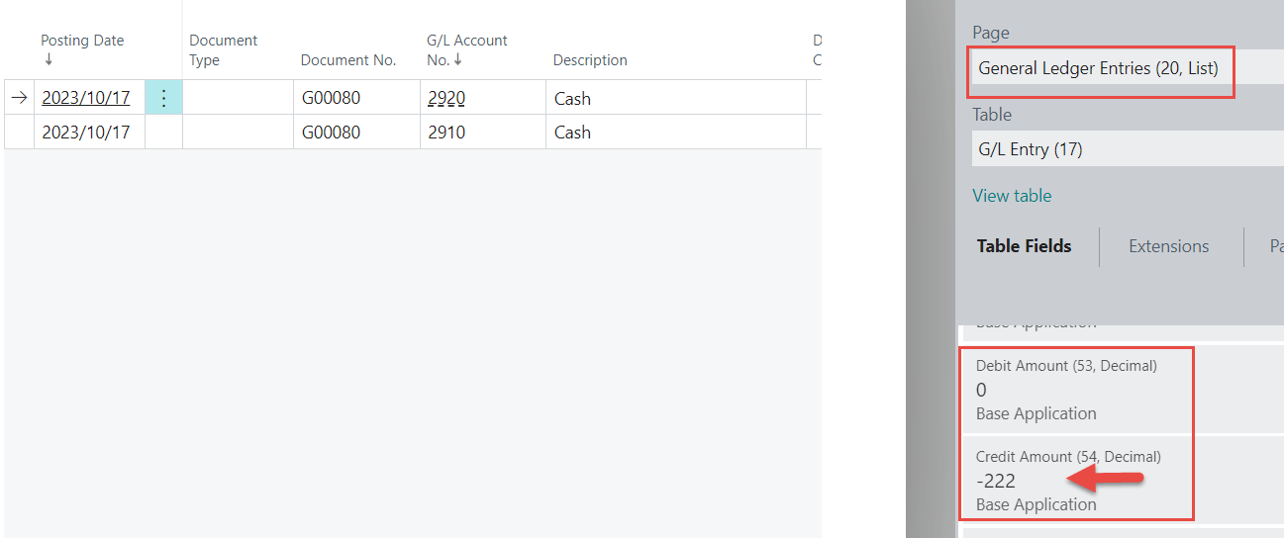
All fields (other amounts- it was created after another transaction) I.
Use of Alt+Ctrl+F1 key combination

Slide 37
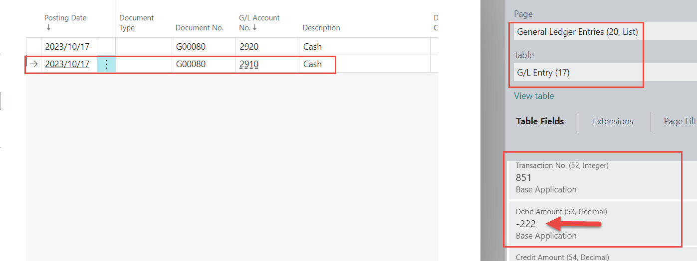
All fields (other amounts- it was created after another transaction) II.
Use of Alt+Ctrl+F1 key combination

Slide 38
