Slide 1
Introduction to MS Dynamics NAV Financial Reports
Ing.J.Skorkovský,CSc.
MASARYK UNIVERSITY BRNO, Czech Republic
Faculty of economics and business administration
Department of Business Management

Slide 2
Preview of Financial Reports
Sales Orders
General Ledger
Entries
Row definition
Purchase Orders
Chart of Account
Transfer Orders
Column Definition
Posting
Production Orders
View what
to see
Service Orders
Assembly Orders
DimensionS
Prodects

Slide 3
Financial reporting
Benefits
User defined templates used to get reports
Programming services necessary to create required specific reports are not used – lower costs and faster access to important data
You can use Financial Reports to analyse figures in G/L accounts or to compare G/L entries with G/L budget entries
By employing user-defined rows and columns, you can decide exactly which figures you wish to compare and how !!
This means that you can create as many customized financial statements as you want without using the Report Designer.

Slide 5
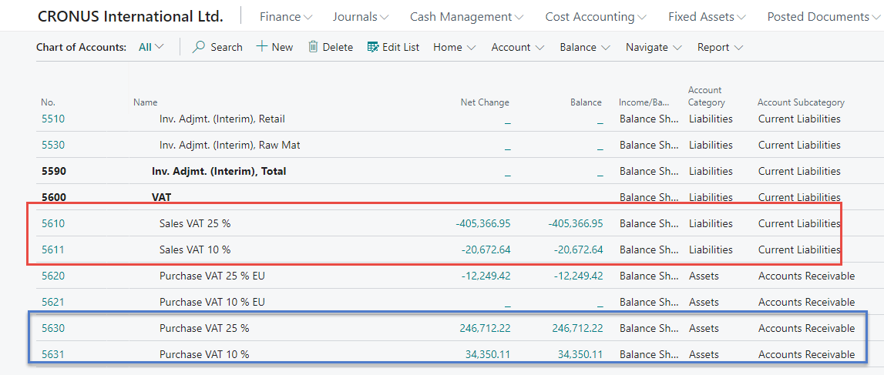
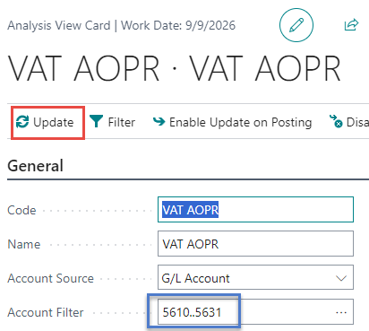
Our model - example
Rows of Financial report setup
Column setup
Financial report

Slide 6
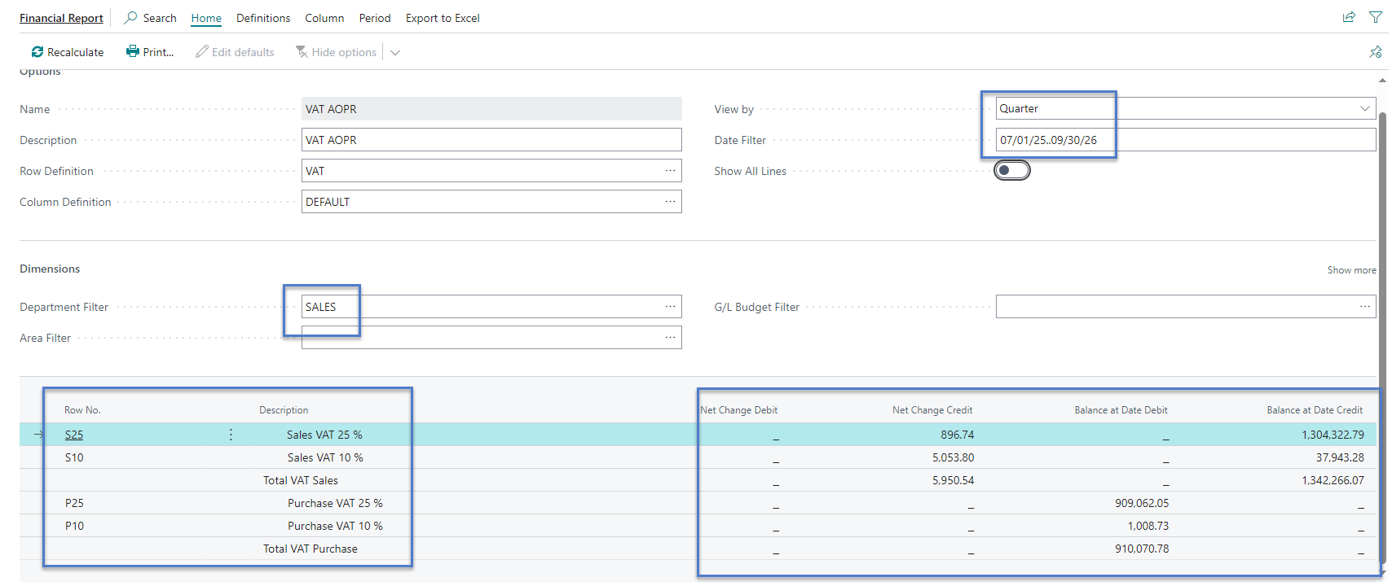
Assembled Financial report

Slide 7
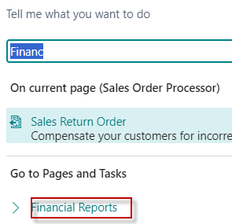
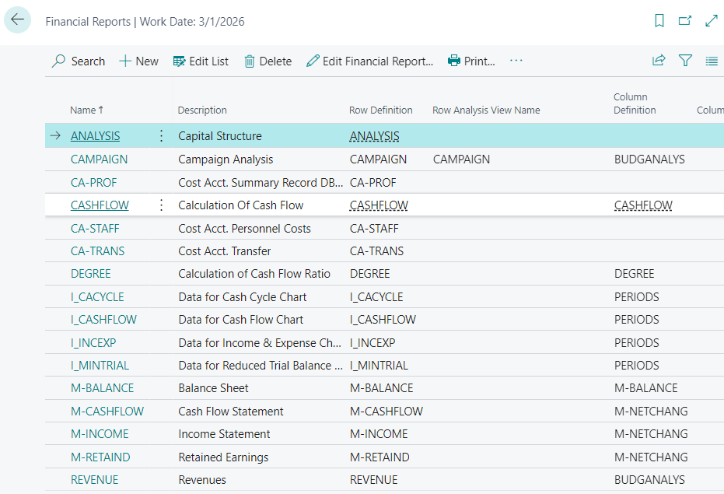
Financial Reports

Slide 8
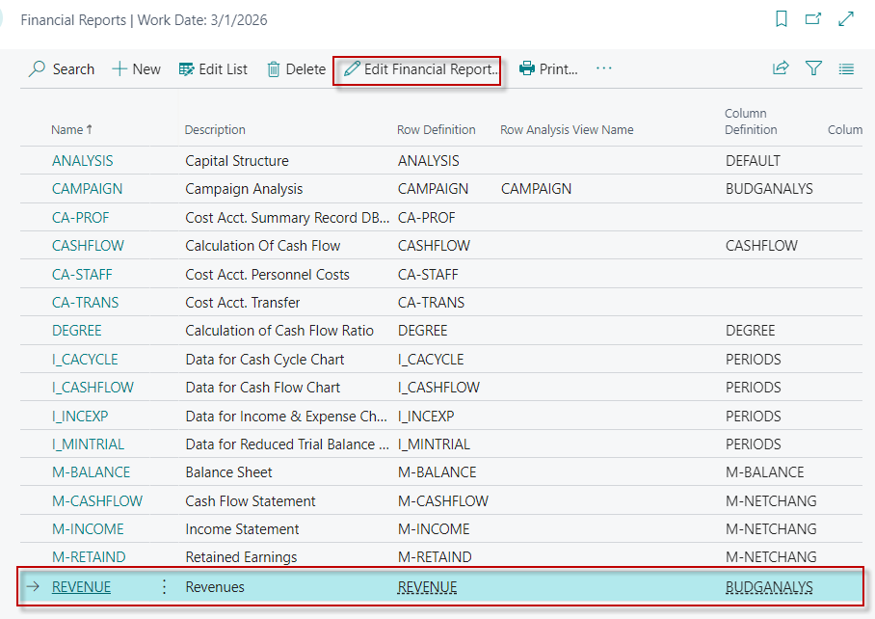
Edit Financial Report in new BC version

Slide 9
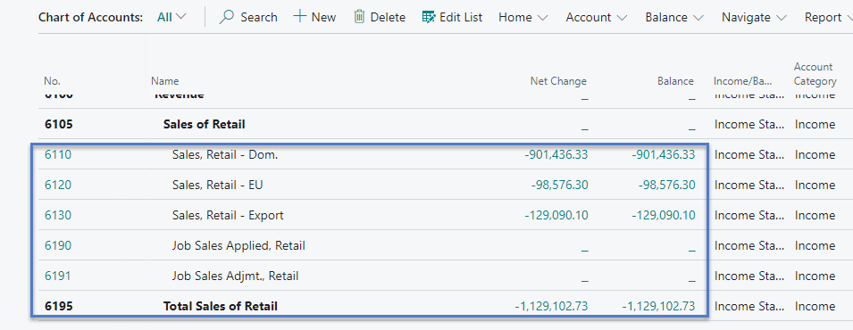
Data from Charr of accounts
Rows of Financial report

Slide 10
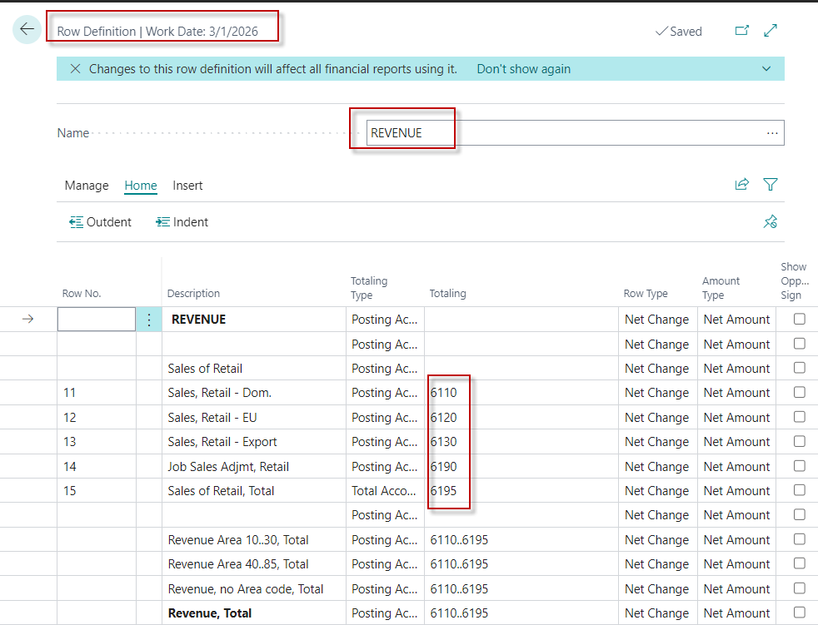
Row Definitions – alreday created report
Accounts 6110..6190 are General Ledger accounts (see Chart of account- previous slide)

Slide 11
Column Definitions

Slide 12
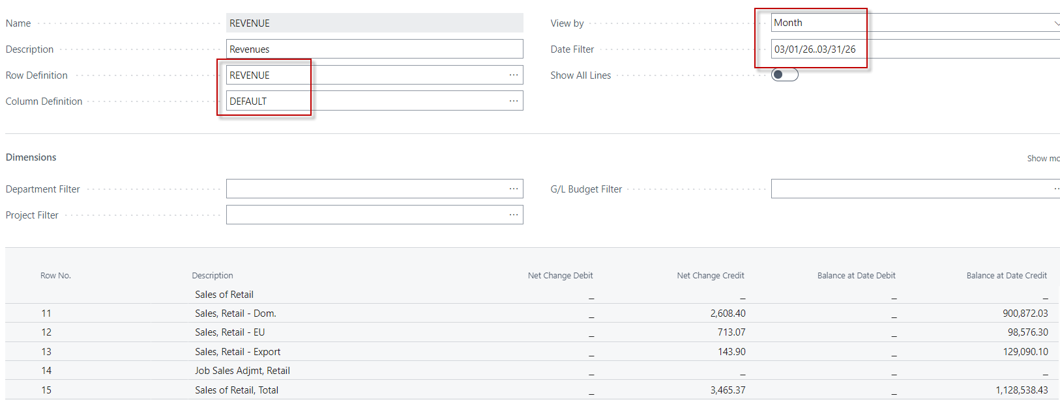
Financial Report overview – Edit FR
FR=Financial Report – to see data from predefined General Ledger accounts

Slide 13
Creation of a new simple VAT report -1st step
See next slide

Slide 14
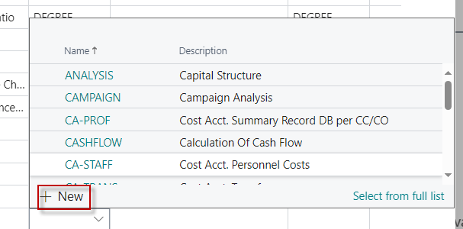
Creation of a new simple VAT report -1st step
Manually enter the code and report description
Row definitions

Slide 15
VAT report - Raw Definitions
Start raw definitions here
Manually enter the Name and Description
EDIT RAW Definitions

Slide 16
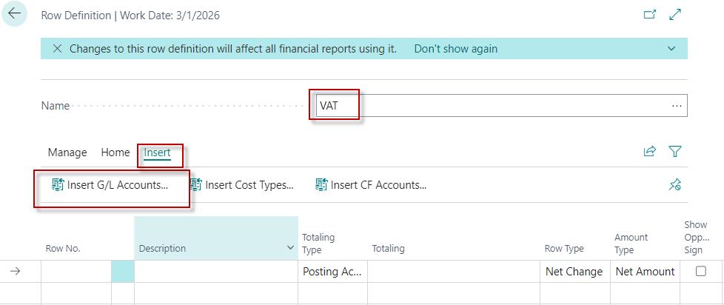
VAT report- raw definition (editining phase)
Manually enter all four account for VAT (Purchase and Sales)

Slide 17
VAT report- raw definition (editining phase)
Manually enter all four account for VAT (Purchase and Sales)
Overwrite the Variables in the column Row No. and write the formula manually . Rewrite original 5610 and 5611 by newly chosen codes S25 and S10 manually !!!

Slide 18
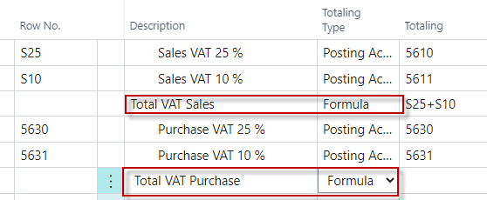
VAT report- raw definition (editining phase)
Manually enter all four account for VAT (Purchase and Sales)
Overwrite the Variables in the column Row No. and write the formula and Description field manually !!!

Slide 19
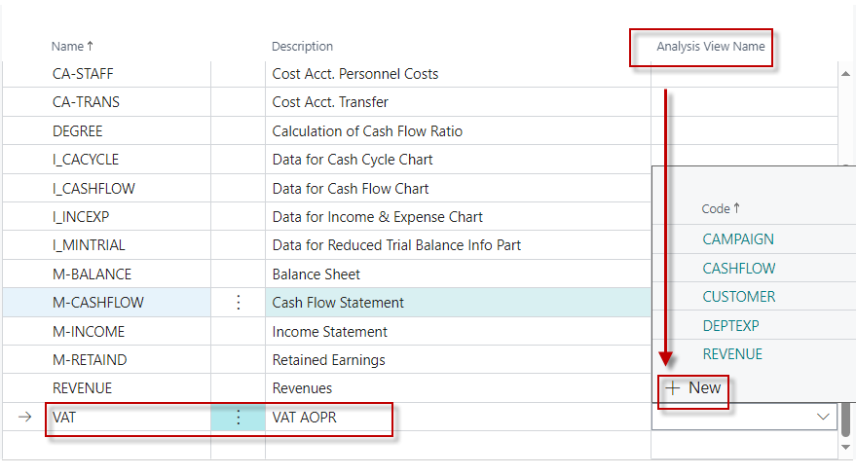
Creation of Ananysis view of VAT report

Slide 20
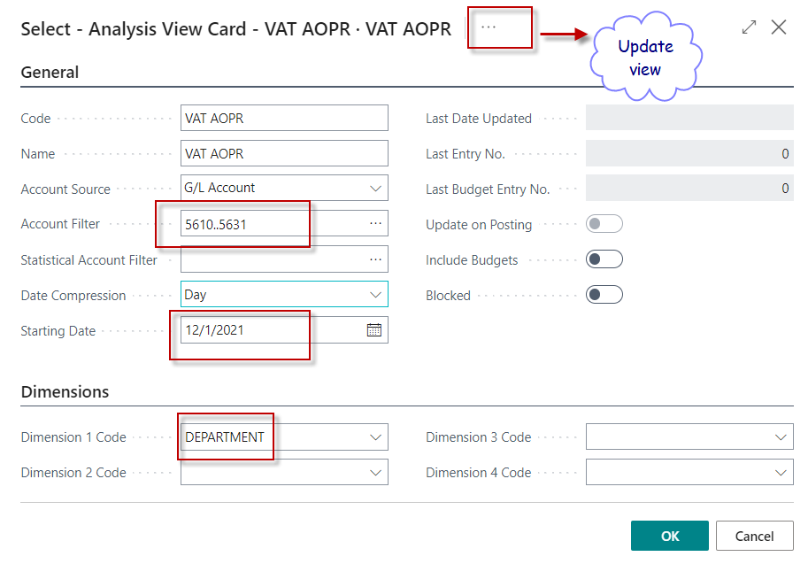
Creation of Ananysis view of VAT report 1st step
For the range of accounts, see Chart of Accounts

Slide 21
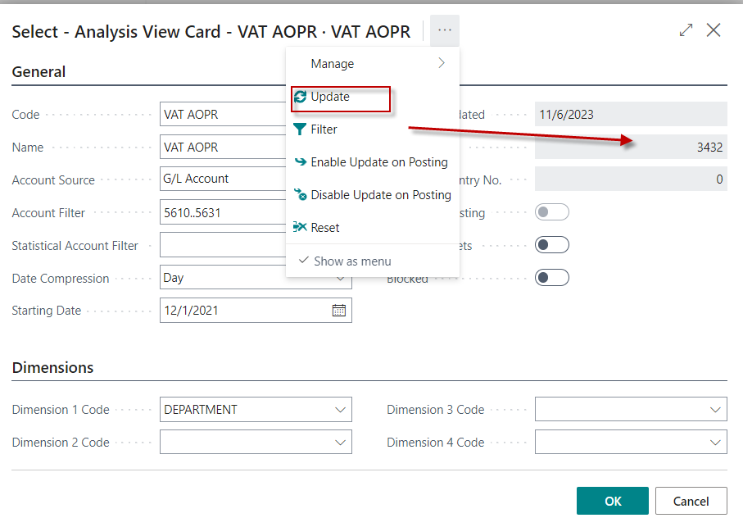
Creation of Ananysis view of VAT report 2nd step after Update action
Confirm

Slide 22
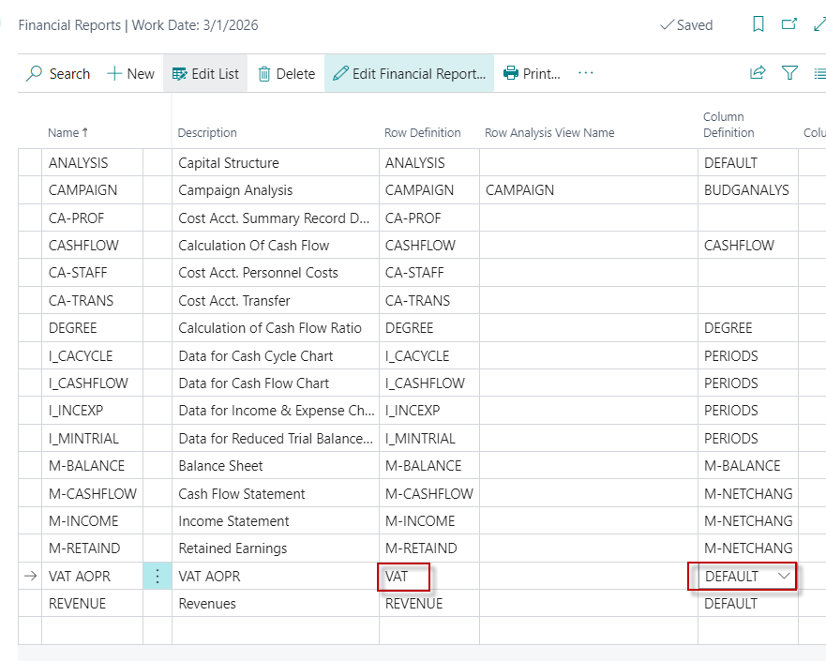
Back to Financial reports list
Complete the Row definitions (by selecting) from the already created definition and select the predefined Default version as the Column view

Slide 23
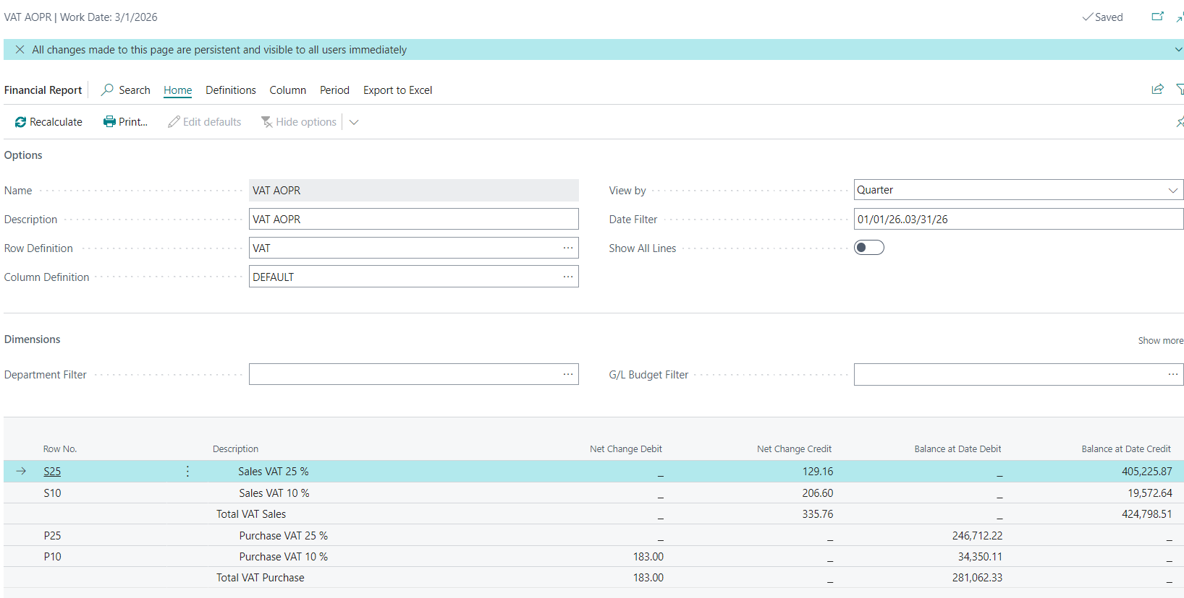
How to see final result of the report I.

Slide 24
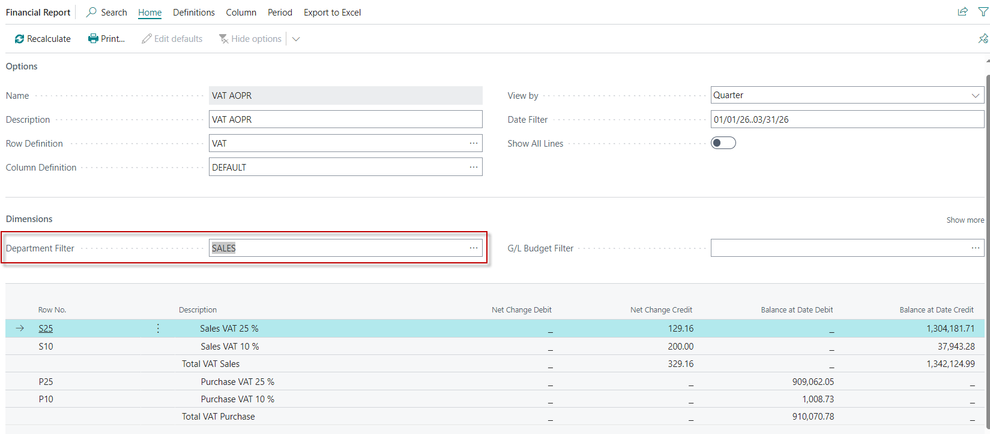
How to see final result of the report II.

Slide 25
Dimensions
Dimensions are values that categorize entries so you can track and analyze them on documents, such as sales orders. Dimensions can, for example, indicate the project or department an entry came from.
So, instead of setting up separate general ledger accounts for each department and project, you can use dimensions as a basis for analysis and avoid having to create a complicated chart of accounts. Learn more at Business Intelligence.

Slide 26
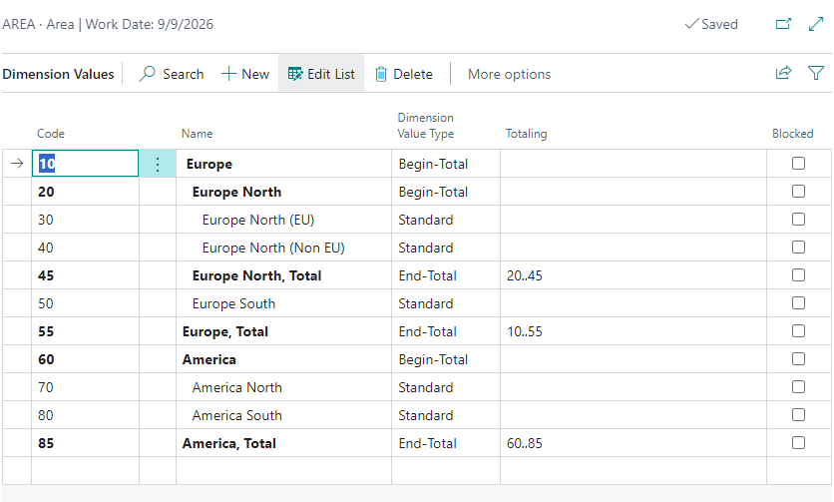
Dimension- examples

Slide 27
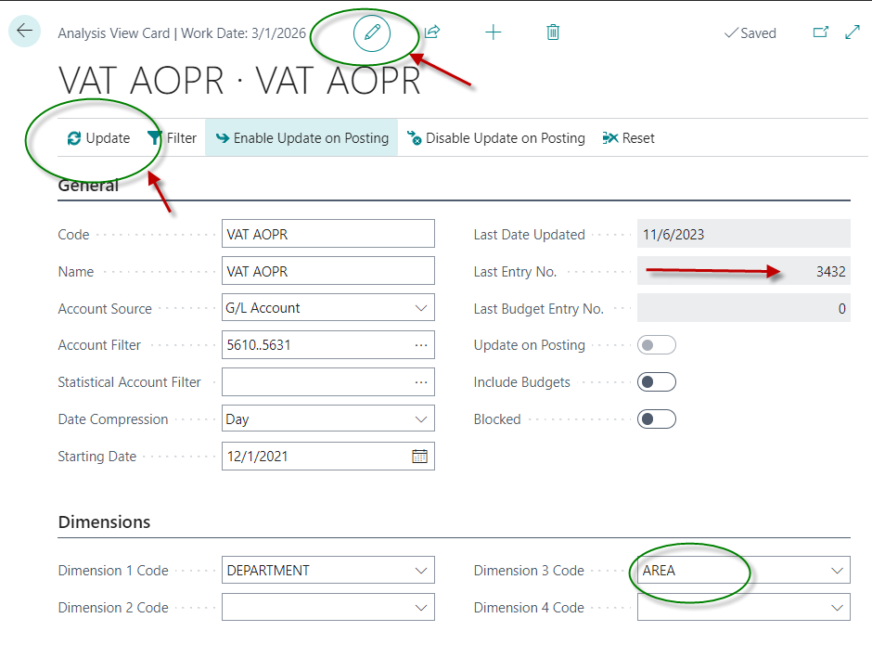
Update Analysis view –before update
Enable editing

Slide 28
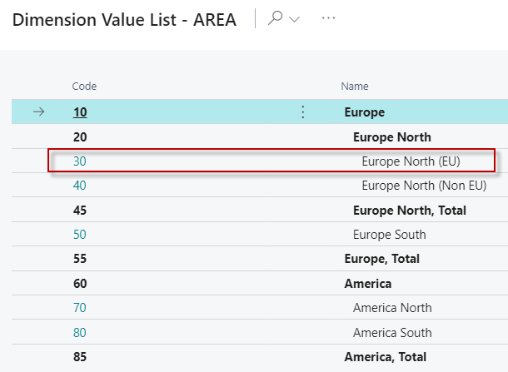
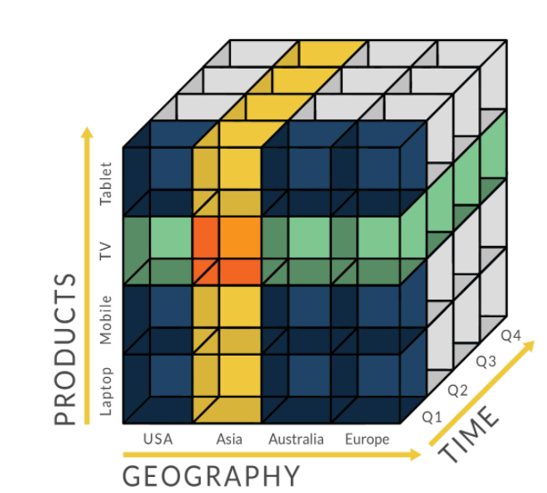
Financial Report for VAT Analysis overview (use of Dimensions - filter )
OLAP=On-Line Analytic Processing

Slide 29
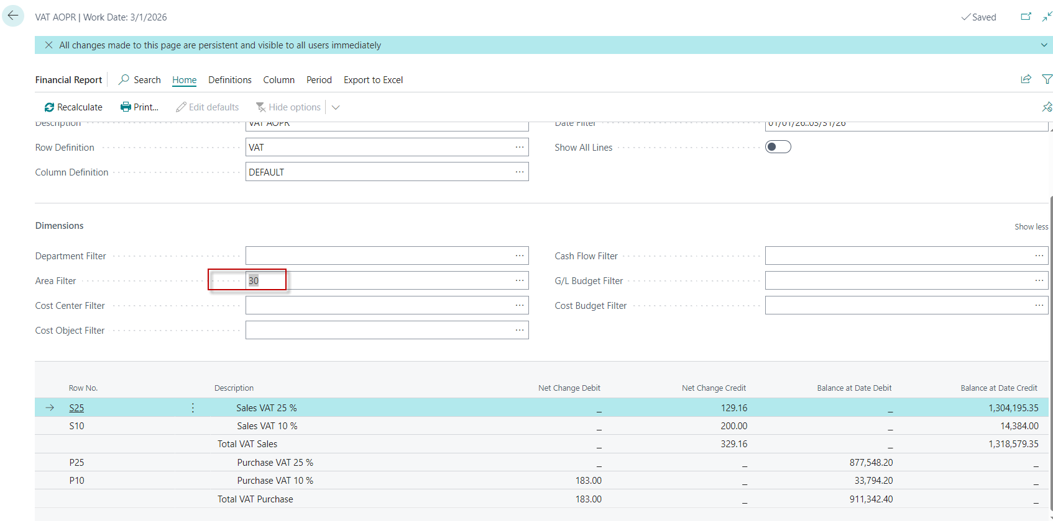
VAT report with Area dimension

Slide 30
Balance sheet report already created (home study)

Slide 31
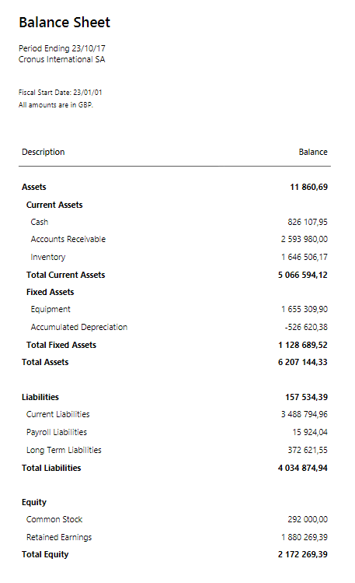
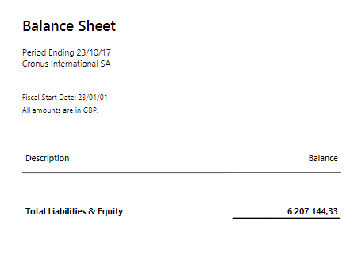
BS Printout
1st part
2nd part

Slide 32
Possible homework

Slide 33
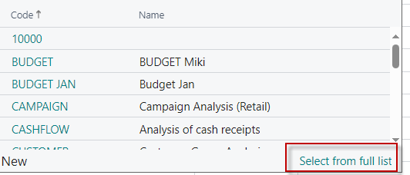
Brand new report creation

Slide 34
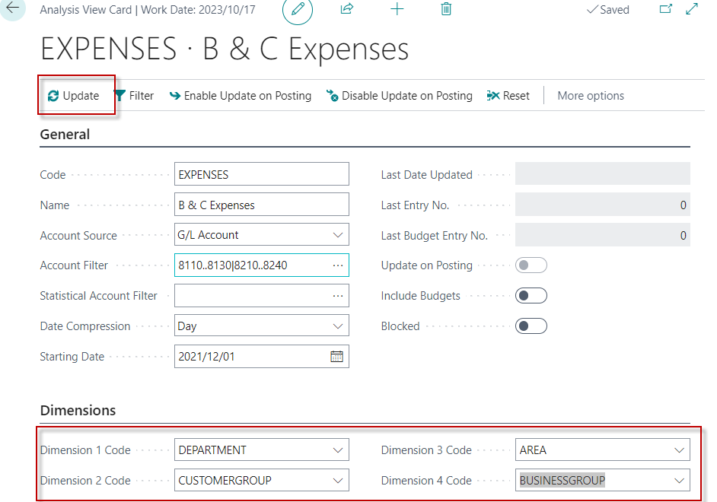
Brand new report creation
Before UPDATE

Slide 35
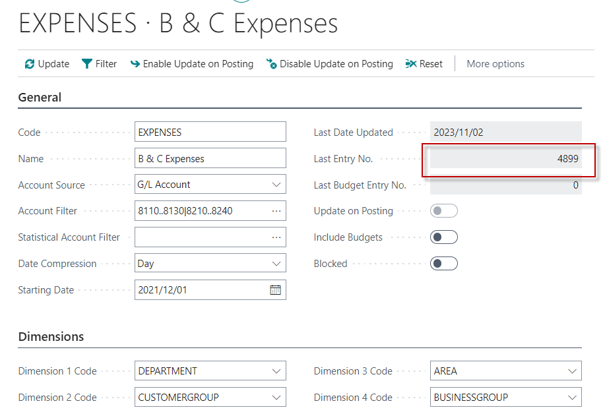
Brand new report creation
After
UPDATE

Slide 36
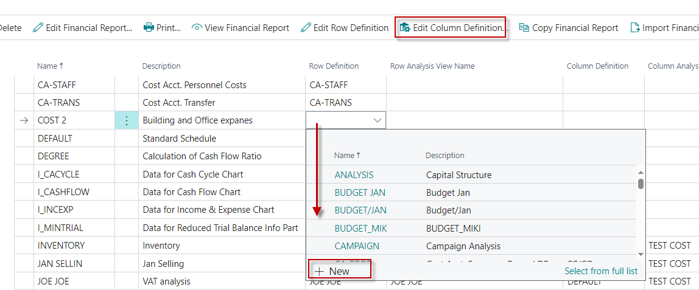
Brand new report creation

Slide 37
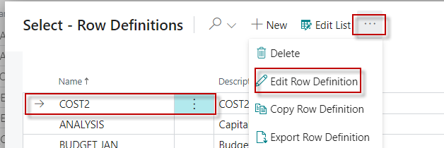
Brand new report creation

Slide 38
Brand new report creation

Slide 39
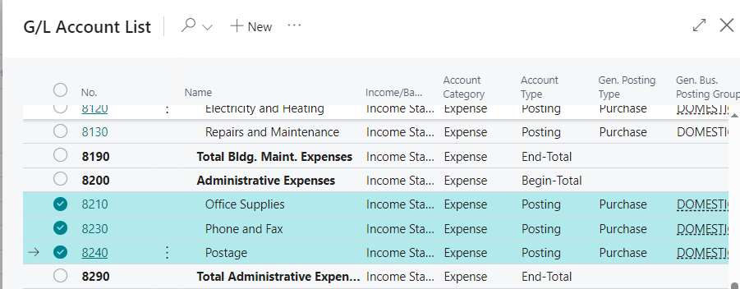
Brand new report creation
Transfer to report rows

Slide 40
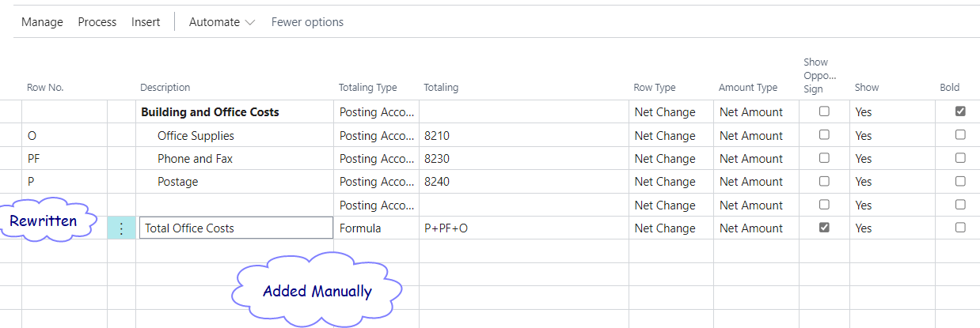
Brand new report creation

Slide 41
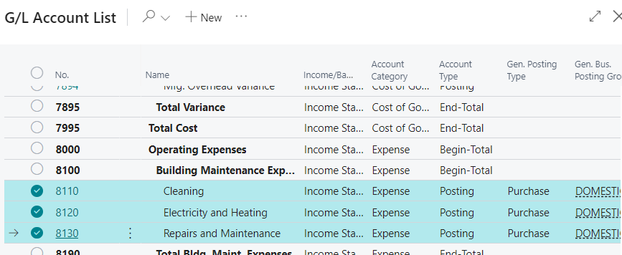
Brand new report creation
2nd set of G/L accounts to be moved to report

Slide 42
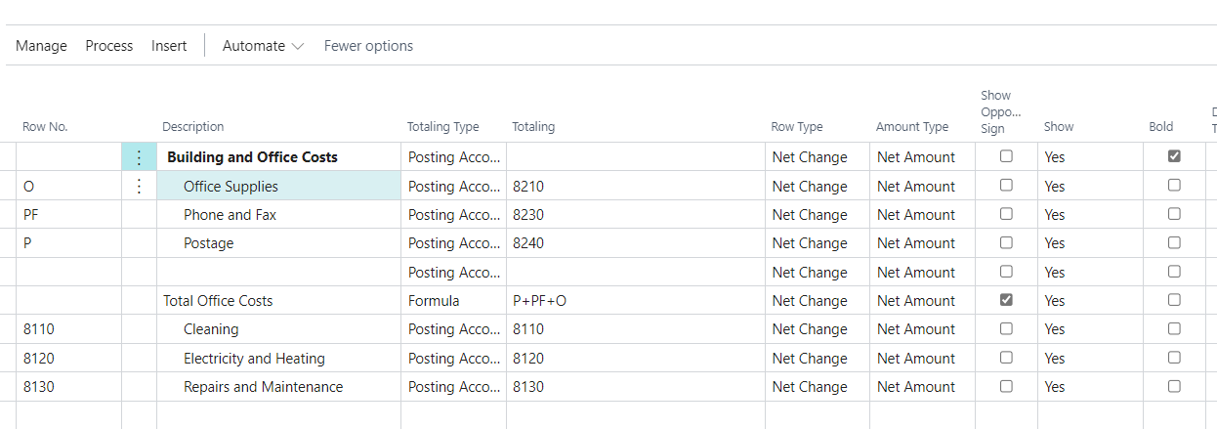
Brand new report creation

Slide 43
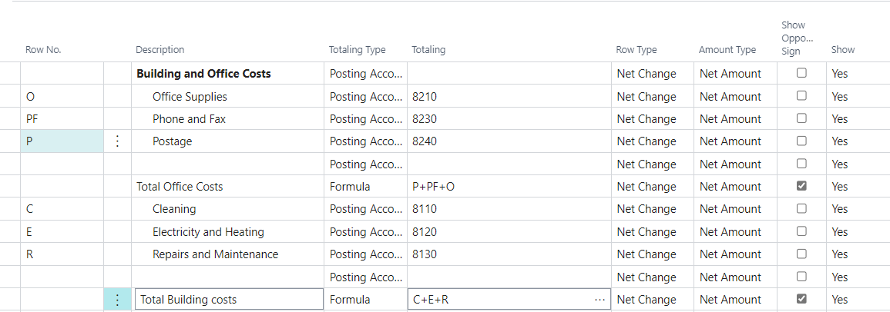
Brand new report creation

Slide 44
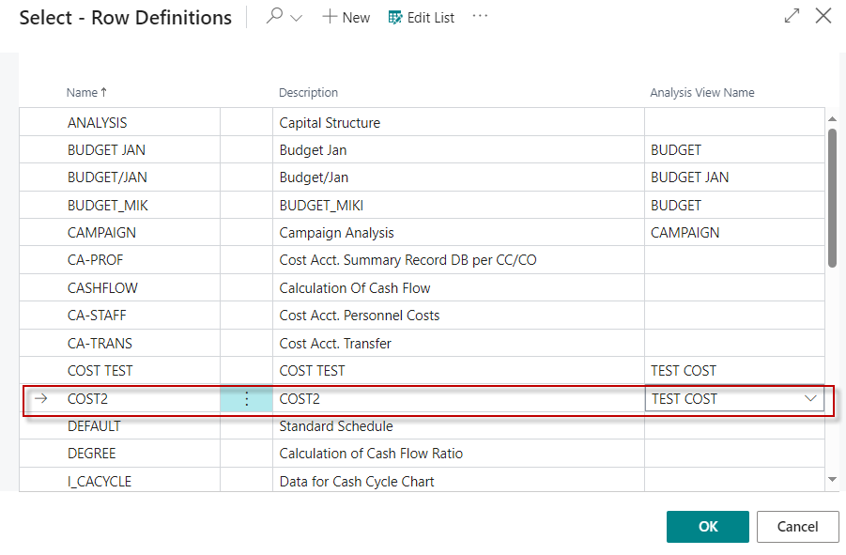
Brand new report creation

Slide 45
Brand new report creation

Slide 46
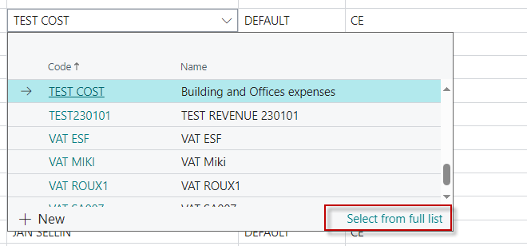
Brand new report creation

Slide 47
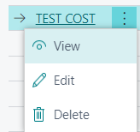
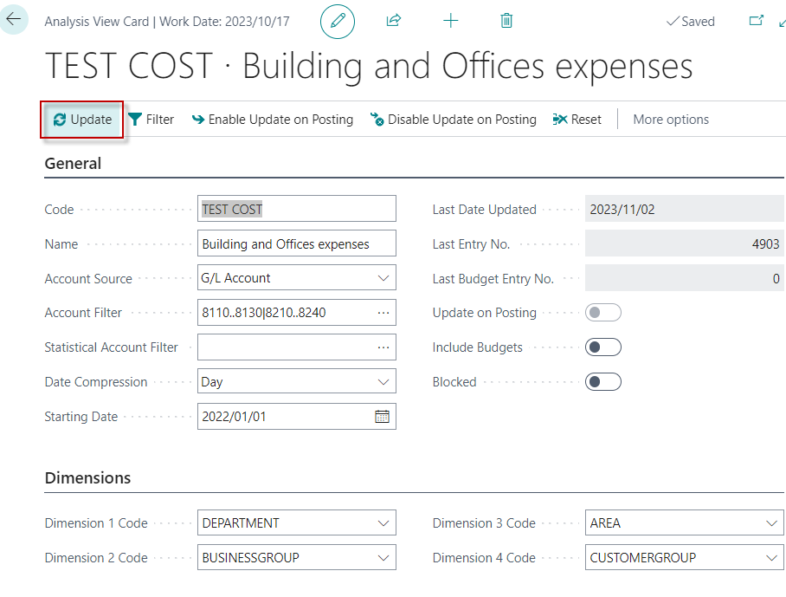
Brand new report creation

Slide 48
Brand new report creation

Slide 49
End of the section

