Slide 1
Business Central Introduction
(ERP=Microsoft Dynamics 365 Business Central)
Budgets and Account Schedules basics
Ing.Jaromír Skorkovský,CSc.
Masaryk University Brno
Czech Republic

Slide 2
Budget creation, G/L data creation and comparing budget data and G/L data
Reasons
  Creation of Budget- budget data
  Creation of entries –actual data
  Creation of an Account schedule to compare actual and budget data
6710 Consulting fee
6710 Budget
Difference =1800-(800+300)= 700

Slide 3

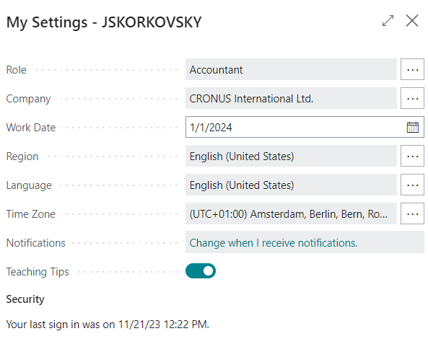
Settings
Use Accountant role

Slide 4
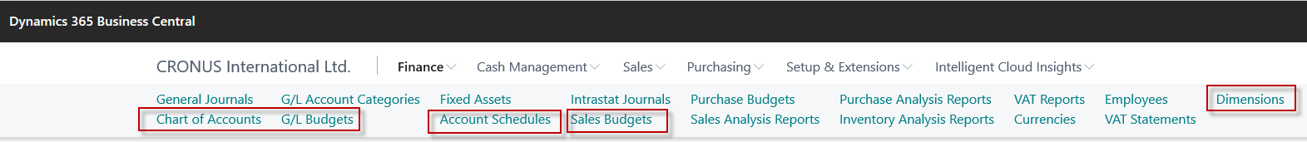
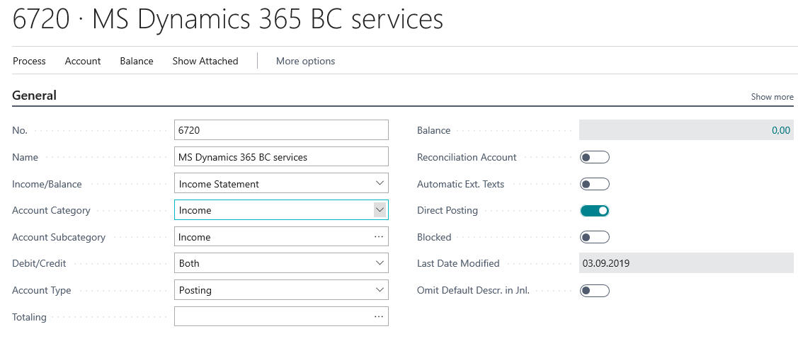

Used tools and new account creation in chart of accounts
New name=Financial reports
Chart of Account
Account Schedules
Sales Budgets
Dimensions
In our examples we created
also other G/L Account such as 6730 and 6740

Slide 5
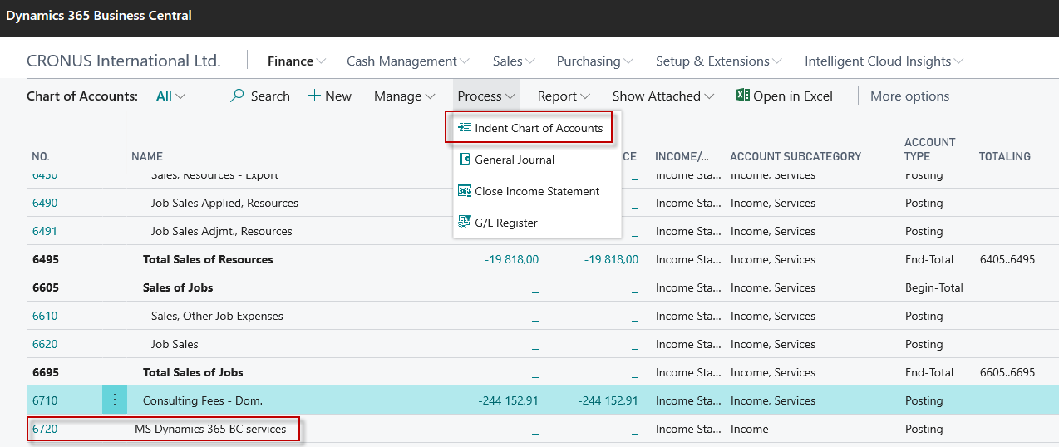
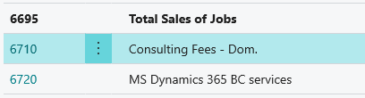
Chart of accounts

Slide 6
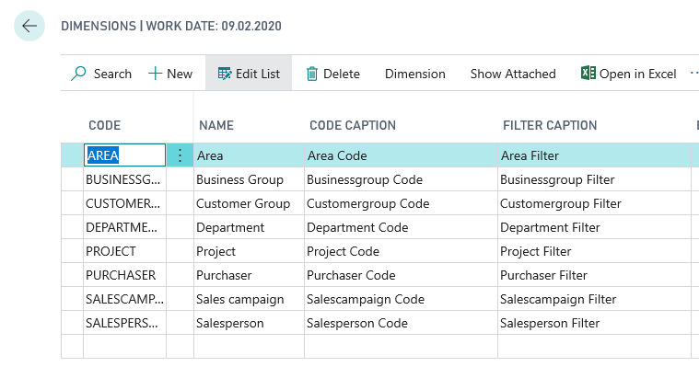

Dimensions (cost centers, income centers)

Slide 7
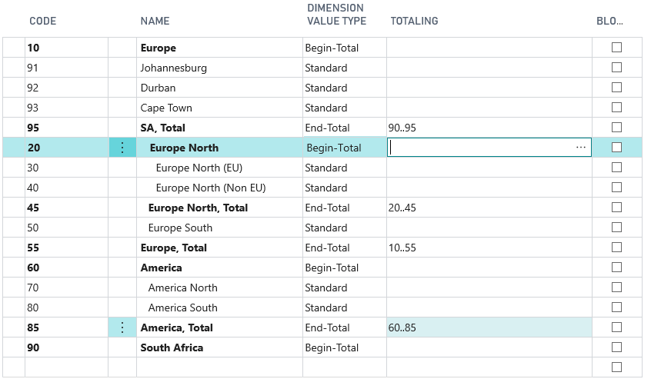

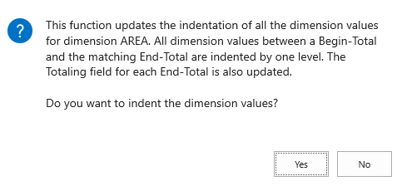
Dimension values (we created here three new areas (91-93)

Slide 8
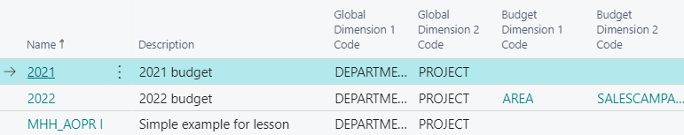


G/L Budget data entry in this model we use account 6730 and budget 2022
See G/L budget matrix next slide

Slide 9
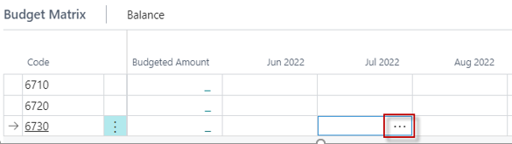
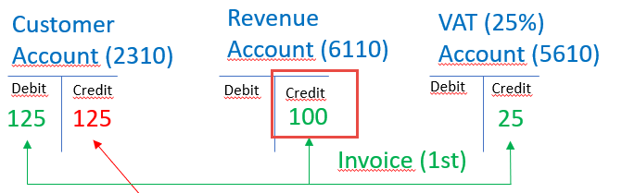
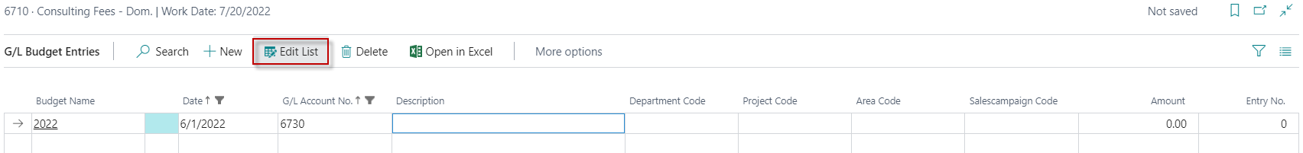
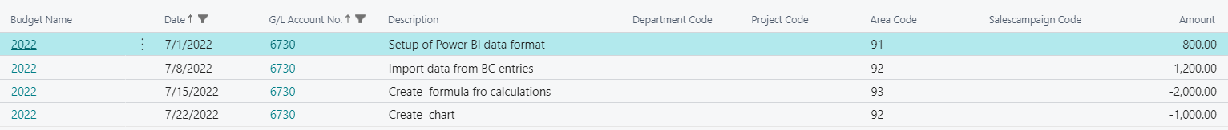
G/L data entry – how to enter data into budget(use of 3 dots icon)
Payment
The reason we enter amounts with
a negative sign in the budget is that
it is the Credit side
Area dimension values entered
as a options manully (we will use
area codes 30 and 40 instead)

Slide 10
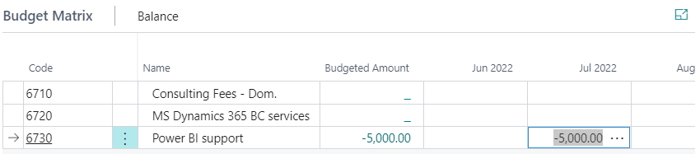
G/L Budget after data entry
5000 = 800+1200+2000+1000
Note that the calculation is displayed in absolute value

Slide 11
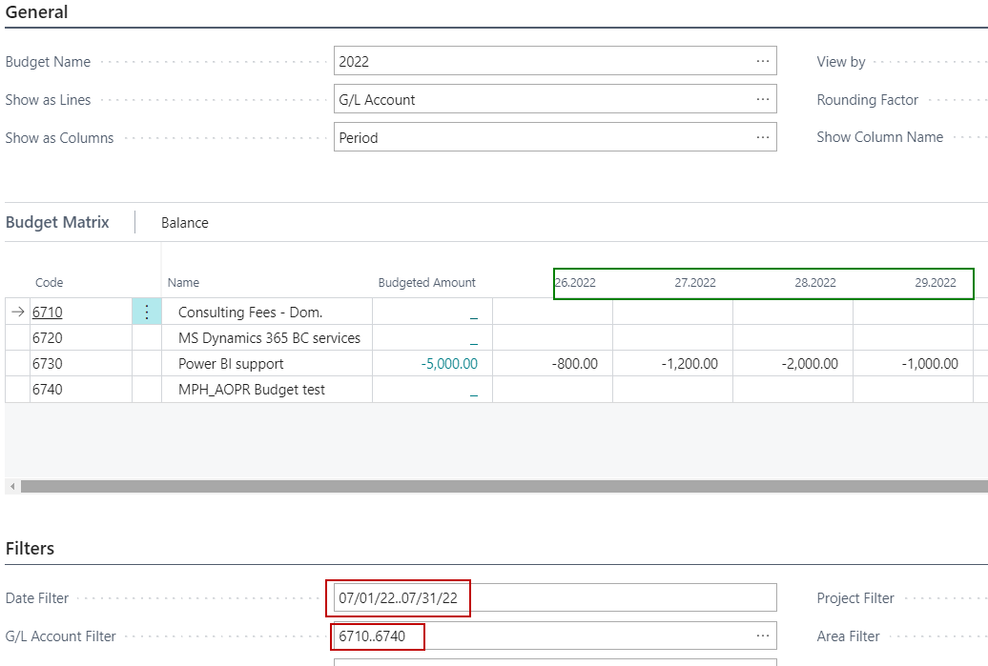
G/L budget matrix with already entered data

Slide 12
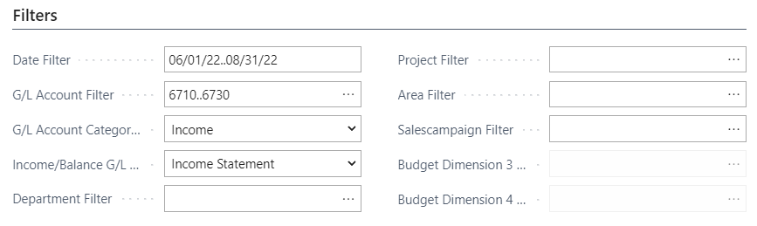
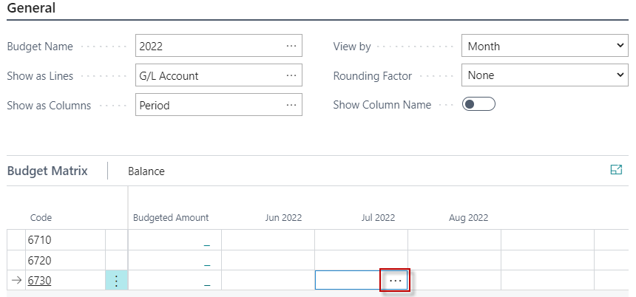
G/L Budget matrix

Slide 13

Actaul data creation

Slide 14
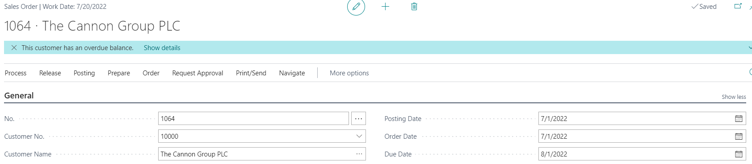
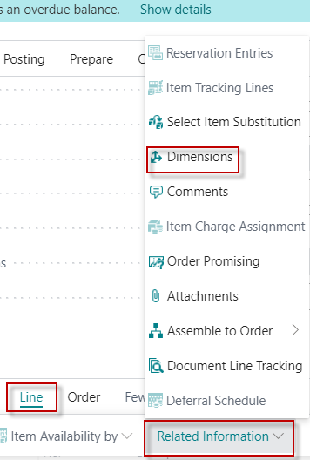
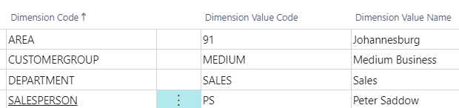
Actual data creation-Sales Invoice I (actual data creation)
F9
Budget=800 Sales order line =700

Slide 15
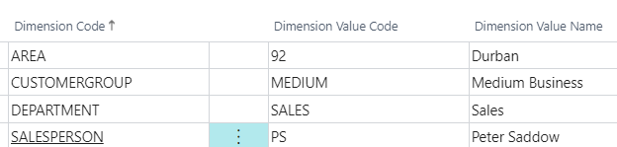
Second part of the invoice II (actual data creation)
Budget=1200 Sales order line =900
We will use the same data entry creation by use of second sales invoice,
but the amounts will differ intentionally from the figure in budget.

Slide 16
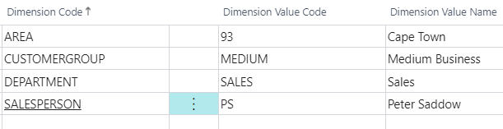
Third Sales invoice III (actual data creation)
Budget=2000 Sales order line =1800

Slide 17
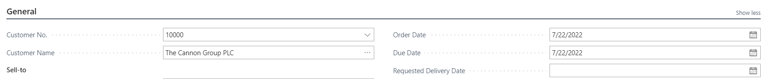
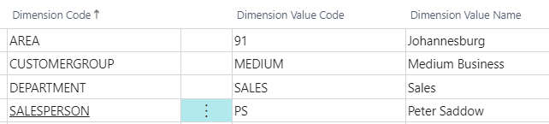
Forth Sales invoice IV (actual data creation)
Budget=1000 Sales order line =3000

Slide 18
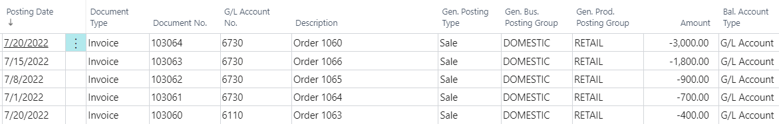
Created G/L Entries – actual data
Here you see, that during actual data creation we had to change working dates.

Slide 19
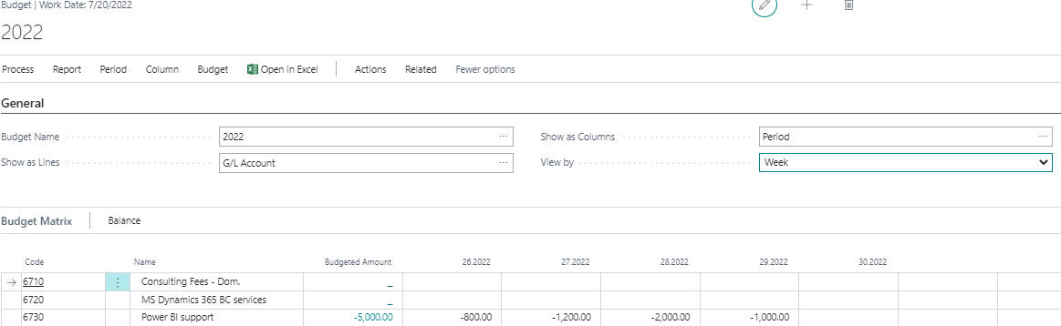

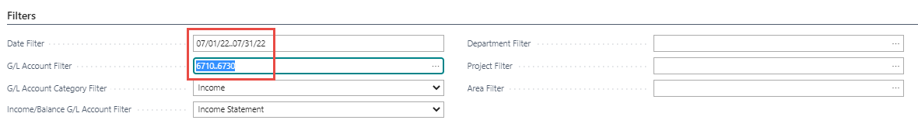
How to get G/L Account Balace Budget by period
Cursor must be here

Slide 20
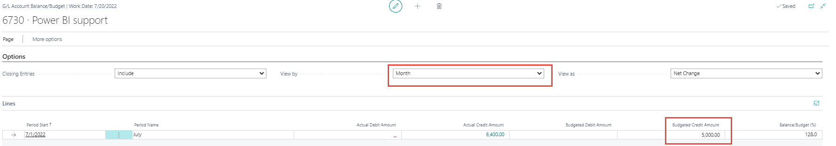
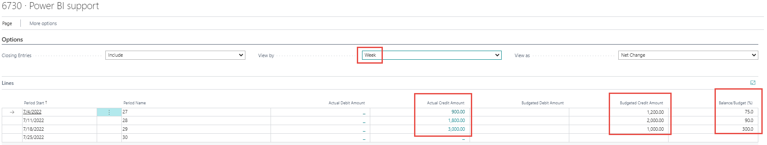
Simple Budget operations (not use of Financial Report for budget analysis)
Change the view by Month ---→Week

Slide 21
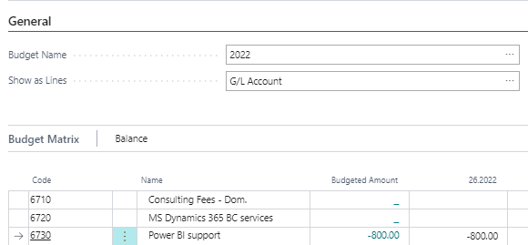
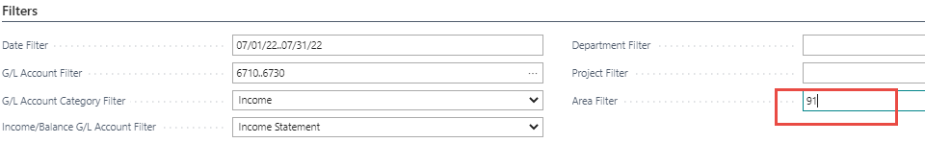
Use of area dimension – firsty go back and enter area dimension value to filter subform
Use Area code =30 (not 91)

Slide 22
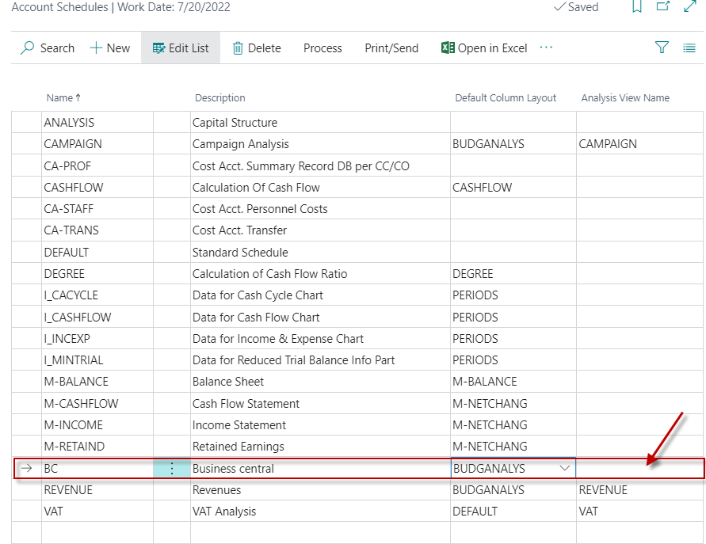
List of finanical reports already created

Slide 23
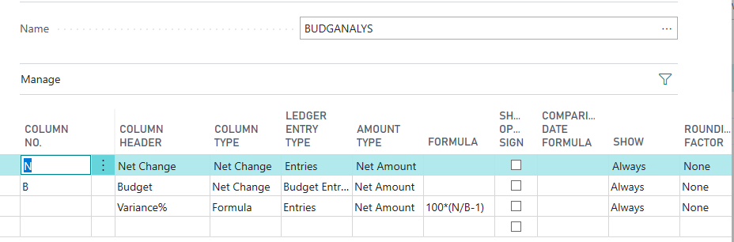
Default column layout based on the rule of three (trinomial)
Trinomial

Slide 24
To create a Financial Report analysing the budget
we have created,
use the BC - 11 Budget Supplement file

Slide 25
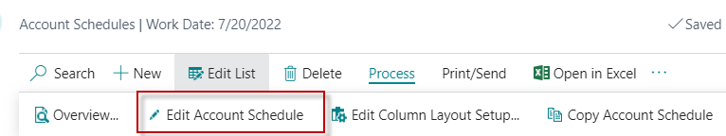
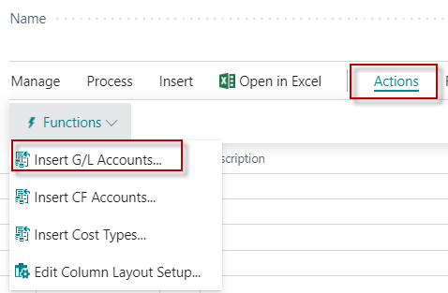
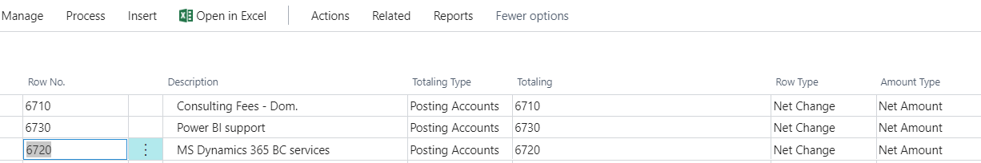
New Financial report -> USE BC-11 Budget Suplement to go further (not folowoing slides)
All chosen account in the new template
were entered by use of icon Insert G/L account
We must create a new Analysis View name (BC) and see the default column layout for budget

Slide 26
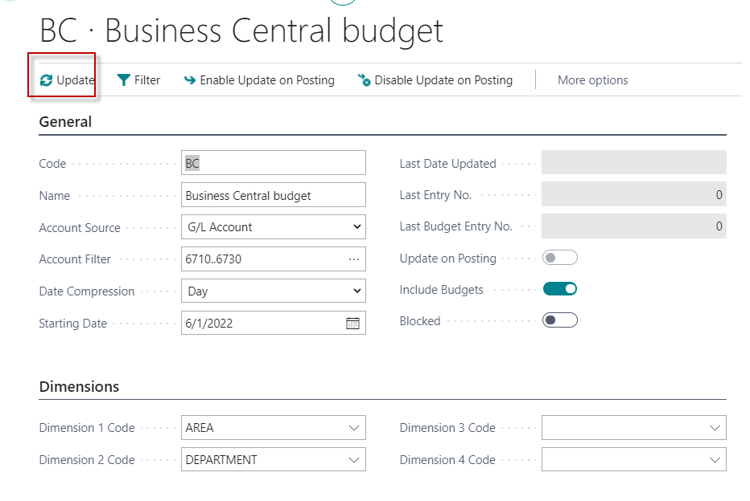
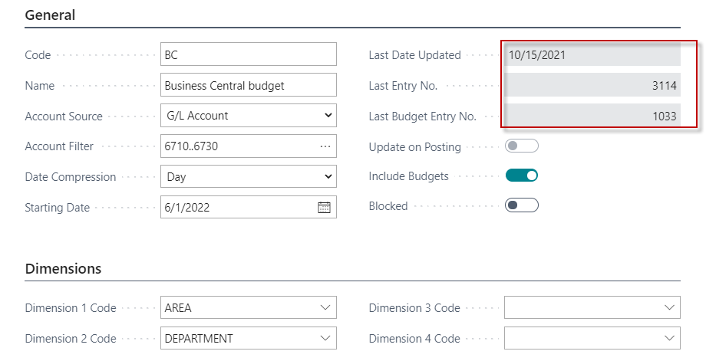
New financial report view
By use of searching window you will get
To see also budget data
represented by budget entries
After a set of parameters (Account numbers , dimensions and so on), this view must be always updated !!!

Slide 27
Default column layout based on the rule of three
Already presented on slide number 24

Slide 28
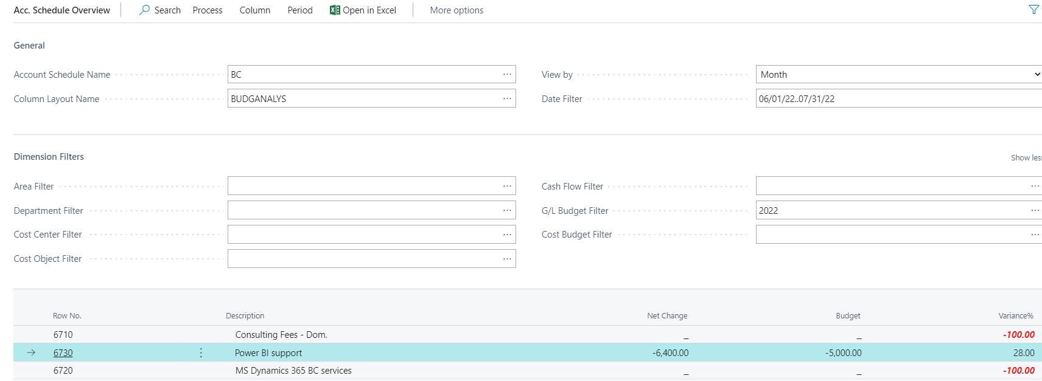
Financial report overview

Slide 29


