Slide 1
Microsoft 365 Business Central Introduction
(ERP=Microsoft Dynamics 365 Business Central)
Ing.J.Skorkovský,CSc.
Department of Business Management
Faculty of Business and Administration
Masaryk University Brno
Czech Republic

Slide 2
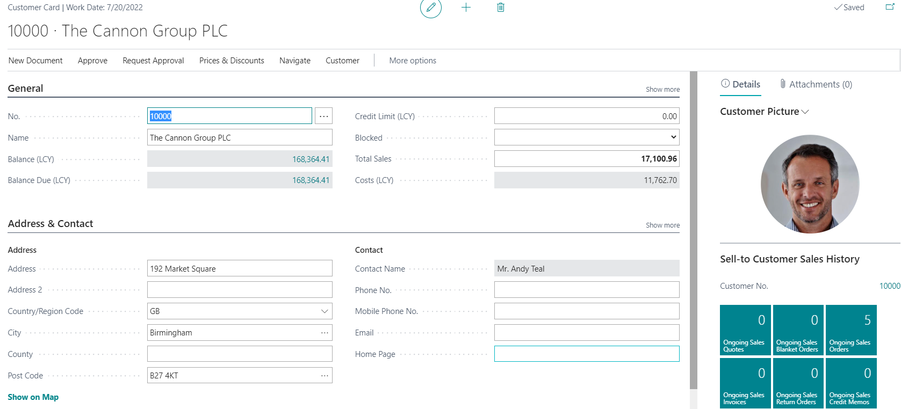
Types of data I. - Data representation method
In computer programming, source data or data source is the primary location from where data comes (tables)
The data source is a database, a dataset, a spreadsheet or even hard-coded data. When data is displayed, it is retrieved from its data source. The software processes this data internally, performing additional calculation, formats and updates the application windows.
In our case it might be Customers, Vendors, Items, G/L Account and so on.
One record
(shown in form of a card)

Slide 3
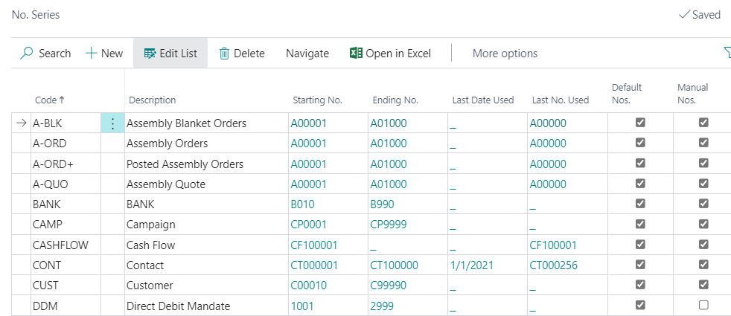
Types of data II. - Data representation method
Many records (shown in form of a list)
Dials - lists

Slide 4
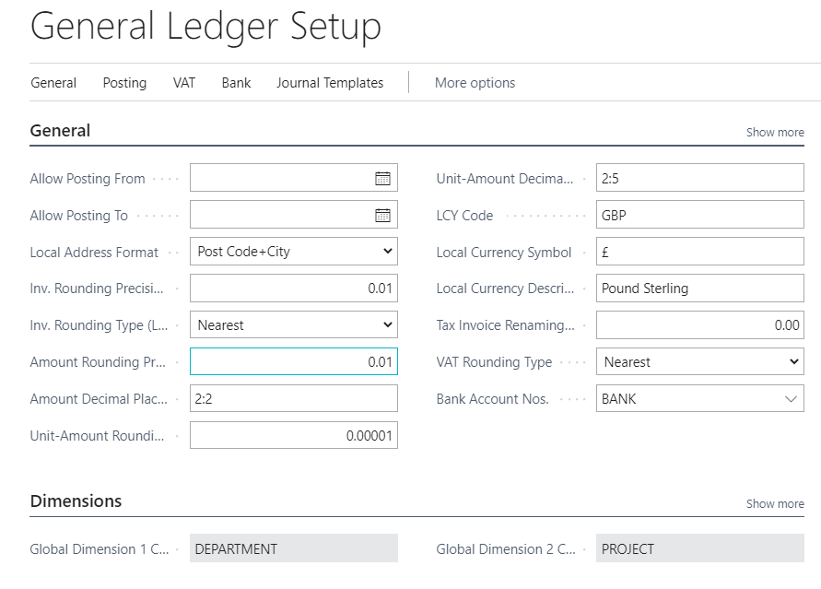
Types of data III. -. Data representation method
Parameters (one of many examples) – Used for Basic Business Central setup

Slide 5
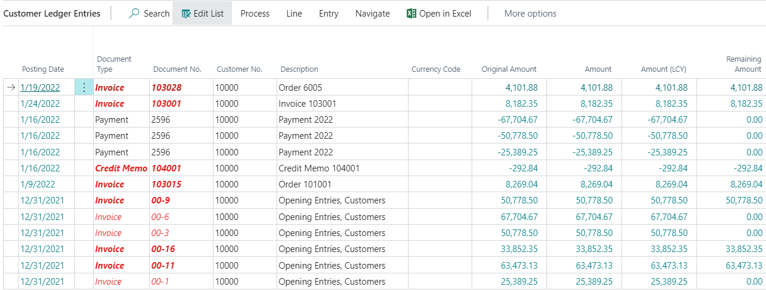
Types of data IV.
Transactions-> Entries -> Created by users (by posting documents)

Slide 6
Some chosen documents handled by ERP
Sales Order
Purchase Order
Transfer Order
Credit Memo
Reminder
Production Order
Bank Statement

Slide 7
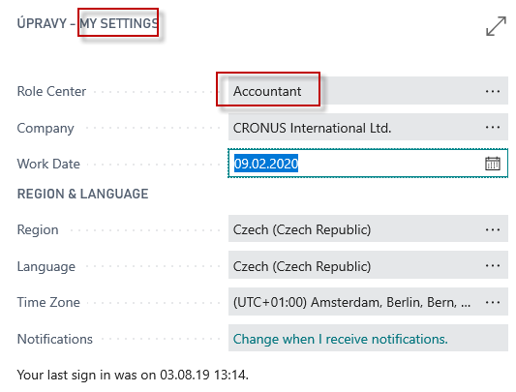
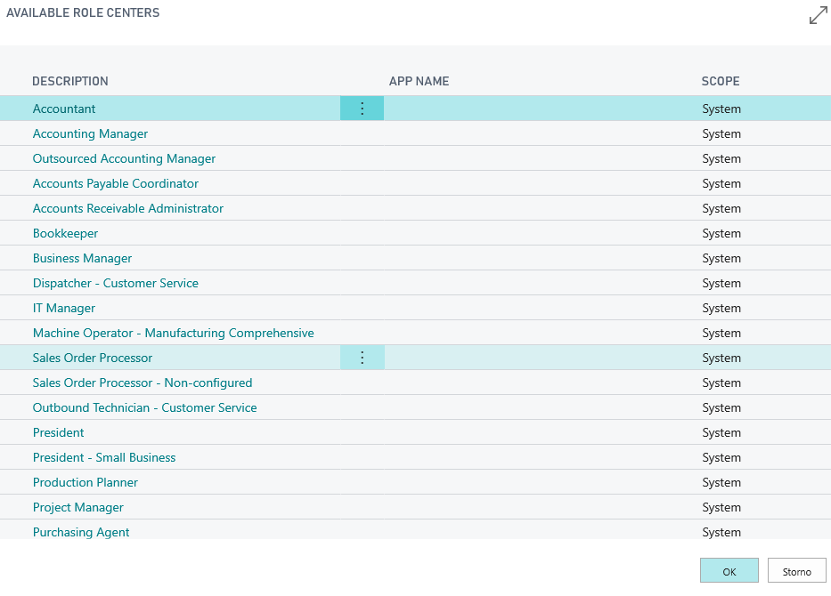
Access and roles -Setting rules for different types of users
MY SETTING
Role Tailored Client philosophy

Slide 8
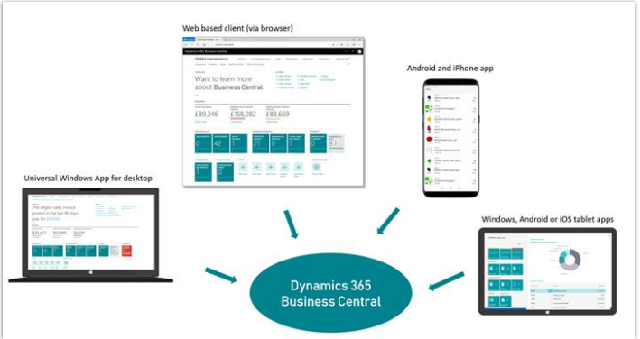
Information is available from everywhere

Slide 9
Functionalities managed by ERP (home study)
Financial Management – general ledger, workflows and audit trails, bank management, budgets, deferrals, bank reconciliation, dimensions, fixed assets and currencies.
Customer Relational Management – contacts, campaigns, opportunity management and built-in integration with Dynamics 365 for Sales.
Supply Chain Management – sales order management, basic receivables, purchase order management, locations, item transfers, and basic warehousing.
Human Resources – employees and expense management.
Project Management – resources, estimates, jobs and time sheets (planning).
Other – multiple languages, reason codes, extended text, Intrastat reporting, scheduled tasks and Outlook integration.
Service Order Management – service orders, service price management, service item management, service contract management, planning and dispatching.
Manufacturing – production orders, version management, agile manufacturing, basic supply planning, demand forecasting, capacity planning, machine centers and finite loading.

Slide 10
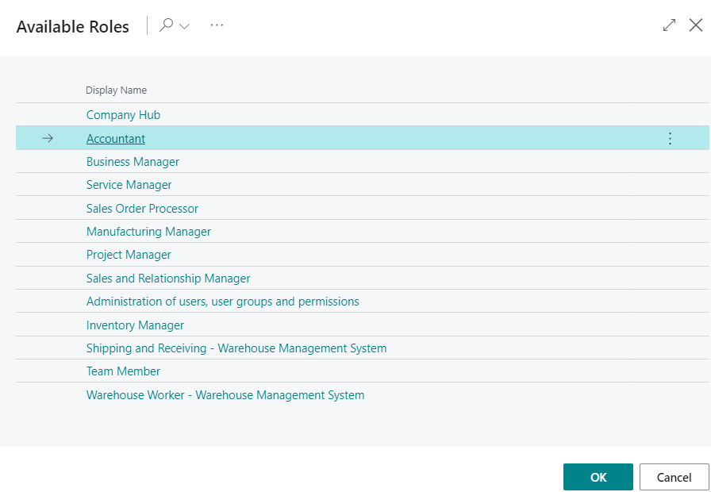
Roles in Business Central
Role Tailor Client Principle

Slide 11
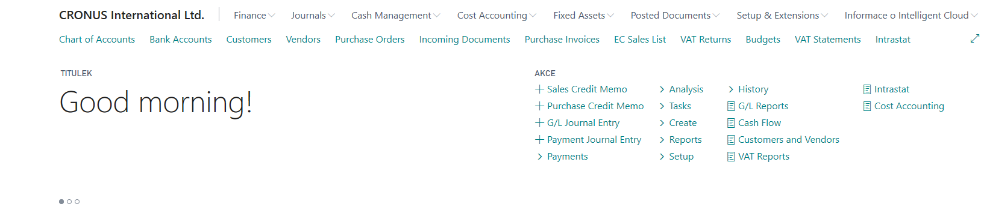
Basic functionalities for chosen role

Slide 12
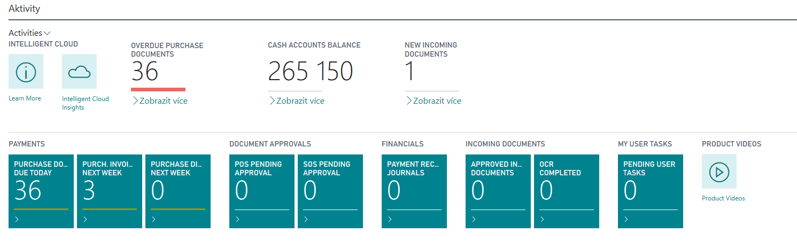
Basic activities
Display more
Display more
Display more

Slide 13
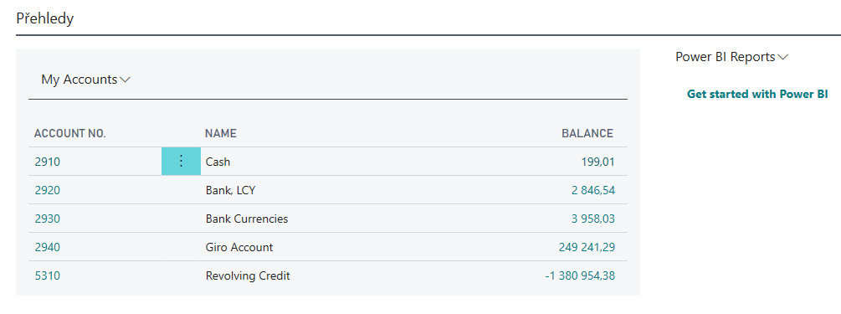
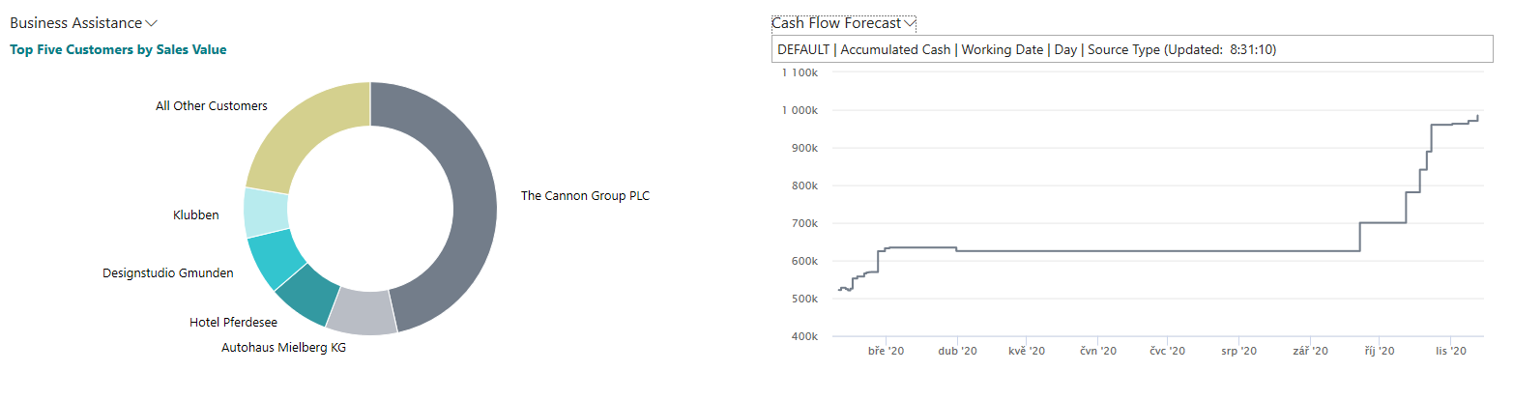
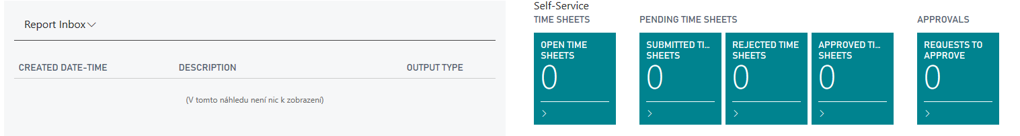
Basic summary (overview, surveys,lists)

Slide 14
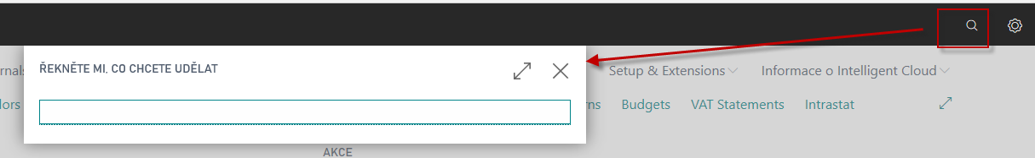
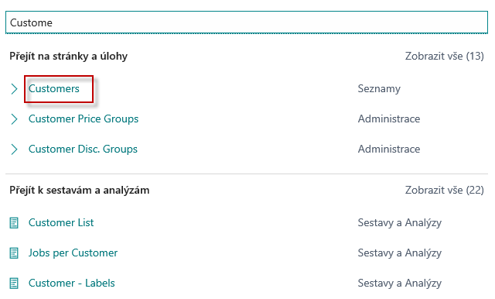
Business Partners (Customers, Vendors, Banks)
Tell me what you want to do
Customer
Full text searching
(I call it Business Central Google search)
Lists
Reports and Analysis

Slide 15
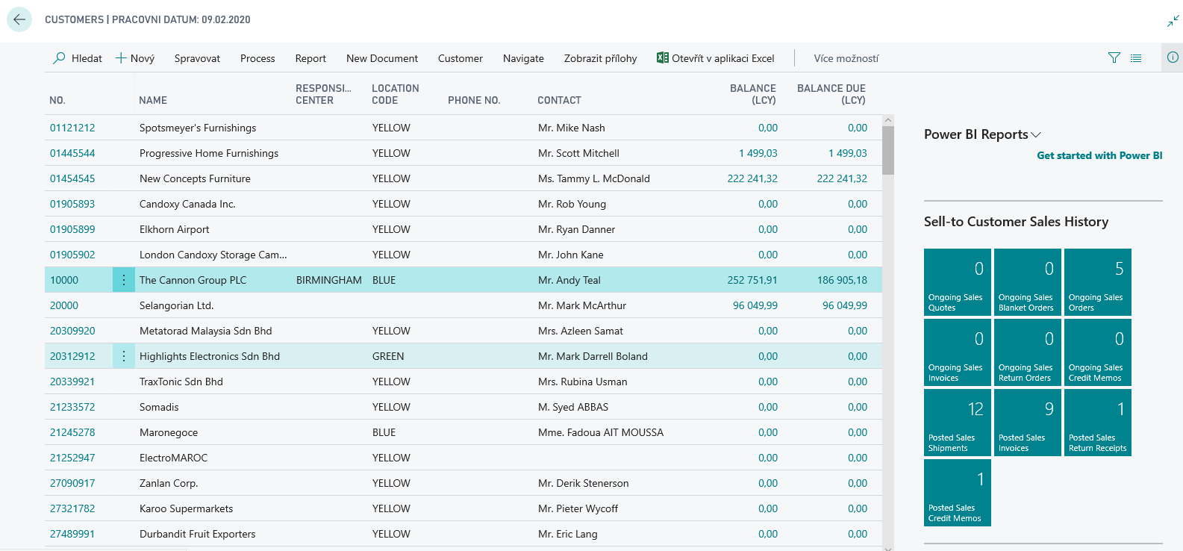
Customer List and Customer Card

Slide 16
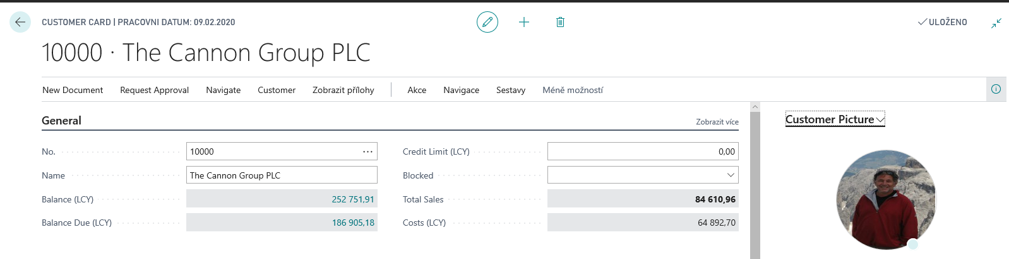
Customer first tab (on Customer card)
Ctrl-F7 (keyboard shortcut to get CLE)
Customer Ledger Entries (CLE)
Transactions=Entries

Slide 17
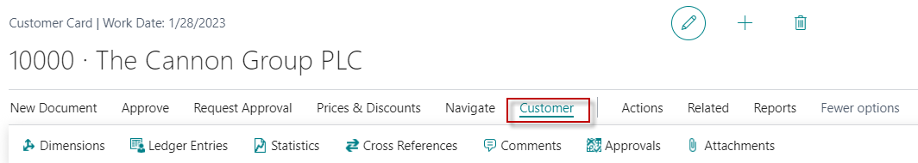
Possibilities how to get to Customer Ledger Entries
From Customer table directly by use of Ctrl-F7 hot keys combination
By use of appropriate icon (less effective)

Slide 18
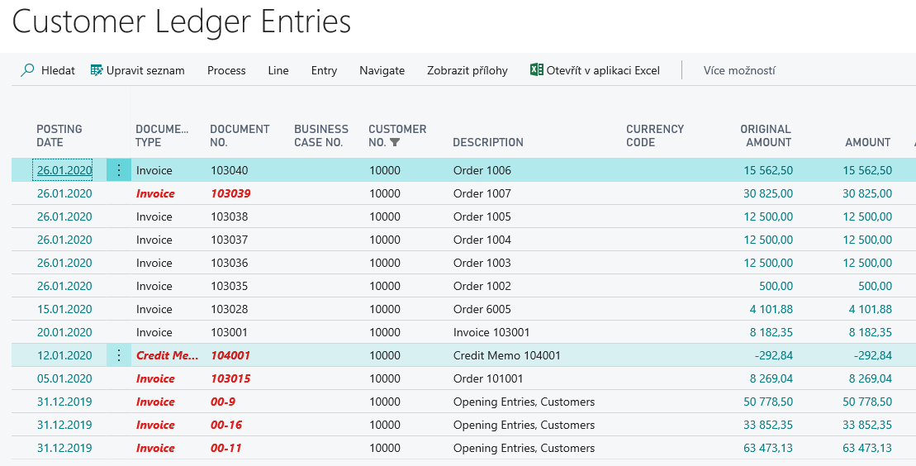
Customer Ledger Entries (transactions see data specification)
Entries = effects having the causes in posted documents (orders, credit memos, reminders and so on)

Slide 19
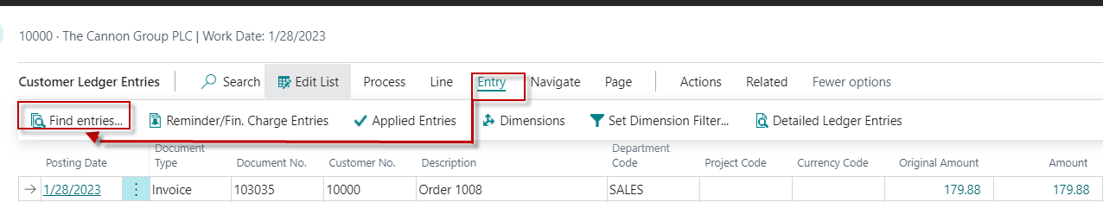
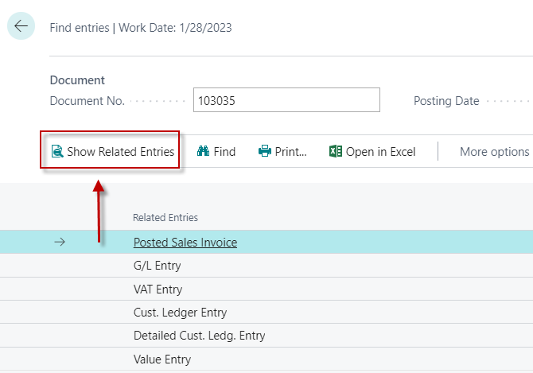
Navigation principle (current version of database)

Slide 20

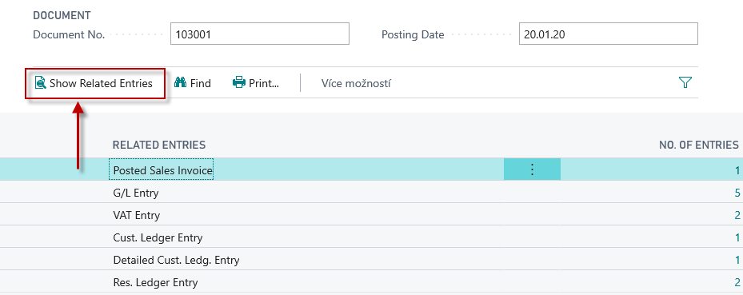
Navigation principle
So you don't get lost
in a sea of data .

Slide 21
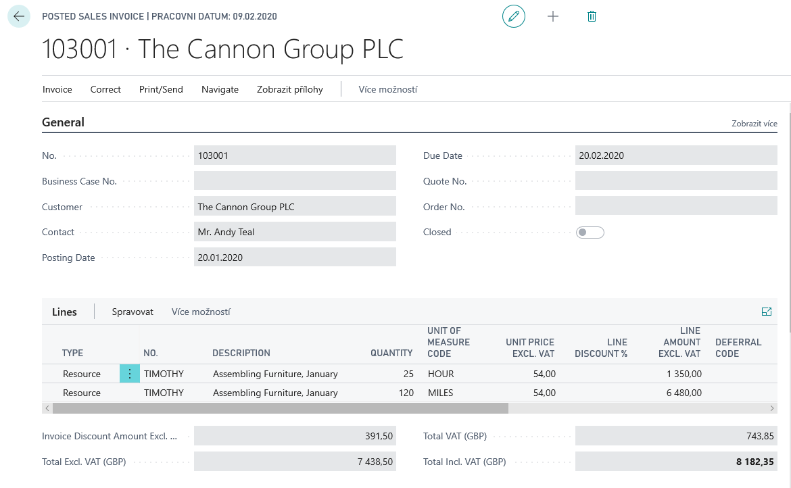
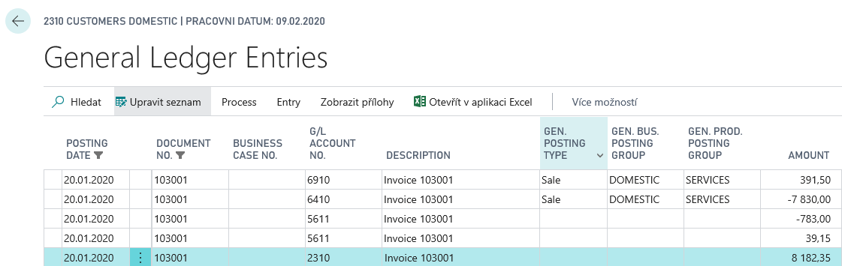
Navigation principle

Slide 22
Flow field –Calculated field (balances, quantity of items in inventory,..)
Amount =1
Amount =2
General Ledger Entries
Amount =3
General Ledger Account
Amount =-4
4
Minus means Credit side of the account
Balance = 2 = (1+2+3-4)
G/L AccountCustomer card
It is a calculated field, but is not stored in the database. Each time a new window is opened in which there is an option to display this calculated field, the amount displayed in this field is recalculated every time

Slide 23
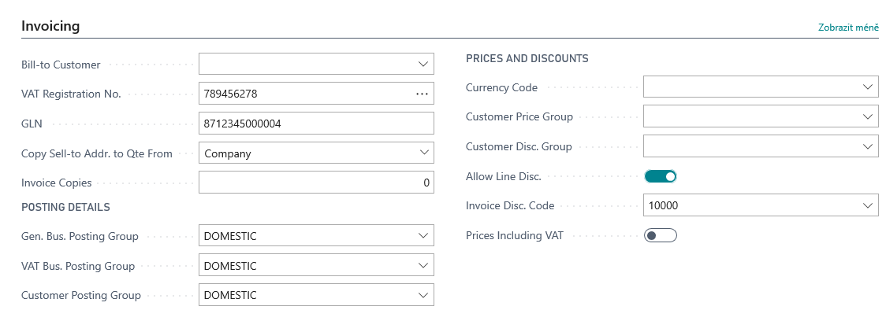
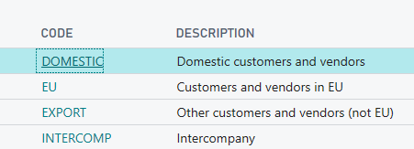
Other important Customer Card tabs
It is about the way of pre-accounting, i.e., how the amounts will be posted to the general ledger automatically by setting these parameters

Slide 24
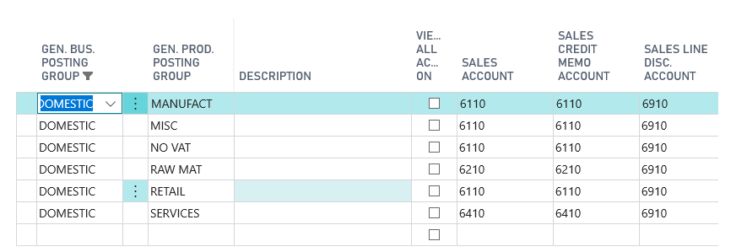
Setup and purpose of General Business Posting Group codes
Customer card
Domestic
Sales Order Header
Sales Order Line
Item card
The result of a combination of two codes from the customer and Item cards (DOMESTIC & RETAIL)
Retail

Slide 25
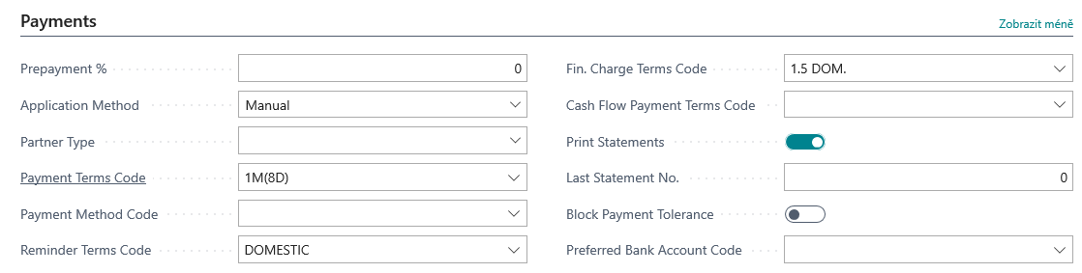
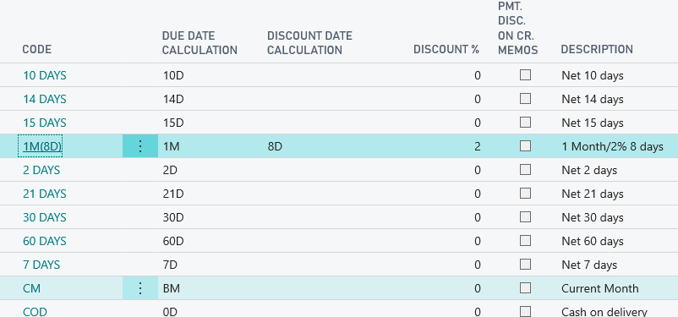
Other important Customer Card tabs
14D = 14day
2W = 2 weeks
M= 1 month
2Y = 2 Year
Formula date
See next slide

Slide 26
Formula date
Enables you to enter the duration of each period. The start and end date of this period is specified by the process logic. For example, if we post an invoice on January 1, 2022 and the customer has a Payment Condition (Payment Term Code)within 14 days (14D or otherwise also 2W ), the end of the period will be January 14, 2022.
And the invoice will be overdue on 15.1.2022

Slide 27
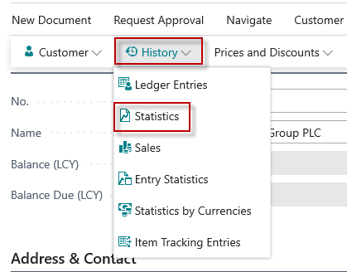
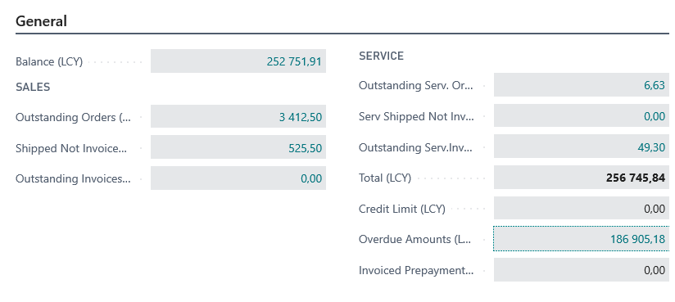
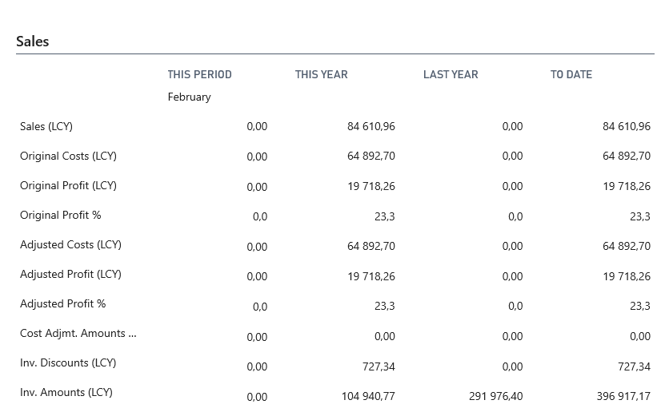
Customer card Statistics (F7)
Ctrl-F7 – Customer Ledger Entries

Slide 28
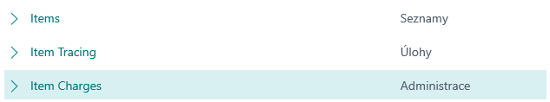
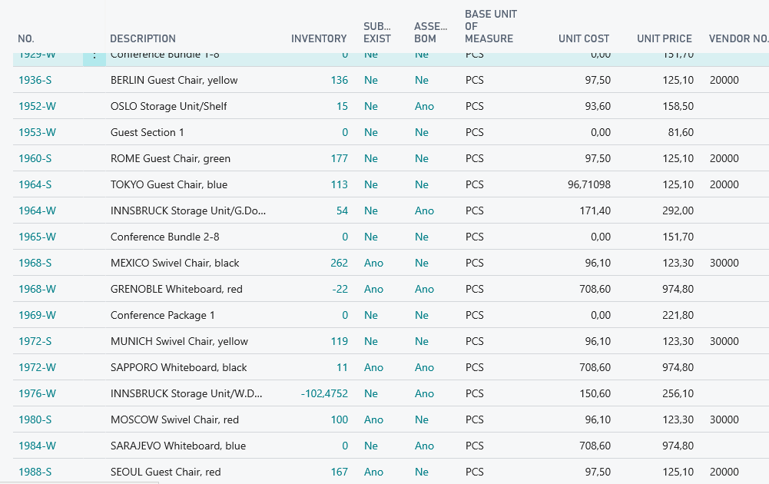
Inventory and use of filters (to get faster required information)
Searching window
Basic filter will be presented by tutor
Lists
Tasks

Slide 29
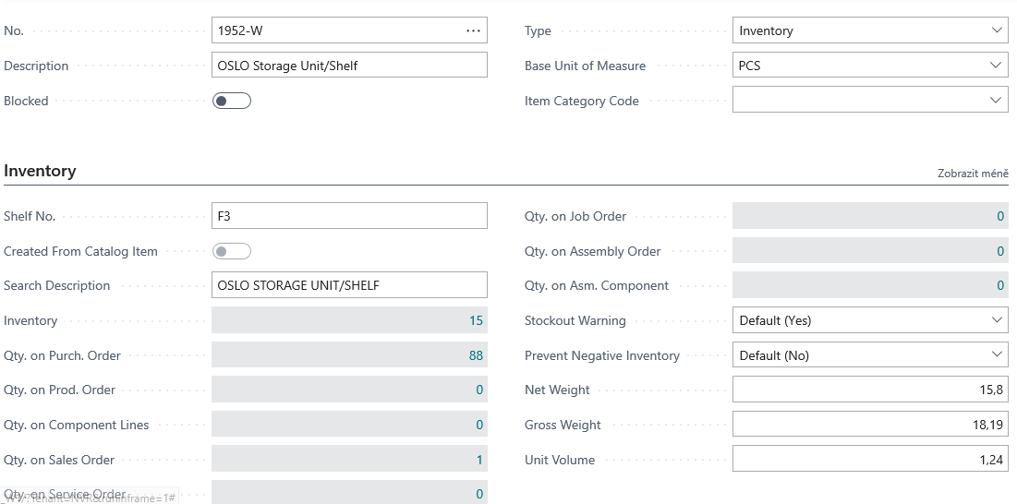
Item card (main tab)
Flow field
(Calculated field)

Slide 30
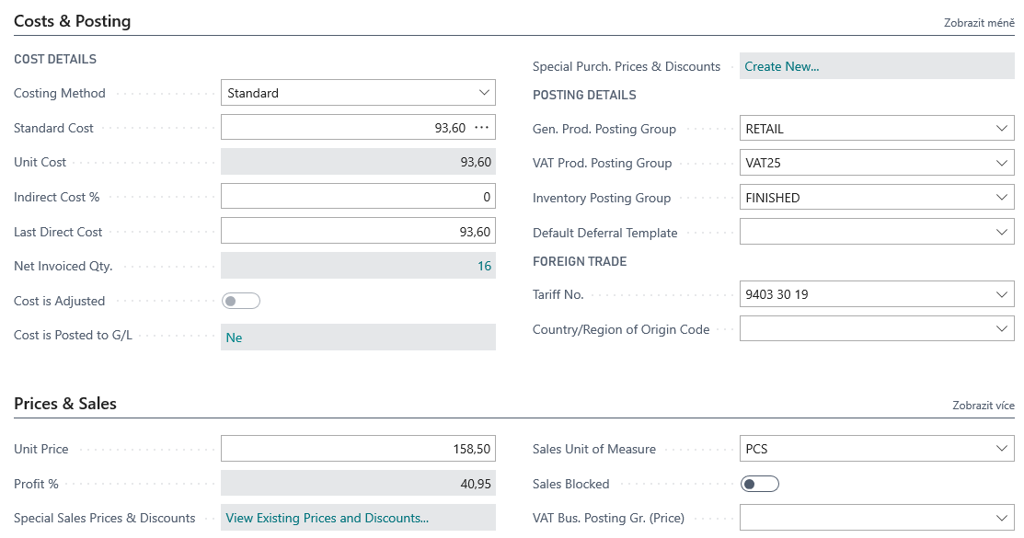

Item card- Cost and Posting tab: Price and Sales
Other options see

Slide 31
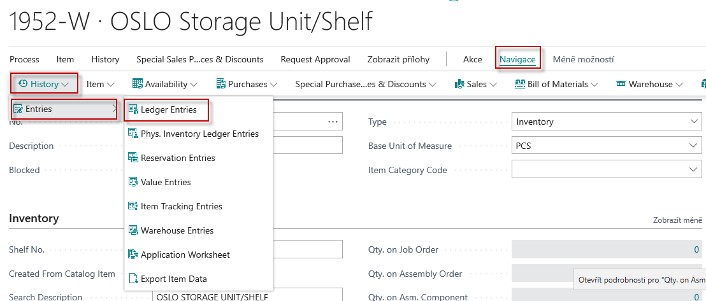
Item Ledger Entries – how to get there (older version of database)

Slide 32
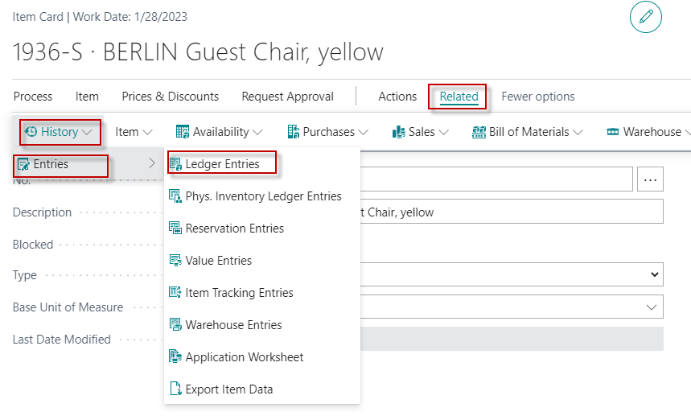
Item Ledger Entries – how to get there (newer version of database-our case)

Slide 33
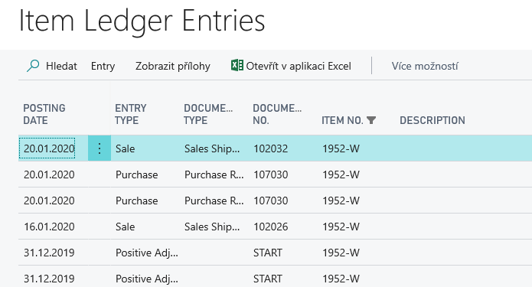
Item Ledger Entries
Navigate function will be shown by tutor
on this screen
Other tabs will be presented later in this course

Slide 34
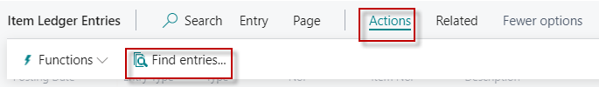
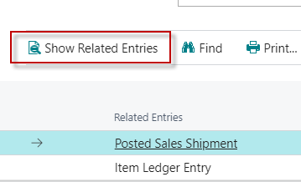
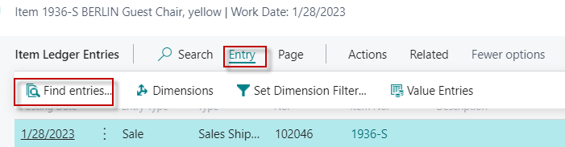
Navigate from Item Ledger Entries card
OR

Slide 35
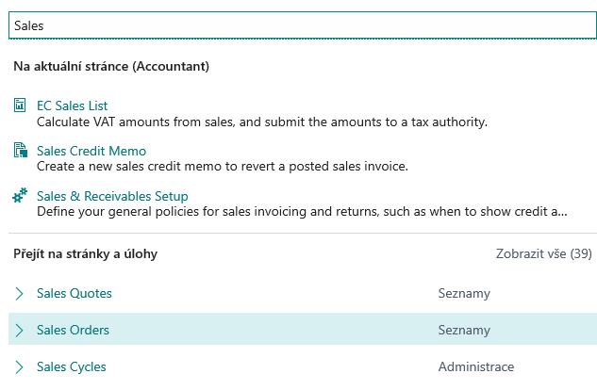
Sales order creation (creation of demand)
Searching window
Lists
See next slide
Lists

Slide 36
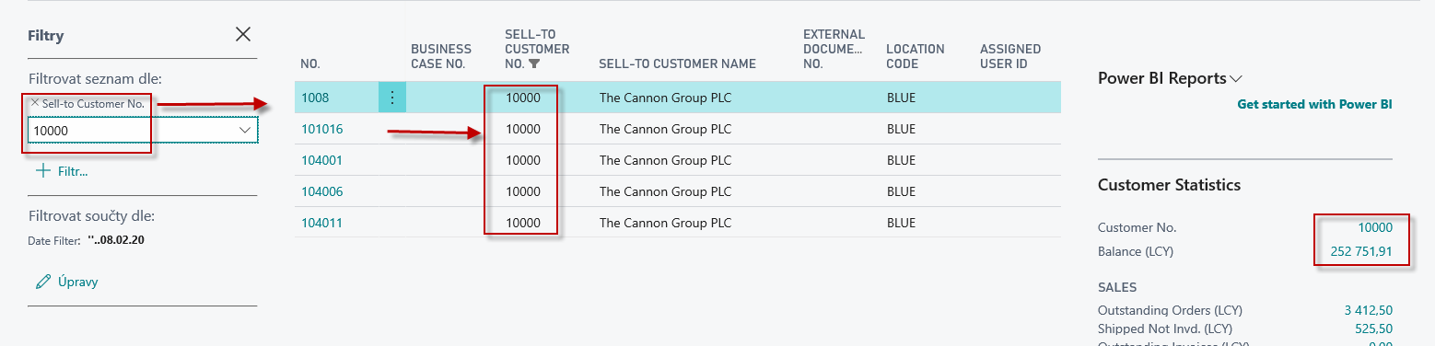
List of already created Sales Orders –SO (filtr applied)
New SO created by use of icon NEW or key combination Ctrl-N
See next slide

Slide 37
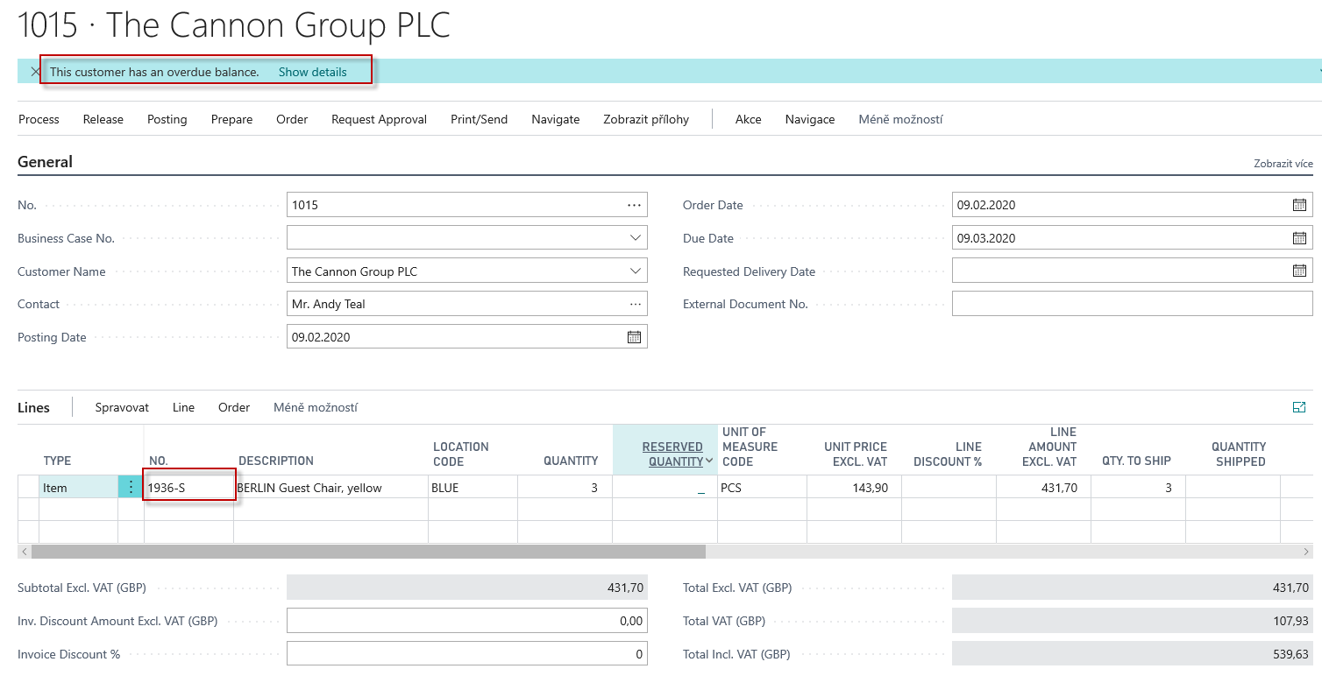
New Sales Order (SO)
SO Header
SO Lines

Slide 38
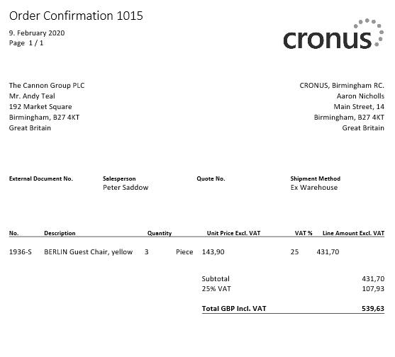
Printed confirmation of SO – preview (icon Print/Send)

Slide 39
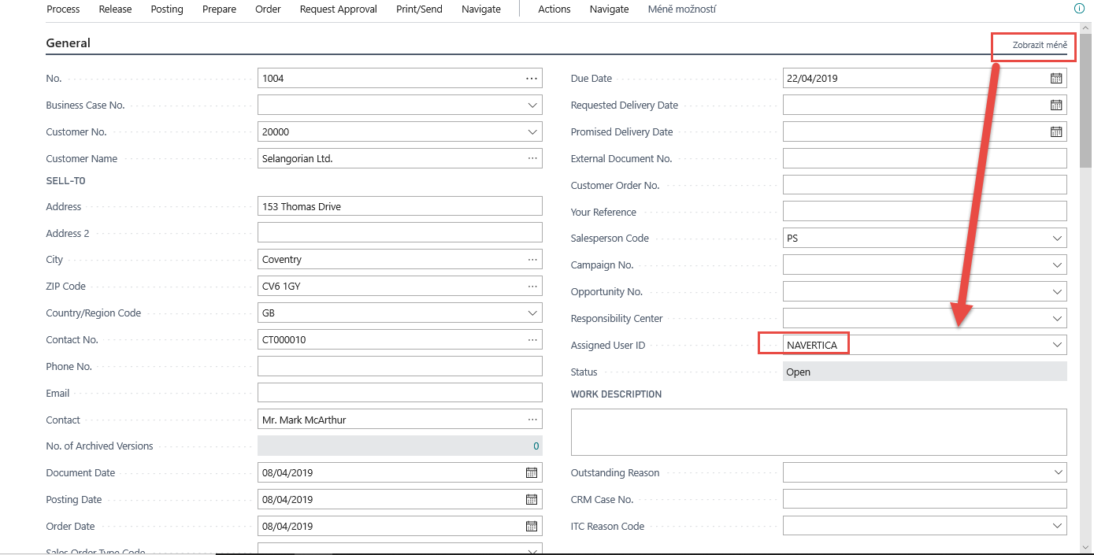
Assigned user ID
Show less

Slide 40
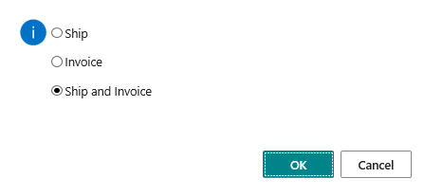
F9 – Posting key (simplest way)

Slide 41
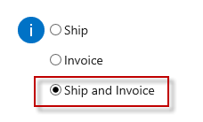
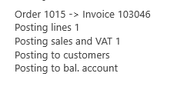

Post SO (Icons Posting->Post document)
Customer Card
Chosen method
Sales Order Header
Sales Order Line (s)
Item card
Customer Ledger Entries
Item Card->Action->History->Entries
Item Ledger Entries

Slide 42



Impacts in General Ledger - basic ERP principles
Credit ->sign =minus, Debit ->sign=plus -> Syntax

Slide 43


