Slide 1
Business Central Introduction-principles
Ing.J.Skorkovský,CSc.
Department of Business Management
Faculty of Business and Administration
Masaryk University Brno
Czech Republic

Slide 2
Roadmap – areas - repetition to refresh from the last class.
Functional Consultant - Some of the areas in which an ERP consultant can offer its services due to its expertise
Service Management
Sales and Purchasing
Financial Management
Marketing (CRM) – CRM =Customer Relationship Management (CRM) is a strategy that companies use to manage interactions with customers and potential customers
Production ( Manufacturing)
Warehousing

Slide 3
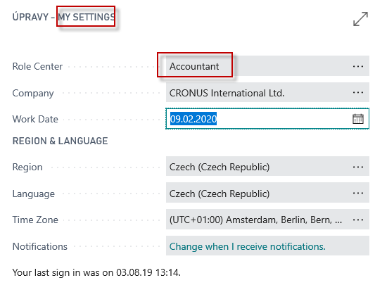
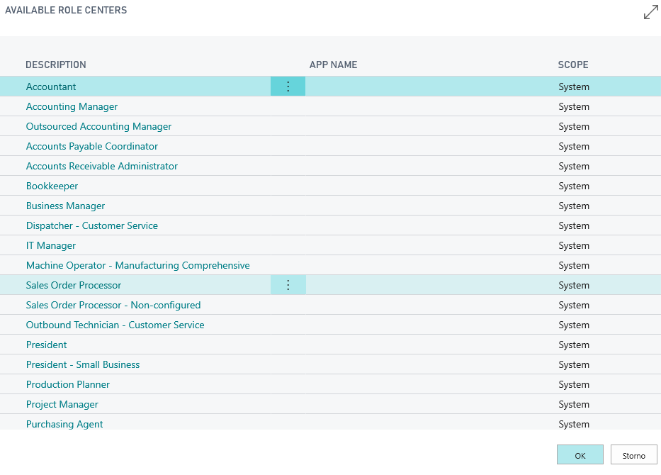
Access and roles – Role Tailored Client Principles
MY SETTING
Our setup for most of the model
is a role called Sales Order Processor

Slide 4
Basic functionalites for chosen role

Slide 5
Basic activities
Display more
Display more
Display more
Each of the icon shows the most important activities of the logged-in user.

Slide 6
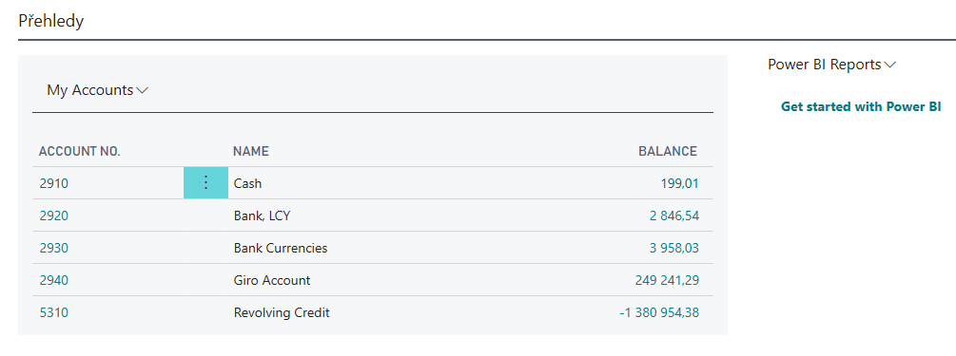
Basic summary (overview, survey)

Slide 7
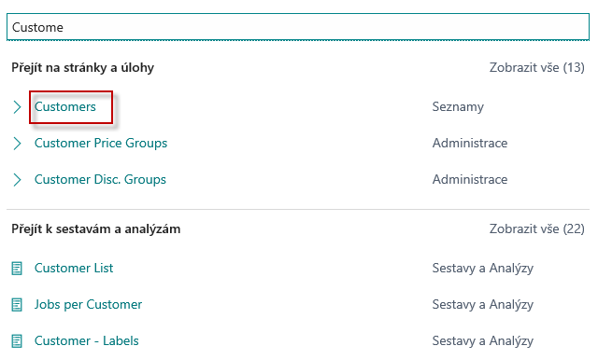
Business Partners (Customers, Vendors, Banks )
Use of searching window – full text searching
Tell me what you want to do
Customer
Show all in English
Lists
Show all in English
Reports and Analysis

Slide 8
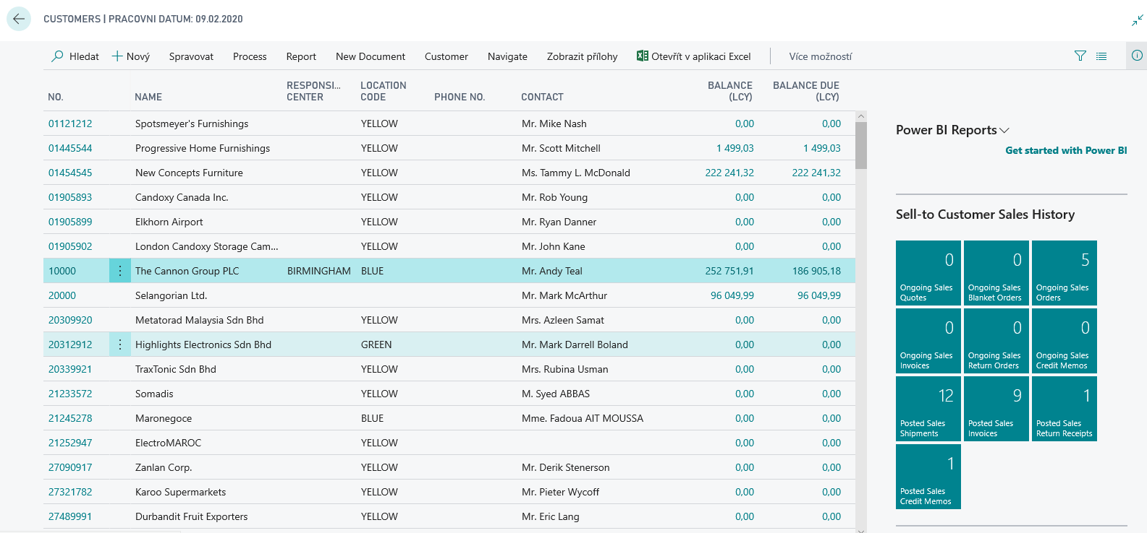
Customer List and card (form type list)

Slide 9
Customer first tab ( part of form type card)
CTRL-F7
The balance is essentially the sum of the amounts
on the posted documents that have not been balanced
(e.g. by payments or credit notes).
It is a so-called calculated field, which is also called a flow field.
It is a virtual field type that is calculated in the background
from the entries (transactions) that represent the documents
posted in the system. This figure is not stored on disk (storage medium) .
Customer Ledger Entries
Keyboard shortcut used to view the entry (transaction)
This keyboard shortcut is used everywhere
in the system to view chosen entry.

Slide 10
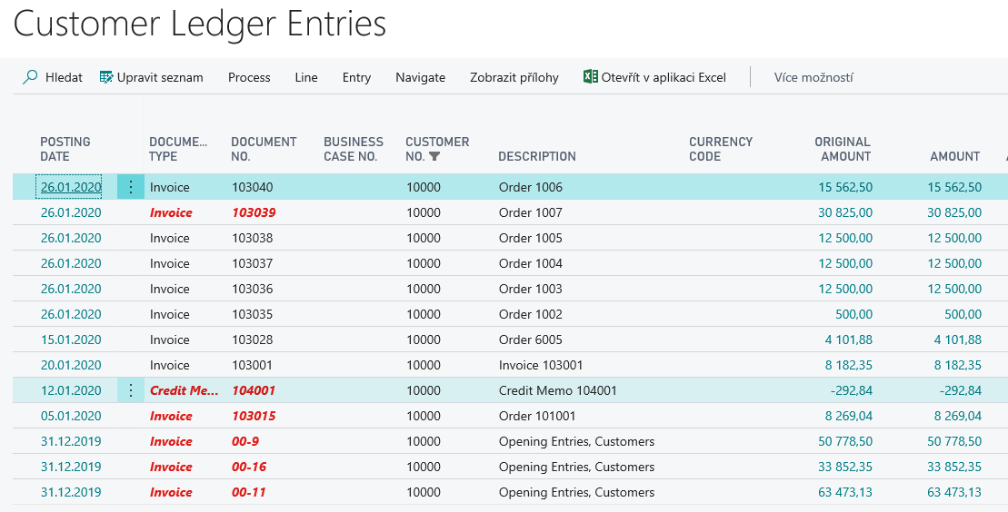
Customer Ledger Entries (created transactions)

Slide 11
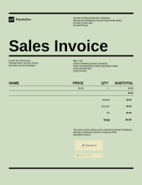
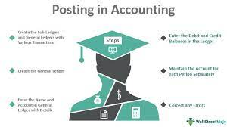
Cause and effect and the other way round
Data in many fields
Navigation ¨FIND ENTRY
Entries _transactions in General Ledger
Entry _transaction in Customer
Ledger Entry
Navigation – in BC calls FIND ENTRY
Data in many fields

Slide 12
Navigation – actual Business Central version in ESF

Slide 13
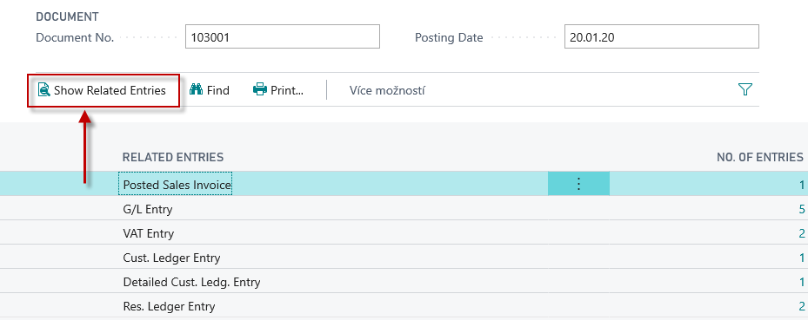
Navigation (Fined Entry) principle

Slide 14
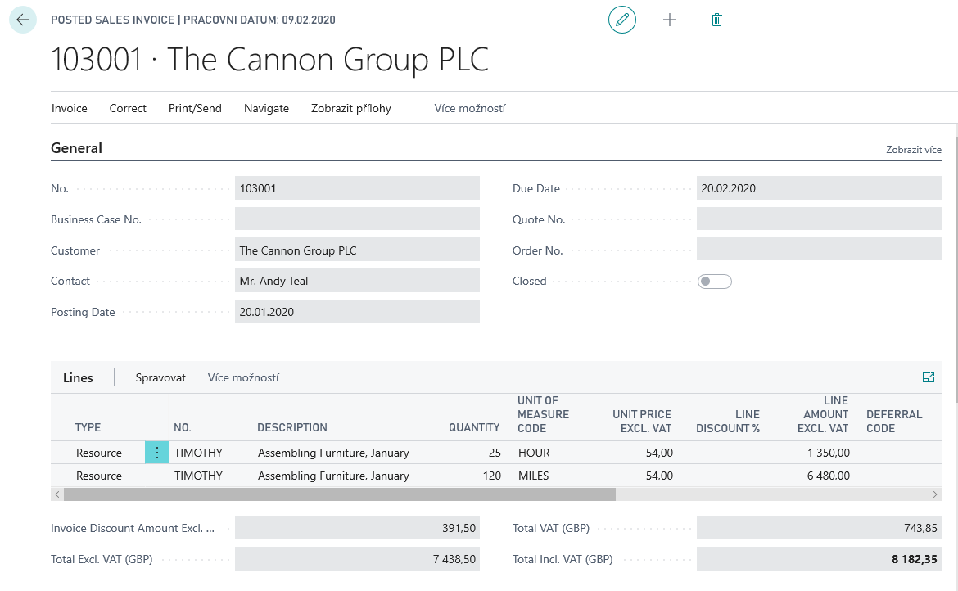
Navigation (Find Entry )principle

Slide 15
Flow field (G/L balance, inventory,…..)
Amount =1
Amount =2
Customer Ledger Entries
Amount =3
Amount =-4
Balance = 2 = (1+2+3-4)
Customer card
Calculation (plus sign = Debit amount, minus sign = Credit Amount)

Slide 16
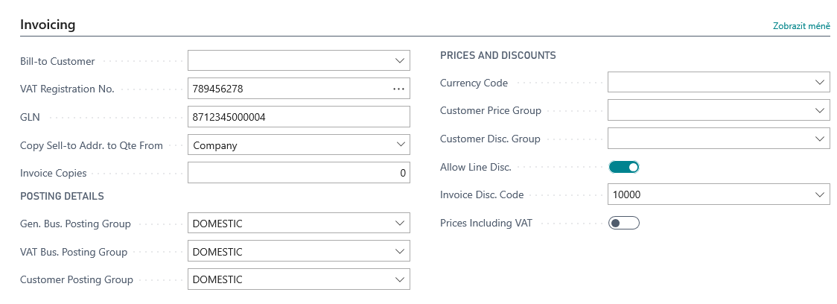
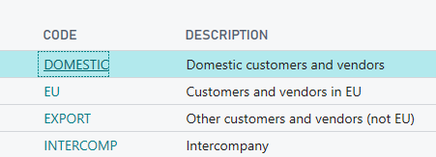
Other important Customer Card tabs

Slide 17
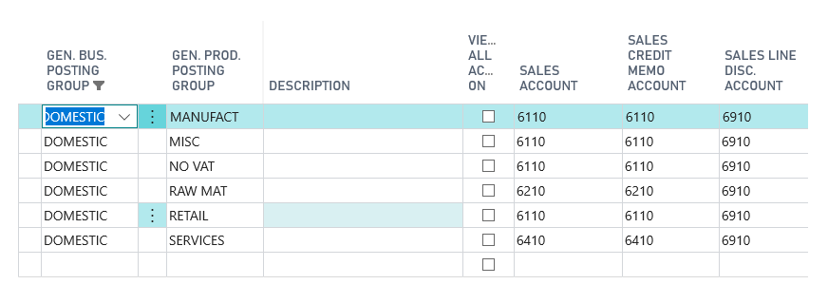
Setup and purpose of General Business Posting Group codes
Customer card
Domestic
Sales Order Header
Sales Order Line
Presetting General Ledger Accounts where all transaction related tu business cases are posted (booked)
Item card
Retail

Slide 18
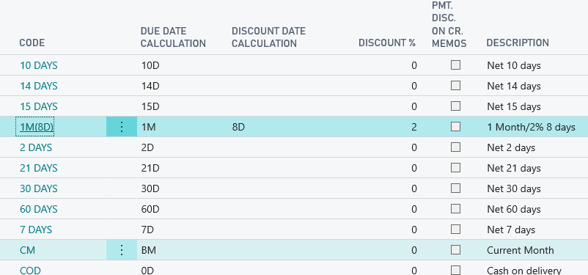
Other important Customer Card tabs
The relevant discount in case we pay the customer
within 8 days or earlier is then posted and can
be seen with the help of Customer Detailed Entries
(will be presented in extra PWP presentation later)

Slide 19
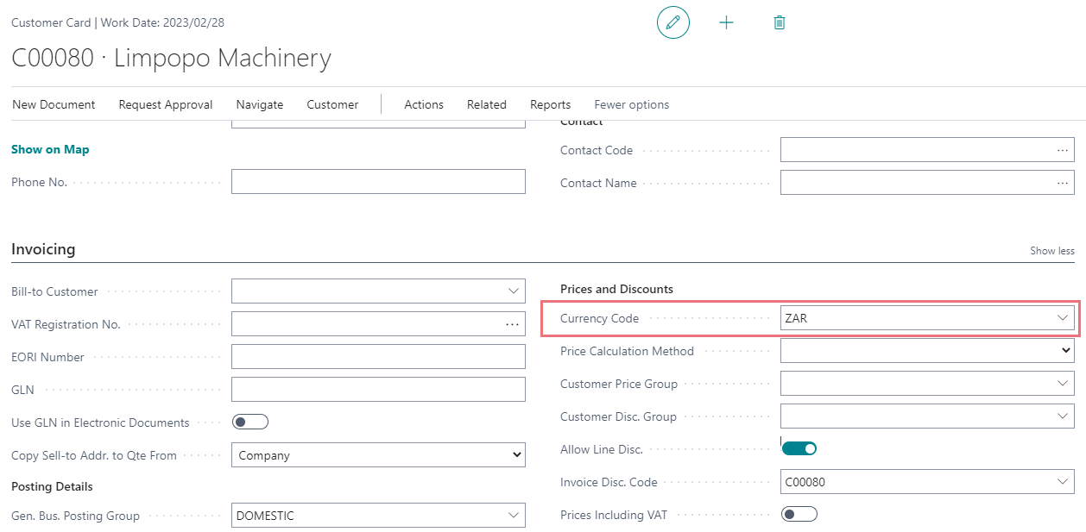
Other important Customer Card tabs

Slide 20
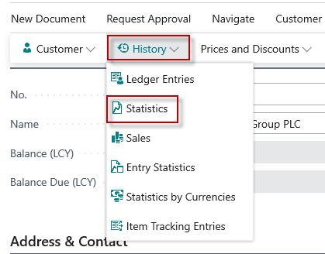
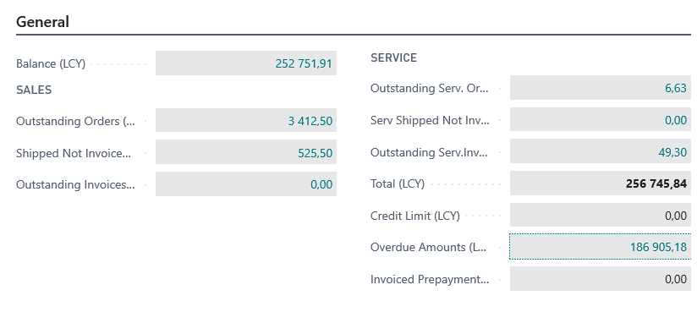
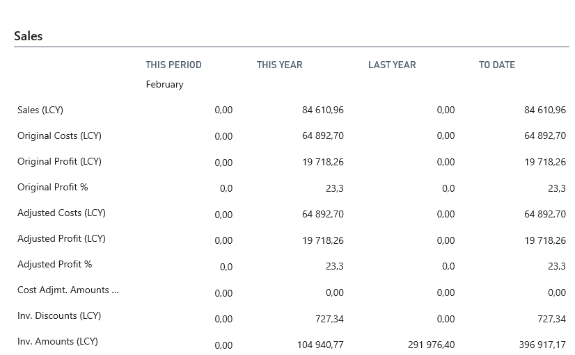
Customer card statistics (Card->F7 key->Statistics)

Slide 21
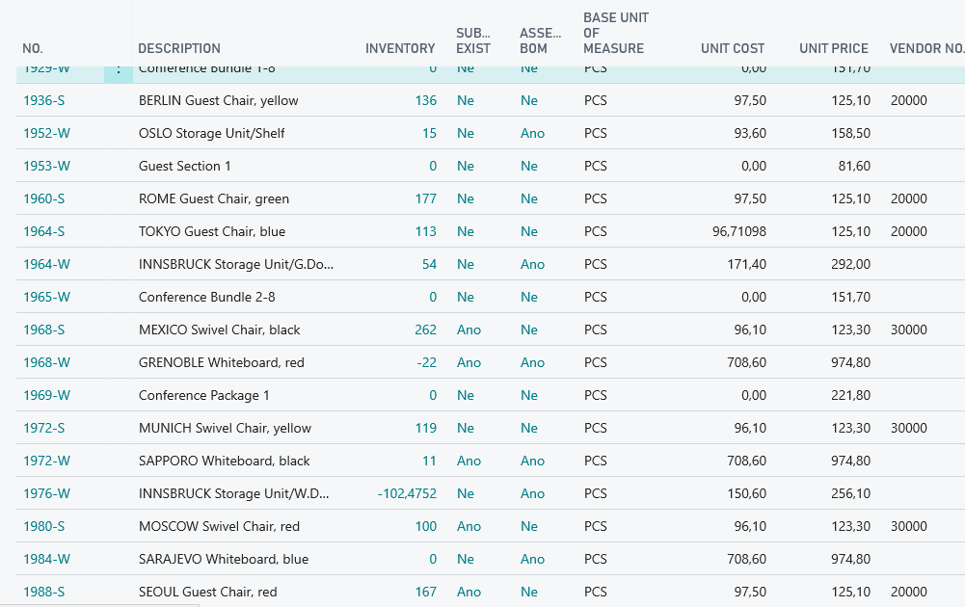
Inventory and use of filters
Searching window
Basic filter will be shown by tutor here
Lists
Tasks

Slide 22
Filters rules
Entering Criteria in Filters - Business Central | Microsoft Learn

Slide 23
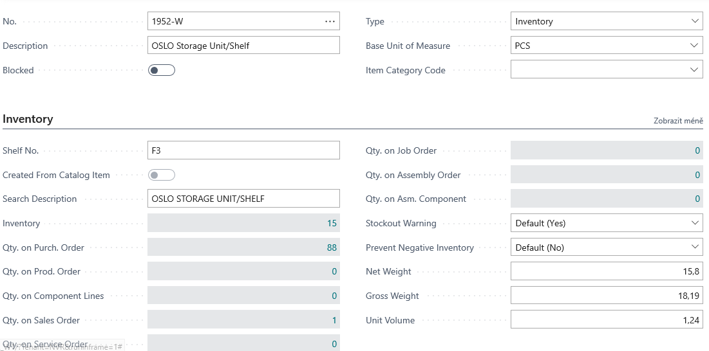
Item card
Flow field
At the moment of opening the item card window, this number displays how much of the selected item we actually have in stock

Slide 24
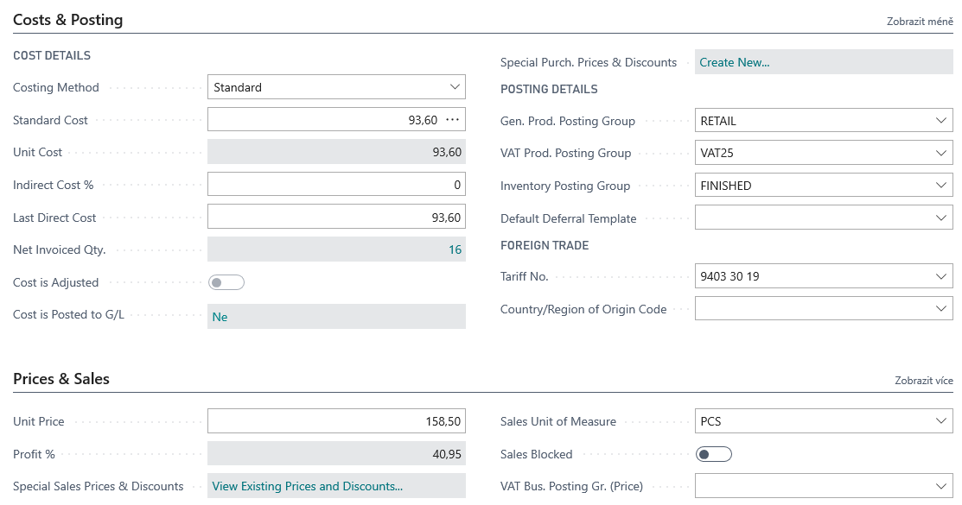
Item card- Cost and Posting :Price and Sales
Other options see

Slide 25
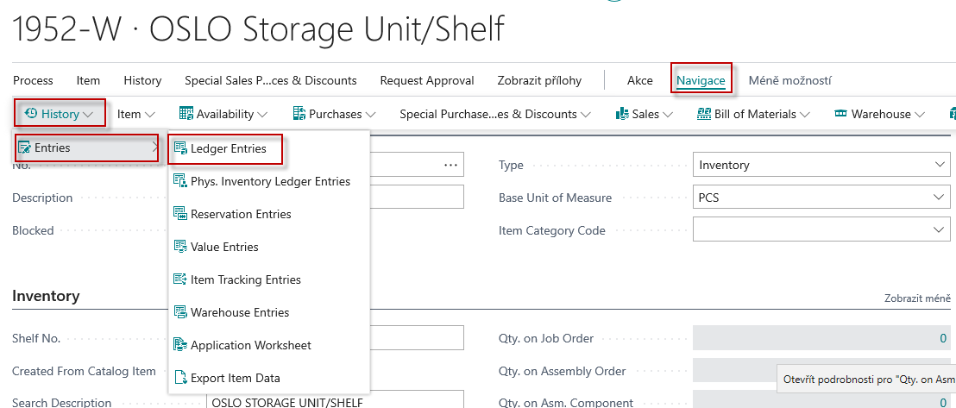
Item ledger Entries – how to get there (or keyboard shortcut Ctrl-F7)

Slide 26
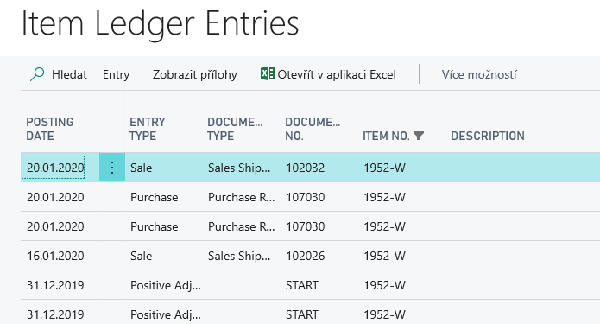
Item Ledger Entries
Other tabs will be presented during the essential Inventory Management section
Find Entries will be shown by tutor here

Slide 27
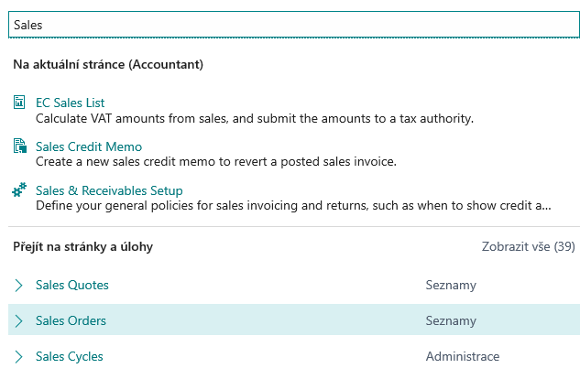
Sales Order Creation (creation of demand)
Searching window
See next slide
Lists
Lists

Slide 28
List of already created Sales Orders –SO (filtr applied)
New SO created by use of icon NEW
See next slide

Slide 29
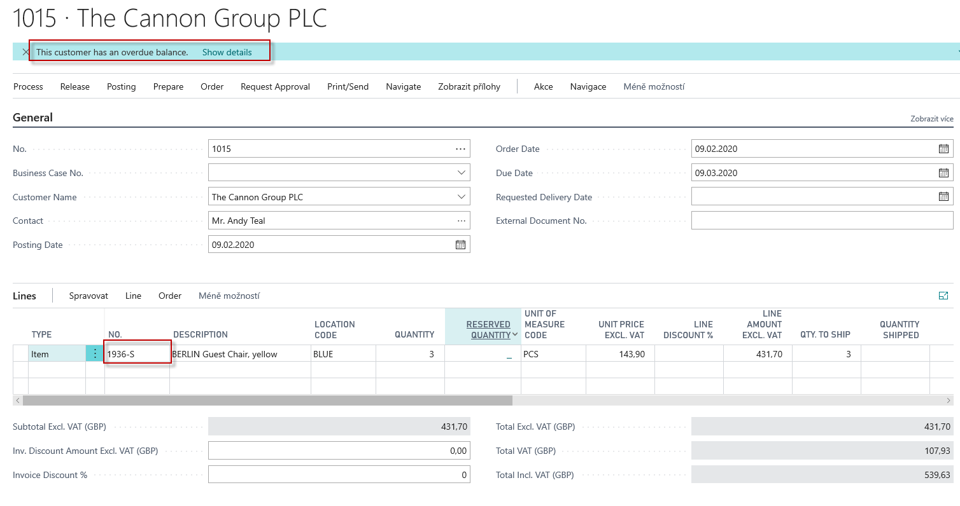
New Sales Order
Sales
Header
Sales Lines

Slide 30
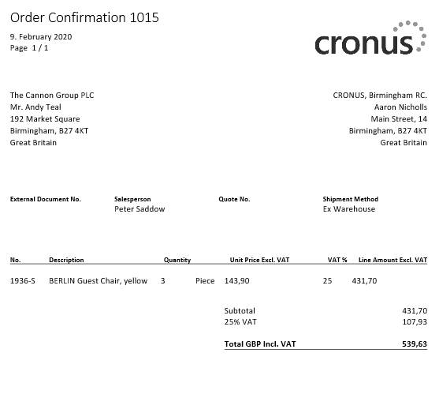
Printed confirmation of SO – preview (icon Print/Send)

Slide 31
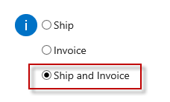
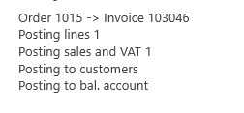
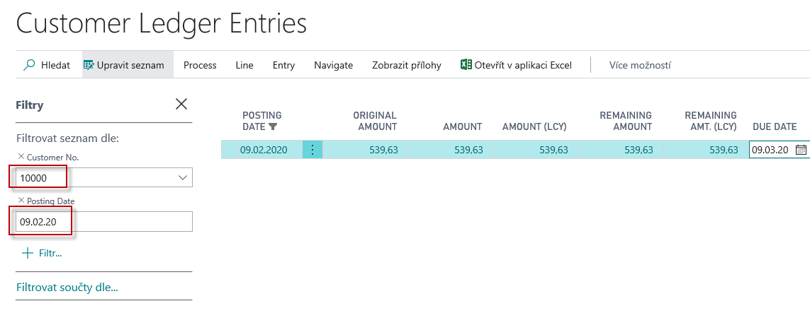
Post SO (Icons Posting->Post)
Customer card
Chosen method
Sales Order Header
Sales Order Line
Item card
Customer Ledger Entries
Item Card->Action->History->Entries
Item ledger Entries

Slide 32
Impacts of posting Sales Order in General Ledger
BC Syntax
Credit ->sign =minus, Debit ->sign=plus

Slide 33
Thank you for keeping a watchful eye

