Slide 1
Business Central Introduction Applying Item Ledger Entries
(ERP=Microsoft Dynamics 365 Business Central)
Miki Skorkovský
Navertica | Masaryk University

Slide 2
Basic principles of Applying
Purchase of 10 items xxx at cost 10 at time t
2. Purchase of 10 items of items xxx at cost 20 at time t+1D (later)
3. Selling 12 items of items xxx at time t+2D
Cost of Good Sold = 10 x 10 + 2x 20 = 140 - applied (balanced)
according to FIFO principle
FIFO applying of item ledger entries is carried out as in Costing
Method =FIFO and in Costing Method =Average

Slide 3
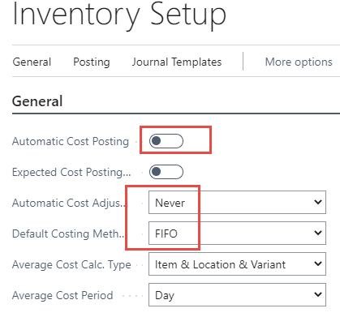
The settings that allow the example to run smoothly
Cost adjustment will be processed manually
Specifies if value entries are automatically posted to the inventory account,
adjustment account, and COGS account in the general ledger when an item transaction is posted.
Alternatively, you can manually post the values at regular intervals with the Post Inventory
Cost to G/L batch job.
Note that costs must be adjusted before posting to the general ledger.

Slide 4
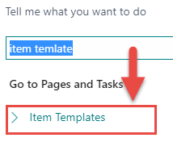
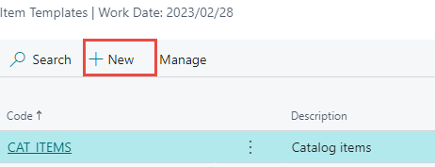
New item template to create new item

Slide 5
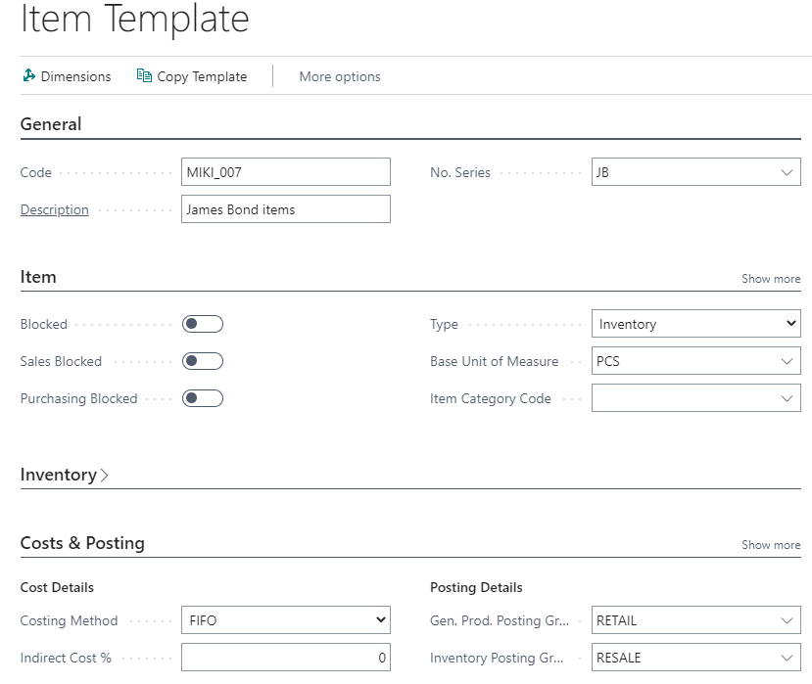
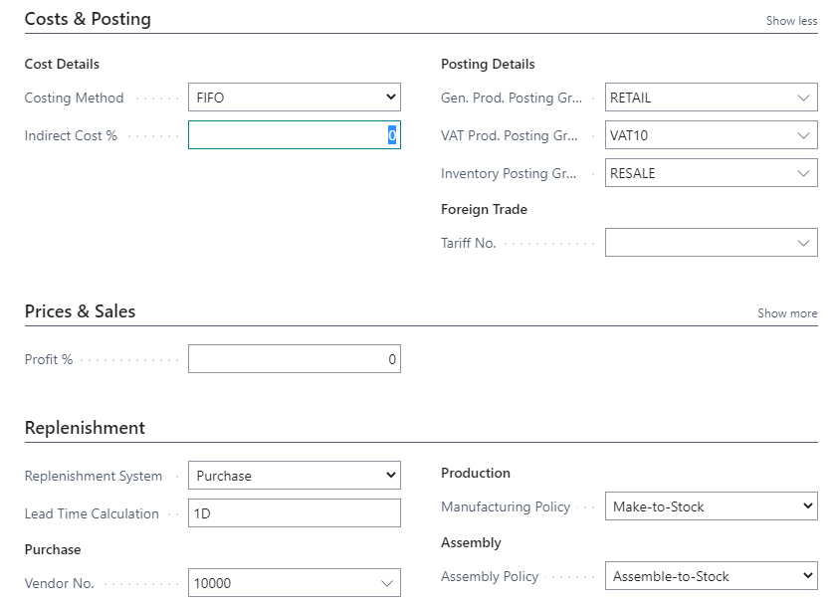
Item template (Creation would be part of the course)

Slide 6
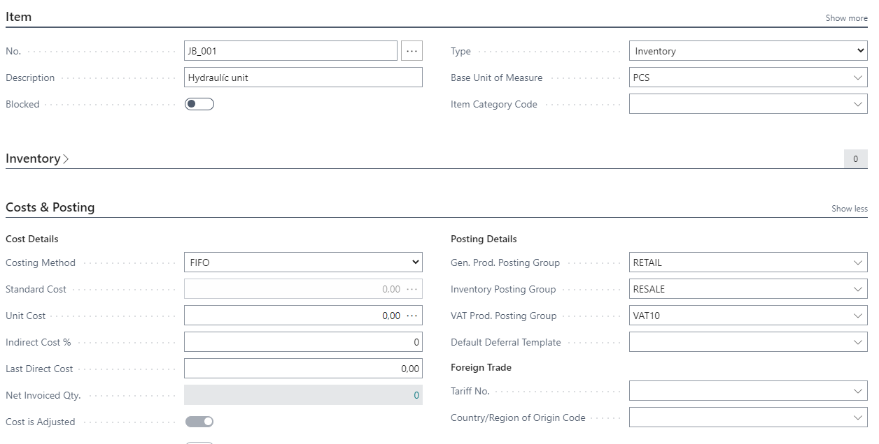
New item created
Item -list->New->selected template-> OK-> Unit Price = 40

Slide 7
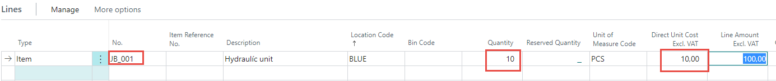
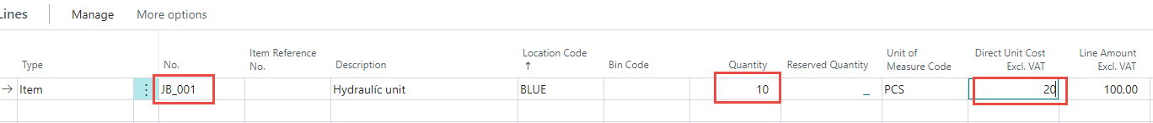
Two purchase orders (only purchase line shown before posting by F9)
See next slide
2 x F9
It could be replaced by item journal as well

Slide 8
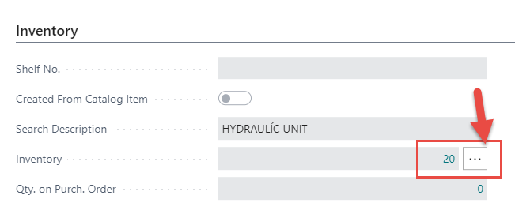
Item ledger entries
Item card JB_001

Slide 9
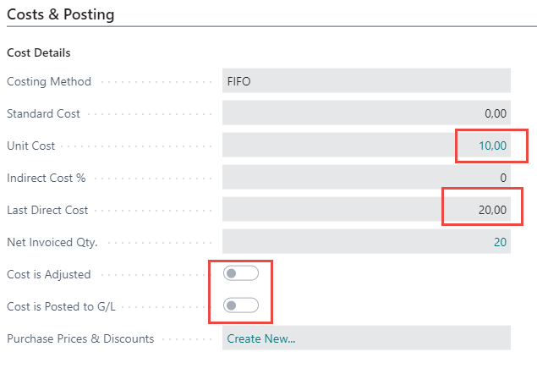
Costs and Posting
Click
Adjustment did not take place so far

Slide 10
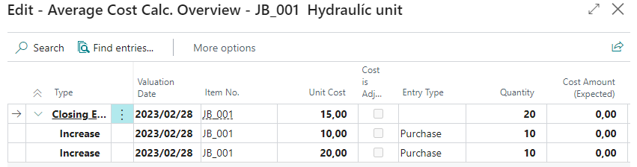
Average cost calculation overview after Purchases only
Click
10 x 10 a 10 x 20 =300 and 300/20=15

Slide 11
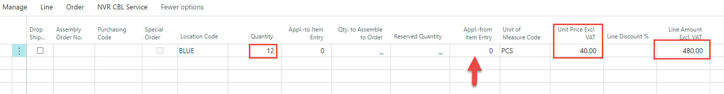
Selling 12 pcs of our model item (only sales lines shown partly)
Push F9 to post Sales order

Slide 12
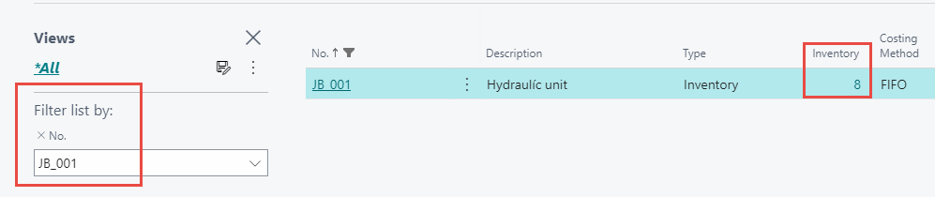
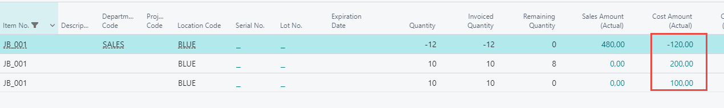
Item ledger entries (ILE) after selling 12 pcs
Item card JB_001
Ctrl-F7
Cost actual =120=10 x 10 + 2x 10 and it's supposed to be 140=10 x 10 + 2x 20
1st ILE
2nd ILE
Unit cost and the Cost & Posting tab are still valued at 10

Slide 13
Average cost calculation overview after subsequent selling of 12 pcs
100+200=300 =original cost after two purchases
300-12x10=180 = new cost after selling 12 pcs (used average cost)
180/8=22,50 = average cost after selling 12 pcs
10+10-12 = 8

Slide 14
Inventory Cost Adjustment principles
The posting process takes two stages
Inventory Ledger
Item Purchases and Sales, Inventory Adjustment, Transfers, Consumption and Output types of Inventory ledger entries
Other Direct and Indirect Costs, Revaulation and Rounding
1st stage
Item Ledger Entry
Value Entries
Post Inventory Cost to G/L batch job
2nd stage
G/L Entries

Slide 15
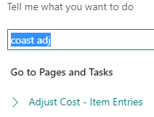
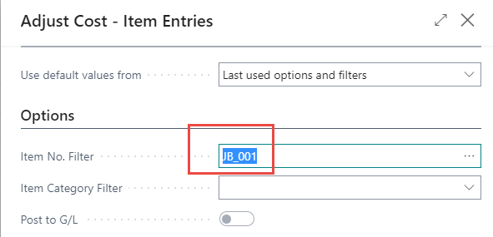
Manual cost adjustment 1st stage

Slide 16
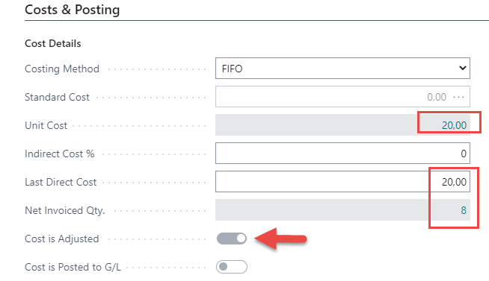
Item card after cost adjustment
Click
The second item (same number) was purchased for 20 and has not yet been balanced by other sales

Slide 17
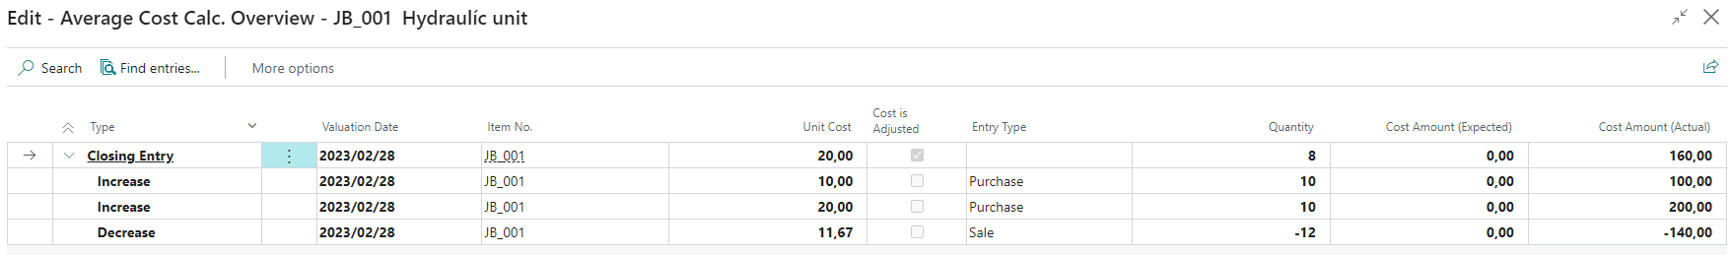
Item card after cost adjustment
100+200=300 =original cost after two purchases
300-(10x10 + 2x20)= 300-140 =160 = after new cost adjustment
160/8=20 = new cost
Cost of Good Sold = 140/12=11,67 per one pc of JB_001
The sale was carried out for this amount

Slide 18
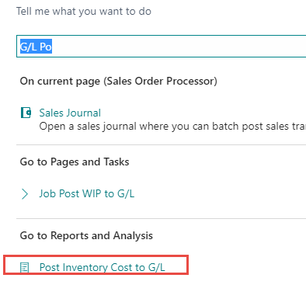
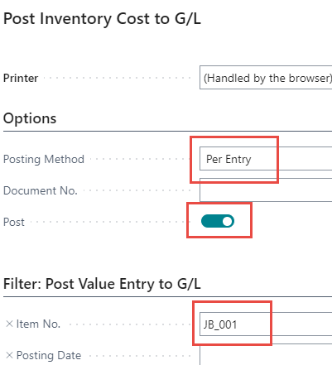
Posting inventory cost to General Ledger

Slide 19
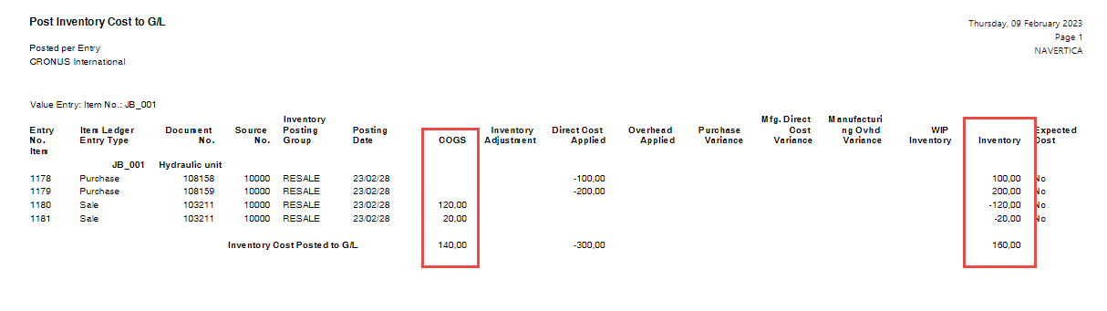
Results

Slide 20
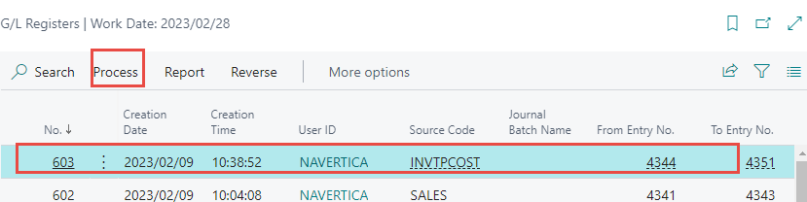
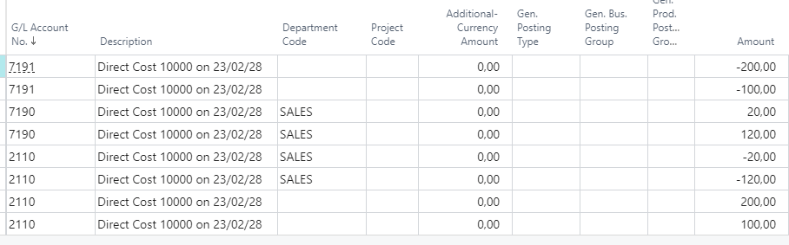
G/L Registers->Archive

Slide 21
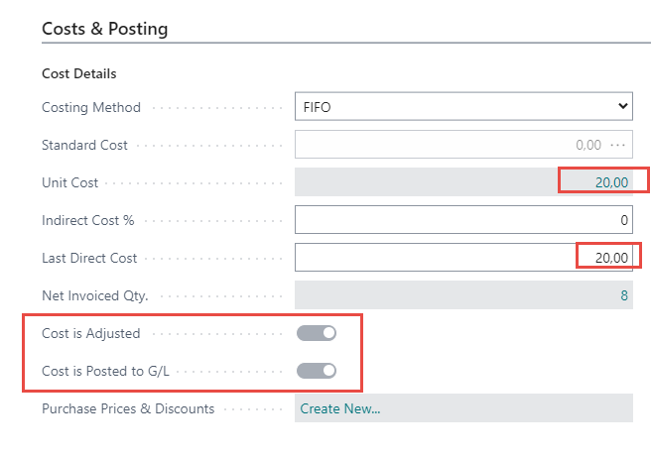
Item card

Slide 22
Another example
(use of item journals)

Slide 23
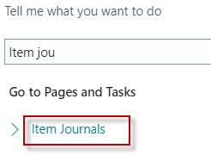
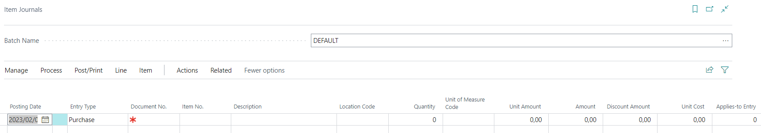
Access to Item Journal

Slide 24
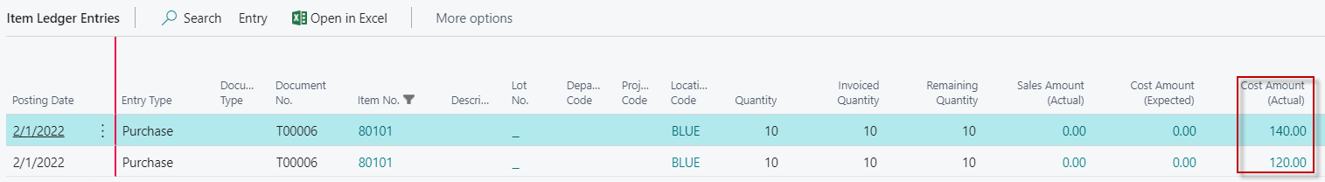
Applying Item Ledger Entries
Purchase of the brand new item by use of item journal with different Cost Amounts
Preparation of data for modelling
the applying of item ledger entries with different acquisition costs
F9

Slide 25
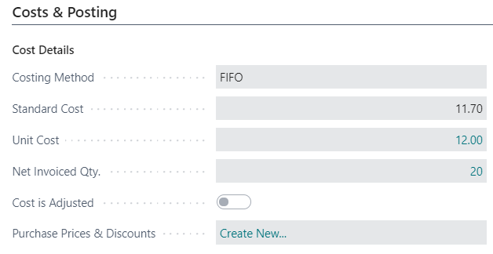
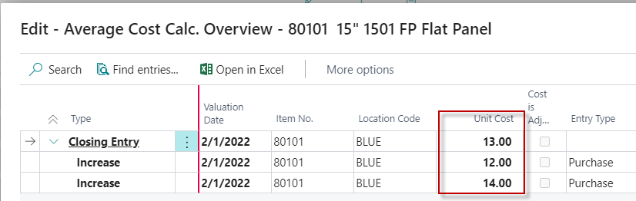
Item card and average cost calculation overview

Slide 26
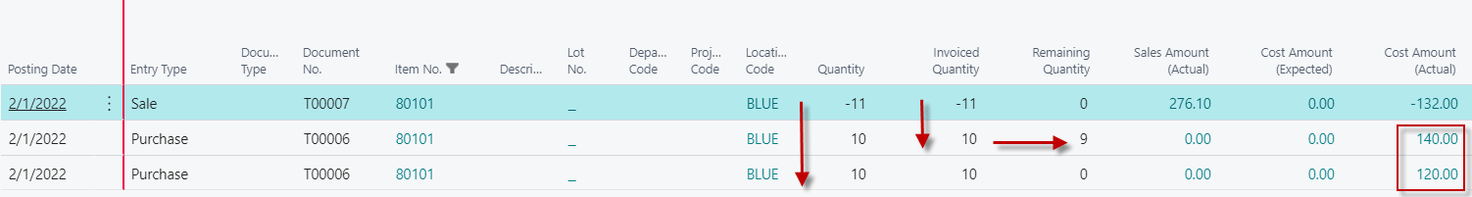
Selling 11 pcs of our item 80101 by Item journal
F9
Cost of 20 pcs = (10 x 14) + (10 x 12) = 120 =260
FIFO principle od applying : 260 - 10x12 - 1x14 = 126 -> Average cost should be = 126/9=14 but see next slide
BC calculated cost as 11*12=132.

Slide 27
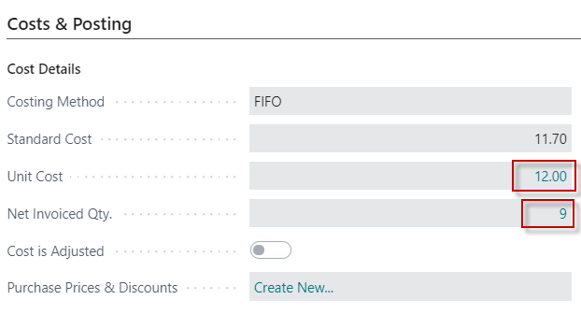
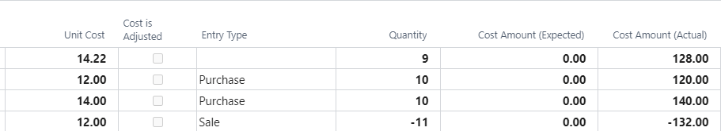
Item card and average cost calculation overview
It must be adjusted by use of adjust cost-item entries batch job !
260-132=128
128/9=14,22 !!!
Cost of 20 pcs = 140 + 120 =260 (see previous slide)
FIFO principle : 260 -10x12 - 1x14 = 126 ->Average cost should be = 126/9=14
BC calculated cost as 11*12=132.
discrepancy

Slide 28
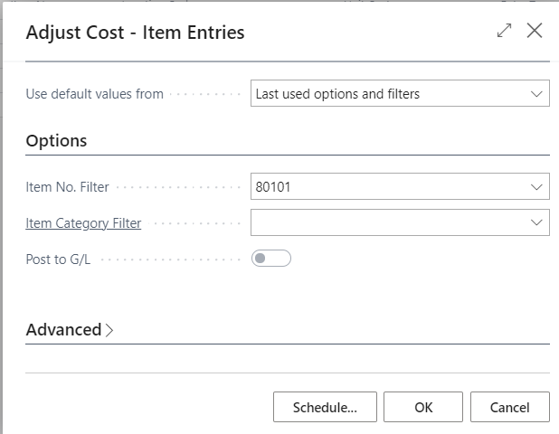
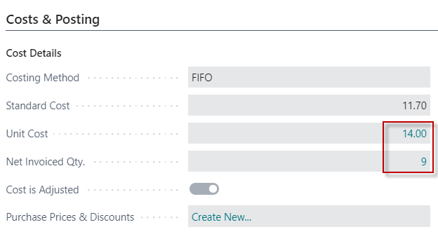
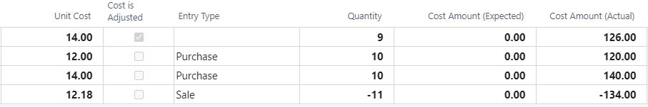
Adjust cost - item entries (manually)

Slide 29
Nulla dies sine gaudium !!!

Slide 30
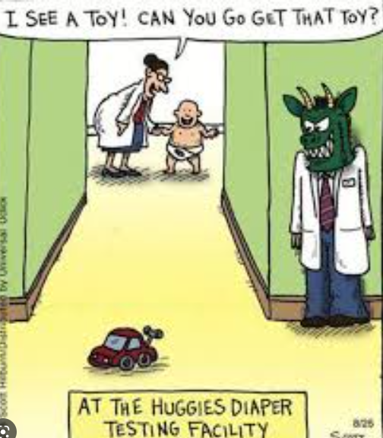

Slide 31
End of Business Central introduction IV

