Slide 1
Introduction to Busniess Central
(Customer Relationship Management)
Ing.J.Skorkovský,CSc.
MASARYK UNIVERSITY BRNO, Czech Republic
Faculty of economics and business administration
Department of corporate economy

Slide 2
CRM – Customer Relationship Management
PROs
  It enables us to keep track of all prospective customer (suspects and prospects)
  Improve sales and marketing service
  The company can promote the work it has done for its customers to approach prospects
CONs
  CRM software may not integrate well with other email and accounting systems
  Another disadvantage to a newly implemented CRM software is the learning curve.

Slide 3
CRM – Customer Relationship Management
Relationship management is a customer-oriented feature with service response based on customer input, one-to-one solutions to customers’ requirements, direct online communications with customer and customer service centers that help customers solve their issues.
Salesforce automation
  Sales promotion analysis
    Advertising
    Personal selling
    Direct marketing
    Public relations
  Automate tracking of a client’s account history
  Use of technology (ERP->MS Dynamics NAV)
Opportunity Management (see an extra picture related to so-called Business Rainbow)

Slide 4
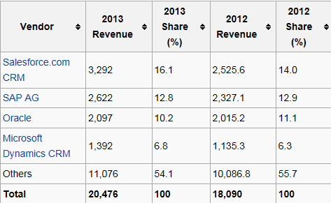

Market leaders (home study)
Although the table is somewhat old-fashioned, I can confirm that the importance of CRM is growing at an extreme pace
figures in millions of US dollars
Source:

Slide 5
Customer (Vendor)-Contact Cards
Customer card
Creation of Customer Card
Interactions
Interactions
Interactions
Contact card 1
Contact card 2
Contact card 3
Opportunity 1
Opportunity 2
Opportunity 3
Sales Cycle stages
Sales Cycle stages
Sales Cycle stages
Lost
Lost
WIN

Slide 6

Partially for MPH_AOPR - read frame only
Vendor
Statistic :
Costs/Revenue
Customer Ledger
Entries
Customer
Interaction
Log
Entries
Contact
Card
Salesperson
To-Do
Card
Profile (Contact properties)
(To-Do)
Assigned
activities
Statistics:
Interactions,
Sales Cycle stages,
Deal chances, Values,..
ABC (Pareto)
Analysis
Opportunity
Activity
code
Sales Cycle
Stages
Partial Activities
Interaction Log
Entries
Meeting /Telephone call
Stage number
Activity

Slide 7
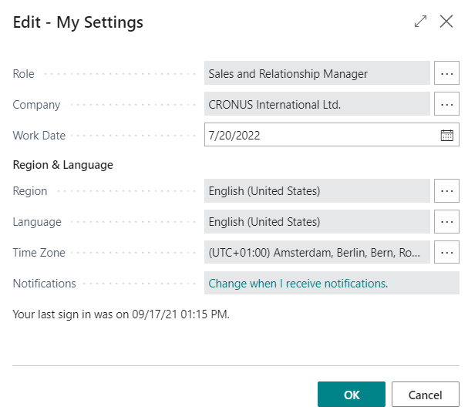
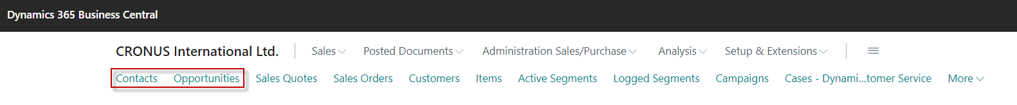

Slide 8
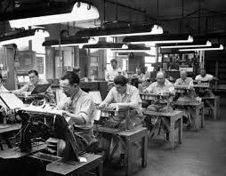
Contact cards
Contact card- company->Customer (Vendor)
Contact card- person -> Customer (Vendor)
Contact Character– profiles, technologies,..
Interactions (driven mostly by wizard) – telephones , meetings, presentations
Business Opportunities (estimated close date and value, probability,.. )
Sales Cycles activities (stages)
Customer Card creation from Contact card using templates
Quotes assigned to Contact cards
Interaction log entries

Slide 9
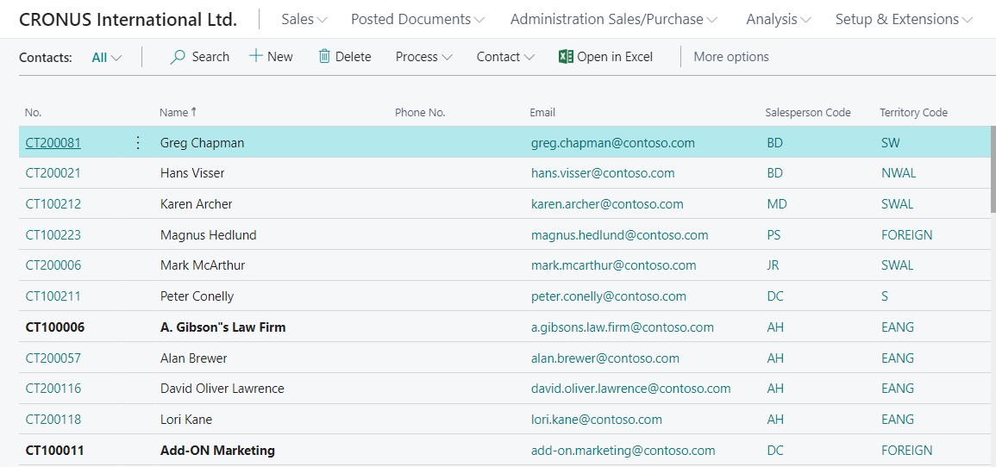
List of contact

Slide 10
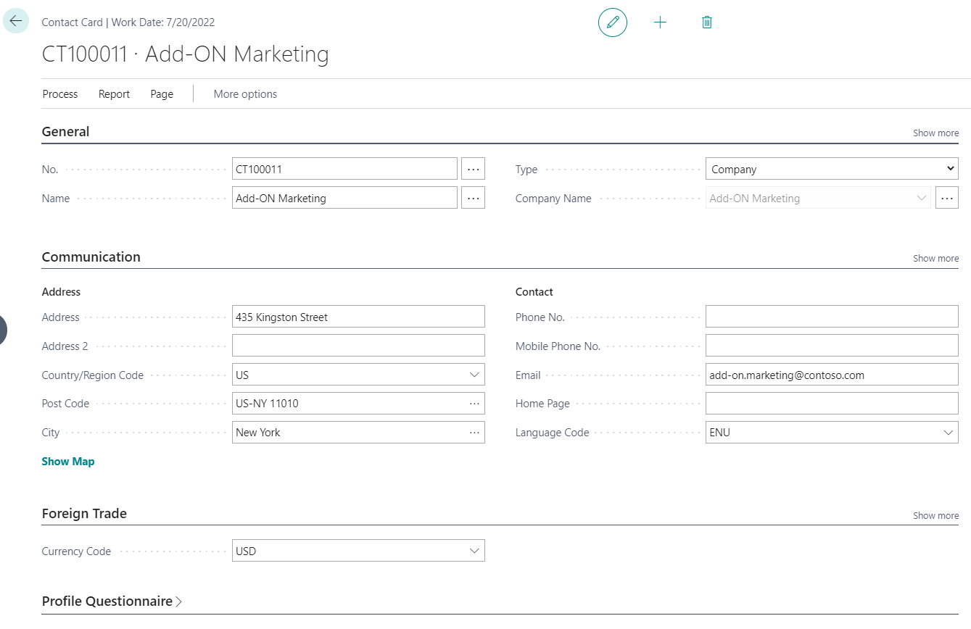
Contact card – company - (Header of the contact card)
Company Contact Card
Eric Clapton
Luciano Pavarotti
Paul McCartney
Contact persons type cards

Slide 11
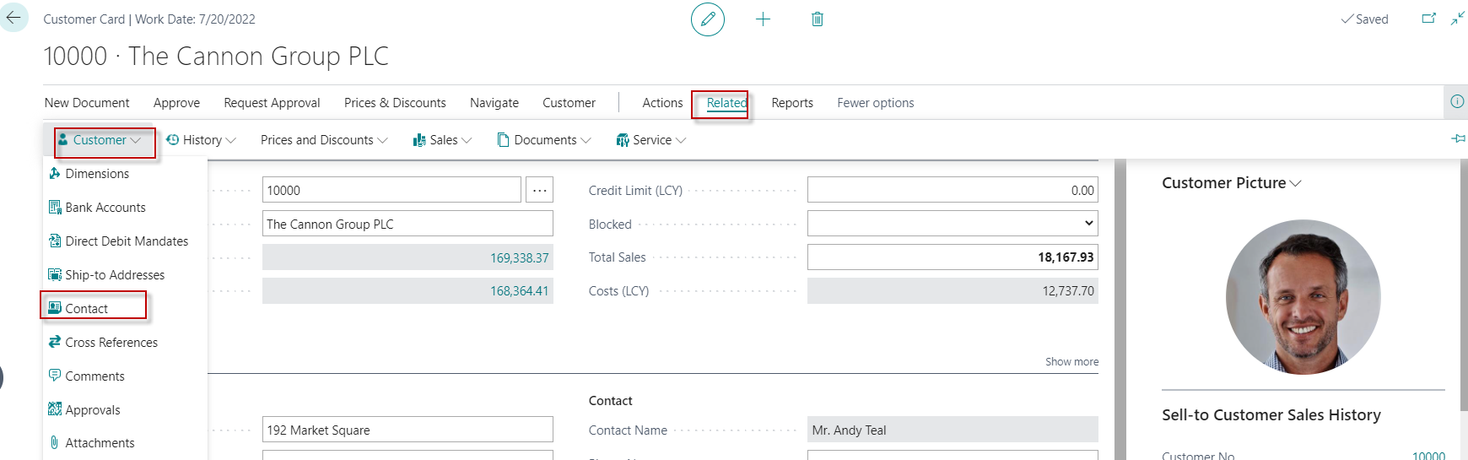
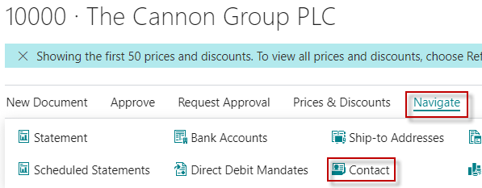
Customer card->Contact card (relationship)
Contact Card
Another option for accessing
contacts from the customer card

Slide 12
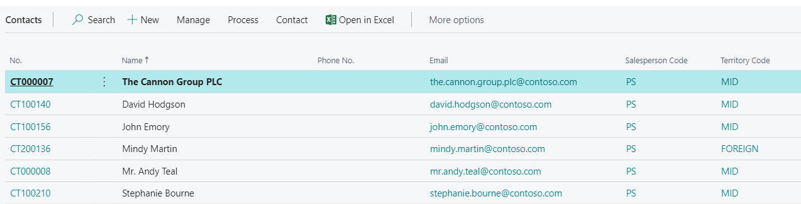
Contact cards
Person card
Company card
See next slide

Slide 13
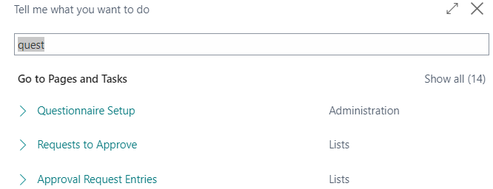
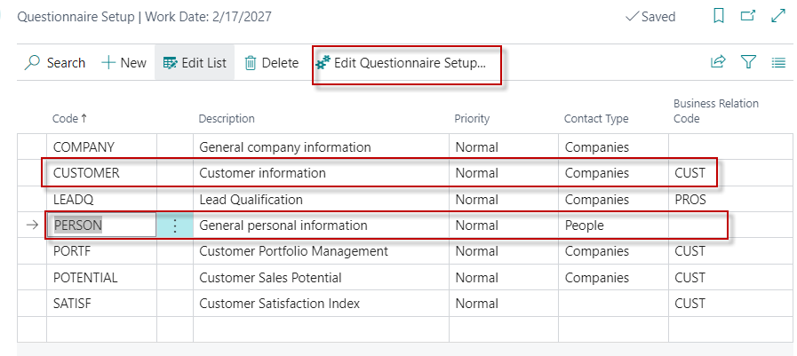
Questionnaire Setup I

Slide 14
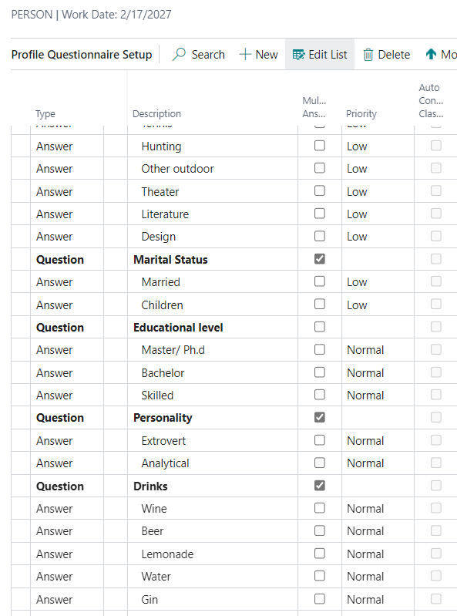
Questionnaire Setup II
You enter this in by yourself

Slide 15
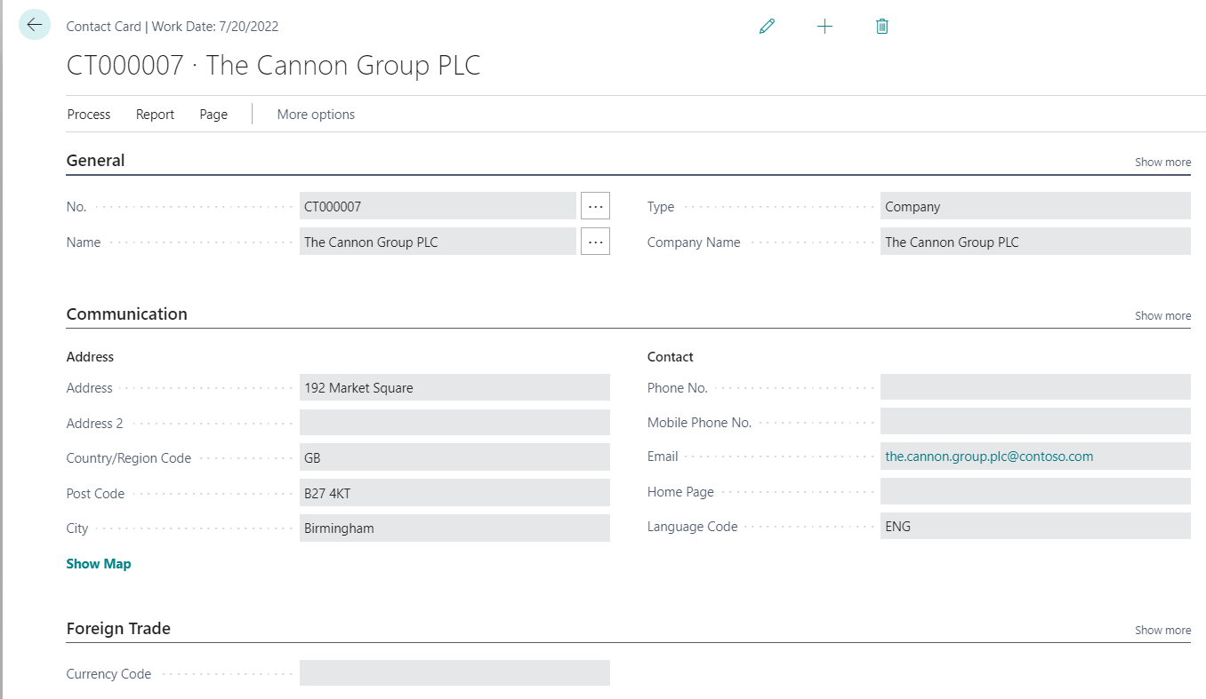
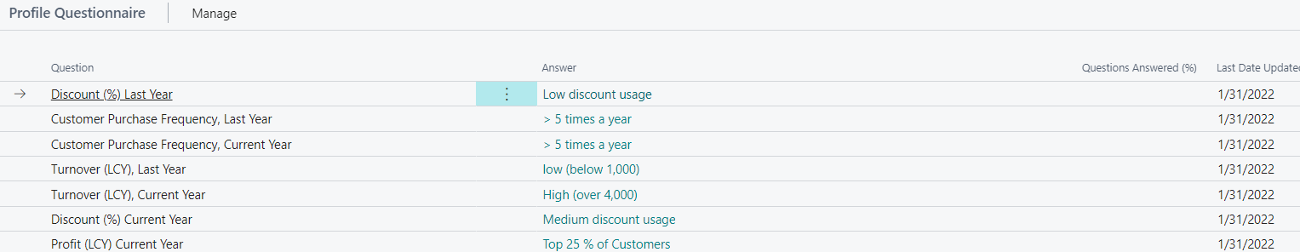
Contact Card (CC) – type=Company
Profile
How to edit and edit profile from one CC ->Related->Contact->Profiles

Slide 16
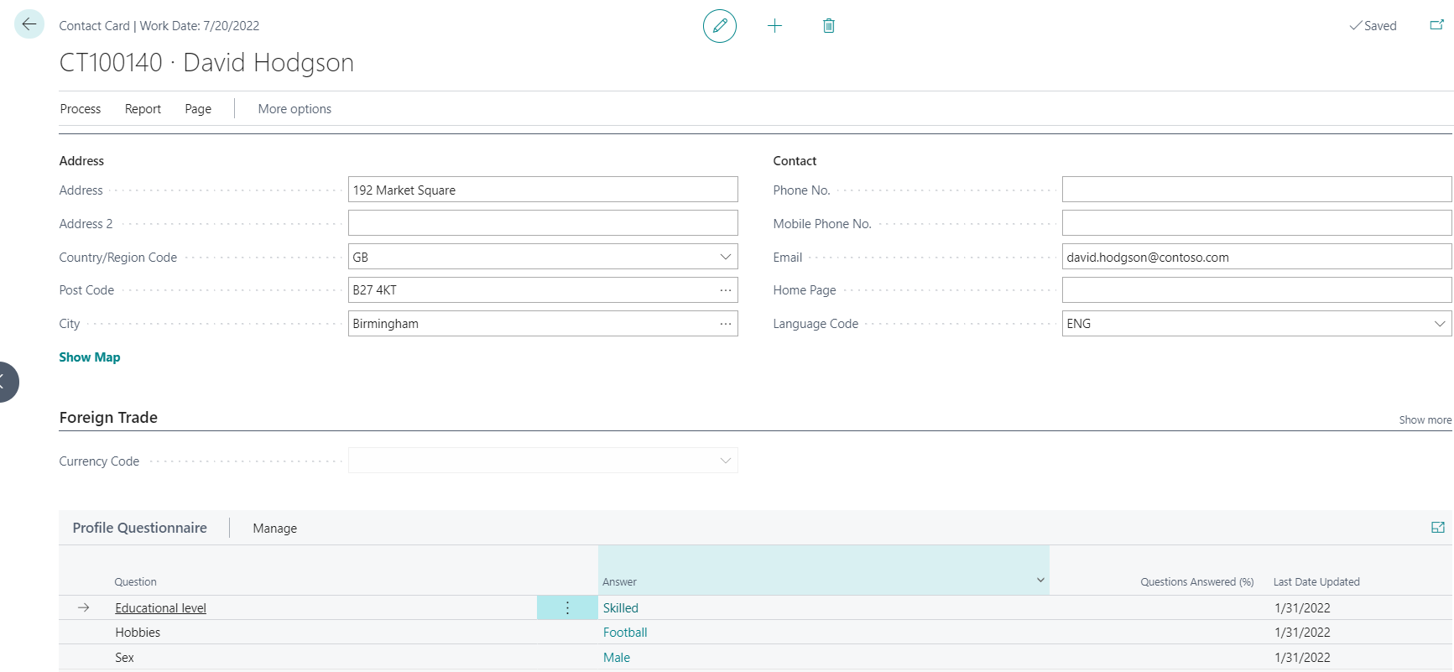
Contact Card- Person
Profile

Slide 17
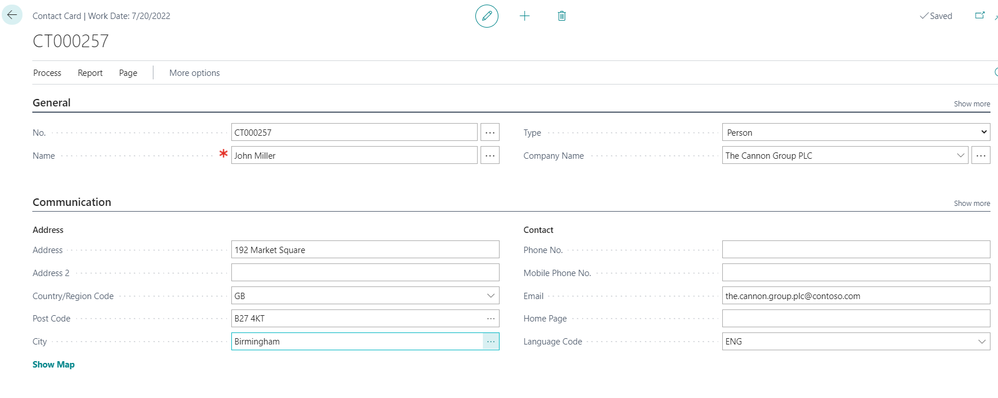
Contact Card- Company-new person
(created from Company card)
See profile settings

Slide 18
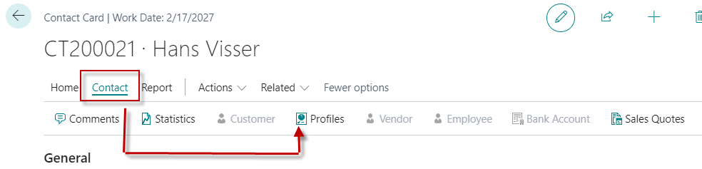
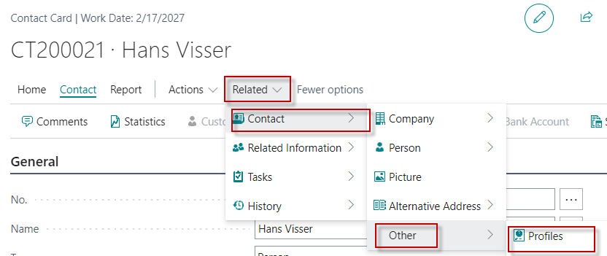
Two ways how to access profile of the Contact Card

Slide 19
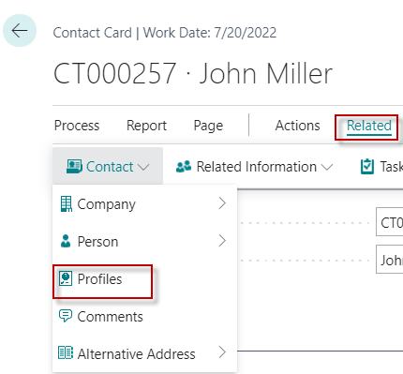
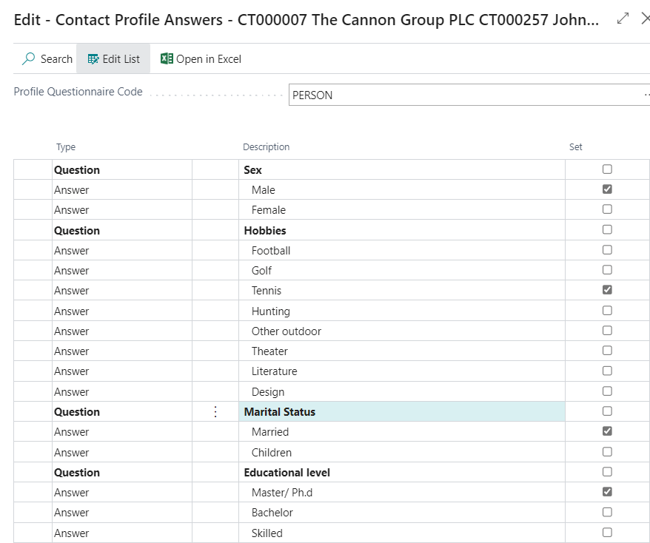
Contact Card- Company-new person – profile I

Slide 20
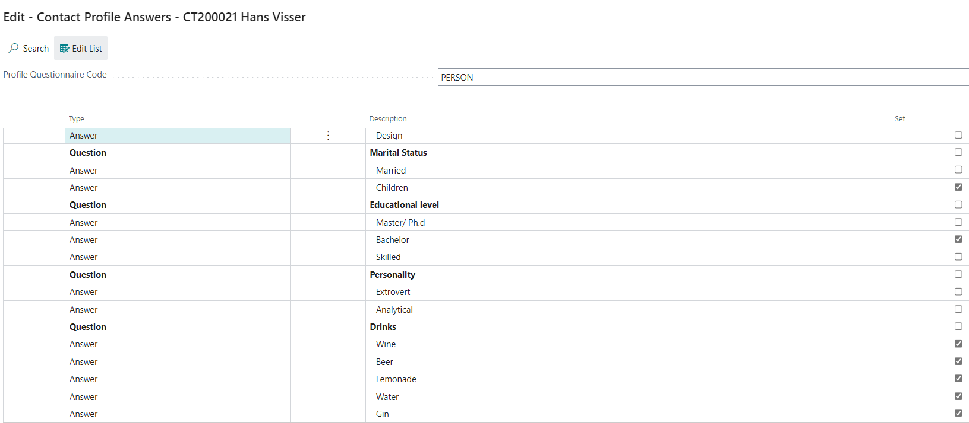
Contact Card- Company-new person – profile II

Slide 21
Pareto analysis explanantion
Customer 1
Customer Ledger Entry 1000
1800
Customer Ledger Entry 800
Sales from 1000 and above -> A
Contact 1
Profile - A
Customer 2
Customer Ledger Entry 90
160
Customer Ledger Entry 70
Sales from 100 to 999S -> B
Contact 2
Profile - B
Customer 3
Customer Ledger Entry 20
24
Customer Ledger Entry 4
Sales from 0 to 99 -> C
Contact 3
Profile - C

Slide 22
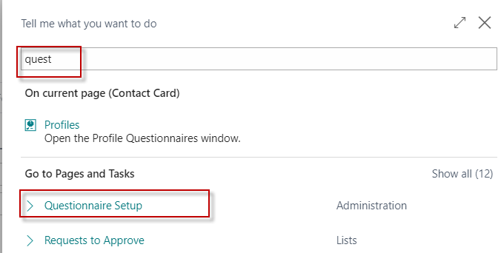
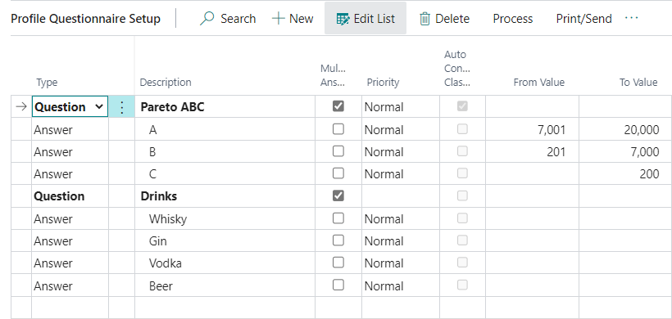
Questionaire modification-creation

Slide 23
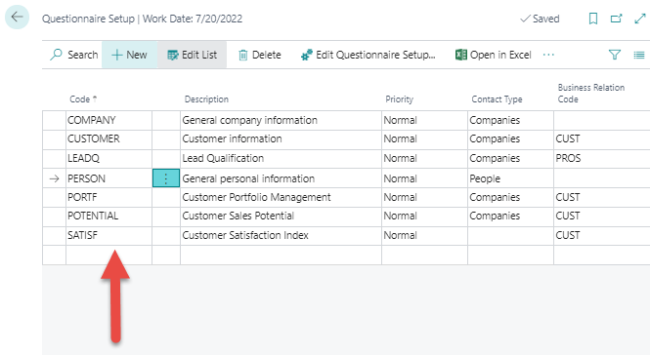
Pareto analysis-see extra example material
We create a new profile
named PARETO

Slide 24
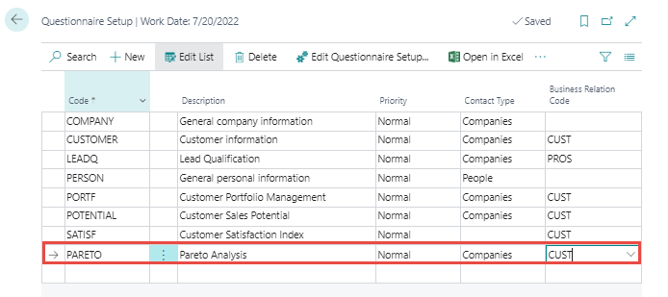

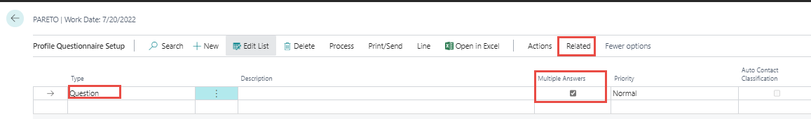
Pareto analysis –specification of questionnaire
Question
There will be either A, B or C

Slide 25
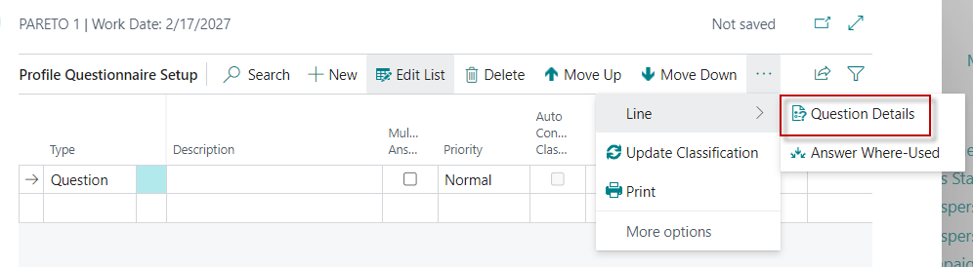
Pareto analysis –specification of questionnaire
Next, you need to specify the Details of the question
that will then be automatically evaluated

Slide 26
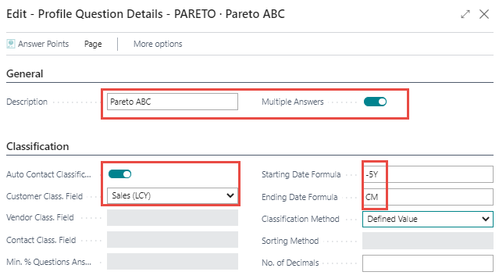
Pareto analysis –specification of questionnaire
We will analyze the sales amounts that are part of Customer Ledger Entries
five years backwards (-5Y) and end the analysis in the current month (CM)

Slide 27
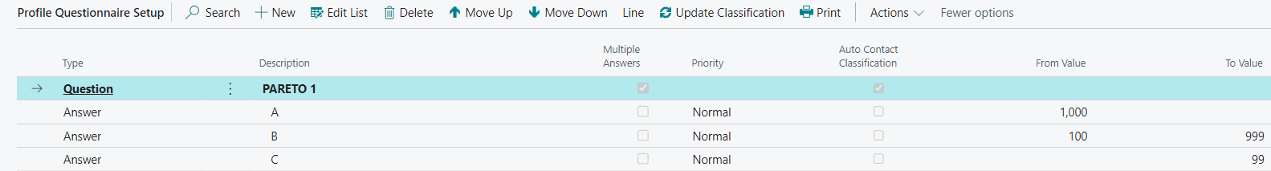
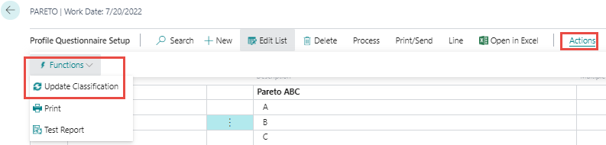
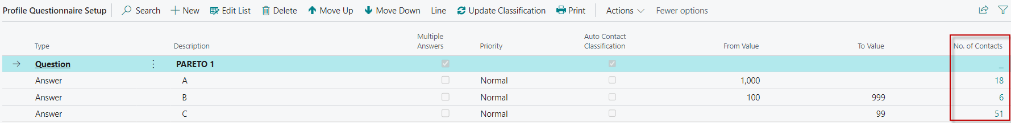
Pareto analysis –specification of questionnaire
Values of limits are entered manualy !!!!!!
Click

Slide 28
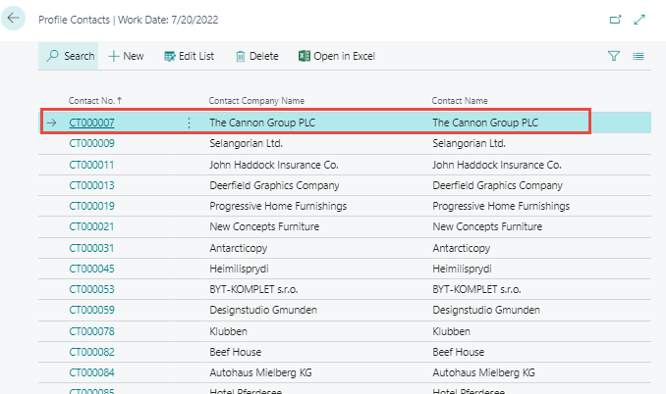
Pareto analysis – specification of questionnaire

Slide 29
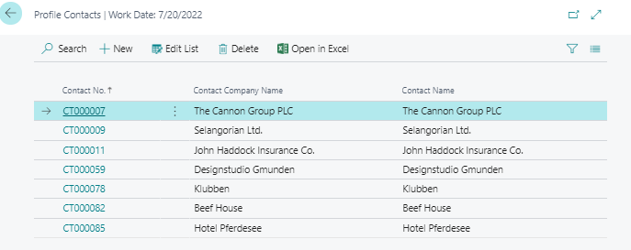
Pareto analysis –specification of questionnaire
Open contact card

Slide 30
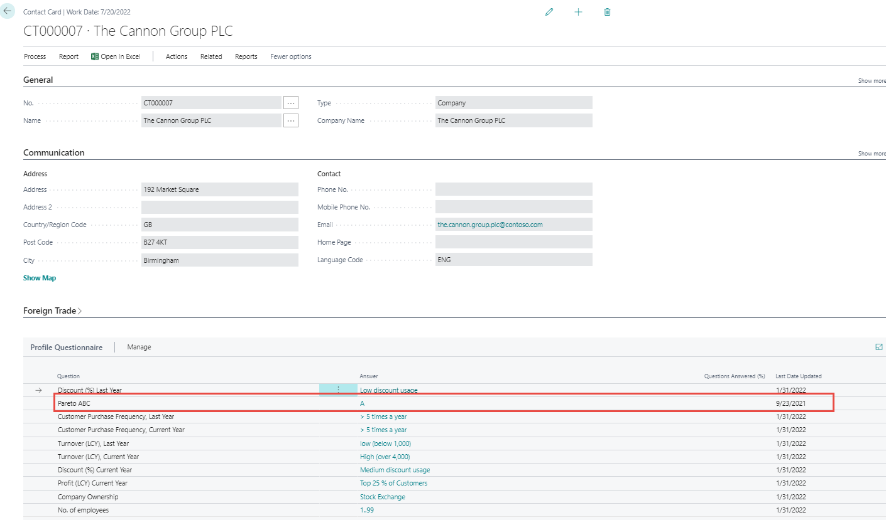
Pareto analysis – specification of questionnaire

Slide 31
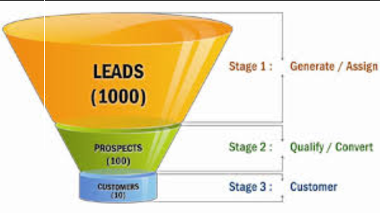
End of the section

Slide 32
Interactions

Slide 33
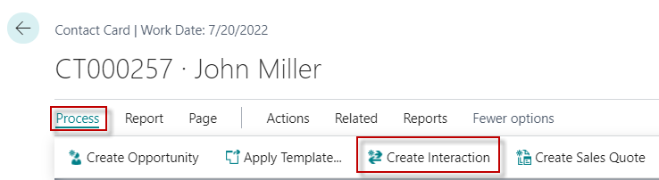
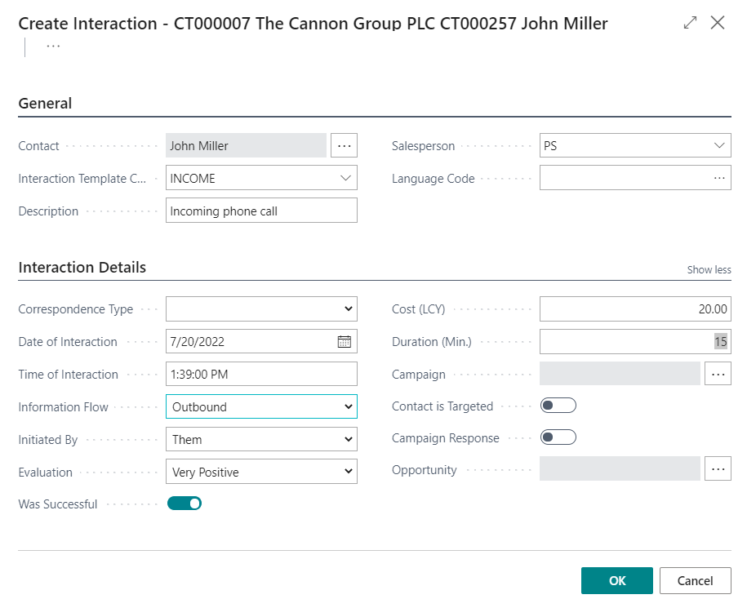
New interaction- use of wizard

Slide 34
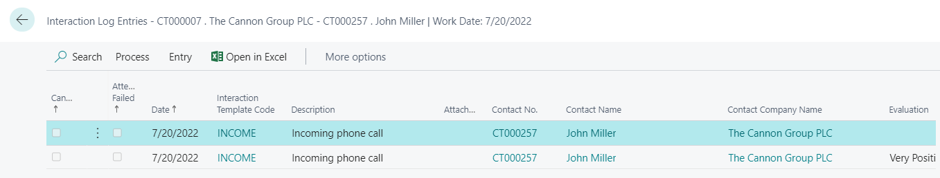
Interaction log entries

Slide 35
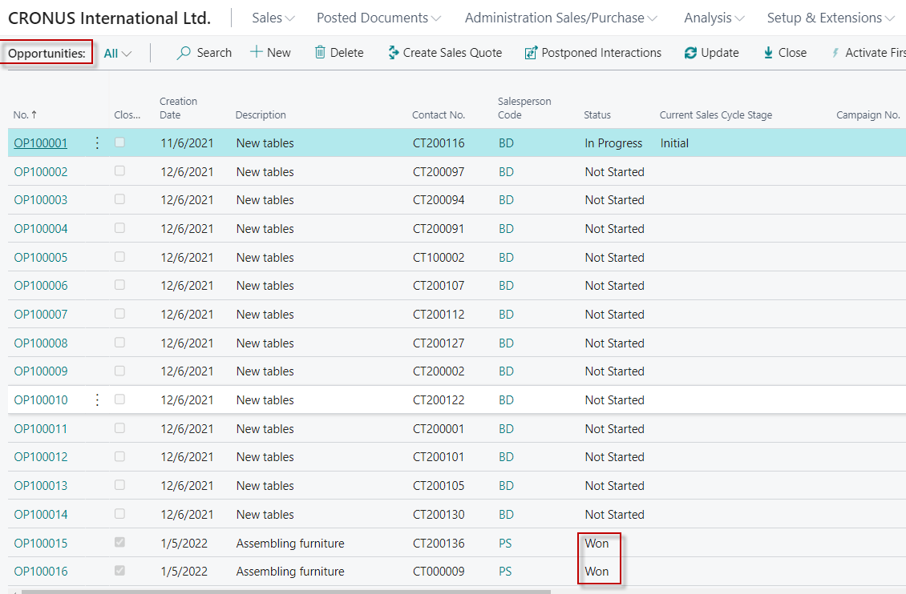
Another CRM area : Opportunity
From searching window

Slide 36
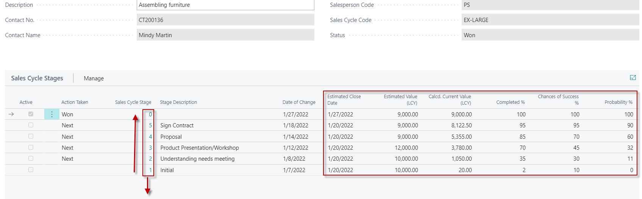
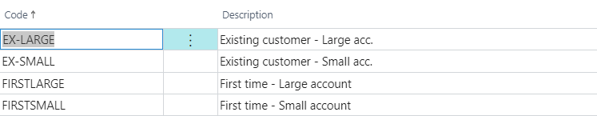
Opportunity structure
See next slide

Slide 37
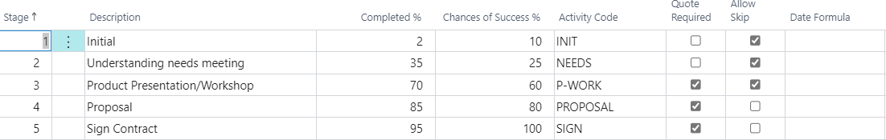
Sale Cycle Stages

Slide 38
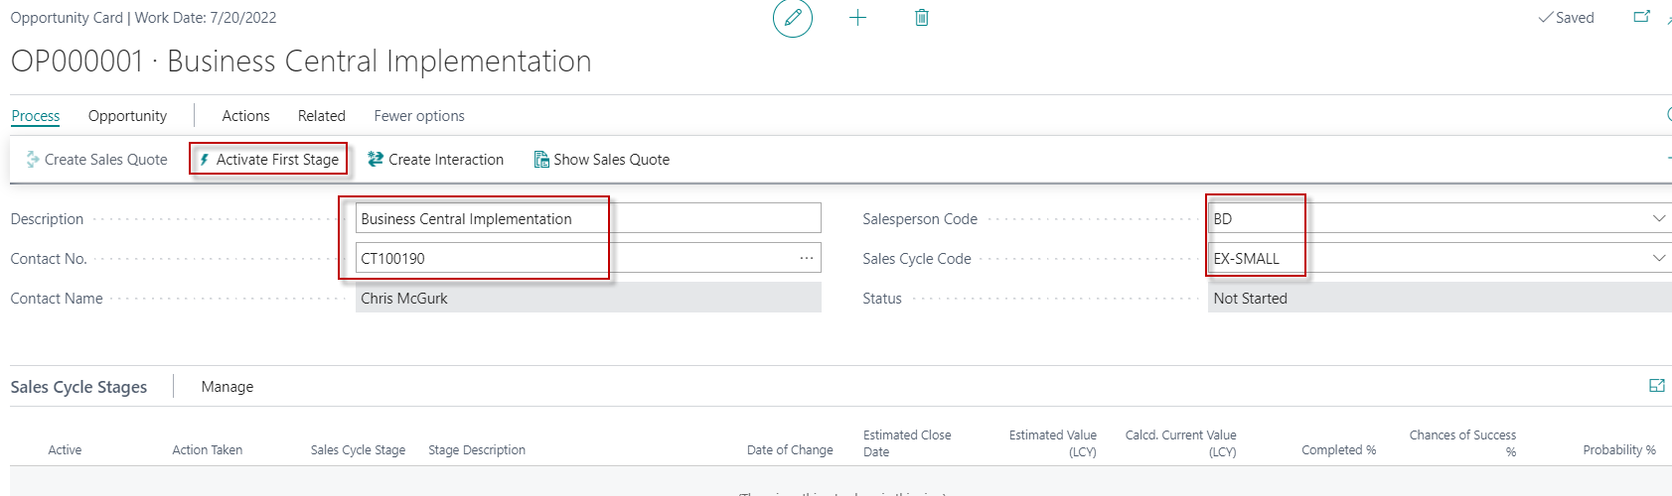


Opportunity creation

Slide 39
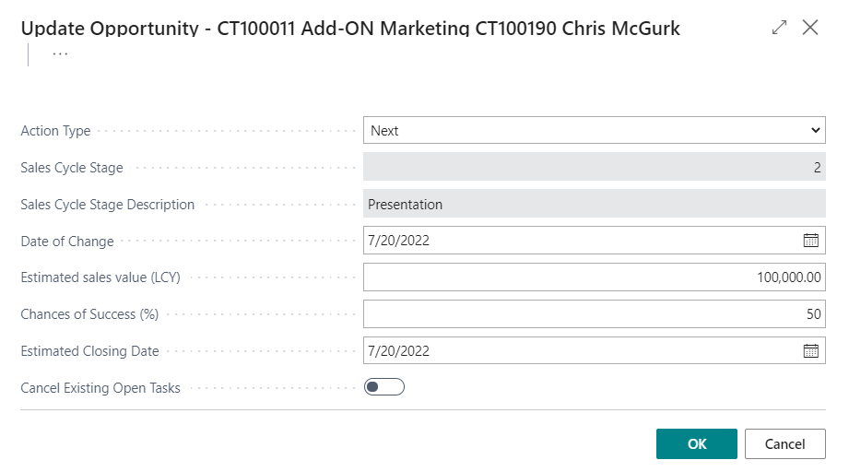
Opportunity creation
Next stage is dependent on a new document creation

Slide 40
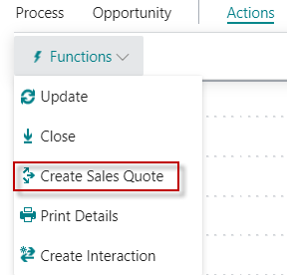
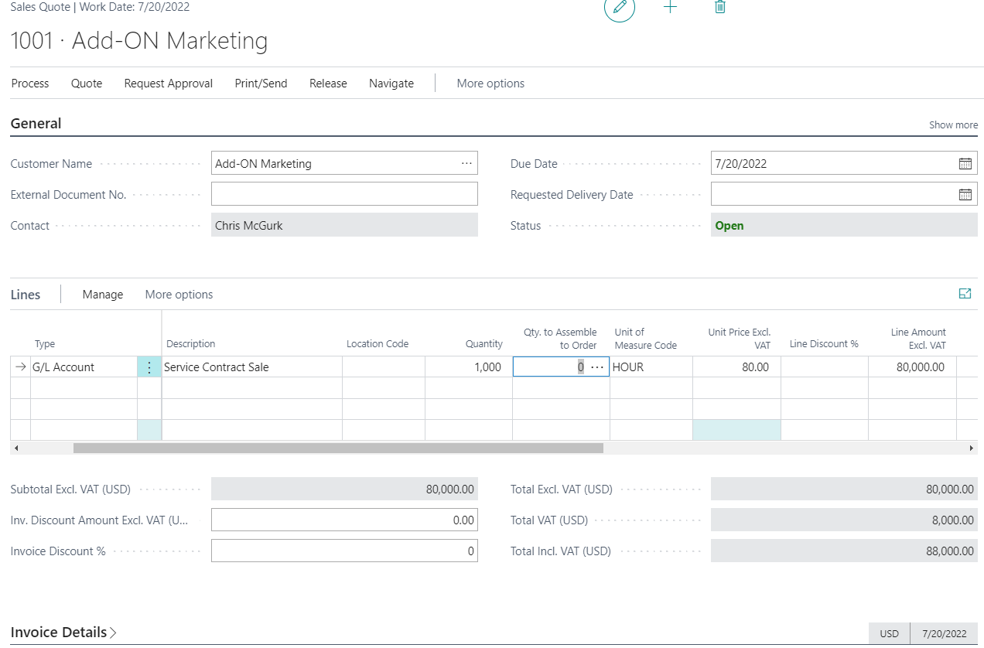
Opportunity creation- new stage

Slide 41
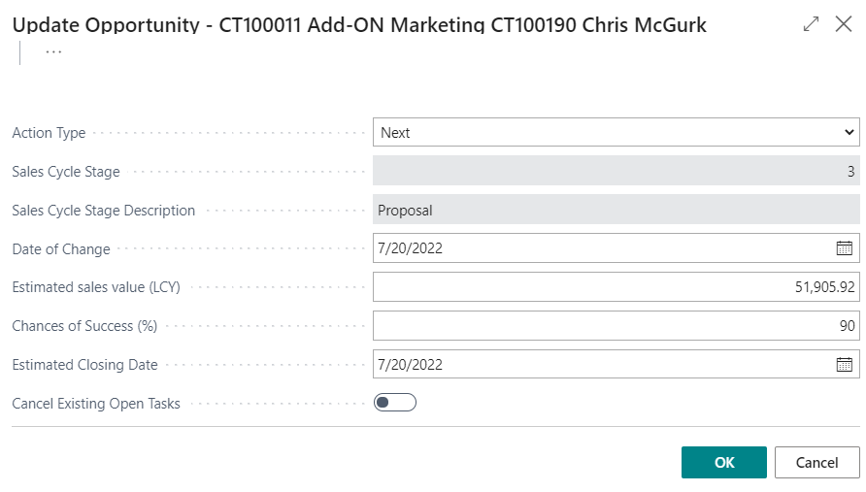
Opportunity creation – after Sales Quotation

Slide 42
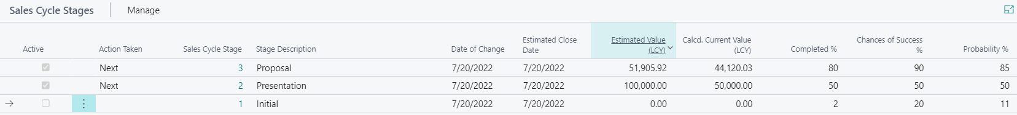
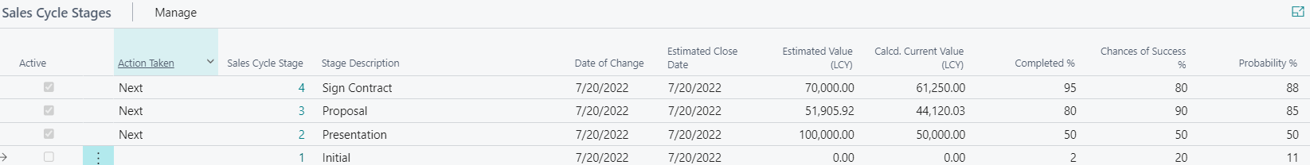
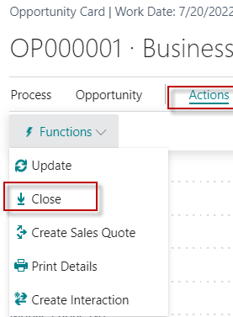
Opportunity creation – after Sales Quotation
Next update

Slide 43


Opportunity creation – closing

Slide 44

Opportunity successfuly processed

Slide 45
Personal profile
modificatoins

Slide 46


Personal profile creation (from Contact card OR Search window)

Slide 47

Personal profile creation
You have to EDIT Questionnaire ->

Slide 48

Personal profile creation

Slide 49

Personal profile creation
Click

Slide 50


Personal profile creation

Slide 51


Personal profile creation – back to setup

