Slide 1
5. Service and Experience Cloud
24. 10. Jiří Karpíšek

Slide 2
Why Customer Care
Resolving Issues and Queries
Enhancing Customer Satisfaction
Reducing Churn and Improving Retention
Netflix invested in a responsive customer care team, contributing to its low churn rate. In 2020, Netflix reported a subscriber base of over 200 million, and a strong customer retention rate played a crucial role in this growth.
Gaining Competitive Advantage
Zappos, the online shoe and clothing retailer, built its brand around excellent customer service. This focus on customer care helped Zappos grow its revenue to around $2 billion in 2019 and set it apart from competitors.
Collecting Customer Feedback
Starbucks actively collects feedback through its customer care channels. This feedback loop allows them to make improvements based on customer suggestions and preferences, contributing to its $22.4 billion in revenue in 2020.
Upselling and Cross-selling
Salesforce, a leading CRM provider, uses its customer support team not only for issue resolution but also to identify opportunities for upselling and cross-selling. This strategy helped Salesforce achieve over $21 billion in revenue in 2021.
Mitigating Negative Publicity
United Airlines faced a public relations crisis when a passenger was forcibly removed from a flight. The company's response to the incident, including improvements to customer care, was instrumental in rebuilding its image and maintaining revenue.
Building Brand Loyalty

Slide 3
80 percent of customers say the experience a company provides is just as important as its products and services.

Slide 4
Customer satisfaction impacting company revenue
American Customer Satisfaction Index (ACSI) and Stock Performance:
Study: The American Customer Satisfaction Index (ACSI) conducts ongoing research to measure customer satisfaction across various industries. They have found a strong correlation between customer satisfaction scores and stock performance of publicly traded companies. Companies with higher customer satisfaction tend to outperform their competitors in terms of stock price.
Impact: This study shows that companies that prioritize customer satisfaction often see a positive impact on their financial performance, as reflected in their stock prices.
Harvard Business Review (HBR) Study on Customer Loyalty:
Study: Harvard Business Review published a study titled "The Value of Customer Experience, Quantified," which analyzed data from various industries. The study found that increasing customer retention rates by just 5% can increase profits by 25% to 95%.
Impact: This study demonstrates the significant financial benefits of customer satisfaction and loyalty, as even small improvements in customer retention can lead to substantial revenue growth.
Temkin Group's ROI of Customer Experience Study:
Study: The Temkin Group conducted a study titled "ROI of Customer Experience," which analyzed the financial performance of companies based on their customer experience ratings. They found that companies with higher customer experience ratings consistently outperformed those with lower ratings in terms of revenue growth.
Impact: This study highlights the tangible link between customer experience, satisfaction, and revenue growth, emphasizing the financial benefits of investing in a positive customer experience.
ForeSee's Impact on Customer Satisfaction on Online Retail Revenue:
Study: ForeSee, a customer experience analytics firm, conducted a study that analyzed the impact of customer satisfaction on online retail revenue. They found that a one-point increase in customer satisfaction scores led to a 10-15% increase in online sales.
Impact: This study provides concrete evidence of the direct relationship between customer satisfaction and online retail revenue, demonstrating the financial consequences of enhancing customer satisfaction in e-commerce.
University of Michigan's Study on Customer Satisfaction and Earnings:
Study: Researchers at the University of Michigan conducted a study examining the impact of customer satisfaction on a firm's earnings. They found a positive correlation between customer satisfaction and earnings growth for companies in various industries.
Impact: This study underscores the connection between customer satisfaction and financial performance, emphasizing that satisfied customers are more likely to contribute to a company's revenue growth.
Notes:
CSAT -> stock performance
Csutomer Retention -> profit
CSAT -> revenue growth
CSAT -> online sales
CSAT -> revenue growth

Slide 5
What is Service Cloud
Service Cloud is a customer service platform that helps businesses manage and resolve customer inquiries and issues. It provides tools for case management, knowledge base, omni-channel support, automation, and analytics, enabling companies to deliver exceptional customer service experiences.
Service Cloud is focused on customer service and support, enabling businesses to manage and resolve customer inquiries. Sales Cloud, on the other hand, is designed for sales teams to manage leads, opportunities, and customer relationships throughout the sales process.
Service Cloud is used by businesses of all sizes, across industries, around the world, that require customer service and support capabilities and are looking to streamline and enhance their customer service operations.
Notes:
Case management
KB, IKB
Omnichannel
Automatizace (apex, flow)
Analytics – reporty, dashboardy, analytics studio, supervisor console
Sales vs Service
Customer Care shift to selling organization

Slide 6
Service cloud
Notes:
Community
Survey
Support process, call skription, IKB
Flow, trigger,
Case management

Slide 7
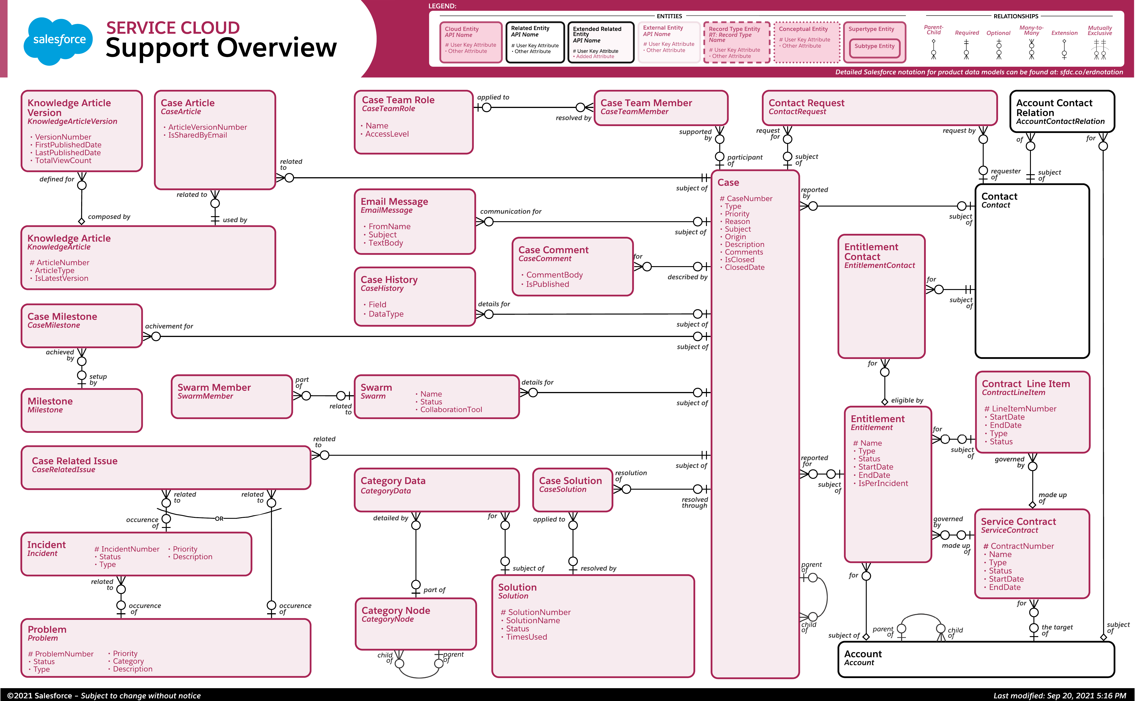
Specific objects
Case
KB
Account / Contact
Task / email / chat / …
Notes:
ERD diagram

Slide 8
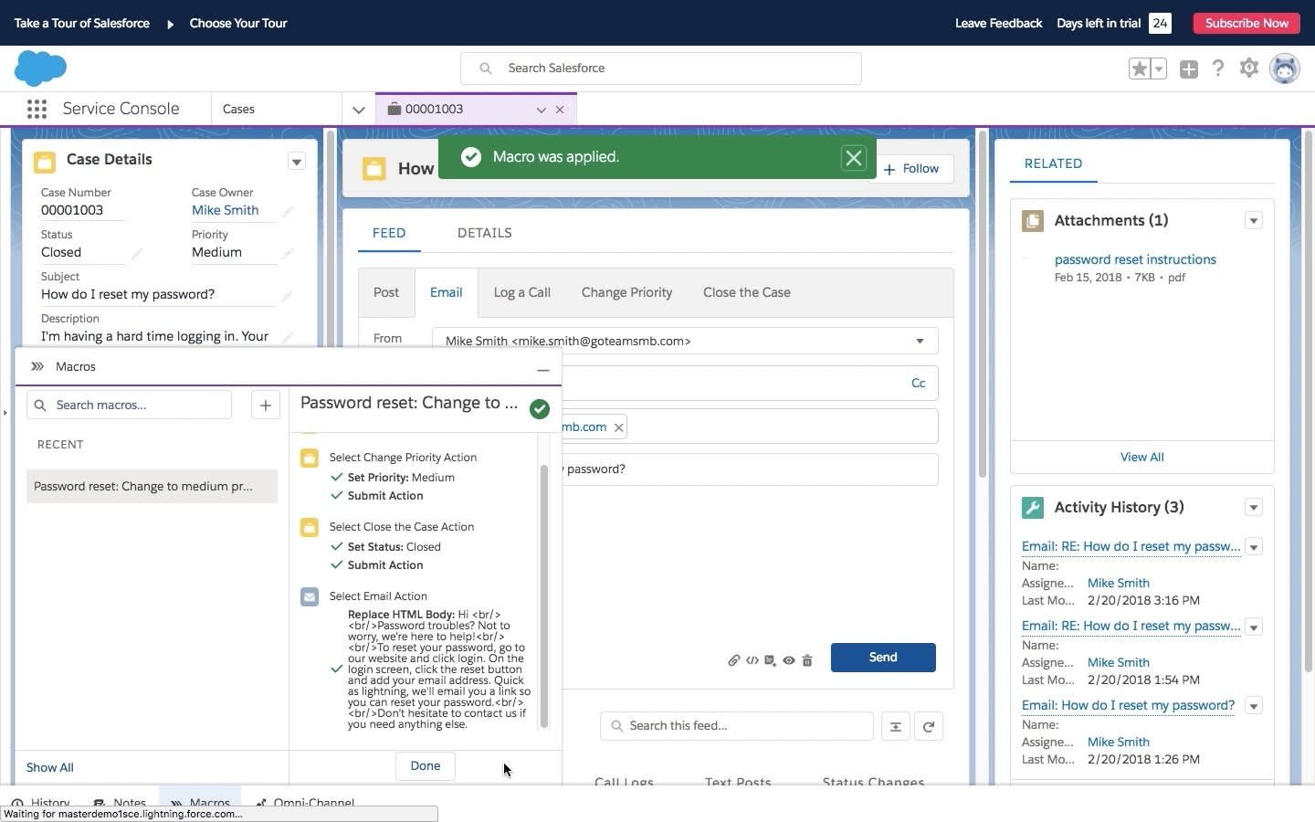
Service Cloud Console
designed to reduce the processing time
can use different applications simultaneously
Notes:
Ve cviceni

Slide 9
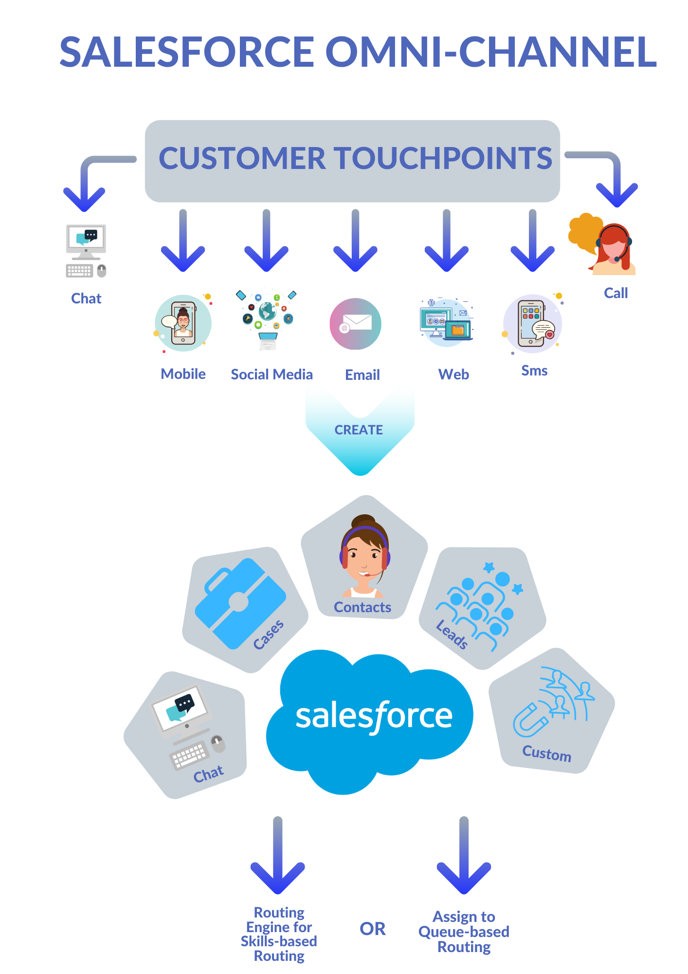
Omnichannel routing
Multiple channels
Skill vs queue based routing
Supervisor console

Slide 10
AI revolution

Slide 11
As AI capabilities shift, human role shift
Notes:
User manual
Telefon / email Support (problem skalovani)
KB – self service
Chatbot / automatizace / AI search
Autonomni AI
Do budoucna AI autonomni agenti , ???
19 stoleti GB, Luddité / luddismus – rozbijeli stroje (tkalcovske stavy), kvuli praci, ne kvuli ochrane prirody
Delegat – dava ukoly a pracuje s vysledky
Dirigent / strojvedouci – ridi orchestr a tvori umelecke dilo

Slide 12
Notes:
Manualni prace
Predikce, best option …
Generative AI pro support (KB, odpoved, kategorizace, case summary, chatbot, phone call review / training, …)

Slide 13
Experience cloud

Slide 14
What is Experience cloud
online platform that enables companies to connect customers, partners, and employees with each other — and the data and records they need to get work done
build communities

Slide 15
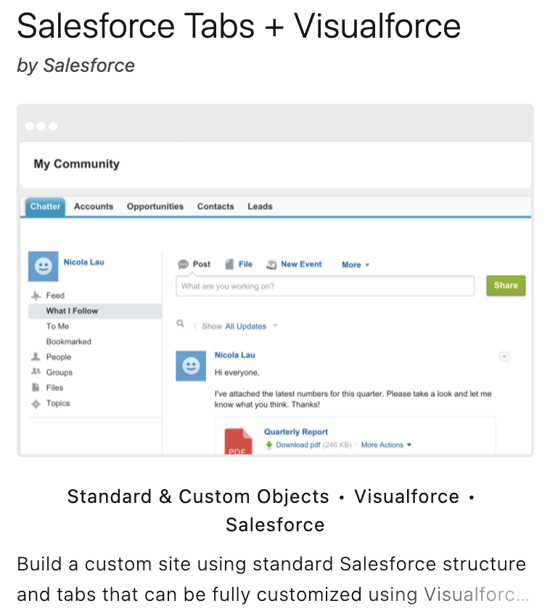
Visual Force template
Visual Force
URL rewriter
Very flexible / legacy (replaced by lightning)
Easier localization public webpages

Slide 16
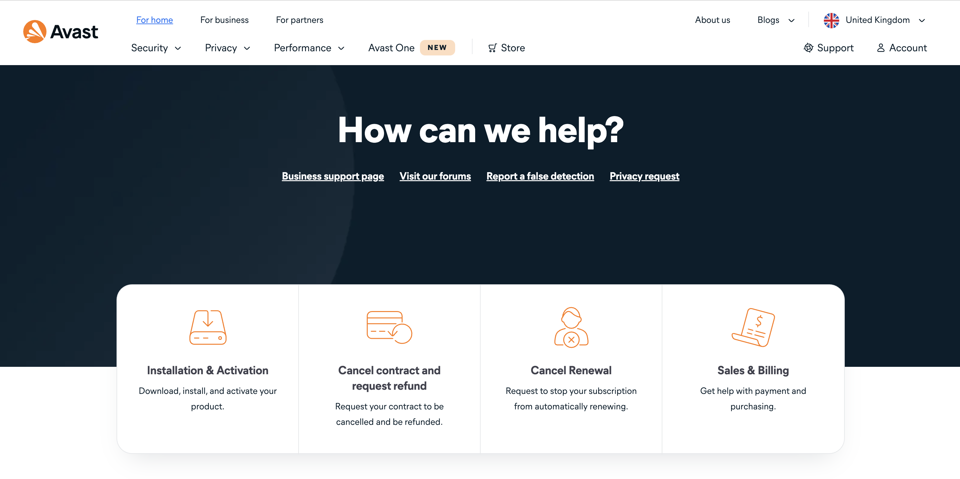
Avast support center

Slide 17
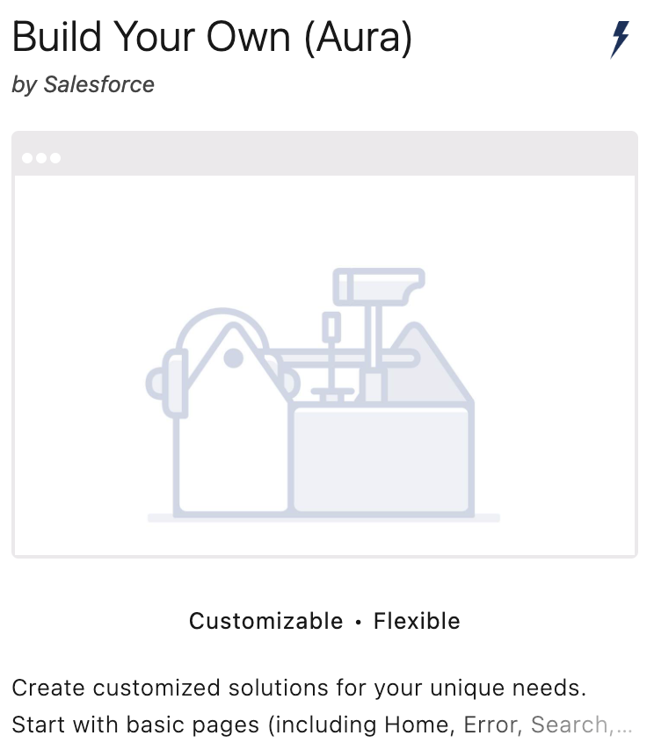
Aura template
Experience builder
Lightning (Aura, LWC)
CMS
Audience / Personalization out of the box

Slide 18
Ccleaner Support center

Slide 19
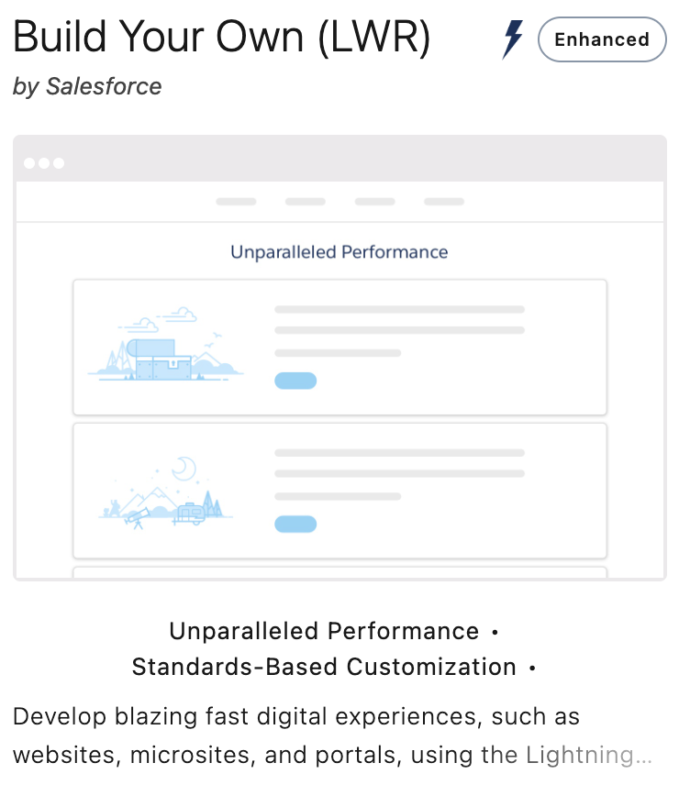
Lightning Web Runtime (LWR)
Experience builder
Lightning (Aura, LWC)
CMS
CDN / loading speed optimization
Content search, but limited to 20 locales only (used to be 10)
No standard Einstein bot component (yet)
Other limitations
Notes:
cviceni

Slide 20
Q&A

Slide 21
Summary
Customer Care is important for long-term business
You can build the help center on SF experience cloud
And case management completely on SF platform to have full customer view shared between sales and support teams

Slide 22
That’s all Thank you
karpisekjiri@gmail.com

Slide 23
Cviceni
User Management Settings
Enhanced Profile User Interface
Enhanced Permission Set Component Views
Service console
App manager, new lightning app
Generate logo, service setup
Utility bar – todo items, macros, history, notes, Omni-Channel utility
Available items – Account, contact, case, digital experience, macros, quick text, tasks, supervisor console
System admin
Quick text settings – share and organize
Quick text tab- default on
Omni Supervisor - default on
Service resourve - default on
Add picklist value Case reason – refund
Case Offer – currency 16,2, to profile, not on layout
Create case
Edit page
Upgrade dynamic forms and dynamic actions
Move sections and remove ribbon
Activate and assign as org default
New field section Refund, display only on refund
Create Contact and link to Case (multiple tabs, sub tabs)

Slide 24
LWR community
Digital experience settings - Enable Digital Experiences
Create new B2C Commerce (LWR)
Omnichannel for chat
Create presence status online and add on profile (Service Presence Statuses Access)
Routing Configurations
Create new queue – Messaging session, add yourself
Chat settings – enable chat
Chat + service cloud user
Assign license PS Messaging for In-App and Web User
Embedded service
Builder settings enable guest access
Community builder – set homepage as public
Messaging Settings -> New messaging channel, add Routing time and queue
Activate channel on detail page
New embedded service deployment (domain community)
Publish on right top corner
Go to to community builder and add embedded messaging
Community settings activate community
Messaging session – edit page and replace conversation with enhanced conversation
Chatbot and transfer to live agent
Enable einstein bot
Create new standard bot from tempate
Remove leads
Create bot
https://help.salesforce.com/s/articleView?id=sf.bots_service_transfer_queue.htm&type=5
Add to main menu Transfer to agent
Activate bot
Setup chat and run preview

