Slide 1
LECTURE 5
Introduction to Econometrics
Multiple Regression Analysis:
Hypothesis Testing II
Hieu Nguyen
Fall semester, 2024
1 / 36

Slide 2
REVISION: the Classical Linear Model (CLM) Assumptions
Linearity: the regression model is linear in the parameters (coefficients)
Random sampling: the data is a random sample drawn from the population and each data point follows the population equation
No perfect collinearity: the values of explanatory variables are not all the same and no explanatory variable is a perfect linear function of any other explanatory variable(s)
Zero conditional mean: values of explanatory variables must contain no information about the mean of the unobserved factors - explanatory variables are uncorrelated with the error term
Homoskedasticity: the error term has a constant variance
Normality of the error term: the error term is normally distributed
12 / 36

Slide 3
TODAY’S LECTURE
e We continue our discussion on how hypotheses about coefficients can be tested in regression models
e We will explain what significance of coefficients mean
e We will learn how to read regression output
e Readings:
Wooldridge Chapter 4;
Studenmund Chapter 5.1-5.4

Slide 4



INFERENCE: The t Test
e „Statistically significant“ variables in a regression
  If a regression coefficient is different from zero in a two-sided test, the corresponding variable is said to be „statistically significant“
  If the number of degrees of freedom is large enough so that the normal approximation applies, the following rules of thumb apply:
„statistically significant at 10 % level“
„statistically significant at 5 % level“
„statistically significant at 1 % level“

Slide 5
INFERENCE: The t Test
e Guidelines for discussing economic and statistical significance
  If a variable is statistically significant, discuss the magnitude of the coefficient to get an idea of its economic or practical importance
  The fact that a coefficient is statistically significant does not necessarily mean it is economically or practically significant!
  If a variable is statistically and economically important but has the „wrong“ sign, the regression model might be misspecified
  If a variable is statistically insignificant at the usual levels (10%, 5%, 1%), one may think of dropping it from the regression
  If the sample size is small, effects might be imprecisely estimated so that the case for dropping insignificant variables is less strong

Slide 6

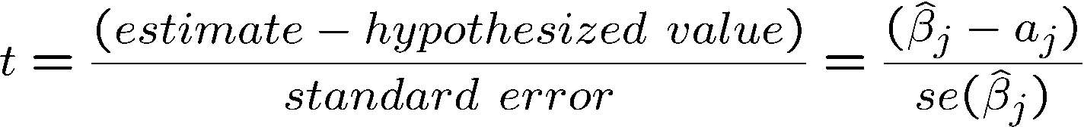
INFERENCE: The t Test
e Testing more general hypotheses about a regression coefficient
e Null hypothesis
e t-statistic
e The test works exactly as before, except that the hypothesized value is substracted from the estimate when forming the statistic
Hypothesized value of the coefficient

Slide 7
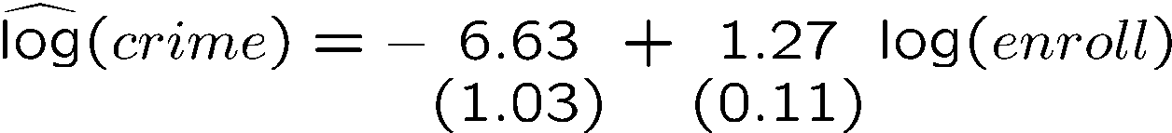

INFERENCE: The t Test
e Example: Campus crime and enrollment
  An interesting hypothesis is whether crime increases by one percent if enrollment is increased by one percent
Estimate is different from one but is this difference statistically significant?
The hypothesis is rejected at the 5% level

Slide 8
INFERENCE: The t Test
e Computing p-values for t-tests
  If the significance level is made smaller and smaller, there will be a point where the null hypothesis cannot be rejected anymore
  The reason is that, by lowering the significance level, one wants to avoid more and more to make the error of rejecting a correct H₀
  The smallest significance level at which the null hypothesis is still rejected, is called the p-value of the hypothesis test
  A small p-value is evidence against the null hypothesis because one would reject the null hypothesis even at small significance levels
  A large p-value is evidence in favor of the null hypothesis
  P-values are more informative than tests at fixed significance levels

Slide 9
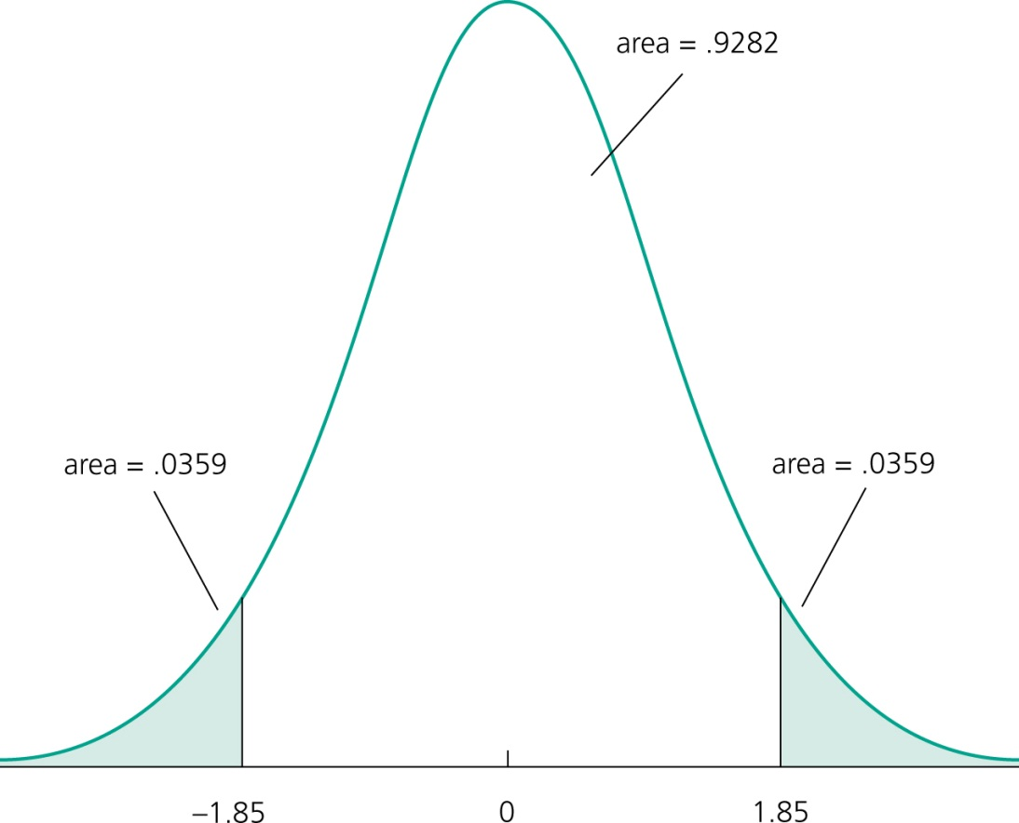
INFERENCE: The t Test
e How the p-value is computed (here: two-sided test)
The p-value is the significance level at which one is indifferent between rejecting and not rejecting the null hypothesis.
In the two-sided case, the p-value is thus the probability that the t-distributed variable takes on a larger absolute value than the realized value of the test statistic, e.g.:
From this, it is clear that a null hypothesis is rejected if and only if the corresponding p-value is smaller than the significance level.
For example, for a significance level of 5% the t-statistic would not lie in the rejection region.
These would be the critical values for a 5% significance level
value of test statistic

Slide 10
INFERENCE: Confidence Intervals
Critical value of
two-sided test
e Confidence intervals
e Simple manipulation of the result in Theorem 4.2 implies that
e Interpretation of the confidence interval
  The bounds of the interval are random
  In repeated samples, the interval that is constructed in the above way will cover the population regression coefficient in 95% of the cases
Lower bound of the
Confidence interval
Upper bound of the
Confidence interval
Confidence level

Slide 11



INFERENCE: Confidence Intervals
e Confidence intervals for typical confidence levels
e Relationship between confidence intervals and hypotheses tests
Use rules of thumb
reject in favor of

Slide 12



INFERENCE: Confidence Intervals
e Example: Model of firms‘ R&D expenditures
Spending on R&D
Annual sales
Profits as percentage of sales
0.0217
(0.0128 )
(0.0128 )
The effect of sales on R&D is relatively precisely estimated as the interval is narrow. Moreover, the effect is significantly different from zero because zero is outside the interval.
This effect is imprecisely estimated as the in-
terval is very wide. It is not even statistically
significant because zero lies in the interval.

Slide 13


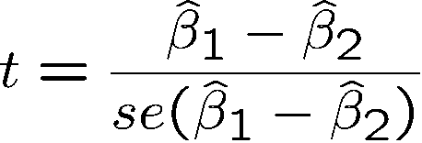
INFERENCE: Testing Hypotheses About a Linear Combination of Parameters
e Example: Return to education at 2 year vs. at 4 year colleges
Years of education at 2 year colleges
Years of education at 4 year colleges
Test against .
A possible test statistic would be:
The difference between the estimates is normalized by the estimated standard deviation of the difference. The null hypothesis would have to be rejected if the statistic is „too negative“ to believe that the true difference between the parameters is equal to zero.

Slide 14



INFERENCE: Testing Hypotheses About a Linear Combination of Parameters
e Impossible to compute with standard regression output because
e Alternative method
Usually not available in regression output
Define and test against .
Insert into original regression
a new regressor (= total years of college)

Slide 15

INFERENCE: Testing Hypotheses About a Linear Combination of Parameters
Total years of college
e Estimation results
e This method works always for single linear hypotheses
Hypothesis is rejected at 10% level but not at 5% level

Slide 16
TESTING MULTIPLE HYPOTHESES
e Suppose we have a model
y_{i} = β₀ + β₁x_{i1} + β₂x_{i2} + β₃x_{i3} + ε_{i}
e Suppose we want to test multiple linear hypotheses in this model
e For example, we want to see if the following restrictions on coefficients hold jointly:
β₁ + β₂ = 1 and β₃ = 0
e We cannot use a t-test in this case (t-test can be used only for one hypothesis at a time)
e We will use an F-test

Slide 17
RESTRICTED VS. UNRESTRICTED MODEL
e We can reformulate the model by plugging the restrictions as if they were true (model under H₀)
e We call this model restricted model as opposed to the
unrestricted model
e The unrestricted model is
y_{i} = β₀ + β₁x_{i1} + β₂x_{i2} + β₃x_{i3} + ε_{i}
e Restricted model can be derived to have the following form:
y∗_{i} = β₀ + β₁x∗_{i} + ε_{i} ,
where y∗_{i} = y_{i} − x_{i2} and x∗_{i} = x_{i1} − x_{i2}

Slide 18
IDEA OF THE F-TEST
e If the restrictions are true, then the restricted model fits the data in the same way as the unrestricted model
residuals are nearly the same
e If the restrictions are false, then the restricted model fits the data poorly
residuals from the restricted model are much larger than those from the unrestricted model
e The idea is thus to compare the residuals from the two models

Slide 19
IDEA OF THE F-TEST
e How to compare residuals in the two models?
Calculate the sum of squared residuals in the two models
Test if the difference between the two sums is equal to zero (statistically)
H₀: the difference is zero (residuals in the two models are the same, restrictions hold)
H_{A}: the difference is positive (residuals in the restricted model are bigger, restrictions do not hold)
e Sum of squared residuals

Slide 20
F-TEST
e The test statistic is defined as
(SSR_{r} − SSR_{ur})/q SSR_{ur}/(n − k − 1)
F =
∼ F
q,n−k−1
,
where:
SSR_{r}
SSR_{ur} q
. . . sum of squared residuals from the restricted model
. . . sum of squared residuals from the unrestricted model
. . . number of restrictions
n
. . . number of observations
k
. . . number of estimated coefficients

Slide 21

INFERENCE: The F Test
e Testing multiple linear restrictions: The F-test
e Testing exclusion restrictions
Average number of
games per year
Salary of major lea-
gue baseball player
Years in
the league
Batting average
Home runs per year
Runs batted in per year
against
Test whether performance measures have no effect/can be exluded from regression.

Slide 22
INFERENCE: The F Test
e Estimation of the unrestricted model
None of these variabels are statistically significant when tested individually
Idea: How would the model fit be if these variables were dropped from the regression?

Slide 23
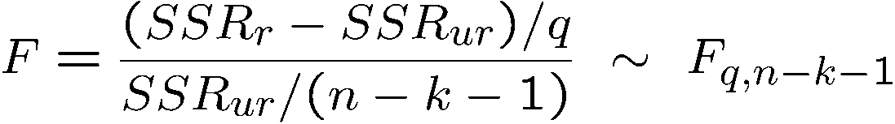
INFERENCE: The F Test
e Estimation of the restricted model
e Test statistic
The sum of squared residuals necessarily increases, but is the increase statistically significant?
Number of restrictions
The relative increase of the sum of squared residuals when going from
H₁ to H₀ follows a F-distribution (if
the null hypothesis H₀ is correct)

Slide 24
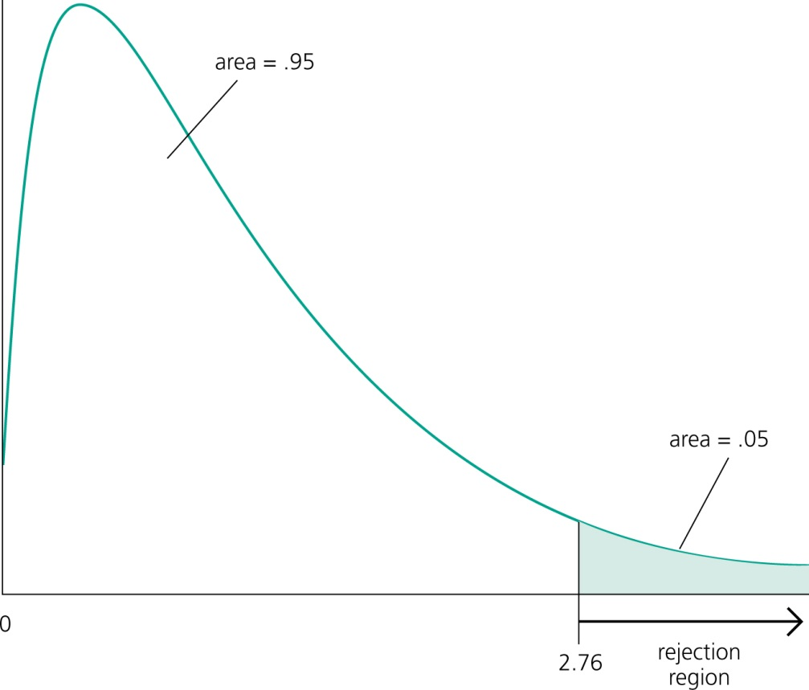
INFERENCE: The F Test
e Rejection rule
A F-distributed variable only takes on positive values. This corresponds to the fact that the sum of squared residuals can only increase if one moves from H₁ to H₀.
Choose the critical value so that the null hypo-thesis is rejected in, for example, 5% of the cases, although it is true.

Slide 25
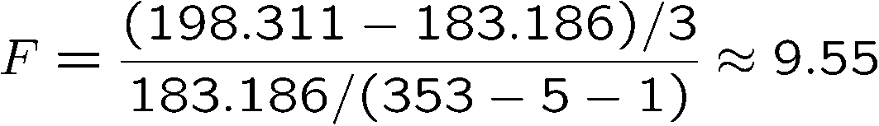
INFERENCE: The F Test
e Test decision in example
e Discussion
  The three variables are „jointly significant“
  They were not significant when tested individually
  The likely reason is multicollinearity between them
Number of restrictions to be tested
Degrees of freedom in
the unrestricted model
The null hypothesis is overwhel-mingly rejected (even at very small significance levels).

Slide 26

INFERENCE: The F Test
e Test of overall significance of a regression
e The test of overall significance is reported in most regression packages; the null hypothesis is usually overwhelmingly rejected
The null hypothesis states that the explanatory variables are not useful at all in explaining the dependent variable
Restricted model
(regression on constant)

Slide 27
GOODNESS OF FIT MEASURE
e We know that education and experience have a significant influence on wages
e But how important are they in determining wages?
e How much of difference in wages between people is explained by differences in education and in experience?
e How well variation in the independent variable(s) explains variation in the dependent variable?
e This are the questions answered by the goodness of fit measure - R²

Slide 28
TOTAL AND EXPLAINED VARIATION
e Total variation in the dependent variable:
e Predicted value of the dependent variable = part that is explained by independent variables:
(case of regression line - for simplicity of notation)
e Explained variation in the dependent variable:

Slide 29
GOODNESS OF FIT - R²
e Denote:
e Define the measure of the goodness of fit:
_{R2 =} SSE ₌ Explained variation in y SST Total variation in y

Slide 30
GOODNESS OF FIT - R²
e In all models: 0 ≤ R² ≤ 1
e R² tells us what percentage of the total variation in the dependent variable is explained by the variation in the independent variable(s)
R² = 0.3 means that the independent variables can explain 30% of the variation in the dependent variable
e Higher R² means better fit of the regression model (not necessarily a better model!)

Slide 31
DECOMPOSING THE VARIANCE
e For models with intercept, R² can be rewritten using the decomposition of variance.
e Variance decomposition:

Slide 32
VARIANCE DECOMPOSITION AND R²
e Variance decomposition: SST = SSE + SSR
e Intuition: total variation can be divided between the explained variation and the unexplained variation
the true value y is a sum of estimated (explained) $\grave{y }$and the
residual e_{i} (unexplained part)
e We can rewrite R²:
SSE SST − SSR SST
SSR SST
2
R =
=
= 1 −
SST

Slide 33
ADJUSTED R²
e The sum of squared residuals (SSR) decreases when additional explanatory variables are introduced in the model, whereas total sum of squares (SST) remains the same
2 SSR
R = 1 − increases if we add explanatory variables
SST
Models with more variables automatically have better fit.
e To deal with this problem, we define the adjusted R²:
SSR
n−k−1
SST
n−1
._{≤ R2}
_{R}2
= 1 −
adj
(k is the number of coefficients)
e This measure introduces a “punishment” for including more explanatory variables

Slide 34
FOUR IMPORTANT SPECIFICATION CRITERIA
Does a variable belong to the equation?
Theory: Is the variable’s place in the equation unambiguous and theoretically sound? Does intuition tells you it should be included?
t-test: Is the variable’s estimated coefficient significant in the expected direction?
R²: Does the overall fit of the equation improve (enough) when the variable is added to the equation?
Bias: Do other variables’ coefficients change significantly when the variable is added to the equation?

Slide 35
FOUR IMPORTANT SPECIFICATION CRITERIA
e If all conditions hold, the variable belongs in the equation
e If none of them holds, the variable is irrelevant and can be safely excluded
e If the criteria give contradictory answers, most importance should be attributed to theoretical justification
Therefore, if theory (intuition) says that variable belongs to the equation, we include it (even though its coefficients might be insignificant!).

