Slide 1
LECTURE 8
Introduction to Econometrics
Multicollinearity & Heteroskedasticity
Hieu Nguyen
Fall semester, 2024

Slide 2
ON PREVIOUS LECTURES
We discussed the specification of a regression equation
Specification consists of choosing:
  correct independent variables (lecture 7: omitted or irrelevant)
  correct functional form (lecture 6)
  correct form of the stochastic error term

Slide 3
ON TODAY’S LECTURE
Today we will continue the discussion of choosing the correct independent variables by talking about multicollinearity
But also, we will start the discussion of the correct form of the error term by talking about heteroskedasticity
For both of these issues, we will learn
what is the nature of the problem
what are its consequences
how it is diagnosed
what are the remedies available

Slide 4
PERFECT MULTICOLLINEARITY
Some explanatory variable is a perfect linear function of one or more other explanatory variables
Violation of one of the classical assumptions
OLS estimate cannot be found
Intuitively: the estimator cannot distinguish which of the explanatory variables causes the change of the dependent variable if they move together
  Technically: the matrix X'X is singular (not invertible)
Rare and easy to detect
  Usually an obvious mistake: e. g. full set of dummies and a constant

Slide 5
EXAMPLES OF PERFECT MULTICOLLINEARITY
Dummy variable trap
Inclusion of dummy variable for each category in the model with intercept
Example: wage equation for sample of individuals who have high-school education or higher:
wage_{i} = β₁ + β₂high school_{i} + β₃university_{i} + β₄phd_{i} + e_{i}
Automatically detected by most statistical softwares

Slide 6
IMPERFECT MULTICOLLINEARITY
Two or more explanatory variables are highly correlated in the particular data set
OLS estimate can be found, but it may be very imprecise
Intuitively: the estimator can hardly distinguish the effects of the explanatory variables if they are highly correlated
Technically: the matrix X^{j}X is nearly singular and this
causes the variance of the estimator
to be very large
Usually referred to simply as “multicollinearity”

Slide 7
CONSEQUENCES OF MULTICOLLINEARITY
Estimates remain unbiased and consistent (estimated coefficients are not affected)
Standard errors of coefficients increase
Confidence intervals are very large - estimates are less reliable
t-statistics are smaller - variables may become insignificant

Slide 8
DETECTION OF MULTICOLLINEARITY
Some degree of multicollinearity exists in every equation - the aim is to recognize when it causes a severe problem
Multicollinearity can be signaled by the underlying theory, but it is very sample depending
We judge the severity of multicollinearity based on the properties of our sample and on the results we obtain
One simple method: examine correlation coefficients between explanatory variables (run covariance)
if some of them is too high, we may suspect that the coefficients of these variables can be affected by multicollinearity

Slide 9
EXAMPLE
Estimating the demand for gasoline in the U.S.:
PCON_{i} | . . . | petroleum consumption in the i-th state
TAX_{i} | . . . | the gasoline tax rate in the i-th state
UHM_{i} | . . . | urban highway miles within the i-th state
REG_{i} | . . . | motor vehicle registrations in the i-the state

Slide 10
EXAMPLE
We suspect a multicollinearity between urban highway miles and motor vehicle registration across states, because those states that have a lot of highways might also have a lot of motor vehicles.
Therefore, we might run into multicollinearity problems. How do we detect multicollinearity?
Look at correlation coefficient. It is indeed huge (0.978).
Look at the coefficients of the two variables. Are they both individually significant? UHM is significant, but REG is not. This further suggests a presence of multicollinearity.
Remedy: try dropping one of the correlated variables.

Slide 11
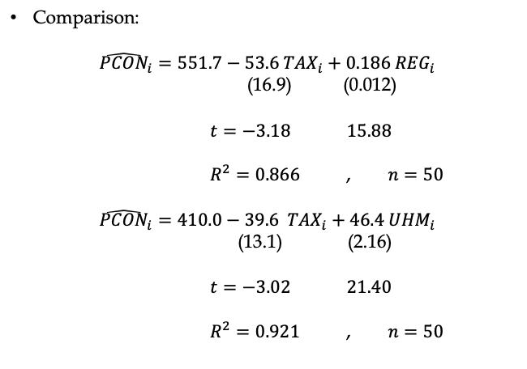
EXAMPLE
Comparison:
$${\hat{PCON}}_{i}=551.7−53.6{ TAX}_{i}+0.186 {REG}_{i}$$
(16.9) (0.012)
$t=−3.18$ $15.88$
$R^{2}=0.866$ , $n=50$
$${\hat{PCON}}_{i}=410.0−39.6 { TAX}_{i}+46.4 {UHM}_{i}$$
(13.1) (2.16)
$t=−3.02$ $21.40$
$R^{2}=0.921$ , $n=50$

Slide 12
REMEDIES FOR MULTICOLLINEARITY
Drop a redundant variable
when the variable is not needed to represent the effect on the dependent variable
in case of severe multicollinearity, it makes no statistical difference which variable is dropped
theoretical underpinnings of the model should be the basis
for such a decision
Do nothing
when multicollinearity does not cause insignificant t-scores or unreliable estimated coefficients
deletion of collinear variable can cause specification bias
Increase the size of the sample
the confidence intervals are narrower when we have more observations

Slide 13
REMEDIES FOR MULTICOLLINEARITY
Transform the multicollinear variables
  in case when all variables are extremely important on theoretical grounds
  we can try various transformations:
    Combination of multicollinear variables
    First differences (for time series)
    Increase the size of the sample (the confidence intervals are narrower when we have more observations)

Slide 14
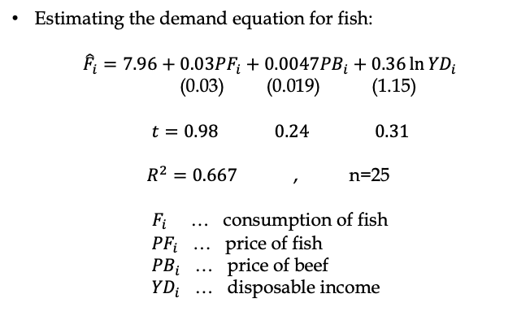
EXAMPLE
Estimating the demand equation for fish:
$${\hat{F}}_{i}=7.96+0.03{PF}_{i}+0.0047{PB}_{i}+0.36\ln{{YD}_{i}}$$
(0.03) (0.019) (1.15)
$t=0.98$ $0.24$ $0.31$
$R^{2}=0.667$ , n=25
$F_{i}$ … consumption of fish
${PF}_{i}$ … price of fish
${PB}_{i}$ … price of beef
${YD}_{i}$ … disposable income

Slide 15
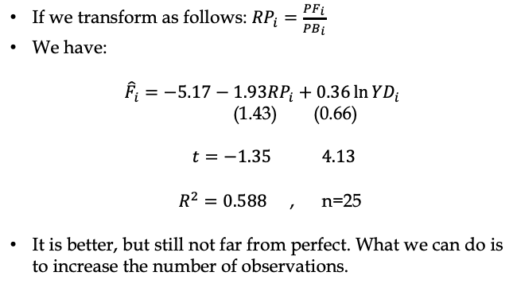
EXAMPLE
If we transform as follows: ${RP}_{i}=\frac{{PF}_{i}}{{PB}_{i}}$
We have:
$${\hat{F}}_{i}=−5.17−1.93{RP}_{i}+0.36\ln{{YD}_{i}}$$
(1.43) (0.66)
$t=−1.35$ $4.13$
$R^{2}=0.588$ , n=25
It is better, but still not far from perfect. What we can do is to increase the number of observations.

Slide 16
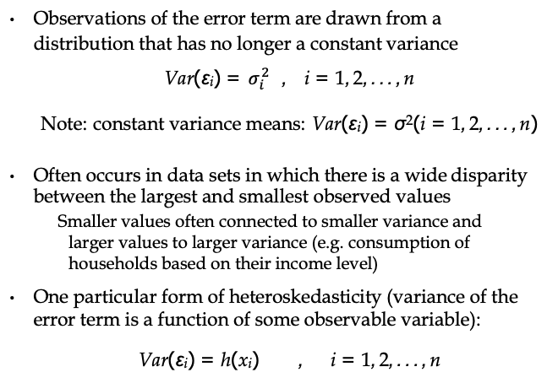
HETEROSKEDASTICITY
Observations of the error term are drawn from a distribution that has no longer a constant variance
Var(ε_{i}) = $σ_{i}^{2}$ , i = 1, 2, . . . , n
Note: constant variance means: Var(ε_{i}) = σ²(i = 1, 2, . . . , n)
Often occurs in data sets in which there is a wide disparity between the largest and smallest observed values
Smaller values often connected to smaller variance and larger values to larger variance (e.g. consumption of households based on their income level)
One particular form of heteroskedasticity (variance of the error term is a function of some observable variable):
Var(ε_{i}) = h(x_{i}) , i = 1, 2, . . . , n

Slide 17
HETEROSKEDASTICITY
Y
X

Slide 18
CONSEQUENCES OF HETEROSKEDASTICITY
Violation of one of the classical assumptions
Estimates remain unbiased and consistent (estimated coefficients are not affected)
Estimated standard errors of the coefficients are biased
heteroskedastic error term causes the dependent variable to fluctuate in a way that the OLS estimation procedure attributes to the independent variable
heteroskedasticity biases t statistics, which leads to unreliable hypothesis testing
typically, we encounter underestimation of the standard errors, so the t scores are incorrectly too high

Slide 19
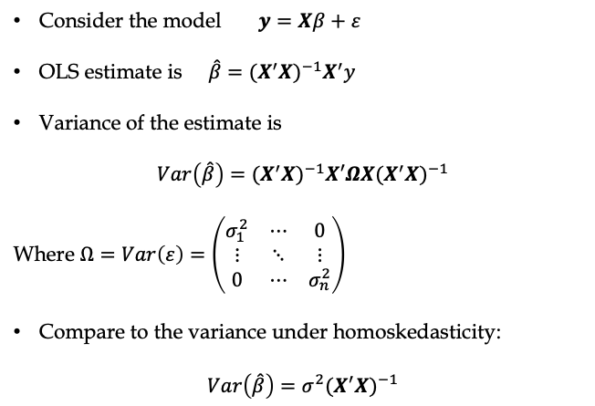
VARIENCE OF OLS UNDER HETEROSKEDASTICITY
Consider the model $y=Xβ+ε$
OLS estimate is $\hat{β}=(X^{′}X)^{−1}X^{′}y$
Variance of the estimate is
$$Var\left(\hat{β}\right)=(X^{′}X)^{−1}X′ΩX(X^{′}X)^{−1}$$
Where $Ω=Var\left(ε\right)=\left(\begin{matrix}σ_{1}^{2} & ⋯ & 0 \\ ⋮ & ⋱ & ⋮ \\ 0 & ⋯ & σ_{n}^{2}\end{matrix}\right)$
Compare to the variance under homoskedasticity:
$$Var\left(\hat{β}\right)=σ^{2}(X^{′}X)^{−1}$$

Slide 20
DETECTION OF HETEROSKEDASTICITY
There is a battery of tests for heteroskedasticity
Sometimes, simple visual analysis of residuals is sufficient to detect heteroskedasticity
We will derive a test for the model
y_{i} = β₀ + β₁x_{i} + β₂z_{i} + ε_{i}
The test is based on analysis of residuals
The null hypothesis for the test is no heteroskedasticity:
E(e²) = σ²
Therefore, we will analyse the relationship between e² and explanatory variables

Slide 21
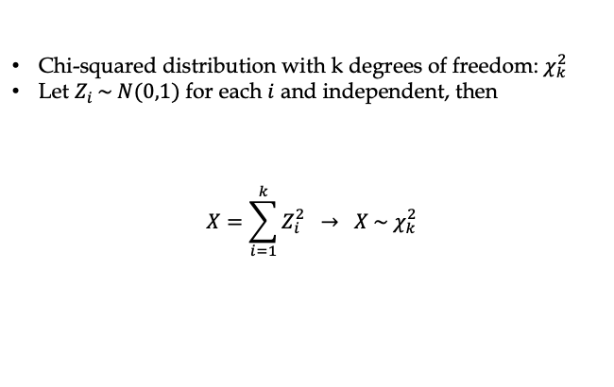
CHI SQUARED DISTRIBUTION
Chi-squared distribution with k degrees of freedom: $χ_{k}^{2}$
Let $Z_{i }\sim N(0,1)$ for each $i$ and independent, then
$$X=\sum_{i=1}^{k}{Z_{i}^{2} → X \sim χ_{k}^{2}}$$

Slide 22
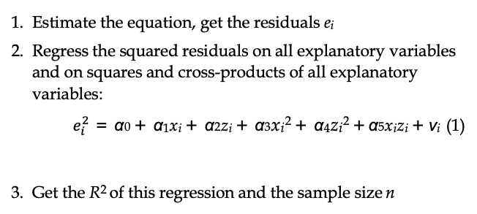
WHITE TEST FOR HETEROSKEDASTICITY
Estimate the equation, get the residuals e_{i}
Regress the squared residuals on all explanatory variables and on squares and cross-products of all explanatory variables:
$e_{i}^{2}$ = α₀ + α₁x_{i} + α₂z_{i} + α₃x_{i}² + α₄z_{i}² + α₅x_{i}z_{i} + ν_{i} (1)
Get the R² of this regression and the sample size n
4. Test the joint significance of (2): test statistic
where k is the number of slope coefficients in (2)
5. If nR² is larger than the χ² critical value, then we have to
k
reject H₀ of no heteroskedasticity

Slide 23
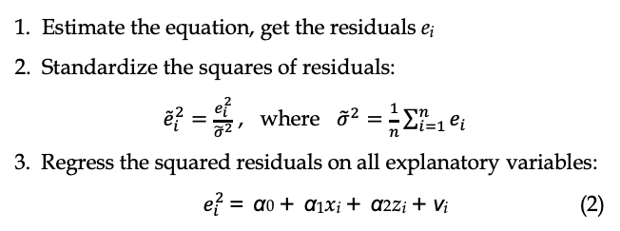
BREUSCH PAGAN TEST FOR HETEROSKEDASTICITY
Estimate the equation, get the residuals e_{i}
Standardize the squares of residuals:
${\tilde{e}}_{i}^{2}=\frac{e_{i}^{2}}{{\tilde{σ}}^{2}}$ , where ${\tilde{σ}}^{2}=\frac{1}{n}\sum_{i=1}^{n}{e_{i}}$
3. Regress the squared residuals on all explanatory variables:
$e_{i}^{2}$ = α₀ + α₁x_{i} + α₂z_{i} + ν_{i} (2)
4. Get the R² of this regression and the sample size n
5
6. If nR² is larger than the χ² critical value, then we have to reject H₀ of no heteroskedasticity

Slide 24
REMEDIES FOR HETEROSKEDASTICITY
Redefining the variables
in order to reduce the variance of observations with extreme values
e.g. by taking logarithms or by scaling some variables
Weighted Least Squares (WLS)
consider the model y_{i} = β₀ + β₁x_{i} + β₂z_{i} + ε_{i}
suppose Var(ε_{i}) = σ²z²_{i}
it can be proved that if we redefine the model as
it becomes homoskedastic
3. Heteroskedasticity-corrected robust standard errors

Slide 25
HETEROSKEDASTICITY-CORRECTED ROBUST ERRORS
The logic behind:
Since heteroskedasticity causes problems with the standard errors of OLS but not with the coefficients, it makes sense to improve the estimation of the standard errors in a way that does not alter the estimate of the coefficients (White, 1980)
Heteroskedasticity-corrected standard errors are typically larger than OLS s.e., thus producing lower t scores
In panel and cross-sectional data with group-level variables, the method of clustering the standard errors is the desired answer to heteroskedasticity

Slide 26
SUMMARY
Multicollinearity
does not lead to inconsistent estimates, but it makes them lose significance
if really necessary, can be remedied by dropping or transforming variables, or by getting more data
Heteroskedasticity
does not lead to inconsistent estimates, but invalidates inference
can be simply remedied by the use of (clustered) robust standard errors
Readings:
Studenmund Chapter 8 and 10
Wooldridge Chapter 8

