Slide 1
Activity Based Costing (ABC)
Ladislav Šiška

Slide 2
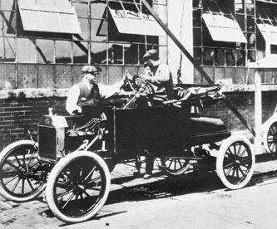
Why Activity Based Costing?
“You can have any colour,
as long as it's black.“
v. Today?

Slide 3
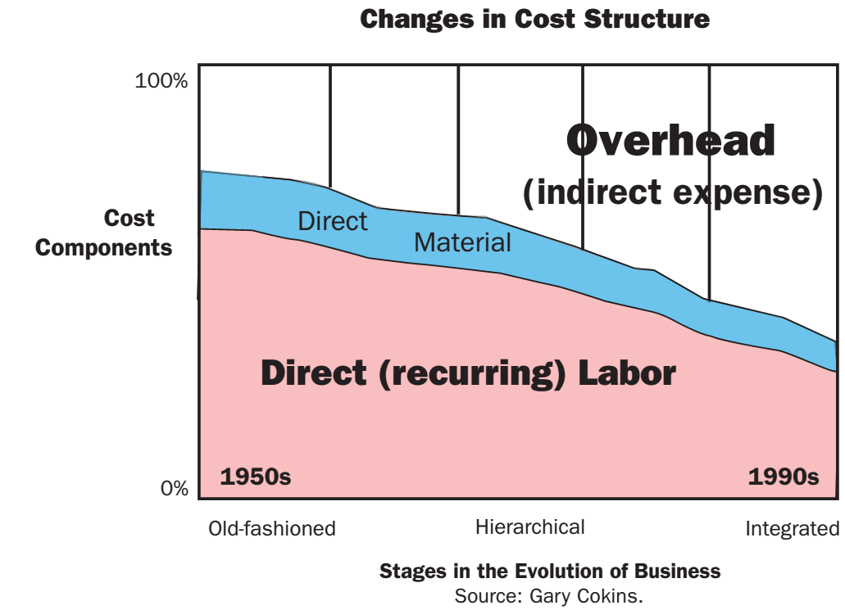
Why Activity Based Costing?
Trends like
complex structure of products
multiple orders and shor delivery times
quality requirements
shortening of product life-cycle
differentiation and customisation of products
=>

Slide 4
Innovations in Management Accounting (MA)
1980s Criticism of MA developmnet
  H. Thomas Johnson, Robert S. Kaplan
  minimal progress after 1925
Main concepts:
    Activity Based Costing / Management (1980s/1990s)
    Target Costing (Japan, 1990s)
    Life Cycle Costing
    Balanced Scorecard (1996)
    in German speaking countries
    – Controlling (Controllership)

Slide 5
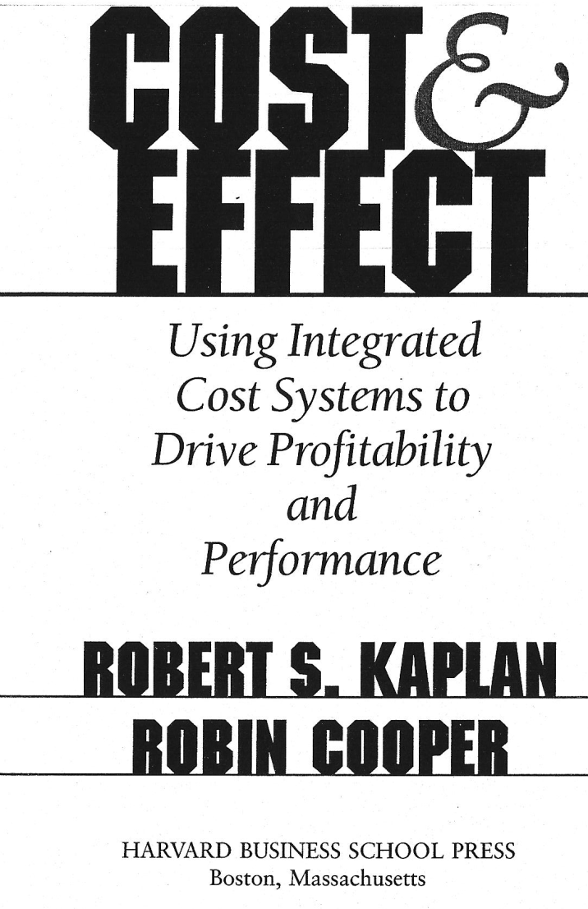
Activity Based Costing
initiated by CAM-I
  „Consortium of Advanced Management International“
  (originally Industrial)
  http://www.cam-i.org/
wide spread through consultants
German-speaking countries
  Prozesskostenrechnung, Aktivitätskostenrechnung
  R.S.Kaplan, R.Cooper (1989)

Slide 6
Traditional Costs Allocation
Direct Costs CZK 43,615,285
Indirect Costs CZK 47,952,293
1st stage
Manufacturing centres
Service centr.
Distrib. and admin c.
2nd stage
CZK 11,412,943 CZK10,441,548 CZK 21,760,795
? CZK ? CZK ? CZK
Wardrobes Tables Drawers
5 000 pcs. 7 000 pcs. 8 080 pcs.
How to assign indirect cost?

Slide 7
Logic of Activity Based Costing
Direct Costs CZK 43,615,285
Indirect Costs CZK 47,952,293
Manufacturing centres
Service centr.
1st stage
Distrib. and admin c.
Resource
Cost Drivers
(RCD)
Processing
Machine set-ups
Assembly…
Repairs
Customer Care
Acc.…
HR
...
Activities
2nd stage
Activity
Cost Drivers
(ACD)
… allocation of other activities costs
CZK 11,412,943 CZK10,441,548 CZK 21,760
? CZK ? CZK ? CZK
Wardrobes Tables Drawers
5 000 pcs. 7 000 pcs. 8 080 pcs.

Slide 8
ABC terminology
Activities
    parts of the whole company process
    = sub-processes
Cost objects
Cost drivers
    analogy to allocation bases
Cost pools
    analogy to cost centres (Drury, 2012)
    collection of activities cost

Slide 9
Designing ABC systems (1/2)
Identify the major activities :
  reasonable level of aggregation
    max 5 % of resource capacity [Kaplan, Cooper (1998): Cost and Effect]
  Choice of activities influenced by
    the total cost of the activity centre and
    the ability of a single cost driver to provide a satisfactory determinant of the cost of the activity.
Assign costs to cost pools (cost centre) for each activity:
  Costs assigned to activity cost pools include
    direct and
    indirect costs - resource cost drivers (RCD)
    used to assign them

Slide 10
Designing ABC systems (2/2)
Determine the activity cost driver for each activity:
  they should:
    provide a good explanation of costs of each activity pool.
    be easily measurable
    the data easy to obtain and identifiable with the product.
  ACD classification:
    transaction ACD
    duration ACD
    intensity ACD
Assign the cost of activities to products

Slide 11
A comparison of traditional and ABC systems
Traditional cost systems
Activity-based systems
two-stage allocation process
  the first stage to allocate costs to departments
  the second stage: smaller number of usually
  volume-based cost drivers (typically direct labour hours DLH or machine hours)
traditional systems often rely on arbitrary allocation bases
two-stage allocation process
  the first stage to allocate costs to activities
  (ABC systems tend to have more cost centres/cost pools)
  the second stage: ABC systems use many second stage cost drivers.
ABC systems seek to use only cause-and-effect

Slide 12
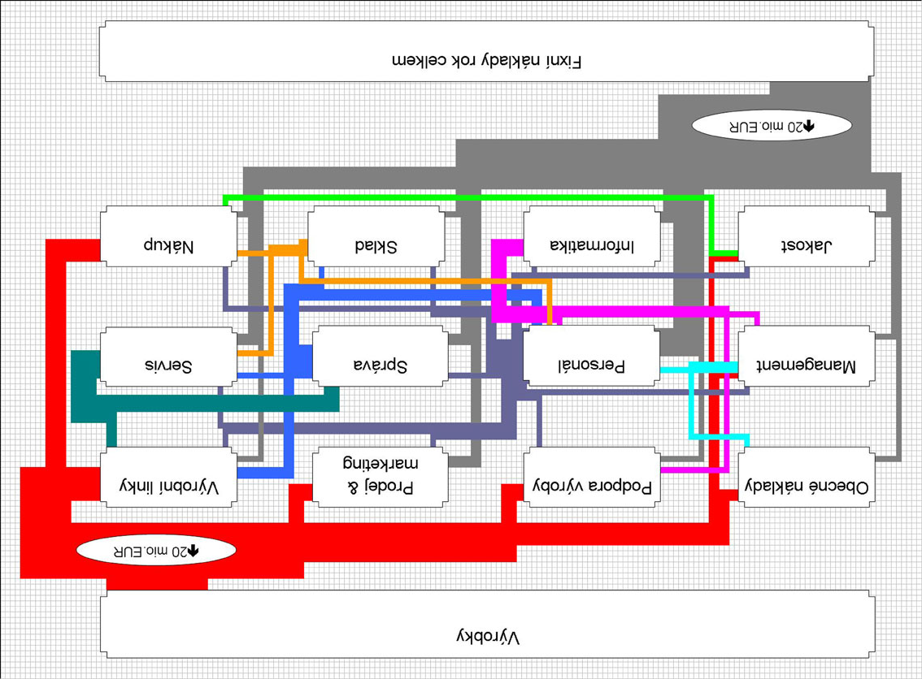
Multistage Activity Based Costing
Indirect cost
20M €
Procurement
Warehouse
IT
Quality
Maintenan.
Admin
HR
Mngt
Production
Marketing
Support
Unused Capacity
20M €
Products
Zdroj: Nekvapil, Tomáš. Jak změnit dva problémy v jednu přednost: příklad TRW Autoelektronika, s.r.o., 2006. (dostupné též na http://abcosting.biz)
Notes:
vlevo, nahoře a dole – vstupy
vpravo - výstupy

Slide 13
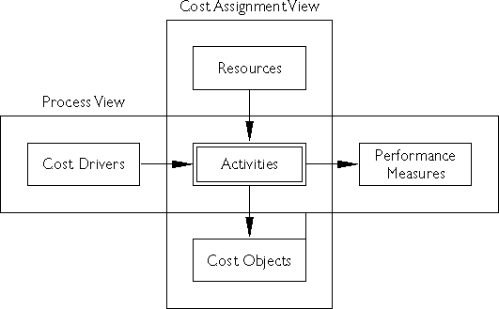
ABC Effects: AB management
„CAM-I Cross“
ABC can be used for a range of cost management applications besides product costing.

Slide 14
ABC Effects:
Classification of activities (1/2)
Unit-level activities:
  Performed each time a unit of goods is produced.
  Resources are consumed in proportion to the number of units of the product or service produced or sold.
  Examples:
    Direct materials and labour, energy costs,expenses consumed in proportion to machine processing time
Batch-related activities:
  Performed each time a batch of goods is produced.
  Costs vary with the number of batches made.
  Examples:
    set-ups, purchase ordering, first-item inspection activities.

Slide 15
ABC Effects:
Classification of activities (2/2)
Product/service sustaining activities:
  Performed to enable the production of individual goods
  Examples:
    activities related to maintaining an accurate bill of materials, preparing engineering change notices
Facility-sustaining
(or business-sustaining) activities:
  Performed to support the organization as a whole.
  Examples:
    plant management, property costs, salaries of general administrative staff, general selling and marketing expenses
  Common to all products and services
  => not allocated to products/services

Slide 16
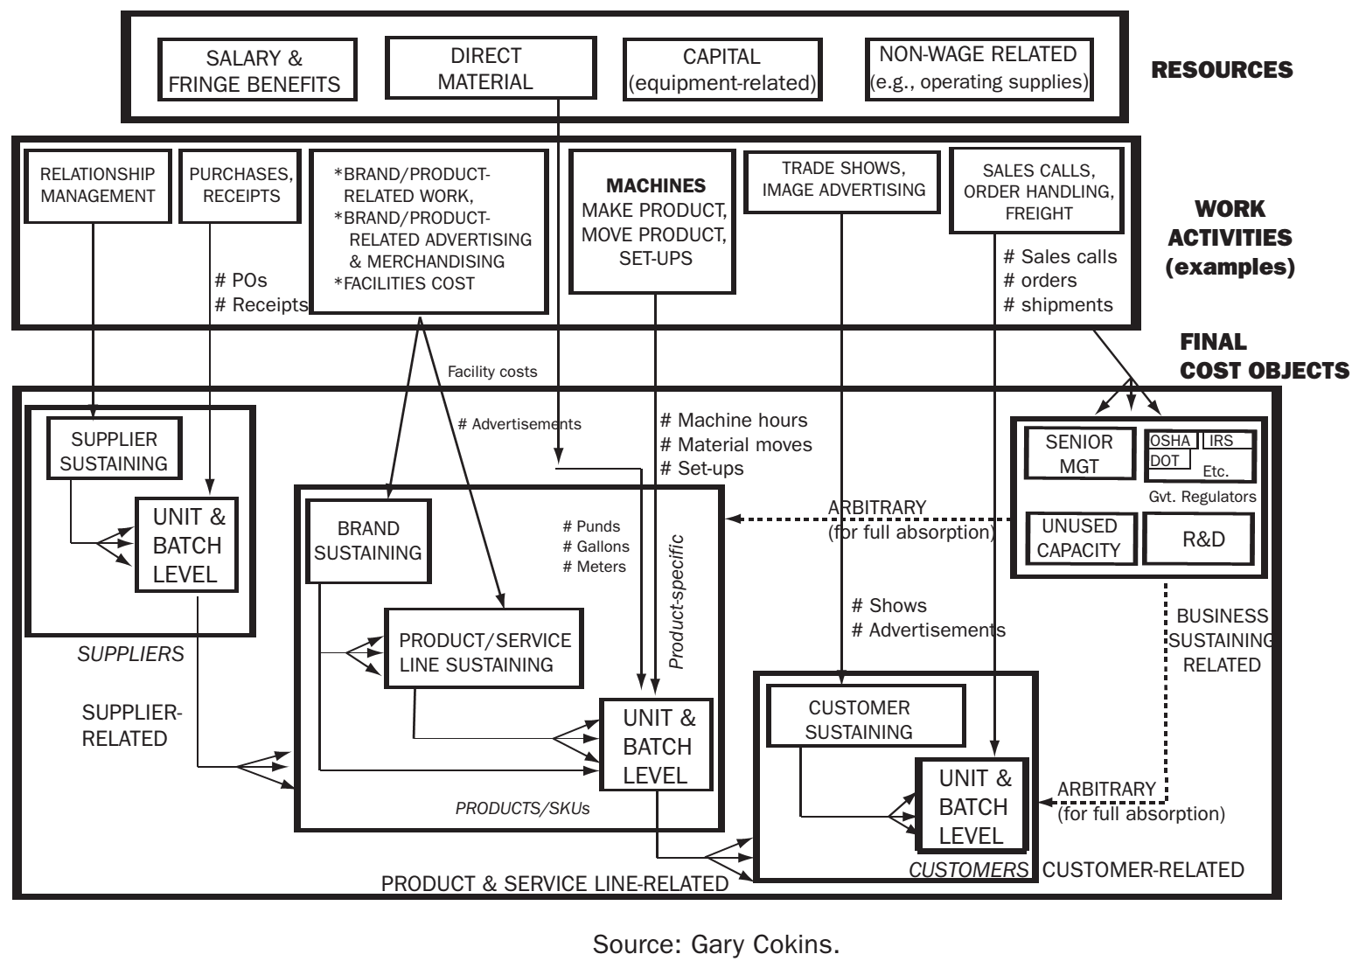
Model ABC
ABC Effects: Different cost objects
Notes:
„potravní řetězec“ á la Cokins
in this exhibit is the customer, ultimately consumes all the other final cost object costs, with
the exception of the business sustaining costs.
Each of the major final cost object categories
(e.g., supplier, product/service line, and customer) has its own “sustaining costs” that are
assignable to its end-product or customer. When
tracing these “sustaining costs,” however, one
cannot apply a measurable product- or customerspecific quantity. For example, a product branding
program from the marketing department may benefit only a select group of products, but how much
of the branding cost should be charged to each
specific product within the brand? Even though
there is no cause-and-effect relationship, these
“product sustaining costs” can be traced using
some “shared” basis, such as sales unit-volume,
or be spread evenly.

Slide 17
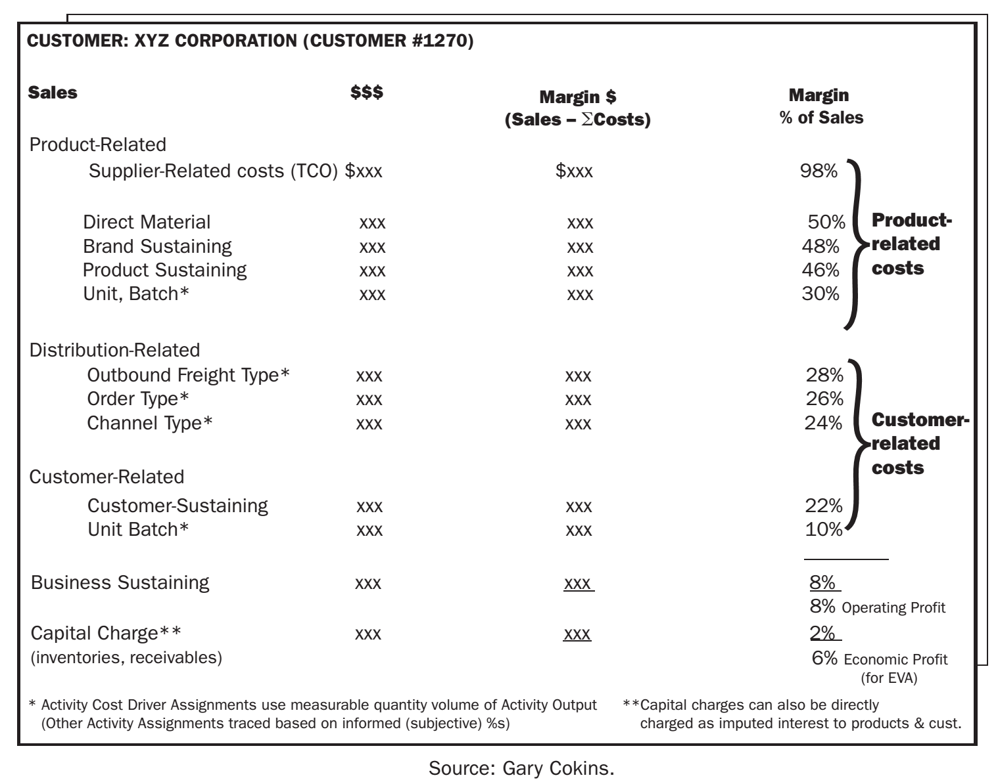
Cost object: customer
podle účelu
může být
vhodnější
retrográdní
vzorec
Zdroj: Drury (2012)

Slide 18
Customer profitability

Slide 19
ABC Effects: Customer Profitability
manufacturing costs of typical products
are customer independent
MSDA (=Marketing, Selling, Distribution, Administrative) overheads allocated:
  usually the cost objects are customers not products
    traditional allocation:
    Activity-based allocation:
MSDA
caused by Department
Allocation base
Customer
MSDA
caused by Resource
Resource
Cost
Driver
Activity
Activity
Cost
Driver
Customer

Slide 20
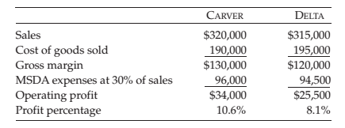
Customer Profitability
Example
traditional allocation of MSDA Expenses
MSDA
caused by Department
Allocation base
Customer

Slide 21
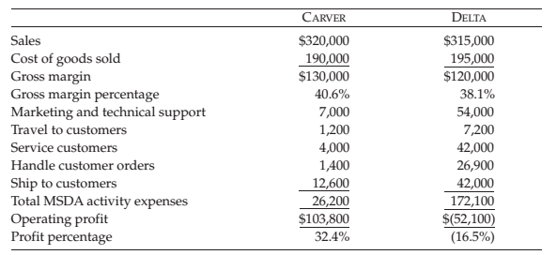
Customer Profitability
Example
Activity based allocation of MSDA Expenses
MSDA
caused by Resource
Resource
Cost
Driver
Activity
Activity
Cost
Driver
Customer

Slide 22
Customers’ segmentation
High Cost-to-Serve Customers
Low Cost-to-Serve Customers
Order custom products
Small order quantities
Unpredictable order arrivals
Customized delivery
Change delivery requirements
Manual processing; high order error rates
Large amounts of pre-sales support (marketing, technical, and sales resources)
Large amounts of post-sales support (installation, training, warranty, field service)
Pay slowly (have high accounts receivable)
Order standard products
High order quantities
Predictable order arrivals
Standard delivery
No changes in delivery requirements
Electronic processing (EDI) with zero defects
Little to no pre-sales support (standard pricing and ordering)
No post-sales support
Pay on time (low accounts receivable)

Slide 23
Customer porfolio visualisation

Slide 24
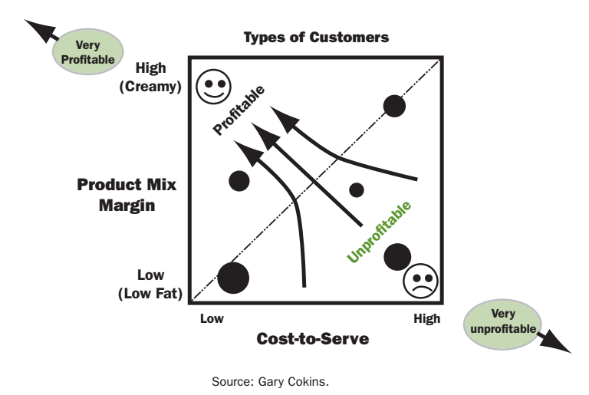
Zero-profit line

Slide 25
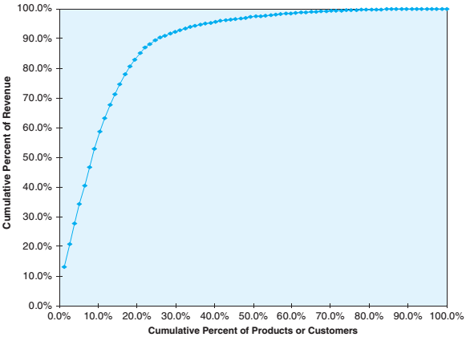
Whale curve
80–20 law applies wel to sales revenues:

Slide 26
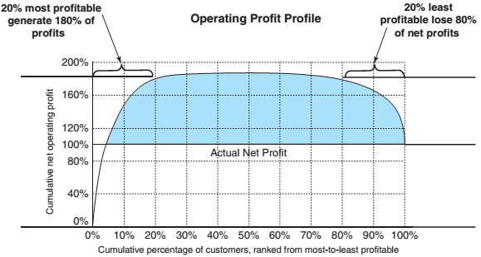
Whale curve
80-20 law does not apply to profits!
Whale curve
A graph of cumulative profits versus customers
The hump (or maximum height) of a cumulative profitability curve generally hits 150% to 250% of total profits, and this height is usually achieved by the most profitable 20% to 40% of customers
Customers’ segmentation

Slide 27


Opportunities to transform loss customers into profitable ones
Process Improvements
    Improve the processes used to produce, sell, deliver, and service the customer.
Activity based pricing
    menu-based pricing to allow the customer to select the features and services it wishes to receive and pay for.
Managing Relationships
    Enhance the customer relationship to improve margins and lower the cost to serve that customer.
    Customer life-time value (CLV):

Slide 28
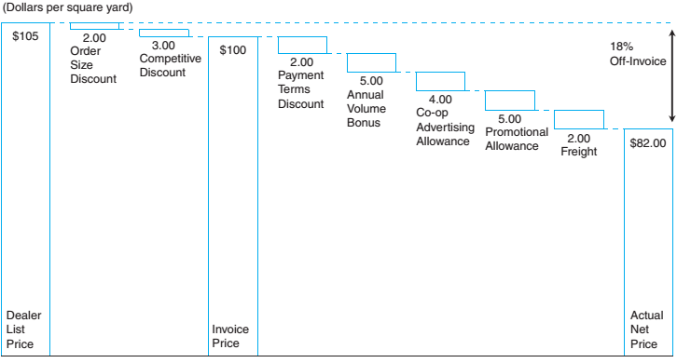
Opportunities to transform loss customers into profitable ones
Use more discipline in granting discounts and allowances
=>
avoiding „price waterfall“

Slide 29
Thank you for your attention!

