Slide 1
Microsoft 365 Business Central Introduction
(ERP=Microsoft Dynamics 365 Business Central)
Ing.J.Skorkovský,CSc.
Department of Business Management
Faculty of Business and Administration
Masaryk University Brno
Czech Republic

Slide 2
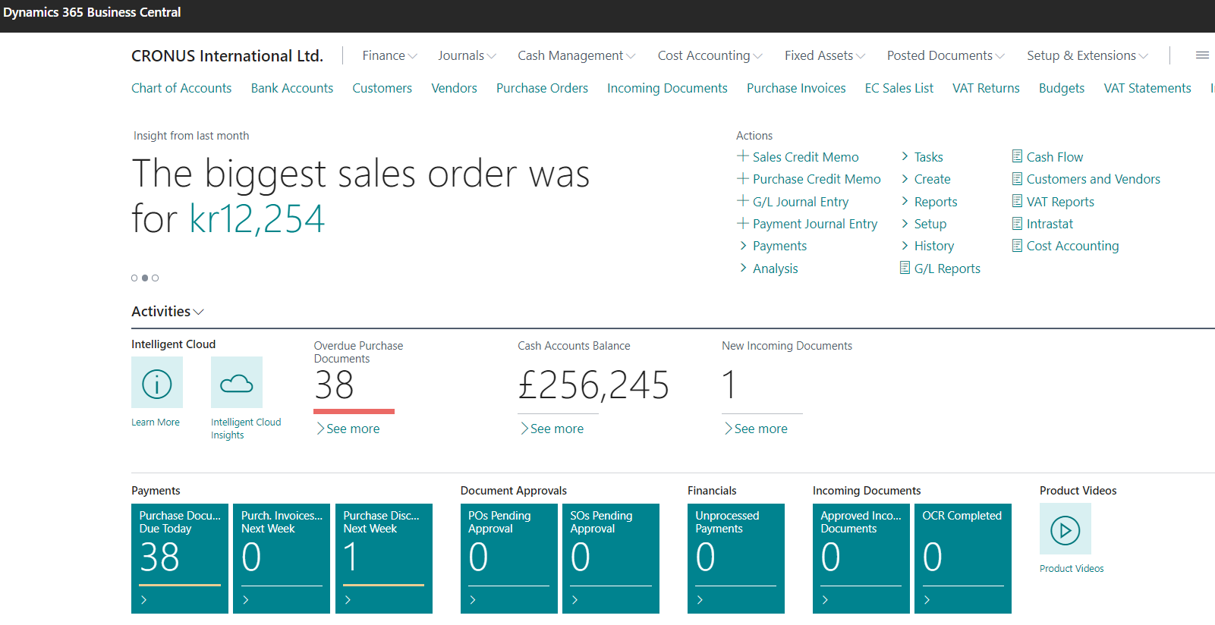

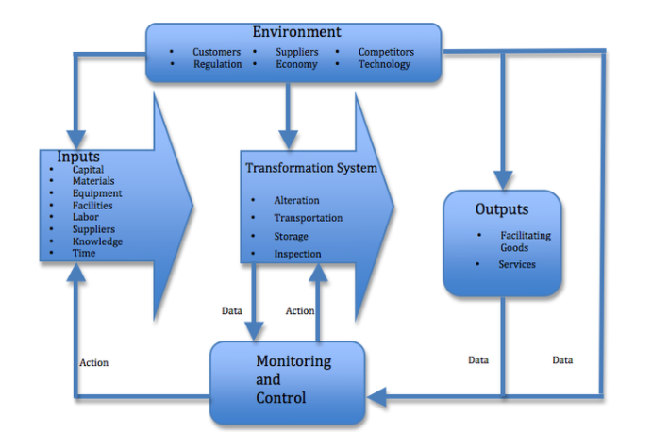
Principles
Data
Management philosophy
Information technology
Feedback

Slide 3
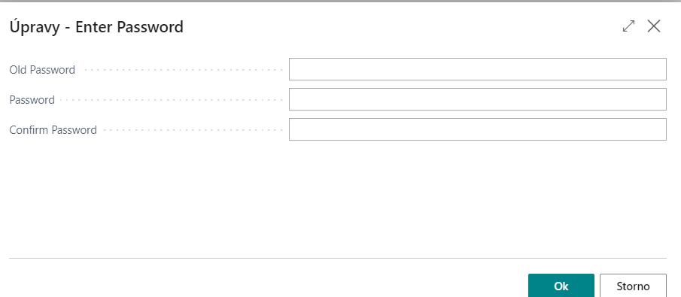
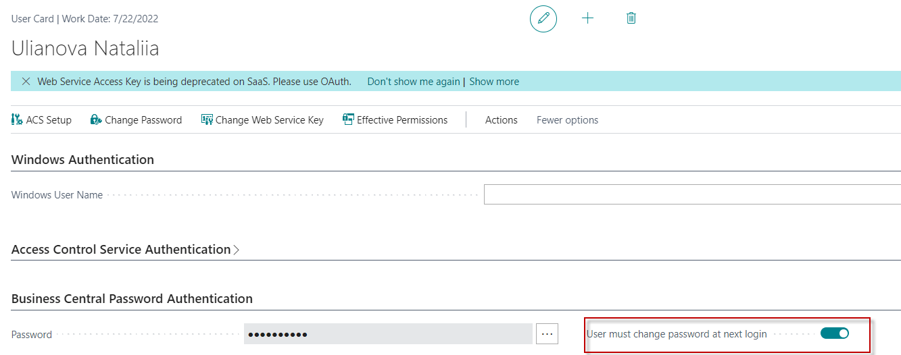
Access to BC
Your real UČO
Password1
secondary password
secondary password
https://dynamics-esf.ucn.muni.cz/514441
User name = UČO and 1st Password=Password1
The prime password for everyone (students only) is Password1, and enter a new password will be after login created by you. Use your secondary password.
Due to the user setting, you must have to enter a new password the first time you enter your ID and preset prime password=Password1.
After 1st login you will be asked to change this prime password to your unique password , in our course it will be secondary password.
Next logins will be always : ID= UČO and PSW= Student Secondary Password

Slide 4
Remote Access from your PC at home
If you are connected to the faculty network, then you only use one of these this links
  https://dynamics-esf.ucn.muni.cz/514441
If you are connected to a different network, then you must install the MUNI VPN on your computers (see instructions at the link provided below and a brief description of the procedure in this presentation ) and then access Business Central using either the same link as the one used if connected to ESF net or by use of
Access to the server is now possible only from the MU network. Access from other networks (from home or abroad) will now only be possible when using MUNI VPN.

Slide 5
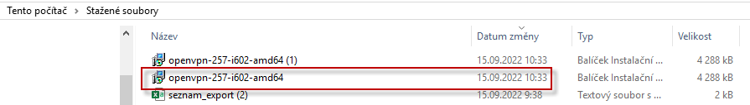
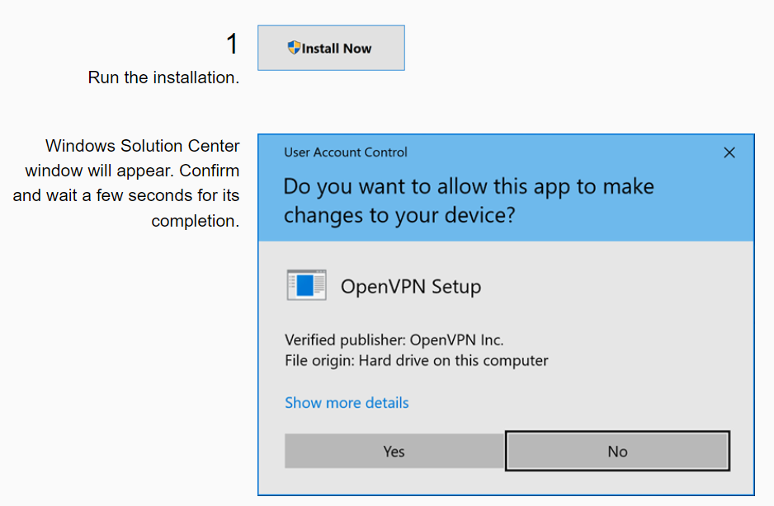
MUNI VPN I. (home study)
Every active MU student or staff member can make use of a VPN. In order to log in, one must use UČO and a secondary password as login data.
Download the OpenVPN client (for 32b system and 64b system). To find out the system type, click Start - Settings - System - About - System Type. Supported versions of Windows is 10 and 11. Older Windows operating systems are not supported.

Slide 6
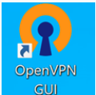
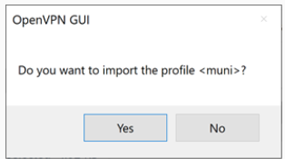
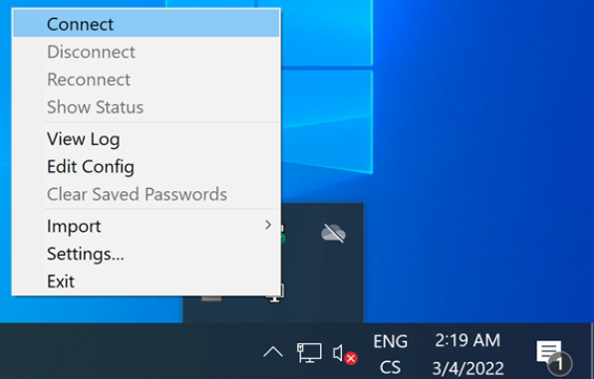
MUNI VPN II. (home study)
An icon of the freshly installed OpenVPN will appear on your desktop (and also right in the system taskbar).
Download the configuration file.
Start the file. You will be prompted to import the configuration. Accept it. If you want to send network traffic only to the MU network, you will find this option in FAQ.
After running the OpenVPN, a graphic interface icon will appear on the system taskbar. For connecting, tap the application icon and select Connect.

Slide 7
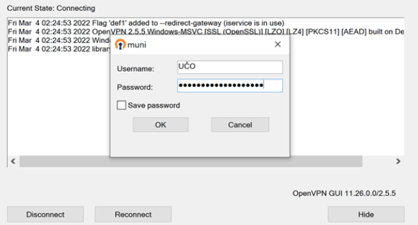
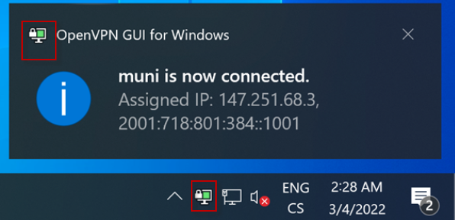
MUNI VPN III. (home study)
The application’s login window will appear. You will be asked to enter login data. Use your UČO as Username and your secondary password as Password, then confirm by tapping OK.

Slide 8


