Slide 1
Introduction to MS Dynamics 365 Business Central
Drop Shipment
Ing.J.Skorkovský,CSc.
Department of Business Management
Faculty of Business and Administration
Masaryk University Brno
Czech Republic

Slide 2
BC Basic procedures
Drop Shipment principles I
Drop shipment
  Principles -Reasons for using drop shipment
    Lower transport costs
    Faster delivery and and thus a shorter due date
    Zero costs for warehouse operations
    Golden Drop Shipment rule->shorter Cash-to-cash cycle
  Setup
  Model example
  Others

Slide 3
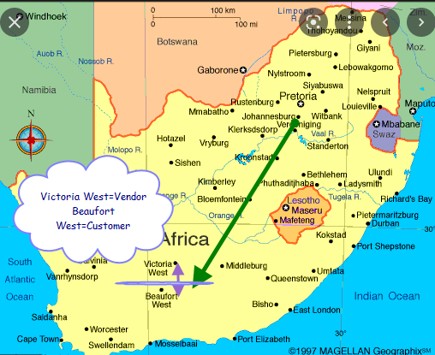
Maps and reasons
Our company
Wholesaler

Slide 4
Drop Shipment principles I.
Drop Shipment principles I.
Specifies whether your Vendor should ship the items on the line directly to your Customer.
You use a Drop shipment when an item or group of items is shipped directly from your Vendor to your Customer and is therefore not registered in inventory.
Vendor
1 | Quote
2 | Sales Order
3 | Purchase Order
4 | Delivery list and delivery itself
5 | Sales invoice
6 | Purchase invoice
3
4
Wholesaler
6
4
2
1
Customer
5

Slide 5
Drop Shipment principles – setup (see Sales Line)
Drop Shipment setup
First place a check mark in the field Drop Shipment to indicate, that the item on the Sales order line is a Drop shipment type and in the Purchase code field you have to choose Drop Shipment code
Then create a Purchase order to order the corresponding items from your Vendor. You can create the order directly from the Purchase Order or indirectly from the Requisition Worksheet (RQWS). In this part of model we will use firstly Direct method and later the one with RQWS.
When you set up the Purchase Order, use the function Drop Shipment and Get Sales Order to link to the relevant Sales Order. The Sales Order lines will be copied to the newly-created Purchase Order. We will not use Item tracking in this model and if Yes - > see next clause:
You cannot post a Drop Shipment order that has item tracking unless item tracking is synchronized - Serial numbers and Lot numbers must be the same between the two connected orders (our model uses synchronization)

Slide 6
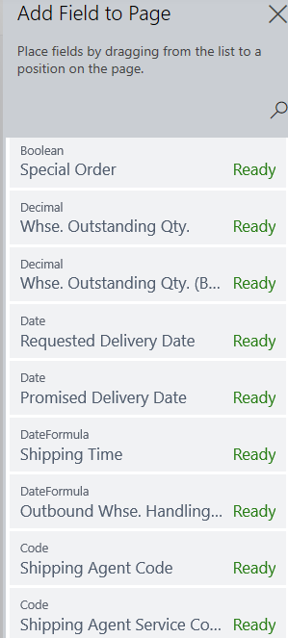
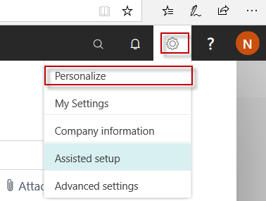

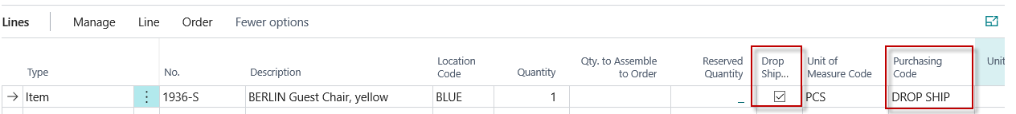
Personification od the Business Central lines
Setup Sales line
If these fields are not already visible in the sales line
Sales Order Line

Slide 7
Drop shipment-> method without using Requisition worksheet
Drop Shipment
Customer 10000
Header
Sales Order line

Slide 8
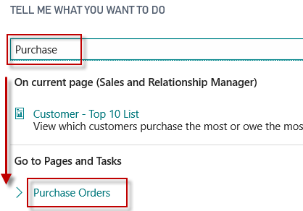
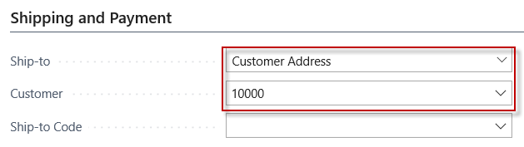
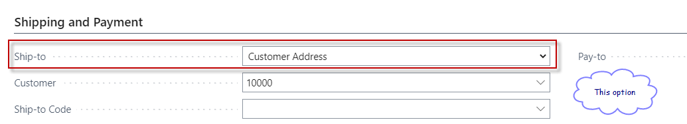
Purchase order –Drop shipment (manual version)
Drop Shipment
It is necessary to input Customer number on tab Shipping and Payment.
First action:
Our customer
See result on the next slide

Slide 9
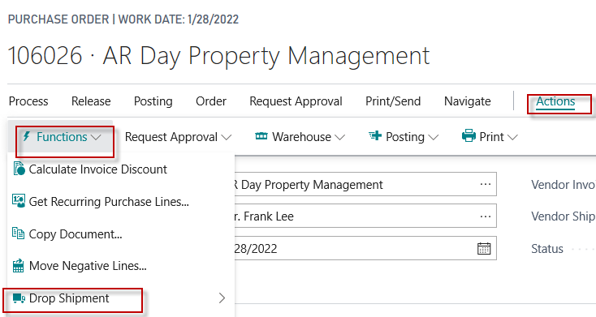

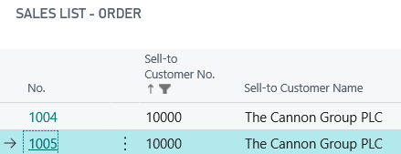
Drop shipment – Purchase Order- transfer of the Sales lines (one possible variant to get SO)
Purchase order creation
Next slide same operation different BC version
Second action (this will access list od Sales Order and you have to make a choice to copy SO in question)
Access to the Drop shipment and
icon Get Sales Order is essentially the same
See result on the next slide

Slide 10
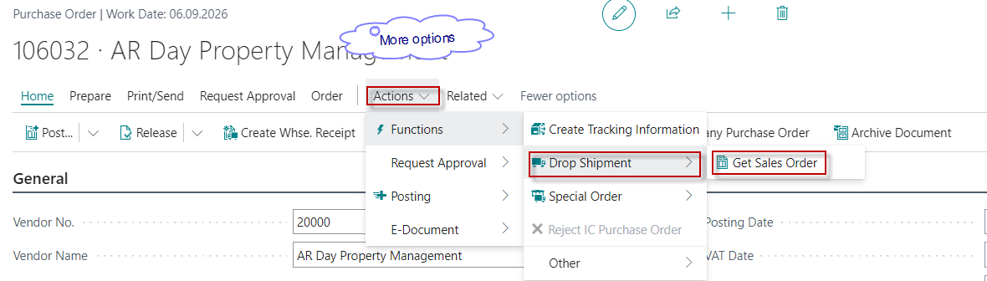
Drop shipment – Purchase Order- transfer of the Sales lines (BC version 23.5)
Access to the Drop shipment and
icon Get Sales Order is essentially the same

Slide 11
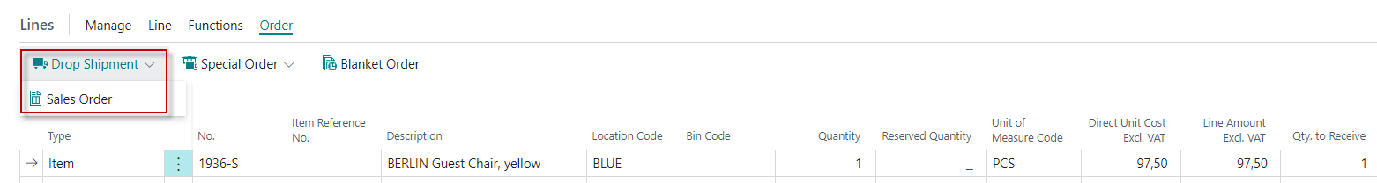
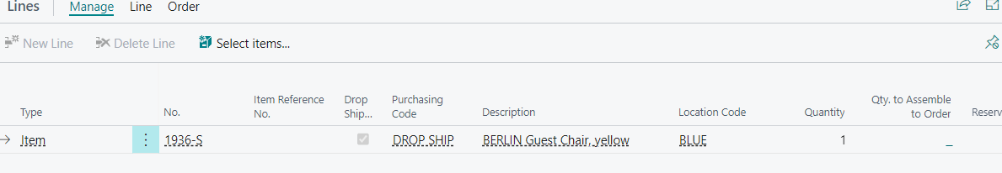
Purchase order line after copy Sales Order line
From here you can see the Sales Order,
which is directly linked to the Purchase Order

Slide 12
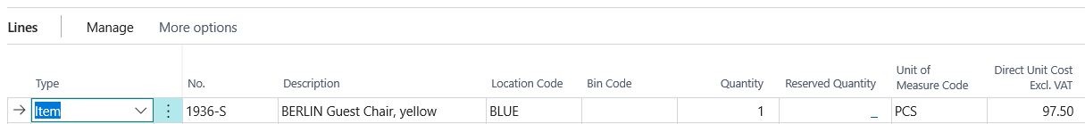
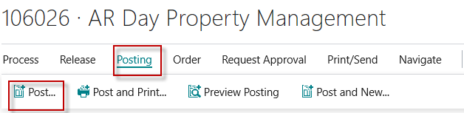
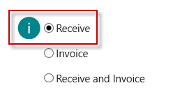
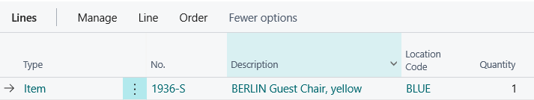

Purchase order –Drop shipment (manually created – Direct method)
Drop Shipment
Purchase order line after copy Sales Order line
Purchase order have to be posted (only Receive!!!)
Sales Order line after Purchase Order was posted as Received

Slide 13
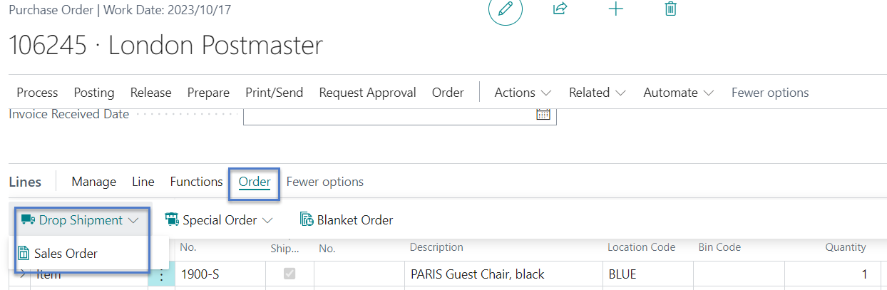
Relations Purchase order <–> Sales order
SO-PO link
It's already been shown once on one of the preceding slides (11)

Slide 14
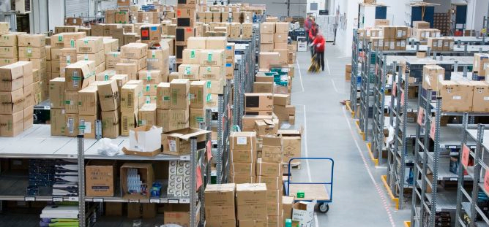
Golden Drop shipment rule
Golden Drop shipment rule
You cannot invoice the purchase order before the sales order is invoiced. If you try, you will get warning message
Go to internet to see cash-to-cash cycle oir next slide

Slide 15
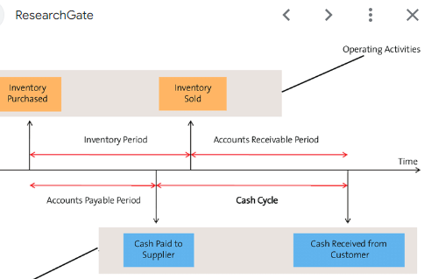
Cash-to-cash cycle
Cash-to-cash cycle
The cash to cash cycle is the time period between when a business pays cash to its suppliers for inventory and receives cash from its customers. The concept is used to determine the amount of cash needed to fund ongoing operations, and is a key factor in estimating financing requirements.
Cash flow

Slide 16
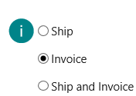
Sales order – Invoicing Sales Order
Drop Shipment
Sales Order line before invoicing
Sales Invoice line after invoicing

Slide 17
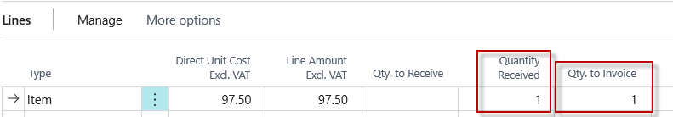

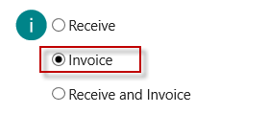
Posting PO (invoice only)
Drop Shipmnet
Part of the Purchase Order Line

Slide 18
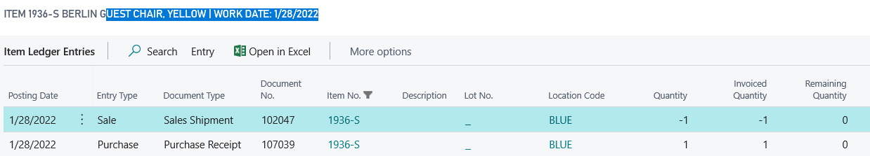
Item Ledger Entries
Drop Shipment

Slide 19
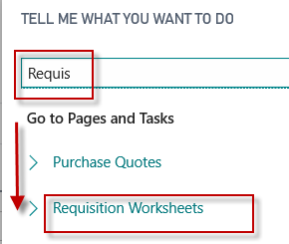

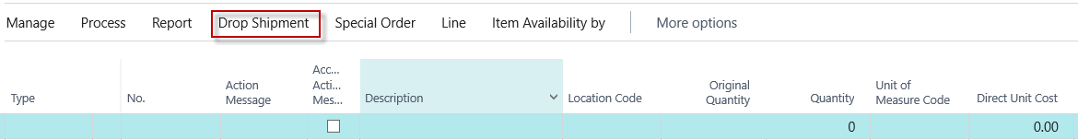
Drop shipment by use of Requisiton worksheet
Drop Shipment
Sales order line

Slide 20
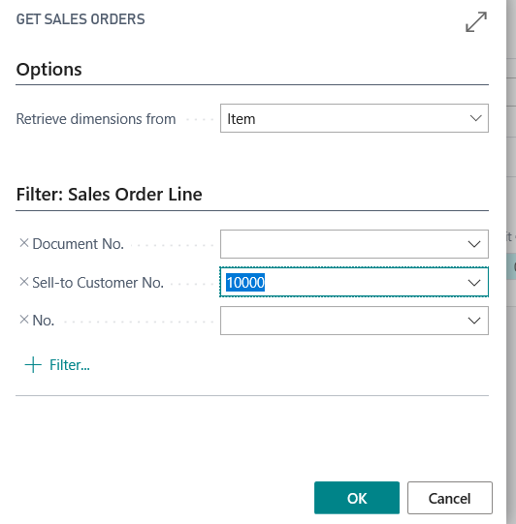
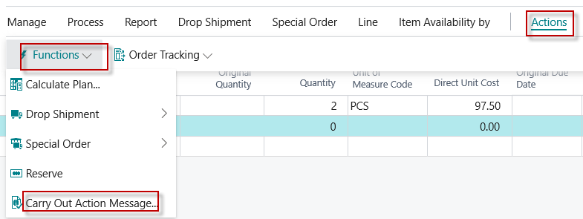
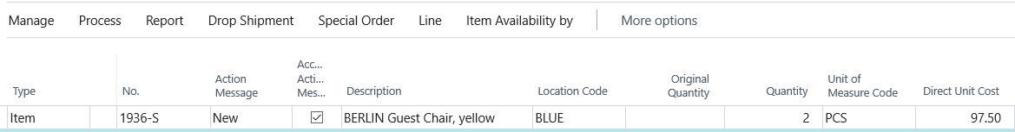
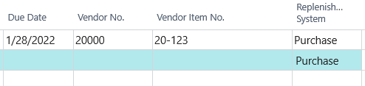
Requisition Worksheet
Drop Shipment
Using option Get Sales Order you must enter code of our model customer.
Before on item card we have to enter code of the prime vendor

Slide 21
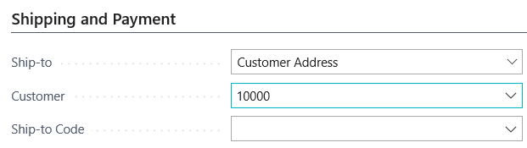
Requisition Worksheet
Drop Shipmnet
Therefore you create Purchase Order and subsequent operations are same
as in manual version (Receiving Purchase Order, Invoicing Sales Order and Invoicing
Purchase Order)
Purchase Order Line

Slide 22
Next example would be suitable after principle of
LOT NUMBERS will be introduced !!!!!
Drop shipment and Lot numbers
We will deal with this issue when we discuss the principles of lot numbers

Slide 23
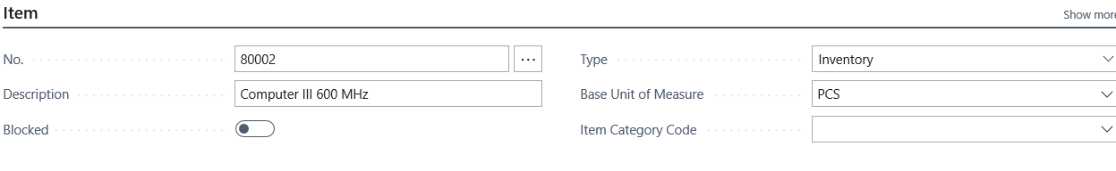
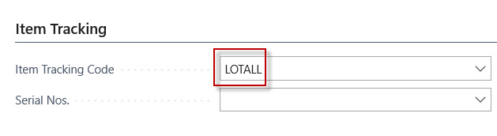
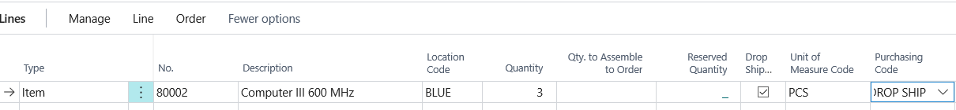
Item and Sales Order line with Drop Shipment Setup – with use of Lot Numbers
Sales Order line with setup Drop Shipment
We have to use still untouched item (no entries created so far)
See next slide

Slide 24
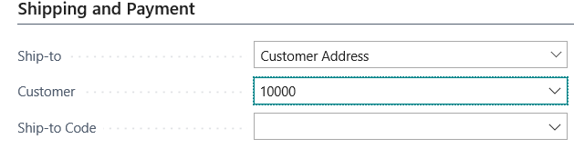
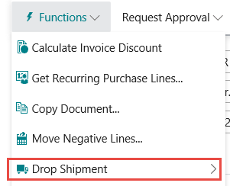

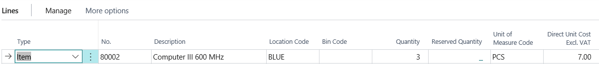
Purchase Order (manual version)
Purchase order
Purchase order line

Slide 25
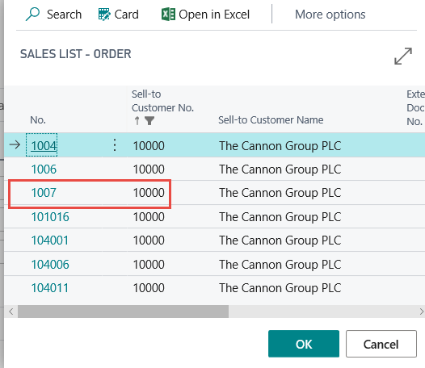
Purchase Order – the list of available Sales Orders
Purchase Order – the list of available Sales Orders

Slide 26
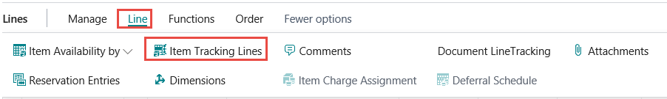
Updated Purchase Line
Updated Purchase Lines
If 80002 item has setup for item tracking you have to assign a Lot code
One whole training session will be devoted
to Lot numbers and expiration dates

Slide 27
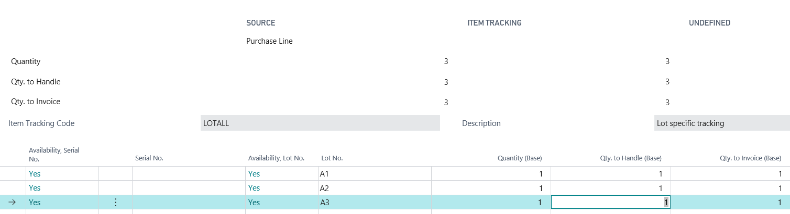
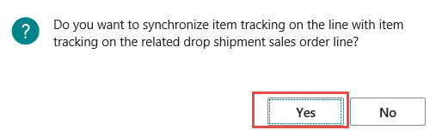
Item Tracking Lines
Item tracking lines
After ESC we will get this message

Slide 28
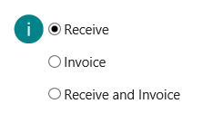




Posting Purchase Order (Receive only )
Posting Purchase Order (Receive only )
Purchase
line
Sales
line

Slide 29
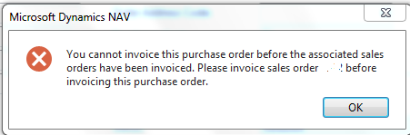
Golden Drop shipment rule
Golden Drop shipment rule
You cannot invoice the purchase order before the sales order is invoiced.If you try, you will get message
X1

Slide 30
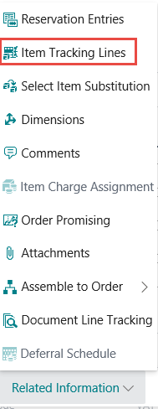
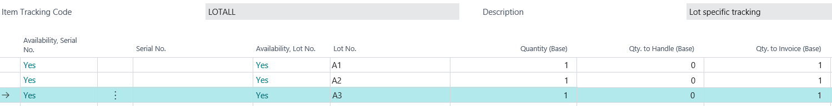
Item tracking lines on Sales Order
We will sell 3 pcs of 80002

Slide 31
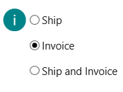
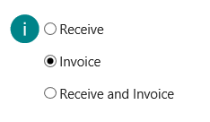
Post only as Invoiced on Sales Order and Purchase Order

Slide 32
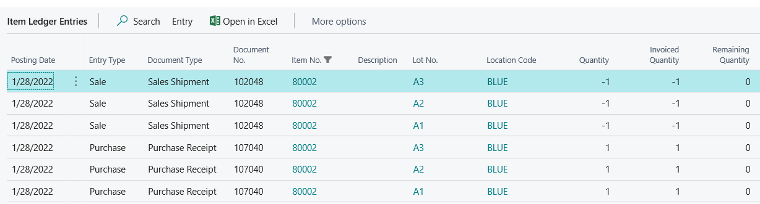
Item Ledger Entries

Slide 33
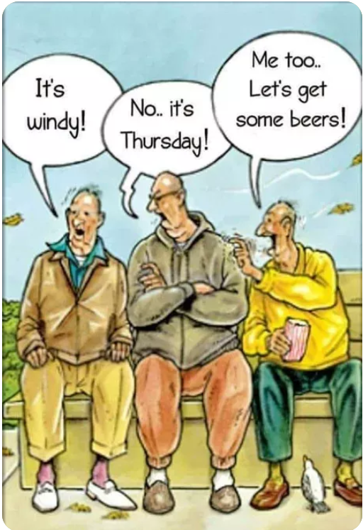

Slide 34
Thanks for Your attention and time

