Slide 1
1. TRANSPORT MARKETS

Slide 2
Economics and transport
Why study transport economics?
Application of microeconomic theory
Economic toolkit; economic way of thinking
Better understanding of the underlying issues and principles

Slide 3
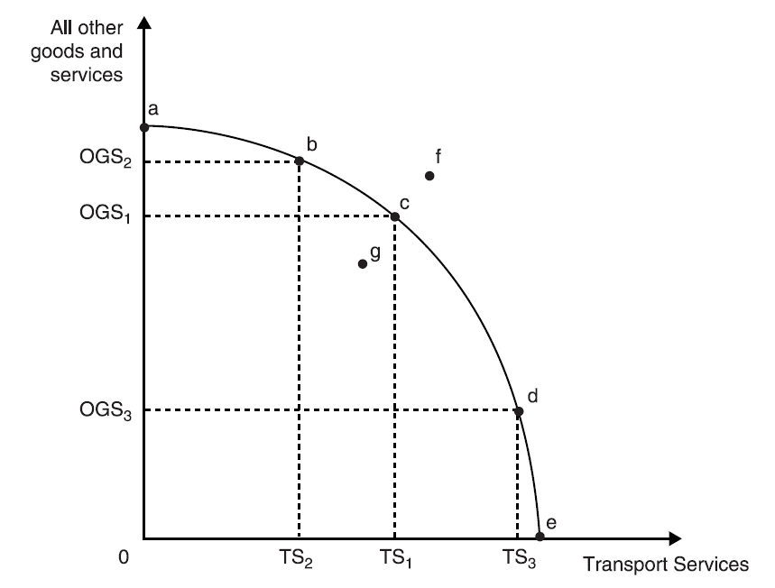
Scarcity and choice
What to produce?
How to produce it?
And for whom to produce it?

Slide 4
Public and private provision
Command, free and mixed market economies
Private and public sector roles in the provision of public transport
Q1: Are private operators more efficient?
Q2: Would you recommend the privatization of the national rail operators in Europe?
Q3: Is private ownership or competition more important in delivering efficiency?

Slide 5
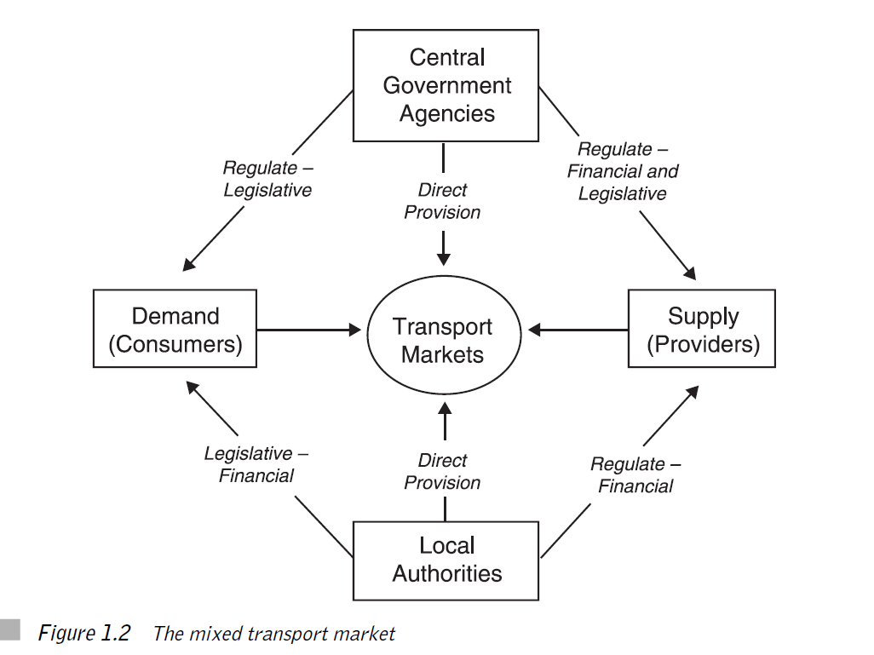

Slide 6
CASE: Glasgow public transport
 | Operators | Structure | Fares and Services
BUS | PRIVATE | COMPETITION | MARKET
TRAIN | PRIVATE | MONOPOLY | REGULATED
UNDER GROUND | PUBLIC | MONOPOLY | REGULATED

Slide 7
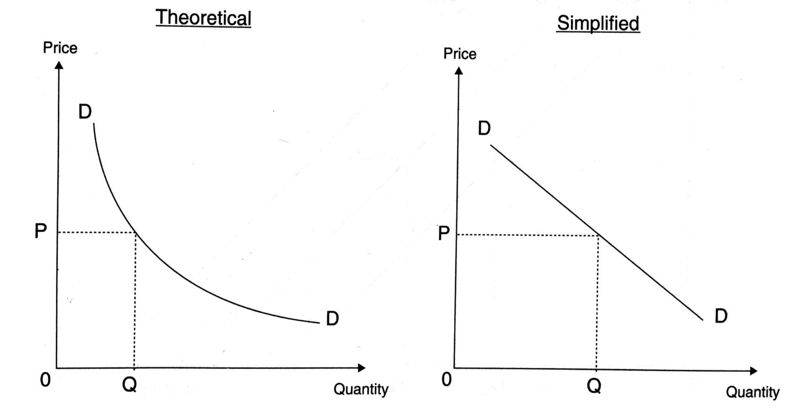
Demand
Law of demand states that, all else being constant, as the price of a product increases (↑), quantity demanded falls (↓)

Slide 8
Demand determinants
Price ↓
Income ↑
Price of substitutes ↑
Price of complements ↓
Fashion, trends, expectations

Slide 9
Demand for transport
Derived demand → it usually follows the demand of individuals for something else
Time specific → demand for transport has a very short expiry date
Follows peaks and throughs → morning and afternoon rush hours

Slide 10
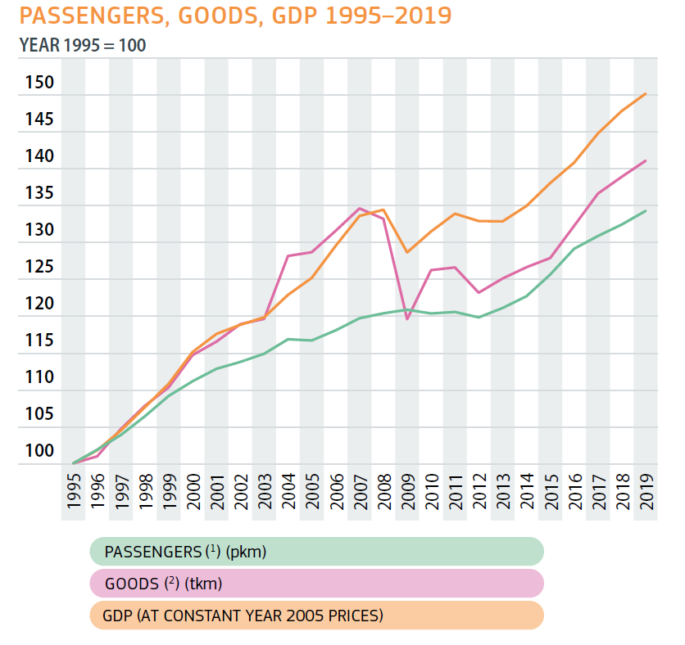
Economic and transport growth (EU)

Slide 11
Modal splits 2019 (%)
 | EU | USA | Japan | China | Russia
FREIGHT
Road | 82 | 56 | 92 | 66 | 10
Rail | 18 | 44 | 8 | 34 | 90
PASSENGER
Car | 82 | 92 | 1 | 38 | n.a.
Bus | 9 | 7 | 13 | n.a. | 49
Train | 9 | 1 | 86 | 62 | 51

Slide 12
Nature or nurture?
The paper examines the reasons for the difference in rail’s share of freight in Europe and the United States.
They find that 83% of the gap in 2000 is probably due to natural or inherent differences, principally geography, shipment distance, and commodity mix.
However, 17% of the gap is presumably due to public policies including priority of passenger service, lack of interoperability at borders, service quality and rates, and incentives of the rail operators.
We estimate that if that policy gap were closed, railroads’ share of freight in Europe would increase from 8% to 13%.
Vassallo, J. M., & Fagan, M. (2007). Nature or nurture: why do railroads carry greater freight share in the United States than in Europe?. Transportation, 34(2), 177-193.

Slide 13
Theory of SUPPLY
The law of supply is a fundamental principle of economic theory which states that, all else equal, an increase in price results in an increase in quantity supplied

Slide 14
Supply determinants
The cost of production → main factor
Government policy → regulation, subsidy
The price of goods in joint supply → passengers and freight
Aims of producer → max. profits, revenue, employment ….

Slide 15
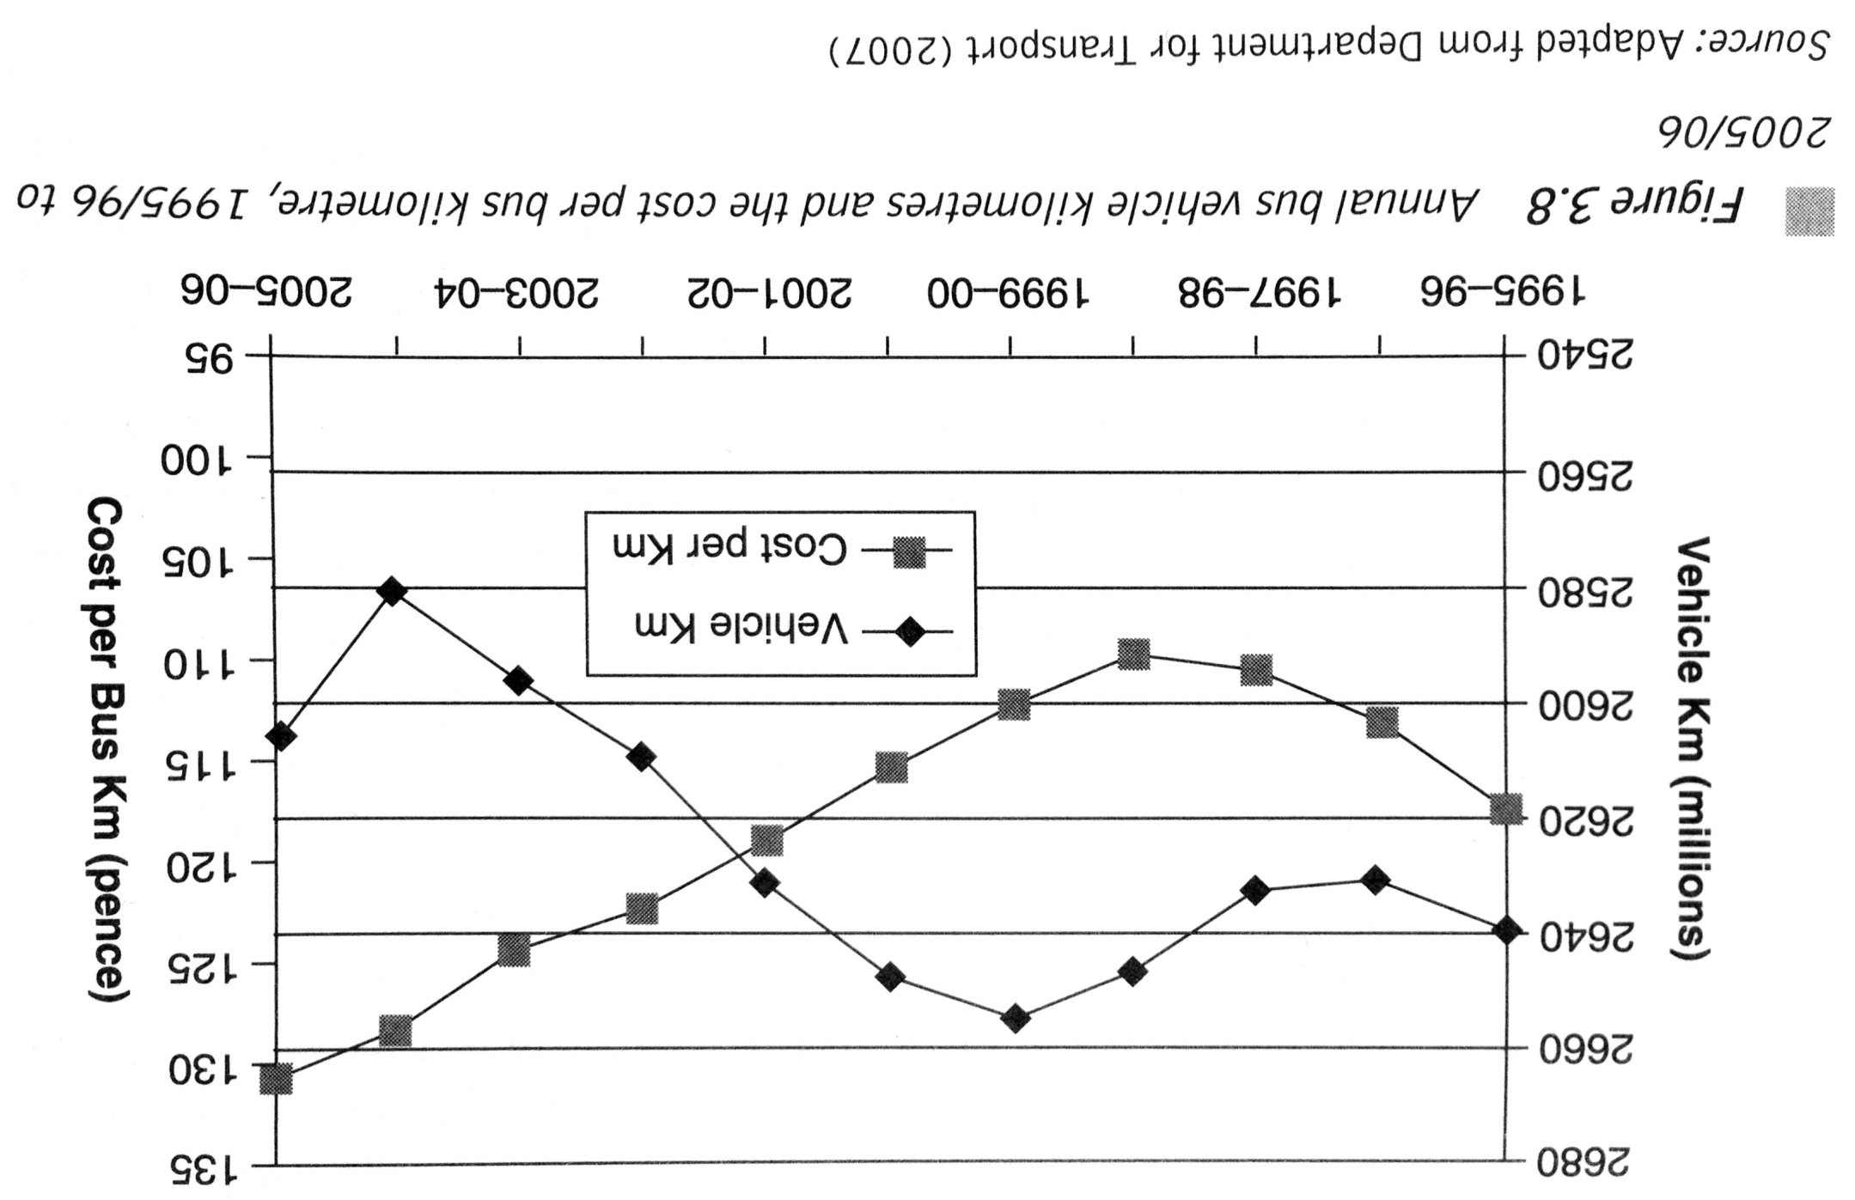
Case: British bus industry

Slide 16
Organization of Supply
Monopoly or Competition?
Privatization or/and Competition?
Regulation or Deregulation (incl. Fares)?
Laissez Fare or Environmental/Social Values?

Slide 17
Market workings
Putting together demand and supply
Incorporate market imperfections
Adding government intervention and regulation

Slide 18
EXERCISES

Slide 19
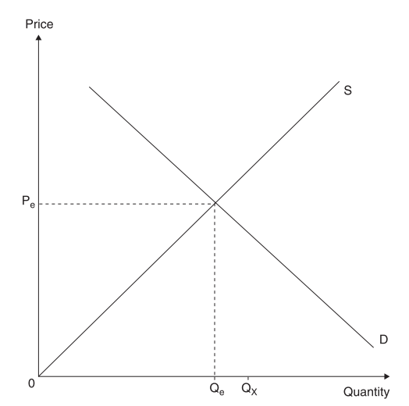
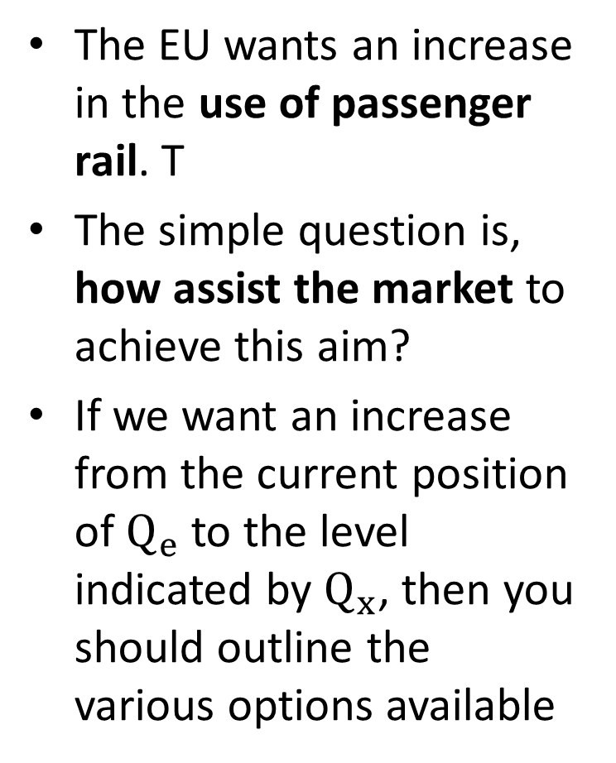
Increasing the use of the railways
The EU wants an increase in the use of passenger rail. T
The simple question is, how assist the market to achieve this aim?
If we want an increase from the current position of $Q_{e}$ to the level indicated by $Q_{x}$, then you should outline the various options available

Slide 20
Demand and supply exercises (1)
You should consider each of the following scenarios on the price and quantity traded for the market highlighted. You should identify what side of the market, demand or supply, is being affected, which particular determinant has changed and you should explain your reasoning at arriving at your answer:
A general rise in incomes on the market for bus services
A rise in the demand for passenger air travel on the market for air cargo
An increase in fuel duty on the market for road haulage services

Slide 21
Demand and supply exercises (2)
A fall in the costs of production of bus services on the market for rail services
The publication of a government report on the detrimental effects of environmental change on the market for private motoring
A weekend ban on lorry movements on the market for rail freight

Slide 22
Demand and supply exercises (3)
The abolition of what had been strict government controls on the entry of new airline operators on the airline market
The announcement of increased grants available for the installation of rail freight facilities (infrastructure) on the actual market for rail freight services
A change in the short run aim of a bus operator that has a cost advantage away from profit maximisation to sale maximisation in order to eradicate the competition currently in the market

Slide 23
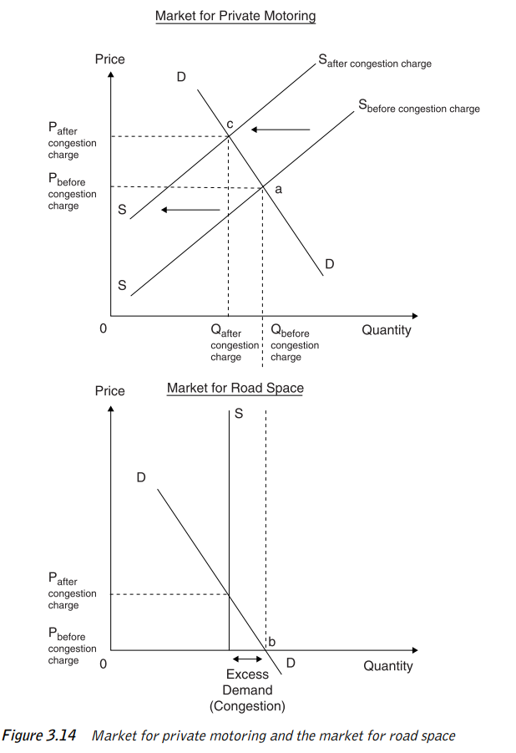
Case 3.3 – The market for urban road space – London car and bus usage
Market for private motoring
Market for road space
Congestion
Congestion charge (2003)
The impact of charge → private car declined, PT increased

Slide 24
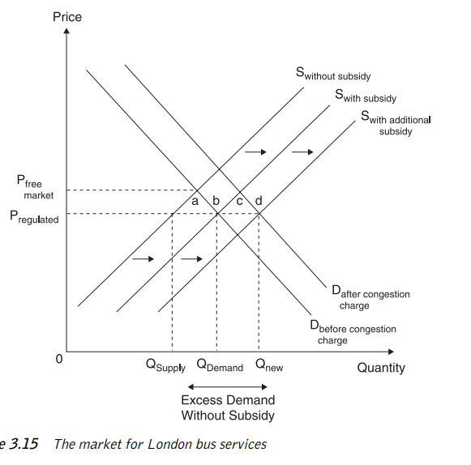
Case 3.3 – The market for urban road space – London car and bus usage
Bus usage ↑ 68%
Bus fares and services set by TfL, not market
Subisdy to operators
Switch from car to bus
Market equlibrium

