Slide 1
2. TRANSPORT DEMAND ELASTICITY

Slide 2
ELASTICITY
Elasticity of demand is the responsiveness of demand to a change in one of its determinants
Price, cross-price, income, …..
Important for evaluation, business and transport policy

Slide 3
Policy
Especially price elasticity has a huge impact on transport policy and decision making
Given that many transport markets are regulated → setting the right fare is essential to achieving policy objectives
Price elasticity is crucial in calculating revenues from the imposition of a tax or in the level of subsidy needed to reduce price

Slide 4
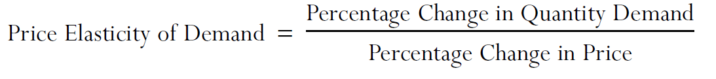
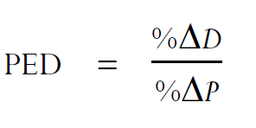
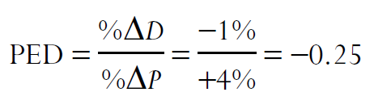
PRICE ELASTICITY
Price elasticity of demand = the consumer's demand responsiveness to changes in prices
=

Slide 5
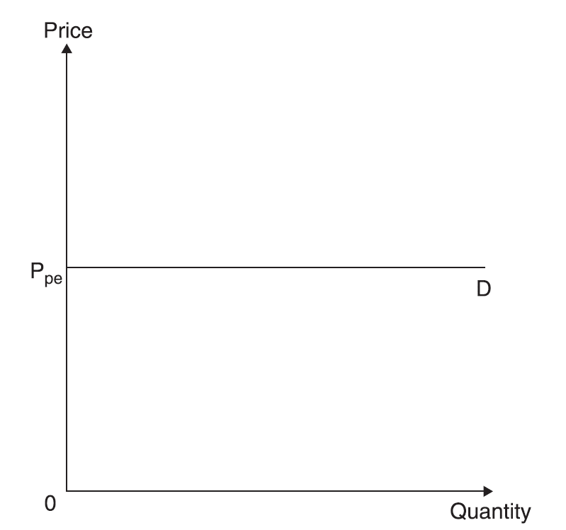
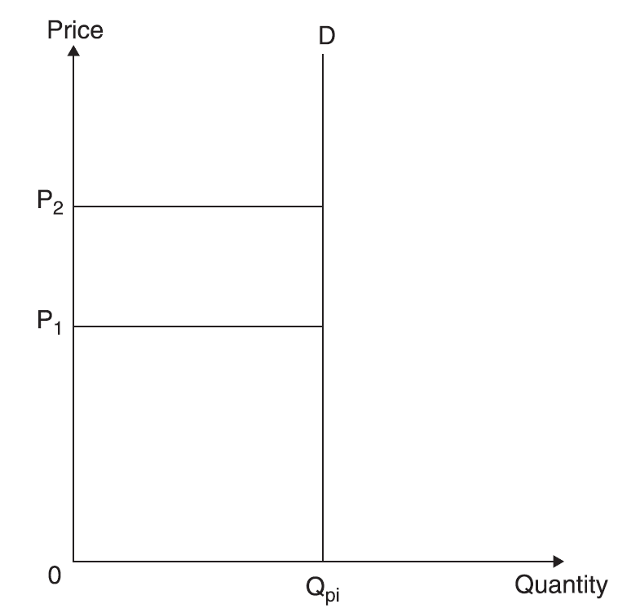
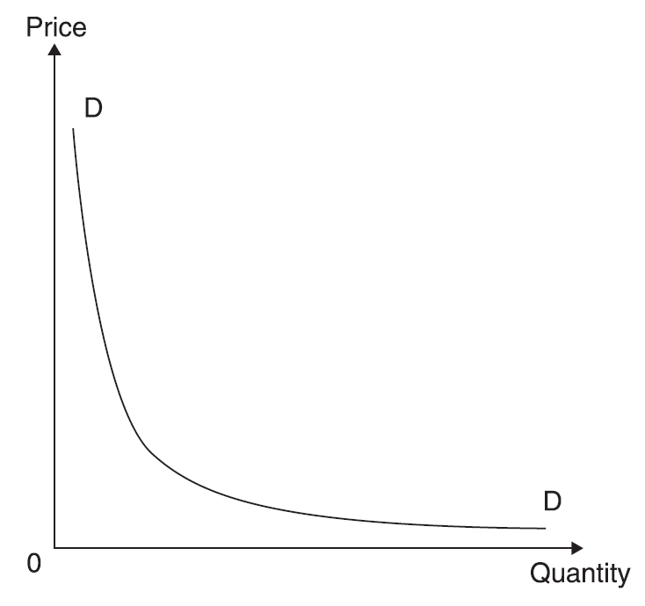
Demand curves
Elastic Inelastic Unitary

Slide 6
Determinants of price elasticity
The number and closeness of alternative modes of travel (substitutes) → the higher the number of alternative modes and the closer they are in meeting the need → the higher price elasticity
Proportion of disposable income spent on the mode of travel → if it is small, the price elasticity will be also small
Time dimension → time may bring about a change in behaviour → over time habits may change

Slide 7
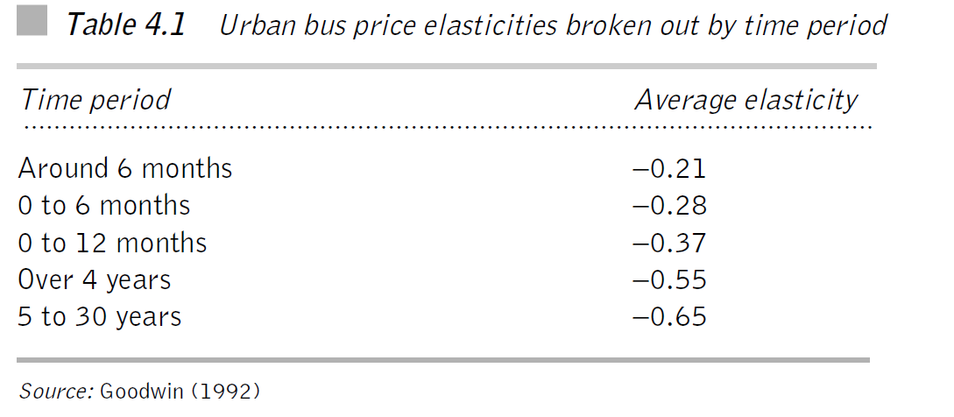
Time dimension

Slide 8
Interpretation
Over time elasticity values for transport have been increasing → consumers of transport services have been becoming more price sensitive over time
Pauley et al. (2006): bus fare elasticities: -0.4 in the short run; -0.55 in the medium run and -1.00 in the long run
Beware of high variability of results among studies → each finding applies to a particular situation

Slide 9
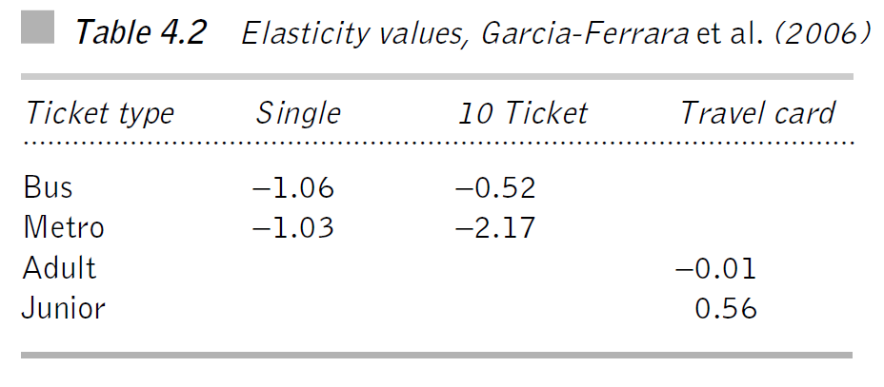
Variability

Slide 10
Interpretation
Single fares unitary elastic, the 10 ticket metro ticket highly elastic; 10 ticket bus fare relatively inelastic
Junior travel card +0.56! → Giffen good →raise in price probably raised awareness of it
High degree of variability in elasticity values → due to travel card option

Slide 11
Purpose and length of journey
Elasticities depend upon the purpose of the journey → e.g. rail fare elasticities (ATOC, 2002): -0.2 business; -0.3 commuting; -1.0 leisure
The impact of distance → bus elasticities higher, the longer the journey (magnitude, leisure, alternatives)
However, Preston and others found for rail decreasing elasticities with the distance (less alternatives for rail in longer distances?)
The price elasticity of petrol follows the pattern of low price elasticity in SR and high price elasticity in LR → shift to more fuel efficient cars → increase in tax to limit car use may have little impact

Slide 12
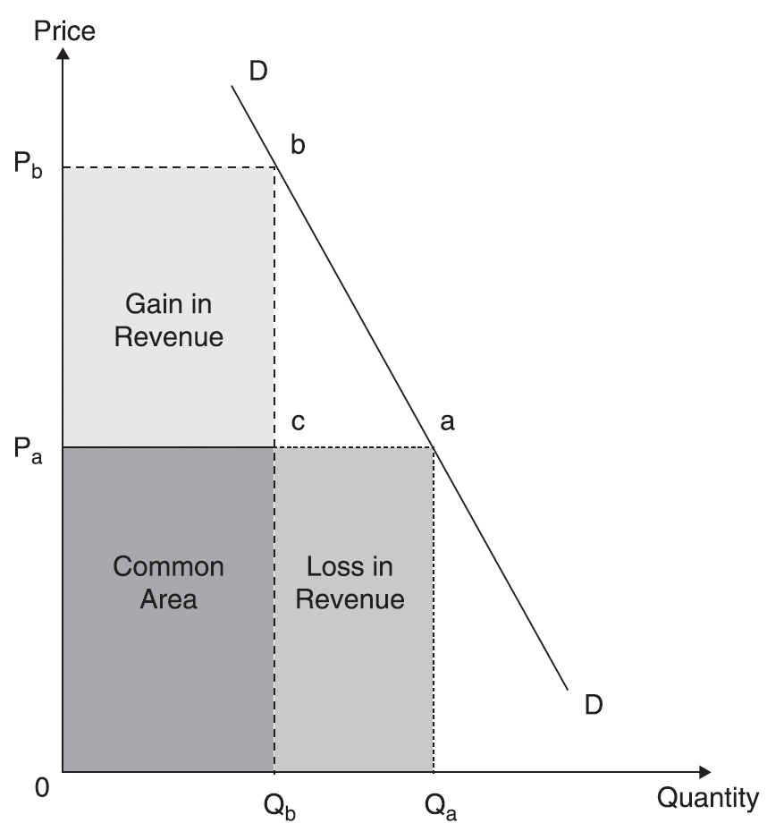
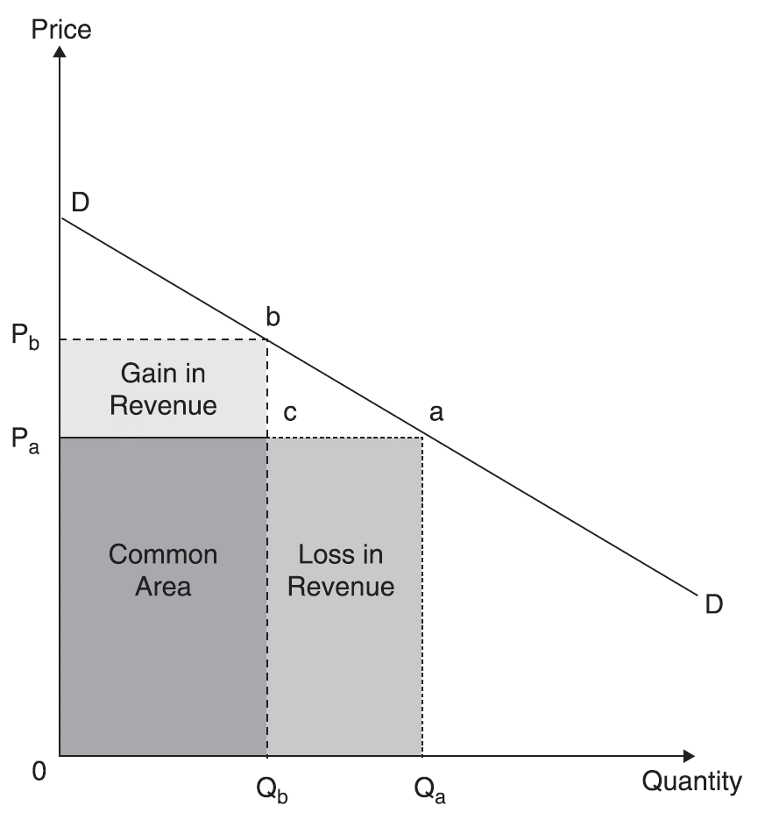
Price elasticity and total revenue
Q: If operators face inelastic demands, why don't they simply keep increasing the fare?

Slide 13
Exercises
Is the price elasticity of demand for airline industry in short-haul markets more or less than long-haul markets? Why?
What are the factors that influence the elasticity of demand for pilots?
The price elasticity of demand for Amtrak, the US rail passenger service, among vacation travellers has been estimated as –1.20. Given that Amtrak faces the market demand for rail passenger trips, what effect will a 15% increase in fares have upon market demand? What effect will the fare increase have upon revenues?

Slide 14
Exercise: Demand estimations
According to demand theory, the market demand curve for transportation is downward-sloping.
You are a transportation economist for rail operator and you are asked to estimate the price elasticity of demand for rail services. Describe in some detail what steps you would follow to obtain the price elasticity of demand.
Suppose that your analysis found that the price elasticity of demand for rail services was –0.78. What impact would a 10% increase in price have upon the quantity of rail services demanded? Do you know whether revenues would rise or fall?

Slide 15
UK price elasticities – urban and regional market
 | SHORT RUN | MEDIUM RUN | LONG RUN
BUS | -0.4 | -0.56 | -1.0
METRO | -0.3 |  | ´-0.6
RAIL | -0.6
Source: Pauley et al. 2006

Slide 16
UK price elasticities – findings (1)
Fare elasticities varies significantly depending not only on the mode and the time period over which is being examined, but also on the specific circumstances
The short run elasticities increased on average from -0.3 to -0.4 between 1980 and 2004
The long run elasticities are close to -1.0 and may even exceed -1.0 → implications for fare/revenue policy
Source: Pauley et al. 2006

Slide 17
UK price elasticities – findings (2)
Fare elasticities may be affected by the magnitude of the fare change → greater fare increases produces higher value of elasticities → the differences are greatest for long run elasticities
Fare elasticity is also affected by the current level of the fare relative to people‘s income
Elasticity values increase with short distance and for rail journeys outside London
Source: Pauley et al. 2006

Slide 18
UK price elasticities – findings (3)
The response to a fare increase may not be equal and opposite to the response to fare decrease
London is a special case due to size of the agglomeration and congestion
Off peak elasticity values are about twice the peak values
Elasticities for people travelling to work and school tend to be lower than for other purposes
Those with access to cars (males) have higher elasticity values; the evidence about age is not clear cut
As for distance, bus elasticities are higher for very short and very long trips; for rail elasticities decrease with distance
Source: Pauley et al. 2006

Slide 19
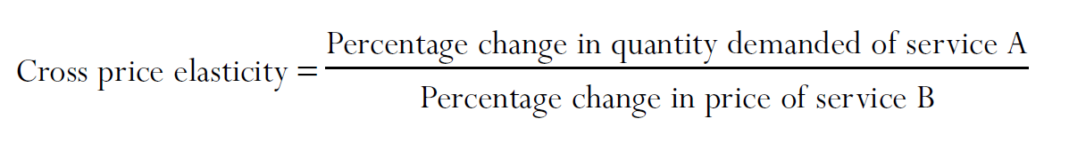
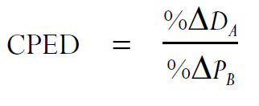
CROSS PRICE ELASTICITY
Cross price elasticity of demand is a measure of the effect of a change in the fares of one transport mode or transport operator on the demand for the services of another

Slide 20
Cross price elasticity
Involves examining two goods or services
Within transport → these services can be examined at different levels → two different modes (train x car) → within the same mode (RegioJet x ČD) → within a same operator (1st class x 2nd class)

Slide 21
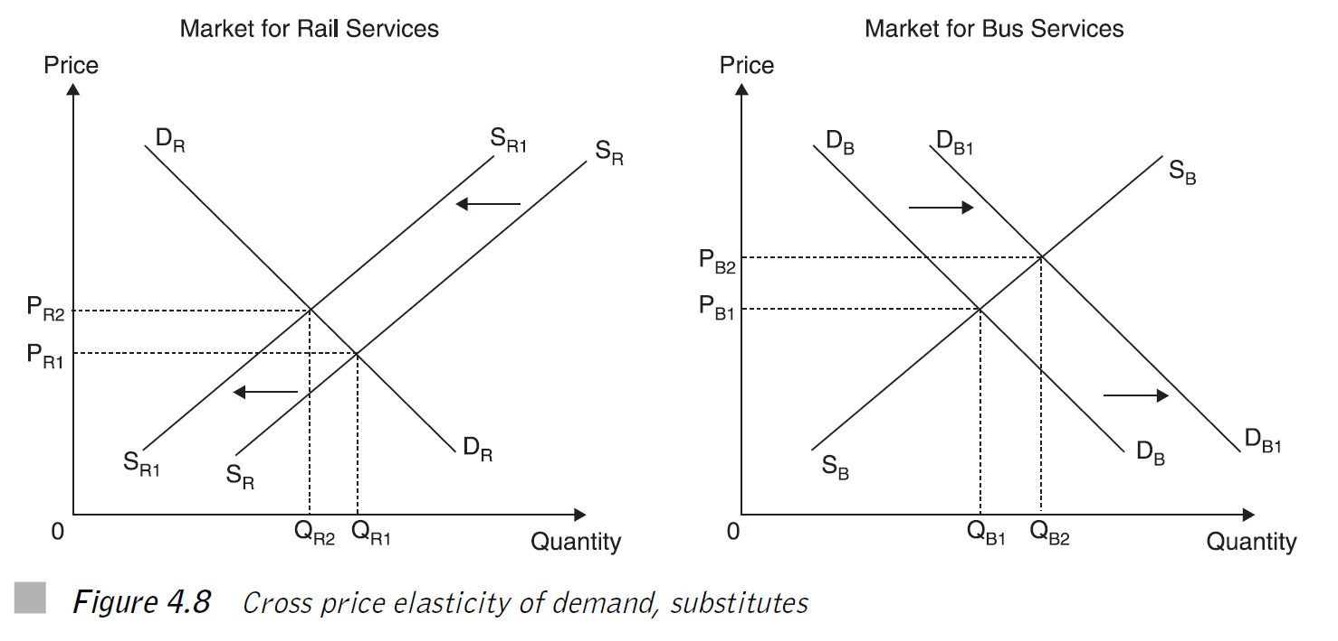
Substitutes (Rail and Bus)
If the effect of price increase in one good has a positive impact on the demand of the another good – SUBSTITUTES

Slide 22
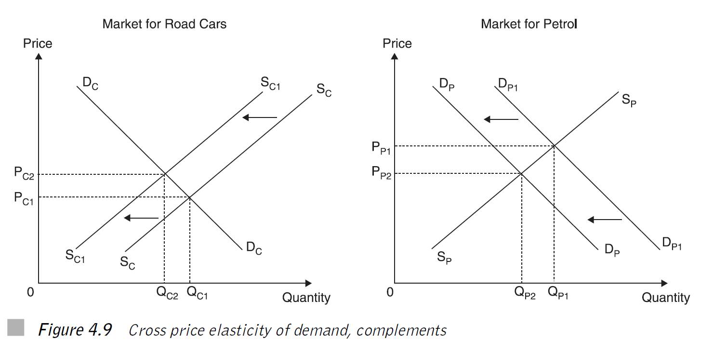
Complements (Car and Petrol)
If the effect of price increase in one good has a negative impact on the demand of another good - COMPLEMENTS

Slide 23
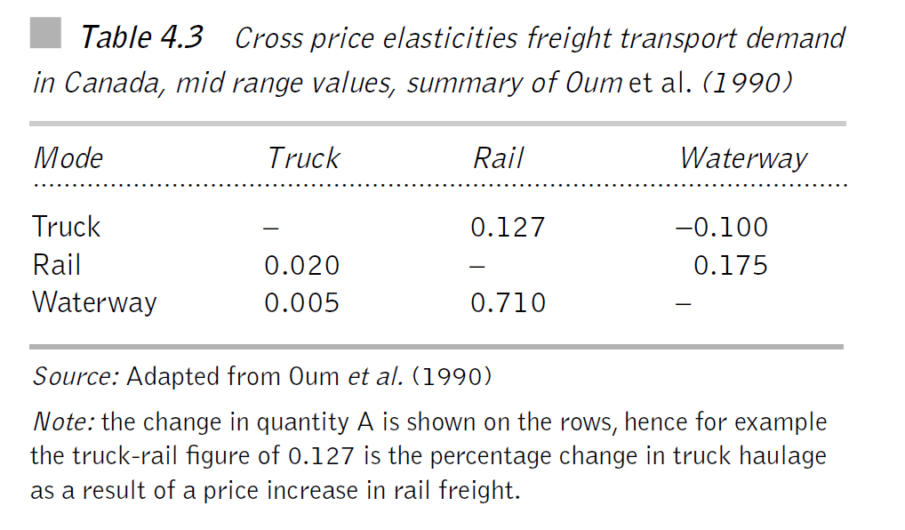
Freight

Slide 24
Interpretation
Elasticities are taken from Canada → the impact of geography and sheer distances
No symmetry in the table: rail-truck ≠ truck-rail → there is no reason to believe that rail users due to increase in rail prices wil react in the exactly same way (by switching to truck) as truck users due to increase in truck prices (by switching to rail)
Rail-water → whilst water is a substitute for the train, the train is far less substitute for water

Slide 25
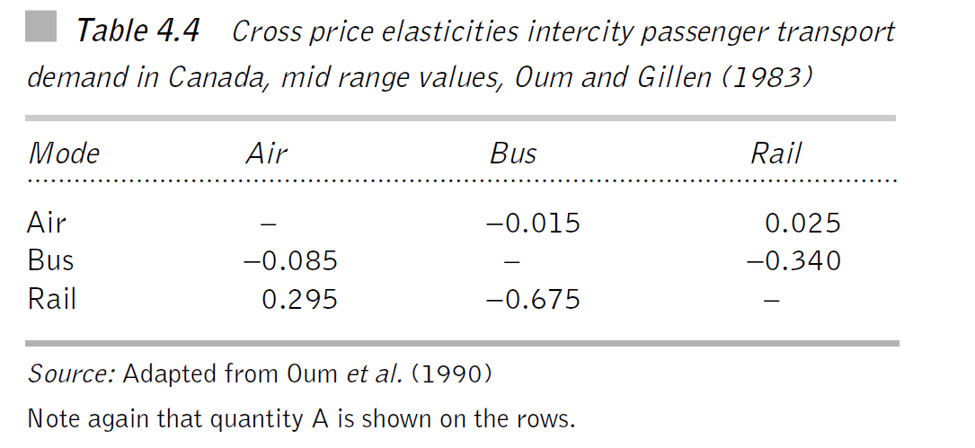
Passenger

Slide 26
Interpretation
Little substitutability between air and bus
Bus and rail → complements → why? → intercity markets where bus can feed ta rail services
The plane competes with the train → train does not compete with the plane ≈ change in air fares has an impact on the rail travel demand, but a change in rail fares has little effect on air travel demand

Slide 27
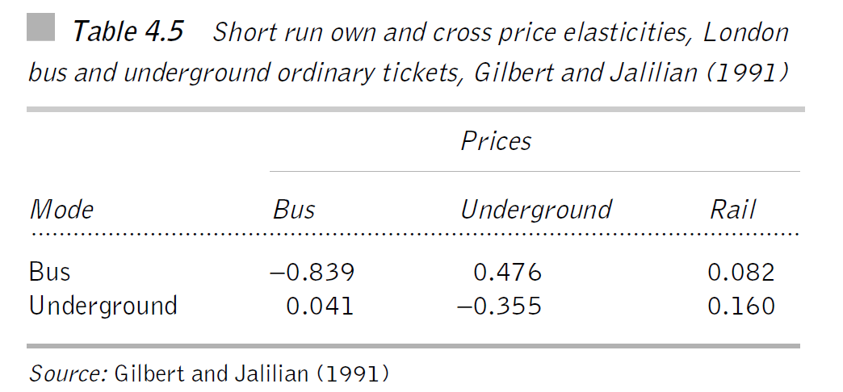
Public transport

Slide 28
Interpretation
The demand for London buses is far more elastic than in other parts of the country
The underground is a substitute for a bus → the bus is not a substitute for underground
The impact of changes in rail fares on the demand for bus services is very small
The bus and rail in London serve two distinct markets

Slide 29
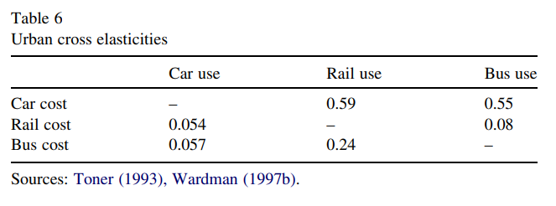
Paulley, N., Balcombe, R., Mackett, R., Titheridge, H., Preston, J., Wardman, M., ... & White, P. (2006). The demand for public transport: The effects of fares, quality of service, income and car ownership. Transport policy, 13(4), 295-306.

Slide 30
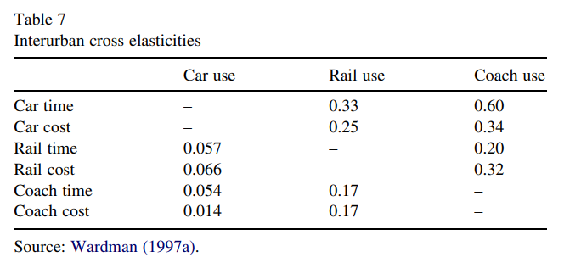
Paulley, N., Balcombe, R., Mackett, R., Titheridge, H., Preston, J., Wardman, M., ... & White, P. (2006). The demand for public transport: The effects of fares, quality of service, income and car ownership. Transport policy, 13(4), 295-306.

Slide 31
INCOME ELASTICITY
Income elasticity of demand is a measure of the responsiveness of demand to changes in income
As real incomes are likely to increase over time, income elasticity identifies potentially growing and falling markets

Slide 32
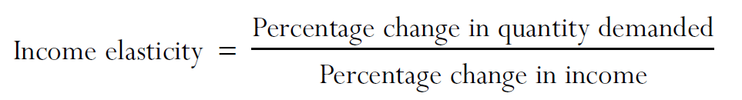
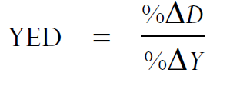
INCOME ELASTICITY

Slide 33
Goods
Income elasticity | Goods | Example
NEGATIVE | INFERIOR | BUS
POSITIVE (0 < IE < 1) | NORMAL | CAR, RAIL
POSITIVE (IE > 1) | LUXURIOUS | PLANE

Slide 34
Discussion questions
Q1: Will bus services disappear?
Q2: Are air services always luxurious good?
Q3: What is the income elasticity of public transport?

Slide 35
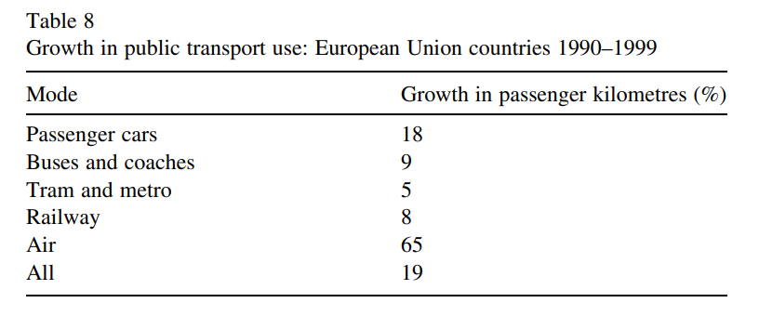
Income elasticity in the EU
Source: Paulley, 2006

Slide 36
Car ownership effect
Income elasticity for public transport is affected both directly by the increase in income that will be generating an increased demand for travel → but also by increasing levels of car ownership
Increase in income will cause an increase in the demand for rail travel, however, this would be smaller than expected as it will be partially offset by increasing levels of car ownership
The effect will be dependent upon the area → in London the car ownership tend to be smaller → income elasticities of public transport tend to be larger → this is not the case for other major conurbation in Britain

Slide 37
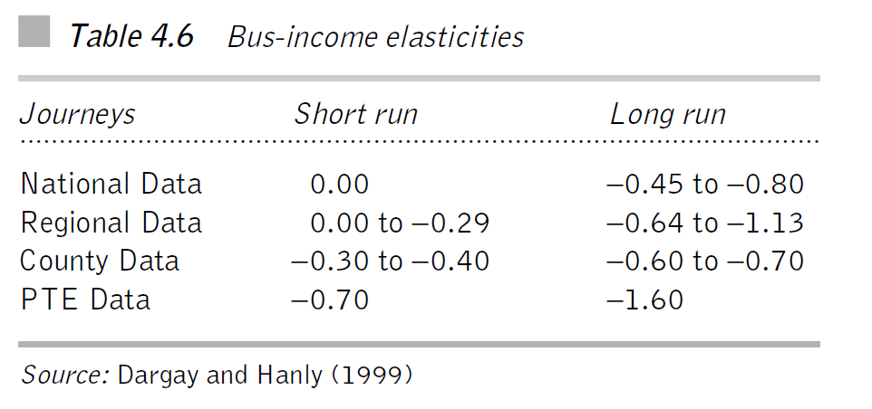
British buses

Slide 38
Interpretation
Data: National → 11 Regions → County level → PTE = 6 largest English conurbations outside of London
Short run = anything less than a year; Long run = anything over that
Bus as an inferior good
Long run effects significantly larger than short run
Changes in income has the largest effect in PTE cities → in counties they are already using the car

Slide 39
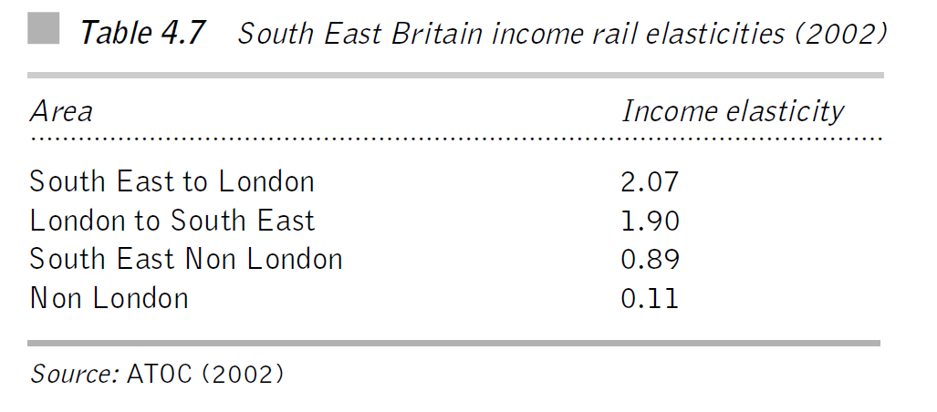
British rail

Slide 40
Interpretation
Data: This ATOC study was based upon relatively short journeys (less than 20 miles)
As expected, all elasticities are positive → strongly related to the economic importance and pulling power of London
Outside London, there are more alternatives (car)
Q: Is south-east (of Britain) different to the rest of Britain?

Slide 41
Summary: income elasticities
The income elasticities are significantly dependent upon the area
In densely populated area, the impact of rising income will be directed towards rail, in less populated areas towards car ownership
In some areas with dominance of rail and metro, buses will have hard times

Slide 42
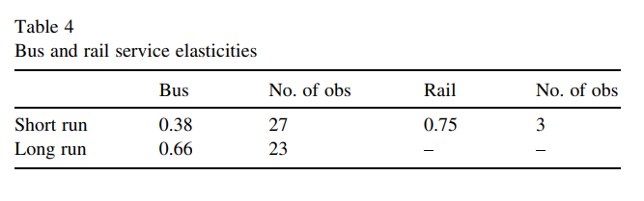
Appendix: Service (frequency) elasticities
Source: Paulley, 2006

