Slide 1
3. TRANSPORT DEMAND ISSUES

Slide 2
PUBLIC TRANSPORT
This paper first provides a brief review of trends in public transport demand from 1980 to 2010 in 16 countries in Europe, North America, and Australia.
The focus, however, is on a detailed analysis of public transport demand in Germany and the USA, using uniquely comparable national travel surveys from 2001/2002 and 2008/2009 for both countries.
Public transport has been far more successful in Germany than in the USA, with much greater growth in overall passenger volumes and trips per capita.
Buehler, R., & Pucher, J. (2012). Demand for public transport in Germany and the USA: an analysis of rider characteristics. Transport Reviews, 32(5), 541-567.

Slide 3
Germans and Americans
Even controlling for differences between the countries in demographics, socio-economics, and land use, logistic regressions show that Germans are five times as likely as Americans to use public transport.
Moreover, public transport in Germany attracts a much broader cross-section of society and for a greater diversity of trip purposes.

Slide 4
Explanation?
The success of German public transport is due to a coordinated package of mutually supportive policies that include the following:
(1) more and better service
(2) attractive fares and convenient ticketing
(3) full multimodal and regional integration
(4) high taxes and restrictions on car use
(5) land-use policies that promote compact,
mixed-use developments.

Slide 5
Conclusion
It is the integrated package of complementary policies that explains why public transport in Germany can compete so well with the private car, even among affluent households.
Conversely, it is the lack of complementary policies that explains the continuing struggle of public transport in the USA.

Slide 6
DEMAND FOR PUBLIC TRANSPORT
Q: Do you agree with the explanation and conclusion of Buehler and Pucher?
Buehler, R., & Pucher, J. (2012). Demand for public transport in Germany and the USA: an analysis of rider characteristics. Transport Reviews, 32(5), 541-567.

Slide 7
Demand for car x public transport
This question remains one of crucial in the transport economics
It has huge economic, transportation, political and environmental consequences
We will now investigate varying approaches

Slide 8
How to increase PT ridership?
In order to give empirically based policy advice on public transport (PT) competitiveness, we have studied revealed mode choice for commuting trips in Norway
Our main finding is that high PT shares require that all of the studied factors; efficient travel times, direct routes or few transfers, and high service frequency is in place. If either one of these are not in place, the market share for PT is significantly reduced.
Lunke, E. B., Fearnley, N., & Aarhaug, J. (2021). Public transport competitiveness vs. the car: Impact of relative journey time and service attributes. Research in Transportation Economics, 90, 101098.

Slide 9
Users and non-users
Waiting time, cleanliness and comfort are PT variables that users most valued, Variables such as driver kindness, bus occupancy and journey time are generally less important.
For potential users the more important variables are waiting time, journey time and above all, level of occupancy. They consider the other variables to be of little importance.
Dell’Olio, L., Ibeas, A., & Cecin, P. (2011). The quality of service desired by public transport users. Transport Policy, 18(1), 217-227.

Slide 10
How to attract car users?
While service reliability and frequency are important, the attributes most effective in attracting car users are largely affective and connected to individual perceptions, motivations and contexts.
Reduced fare promotions and other habit-interrupting transport policy measures can succeed in encouraging car users to try PT services initially.
Attributes over and above basic accessibility, reliability and mobility provision, perceived by the target market as important service attributes, must then be provided in sustaining the switch from car use after promotional tactics have expired
Redman, L., Friman, M., Gärling, T., & Hartig, T. (2013). Quality attributes of public transport that attract car users: A research review. Transport policy, 25, 119-127.

Slide 11
Users are not homogenous…
To develop a series of models that reflects the different groups using transit; captive riders (users who are dependent on transit), choice riders (car owners who choose to take transit), and captive-by-choice riders (users who are dependent on transit but could own a car) are accounted for.
The findings from this study are used to define areas where transit agencies can develop specific strategies
Insight into the perceptions of passengers can help transit agencies understand what inspires customers' perceptions of satisfaction and loyalty.
Van Lierop, D., & El-Geneidy, A. (2016). Enjoying loyalty: The relationship between service quality, customer satisfaction, and behavioral intentions in public transit. Research in Transportation Economics, 59, 50-59.

Slide 12
Policy design matters….
The public transport service should be designed in a way that accommodates the levels of service required by customers and by doing so, attract potential users.
The choice of transport is influenced by several factors, such as individual characteristics and lifestyle, the type of journey, the perceived service performance of each transport mode and situational variables.
This suggests the need for segmentation taking into account travel attitudes and behaviours.
Policies which aim to influence car usage should be targeted at the market segments that are most motivated to change and willing to reduce frequency of car use.
Beirão, G., & Cabral, J. S. (2007). Understanding attitudes towards public transport and private car: A qualitative study. Transport policy, 14(6), 478-489.

Slide 13
To abolish fares?
Although the policy of abolishing fares in public transport (PT)—here referred to as “fare-free public transport” (FFPT)—exists in full form in nearly 100 cities worldwide, it remains highly controversial.
On the one hand, it is criticised by transport engineers and economists. They argue that zeroing fares may harm PT networks financially and generate “useless mobility”
They further claim that FFPT negates the principle that a commodity should come at a “right” price.
Moreover, scholars and practitioners point out the weakness of FFPT in terms of generating a modal shift from private vehicles to PT
Kębłowski, W. (2020). Why (not) abolish fares? Exploring the global geography of fare-free public transport. Transportation, 47(6), 2807-2835.

Slide 14
Car as status?
Study among travellers and commuters in Netherlands
Car use not only fulfils instrumental (transport) functions, but also important symbolic and affective functions.
it appeared that commuter car use was most strongly related to symbolic and affective motives, and not to instrumental motives.
Especially frequent drivers, respondents with a positive car attitude, male and younger respondents valued these non-instrumental motives for car use
Steg, L. (2005). Car use: lust and must. Instrumental, symbolic and affective motives for car use. Transportation Research Part A: Policy and Practice, 39(2-3), 147-162.

Slide 15
Car restrictions?
More effective than PT promotion in stimulating modal shift can be direct restrictions on car usage, such as:
Car restrictions
Congestion charges
Parking policies

Slide 16
Environmental beliefs?
In two empirical studies, the impact of attitudes and environmental knowledge on driving distance, travel behaviour and acceptance of various restrictions was investigated. The first study included the population in Lund, and the second the politicians and civil servants responsible for transports and environment in the same city.
Comparisons of the two samples revealed similar psychological processes, including environmental concern, hazard/efficiency perception and car affection, whereas environmental knowledge seemed to have a subordinate role.
Nilsson, M., & Küller, R. (2000). Travel behaviour and environmental concern. Transportation Research Part D: Transport and Environment, 5(3), 211-234.

Slide 17
COVID
Our results indicate that public transport lost ground during the particularly restricted period of lockdown while individual modes of transport, especially the private car, became more important.
Our findings are highly relevant for transport policy when developing measures for expanding the possibilities for sustainable individual transport and developing concepts that strengthen public transport.
These aspects are key for achieving a sustainable transport system in the medium- and long-term despite the coronavirus pandemic.
Eisenmann, C., Nobis, C., Kolarova, V., Lenz, B., & Winkler, C. (2021). Transport mode use during the COVID-19 lockdown period in Germany: The car became more important, public transport lost ground. Transport policy, 103, 60-67.

Slide 18
Summary (PT x car)
The impact of price/fares is very limited
Higher importance have service attributes such as time, frequency, changes, quality
Even higher importance have individual beliefs and affections (status, environment)
Very effective are direct car restrictions

Slide 19
DEMAND FOR TRANSPORT MODES
Two approaches to modelling demand for transport modes
SR: Hedonic approach (P, P^{S},P^{C}, GDP, POP)
LR: Product life cycle

Slide 20
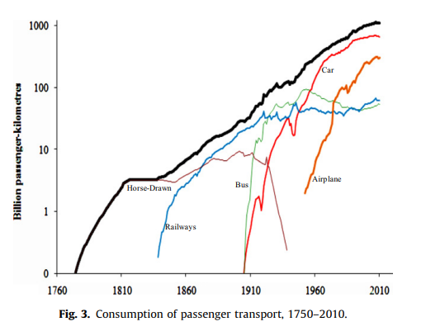
Life cycles of transport modes
Fouquet, R. (2012). Trends in income and price elasticities of transport demand (1850–2010). Energy Policy, 50, 62-71.

Slide 21
Metz, D. (2013). Peak car and beyond: the fourth era of travel. Transport Reviews, 33(3), 255-270.
Peak car
There is emerging evidence that personal daily travel, particularly by car, has ceased to grow in the developed economies.
We are therefore at a time of transition from an era of growth of per capita travel to an era of stability, in which the future factors determining the growth of total travel demand are demographic — population growth, increasing longevity, and urbanisation.
The peak car phenomenon, which marks this transition, is seen in successful cities that attract a growing population whose travel needs are increasingly met by investment in rail-based transport, the revival of which is a characteristic of the new era

Slide 22
Reducing car dependence
Munich, Berlin, Hamburg, Vienna, and Zurich – the largest cities in Germany, Austria, and Switzerland – have significantly reduced the car share of trips over the past 25 years in spite of high motorisation rates.
The key to their success has been a coordinated package of mutually reinforcing transport and landuse policies that have made car use slower, less convenient, and more costly, while increasing the safety, convenience, and feasibility of walking, cycling, and public transport.
Buehler, R., Pucher, J., Gerike, R., & Götschi, T. (2017). Reducing car dependence in the heart of Europe: lessons from Germany, Austria, and Switzerland. Transport reviews, 37(1), 4-28.

Slide 23
Reducing car dependence (2)
The mix of policies implemented in each city has been somewhat different. The German cities have done far more to promote cycling, while Zurich and Vienna offer more public transport service per capita at lower fares.
All five of the cities have implemented roughly the same policies to promote walking, foster compact mixed-use development, and discourage car use. Of the car-restrictive policies, parking management has been by far the most important.
The five case study cities demonstrate that it is possible to reduce car dependence even in affluent societies with high levels of car ownership and high expectations for quality of travel

Slide 24
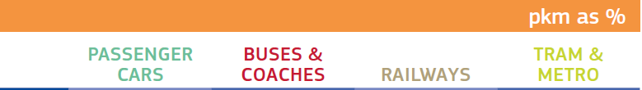
Modal split – passengers (2019)

Slide 25
THE PROBLEM OF THE PEAK
Economic analysis is usually simplified by the removal of time as a factor that needs consideration
In practise this means that it is assumed, usually implicitly, that the number of units of a product demanded per unit of time is constant
In transport economics this assumption cannot be made as there are peaks in demand that occur on a regular basis
The peaks are not random, they occur on a uniform basis

Slide 26
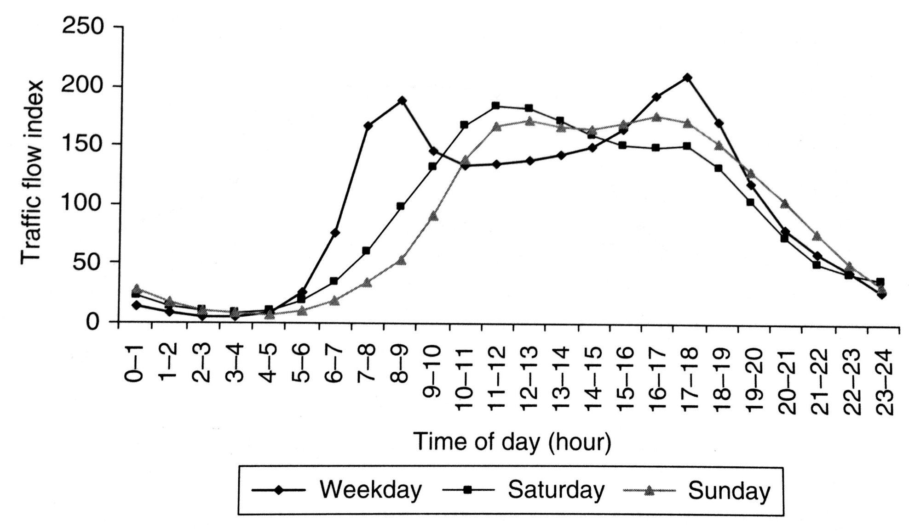
Distribution of traffic by time of the day, UK, 2004: Cars

Slide 27
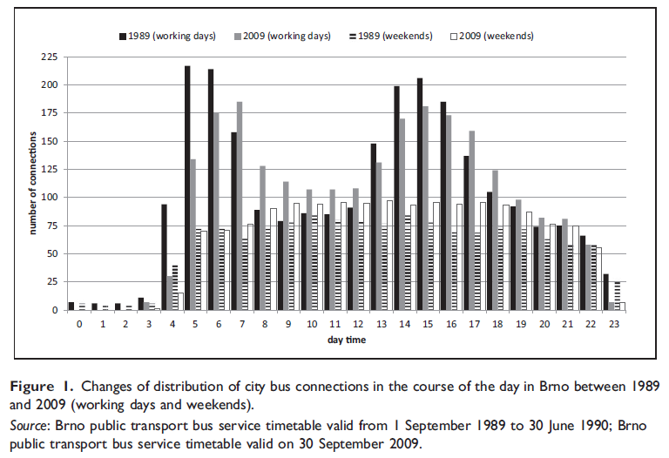
Peak and off peak periods
Mulíček – Osman – Seidenglanz (2016) constructed frequency distribution of bus services in Brno during the day in 1989 and 2009. Discuss the reasons why the distribution has changed.

Slide 28
The problem of rural demand
The provision of public transport services to satisfy demand in rural areas has always been problematic.
Such services have high costs, but low revenues due to low load factors. They are uneconomic.
However, the demand for these services is very real, as rural populations require them to get to work, to do their shopping, to access schools and medical care and for social reasons.

Slide 29
The problem of rural demand
This problem has worsened in recent times for four main reasons:
  Greater car usage
  Growth of cities
  Public services concentrated in cities
  Population ageing

Slide 30
Provision of rural services
The provision of rural transport services is a real problem for policy makers.
Is it justifiable to provide such uneconomic services when the required public investment could be used to a greater welfare effect elsewhere?
Are there any alternatives?
How to organize such services?
Electoral support for such services has always be strong …..

Slide 31
COMMUTING PARADOX
People spend a lot of time commuting and often find it a burden. According to standard economics, the burden of commuting is chosen when compensated either on the labor or on the housing market so that individuals’ utility is equalized.
However, in a direct test of this strong notion of equilibrium with panel data, we find that people with longer commuting time report systematically lower subjective well-being. This result is robust with regard to a number of alternative explanations.
We mention several possibilities of an extended model of human behaviour able to explain this “commuting paradox”
Stutzer, A., & Frey, B. S. (2008). Stress that doesn't pay: The commuting paradox. Scandinavian Journal of Economics, 110(2), 339-366.

Slide 32
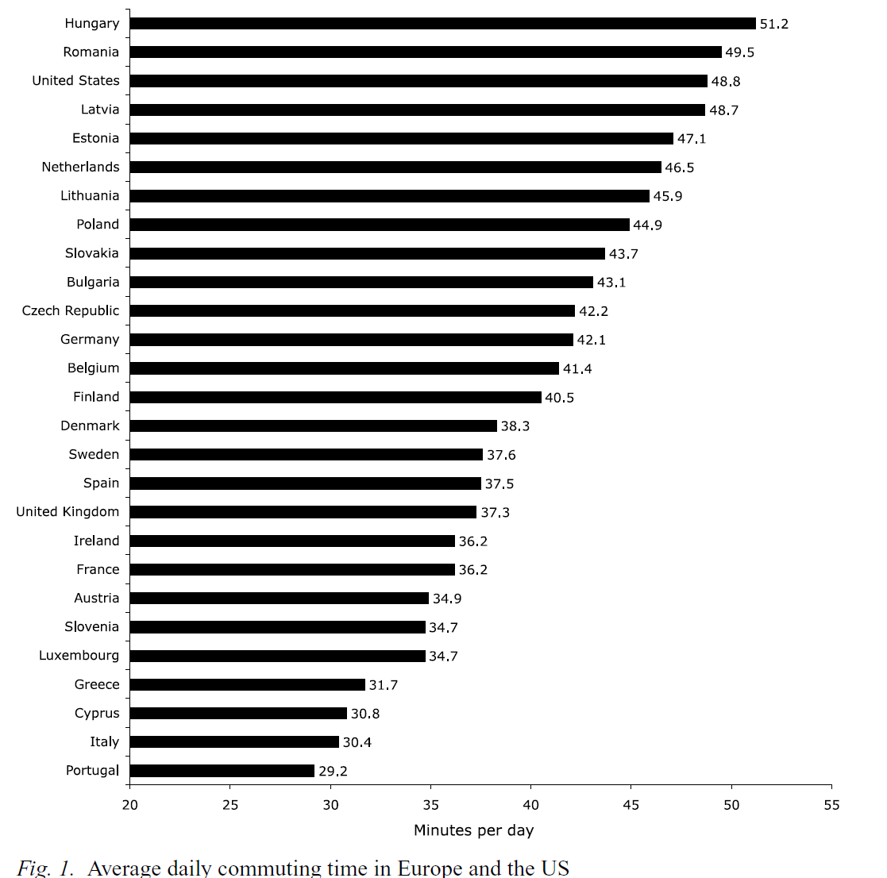
Commuting time
Why do people commute?
Why are such huge differences in commuting time?

Slide 33
EX (1): Monetary and time costs
In 1983, 87.4 % of household trips to work were by private motor vehicle, 4.6 % by public transit, and 8.0 % by other modes of travel (for example, bicycle or walk).
For private transportation, the average length of work trip (one way) was 8.5 miles, with an average commute time equal to 20 minutes. The operating cost per mile for private transportation was 8.36 cents.
For public transit, the average commute time was 46.1 minutes per one-way trip, with an average fare equal to 60 cents.
For other work-trip modes, the average one-way trip length was 5.6 miles, with an average trip time equal to 30 minutes.
For each of the three modes, what is the monetary cost per trip?
Assuming an average hourly wage rate equal to USD 10, what is the total cost pet work trip on each mode?

Slide 34
EX (2): Value of time
Most studies of modal choice find that the value of in-vehicle travel time is less than the value that travellers place upon waiting time.
Suppose that you’re an economist for a commuter railroad system. The manager of the agency is considering either of two policies: adding additional stops, with the expected result of reducing on-line speeds but also reducing the headway (that is, the average time between trains); or removing some stops, which would increase on-line speeds but also entail longer headways.
Overall, both policies are predicted to have the same effect on total travel time for the average consumer.
Discuss how you would use information on riders’ values of time in your police recommendation.

Slide 35
EX (3): Population density and public transport
One would expect that the demand for automobile ownership in metropolitan areas would be influenced by population density. Holding all else constant, the denser the area, the more public transit will be provided. Also, the denser the area, the more traffic congestion will be present.
Assuming that the public transit fare remains constant, explain why an increased supply of public transit in denser areas would reduce the opportunity cost of public transit.
Assuming no change in the per-mile monetary cost of automobile travel, explain why increased congestion will increase the opportunity cost of automobile travel.

Slide 36
Ex (4): The notion of need
There are some advocates of the idea that transport services, or at least some of them, should be allocated according to need rather than effective demand.
The idea is that just as everyone in a civilized society is entitled to expect a certain standard of education, medical care, security and so on, so they are also entitled to enjoy a certain minimum standard of transport provision.
Do you agree with this idea?

