Slide 1
4. TRANSPORT COSTS

Slide 2
Introduction
Elasticity of demand → major factor on the demand side
Cost of production → major factor on the supply side
Generalized cost (monetary + time costs) + External costs = Total costs

Slide 3
Public transport costs
Public transport services are vital for modern societies and economies; however, they usually need to be subsidized (because of low revenues)
However, it is crucial to keep downward pressure on the cost in order to provide more services or keep subsidies low; but this is difficult
How are costs incurred in public transport? → usually large fixed costs and small marginal costs (when operating under less than full capacity)

Slide 4
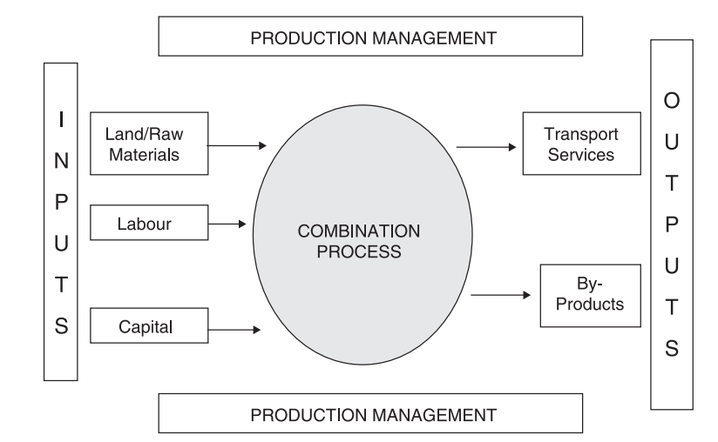
Production process

Slide 5
Efficiency
The inputs/outputs ratio is the main base for assessing whether a given operation can be described as efficient or not.
Measurement of efficiency is very helpful in the assessment of the performance of (subsidized) public transport operators (whether they provide good service for taxpayer's money)
It can be also utilized for benchmarking

Slide 6
Technical, cost and allocative efficiency
Technical efficiency = minimum level of inputs to produce maximum level of outputs
Cost efficiency = most cost efficient input minimization
Allocative efficiency = cost efficiency + right quantities

Slide 7
CASE STUDY IN RAIL EFFICIENCY
This paper empirically explores the relationship between competition design and efficiency in the railway industry.
It uses Data Envelopment Analysis (DEA) to construct efficiency scores, and explain these scores, using variables reflecting institutional factors and competition design.
Driessen, G., Lijesen, M., & Mulder, M. (2006). The impact of competition on productive efficiency in European railways (No. 71). CPB Netherlands Bureau for Economic Policy Analysis.

Slide 8
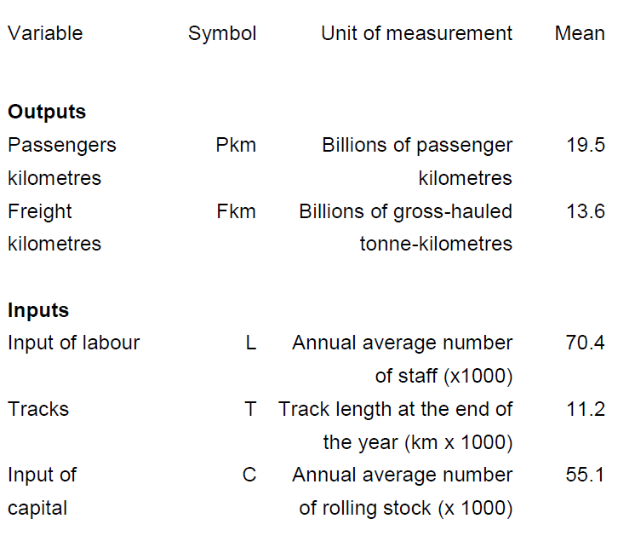
Outputs and inputs

Slide 9
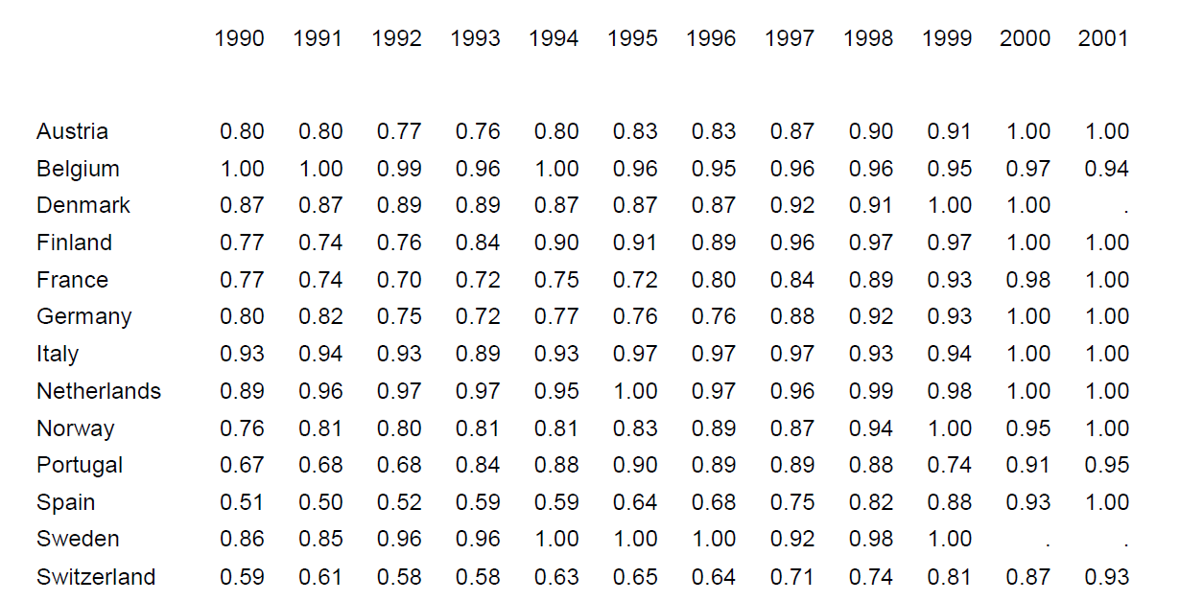
Efficiency scores
Source: Driessen et al. (2006)

Slide 10
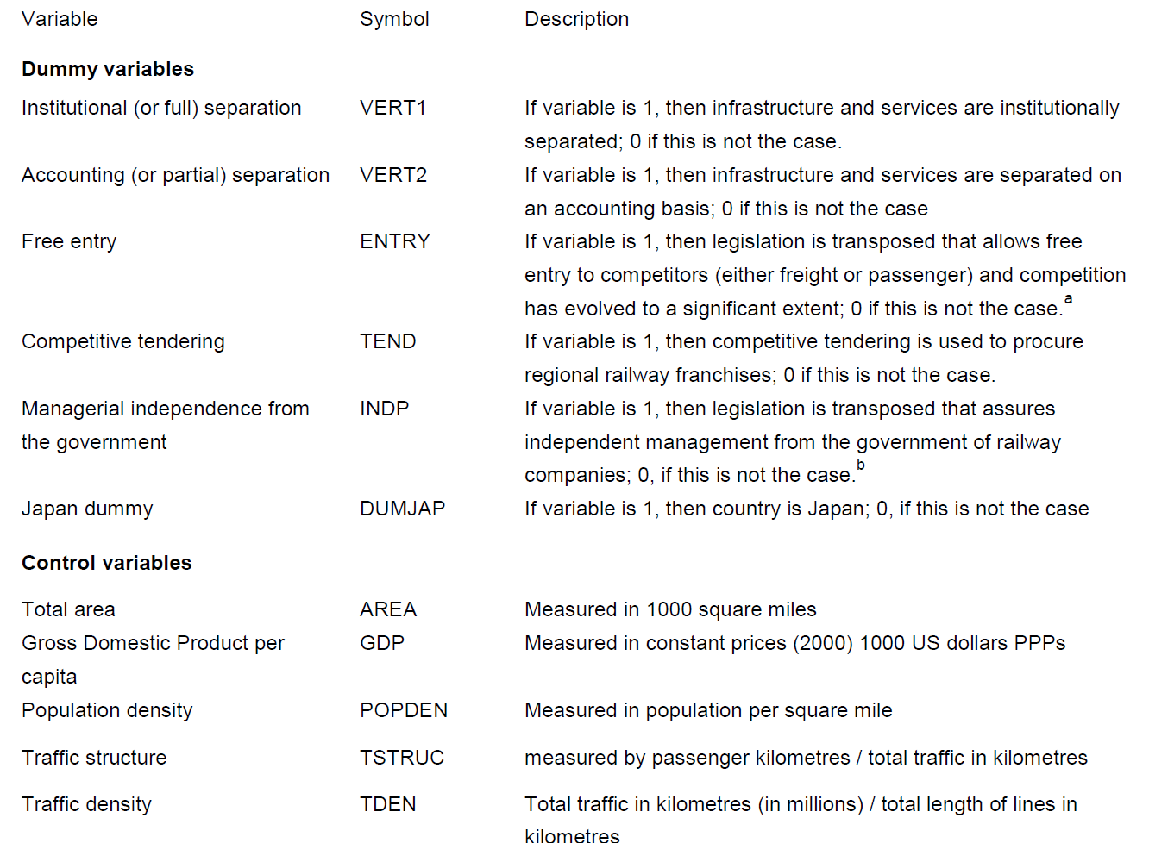
Efficiency determinants - data
Source: Driessen et al. (2006)

Slide 11
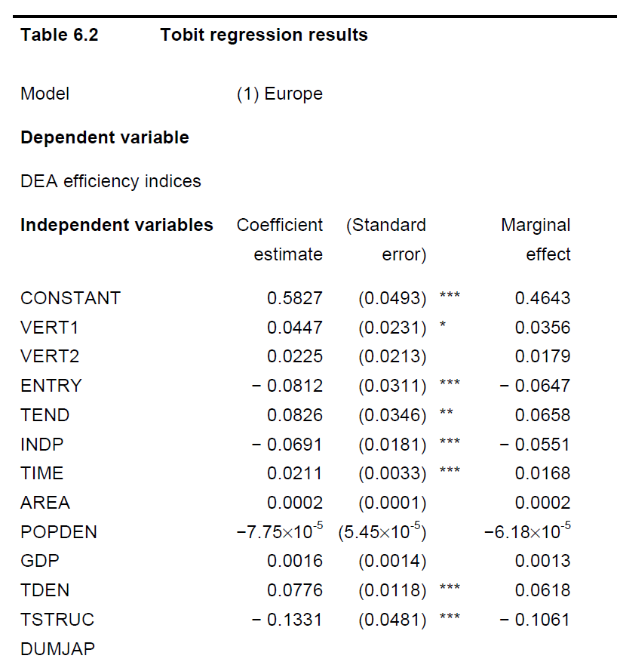
Efficiency determinants – results
Source: Driessen et al. (2006)

Slide 12
Conclusions
The results suggest that competitive tendering improves productive efficiency, which is in line with economic intuition as well as with expectations.
They also found that free entry lowers productive efficiency. A possible explanation is that free entry may disable railway operators to reap economies of density.
The final result is that more autonomy of management lowers productive efficiency. Most of the incumbent railway companies are state owned and do not face any competitive pressure. As a consequence, increased independence without sufficient competition and adequate regulation may deteriorate incentives for productive efficiency.

Slide 13
COSTS IN THE SHORT RUN

Slide 14
Short run – level of capital fixed
In the short run at least one factor of production is fixed (we assume capital)
In the short run, a discussion of returns to scale is not relevant, since all inputs cannot change in the same proportion.
Adding more workers to a fixed amount of capital reduces MP_{L} = law of diminishing returns.

Slide 15
Passenger x Freight
Production: Inputs (vehicles, drivers, power); Output (vehicle-km)
Passenger x freight → passengers load and unload by themselves!
- Are passenger services more efficient?
Are there any complementarities in producing together passenger and freight? (air, rail)
Freight rail need 1.45 higher labour component in comparison with passenger rail (Nash, 1985)

Slide 16
Case: Mode cost comparison

Slide 17
Modal comparisons
Labour intensive industries: parcel and bus operations;
Capital intensive industries: railways, ferries and airlines
High fuel costs: bus, airline
High fixed costs: railways;
Low fixed costs: parcels, bus

Slide 18
Market structure
The division between fixed and variable costs has major implications on the structure of the market
High level of FC together with capital intensive production would suggest large firms, which would act against market entry and competition in the market
On the other hand, on more labour intensive industries such as bus and parcel operations, competition in the market should be both achievable and sustainable

Slide 19
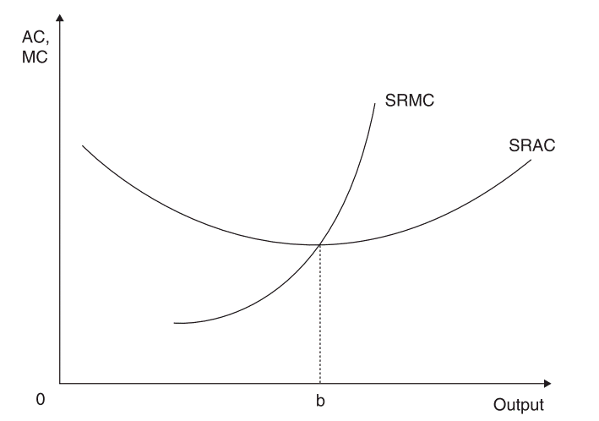
Short run average and marginal costs

Slide 20
Case: The importance of AC in the business model of low cost airlines
The importance of AC is highlighted in this case study that looks at the operational characteristics of low cost airlines
Their business model is based on achieving low AC; not only by cutting costs but also by other measures
Before deregulation of US (1978) and EU (1990) of air markets, there was restricted capacity on routes and regulated price and market was dominated by national operators
After deregulation, many low cost operators entered the market (Ryanair and many others…) – it is important to achieve low AC, not just low cost

Slide 21
Low average cost model
Low staff costs
Low aircraft turnaround times
Route networks based on secondary airports
On-line ticket sales
Cabin crew perform other duties
Point to point operations (no hub and spoke)
All extras for a charge
No spare aircraft capacity in reserve
Fleet based on a single aircraft type

Slide 22
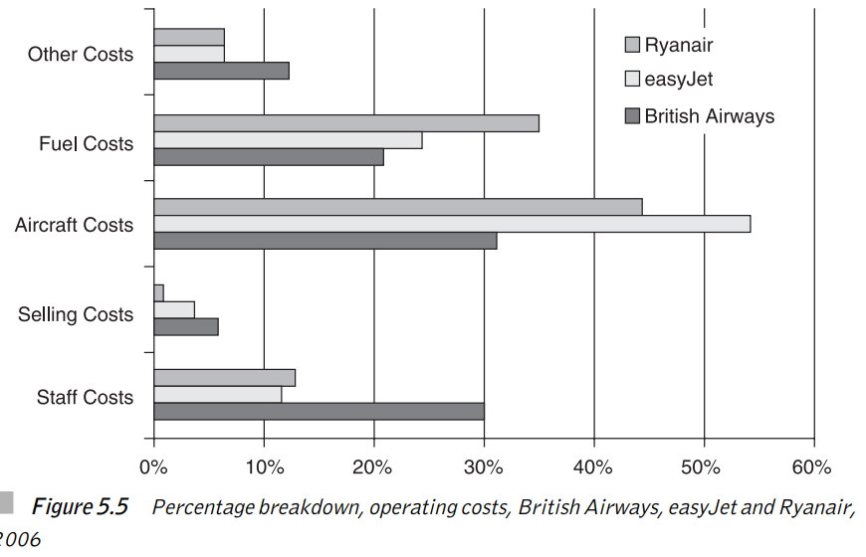
Operational costs

Slide 23
National x low cost operators
National operators have higher share of labour and selling costs.
When labour is salaried, then in the SR it is more FC than VC. The share of VC is around 50% for BA but about 70% for LCA
Variable cost vary with output, however fixed costs do not. The key to success is high utilization of fixed assets (costs) – aircraft, crew

Slide 24
Conclusion – LCA business model
The key is to achieve high utilization of pilots, crew and aircrafts – to achieve low AC
LCA changed the economics of airline operations. Traditional thinking used to be that it is an industry with a high proportion of capital costs and a relatively low level of variable costs
Under regulation, operators limited supply as this increased profits. In the LCA model, profits are maximized through low profit margins and high passenger volumes

Slide 25
COSTS IN THE LONG RUN

Slide 26
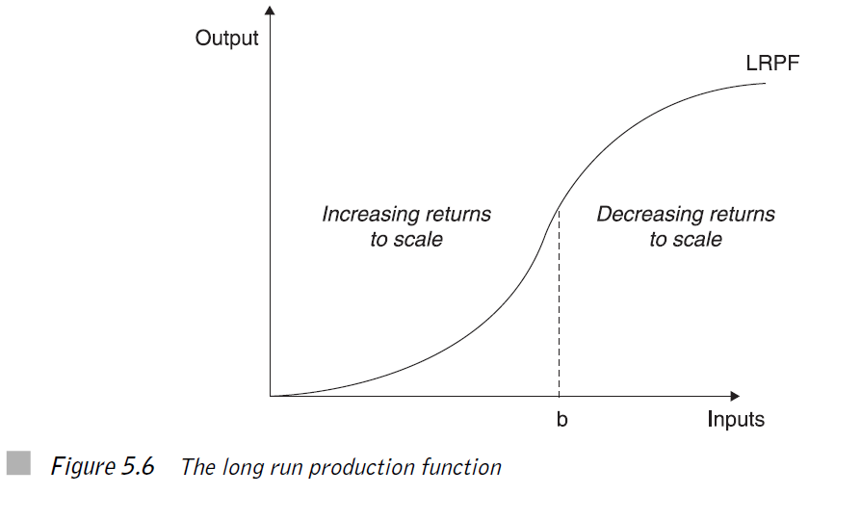
Economies of scale

Slide 27
Sources of increasing returns to scale
Specialization of labour → larger firm allow more specialization of the workforce
Scheduling of inputs → larger firms have greater flexibility in the combination of inputs
Capital input → expensive capital purchases, specialization
Indivisibilities → investment needs come when the operation is close to capacity

Slide 28
Sources of decreasing returns to scale
Loss of control → as firm size increases, there is a loss of control over the whole organization; the emergence of X-inefficiency
Geographical location → when firm moves out of optimal location, the costs will increase
Administration procedures → large firms need middle and upper management; the emergence of bureaucracy; the longer time for decision-making

Slide 29
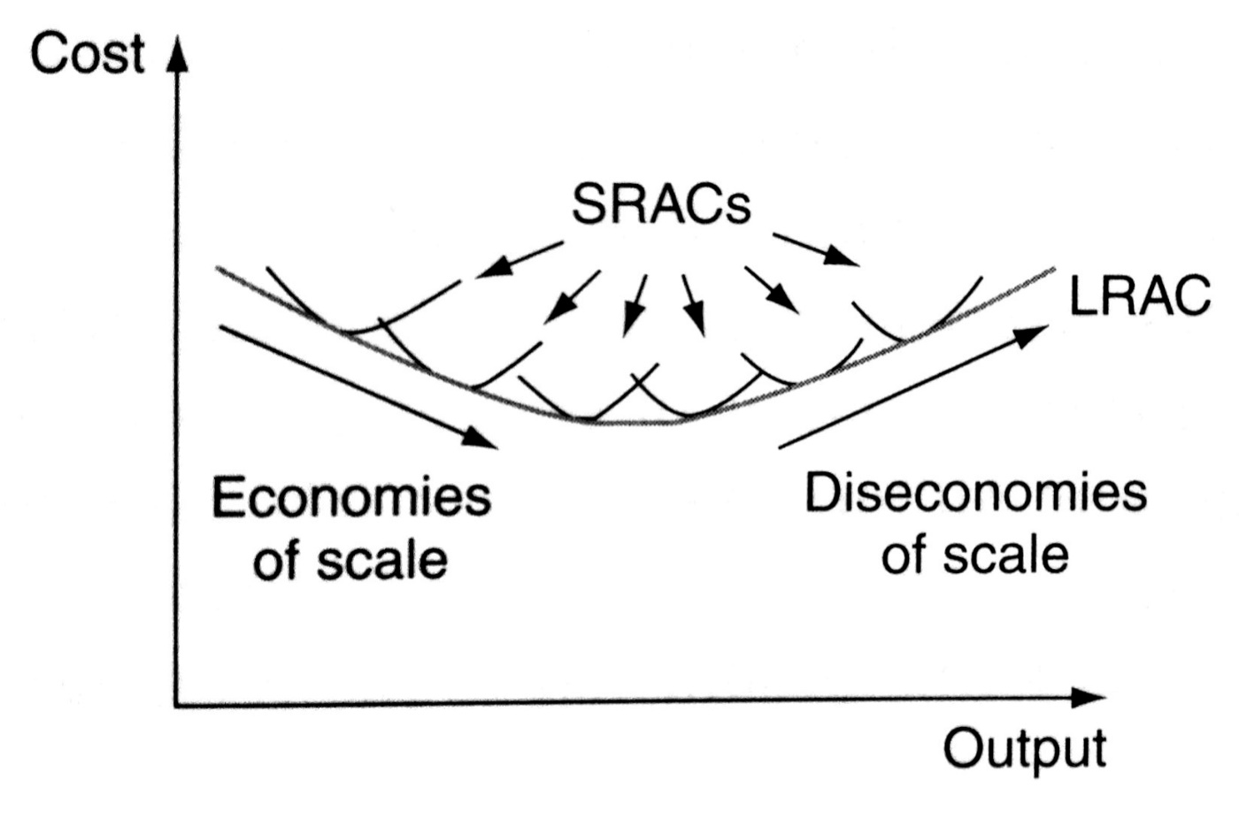
SR and LR average cost curves

Slide 30
Minimum efficiency size
The average costs fall firstly with firm size, then they reach minimum at the optimal level of production, known as minimum efficiency size (MES)
The firm has higher production flexibility in SR than in LR
The optimalization in transport is complicated by the demand peaks and natural monopoly elements

Slide 31
Case: Economies of scale and reform in railway operations
The general view of economies of scale within the rail industry used to be that, due to a high capital requirements, economies of scale are significant and hence company size needs to be large in order to capture them
In the past this was one of the main reasons which led to nationalization of railway industries across Europe (CH: 1901 – UK: 1948)

Slide 32
Vertical separation
However, in the last 30 years a new approach has emerged. It argues that economies of scale are associated with the infrastructure only and not with services
Therefore the solution is to separate infrastructure from services, to keep a monopolistic provider of infrastructure and to allow competition in the provision of rail services
Vertical separation (SE, UK, CZ) x Holding structure (DE, FR, AT)

Slide 33
Empirical evidence
Preston (1994, 1999) in a study of 15 (integrated) Western railways found diseconomies of scale for larger rail systems (W. Germany and UK) and increasing returns for smaller systems (Ireland, Switzerland). Optimal size: Danish or Belgian rail network
Implication: Germany and UK should divide their systems into three or four smaller integrated networks
Swiss private rail network would benefit from mergers

Slide 34
Does vertical separation work?
The impact of vertical separation on the efficiency of rail operations is not clear from empirical studies (competition entry x loss of coordination)
Are there really no economies of scale in the provision of rail services?
Even if they are, the dynamic entry of low cost rail operators (RegioJet, Quigo) may overrun scale considerations

Slide 35
Economies of scale, density and scope
If an equal proportionate increase in all outputs and route kilometers leads to the same proportionate increase in costs → constant returns to scale
If an equal proportionate increase in all outputs holding route kilometers constant leads to the same proportionate increase in costs → constant returns to density
If splitting the production of passenger and freight outputs and of infrastructure leads to increased costs → the railway is said to experience economies of scope
Nash, C. (2011). Competition and regulation in rail transport. Handbook of Transport Economics.

Slide 36
Empirical update
Current empirical studies state that:
Competition entries increase efficiency
Economies of scale in operation are small to negligible
Economies of scope were (vertical integration) not identified
Economies of density are strong

Slide 37
Exercises (1)
Identify reasons why airlines would want to take over other airlines.
Critically evaluate the following statement: “All constraints on behaviour are costly, which explains why the short-run total cost curve lies above the long-run total cost curve.”

Slide 38
Exercise (2)
Fuel costs are important inputs to any transportation activity. Suppose that real energy prices rise. Graphically depict the impact that this would have upon a firm’s total short-run and long-run cost structure.
Would you expect a firm’s long-run response to a fall in energy to be greater, less, or equal to its short-run response to a fall in energy prices?
What does this suggest about the firm’s short-run input price elasticity of fuel relative to its long-run input price elasticity of fuel?

Slide 39
Exercise (3)
The July 7, 1993 Wall Street Journal provides the following information: “Northwest Airlines averted – at least for now – a threatened federal bankruptcy-law filling after its pilots’ union agreed to a last-minute pact to save the carrier 365 USD million over three years.” Using Northwest’s short-run cost curves, depict where Northwest was operating before and after the agreement with the pilots’ union.

Slide 40
Exercise (4)
Suppose that you are given the following information on All Around Airlines:
The average variable cost of producing airline trips varies between 11.5 cents a mile when 50,000 trips per year are produced and 16.7 cents per mile when 500,000 trips per year are produced. Its lowest value is 11.5 cents a mile when 250,000 trips are produced.
The average total cost of producing trips varies between 15.3 cents per mile when 250,000 trips are produced and 17.3 cents per mile when 500,000 trips are produced. The minimum short-run average total cost is 13.0 cents when 300,000 trips are produced.
Questions:
  Approximately, how many trips will be produced in the short run if the fare is 15.4 cents per mile?
  Will any trips be produced if the fare is 12.1 cents per mile? If so, why; and if not, why not?
  Will any trips be produced if the fare is 10 cents per mile? If so, why; and if not, why not?

Slide 41
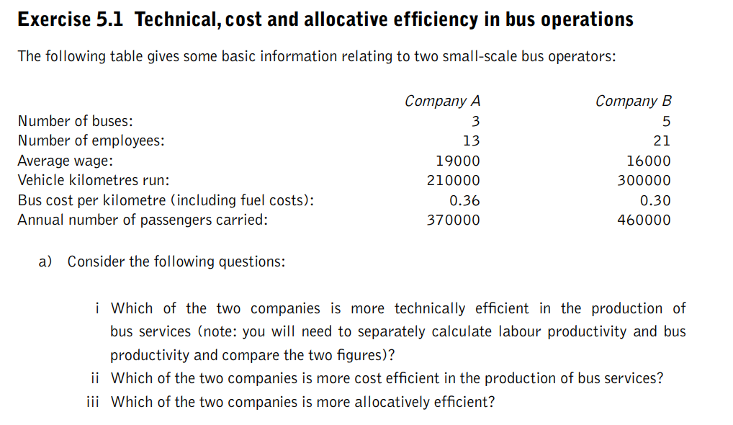
Exercise (5)

Slide 42
Exercise (6)
Economies of scale in railway operations
List what you believe to be the main sources of economies of scale in the rail industry. Once you have produced this list, indicate which arise as a result of returns to scale and which are cost savings.
What on the other hand do you believe are the main sources of diseconomies of scale in larger integrated railways?
If you were a rail industry regulator in Britain today, what other factors apart from economies of scale would you take into account when deciding on the number of operators to have in the market?

Slide 43
Exercise (7)

Slide 44
Exercise (8)

