Slide 1
5. COMPETITION

Slide 2
Introduction
The general economists' view of competition: it is a good thing; and no competition – monopoly – it is a bad thing
Generally speaking, it is correct, however firstly how exactly competition delivers good outcomes, secondly sometimes competition does not produce the best outcome, and this is particularly relevant in transport industries
The aim of this lecture – to understand when and how competition delivers efficient outcomes and when it is not the case and the government intervention is needed (usually because of market failure)

Slide 3
Background
Neo-classical economics and economic policy → the power of competition (remember airline deregulation)
One of the major problems with transport markets → a general lack of competition
Cost structure of the industry (FC/VC) determine teh number of firms in the market and thus the level of competition

Slide 4
PERFECT COMPETITION
(basic assumptions)
Many buyers and sellers
No barriers to entry or exit
All firms are profit maximisers
All consumers are utility maximisers
Perfect information
Homogenous product
Example: Road freight

Slide 5
Perfect competition
(further assumptions)
Non increasing production technologies → no economies of scale
Non rivalry in consumption → consumption by one individual does not preclude consumption by other
Absence of externalities → all benefits and costs are private and thus taken into account in market based decisions
No government intervention → to interfere between the forces of demand and supply

Slide 6
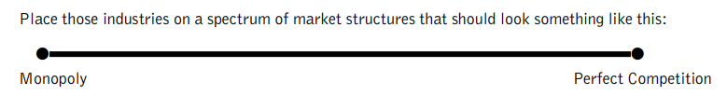
Exercise: Market structures
From the following list of transport industries:
  Long distance buses
  Commuter rail
  European passenger air services
  Transatlantic passenger air services
  Rail freight
  Road freight
  Urban taxi
  Urban public transport

Slide 7
IMPERFECT COMPETITION and BARRIERS TO ENTRY

Slide 8
IMPERFECT Competition
Breaches one or more of the assumptions of perfect competition. The result is a market that may have some form of competition, but the competition tends to be flawed in some respect
When left to the free market, historically most transport industries have tended towards oligopoly or monopoly. Imperfect competition has problems as well as potential advantages.
Many reforms intending to introduce competitive environment were unsuccessful in the long run

Slide 9
Barriers to entry
Barriers to entry are key to sustaining a short term monopoly into the longer term, as they stop new firms entering the market and competing with the established operator
Structural barriers → there are basic industry conditions that may limit market entry
Strategic barriers → organizational barriers are put in place by incumbent firms to achieve the same effect

Slide 10
Structural barriers
Firm size → when there are significant economies of scale (rail, air)
High sunk costs → cost that cannot be redeemed or reclaimed when the firm leaves the market (Channel Tunnel)
Product differentiation → when strong brand loyalty is created
Experience → cost advantages due to the experience of being in the industry for a long time (learner curve, market knowledge, good reputation)

Slide 11
Strategic barriers
Legal protection → a legal right to be the only provider → e.g. winners of the tender for PSO services (rail, bus) → direct competition on the route is prevented
Control of the factors of production → skilled labour (rail drivers); vertical integration (production and transport); rolling stock (rail)
Exclusive dealerships → car selling → manufacturers can control the network of outlets and prevent local competition in the new car sales → variation in car prices
Branding → creation of strong brands as barriers to entry

Slide 12
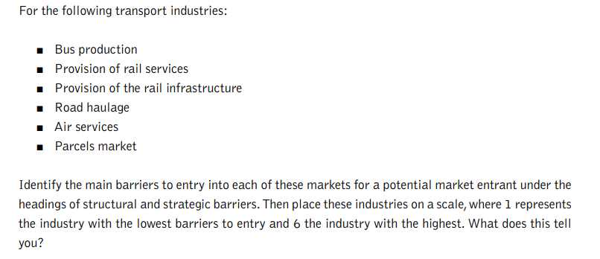
Exercise: Barriers to entry

Slide 13
MONOPOLY

Slide 14
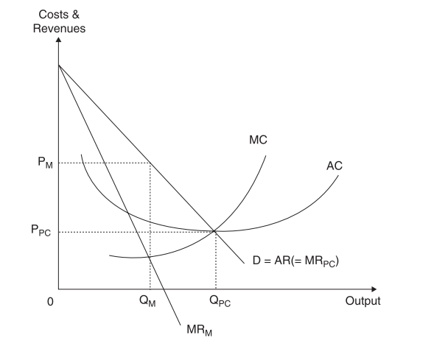
Monopoly versus perfect competition

Slide 15
Disadvantages of MONOPOLY (1)
Production inefficiencies → the monopoly is not forced to produce with the minimal long run average cost → resources are being used inefficiently → mainly because scale inefficiency → restriction of supply
Higher prices charged → monopoly restricts supply in order to induce high prices → public ownership (or introduction of competition) may try to increase output and decrease prices
Reduction of consumer surplus → consumer surplus is changed into producers surplus. This transfer is potentially regressive as users of transport system are usually poorer than shareholders of the monopoly

Slide 16
Disadvantages of MONOPOLY (2)
Net welfare loss → reduction of the total benefits from the exchange (consumers who no longer use the service)
X – inefficiency → costs are higher than they should be due to general management slack (state ownership, no competition, no threat of bankruptcy)
The market no longer regulates itself → accumulation of previous points; external intervention needed to provide regulation; emergence of regulatory bodies (not producing anything)

Slide 17
ADVANTAGES of MONOPOLY
A higher level of expenditure on research and development → when there is only one single large firm, it may have more resources and higher confidence to invest (TGV)
Market size – a natural monopoly
Wasteful competition
Hotelling‘s law

Slide 18
2) Market size – a natural monopoly
Market is of such small size, that only one firm can achieve all economies of scale
This argument normally applies where there is some form of network used in the production (rail infrastructure)

Slide 19
3) Wasteful competition
Closely related to the natural monopoly argument
It occurs when effectively double or treble the production resources are used to provide a service
Nash (1982) explains that wasteful competition happens when competition leads to the bidding down the average loads and consequently average costs rise.
Economies of scale (natural monopoly) x economies of density (wasteful competition)

Slide 20
4) Hotelling's law
Hoteling's theory (1929) of location competition – ice cream sellers on the beach
Non - optimal equilibrium, overcrowding in the middle
Application to transport – competition in the timetables → Can lead to disruptions due to constant changes in departure times

Slide 21
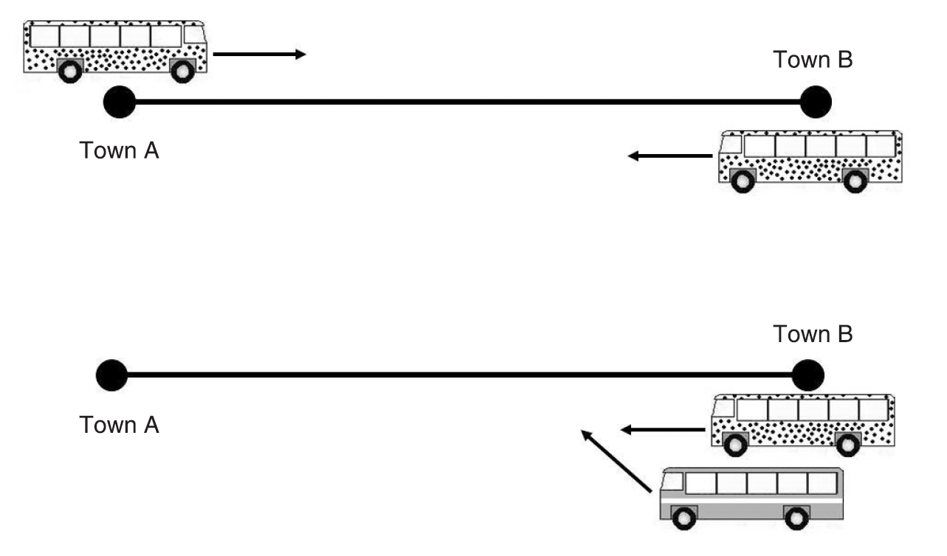
4) Hotelling's law applied to buses
(competition in departure times)

Slide 22
Contestable markets
Baumol (1982) – it is unnecessary for the market to be in perfect competition in order to produce economically efficient results. It is enough to be a contestable market.
If a new market entrant could enter the market and compete with the incumbent, then the threat of this potential competition would force the incumbent to act as if under (a perfect) competition
Contestable market = entry to the market is free and exit is costless
Q: Examine the extent to which you believe that the low cost airline market meets the conditions of the contestable market.

Slide 23
Contestable markets
Very few contestable markets seem to exist in reality; assumptions are highly restrictive
Low cost airlines may be close to this model
Contestable markets suffer from hit and run entry (cream off profits and run away)
They can also suffer from cherry – picking (concentration on the highest return's part of the market)

Slide 24
Case: Contestability in airlines
The sector is becoming more contestable because:
Control over landing slots is lower (demise of airlines, regional airports)
The spread of information through Internet (expanded access to information)
The frequent flyer initiative is on retreat (is now a less of a benefit to passengers)
The growth of low cost airlines (it is possible to compete against established operators)
Q: Are railways contestable markets?

Slide 25
OLIGOPOLY

Slide 26
1) Few sellers, many buyers
When making market conduct decisions (fares, services), firms will take into account rivals' likely reactions to their market conduct
This contrasts both with perfect competition and monopoly

Slide 27
2) Barriers to entry are significant
With significant barriers to entry, firms within industry have a degree of protection from new entrants
When considering market conduct decisions, little account needs to be taken of any potential competition
Contestability of the market is thus limited

Slide 28
3) Non price competition
When there are very few sellers, price wars tend to damage all firms in the industry and benefit none
What tends to happen is that firms compete on factors other than price, thus all charge similar prices but differentiate the product or service that is offered
The idea of kinked demand curve → all firms will charge the same price, price leadership
Non price competition is generally regarded as a characteristic of oligopolistic markets, some markets have pretty vicious price competition (parcels, energy providers…)

Slide 29
4) Product differentiation
The differentiation can take the form of the differences in the frequency of service patterns, the flexibility of tickets sold, role of special offers
Degree of brand loyalty starts to exist → advertising and branding become important
Advertising → perception of difference → brand loyalty → degree of market power → more flexibility in setting the price

Slide 30
5) Tacit collusion
Tacit collusion = hidden degree of cooperation
There is a strong incentive for firms to cooperate than compete
Open cartels are illegal
However, tacit collusion means unspoken, passive cooperation in order to relax competitive pressures
Examples: buses in the UK, rail in CZ: the period of price wars, followed by consolidations and the emergence of large operators with home markets

Slide 31
The process of competition in oligopolistic markets

Slide 32
Introduction
Why some markets have significant degree of competition and others have not?
Many transport market evolve over time towards oligopoly, even if the deregulatory design was to produce competitive industry (US air, freight rail; UK bus, rail freight, EU air)
Anti-competitive nature of many transport markets? → A major concern in the reform of public transport markets

Slide 33
Downie process of competition
Downie‘s little known theory of the competitive process (Downie, 1958)
This theory examines the competitive process over time and is primarily based upon the ethos of the survival of the fittest
The fittest in this case being the most efficient firms
Further theoretical perspectives to explain the tendency towards supply side consolidation

Slide 34
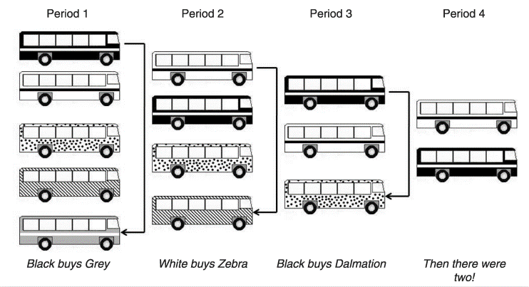
Downie competitive process applied to buses

Slide 35
Downie competition
Less efficient operators are vulnerable to takeovers. This process diminishes the actual level of competition
The motivation to purchase other companies is primarily driven by the desire for growth (of revenues not profit!)
Downie model of competition → consolidation (and less competition) makes industry more efficient (as operations of less efficient operators are taken over and rationalized by the more efficient ones)
This is more likely to occur in markets where there is wasteful competition
This is not consistent with neo-classical micro (less competition should lead to lower efficiency)

Slide 36
Further development
Efficiency improvements will be spread into other industries through horizontal acquisitions. E.g. in period 5, Black Bus may purchase a train operator, and transform into the Black Group
The definition of the market may change (bus x PT x transport services; national x international)
Example: British buses after deregulation: mergers and acquisitions occurred; efficiency improved; competition declined
Conclusion: competition based on market forces is unattainable, the market tends to oligopoly with higher prices and lower capacity → market no longer regulates itself → regulation needed!

Slide 37
Case: British bus reform

Slide 38
Before 1980
Regulation of bus services regarding market entry, the level of service, frequency, fares and qualitative regulation
On the supply side →state-controlled monopoly (National Bus Company) + local operators
Local monopolies, exclusive rights, very little direct competition
Prices and frequencies strictly controlled

Slide 39
1980
Deregulation of long distance bus market
Any operator was free to compete with NBS on LD routes and charge whatever price they wished
Results → increased patronage; reduced prices, significantly increased network of services

Slide 40
1986
Deregulation of all bus services (except in London)
Re-organization of supply → 150 new bus companies
NBS → transformed into 72 regionally based operators
Local authorities should separate their bus operations from local authority
Local authority powers in the planning and control of bus routes was severely limited
No industry regulator
Belief in the power of competition

Slide 41
Results
All bus services outside London were deregulated on 23 October 1986
Massive disruptions in most major cities
Bus wars → cut-throat competition to gain market shares
Constant changes in timetables, wasteful competition in duplication of well-served routes, withdrawal of rural services, dangerous driving, dubious business practices

Slide 42
Conclusion
Concentration in the industry → mergers; emergence of teritorries and local monopolies again
Costs → downward pressure
More focus on customer, increased investment in the rolling stock; what customers want?
Move to the competition for the market from the competition on the market

