Slide 1
8. PRICING

Slide 2
Introduction
Pricing is a vital component in the economics of transport
The price determine who gets and who doesn’t get a particular service, but also determines the distribution of rewards between the provider and the user
The imperfect market structures are characterized by higher rewards for the providers

Slide 3
The principles of pricing
In most cases, transport services are subsidised and/or regulated, however a basic understanding of pricing principles is needed
In order to achieve economic efficiency, the price should equal the marginal cost
In imperfect competition markets, it is possible to observe 1) price discrimination, 2) predatory pricing/bidding, 3) price fixing
We will also investigate congestion pricing

Slide 4
Price DISCRIMINATION
Price discrimination refers to a situation where a company charges particular consumers a higher price than others for the same product for reasons unrelated to cost.
The seller: 1) must possess a degree of market power, 2) must be able to divide the market and 3) market segments must have differing elasticities of demand.

Slide 5
Perfect price discrimination
To sell each unit (or ticket) separately, charging the highest price that each consumer is prepared to pay
If this was achievable, the seller would obtain the entire consumer surplus from the consumer
The seller must know the exact shape of each consumer’s demand and charge each consumer the maximum price they are prepared to pay

Slide 6
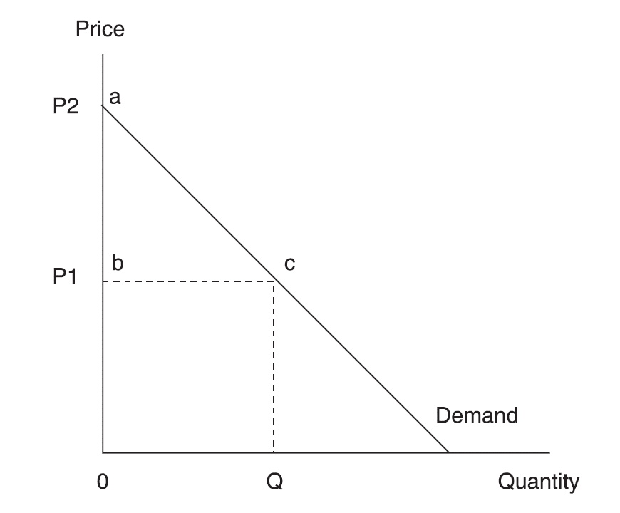
Consumer surplus
Perfect price discrimination means capturing all consumer surplus (area abc)

Slide 7
Case: Sale of airline tickets
On a typical airline flight there are three classes, namely First, Business and Economy.
Figure on the next slide refers to travel in a particular class and the assumption is made that the marginal cost of one extra passenger is constant up to the point where the aircraft reaches full capacity. At this point the MC curve becomes perfectly inelastic

Slide 8
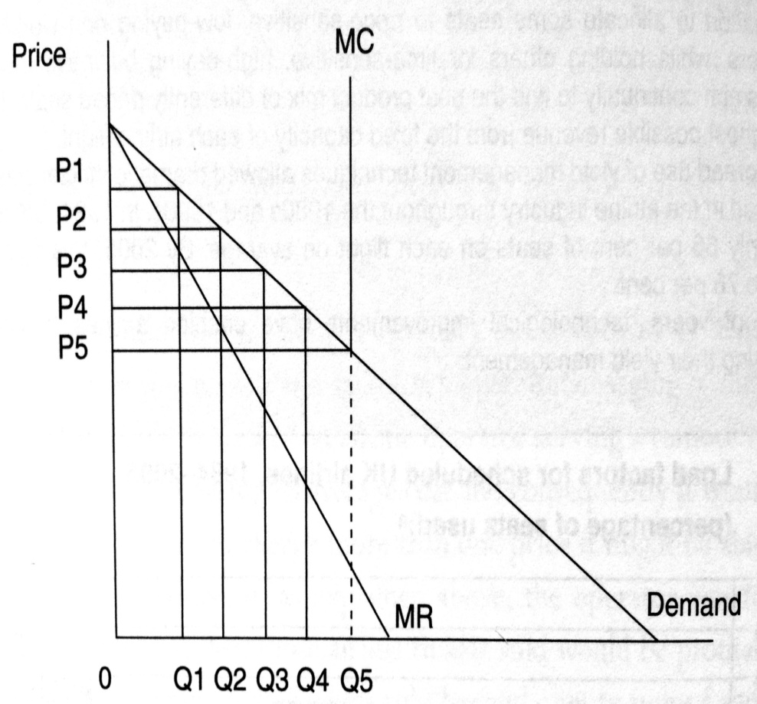
Airline price discrimination

Slide 9
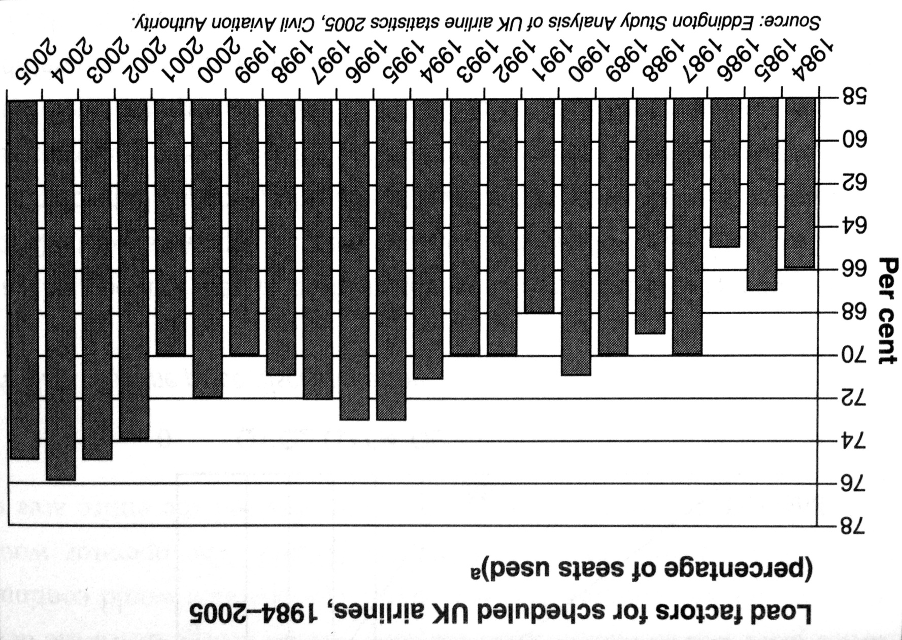
Yield management in the aviation

Slide 10
Exercise (1)
You are the manager of the Airline and unable to determine whether any given passenger is a business or leisure traveller.
Can you think of a self-correction mechanism that would permit you identify business and leisure travellers?

Slide 11
Exercise (2)
Suppose that a transport carrier is accused of price discriminating in two separate markets.
The carrier replies that he can’t be price discriminating, since he is charging the same price in each of the markets.
Do you agree or disagree with the carrier’s response?

Slide 12
Exercise (3)
Business travellers have more inelastic demands for air services in comparison with vacation travellers.
If an airline charges business and vacations travellers the same route fare between Chicago and Los Angeles, does this necessarily imply that the airline is not price discriminating?
Under what conditions would this be consistent with price discrimination?

Slide 13
PREDATORY pricing
Predatory pricing occurs when a firm with market power reduces its price below cost in the short run so as to obtain abnormal profit in the long run.
Predatory pricing is aimed at either achieving or maintaining a monopoly situation, with the price set so as to bankrupt competitors, „encourage“ them to merge or in fact collude.

Slide 14
Predatory pricing
The consumer may benefit in the short run from lower prices, due lower competition such activity may not be in the public interest in the long run.
In practise it can be very difficult to prove that such activity has taken place
Predatory pricing is an appealing strategy in a segmented market

Slide 15
EWS and predatory pricing
EWS (English Welsh and Scottish Railways) has been at the centre of a number of accusation of predatory pricing
One case was heavy haul sector in rail freight where EWS acted as freight forwarder and offered customers end to end services in the transportation of coal.
In 2001 Freightliner, the other main rail operator entered the heavy haul sector with direct competition with EWS

Slide 16
EWS was accused of:
Discriminatory pricing practices → by offering selective price reductions to various customers
Predatory behaviour towards Freightliner → EWS had offered prices to two electricity generators that were significantly below its average costs
Exclusive contracts → several power generator customers were required to sign long term supply contracts with EWS

Slide 17
Verdict
The regulator ORR found EWS guilty and fined it with 4m GBP; due to leniency program, there was a 35% discount in fine due to EWS cooperation in the investigation
In similar case – lease of loco for tourist charter trains in Scotland – ORR decided that there were no grounds to conclude that EWS had engaged in predatory pricing or anti-competitive behaviour

Slide 18
Predatory BIDDING
A similar practise to predatory pricing is a predatory bidding that relates to predatory pricing in competitive tenders.
The competitive tendering occurs when firms bid for right to run service or gain a certain contract.
The competitive tender is often utilized to choose the provider of subsidized rail passenger services.
Q: Do you think it is a good idea to choose the operator in such tender on the base of only one parameter – lowest price?

Slide 19
Predatory bidding in Sweden
Alexandersson, G., & Hultén, S. (2006). Predatory bidding in competitive tenders: A Swedish case study. European Journal of Law and Economics, 22(1), 73-94.

Slide 20
Abstract
Public procurement by competitive tendering is an important part of European policies to encourage competition in network industries previously dominated by public companies.
In recent years, the appearance of very low bids has become an issue in several countries.
A case of tendering for train services in Sweden is used to illustrate the possibilities to detect an abnormally low bid.

Slide 21
Why do firms place very low bids in tenders?
Cost advantage
Economies of scale
To weaken/destroy competitors
Winner's curse
Moral hazard

Slide 22
Legislators view on predatory bids
EU legislation does not consider predatory pricing as such
Instead, it focuses on price reductions as one of several practices related to abuse of dominant position
How to identify „unreasonably low bids“?

Slide 23
Tendering in northern Sweden
In 2002 Connex won tender for operating night train services to northern Sweden
Connex, originating from France, is Europe biggest private passenger transportation company (55.000 employees and 3.4 bn EUR turnover (2003))
Tagkompaniet – small competitor that lost the contract (this contract was 80% of its turnover) bitterly complained that Connex bid was „totally unrealistic“
Swedish Competition Authority decided not to take action, after failing to find sufficient support to investigate any possible violation of the Competition Act

Slide 24
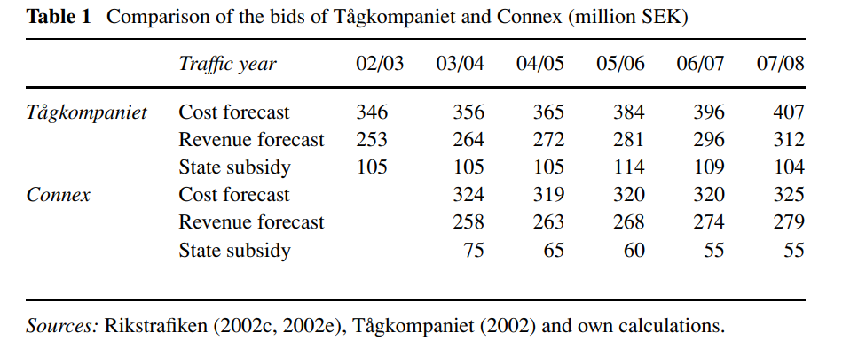
Comparison of the bids

Slide 25
The assessment of Connex bid
Conservative in revenue projections
Very ambitious in cost reductions
Connex publicly declared that it will not cut down on staff or change the working conditions
No allowance for expanded vehicle maintenance
Summary: Connex bid has been „extremely low“

Slide 26
Subsequent development
2004 – Connex were criticized for running old and very run-down trains, lacking the comfort passengers expected.
Connex appeared not to be willing or able to keep the interior of trains in good shape
Patronage plummeted and in late 2004 the management of Connex was facing massive criticism from staff and union.
The head of the services was replaced

Slide 27
Subsequent development
Worsening conditions for travelling by train between Stockholm and Northern Sweden, causing a political debate that soon reached the national level
The end result was a decision in Parliament to direct an extra 100 million SEK per year to improve the quality of services
It is pretty clear that the bid of Connex was not realistic
Q: What are the lessons from this case study?

Slide 28
Price fixing
Firms in oligopolistic markets often face a dilemma as whether to compete or to collude
Collusion allows firms to act as a monopolist with maximising their joint profit
Price fixing is one such collusive activity, a situation where firms agree on the price in order to remove price competitiveness
Active collusion (as opposed to tacit collusion) in most developed countries is against competitive legislation and therefore illegal.

Slide 29
British Airways and price fixing
In August 2007 the Office of Fair Trading (OFT) fined British Airways £121.5m for illegally fixing fuel surcharges levied on its passengers undertaking long-haul flights.
The fine, which represents 1 per cent of BA’s turnover, was the result of investigations by the OFT (which began in June 2006) into collusion between BA and Virgin Atlantic in terms of setting fuel surcharges over the period August 2004 to January 2006.
BA and Virgin are said to have discussed or informed each other about their proposed changes to fuel surcharges, as opposed to independently setting levels which is required by Competition Law over that period.

Slide 30
Competition policy
It can be quite difficult to distinguish between price fixing which is illegal and legal price setting that constitutes price leadership.
In this case of fuel surcharge price fixing, Virgin Atlantic contacted the OFT in order to report the collusive activity and as such escaped a fine itself since under the OFT ‘leniency policy’ it was granted immunity
The fixing of the fuel surcharge have increased their profit margins, It is however a risky activity, as shown by BA’s experience since it is illegal and liable to financial penalty if exposed. The whole episode reflects negatively on the reputation of BA and Virgin Atlantic

Slide 31
Airport charges
Bel, G., & Fageda, X. (2010). Privatization, regulation and airport pricing: an empirical analysis for Europe. Journal of Regulatory Economics, 37(2), 142-161.

Slide 32
Introduction
Both airports and major airline operators have significant market power
What are factors that determine the level of airport charges? - Volume of traffic? Public/private ownership? Regulation? Competition?
Is it necessary/useful to regulate the level of airport charges?

Slide 33
Variables
PR is he price charged by the airports to airlines fo traffic within EU.
Total_Traffic is the airport‘s total volume of traffic.
%National_Traffic is the domestic traffic as a percentage of the airport’s total traffic.
Number_nearby_airports is the number of airports that lie fewer than 100 km away.
HHI is the the Hirschman-Herfindhal index of concentration at the airport in the terms of the number of flights offered by the airlines operating out of it.
%Airline_alliance_traffic is the percentage of traffic channelled by the airlines integrated within international alliances.
Private_Non_Regulated is the dummy for private and non regulated airports.
D^{island} is a dummy for airports with an island location.
D^{system} is a dummy for airports in countries that operate a price fixing system.

Slide 34
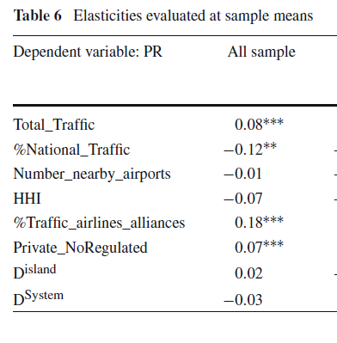
Results

Slide 35
Discussion
Airports with the highest volumes of traffic charge higher prices to airlines. There are two possible explanations for this result; higher extraordinary rents or higher overall costs.
The amount of domestic traffic as a proportion of total traffic has a negative influence on airport charges, since this traffic is more vulnerable to competition from other transport modes or to the fact that the country’s airport policy might favor lower prices
An airline’s negotiating power with the airport is greater the larger the market share this airline enjoys at that particular airport

Slide 36
Conclusions
This paper examines factors determining airport charges. Using data for 100 large airports in Europe, we find that they charge higher prices when they move more passengers.
Competition from other transport modes and nearby airports imposes some discipline on the pricing behaviour of airports. Low-cost carriers and airlines with a high market share seem to have a stronger countervailing power.
We also find that private airports not regulated charge higher prices than public or regulated airports.
Finally, the regulation mechanism does not seem to influence substantially the level of airport charges.

Slide 37
CONGESTION PRICING
Road pricing is designed as a measure to reduce congestion. As such it will impact on the price of the journey, it represents a charge for the use of road space
Number of schemes worldwide: Singapore, Stockholm, London
The first major congestion charging scheme in Britain was launched in Central London In February 2003. The aim of this scheme was to reduce congestion

Slide 38
Congestion charges London - design
Motorists entering the congestion charging zone between 7 am and 6 pm, Mon – Fri, excl. Public holiday are charged 8 GBP.
700 video cameras enforce the scheme via the scanning the rear number plate
Motorist have to pay the charge by midnight
If they fail a fine 100/50 GBP is imposed
Certain groups are exempt or given a discount

Slide 39
Congestion charges London - advantages
Reducing market failure (congestion)
More efficient usage of scarce resource (road space)
Revenue from congestion charges can be used to improve alternatives (PT)
More direct than regulation
Encourages PT
Can be varied at very short notice – it is flexible
It works – it has impact on congestion

Slide 40
Congestion charges London - disadvantages
Invasion of privacy – photos of vehicle number plates
Regressive nature – lower income householed pay higher proportion of their income
High administrative costs
Simplistic technology – the charge is not changing with the level of congestion
Double payment of road users (taxes, charges)

Slide 41
Discussion question
Would you recommend the introduction of congestion charges for your home town?

