Slide 1
9. SUBSIDY

Slide 2
Pricing and subsidies
Close connection between pricing and subsidy
When the prices are not right – there is often a need for subsidy
Why so often the prices in transport are not right?

Slide 3
Discussion questions
Discuss the following simple statements, which should help to build on and develop some of the issues discussed in this lecture:
Low subsidy is “good” and high subsidy is “bad”
Transport should only be subsidized on the basis of what can be afforded by the relevant authorities
Public transport is a public good, therefore should be subsidized
Road networks, because they are provided and maintained by the state, are therefore provided free of charge

Slide 4
Subsidy
The transport markets are made up of a combination of market forces and the actions of transport planning authorities
Subsidies are playing the pivotal role in reconciling these two forces in the actual marketplace
If the transport authority wants to have a service that does not generate the profit, it can allocate a subsidy for the difference between costs and revenues
Any problems with such approach?

Slide 5
Subsidy or payment for public service?
The payment of subsidy is also closely related to aspects of regulation
With the more private sector involment, many argue that there is no longer a subsidy but rather a payment for the contract for providing a public service
The issue is further complicated by the fact, that paying transport subsidies has also a very strong political dimension

Slide 6
The rationale for public subsidy
Transport subsidies are helping to keep the whole transport system working (commuting)
It pushes transport operations towards more land use efficient and environmentally friendly modes of transport
What is the relationship between subsidies and efficiency?
There are many externalities in the transport industry

Slide 7
Externalities
Externalities = spill – over effects; they occur when costs (or benefits) fall not only on the producer of the service
Private costs + public costs = social costs
External costs and over–production (pollution, noise….)
External benefits and under–consumption (land use, environmentally efficient modes of transport, education …)

Slide 8
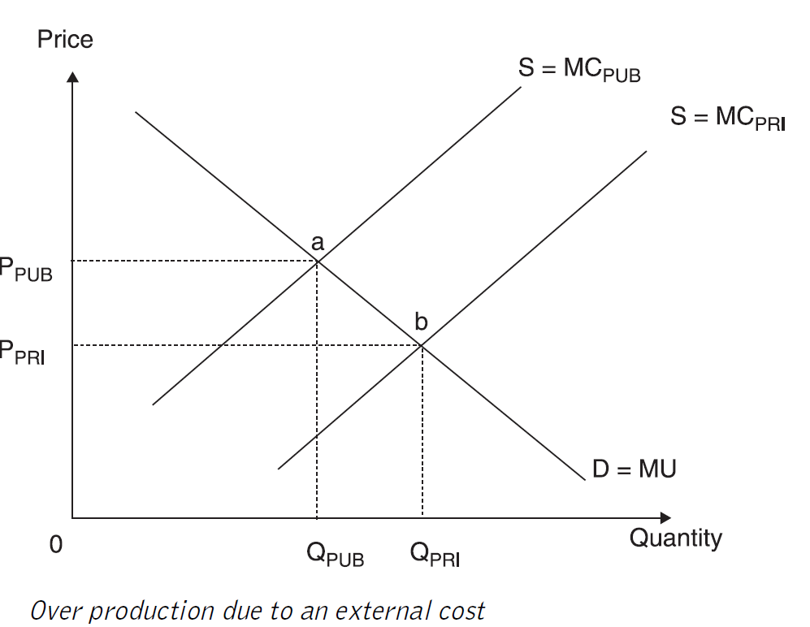
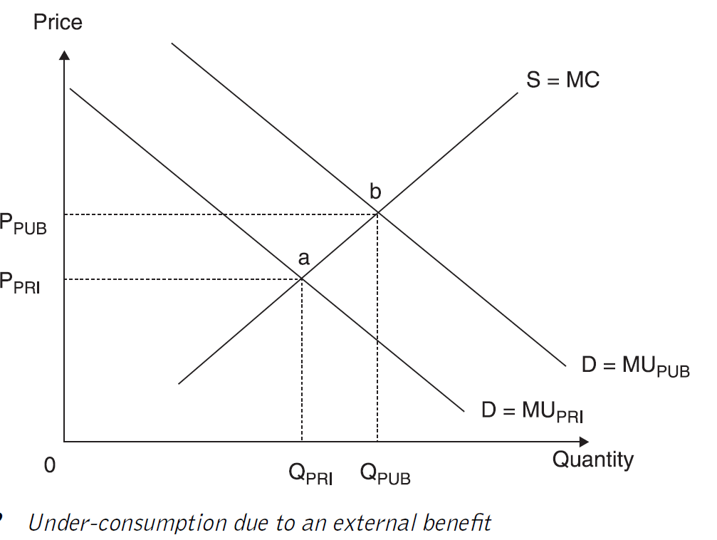
Externalities

Slide 9
The economic rationale for subsidization
Market failure present → its correction is the strongest argument for subsidy
Two bads (market failure + taxation) = One good (optimal market solution)
Subsidy as a tool to improve the efficiency of market x Subsidy as a tool to subsidize inefficient (public) operators

Slide 10
The economic rationale for subsidisation
In support of land use efficient modes of transport → against car use and congestions
To lessen the impact of environmentally unfriendly modes of transport → to support trains and ships against cars and planes
To support economic development or regeneration of an area
To support socially necessary services → the problem of rural demand

Slide 11
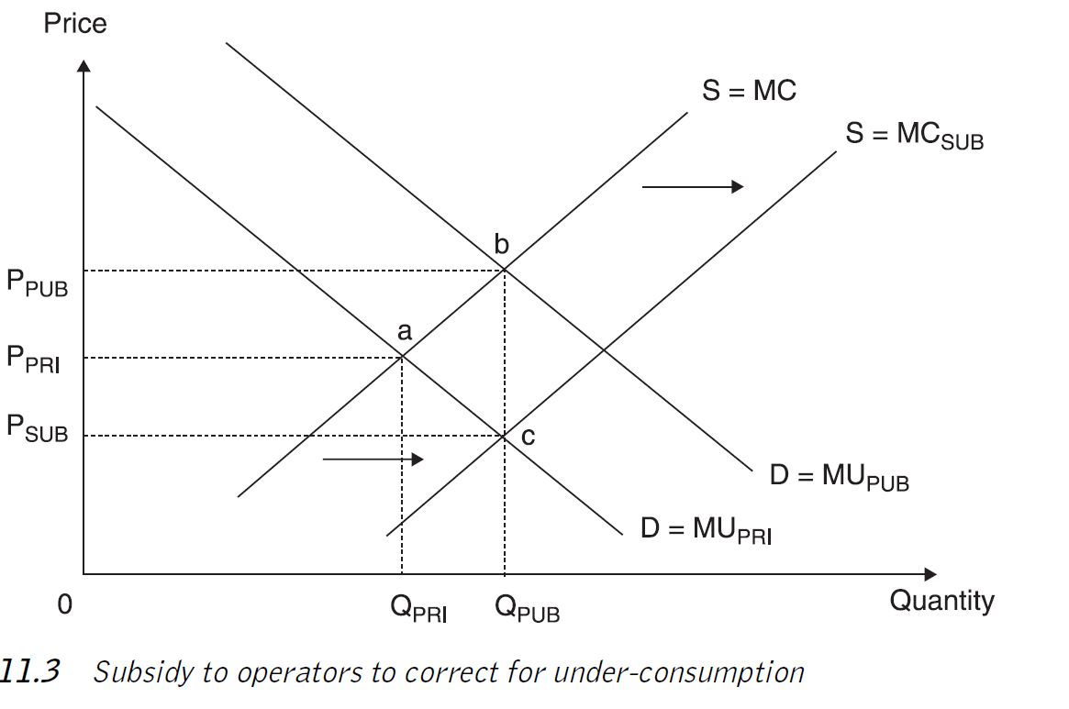
Subsidy to operators to correct for under-consumption (supply side measure)

Slide 12
Demand side measures
Far more straightforward
Used to correct for a demand side market failure
Specific groups and individuals are targeted to receive the subsidy
In effect the individual is given a concession (a reduced fare) to use a service
Free Fare Systems (to be analysed later)

Slide 13
Drawbacks of paying subsidy (1)
It is always a second best solution → the best solution is always market with perfect competition; when subsidy is introduced, it will be usually accompanied by some form of regulation
Can lead to inefficient operation → because the organization is not working to strict market principles, then costs are not as low as they should be → most research found that operators with higher levels of subsidy tend to be less efficient; what is the causality?; rural services problem; US research: federal subsidies have adverse effect on efficiency; local subsidies small positive effect

Slide 14
Drawbacks of paying subsidy (2)
The winners curse syndrome → the idea is from auction theory to explain why winning bids may be based upon judgemental failures where the auction is ultimately won by the most optimistic valuation
Subsidise a service that doesn't actually need a subsidy → rather than being used to provide an essential service, the subsidy is being used to boost the operators' profits → the risk of withdrawing the marginally profitable commercial services in knowledge that the authorities will reinstall it with the subsidy

Slide 15
Cross-subsidization
Cross-subsidization occurs where the profits of one route or service are used to pay for the losses on another route or service.
It has often been used in the past to reduce the level of total subsidy or at least reduce the level of subsidy to be paid.
It can be used for local bus or rail services where the profits from high density routes are used to cover some of the losses from little used low-density routes, hence reducing the overall reliance on subsidy
It is necessary to protect such system from competition
Is it a good system?

Slide 16
Cross-subsidization - drawbacks
Hides true costs of providing a particular service → true costs of operations are hidden → we do not know what are true csts of providing the service → direct accountability is therefore lost
Users of profitable routes are penalized → as they are paying for the users of the poorly used routes
There are better instruments to ensure provision of services → why the users of profitable bus/rail routes should contribute when car drivers make no contribution at all?

Slide 17
Methods of paying subsidy (1)
Deficit subsidy → authority pays the difference between revenue and costs → this used to be an open-ended subsidy → authority covered the size of deficit, irrespective of the size
Net cost contract → Under such contract, the operator acts as a sub-contractor to government to provide transport services within a given area →this reduces cross-subsidisation and produces greater visibility → should government opt for short- or long-term contract?

Slide 18
Methods of paying subsidy (2)
Full cost contract → bid for subsidy is based on the full costs of running the service or network → Fares charged are specified by the authority but collected by the operator who then returns the revenue to the authority → the net subsidy is costs of operations minus the revenue from passengers. → all revenue risk rests with the authority and none with operator
Design, Built, Operate and Maintain (DBOM) → used for big infrastructure projects → tenders will be based upon the price required to design, build, operate and maintain the infrastructure over a set period of time → due to the high investment required → usually long term contracts

Slide 19
Case: Free Fare Tallin
The subsidy level of public transport systems varies considerably among systems worldwide.
While limited-scale free-fare public transport (FFPT) services such as limited campaigns and fare evasion for special groups or specific services are prevalent, there is only limited evidence on the consequences of introducing a full-fledged FFPT.
The case of Tallinn, Estonia offers a full-scale experiment that provides a unique opportunity to investigate the impacts of FFPT.
Cats, O., Susilo, Y. O., & Reimal, T. (2017). The prospects of fare-free public transport: evidence from Tallinn. Transportation, 44, 1083-1104.

Slide 20
Background
Pricing is a policy instruments that can be devised to bring about a modal shift in favour of public transport.
A survey (2013) found that the Europeans believe that the two best measures to improve urban transport are lower prices (59 % of all respondents) and better (56 %) public transport.
The support for these measures was high among all users and particularly high among those that consider road congestion to be an important problem.
In half of the 28 EU member states lowering fares was the most frequently selected instrument. In contrast, only 9 % believe that road pricing is a good measure

Slide 21
What Are Free - Fare Systems?
Some activist groups, non–governmental organizations and political parties advocate for completely revoking fares in public transport systems.
While free–fare public transport services exist in numerous countries, they remain the exception.
The term Free – Fare Public Transport (FFPT) is used here rather than the common ‘free public transport’, since this policy is not free-of-charge.
While passengers have no out-of-pocket costs, the public transport system does not run for free.
Service provider will have to cover for the lost fare revenues in order to fully subsidize the service.

Slide 22
Pricing and subsidy in Urban PT
Urban public transport systems are subsidized in virtually all European cities.
However, the extent of subsidy varies considerably among cities (e.g., 15 % in Hannover, 50 % in Stockholm, 68 % in Haag).
Most Baltic cities including Stockholm, Copenhagen, Malmo¨, and Turku have a subsidy level between 30 and 60 % (Nielsen et al. 2005a).
Note that this is true across various procurement strategies as these cities have adopted different contracting schemes.
Moreover, the public transport pricing scheme also varies considerably among these cities.

Slide 23
The case of Tallin
Tallinn, with approximately 420,000 residents, is the first European capital and the largest city in the world so far that offers FFPT services to all of its inhabitants.
The City of Tallinn introduced this policy as part of its overarching agenda to promote sustainable transport solutions.
The FFPT policy was introduced on January 2013.

Slide 24
Public transport in Tallin
Public transport in Tallinn had in 2012 a substantial market share, with 40 % of all trips in the city performed by the urban public transport system. Moreover, 30 % of the trips were performed by foot. However, this favourable modal split followed a negative trend.
The share of public transport trips decreased during the last two decades, since Estonia regained its independence in 1991.
The motorization rate—the number of private cars per 1000 inhabitants—has more than doubled during the same period, up to the level of 456 cars per 1000 residents

Slide 25
Situation
Ticket sales covered in 2012 only one-third of the costs. This is a very low fare–box recovery rate. A single ride ticket costed 1 euro in December 2012.
Since 2003, a smart card was launched. It included a 40 % fare reduction for residents of Tallinn and children, elderly and others had fare exemption.
The full-scale FFPT can therefore be conceived as the final stage in a sequence of steps. Nevertheless, fares were identified as a primary problem.
On an annual municipal public transport satisfaction survey from 2010, fare was the most commonly mentioned source of dissatisfaction with 49 % of the respondents, followed by crowding (29 %) and frequency (21 %).

Slide 26
Policy Aims
A full-scale FFPT policy for all city residents was initiated with the following objectives: (a) promoting modal shift from private car to public transport; (b) improving the mobility of unemployed and low-income residents, and; (c) stimulating the registration of inhabitants as residents of Tallinn in order to increase the municipal income tax.
This led the City of Tallinn to initiate a popular referendum where 75 % of the voters supported the new policy albeit the voting rate was only 20 %.
Following the referendum, the city council approved the measure. Notwithstanding, the FFPT became a controversial political topic in Estonia in general and in Tallinn in particular.

Slide 27
Financing
When initiating the FFPT policy, the City of Tallinn proclaimed that the lost ticket revenues will be covered through increased municipal income tax. The annual revenues from ticket sales amounted to 12 million euros in 2012.
In Estonia, a share of the income tax is charged by the municipality at which a person is registered. Some of the people who migrate to Tallinn do not change their registration and thus continue pay their income tax to their city of origin.
This is especially prevalent among students and people who migrate from the countryside and feel affiliation towards their place of origin and thus prefer to support it financially.

Slide 28
Financing II
While the exact number of Tallinn inhabitants that are not registered was unknown, municipal officials estimated it at about 25,000–30,000.
It should be noted that the fare reduction for Tallinn residents in 2003 resulted with 30,000 newly registered residents. City authorities estimate that each registered resident contributes approx. 1000 euro in annual municipal tax.
Hence, if the FFPT is successful in attracting more than 12,000 nonregistered Tallinn inhabitants to register themselves in order to be benefit from the new policy, then the increased municipal tax collection can compensate for the lost ticket revenues.

Slide 29
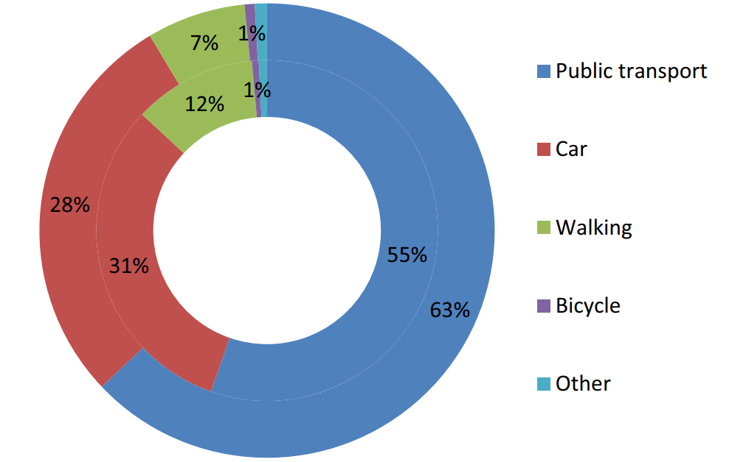
Modal split in 2012 (inner ring) and 2013 (outer ring)

Slide 30
Main result
Almost a year after the introduction of FFPT, public transport usage increased by 14 % and there is evidence that the mobility of low-income residents has improved.
The effect of FFPT on ridership is substantially lower than those reported in previous studies due to the good level of service provision, high public transport usage and low public transport fees that existed already prior to the FFPT.

Slide 31
Modal shift
There is a considerable shift from walking to public transport in 2013, with a 40 % decrease in the share of walking trips.
It is noteworthy that while the share of car users decreased by 5 %, the average distance travelled by car increased resulting with a 31 % increase in total vehiclekm.
This is explained by the increase in daily travel distance, i.e., from 7.98 to 9.07 km per person, a 13 % increase, driven by changes in shopping and leisure destination choices.
In summary, the modal shift from car to public transport was accompanied by an undesired shift from walking to public transport and an increase in car traffic.

Slide 32
Equity issues
There is mixed evidence concerning whether FFPT improved mobility and accessibility of low-income and unemployed residents.
FFPT led to a trip generation effect among these user groups and the respective market share of public transport increased by more than 20 %.
However, there is no indication that employment opportunities improved as a result of this policy. Satisfaction with public transport and popular support in FFPT increased during the study period.

Slide 33
Financing
One of the objectives of the FFPT policy is to increase local income tax collection.
The policy has been successful in this regard with 11,000 new residents in 2013, approx. 40 % of unregistered residents based on estimates made by city officials prior to policy introduction.
On average, the municipality receives 1000 euro in tax from each registered resident.
Hence, the newly registered residents contribute annually approximately 11 million euro, almost equivalent to the lost income from ticket sales.
Furthermore, 42 % of the respondents that were unregister in the end of 2013 answered that FFPT makes them more inclined to register themselves as Tallinn residents

Slide 34
Political economy
The newly registered residents induces also a loss to other municipalities where they were formerly registered which benefited from the misalignment between place of residence and place of registration.
Given the relative importance of Tallinn in Estonia (33 % of the population and 50 % of the GDP), these changes cause redistribution effects that may increase regional disparity at the national level.

Slide 35
Summary
The long-term effects of a FFPT still remain to be assessed and will allow determining whether the results attained in the analysis period are sustained.
A cost-benefit analysis of the FFPT policy should also encompass wider economic benefits such as labour market effects and location choice.
The next step of this study will be to further investigate individual travel patterns by performing a detailed multivariate analysis of before and after travel diaries to identify the role of individual attributes such as trip purpose, travel attitudes and socio-demographic attributes on changes in travel behaviour.

Slide 36
Free Fares - Assessment
Fearnley (2013) analysed the impact of free-fare policies on modal shares and other policy goals (economic, political, and environmental)
He argued that although these policies seem to be attractive, their rate of goal achievement is poor and comes at high costs
The effects on car ridership are marginal and typically offset by a few years of growth.
Successful free-fare traffic schemes are those that concentrate only on public transport ridership growth.
Other goals are best achieved with targeted measures.

Slide 37
Free Fare in Central Europe
Slovakia has introduced 100% fare discounts for children, students, and pensioners for railways from November 2014. The Czech Republic has introduced 75% discounts for children, students, and pensioners for both trains and buses from September 2018.
The policies significantly increased ridership and the modal share of railways went up significantly. The mobility of the targeted groups was significantly affected and the share of young and elderly riders increased.
However, the policies were costly and also had some undesirable side effects that could have been prevented by better policy design.
Tomeš, Z., Fitzová, H., Pařil, ….. (2022). Fare discounts and free fares in long-distance public transport in central Europe. Case Studies on Transport Policy, 10(1), 507-517.

Slide 38
Free fare – Rail Slovakia
The intention of free fare policy was:
To increase the modal share of rail
To improve social inclusion
Coverage: Free fare in PSO rail services for children, students and pensioners.
No discounts for buses!
Čarek (2017): Learning the lesson of free rail travel. Railway Gazette International.

Slide 39
Results
Increased ridership
Higher vehicle occupancy
Occasional overcrowding
Rise in the government subsidies
Shift of demand from buses to trains

Slide 40
Policy pitfalls
How to maintain service quality? (for paying customers)
Cumbersome registration
Introduction of compulsory seat reservations
Student parties and homeless people in trains
Modal shift from buses to trains
Little effect on car ridership
Hurting commercial rail services and competition
Čarek (2017): Learning the lesson of free rail travel. Railway Gazette International.

Slide 41
Assessment
Significant market distortions and unintended consequences
The scope was too broad (possible restriction in students travel)
Once introduced – hard to cancel (political risk)
The rise in supply – better even for paying customers
Čarek (2017): Learning the lesson of free rail travel. Railway Gazette International.

Slide 42
Czech Republic – Better design?
The design of the policy was more sophisticated in the Czech Republic, where it was undoubtedly inspired by the shortcomings of the Slovak policy. The exclusion of buses in Slovakia was a significant omission.
The crucial decision in the Czech policy design was to keep some monetary costs present
However, both designs did little to differentiate between peak and off-peak travel and have no bonuses/stimulation for travel from or to disadvantaged regions
Tomeš, Z., Fitzová, H., Pařil, ….. (2022). Fare discounts and free fares in long-distance public transport in central Europe. Case Studies on Transport Policy, 10(1), 507-517.

Slide 43
FREE FARES - summary
Free fares and fare discounts are frequently used tools. They are utilized to stimulate public transport ridership, and promote transport equity and justice.
Policymakers are trying to limit car usage growth and promote public transport to battle congestion and decrease environmental damage.
The aim of fare reduction policies is to make transport cheaper, improve its affordability, and stimulate ridership. The crucial issue is the price elasticity of demand.
However, research suggested that price is not the only factor and is not the most important in determining transport ridership (service quality, time, route, and status)
Particularly problematic has been switching car user

Slide 44
Free Fares - Political economy
Scheiner – Starling (1974) analysed the political economy of free-fare transport. They argued that four issues are critical:
demand elasticity and its responsiveness to the introduction of free fares
the costs of such policies and their financing
identification and evaluation of the benefits
political feasibility of the policy.

Slide 45
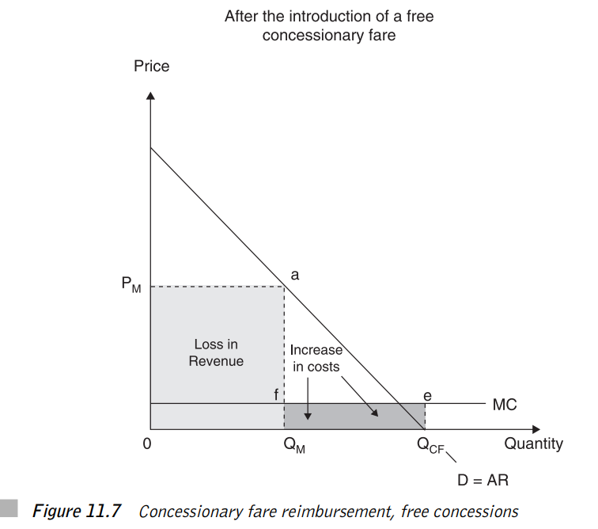

Slide 46
