Slide 1
10. Transport and the Environment
The Economics of Freight

Slide 2
Introduction
There is a link between the demand for transport and economic growth → this link has environmental implications → if left unchecked these will impact on economic activity
Vehicle emissions impact on the quality of life both at the local and global level
Air transport is also contributing to a climate change
Transport is also a major consumer of energy

Slide 3
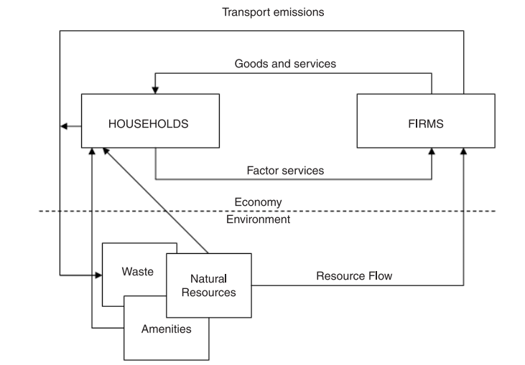
Transport and Environment

Slide 4
Transport emissions
Carbon dioxide
Carbon monoxide
Nitrogen oxide
Particulates
Benzene
Lead

Slide 5
Aviation and environment
The air traffic has been increasing steadily → there are undoubted economic benefits, but there are also significant environmental costs (emissions, noise)
The growing income is encouraging more flying
Flight shame or flygskam is an anti-flying social movement, with the aim of reducing the environmental impact of aviation. Flight shame refers to an individual's uneasiness over engaging in consumption that is energy-intense and climatically problematic

Slide 6
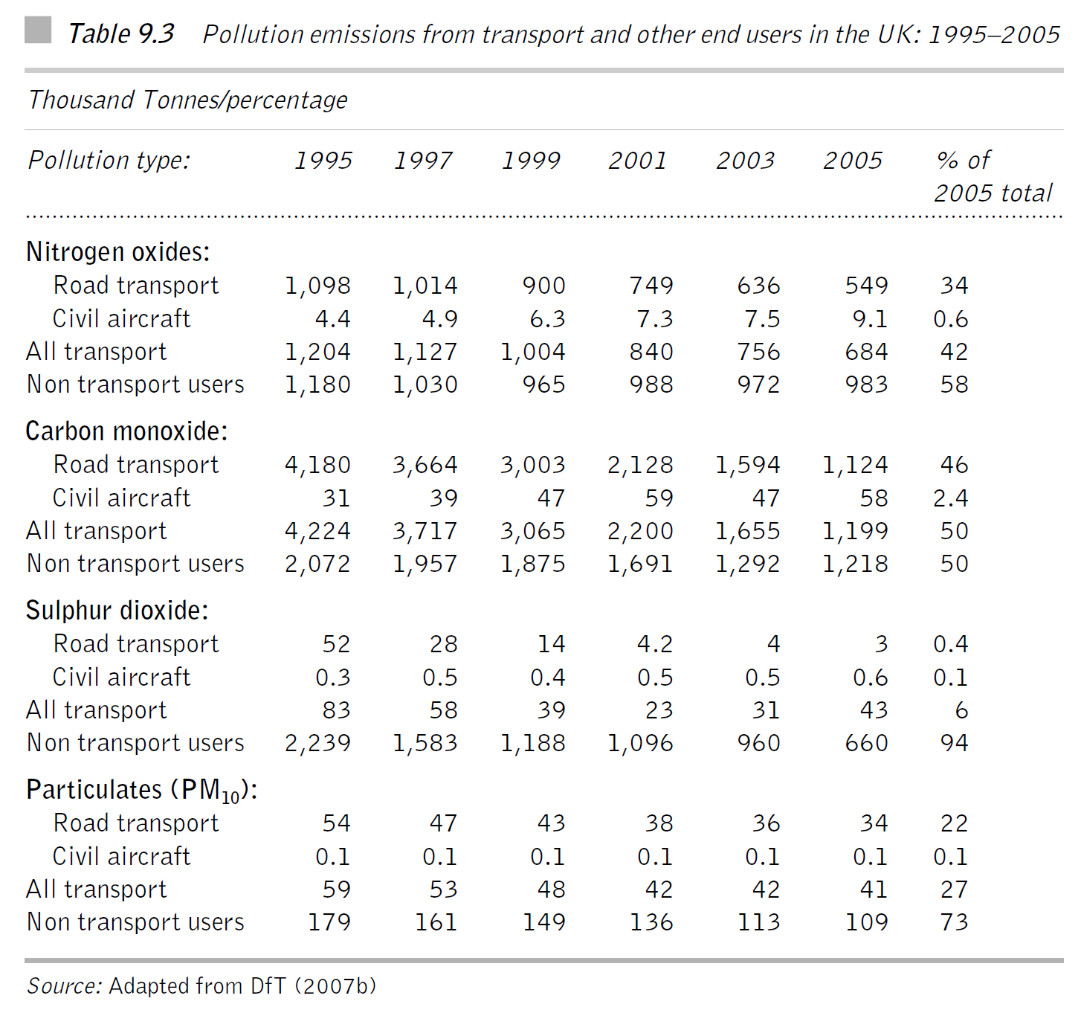

Slide 7
Freight transport and the environment
Close relation between freight transport activity and GDP → in the EU intensified by the reduction in trade restrictions
What is the impact on the environment?
Geographical areas with valuable environment and significant growth in freight traffic (Alps) → Switzerland (truck 28 tonne weight limit) → Austria (ban on night and weekend road haulage movements)

Slide 8
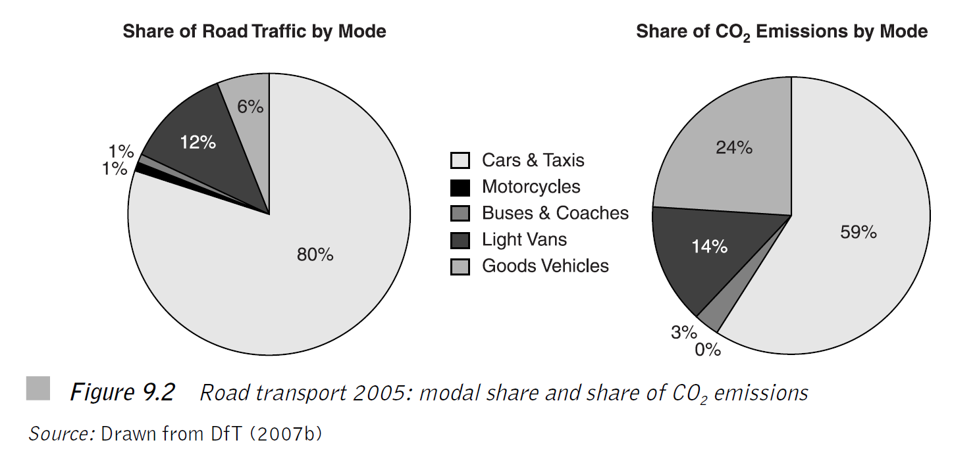

Slide 9
Is it really road haulage that is bad for the environment?
Road haulage is a major contributor to the deterioration of the natural environment
If road freight is so bad for the environment, why don't we just get rid of it?
Lets speculate about the world with significant reduction or eradication of road haulage (e.g. stimulating modal shift to rail)

Slide 10
Problems with modal shift away from road
Road network is about 25 times longer (in the UK) than rail network → rail just could not cope with such increased traffic; rail cannot serve the lower level of supply chains
Product substitution → (move away from fresh to frozen products, greater stocks needed, shift away from consumer society)
Modal substitution → rail network would have to change completely to accommodate new traffic
Locational substitution → reversion of trends of geographical decentralization of economic and residential activities

Slide 11
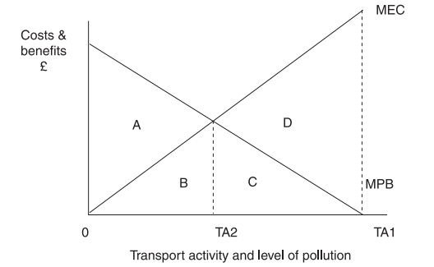
An Economic Model Of Transport and Pollution

Slide 12
Explainer
Marginal private benefit (MPB) = additional benefits in terms of satisfaction received by road user or airline passenger from undertaking journey
Marginal external cost (MEC) = additional environmental cost of transport activity in terms of air pollution, noise and so on
If the transport user/sector is not constrained in terms of their level of activity → they will consume/provide an amount equal to TA1
However, the optimal level of pollution is TA2

Slide 13
Policy options
There are a number of options how to deal with the environmental impacts of road and air transport:
Bargaining solution
Tax based solution
Tradable permits
Setting of standards
Technological change
Encouragement of alternative modes

Slide 14
1) Bargaining solution
If property rights are assigned, than bargaining will occur between parties affected by external costs
Example: airport noise pollution. Who has the right for quieter operations ? Airport+ operators or people leaving nearby?
In both cases successful negotiation can occur about the compensations

Slide 15
Equity issues
Those affected by pollution will often find difficult to organize themselves
Those who suffer from pollution may have not sufficient funds to compensate those who pollute
Certain individuals who suffer from pollution may be reluctant to contribute (free riders)
If polluters were to pay → they would curb activities or support R&D (e.g., quieter aero engines)
→ these issues seem to favour the polluter pays principle

Slide 16
2) Tax based solution
The principle of tax based solution involve setting a price which places a monetary value on the environmental costs of transport using taxation and imposes these upon the polluter
Such solution is likely to reduce the demand to travel and therefore the environmental impact
Using an environmental tax is a way of internalising the external cost and the tax can be viewed as the optimum tax.

Slide 17
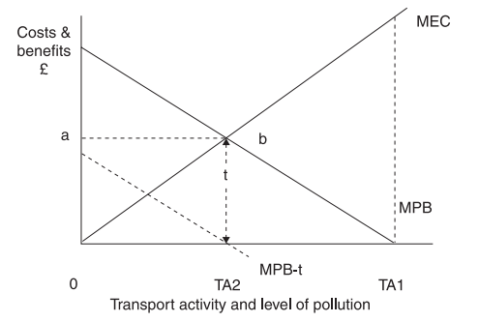

Slide 18
Advantages of tax-based solution
The air or road users or operators has to pay a price for pollution → the polluter has the incentive to reduce their level of activity to the optimal level TA2
The introduction of an environmental tax allows the users to decide how they will respond (unlike the use of standard which sets a particular limit)

Slide 19
Disadvantages of tax-based solution
Difficulties in establishing the optimum tax t
There are often political difficulties when introducing a new tax. There may be resistance in the belief that the tax will be raised above the optimal level as a way of revenue collection
Transport user is penalized twice – lower activity, paying the tax

Slide 20
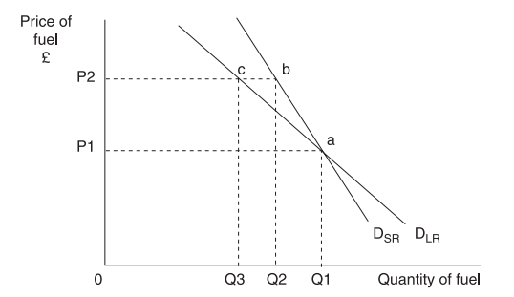
Fuel tax

Slide 21
Advantages of fuel tax
The amount of tax paid varies with the environmental cost
It is simple to administer, it costs little to collect, is difficult to avoid or evade and can easily be modified
Road users have discretion how to respond

Slide 22
3) Tradable permits
The idea behind tradable permits is that polluters are presented with a number of permits which allow them to emit a particular level of CO2
The number of permits which exist limits the amount of emissions
The permits are tradable in that they can be bought and sold to other polluters who are participating in the scheme
CASE: The EU Emissions Trading Scheme → the major economic instrument in addressing greenhouse gas emissions

Slide 23
Design
How are permits allocated at the beginning? (the issue of previous environmental investment)
Should permits be freely allocated or should they be auctioned?
What should be the overall number of permits in circulation?
The incumbents may corner the market in permits → making it barrier to entry
There are administrative costs

Slide 24
Advantages
It is flexible. Companies may choose to reduce emissions in operations or buy permits
It may be politically easier to introduce than outright taxation
It is cost effective → incentives are provided to address emissions levels
Unlike a Pigouvian tax which needs to estimate the cost of pollution, with tradable permits it is the market (in the tradable permits) that will find the optimum price

Slide 25
4) The setting of standards
It is not the economic instrument and may have a considerable impact
e.g.: Requirement for annual vehicle inspection for road vehicles
Setting of standards aims to achieve the optimal level of transport activity → if achieved this would result in the optimal level of pollution
As with taxation, the challenge is to set them correctly (overestimation x underestimation)

Slide 26
5) Technological change
Can decrease emissions by new technologies → e.g. cleaner fuels, catalytic converters, fuel efficient cars, renewable sources
It improves ways in which individuals can make choices → in car information and real time information in public transport stops
On-line meetings can be undertaken without the need to travel

Slide 27
6) Promotion of alternative modes of transport
This policy option involves encouraging the alternative modes such as public transport, walking, cycling, rail freight and shipping
The private car has the advantage of convenience and flexibility, whereas public transport tends to be confined to fixed routes.
Solutions: dedicated bus lines, introduction of new public transport, improved facilities for cycling and walking

Slide 28
Summary and Reflection
Bargaining → theoretically attractive, it raised many issues in terms of the practicalities of implementation
Taxes → how to set the correct tax? But it allows flexibility in responding
Permits → also allow flexibility and may be easier politically to introduce. How to design it?
Alternatives → standards, technological change, promotion of alternatives

Slide 29
Shall we ban short flights?
Dobruszkes, F., Mattioli, G., & Mathieu, L. (2022). Banning super short-haul flights: Environmental evidence or political turbulence?. Journal of Transport Geography, 104, 103457.

Slide 30
Should we ban short distance flights?
Several countries have considered banning or even decided to ban or tax super short-haul flights, arguing that the availability of rail alternatives makes them unnecessary.
Such policies result from the need for governments to be seen as acting to mitigate climate change and scholars favouring energy (climate) efficiency perspectives over the absolute amount of fuel burnt (greenhouse gas emissions emitted).

Slide 31
Evidence
Yet climate change is due to absolute emissions, and it is a fact that the longer a flight is, the greater the amount of fuel is burnt (emissions).
Considering all departing flights from 31 European countries, our study found that flights shorter than 500 km account for 27.9% of departures but 5.9% of fuel burnt. In contrast, flights longer than 4,000 km account for 6.2% of departures but 47.0% of fuel burnt, although with significant variation across countries.
We conclude that targeting shorter flights (which often exist to alleviate physical obstacles imposed by physical geography) will contribute little to reducing the impact of aviation on climate, and that policy initiatives that target longer flights are urgently needed

Slide 32
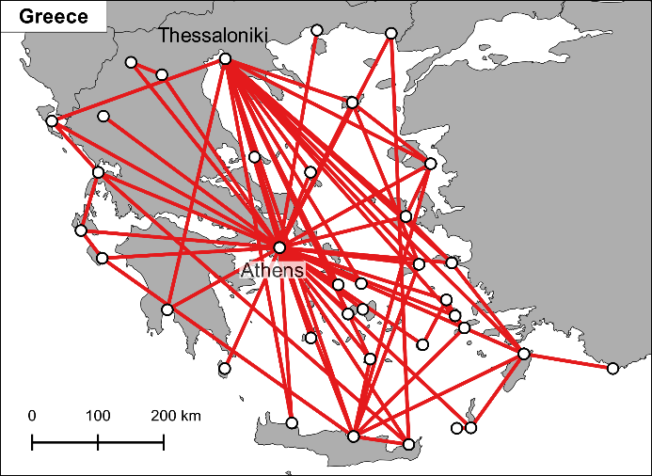
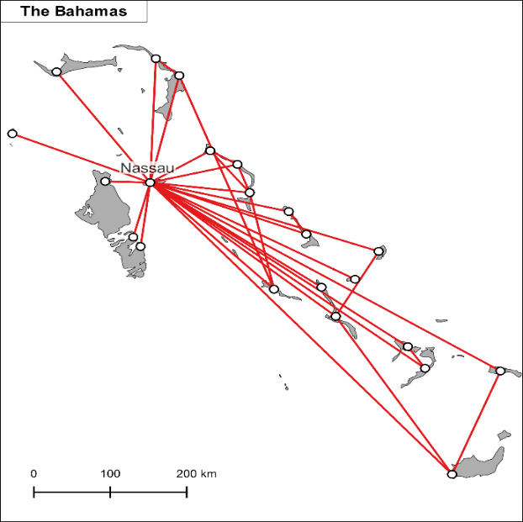
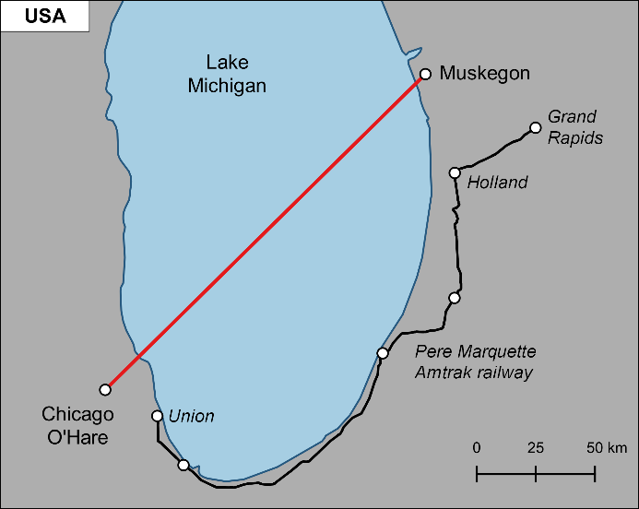
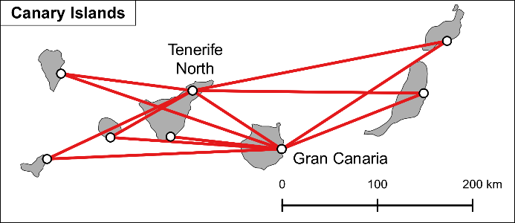
Examples of short haul flights

Slide 33
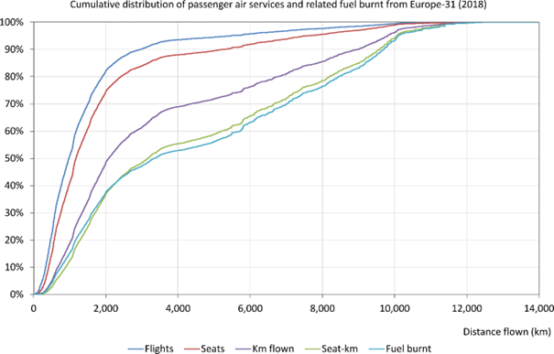
Cumulative distribution of passenger air services and fuel burnt from Europe

Slide 34
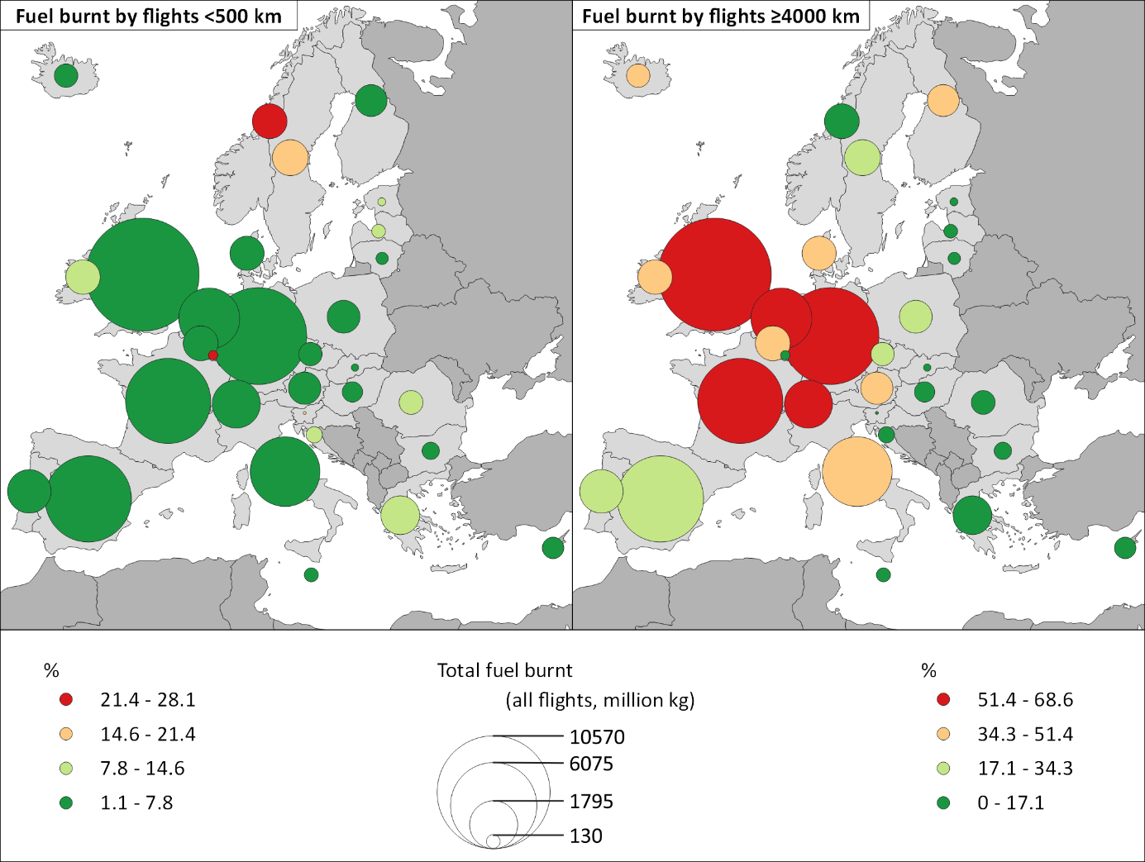
Fuel burnt by the shortest and longest flights at the country level

Slide 35
Conclusions
Our results lead to a conclusion: in nearly all the 31 European countries under investigation, banning super short-haul flights will help very little in mitigating aviation’s contribution to climate change.
While these measures might make a difference in some countries such as Norway, this would likely be to the detriment of remote, small communities, for which limited transport alternatives are available.
In other words, if the goal is to reduce the climate footprint of aviation, it is longer, not shorter flights that ought to be the primary target for action.

Slide 36
Policy implications
The current debate also tends to overlook that shifting passengers from super-short haul flights to trains may also induce unexpected effects in two ways.
First, freeing slots at constrained airports (namely, airports in which no more slots are available at relevant hours) by banning shorter flights could mean they would be replaced by longer flights, which would generate more GHG emissions.
Second, the lack of super short-haul flights may induce passengers to consider car travel instead of railways, and car travel can result in as much emissions as air travel

Slide 37
THE ECONOMICS OF FREIGHT

Slide 38
Introduction
In comparison with passenger transport, freight is an often overlooked and under researched area.
The freight transport in Europe (and elsewhere) is becoming more international (because of decline of transport costs)

Slide 39
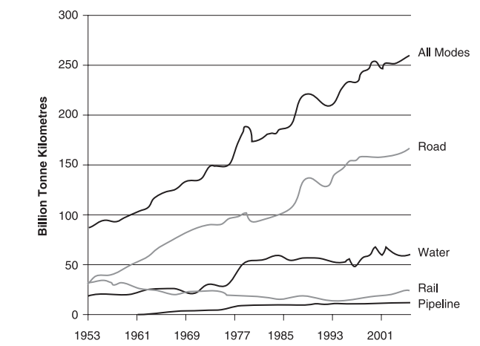
Trends in the UK freight transport

Slide 40
Road haulage
Market segments: truck load x less than truck load (LTL)
Truck load – many small firms, point to point operations over long distances
LTL segment – much more sophisticated – demanding logistic – parcel services
Cost structures – higher fixed costs in LTL
Economies of density crucial

Slide 41
Rail freight
Determined by history (infrastructure, organization)
Decline of modal share of rail freight in Europe unlike other parts of the world (especially N. America)
USA (2006): rail freight carried 3% of the value of the freight; 10% of the weight and 31% of tonne-km
Differences in structure and ownership: US x EU

Slide 42
Key economic characteristics of rail freight
Barriers to entry (legal obstacles, high start-up costs, firm size, infrastructure bottlenecks)
Costs structures (high fixed costs, economies of density)
Economies of scale and scope
High break even point

Slide 43
Advantages of rail freight
Friendly environmental impact
High capacity – the potential to move large volumes of freight quickly and efficiently
Power costs – rail transport per tonne handled has a very low power costs
Distance – rail has a major cost advantage in medium and long distances over road transport

Slide 44
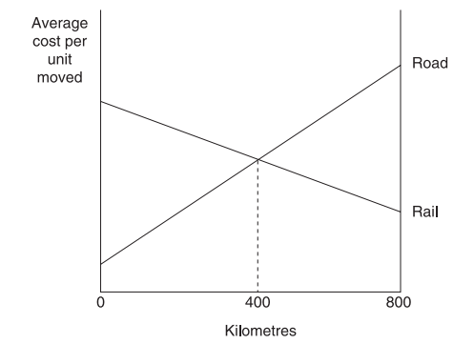
Rail x Road: Average costs per unit moved

Slide 45
Disadvantages (rail freight)
Accessibility: rail has only limited number of point of access; last mile problem
Shipment size – to capture benefits, it is necessary to have a minimum shipment size; however the economy is moving towards weightless economy
Frequency – rail is less frequent
Security – may be a challenge

Slide 46
Challenges
Industry has been facing falling or stagnating freight tonnage
National focus of railways
Lack of harmonization standards – complex patchwork of conflicting standards and requirements
Bottlenecks around major cities (e.g. Milano, Vienna, Munich, Rotterdam)
Structural economic change (move from heavy industry towards services)
Passenger oriented rail networks (in Europe)

Slide 47
Rail - summary
Rail freight has the potential to reduce road congestion and its impact upon the environment by switching large volumes of freight to railways
It is easier said than done
Rail freight in Europe is declining and even reforms (UK, EU) have not been able to reverse the declining trend
Potential measures: increasing capacity
Summary: however, the total market opportunities seem limited

Slide 48
Air and maritime freight
Air freight → fastest growing mode of freight transport recently → strongly tied with the globalization of the world economy → most air freight goes by passenger aircraft (goods in joint supply) → increasing environmental concerns may limit future growth
Maritime shipping → main mode of transport for long distance international freight → economies of scale are important

