Slide 1
11. TRANSPORT FORECASTING

Slide 2
Transport and economic growth
Transport has played a vital role in economic development → it enabled separation of production and consumption
The wealthy society needs a lot of transport to move: Freight – all these goods; Passengers – to enable individual mobility
Why? → Division of labour; consumer preferences, optimal matching …..
There is a close link between transport levels and economic wealth (or income)

Slide 3
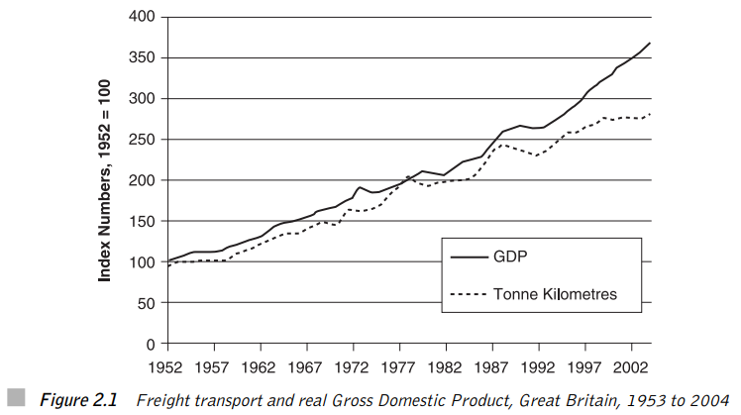
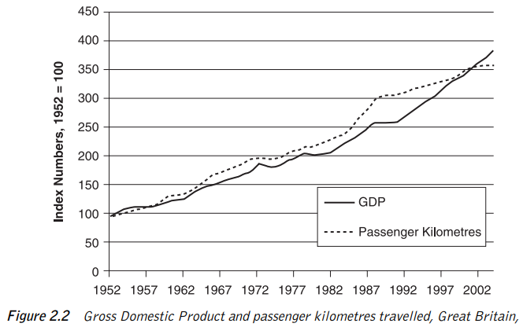

Slide 4
Questions
What is the direction of causation?
Is this pattern sustainable in the long run?
Can we decouple economic and transport growth?
Can we change our behaviour? (15 minutes city, electromobility)

Slide 5
Direction of causation?
The association between transport volumes and GDP has long been recognized, there remains real question over the direction of causation
Is it that as income rise, more goods are demanded and transported?
The alternative hypothesis is that advances in freight transport will result in reduced transport costs and it will lead to more goods produced

Slide 6
Supply led view – transport leads to economic development
To adopt a supply led model is to suggest that the casual relationship is that improving the transport infrastructure of an area will automatically stimulate economic activity. This would occur for a number of reasons:
Widening of markets, increased production and multiplier effects → the range of potential markets will be expanded
Indirect effects on employment in construction and operation → huge infrastructure projects create an increase in demand
Examples: 1) Role of railways during Industrial Revolution → movement from agricultural to a manufacturing-based economy 2) Exploitation of Brazilian rainforest by better lines of communications

Slide 7
Demand led models – economic development drives demand for transport
Contrasting with the supply led view is the alternative idea that transport provision is a invariably a response to a basic demand → hence the casual relationship is that economic development leads to a demand for better transport facilities
Without a basic demand for an area’s goods and services, then irrespective of the quality of the transport infrastructure this will never stimulate that demand
The demand required can come from revealed (existing) or latent (potential) demand

Slide 8
Synthesis
There is no clear answer to the direction of causation and the two are closely associated
Under a supply led view improving transport services and/or upgrading the infrastructure is a necessary and sufficient condition for improved transport to lead to economic development
Under a demand led view, however, it is a necessary but not sufficient condition, i.e. the only condition required. There has to also be a basic derived demand for transport services in order for transport developments to facilitate economic development.

Slide 9
Passenger transport and development
When people travel more, do they become better off?
Supply effects: upgrading existing transport links → will increase passenger travel → and thereby increase GDP. What about the emergence of commuter belt zones?
Demand effects → e.g. Heavily used commuter routes with congested routes and overcrowded public transport → time is money → investing in new infrastructure → any problem with such approach?
Demand effects: 1) High speed rail can create new (commuting) markets. 2) Increased wealth creates a demand for more leisure activities 3) Higher incomes tend to produce a modal switch away from public transport towards cars → creating multiple car households

Slide 10
What is the empirical evidence?
Fogel (1964) → Railroads and economic growth in the USA
Purvis (1985) → what is the impact of highway construction on the economic growth?
Aschauer (1989) → what is the elasticity of aggregated output with respect to infrastructure spending?
Harmatuck (1997) → return on infrastructure investment will decline as maintenance expenditure goes up
Rodriguez-Pose (2004) → impact of European transport investment on economic development (almost zero)
Prudhomme and Lee (1999) → how time savings affects the productivity increases?
Rice and Venables (2004) → the impact of transport on economies of density and scale

Slide 11
Supply or demand transport initiatives?
CrossRail – this project is to build new railway connections under central London.
The Channel Tunnel that was opened in 1995 and links Britain to France
The opening of the M6 Toll motorway around Birmingham in December 2003, thus effectively providing a Birmingham by-pass and considerably reducing through journey times.
The Golden Gate Bridge across the opening of San Francisco Bay completed in 1937, which provided the first fixed link northwards out of San Francisco.
The opening of phase one of the high-speed train line (the TGV Est) from Paris to the west of Nancy in June 2007.
The construction of a container terminal at the port of Mundra on the Gujarat coast in North West India. This will be the port’s first container terminal.

Slide 12
Decoupling transport from GDP
There is a very close association between freight and passenger traffic and GDP
This has now become a major problem, due to negative impact of transport on the environment
Decoupling = GDP can continue to grow without being associated with the growth of traffic
Is decoupling achievable?

Slide 13
TRANSPORT FORECASTING

Slide 14
Introduction
In order to assess if the provision of a new or improved transport service makes economic sense, we need to have some idea of how public will respond, both immediately and in the far distant future
Forecasting is about collecting information from all relevant sources and analysing it in a consistent structured fashion.
When to use economic modelling and when to seek experts' advice?

Slide 15
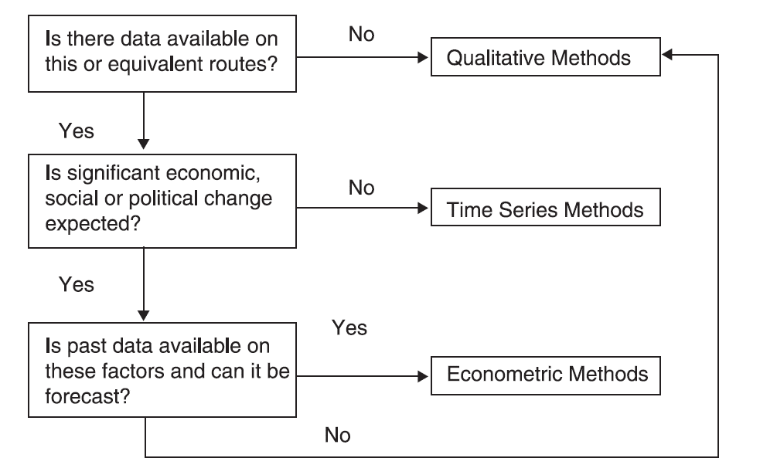
Choosing between methods

Slide 16
QUALITATIVE Methods
Qualitative Forecasting Methods are based on surveys of either potential customers or „experts“
The major problem is identifying who to ask
Small and contained target group x representative sample
Problems: over-estimation of behavioural changes, identification of the target groups

Slide 17
Expert's opinions
May be very valuable in forecasting future trends
Problems: anchoring bias, group think and status deferral
Rules: facilitation, interdisciplinarity, equality, reviews of previous forecasts
Delphi technique = group of interdisciplinary experts discussing until consensus is reached

Slide 18
TIME SERIES analysis
In time series analysis we seek to identify the three elements:
The Trend
Seasonal or Cyclical Factors
The unusual (sometimes termed the stochastic factor or noise)

Slide 19
ECONOMETRIC methods
The modelling process involves 6 stages:
Understanding the Problem
Obtaining the Data
Specifying the Model
4. Estimating the Specified Model
5. Validating the Model
6. Simulation/Forecasting

Slide 20

The gravity model
The model that predicts the level of transport between two locations to be dependent upon their respective population sizes and the distance between them
F = the Flow between destinations
O = the size of the Origin
D = the size of the destination
C = the cost of travelling between them

Slide 21
Case: Border effect
A traveller flying from Hanover to Bologna has to change at Munich airport, i.e. from a domestic to a border-crossing flight. For the first part of the trip, he may select between eight flights and will be carried by wide-bodied aircraft such as the Airbus 320 or the Boeing 737.
For the second part, only four flights per day are available, and the typical aircraft is a narrow-bodied one with a capacity of less than 50 seats.
Apparently, there is much lower demand for flights between Munich and Bologna than between Munich and Hanover, although distances are similar and economic activity in the Bologna region is about as high as in the Hanover region.
The border between Germany and Italy seems to substantially suppress air traffic activity.
Klodt, H. (2004). Border effects in passenger air traffic. Kyklos, 57(4), 519-532.

Slide 22
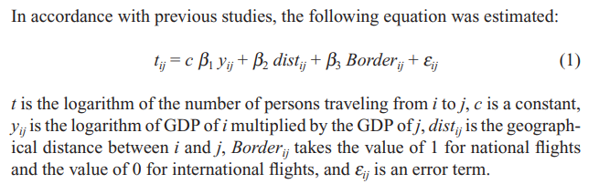
Methodology: Gravity model

Slide 23
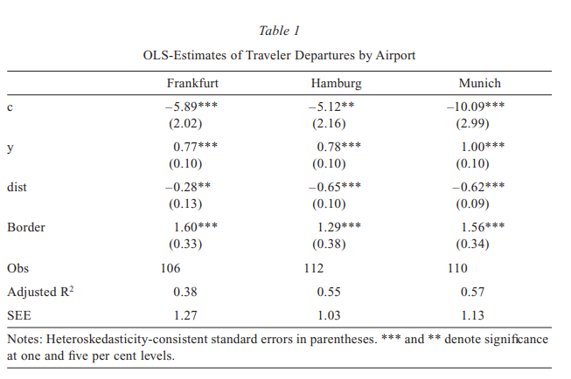

Slide 24

Econometric demand models
The demand for particular mode (road, rail, air) will be determined by income, price, journey, times, frequency and comparative quality

Slide 25
CASE: The demand for ferry services
Short sea crossings
to and from the UK

Slide 26
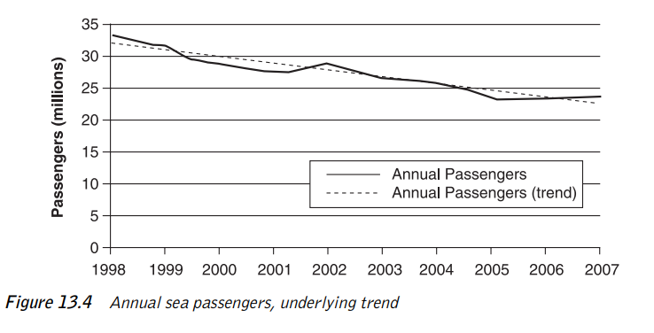
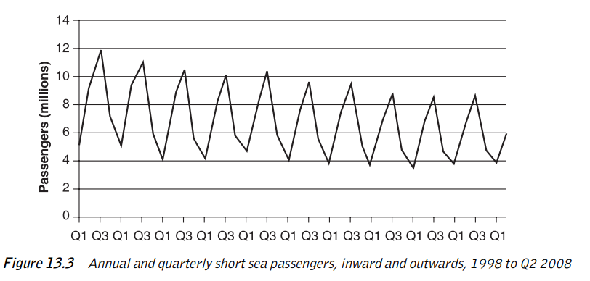

Slide 27
Interpretation
There is a clear seasonal pattern when we may expect a higher demand in summer than in a winter
There is also a clear downward trend → how to forecast it into the future?
Y = α + β (YEAR) + Ɛ = 33,06 – 1,05 (YEAR) → the demand will be lower by 1,05 million passengers every year
Y = α + e^{β (YEAR)} + Ɛ → growth rate of demand was found to be -3.8%

Slide 28
Seasonal fluctuations
When planning capacity → if there is a marked seasonal fluctuation → then a seasonal forecast is required
It is possible to use weighted averages of the seasonal differences (or ratios)
A simple approach utilising the regression involves the use of dummy variables → four dummies for quarters without a constant OR three quarter dummies and a constant

Slide 29
Misspecification and demand for ferry services
The number of ferry passengers is in decline
Since foreign travel is a luxury, our economics suggests it is likely to grow with income, hence it should have a positive income elasticity
We may also suspect that cheaper more available air services and the advent of the Channel Tunnel might influence demand for ferries

Slide 30
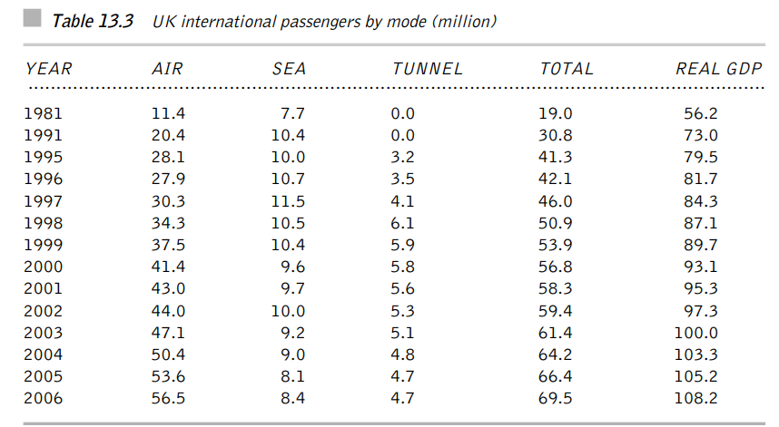
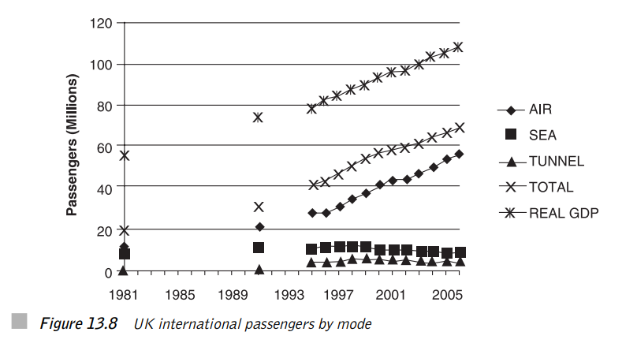

Slide 31
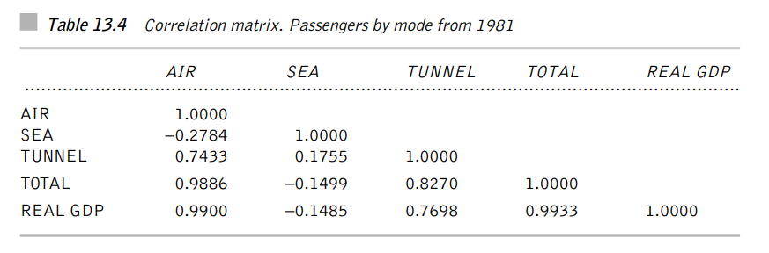
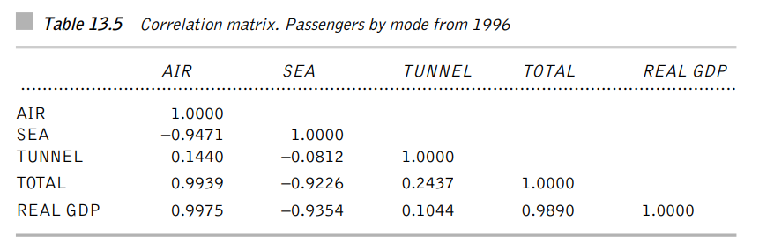

Slide 32
Interpretation
There is a significant difference between correlations values based on the first (1981- ) and second (1995- ) table → there is a strong negative correlation (- 0.93) between Sea Travel and Income in the period 1995 – 2007
It may be that it reflects the fact that sea travel on holiday is an inferior product with a large negative income elasticity → i.e. as Britons get richer, they are, ceteris paribus, less likely to take their cars on to a ferry to Europe

Slide 33
The impact of air fares?
Conversely, we may well believe that this is a short-term effect brought on by rapidly declining air fares in recent years and that the longer series with much weaker correlation (-0.148) is a better indication of what to expect in the future
It is important to recognize that our understanding from economic theory of what underlies change is crucial to modelling and forecasting

Slide 34
The impact of competing modes
To forecast demand for sea ferries we really require the price of ferry services, price of air services and price of tunnel services
As discussed earlier obtaining „a price“ for a single route is extremely difficult, for a combination virtually impossible
Since we expect price and demand to be quite strongly inversely related, we can sometimes use „demand numbers“ as proxies for prices
I addition, the number of air passengers also reflects increases in capacity
It seems reasonable to try to explain the number of sea passengers by numbers on the other modes and income

Slide 35
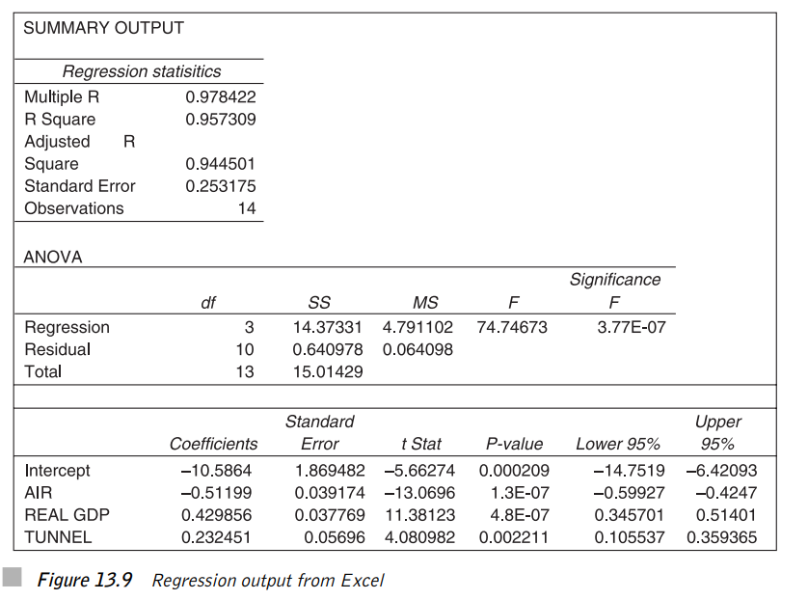

Slide 36
Conclusions
The fit of the model is good (95%) and more importantly, the coefficients have the right signs. Income elasticity of sea travel is almost 4
The increases in air travel and not Channel Tunnel has been the most important factor in slowing down the demand for ferries
If airline growth is checked because of higher fuel prices and carbon pricing than we would confidently expect significant growth in the ferry market well more than the growth of GDP
It is important to note that if data on prices were available, it would be far better than using the proxy variables
In addition, a better modelling strategy might well be to model the total market and relate that to GDP and model mode choice separately based on factors such as price and journey time

Slide 37
MODELLING CHOICE

Slide 38
Background
It is often the case that we are more concerned with forecasting the share of existing traffic than the growth of that traffic
Example: Investing in a new toll motorway that runs parallel to an overcrowded existing motorway → the key question is how many vehicles we might expect at various levels of toll
Modelling → gravity model → total traffic → choice model → shares of old and new motorway

Slide 39
Data and Specifications
Choice modelling data comes in two forms: a) Individual Data gathered within one time period b) Market Share Data which can be cross section, time series or panel
Increasingly, when contemplating quality changes, a survey is undertaken where customers are presented with number of alternatives and asked to choose between them → Choice Experiment
Forecasting Shares: The choices are made on the basis of differences between factors such as journey time and price → The specified model must consider the logical limits of proportions and the law of diminishing marginal utility → One common form is the Logistic Curve

Slide 40
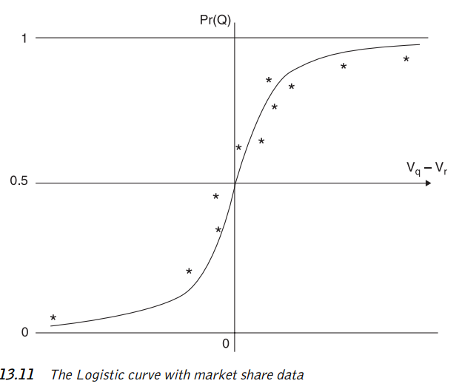
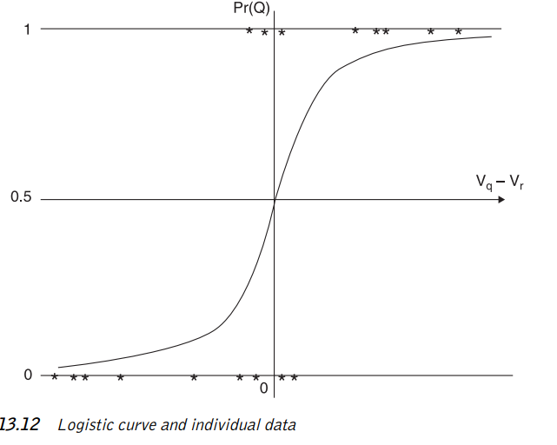
Logistic curve

Slide 41
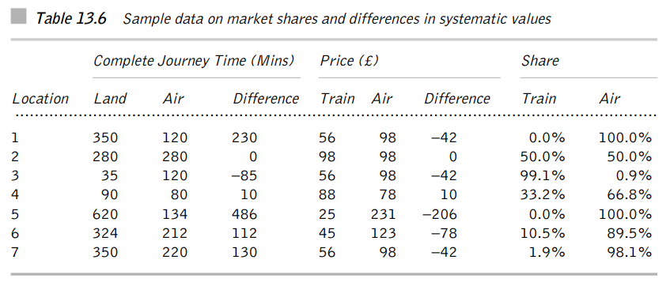

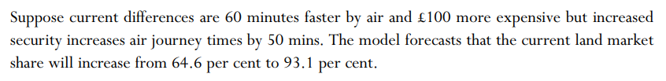
Example: Following table gives data of mode shares between metropolitan area (some of which are on islands):

Slide 42
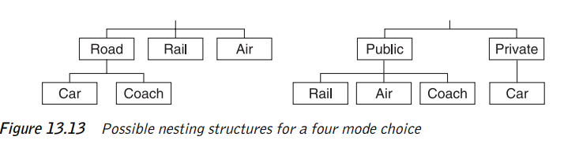
Developments in choice modelling
Extensions to models with more than two choices
Multinominal logit has a significant limitation → independence of irrelevant alternatives
The preferred model is usually nested model

Slide 43
CASE: Forecasting a demand for a new ferry service
Islay and Jura are two adjacent islands off the Southwest of Scotland
Populations: Jura (461); Islay (6.500)
Transport to Islay from mainland → 3 return services per day. Journey time: 2 hours
Proposed new service: Mainland → Jura → Islay. Journey time: 1 hour. However not suitable for the heavy lorry traffic (distilleries) → old connection still needed
What is the economics?
Initial survey → considerable demand for a new service → road system would need to be improved
Re-examination in 1996 → demand and choice modelling

Slide 44
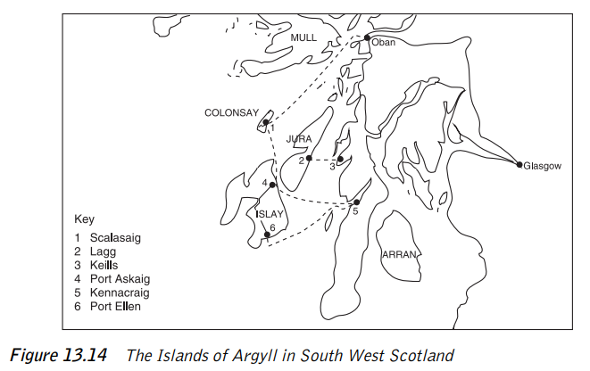

Slide 45
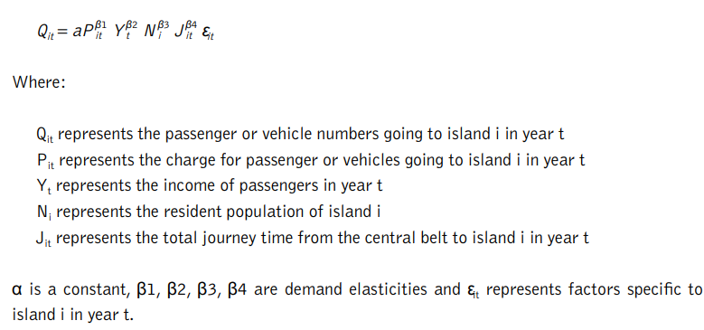
Demand Model – to forecast the total traffic

Slide 46
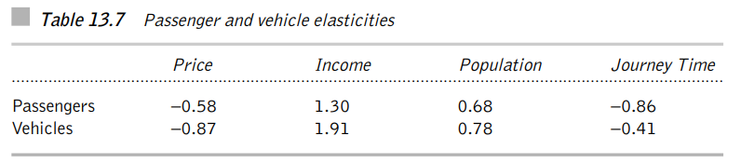
Results
Assuming real prices and populations are relatively stable → a forecast of demand for Islay/Jura was generated → assuming 3 different growth rates and a reduction in a journey time by an hour → this gave estimates of demand growth between 33% and 66% → the numbers travelling to islands would increase substantially → main problem was modelling tourism

Slide 47
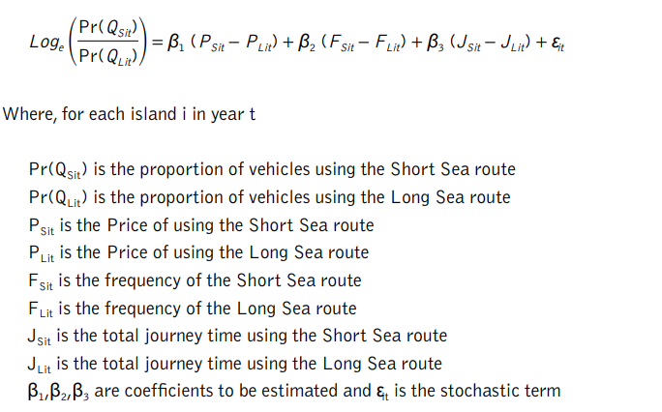
Choice model – to forecast the shares of long and short sea routes

Slide 48
Conclusion
Choice model explained 97% of variance and coefficients were highly significant
It was supposed that the new connection would be only slightly cheaper than the long route, but would be substantially faster and more frequent → the result was that 80% of vehicles would switch to the short crossing
However, this would put into problems/closure longer route (essential for freight). Together with need to improve the road system (high costs) → the plan was rejected → to the dismay of many local groups

Slide 49
Forecasting demand for high speed rail
Börjesson, M. (2014). Forecasting demand for high speed rail. Transportation Research Part A: Policy and Practice, 70, 81-92.

Slide 50
Summary
It is sometimes argued that standard state-of-practice logit-based models cannot forecast the demand for substantially reduced travel times, for instance due to High Speed Rail (HSR).
The present paper investigates this issue by reviewing the literature on travel time elasticities for long distance rail travel and comparing these with elasticities observed when new HSR lines have opened.
This paper also validates the Swedish long distance model, Sampers, and its forecast demand for a proposed new HSR, Results indicate that the Sampers model is indeed able to predict the demand for HSR reasonably well.

Slide 51
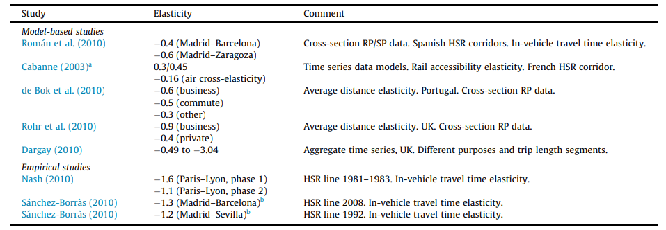
Rail elasticities in the literature

Slide 52
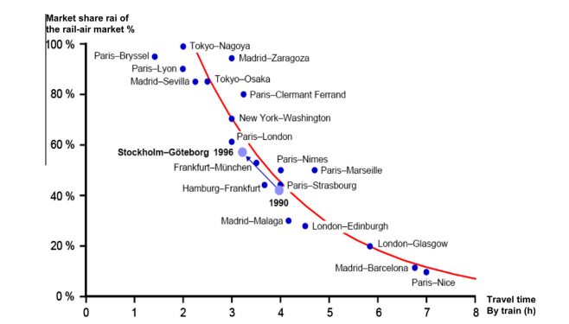
Estimated relationship between share of rail trips (air-rail mode split) and in-vehicle train travel time

Slide 53
HSR in Sweden
The Swedish Transport Administration has used the Sampers long distance model to forecast the effects of a proposed HSR rail track in the Stockholm-Gothenburg corridor.
The thick line on the map in Fig. 2 marks this HSR track
The travel demand has been forecast in a HSR scenario and in a baseline scenario, the former with the new HSR investment and the latter without. Both scenarios refer to year 2020.
In the baseline scenario the travel time of the X2000 trains is on average 3 h 5 min and there are 18 return trips a day. In the HSR scenario it is assumed that the travel time decreases to 2 h 14 min and the frequency increases to 24 return trips a day

Slide 54
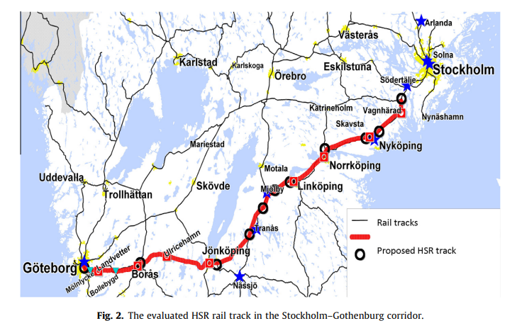

Slide 55
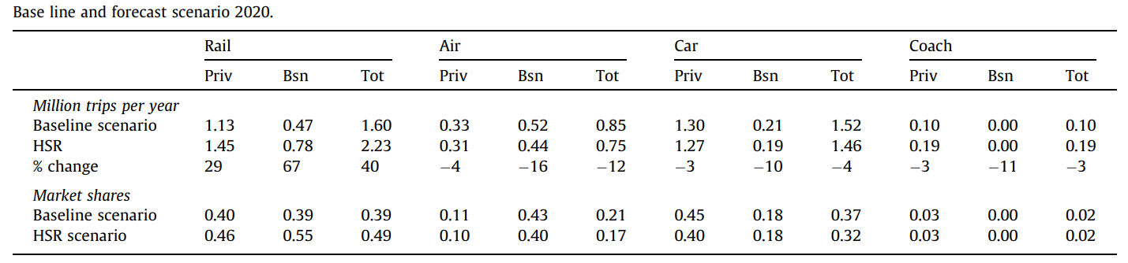
Estimation: Total traffic and market shares

Slide 56
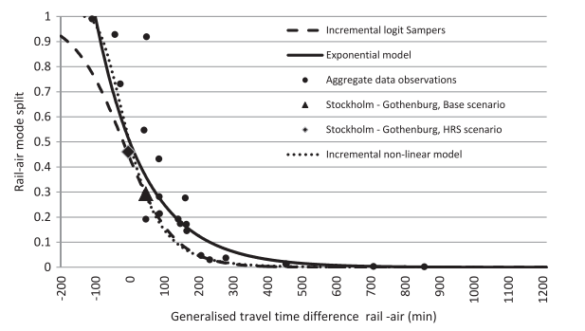
Share for rail travel, as function of generalized travel time difference between air and rail, business trips

Slide 57
Conclusions
In general, the elasticities of long-distance models estimated on cross-sectional data in the literature tend to be lower (in absolute terms) than the elasticities observed when new HSR lines has been opened, such as those in Madrid–Barcelona, Madrid–Seville and the first phase of the Paris–Lyon HSR line.
The high observed elasticities, however, are likely a result of very long initial rail travel times, in particular in the Spanish corridors.
The own elasticity of in-vehicle travel time on travel demand in response to a proposed HSR line in the Stockholm–Gothenburg corridor is - 1.0 to - 1.15 in the non-linear model, which is similar to the second phase of the opening of the Paris–Lyon HSR line

