Slide 1
12. TRANSPORT APPRAISAL

Slide 2
Introduction
Appraisal = is a way of thinking about all the costs and benefits of different spending projects in a systematic manner so that, different projects can be compared and investment made which are going to rpovide the maximum return.
Transport involves the expenditure of resources on a combination of investment in capital items (e.g. stations, tracks, roads) and/or in operations (e.g. subsidy)
Society has limited resources → therefore it should seek to maximise the return from investments

Slide 3
Alternatives
Appraisal is a way of predicitng how much utility we as society will derive from the expenditure of resources on one thing compared to another, by predicting the utility that will arise from each
For example → how much utility would we get from spending 10 bn CZK on a new motorway compared to a new railway

Slide 4
Appraisal and Forecasting
It is fundamental to realise that inherent in appraisal, there is some kind of prediction or foracsting required
Because we have not built the project, we are only considering whether it will be wortwhile or not → we have to try to forecast the future → sometimes quite far into the future
Two main techniques can be used:
- Looking at the performance of similar,
existing projects
- Using predictive models

Slide 5
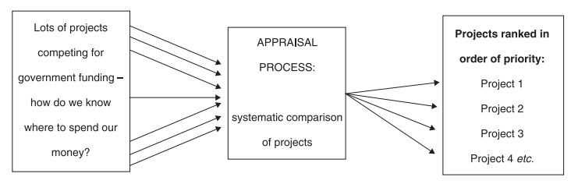
The appraisal process

Slide 6
The role of politics
Appraisal is not the only basis on which projects are selected for funding; politics often play a major role
Politicians may have „non-rational“ reasons for wanting or not wanting projetcs and these may have little to do with the results of appraisal
The appraisals are frequently done after the desicion to build the project had been taken – ex post justification of a political decision
Appraisal provides the advice, that may be ignored by politicians. The politicians také the ultimate decisions.

Slide 7
Cost benefit analysis
Cost benefit analysis (CBA) estimates and totals up the equivalent money value of the benefits and costs to the community of projects to establish whether they are worthwhile
The results of CBA is a number: this shows the ratio of benefits to costs for the scheme.
If it is less than 1 (costs exceed benefits) then the rational government or organization would be expected to be unlikely to fund the scheme
Values above 1 indicate the overal benefit to society and higher the ratio, the higher the probabilty that it will be financed

Slide 8
Monetary values
The basis of CBA is that a monetary value needs to be allocated to all benefits and costs associated with a given project.
Some costs and benefits can easily be expressed in monetary terms (fares, costs of building roads or operating trains), some are harder to monetize (accidents, noise) and finally some are very extremely diffucult to exprsss in monetary terms (change in the quality of landscape, wider economic benefits)
This is a funamental diffuclty in CBA from their beginings in late 1950s

Slide 9
From CBA to SCBA
Private sector → CBA is straightforward → only costs and benefits that can be sold at the market
Public sector → wider range of costs and benefits → what to include and what to exclude? → many factors (time and accidents savings) cannot be bought at the open market
Social costs benefit analysis (SCBA) → CBA that includes factors without direct market value, but with social value

Slide 10
One problem
The factors that are excluded from SCBA may be sometimes viewed as more important than those that are included → is it feasible to include all factors?
The results of SCBA shows only how the scheme performs in terms of factors included in the analysis → but not necessarily how it performs in realtion to the objectives set fro the scheme
Alternative appraisal methodology → objective – based appraisal (or multicriteria analysis)

Slide 11
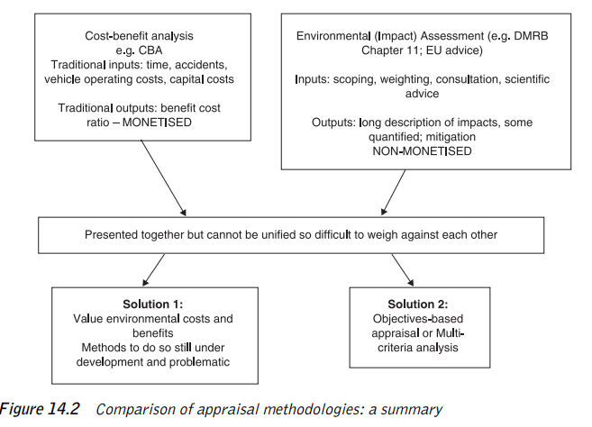

Slide 12
Objective - based appraisal
Good objective based appraisal needs clear objectives
SMART objectives → specific, measurable, agreed, realistic and time-dependent
UK governemnt objectives → Economy, Enviroment, Safety, Integration, Accessibility and social inclusion
There is an element of political controversy in objective based appraisal (choice and clarity of goals) → SCBA avoid this
it is difficult to argue against the project that appears to be good value for money → it is quite easy to argue against a projects that performs well against an objective with wchich you do not agree

Slide 13
How does CBA work?
Despite the emergence of objective based appraisal, CBA remains the main appraisal tool
The prurpose is to weigh up the costs and benefits and to see whether benefits are higher, and if so, by how much.
Example: Tram bypass in Gothenburg → tram network congested in city cetre → idea of tram bypass to provide faster journey times across town and to provide new journey opportunity

Slide 14
Steps in CBA
Choose one or more alternative options → against which to assess the tram bypass scheme. The base option (Option B) → to build nothing/minor improvement against (Option A) → building tram bypass
Choose length of time → probably several decades → over which to assess
Use a predcitve model to calculate the likely ridership during the whole evaluation period on the tram network in Options A, B. → From this, calculate the revenue
Use the same predictive model → to calculate total journey times on different options over the whole evaluation period

Slide 15
Steps in CBA (2)
For Option A calculate the journey time savings likely to result from the project
In a similar way, calculate journey time savings on the road network resulting from the tram bypass → if people are predicted to transfer from car and/or bus to tram
Calculate construction, maintenance and operating costs of the different options
Také away the benefits (revenue plus journey time savings) from the costs for Option A to find out whether benefits exceed costs and, if so, by how much.

Slide 16
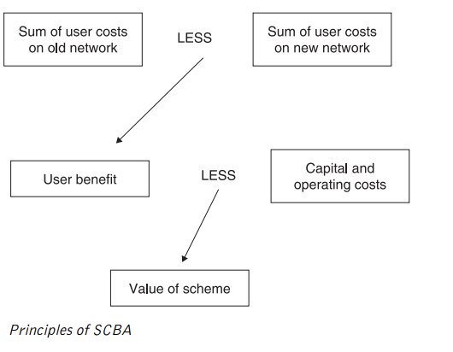

Slide 17
Key elements of SCBA (1)
Project appraisal period → usually 30 – 60 years
The benefits that are assessed → changes in travel time, revenues, vehicle operating costs, accident costs, (increasingly) noise and air pollution
Forecasting and modelling → modelling should be traeted as indikative → induced traffic and newly created congestion
Present values → costs and benefits have to be calculated in their net present values (NPV)

Slide 18
Key elements of SCBA (2)
Accident valuation → usually based on insurance costs (policing, medical, pain and suffering, economic losses) → willigness to pay for safety improvements
Operating costs → e.g. By raising average speed and reducing congestion, a new road is likely to reduce operating costs for all users
Revenue → discounted flow of revenues

Slide 19
Value of time
Values of time → normally the most significant benefit in SBCA → value of time used is abolutely critical to the final outcome of the evaluation
Usually very small individual journey times savings multiplied by a very large number of users over a long period
How to estimate reliably values of time? → estimation techniques → working and non working time → opportunity costs

Slide 20
Discussion
Valuing time savings → proportional valuation of small and big time savings? →what we actually do with the time saved?
What to value? → many costs and benefits are left out
Discount rate and length of time → they are arbitrary and critical to the outcome
What does NPV shows us? → they may not help us with trasnport policy objectives
Equity and distributional effects → fairness and political considerations
Project pricing – optimism and inaccuracy → usual escalation of costs

Slide 21
Exercise (1) – Discount rate
The effect of the discounting rate and project time period
First, discount the following stream of benefits from a project and derive a total NPB for price base year 2002. Use a discount rate of 3.5 per cent.
Year | Benefit (undiscounted) (£)
2003 | 35,000
2006 | 60,000
2008 | 100,000
2010 | 25,000
2014 | 40,000
2017 | 70,000

Slide 22
Exercise (2) – Value of licence
Suppose you are interested in operating a taxi and you are considering purchasing a taxi operating certificate form an existing operator. You estimate that the current operator makes annual excess profits equal to 100.000 CZK. At a 5% rate of interest, what is the maximum price you are willing to pay for this license? Would you be willing to pay this same price if the interest rate were 10%?

Slide 23
Exercise (3) – Investments „needs“
Critique the following statement: “We currently do not have sufficient airport capacity to meet the continuing growth in airline traffic. In order to avoid gridlock at our nations airport, we need to build additional airports”.

Slide 24
Exercise (4) – Value of time
Decide which values of time you should use for a person who is travelling by underground train on works’ business; and for a person who is travelling to work by bus. Why do you think that values of time when travelling in working time are highest for travellers on the underground and lowest for those on the bus?

Slide 25
The Economics of Investment in High Speed Rail
based on J. Preston (2013)

Slide 26
Introduction
Origin in Japan - Shinkansen (1964)
Defined as new rail lines capable of operating speeds of 250 kilometres per hour or more
World HSR network (2013) – 22.000 km
China, Japan, France, Spain
Germany, UK, Italy, Korea, Taiwan, ……
HSR extremely costly
Better understanding of the economics of HSR needed

Slide 27
Design
Largely freestanding systems (Japan, China) x systems integrated with conventional rail (France, Spain, Germany)
HSR may penetrate city centres using conventional tracks (France) or new tracks (Japan) or may serve edge of city locations (China)

Slide 28
Aims
Capacity = separating fast and slow trains
Speed = rail to compete with air
Promoting national champions (in supply)
Journey time reliability (UK)
Economic development (China)
Political integration/centralization (Spain)
Enviroment (UK)

Slide 29
Appraisal and Evaluation
In both ex-ante appraisal and ex-post evaluation of HSR cost-benefit analysis is the dominant methodological tool
Sometimes distributional impacts are important

Slide 30
Benefits of HSR (UK evidence)
30% revenue
50% users time savings
10% reduction of rail overcrowding
10% wider economic benefits
Benefits from reduced rpoad congestion and enviroment improvement were relatively minor

Slide 31
HSR traffic (European evidence)
30% abstracted from air
30% abstracted from classic rail
15% from road (predominantly car)
25% generated

Slide 32
Capital costs
High capital costs are required to achieve grade separation, curvature and gradient
Costs higher when high population densities, high land values and unfavourable topography
Costs may vary from below EUR 10 million per km (China) to over EUR 100 million per km (HS1 approaches to London)
Economies of density important
Operating speed is a key driver of capital costs

Slide 33
Demand
High degree of variability in demand for HSR schemes from below 4 million passengers per annum (Madrid-Seville) to over 200 million passenger per annum (for the Tokaido and Sanyo Shinkansen)
Determinants: population, spatial structures, fare levels, HSR stations location, national and sometimes regional borders
Demand estimations: gravity model

Slide 34
Competition
Intermodal competition – very intensive, low cost airlines
Italy – HSR open access competition between Trenitalia and NTV:
    30% reduction in fares
    45% increase in services
    30% increase in demand
    It is not clear whether this competition will be sustainable
High access charges (typically 25-45% of HSR revenue) can limit open access competition

Slide 35
Analysis
Paralysis by analysis (UK, US) – many studies, minimum service
Build and see (China, Spain) – large increases in HSR network
Step by step x big bang approach

Slide 36
Test for HSR investment
Does HSR make a commercial return?
Does HSR make a social return?
Does HSR make a social return including impacts on other transport systems and wider economic benefits?
Does HSR have social returns when qualitative wider benefits are taken into account?

Slide 37
Nash (2015): When to invest in HSR?

Slide 38
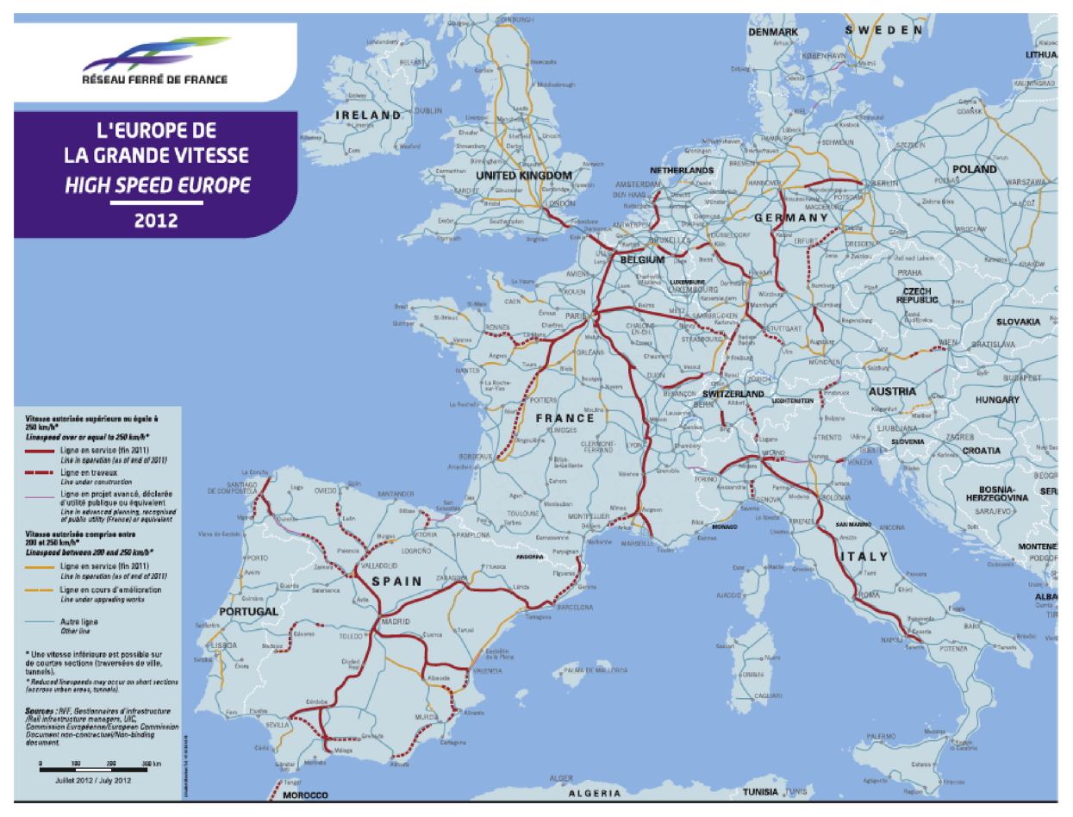

Slide 39
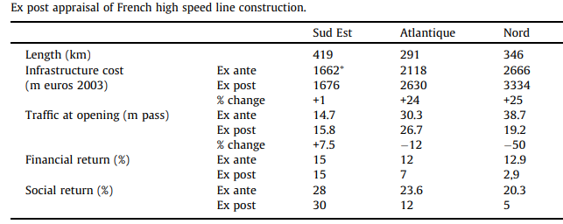
HSR in France

Slide 40
CBA of HSR in Spain

Slide 41
CBA of HSR in Britain
Nash (2015)

Slide 42
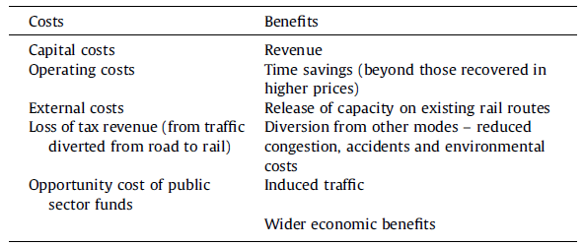
HSR costs and benefits

Slide 43
HSR in the Czech Republic

Slide 44
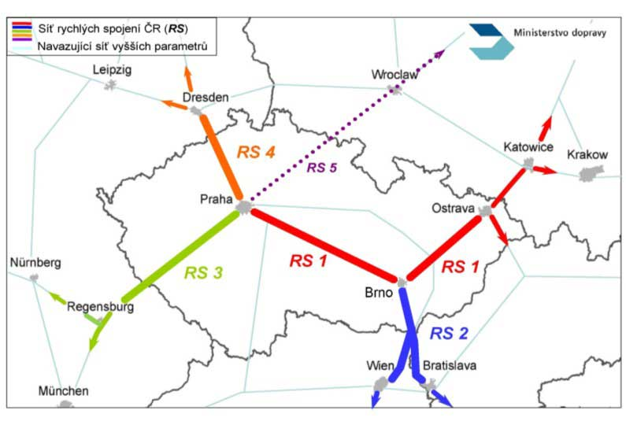
Is it a good idea to build HSR in the Czech Republic?

Slide 45
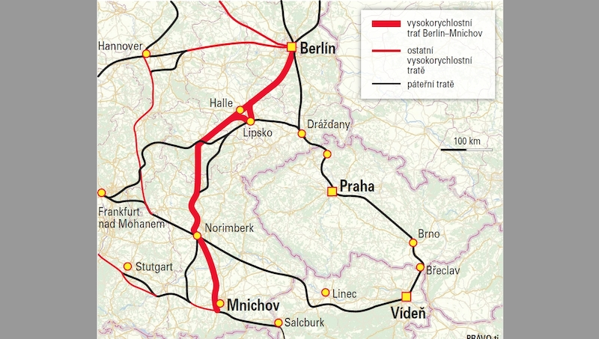
The „threat“ of being excluded from HSR network in Central Europe

Slide 46
Bent Flyvbjerg

Slide 47
Biased demand forecasts
The study of traffic forecasts in transportation infrastructure projects. The sample used is the largest of its kind, covering 210 projects in 14 nations. The study shows that forecasters generally do a poor job of estimating the demand for transportation infrastructure projects.
For 9 out of 10 rail projects, passenger forecasts are overestimated; the average overestimation is 106%. For half of all road projects, the difference between actual and forecasted traffic is more than ±20%.
The result is substantial financial risks, which are typically ignored or downplayed by planners and decision makers to the detriment of social and economic welfare.
Flyvbjerg, B., Skamris Holm, M. K., & Buhl, S. L. (2005). How (in) accurate are demand forecasts in public works projects?: The case of transportation. Journal of the American planning association, 71(2), 131-146.

Slide 48
Cost escalation
The study of cost escalation in transportation infrastructure projects. Based on a sample of 258 transportation infrastructure projects worth US$90 billion it is found that the cost estimates used to decide whether such projects should be built are highly and systematically misleading.
Underestimation cannot be explained by error and is best explained by strategic misrepresentation, that is, lying.
The policy implications are clear: legislators, administrators, investors, media representatives, and members of the public who value honest numbers should not trust cost estimates and cost-benefit analyses produced by project promoters and their analysts.
Flyvbjerg, B., Holm, M. S., & Buhl, S. (2002). Underestimating costs in public works projects: Error or lie?. Journal of the American planning association, 68(3), 279-295.

