Slide 1
Consultancy project:
Strategy Setting
By Jakub Čech & Andrej Šišolák
Notes:
Note: Please after inserting your picture, “Right Click” on the picture and “Send it to Back” to get the “Gradient” effect.

Slide 2
Our Agenda
Consultancy Project | Strategy Setting
10 min
01
Basic principles
10 min
02
Mission statement
20 min
03
Long term vision
20 min
04
Business strategy
20 min
05
Strategy elements

Slide 3
Strategy Setting
Basic Principles
By Jakub Čech & Andrej Šišolák
Notes:
Note: Please after inserting your picture, “Right Click” on the picture and “Send it to Back” to get the “Gradient” effect.

Slide 4
Three Pillars
Consultancy Project | Strategy Setting | Basic Principles
Mission
Vision
Strategy
It formulates why do we exist. What is the main purpose of our company.
Same during the entire operation of the company
Specific, company can be recognized by its mission
Public, part of the company PR
Attracts the future employees
Should define a higher purpouse of meaning of company's activities
It explains the goal for specific period of time. What we want to achieve in the near future. Where do we want to go as a company.
Time framed, new vision is created when the previous where achieved
Shows the direction to the people
Alligns the people´s work to one direction
Adjustable based on new circumstances
Evaluable
Particular goals which contribute to the vision achivement in the future. It includes the organizationa and resources alocation. Tells how to achieve the vision
Time framed
Measurable
It contains particular steps towards the vision

Slide 5



Company Thinking
Consultancy Project | Strategy Setting | Basic Principles
Mission
Why do we exist
WHY
Vision
Where we want to go, what we want to achieve
WHAT
Strategy
How to do it
HOW

Slide 6
Strategy Setting
Mission Statement
By Jakub Čech & Andrej Šišolák
Notes:
Note: Please after inserting your picture, “Right Click” on the picture and “Send it to Back” to get the “Gradient” effect.

Slide 7
Definition of Mission Statement
Consultancy Project | Strategy Setting | Mission Statement
Mission
Vision
Strategy
It formulates why do we exist. What is the main purpose of our company.
Same during the entire operation of the company
Specific, company can be recognized by its mission
Public, part of the company PR
Attracts the future employees
Should define a higher purpouse of meaning of company's activities
It explains the goal for specific period of time. What we want to achieve in the near future. Where do we want to go as a company.
Time framed, new vision is created when the previous where achieved
Shows the direction to the people
Alligns the people´s work to one direction
Adjustable based on new circumstances
Evaluable
Particular goals which contribute to the vision achivement in the future. It includes the organizationa and resources alocation. Tells how to achieve the vision
Time framed
Measurable
It contains particular steps towards the vision

Slide 8



Elements of the Mission
Consultancy Project| Strategy Setting | Mission Statement
Purpose
What does your products or services do or aim to provide and to whom. Why do you exist
Brand values
What does the company stand for? Values, which makes your company unique.
Brand goals
What does your company do for the customers. Why should they buy the products from you instead of competition.

Slide 9



Examples of the Mission
Consultancy Project| Strategy Setting | Mission Statement
LG Electronics focused on developing new innovations across the globe. We are committed to providing electronic products that help customers live better. To support this, we wish to continue bringing added value to the lives of a consumers. LG's Mission is to be #1 by creating a better life with our customers.
We're building a world powered by solar energy, running on batteries and transported by electric vehicles. Explore the most recent impact of our products, people and supply chain. We design sustainable systems that are massively scalable—resulting in the greatest environmental benefit possible.
To bring the best user experience to customers through innovative hardware, software, and services.

Slide 10




Examples of the Mission
Consultancy Project| Strategy Setting | Mission Statement
To make delicious feel-good moments easy for everyone. This is how we uniquely feed and foster communities. We serve delicious food people feel good about eating, with convenient locations and hours and affordable prices, and by working hard to offer the speed, choice and personalization our customers expect. At our best, we don’t just serve food, we serve moments of feel-good, all with the lighthearted, unpretentious, welcoming, dependable personality consumers know and love.
Commitment to to being at the forefront of technology Innovation. The company aims to solve complex problems through the development and deployment of advanced computing platforms, therey enhancing the quality of life for people around the world.
We aim to build a better world - helping people live better and renew the planet while building thriving, resilient communities. For us, this means working to create opportunity, build a more sustainable future, advance diversity, equity and inclusion and bring communities closer together. And at the end of the day, helping our customers save more of their hard earned money for the things they care about most. Because at Walmart, Live Better is what we do every day.
We will provide products and services of superior quality which improves and protects the health of the feet of our customers. We are the innovator and driving the industry. We are the preferred business partner for our customers.

Slide 11
Strategy Setting
Long Term Vision
By Jakub Čech & Andrej Šišolák
Notes:
Note: Please after inserting your picture, “Right Click” on the picture and “Send it to Back” to get the “Gradient” effect.

Slide 12
Definition of Vision
Consultancy Project | Strategy Setting | Long Term Vision
Mission
Vision
Strategy
It formulates why do we exist. What is the main purpose of our company.
Same during the entire operation of the company
Specific, company can be recognized by its mission
Public, part of the company PR
Attracts the future employees
Should define a higher purpouse of meaning of company's activities
It explains the goal for specific period of time. What we want to achieve in the near future. Where do we want to go as a company.
Time framed, new vision is created when the previous where achieved
Shows the direction to the people
Alligns the people´s work to one direction
Adjustable based on new circumstances
Evaluable
Particular goals which contribute to the vision achivement in the future. It includes the organizationa and resources alocation. Tells how to achieve the vision
Time framed
Measurable
It contains particular steps towards the vision

Slide 13



Jim Collins The Hedgehog Concept
Consultancy Project| Strategy Setting | Long Term Vision
The Hedgehog Concept is not a goal to be best, a strategy to be the best, an intention to be the best, a plant to be best. It is an understanding of what you can be the best at.
Passion about?
What Are You Deeply
Passionate About ?
Try to identify areas of business for which are you passionate about. Try to find a higher meaning of your activity. Do not try make people passionate about the vison or strategy.
Be the best in the world?
And what you can not be the best in the world. Does not have to be your current core competencies. It can be something in which you are not even in yet.
What You Can Be The Best In The World At?
What Drives Your Economic Engine?
Drivers of economic engine?
Define the most important profit denominator. Profit per customer, product, employee, customer visit, shop, sales region etc.

Slide 14


Elements of the Vision
Consultancy Project| Strategy Setting | Long Term Vision
Target
Where, who, or what do we want to become in the defined period?
Content
What will our future look like within a couple of years? Describe the future status of the company.
KPI’s
Set a couple of the most important Key Performance Indicators by which we will evaluate the achievements of the vision's targets.

Slide 15
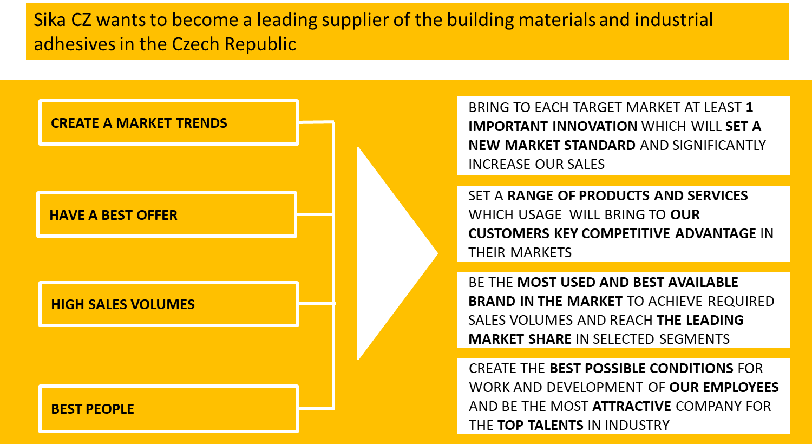
Sika CZ Vision 2023
Consultancy Project| Strategy Setting | Long Term Vision

Slide 16
Strategy Setting
Business Strategy
By Jakub Čech & Andrej Šišolák
Notes:
Note: Please after inserting your picture, “Right Click” on the picture and “Send it to Back” to get the “Gradient” effect.

Slide 17
Definition of Strategy
Consultancy Project | Strategy Setting | Business Strategy
Mission
Vision
Strategy
It formulates why do we exist. What is the main purpose of our company.
Same during the entire operation of the company
Specific, company can be recognized by its mission
Public, part of the company PR
Attracts the future employees
Should define a higher purpouse of meaning of company's activities
It explains the goal for specific period of time. What we want to achieve in the near future. Where do we want to go as a company.
Time framed, new vision is created when the previous where achieved
Shows the direction to the people
Alligns the people´s work to one direction
Adjustable based on new circumstances
Evaluable
Particular goals which contribute to the vision achivement in the future. It includes the organizational and resources alocation. Tells how to achieve the vision
Time framed
Measurable
It contains particular steps towards the vision

Slide 18
Strategy Content
Consultancy project Introduction | Strategy Setting | Business Strategy
Why?
01
02
Where?
Which parameters confirm that the selected market segment is the best for company‘s future development?
What market segment will be the best for future company development?
What?
03
04
How?
What elements will be the main drivers of the value proposition of the company‘s product and services portfolio?
Which way will be the best to successful approach selected market segment?
Who?
05
06
When?
How will the company organize itself for the successful implementation of the strategy?
What will be timing of all the strategic activities?

Slide 19
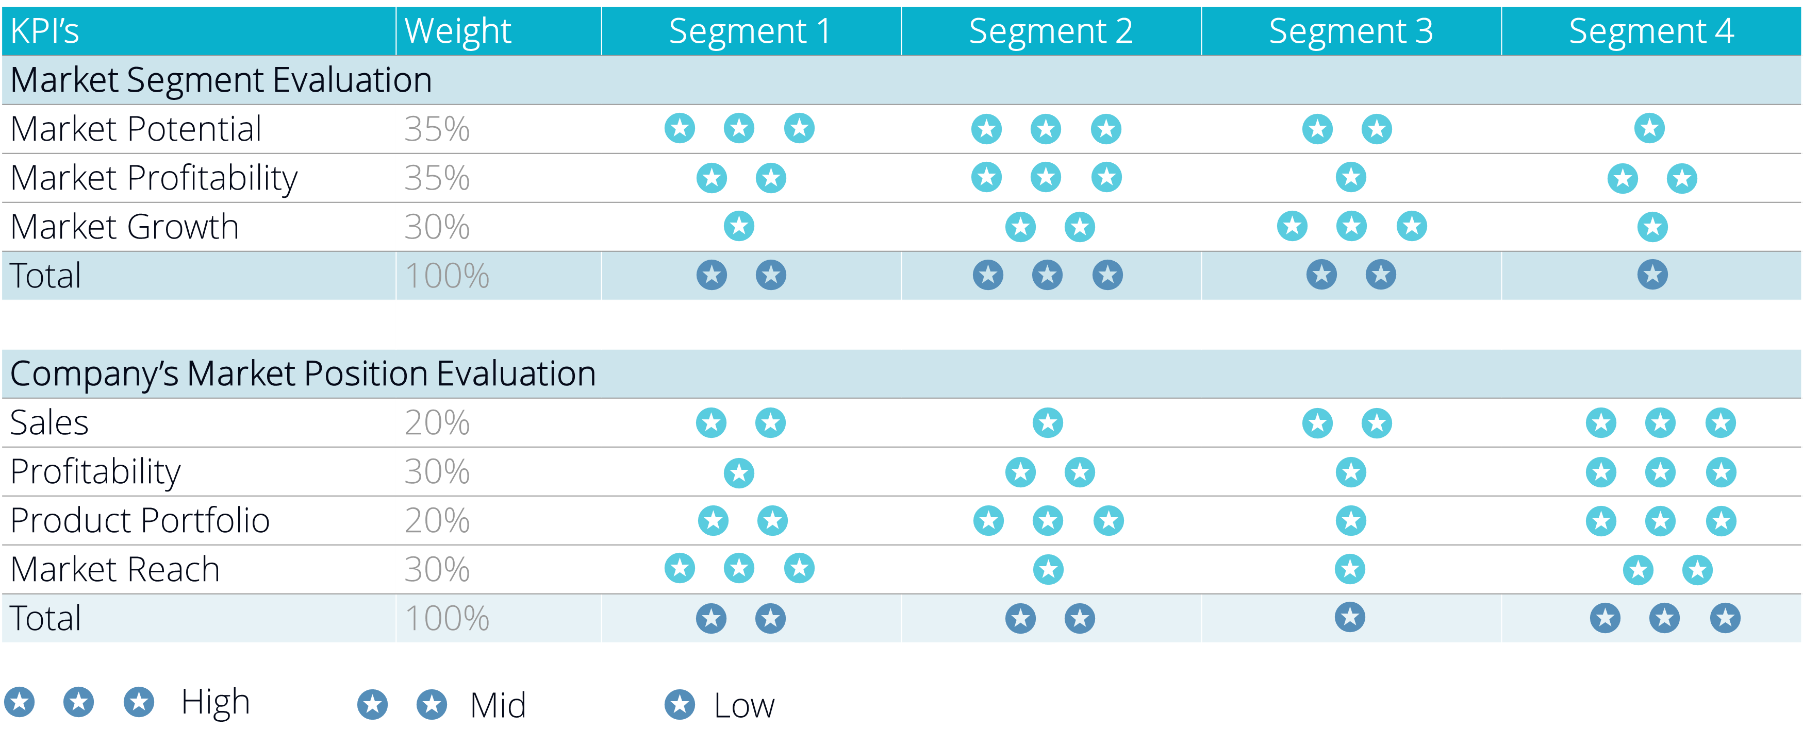
Why? Where?
Consultancy project Introduction | Strategy Setting | Business Strategy

Slide 20



Why? Where?
Consultancy project Introduction | Strategy Setting | Business Strategy
Business Unit Strength
High
Medium
Low
Grow | Grow | Hold
Grow | Hold | Harvest
Hold | Harvest | Harvest
Grow
Segment 1
100m$
Segment 3
45m$
High
Segments with the leadership position in the attractive market segments. Needs investments to grow or protect the position.
Segment 2
80m$
7%
25%
Hold
Medium
18%
Selectivity | earnings segments. Invest into the business with the low position in the attractive markets or harvest the business with the strong position in not attractive market.
Market Attractiveness
Segment 4
110m$
Harvest
Low
15%
Segments with weak position in the unattractive markets. Go for divestments of maximize the profit.

Slide 21



What? Value Proposition
Consultancy project Introduction | Strategy Setting | Business Strategy
Value proposition is the value a company promises to deliver to customers should they choose to buy their products.
Needs
Value proposition should contain an easy-to-understand reason why a customer should buy product or service from that particular business
Benefits
Value proposition should clearly explain how products fill a needs, communicate the specifics of its added benefits, and state the reason why it is better than similar products on the market
Importance
The ideal value proposition is to-the-point and appeals to a customer’s strongest decision-making drivers

Slide 22





How? Value Chain (M. Porter)
Consultancy project Introduction | Strategy Setting | Business Strategy
A business model that describes the full range of activities needed to create and deliver product or service with promised value proposition.
Technology Development
Firm Infrastructure
Technology Development
Supporting
Activities
Human Resources Management
Technology Development
Technology Development
Procurement
Margin
Primary
Activities
Inbound logistic
Operations
Outbound logistic
Marketing&Sales
Service

Slide 23
How? Value Chain (M. Porter)
Consultancy project Introduction | Strategy Setting | Business Strategy
Example | Primary Activities
Inbound logistics
Apple has a massive supply chain, and it has several alternatives to getting raw materials. Its top 200 suppliers include component suppliers and others who accounted for at least 97 percent of its materials, manufacturing, and assembly procurement spending in 2016.
China and Japan are home to a substantial number of the company’s leading suppliers. 3M and Foxconn are two of its key raw material suppliers. Apple has a lot of negotiating leverage with its suppliers because of its financial heft. It has set quality requirements for its suppliers to ensure that its goods and services meet the highest possible standards. Apart from that, Apple has used more sophisticated ways to decrease storage needs and expedite the purchase process.
Operations
Apple goods are manufactured in several different countries. However, most of its items are assembled in China, which is why some of them have the Made in China label. Apple is also in negotiations with the Indian government, and production might begin there shortly. A significant portion of the assembly is done in China, although a minor part is done in other countries. Because labor expenses are lower in Asian countries, Apple’s production costs are cheaper. Aside from that, Apple has decreased the usage of hazardous chemicals in its product production and assembly. Apple is increasingly using recyclable materials. By outsourcing its production, on the other hand, the company has been able to control its production costs to an acceptable level.

Slide 24
How? Value Chain (M. Porter)
Consultancy project Introduction | Strategy Setting | Business Strategy
Example | Primary Activities
Outbound logistics
Apple has a massive distribution network that includes both direct and indirect channels. Apple has an extensive channel for distributing its products to clients, ranging from retail shops to internet shopping and its own branded stores. It has improved its distribution route and increased the number of brand outlets over time. Apart from these considerations, the focus has remained on green packaging and waste reduction.
Marketing and Sales
Apple is a well-known brand whose goods are recognized for their high quality, innovative design, and technical advancements. Any new Apple product is news, and it is covered not only by the media but also by a variety of other sources, including small and large websites. That does not, however, imply that Apple does not invest in brand marketing. While Apple’s goods are extensively promoted in the media, it also creates distinctive advertisements that engage its fans. It has a high level of brand loyalty due to its advertising strategy’s originality and imagination. Apart from television and internet commercials, the company also uses print advertisements to market and promote its products.
Apple sells its products through the following channels:
Value-added resellers, Retailers, Wholesalers, Third-party cellular network carriers, Direct salesforce, Apple online store, Apple retail stores.
The IT behemoth is steadily expanding the proportion of sales made through direct channels instead of indirect ones. Net sales through the company’s direct and indirect distribution channels will account for 34 percent and 66 percent of total net sales in 2020, respectively. Apple has been focusing more on corporate sales in recent years, and CEO Tim Cook recently indicated that the company would rely heavily on channel partners to boost enterprise sales even more.

Slide 25
How? Value Chain (M. Porter)
Consultancy project Introduction | Strategy Setting | Business Strategy
Example | Primary Activities
Products and Services
Apple provides its customers with complete after-sales assistance. The majority of Apple goods come with 90 days of free service and a one-year limited warranty. Aside from that, Apple users may get support via the online shop. They may monitor the status of their order online. Customers may talk to professionals online or call Apple for assistance. Customers may fix their phones or other Apple goods at an Apple-approved service provider or an Apple shop with a genius bar.
Apple provides outstanding customer support at all three phases of the buying process: pre-purchase, purchase, and post-purchase. Apple has experience centers in key cities worldwide where anybody may try out its goods and get persuaded of their excellence. Apple salespeople are often well-trained, courteous young men and women tech-savvy and eager to show product features and capabilities.
With unique iPhone trade-in schemes that allow iPhone customers to switch to newer models with additional cost, post-purchase customer care is also outstanding. Only products purchased directly from Apple, either online or at an Apple Retail Store, can be returned to Apple. Within 14 calendar days of purchase, products can be returned.
Customers can go to Apple Stores if they are unsure about anything or if something goes wrong. Customers have had their broken iPhone screens fixed for free at an Apple Store in the past.

Slide 26
How? Value Chain (M. Porter)
Consultancy project Introduction | Strategy Setting | Business Strategy
Example | Support Activities
Technolody and R&D
Apple invests a lot of money in R&D. Its brand is recognized for technical innovation as well as high quality and distinctive product designs. The brand must invest heavily in R&D in order to preserve its competitive advantage.
The company spent more than ten billion dollars on research and development in 2016 and 11.6 billion dollars in 2017. Apple has raised its R&D investment by more than 5 billion dollars since 2014. Three significant causes fuel this drive. Its expanded product variety, increasing the scope of Apple’s services, and increased concentration on in-house technological development are among them.
HR Management
Human resource management is also an essential element of a company’s value chain. Apple prioritizes both hiring and remuneration. Since the days of Apple founder Steve Jobs, this has been the standard. Apple has always sought the most acceptable candidates. However, during Tim Cook’s tenure, the HRM style has shifted slightly. Apart from inclusion and diversity, the new CEO has implemented many measures to improve Apple’s HR reputation.
Procurement
At Apple, procurement is also a significant priority. It has maintained positive ties with its vendors. Suppliers must provide safe working conditions for employees as well as goods and services that meet industry standards. All of these variables have an impact on supplier relationships. Apple, on the other hand, is a big buyer for most of its suppliers. Thus the two have a mutually beneficial partnership.

Slide 27
Who? Organization Set-up
Consultancy project Introduction | Strategy Setting | Business Strategy
Territorial Sales
Sales
Specialized Sales
Customers’ Segment
Communication Team
Marketing
Development Team
Operations
Service
Logistic

Slide 28
When? Process Goals & Milestones
Consultancy project Introduction | Strategy Setting | Business Strategy
 |  | Vision & Strategy 2027
 |  | 2023 |  |  |  |  |  |  | 2024 |  |  |  |  |  |  | 2025 |  |  |  |  |  |  | 2026
No. | Tasks | 1 | 2 | 3 | 4 | 5 | 6 | 7 | 8 | 9 | 10 | 11 | 12 | 13 | 14 | 15 | 16 | 17 | 18 | 19 | 20 | 21 | 22 | 23 | 24 | 25 | 26 | 27 | 28 | 29 | 30
01 | New organization set-up
02 | Product development
03 | Marketing campaign
04 | Sales promotion activities
05 | Acquisition
06 | Integration
07 | Check the final
Task Duration
Task Completed
Process goals

Slide 29
Thank You
For Your Watching
Jakub & Andrej

