Slide 1
QUO VADIS MPH-AOPR?
Ing.J.Skorkovský, CSc,
Department of Corporate Economy
FACULTY OF ECONOMICS AND ADMINISTRATION
Masaryk University Brno
Czech Republic

Slide 2

First approach
You are at the beginning of the course you learned about from the university server is.muni.cz.
This course will be present the symbiosis between the principles of operations management (OR) and the tools, that are used to control processes. Classic operations research courses are often devoted to methods and solving problems associated with processes. On the other hand, in courses that discuss sophisticated software tools such as the ERP or CRM, students will learn how to use this or that function or how these systems configured. This information is without a doubt very useful, especially for IT managers.
Still, it is utterly insufficient for standard users who need to know how structured data provided by the software can be used for improvements of existing processes. This course integrates ERP and the management of operations from the perspective of the ERP system, Microsoft 365 Business Central. Operations may be interpreted as a set of functions or parts of systems transferring inputs into outputs of handy value while taking into consideration, that basic principles of operational proceedings are based on feedback and requirements.

Slide 3
Operational horizons
The operational horizons addressed in the course are divided into following sectors:
Finance and Accounting
  Handling data (chart of accounts, G/L entries,
  Basic watehousing (locations, Costing Methods…) –related to inventory cost management
  Basic reporting
  Payments
  G/L Budgets
Suppliers
  Purchase Orderss for to cover demands (Sales Orders of Forecats) - material replenishment
  Material availability (MRP)
  Marketing _CRM (product availability, lead time estimates, business opportunities, dispatching, sales forecasts, customer feedback).
Customers
  Sales Orders , margins, balances, Credit limits,Payment terms,…
  Sales Analysis

Slide 4

2nd approach
Thanks to your previous experience and the courses you have taken from your former student experience or actual life practice, you will have an idea of what it could be about and whether it will be helpful to you.
Main objective of the course : to ignite in students a spark of interest in the subject

Slide 5

3rd approach
You might know only about some basic requirements hazily
You don't know anything about the teacher and his experience from real projects, which is an invaluable experience for teaching
You know nothing about the possible tools that will be used in the class (Business Central)

Slide 6
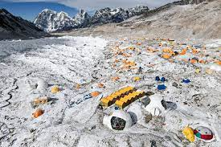
Basic camp
You only know some basic requirements hazily, you don't know anything about the teacher and his experience from real projects, which is an invaluable experience for teaching, and you know nothing about the possible tools that will be used in the class.
You are like climbers in a base camp, with a challenging climb ahead of you.

Slide 7

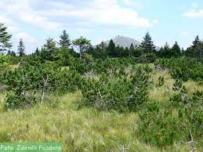

Another approach
Lost in the black and deep forest and and over time….…. And that is the power of knowledge.

Slide 8

At the top
But as you continue to "climb" and therefoire your horizons will expand
At the top, you will hopefully realize that all the effort was worth it.

Slide 9
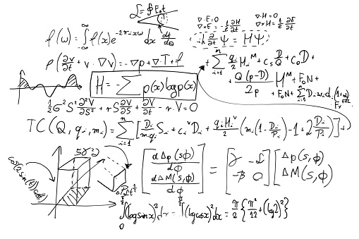

After MPH_AOPR
And if what you hope to learn ignites a spark of interest, you will want to climb other peaks.
Solving this
task is a
piece of
cake
for me

Slide 10
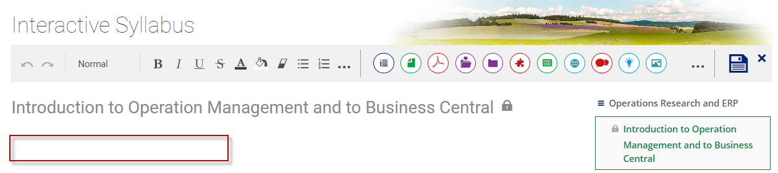
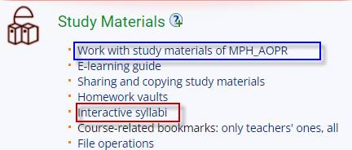
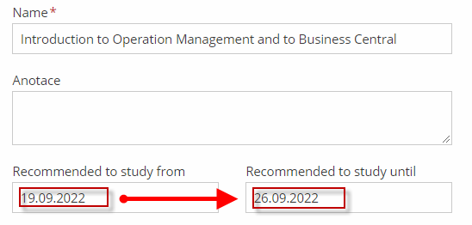
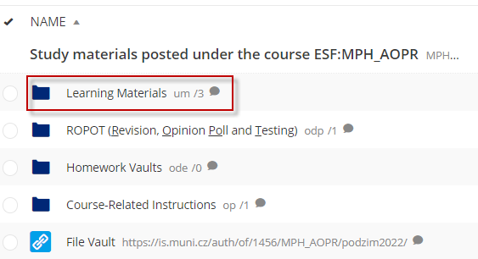
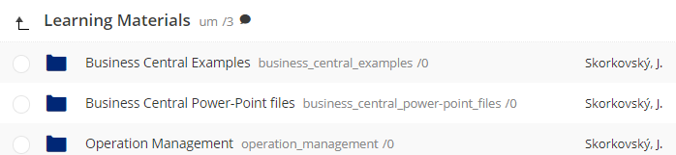
The organisation of teaching materials I
IS MUNI
Files

Slide 11
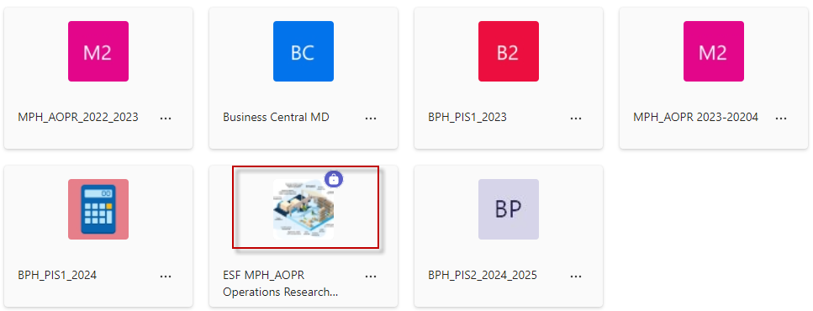

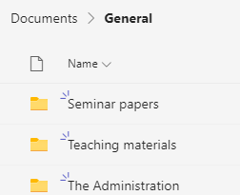

The organisation of teaching materials MS TEAMS II

Slide 12
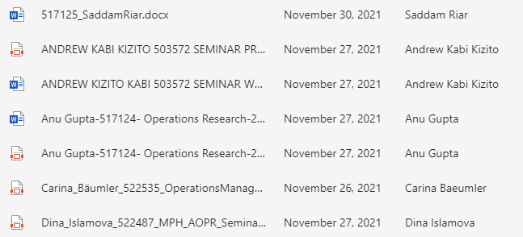
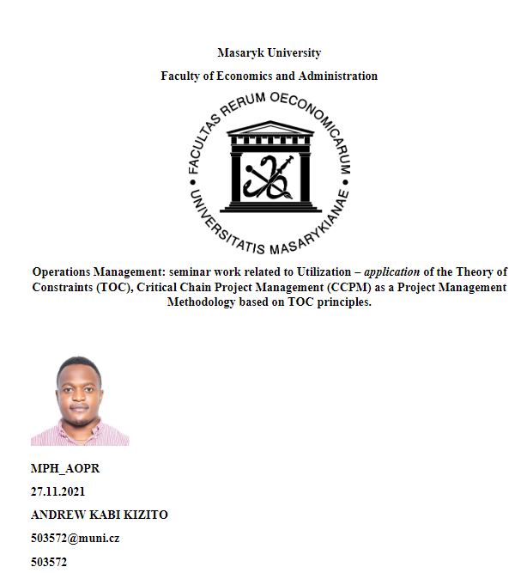
The organisation of teaching materials MS TEAMS III

Slide 13
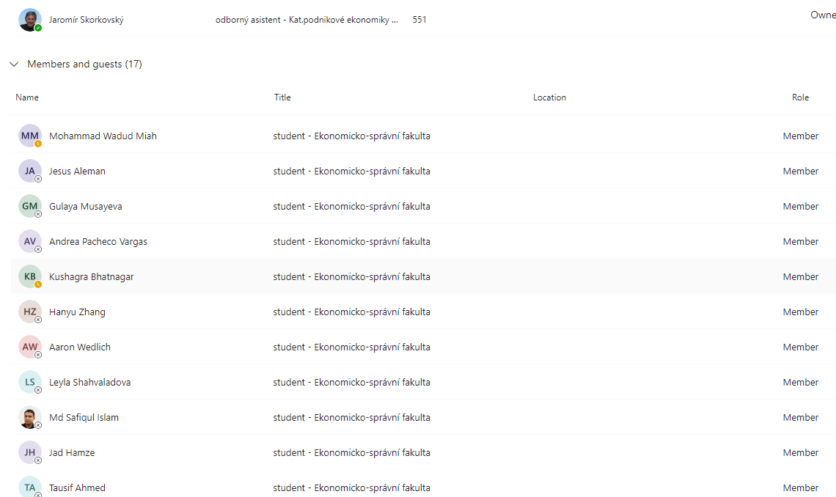
The organisation of teaching materials –MS TEAMS IV

Slide 14
Operation Management Process
An operations process is simply defined as the organizational method for getting a task accomplished.
It consists of four distinct primary activities, which are :
  Planning
  Preparing
  Executing
  Assessing

Slide 15
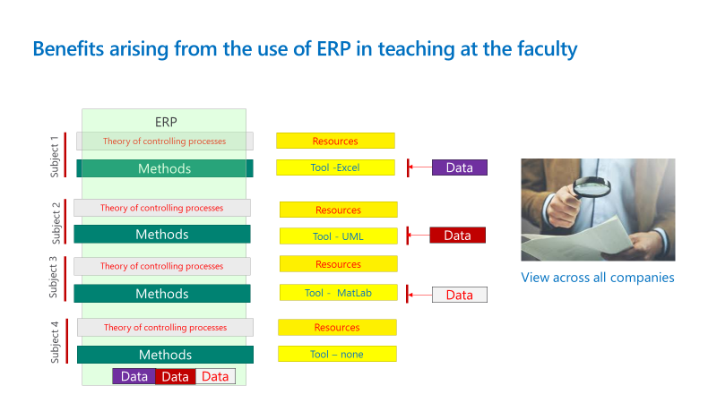

Slide 16
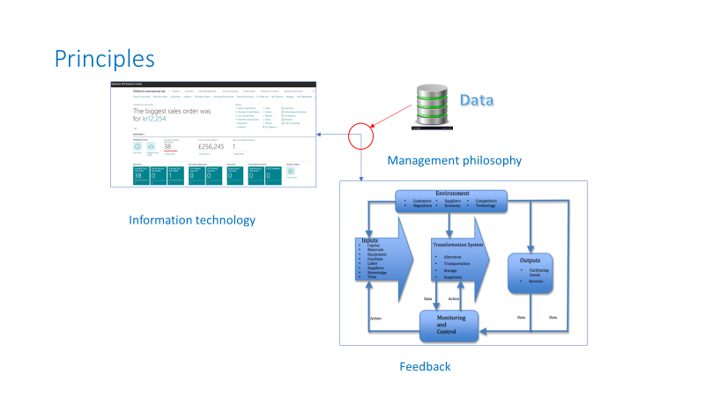

Slide 17
The goal of a business manager using operations and operations research methods is to improve the processes.
But you have to determine (find) that goal in advance.
To achieve a goal that you do not determine is as difficult as returning from a place you have never been.

Slide 18
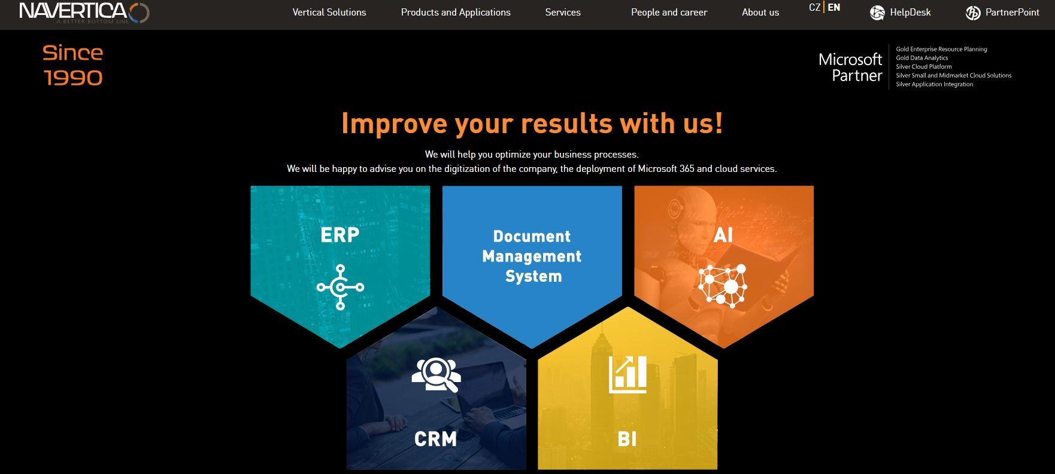
NAVERTICA, the company that runs support Business Central at our faculty has a main goal : Better Bottom Line
One last question : what is the Better Bottom line ?

Slide 19
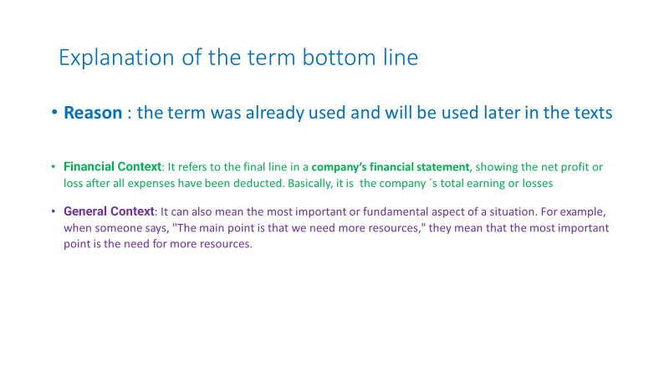

Slide 20
