Slide 1
Business Central Introduction
Transfers
Used ERP=Microsoft Dynamics 365 Business Central
Ing.J.Skorkovský,CSc.
Department of Business Management
Faculty of economics and business administration
MASARYK UNIVERSITY BRNO, Czech Republic

Slide 2
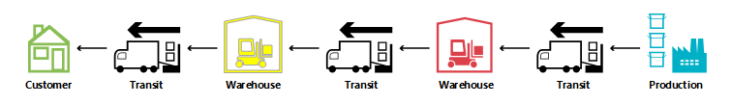
Transfers (Transfer items (goods) between warehouse locations)
A transfer order looks much like any other order in MS Dynamics 365 Business Central application.
However, behind the scenes, it is very different.
One fundamental aspect that makes transfers in planning different from purchase and production orders
(these types of orders represent stock replenishment actions) is that a transfer line represents
demand and supply at the same time.
The outbound part, shipped from the old location, is in demand.
The inbound part to be received at the new location is supplied at that stock location.

Slide 3
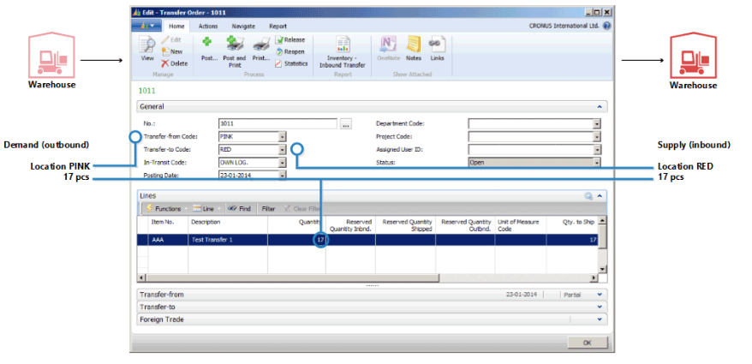
Structure of Transfer Order
Old version form of Transfer Order (NAV 2018)
Own or foreign ("hired")
transport services

Slide 4
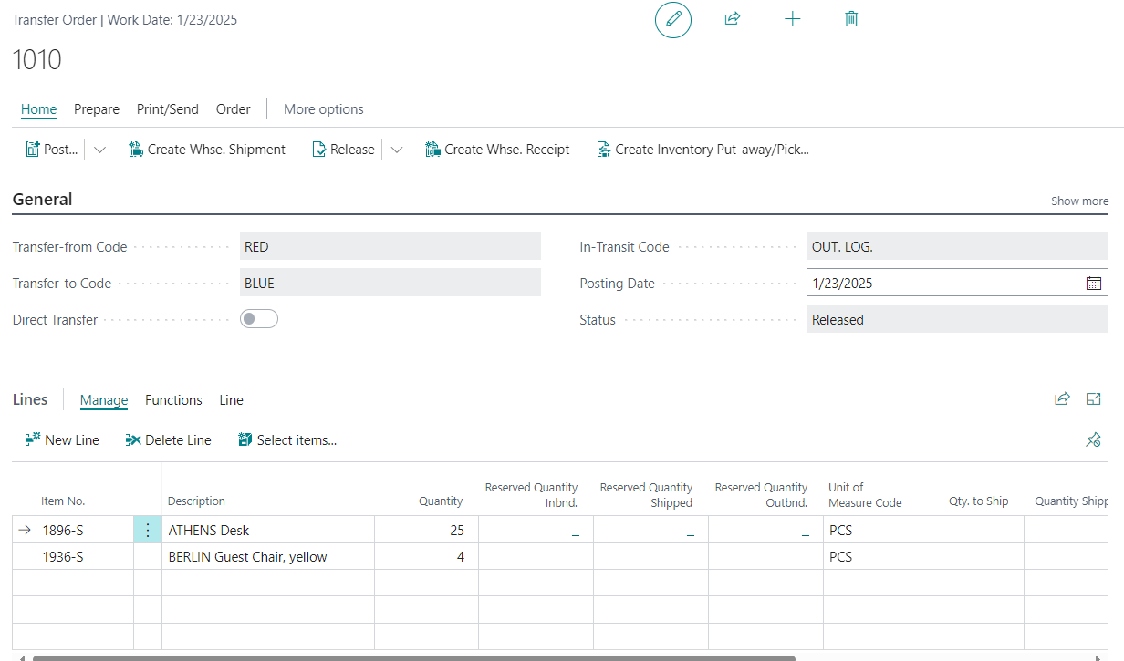
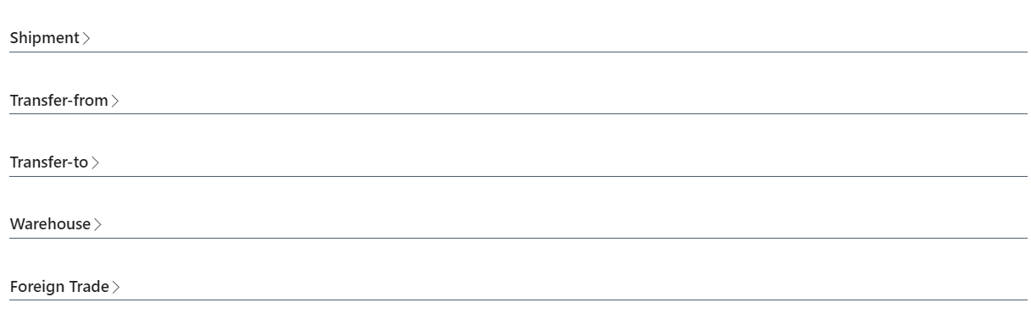
Structure of Transfer Order – Business Central
Basically, it's a very similar form.
The main distinction is the icons
used to control operations

Slide 5
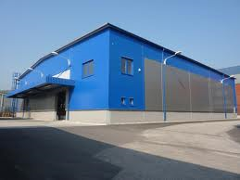
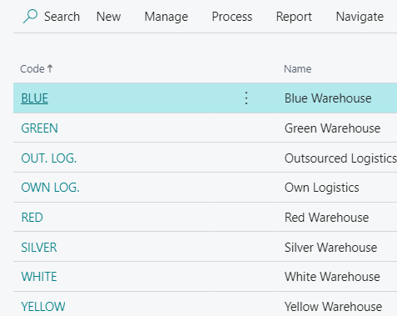
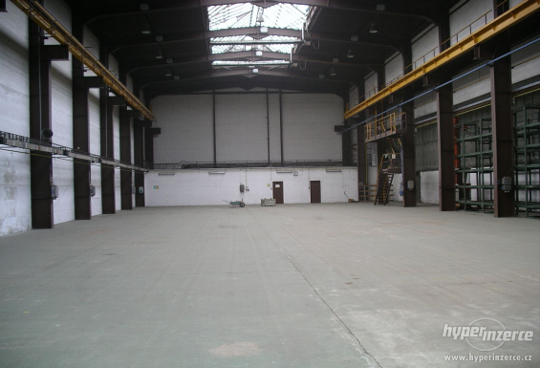
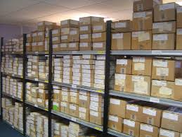
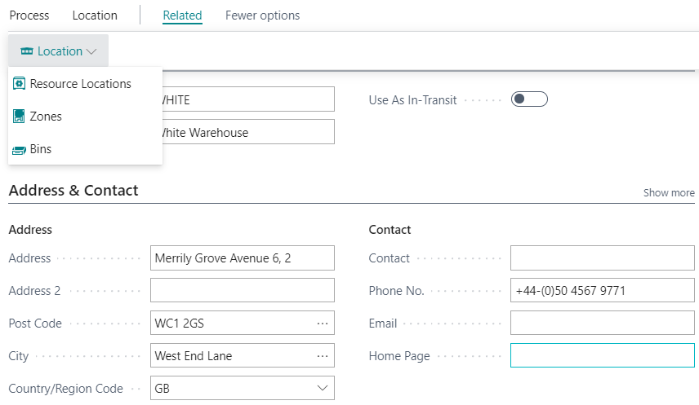
Inventory Locations and Bins
Location
Inventory Zones
Bin
See bins on the next slides
A bin is the smallest specification of a storage position, which is therefore no longer divisible !!!

Slide 6
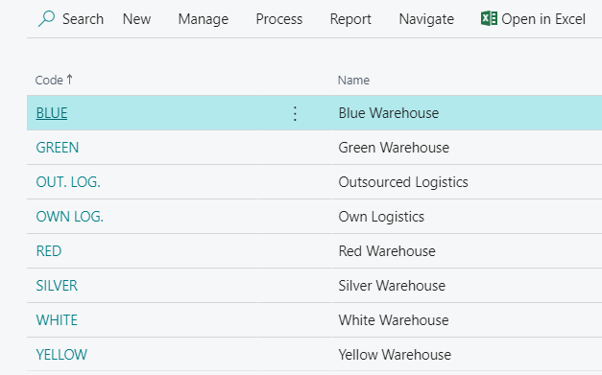
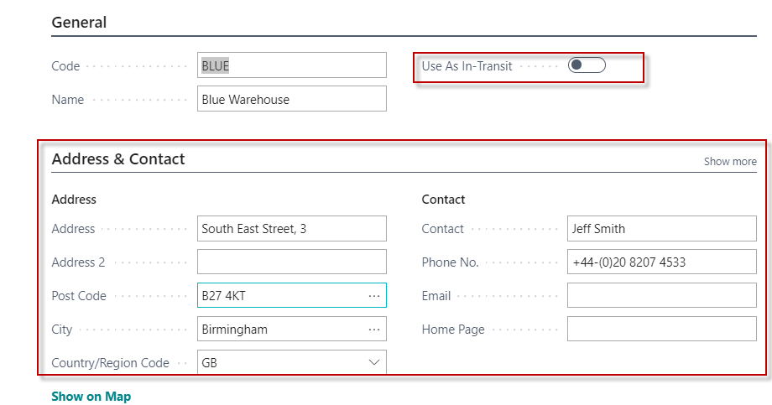
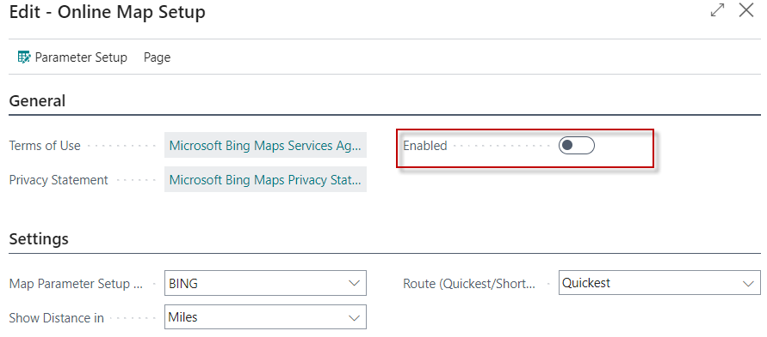
Locations I – stock (part of inventory management)

Slide 7
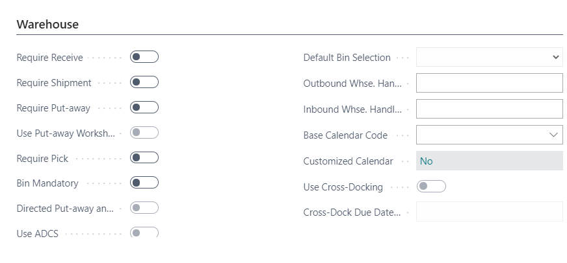
Locations II –setup for locations Blue or Red
In our models we will use only the Blue and Red locations.
The other locations are set up for Advanced Warehousing

Slide 8
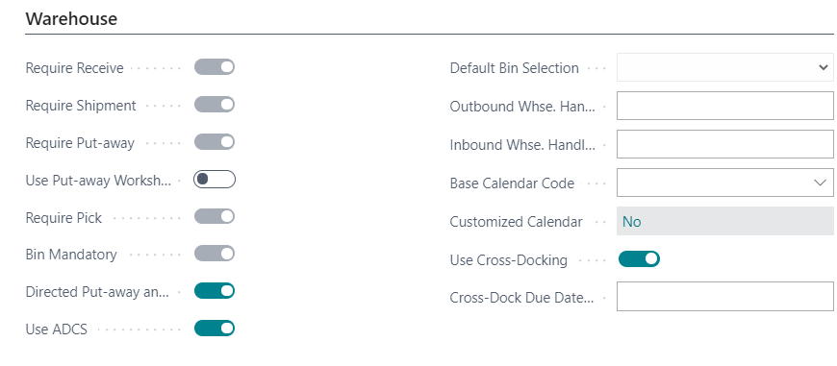
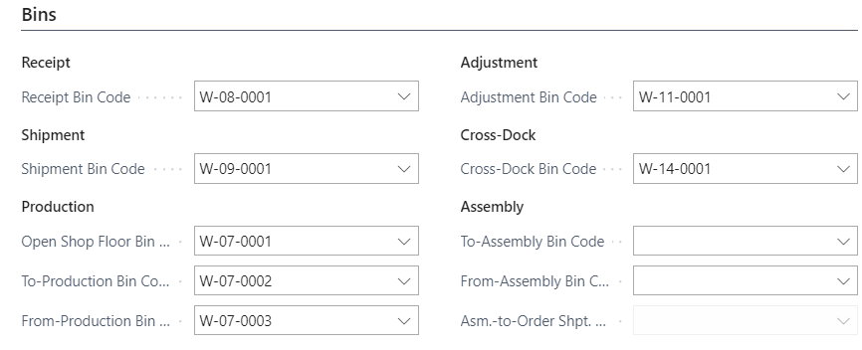
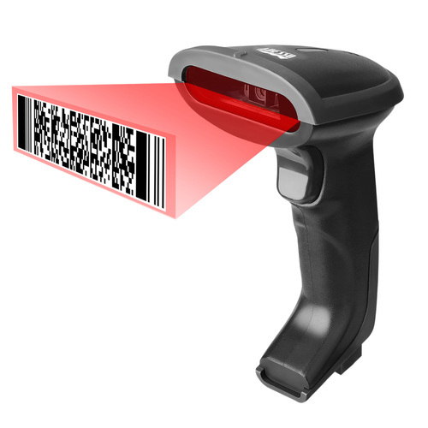
Locations III – setup for location White (Advanced Warehouse Management)
ADCS = Automated Data Capture System
The Automated Data Capture System (ADCS) solution provides
a way for Business Central to communicate with handheld devices
through web services. It would be best if you worked with a Microsoft partner
who can provide the link between the web service and the specific
handheld device.

Slide 9
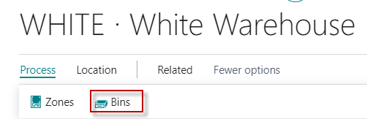
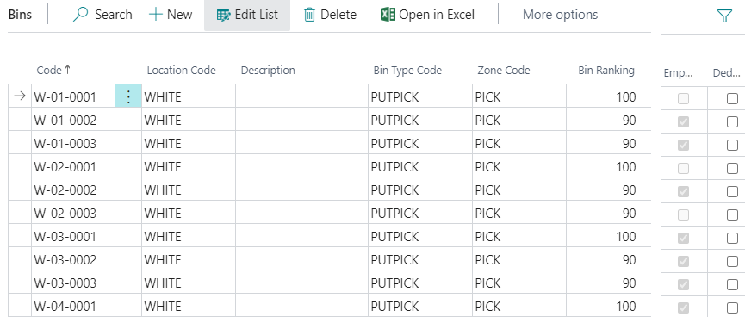
Bins I. (Location White in our demo BC version)
Bin numbers. The bins are the smallest area (position) of the warehouse.
Bins have several attributes (bin type, ranking, zone code, weight, volume, position)
Bin Type Code : you can either put-away
items into bins or you can pick items from bins

Slide 10
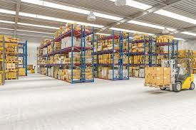
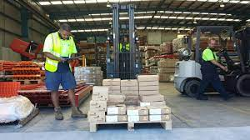
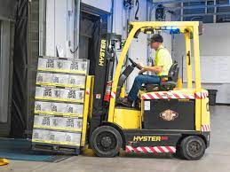
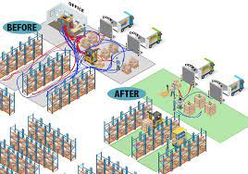
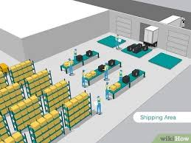
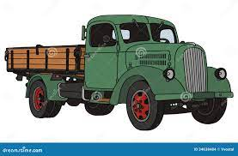
Put-away & Picking from the stock
Picking items by fork lift
Receiving and inspection of goods
Put-away
Picking
Shipping

Slide 11
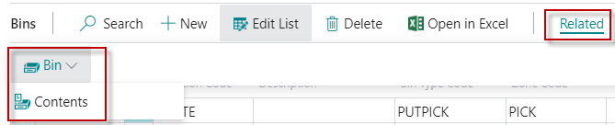
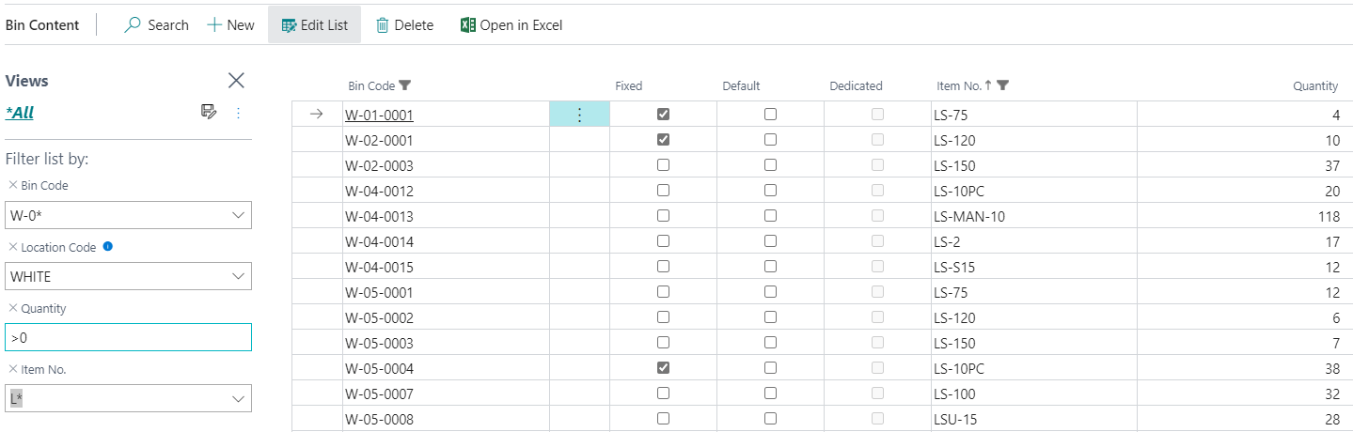
Bins II.

Slide 12
Graphical representation I.
Location could be hall, shed or assembly shop
Inventory zone
Bin

Slide 13
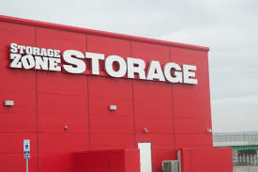
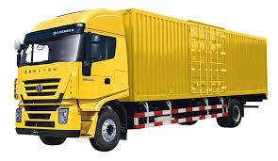
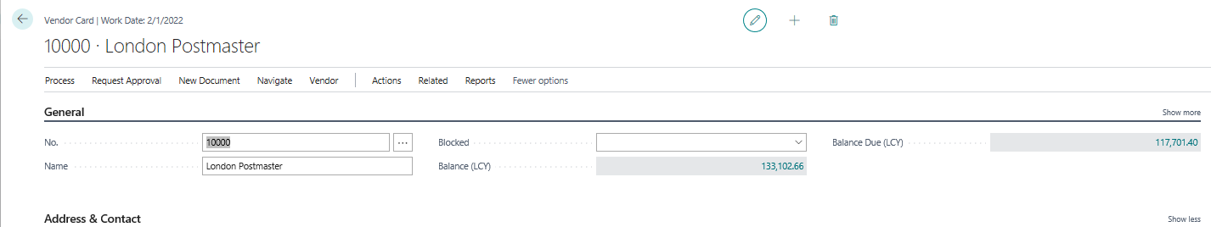

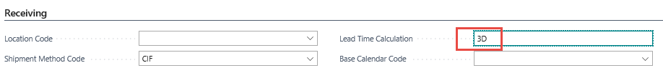
Times –> Locations-> Transfers
Red
location
Blue
location
Outbound
Warehouse handling time=OWT
Shipping time
Inbound
Warehouse handling time=IWHT
Outsource/Own
Location => Vehicle
OWT
Lead time
&
IWHT
Purchase Order
and basic time parameters
such as Lead time

Slide 14
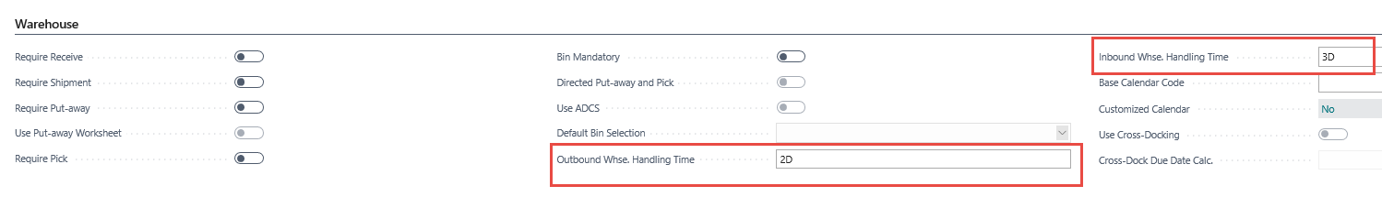
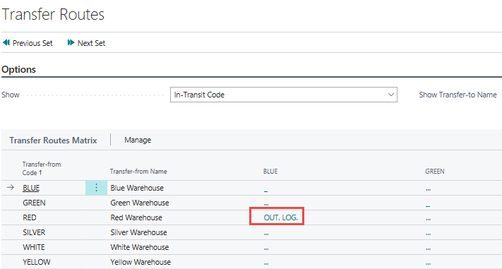
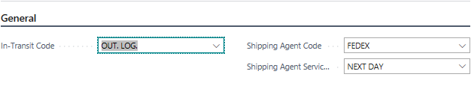
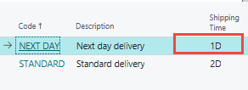
Parameters presented on previous slide I.
OWHT+IWHT+ST=2D+3D+1D=6D
(In this example). Later IWHT was changed
to 2D only
ST = Shipping Time

Slide 15
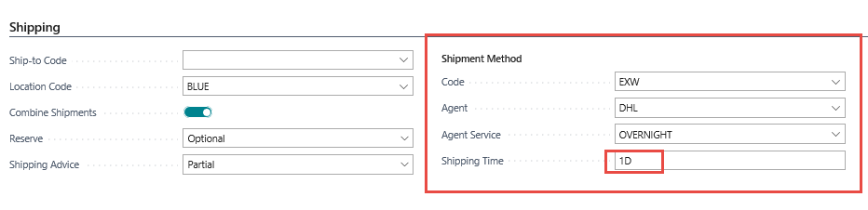
Parameters presented on previous slide I.
Customer Card
Another possibility to specify Shipping time on Customer card

Slide 16
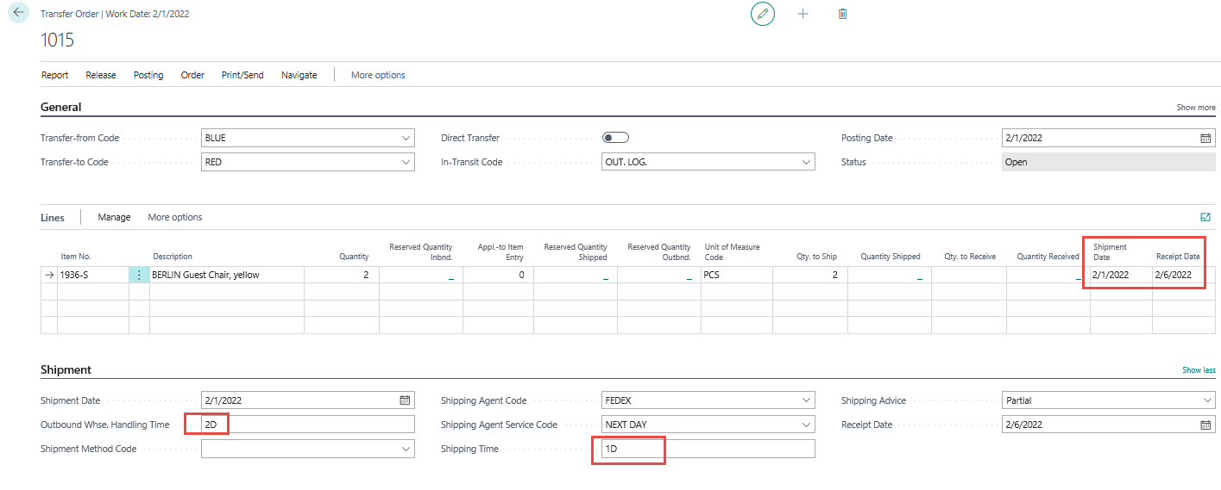
Transfer Orders
5 days
5 Days = 2D (Outbount WHT Blue)+1D (shipping time ) + 2D (Inbount WHT Red)
WH = WareHouse HT=handling time

Slide 17
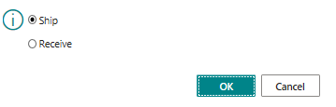
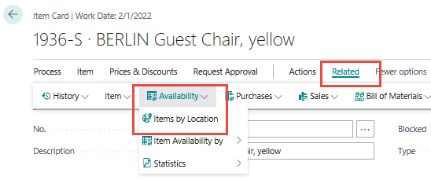

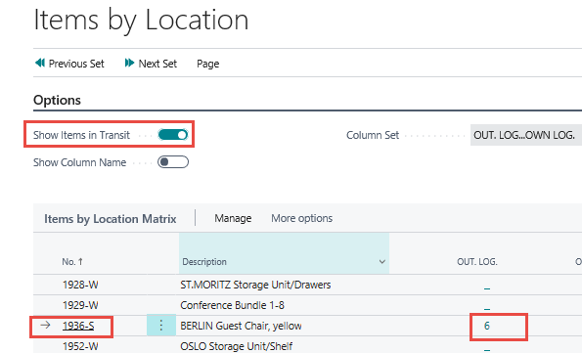
Transfer Order – Posting two times (from Blue Location to Vehicle and From Vehicle to Red Location)
Item card
Calculated field

Slide 18
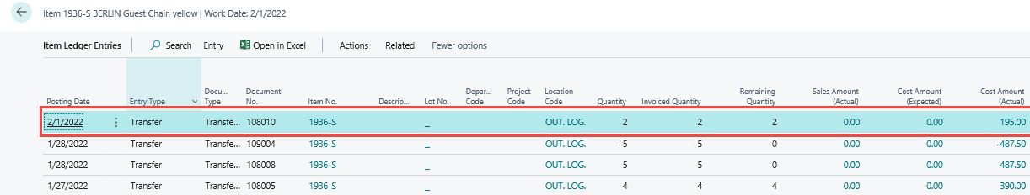
Item ledger entries (transactions) after 1st post action

Slide 19
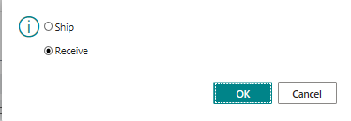
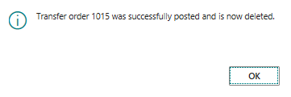
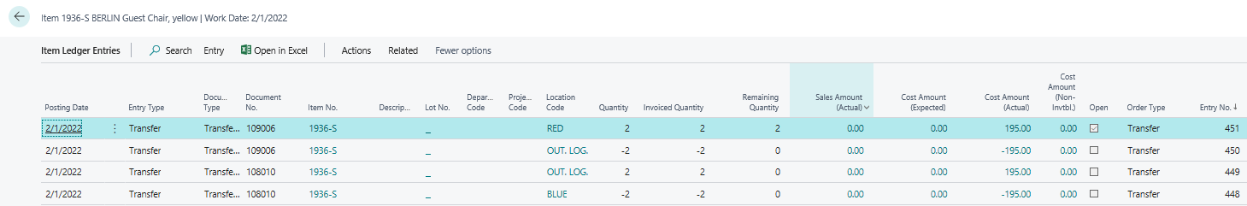
2nd Posting of Transfer Order

Slide 20
Costing (applying additional cost of transfer)
Item number 1936-S Berlin Guest chair
Blue stock location
Red stock location
1936-S (20 pcs )
Cost =100/pc
1936-S (10 pcs )
Cost =105/pc ->margin will be lower if Selling price (Unit price)
remains constant
TRANSFER of 10 pcs
FEDEX – transfer agent
Fedex
Purchase order
(purchase of services
transfer type service
Transfer cost -> 50 Pounds
Cost of Transfer per 1 pc of 1936-S = 50/10= 5 Pounds

Slide 21
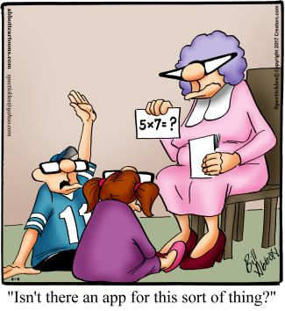

Slide 22


