Slide 1
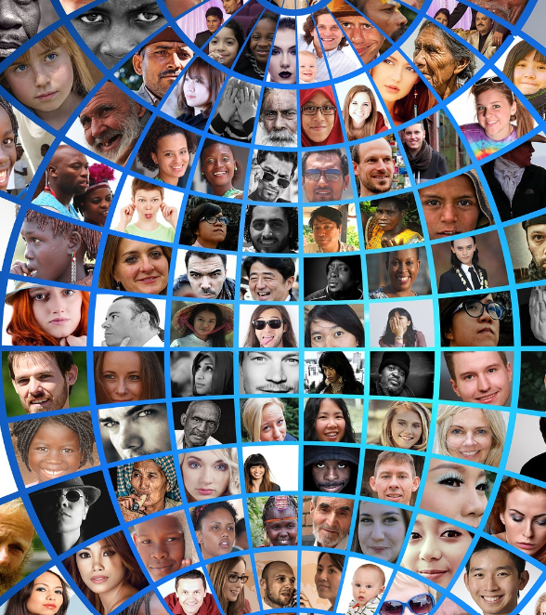
Managing Diversity and Mindfulness

Slide 2
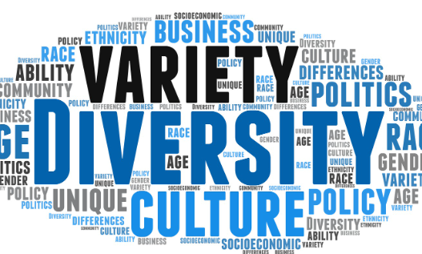
Agenda
Core Definitions
Theoretical foundations
Diversity matters
Dimensions of diversity
Diversity branding
Managing diversity
Levers for change
Statistics

Slide 3
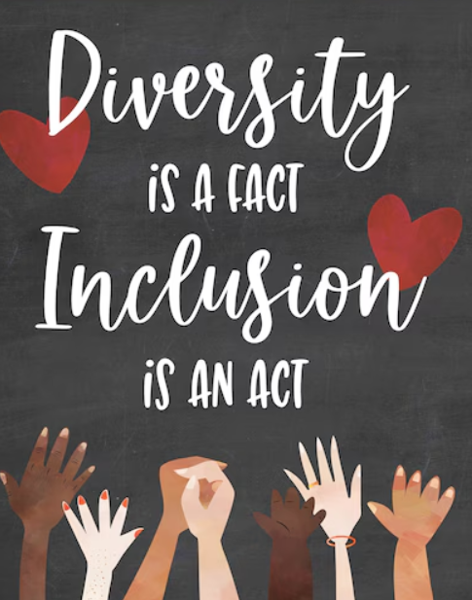
Exercise: 5 minutes
1. Have a conversation in pairs
2.Identify something is different about yourself
3. Share the diversity and why it is important for the workplace

Slide 4
Why does cultural diversity matter?
People from different races, etc., have different life experiences.
This flavors their interpretation of events - these differences can strengthen the group if they are valued and integrated into the group dynamics.
It can take time, intent, and the willingness to be open-minded and non-judgmental about the value the differences bring.
It takes effort to make cultural diversity a strength.
Cultural diversity can also weaken a group - differences in interpretation of events can lead to miscommunication, awkwardness, and hostilities if not addressed.
Different types of employees at work fun:
https://vm.tiktok.com/ZMhna1hDd/

Slide 5
Why Does Diversity Matter ??
Ethnic Diversity Drives Financial Performance
Broader Perspectives: Ethnically diverse teams bring varied experiences, enhancing understanding of diverse customer bases.
Market Expansion: Diversity helps companies enter new markets and adapt effectively.
Boosted Innovation: Varied perspectives foster creativity, better problem-solving, and decision-making.
Financial Impact: Teams with strong ethnic representation are 27% more likely to outperform, positioning companies for competitive advantage.
Gender and Ethnicity Together Have the Highest Penalty for Low Representation
Missed Opportunities: Lack of both gender and ethnic diversity prevents companies from benefiting from the combined advantages of inclusion across dimensions.
Innovation and Insight Gaps: Poor representation limits creativity, innovation, and understanding of diverse markets.
Increased Risks: Companies face groupthink, customer alienation, and failure to meet societal and investor expectations.
Financial Penalty: A 66% lower likelihood of financial outperformance reflects the cost of neglecting diversity.
Progress Over Time Highlights Growing Impact
Increasing Penalties: Financial penalties for low diversity have risen (e.g., 19% to 31% for gender representation), reflecting shifting societal and investor priorities.
Demand for Accountability: Stakeholders now expect greater accountability for diversity, linking it to financial resilience and long-term success.
Reputational and Operational Risks: Companies neglecting diversity struggle to attract talent, retain employees, and meet diverse customer needs, directly affecting their bottom line.

Slide 6
Managing Diversity in the Workplace: Important Definitions
Diversity: Representing various demographic, social, and professional groups, driving innovation and better decision-making in organizations (McKinsey & Company, 2023; Wu & Apfelbaum, 2024).
Equity: Providing fair access and opportunities for all employees, especially historically marginalized groups, to foster fairness and trust (Gündemir et al., 2024; Wu & Apfelbaum, 2024).
Inclusion: Actively creating environments where everyone feels valued, respected, and empowered to contribute their best (Byrd, 2018; Wu & Apfelbaum, 2024).
Belonging: Coqual (2020) defines belonging as feeling accepted, valued, and connected, where employees’ authentic selves are recognized and aligned with organizational values.
Psychological Safety: Edmondson (1999) describes psychological safety as a team’s belief that they can take interpersonal risks—sharing ideas or admitting mistakes—without fear of negative consequences.
Unconscious Bias: Implicit attitudes or stereotypes that affect understanding, actions, and decisions (Onyeador et al., 2024).
Mindfulness: A mental practice of awareness and non-judgment, which bridges diversity, equity, and inclusion by reducing bias and fostering empathy (Wu & Apfelbaum, 2024).

Slide 7
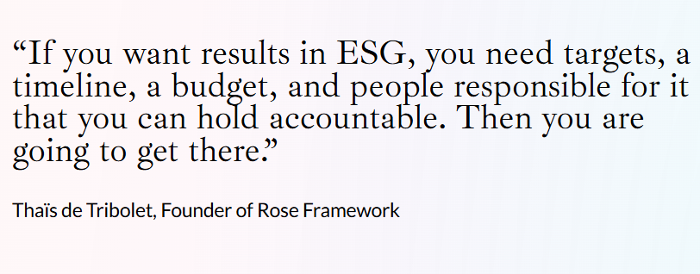
Factors that Affect Diversity
Research suggests that whether or not diversity has a positive or negative effect depends on different aspects of the organization’s strategies, culture, and human resource practices. This indicates that diversity may be beneficial under certain conditions and in certain organizations (Pugh, Dietz, Brief, & Wiley, 2008).
  Size of the organization
  Age of the organization
  Type of organization
  Diversity of the community surrounding an organization
Diversity Metrics
ESG stands for environmental, social, and governance.
These are called pillars in ESG frameworks and represent the 3 main topic areas companies are expected to report.
Diversity, Equity, and Inclusion (DEI) comprises the central 'S' in ESG.
There can be no successful ESG without a honed focus on DEI.

Slide 8
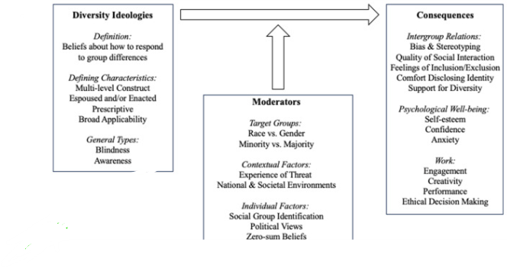
Diversity Theoretical Ideologies
Foundations and Forms
Shaping the Impact of Diversity Ideologies
(minimizing group differences)
(acknowledging and addressing group differences).
The framework highlights how diversity ideologies, moderators, and consequences interact, showing that their effectiveness varies with context, group dynamics, and individual perceptions. It helps predict both positive and negative outcomes of diversity initiatives.

Slide 9



Please download and install the Slido app on all computers you use
What are visible and nonvisible diversities?
ⓘ Start presenting to display the poll results on this slide.

Slide 10
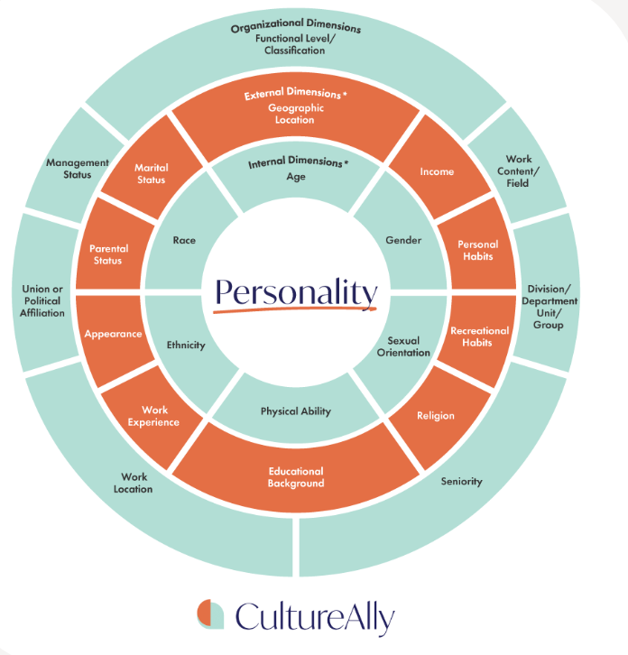
Dimensions of diversity
Primary Dimension:
Demographic Diversity
Traits you are born with, such as sex, ethnicity, race, etc. You will carry around these traits for the rest of your life.
Secondary Dimension:
Experiential Diversity
Based on life experiences that shape us; affinities, hobbies, and abilities.
Tertiary Dimension:
Cognitive Diversity
How we approach problems and think about the world.

Slide 11
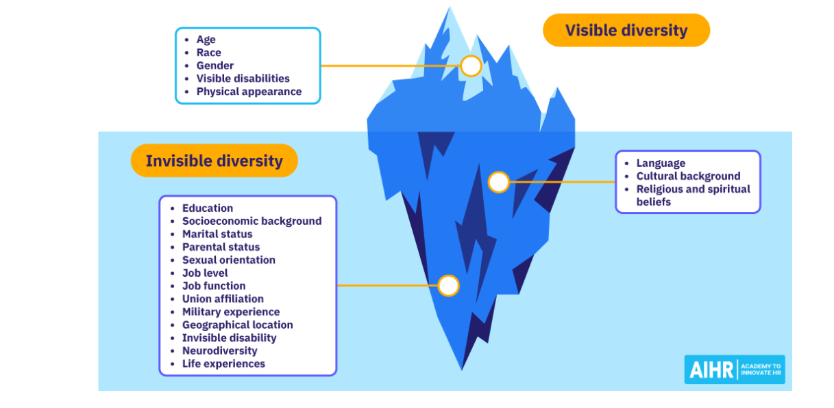
Types of workplace diversity
https://www.youtube.com/watch?v=AR6y-LEHrwU&t=36s

Slide 12

Please download and install the Slido app on all computers you use
What are the key types of diversity in the workplace ?
ⓘ Start presenting to display the poll results on this slide.

Slide 13
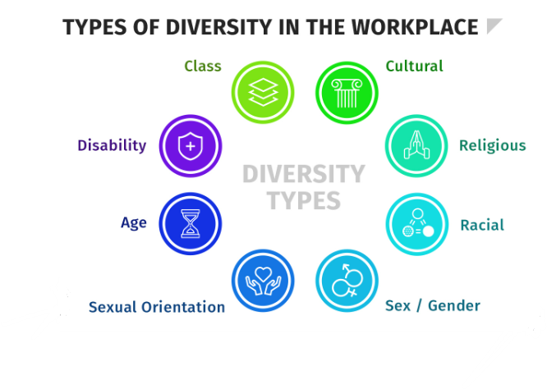

Slide 14
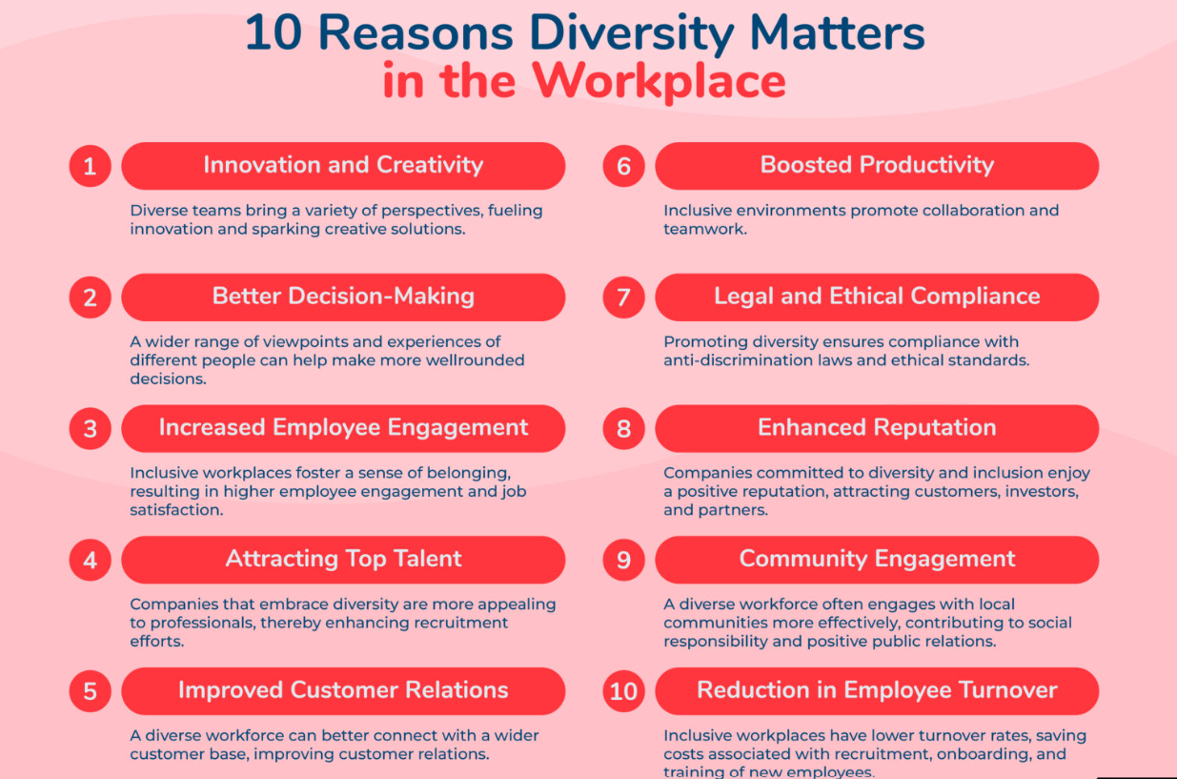

Slide 15
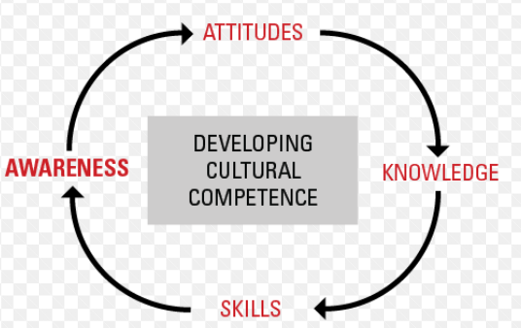
Cultural competence
Cultural competence is understanding, communicating with, and effectively interacting with people across cultures. An awareness of one’s cultural worldview, the capacity to recognize and appreciate cultural differences, and the skills necessary to navigate diverse cultural contexts (Oxford Review, n.d.).
Cultural competence comprises four components:
Awareness of one's cultural worldview
Attitude towards cultural differences
Knowledge of different cultural practices and worldviews
Cross-cultural skills
Acquiring Cultural Competence
Starts with Awareness
Grows with Knowledge
Enhanced with Specific Skills
Polished through Cross-Cultural Encounters

Slide 16

Diversity Branding Definition
Authentic branding reflects an organization’s commitment to diversity, aiming to attract diverse talent while addressing internal biases.
Companies leveraging authentic diversity branding experience a 15% increase in applicant diversity​
Misaligned branding statements can backfire, undermining efforts if not supported by genuine practices​(Diversity Branding Stra…).
https://www.youtube.com/watch?v=h2YTEbPIBck
Company | Metric | Before Implementation | After Implementation | Source
Pfizer | Employee Engagement (%) | 78% | 85% | Pfizer DEI Case Study
Google | Representation of Women in Tech Roles (%) | 20% | 25% | Google Diversity Annual Report
Microsoft | Representation of Women in Global Workforce (%) | 29% | 30% | CultureAlly Blog

Slide 17
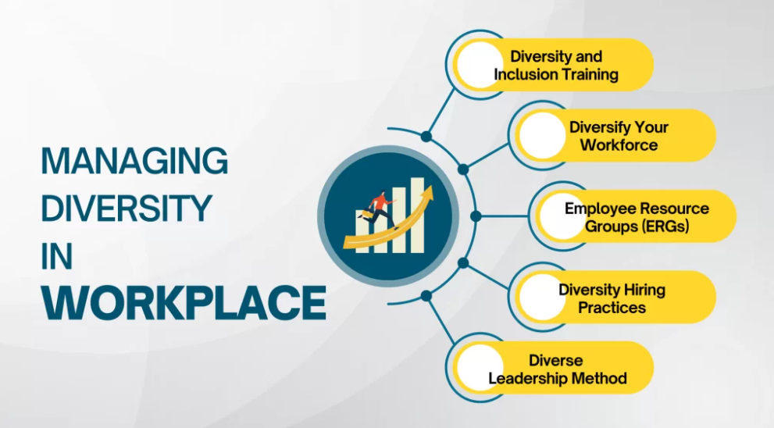
Managing diversity involves planning and implementing organizational systems and practices to maximize diversity’s potential advantages while minimizing its potential disadvantages.
Inclusive workplace culture such as online modules, workshops, or coaching, focusing on unconscious bias, cultural awareness, and effective communication.
For example, Google offers a program called “Unconscious Bias” that teaches employees how to recognize and overcome their biases and create a more inclusive work environment. The training has been credited with helping to increase diversity in the company’s workforce.
Flexible Diversity Solutions: Use hybrid models and tools like EmpMonitor to boost productivity, collaboration, and security.
Employee Resource Groups foster community, support, and advocacy for diverse employees, driving personal growth and workplace inclusion.
Boost Inclusion with Diverse Hiring: Attract talent through blind hiring, bias training, and inclusive job ads to build a diverse workforce. Inclusive Hiring & Policies: Target diverse talent and offer flexible schedules to drive innovation and growth.
Drive Innovation with Diverse Leadership: Inclusive leaders bring fresh perspectives, better decisions, and a culture of openness. For example, Johnson & Johnson has implemented a program called “Leading Inclusively,” which trains leaders to be more aware of unconscious bias and to create a more inclusive work environment. The program has helped to increase diversity in the company’s leadership ranks.

Slide 18
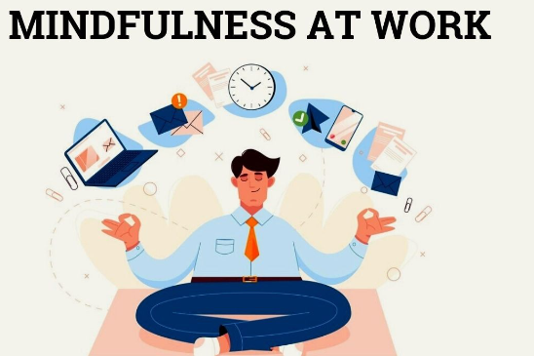
Mindfulness Practices to Support DEI
Mindful Listening Definition:
Giving full, undivided attention to the speaker without preconceived judgments or distractions, fosters mutual respect and understanding in workplace conversations (Passmore, 2019).
"65% of employees who engage in regular mindfulness practices report improved inclusivity within their teams" (Passmore, 2019).
Improves communication by reducing defensive behaviors.
Enhances empathy, creating a more inclusive workplace.
Google uses mindful listening exercises in team meetings, resulting in better collaboration and reduced conflicts.
Perspective-Taking:
Encourages employees to empathize with others by imagining themselves in others’ shoes, often through role-playing activities (Onyeador et al., 2024).
Increases cultural competence.
Promotes intergroup understanding, reducing biases.
Microsoft employs role-playing scenarios in DEI training to improve cultural navigation and inclusivity.
Mindfulness-Based Programs: Mindfulness exercises, like meditation, reduce workplace stress, enhance emotional regulation, and promote psychological safety (Passmore, 2019).
Teams practicing mindfulness report a 40% reduction in stress and better collaboration.
Increases productivity by enhancing focus and reducing absenteeism by 20%.
LinkedIn’s weekly mindfulness sessions led to a 15% rise in employee satisfaction and reduced burnout.

Slide 19
Levers for change
Commit to a systematic, purpose-led approach to benefit all stakeholders
Purpose Drives Success: Mission-led strategies enhance satisfaction, community, and financial performance.
DEI Unlocks Impact: Diverse leadership and initiatives boost productivity and community ties.
ESG Powers Growth: Inclusive practices align with stakeholder expectations and fuel results.
Embed your strategy in companywide business initiatives while tailoring to local context
Leadership with Local Focus: Top leadership drives DEI, empowering local teams to adapt strategies to their contexts.
Global Values, Local Action: Open communication ensures DEI moves from ideals to impactful, tailored actions.
Employee Networks Drive DEI: Global networks guide strategy; local groups implement and refine it.
Prioritize belonging and inclusive practices to unlock performance
Inclusion Boosts Belonging: Empowering employees improves satisfaction and retention, especially for underrepresented groups.
Culture Over Quotas: Inclusive cultures build trust, authenticity, and better team performance.
Belonging Powers Success: Companies fostering belonging outperform peers and build
Embolden and activate champions and allies by providing adequate resources and support
Women Leaders Face Bias: Women, especially women of color, encounter microaggressions and burnout despite driving DEI and workplace inclusion.
Recognize DEI Work: Integrate DEI contributions into reviews, mentor champions, and provide leadership training.
Allyship Unlocks Potential: Embedding allyship ensures diverse voices are valued and impactful.
Act on feedback, including dissenting voices
Embrace Feedback: Use workforce and stakeholder input to refine DEI strategies and foster inclusivity.
Educate for Alignment: Address criticism with education on DEI benefits and bias risks.
Stay Agile: Empower local teams to adapt and refine policies through open dialogue.

Slide 20
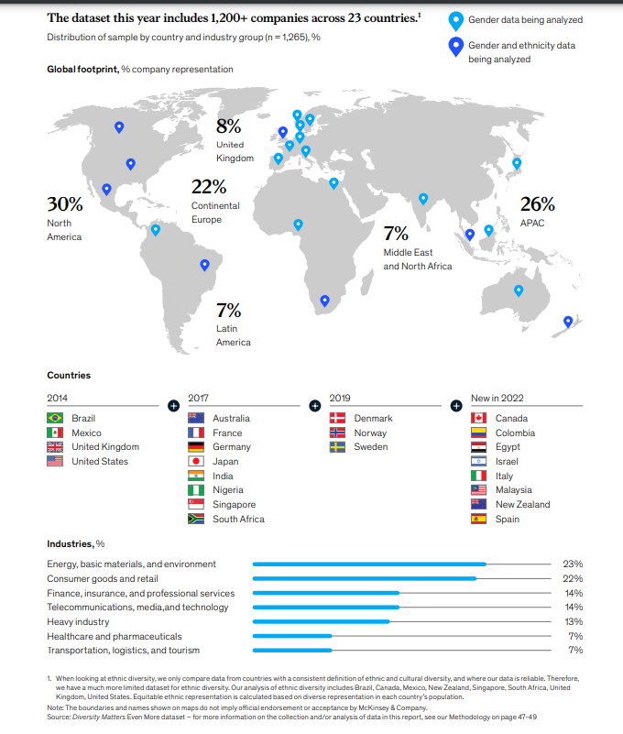
Measurements ( Mckinsey)
The dataset expanded from 4 countries in 2014 to 23 in 2022, adding regions like Canada, Egypt, and Malaysia, showcasing a major leap in global diversity inclusion.
Gender Diversity: Well-represented across all 23 countries in the dataset.
Ethnic Diversity: Limited to a few countries like Brazil, Canada, South Africa, and the U.S.
Regional Gaps: Largely unavailable in APAC (26% of companies) and MENA (7%), creating significant disparities.
Strong gender data contrasts with gaps in ethnic diversity, especially in Asia-Pacific and MENA, hindering a full global diversity assessment.
Industry Representation:
Industries like Energy (23%) and Consumer Goods (22%) show strong diversity focus, while Healthcare (7%) and Transportation (7%) lag, highlighting uneven diversity efforts across sectors.

Slide 21
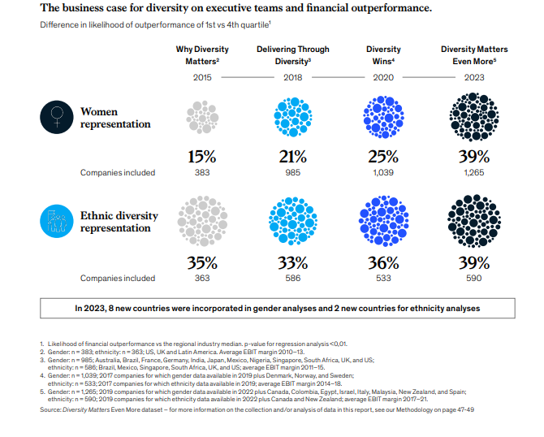

Slide 22
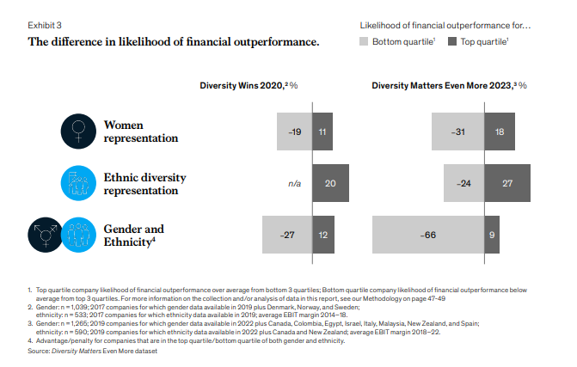

Slide 23

THANK YOU FOR YOU TIME AND ATTENTION
Questions ??

