Slide 1

Organizational Behavior
AI and Automation
(STARA)
Smart Technology, Artificial Intelligence, Robotics, and Algorithms (STARA):
Employees’ perceptions of our future workplace “ Extent to which their jobs could be replaced
Prof David Brougham And Jarrod Haar
Nathalie Houtzamer, MBL, Mcom 26 Nov 2024

Slide 2

- Introduction
- Evolution: Industries
- Leadership in the world of AI
- STARA
- Ethics
- Summary
AGENDA

Slide 3

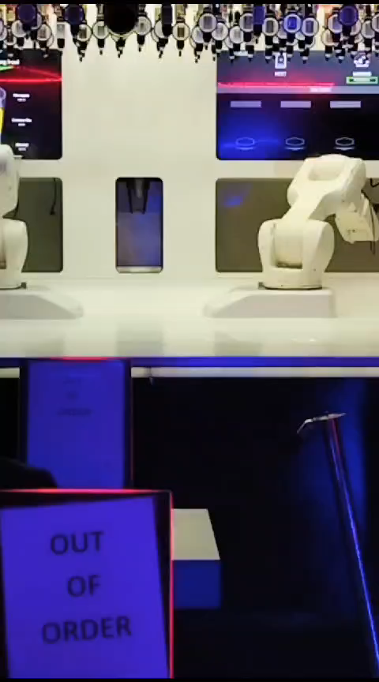
Notes:
Prague Visit, Interesting find
- Is this AI ?? What sort ?

Slide 4

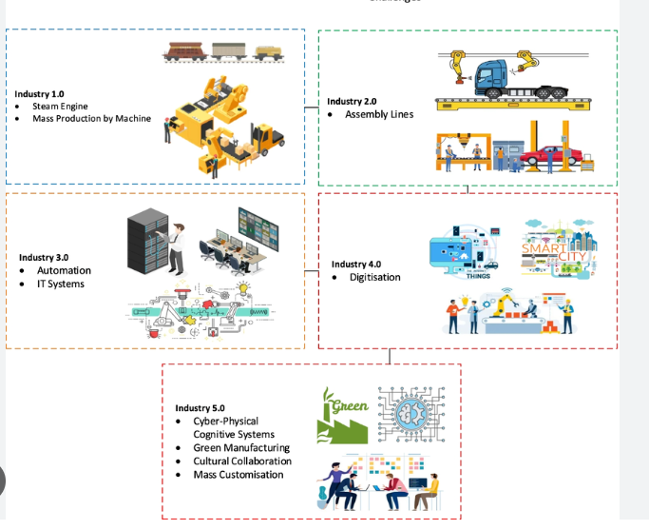
THE INDUSTRIAL EVOLUTION
BABY BOOMERS
Pursues Education
Comfortable wit h technology
Technology is important
EMPLOYEE
Veterans
authority with experience
Valuing workplace visibility
Intro to technology
Leadership Styles ??
Gen Y
Ethics and values
Side hustles
Technology is essential
EMPLOYEE GEN X
Innovators
Values Flexibility
Google
Technology is very important
Alpha
Tech-savvy digital natives.
Social impact initiatives.
Futuristic
Industry 6.0
Gen Z
Personalized work
Hybrid/Remote
Side hustles
Technology is my life
Notes:
EVOLUTION
WAY WE WORK
PEOPLE

Slide 5



Please download and install the Slido app on all computers you use
Do you think technology will increase the number of jobs in the future ?
ⓘ Start presenting to display the audience questions on this slide.

Slide 6

Please download and install the Slido app on all computers you use
By what % do you think jobs may increase by 2025?
ⓘ Start presenting to display the poll results on this slide.

Slide 7
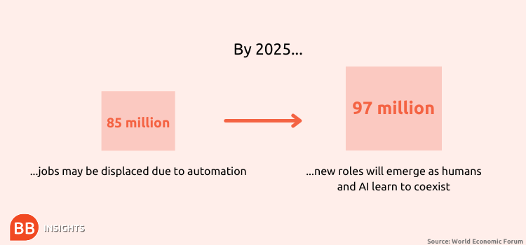
FUTURE ANTICIPATION
The World Economic Forum estimates that by 2025, technology will create at least 12 million more jobs than it destroys.
AI’S CHALLENGE: GET USERS TO ADAPT AND ADOPT
  IT industry analysts concur that AI technology will cause strong growth over the next three years.
  Growth will hinge on the ability of sectors to overcome technical, commercial, and regulatory challenges.
DO YOU
AGREE?
Or
Notes:
MGI-Artificial-Intelligence-Discussion-paper.ashx (mckinsey.com)
What Are The Problems Of Artificial Intelligence In Business? (businessbecause.com)
Most of the firms surveyed (McKinsey Global Institute) expected to increase spending on AI in the coming three years, a finding echoed in other recent surveys. For example, 75 percent of the 203 executives queried in an Economist Intelligence Unit survey said AI would be “actively implemented” in their firms within three years (3 percent said it had already happened)

Slide 8

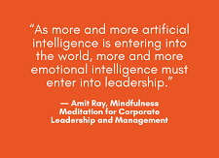
WHAT IS GOING TO BE YOUR LEADERSHIP ATTITUDE TO DEAL WITH STARA?

Slide 9
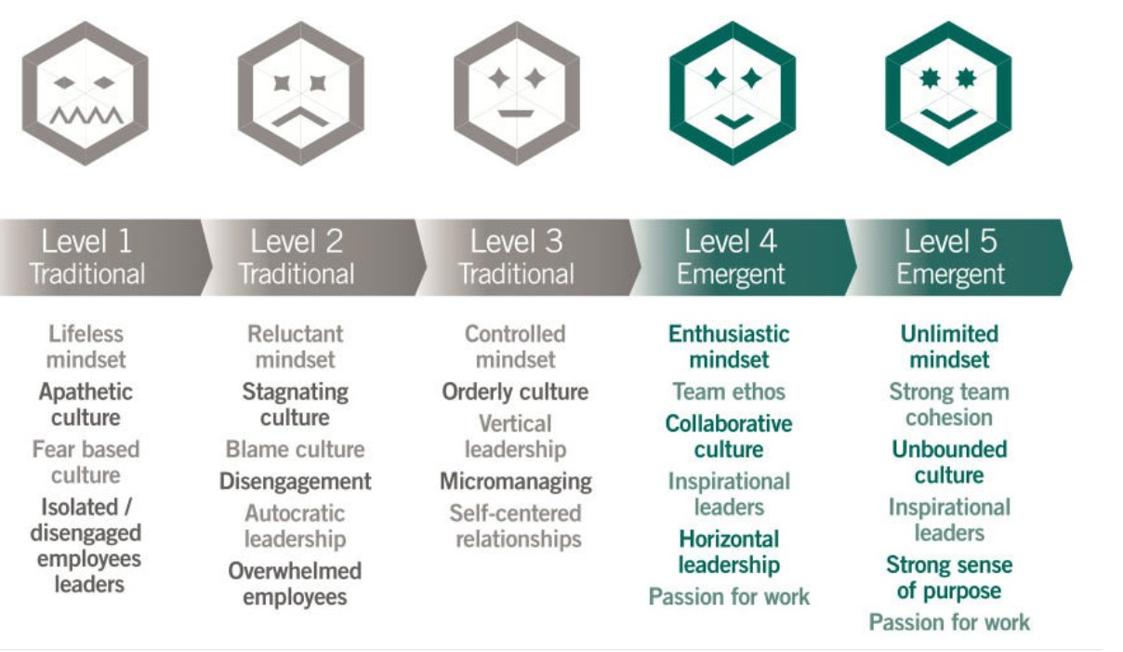
LEADERSHIP IN TRANSITION
https://www.youtube.com/watch?v=a1lzlO94PGc
Notes:
WHAT LEADERSHIP STYLES DO YOU THIMK IS REQUIRED FOR INDUSTRY 4 and BEYOND ????????????

Slide 10
LEADERSHIP ATTITUDE
Forbes, 2023
Nick Wilton, 2016
Behaviour | Attitude | Behaviour | Attitude
Adaptability | Willingness to change | Communication | Communication, collaboration, negotiation, facilitation, social influence and active listening.
Intuitive | Taking on challenges | Growth mindset | Unlearn to relearn, be curious
Resilience | Ability to bounce back | Adaptiveness | Becoming agile through change
Self-motivation | Personal drive to achieve goal | Emotional Intelligence | Self-awareness to aid in inspiring others
Teamwork | Collaboration | Abundance Mindset | Abundance mindset instead of a scarcity mindset allows us to reframe uncomfortable situations into opportunities.
Continuous learning | Ongoing personal & professional Development | Domain Expertise | Understand the latest technological developments
Professionalism | Integrity & ethical behavior | AI Skills | Learning how to leverage AI
Problem Solving | Approach challenges with a solution | Analytical Skills | Systems thinking ability and the associated mindset, 360-degree thinking.
Networking | Building and maintaining relationships | Creativity | See all perspectives
 |  | Risk Awareness | Understanding the risk of technology
Industry 4.0
Industry 5.0
Notes:
10 Characteristics Business Leaders Will Need In The Age Of AI (forbes.com)

Slide 11
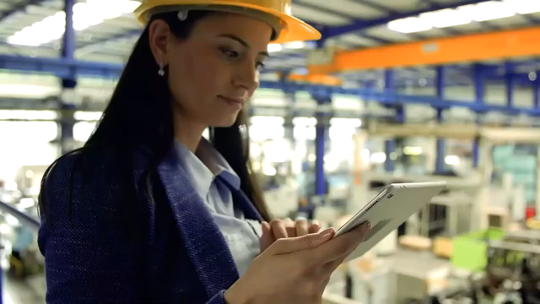

Slide 12
S T A R A.
Smart Technology
Artificial Intelligence.
Robotics
Algorithms
Smart Technology, Artificial Intelligence, Robotics, and Algorithms (STARA):
Employees’ perceptions of our future workplace “ Extent to which their jobs could be replaced
Prof David Brougham And Jarrod Haar
Notes:
WHY :Greater productivity – productivity can soar without people and resources bogged down in routine tasks. According to the Nielsen Norman Group, generative AI systems improve employee productivity by 66%.
Increased efficiency – AI can carry out some routine tasks faster and more efficiently than humans. And of course, unlike human employees, AI-driven services are available 24/7 to monitor for fraud, answer customer queries and scan job applications, saving time and resources. * Solving complex problems – advances in machine learning mean AI can now be put to work on more complex tasks – medical diagnosis, for example, again freeing up resources and increasing productivity. Innovation – From AI-generated ideas in brainstorming sessions, interaction in virtual spaces in the Metaverse, and using AI in the supply chain to understand what consumers want (and then make relevant product decisions), AI is helping organizations innovate to succeed.

Slide 13
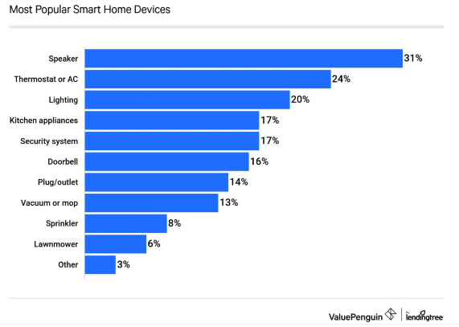
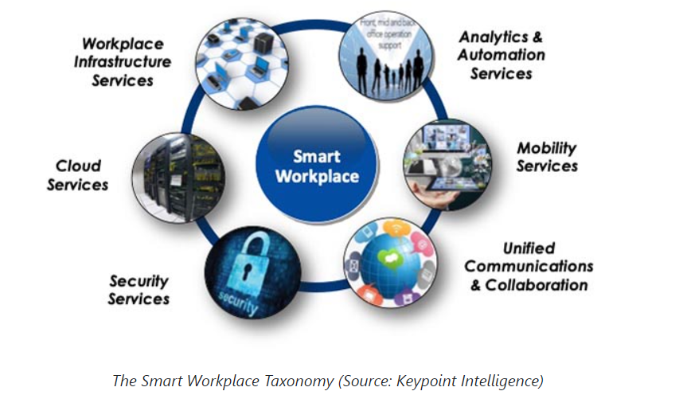
SMART TECHNOLOGY
The integration of computing and telecommunication technology and the ability to communicate and work with other networked technologies
“Smart tech” is advanced digital technologies that make decisions for people and instead of people.
Includes machine learning, natural language processing, smart forms, chatbots, robots, and more.
Its use is skyrocketing and embedded in every functional area from HR to communications, accounting, and service delivery.
Organisations
Society
Office Products
The Artome M10
The Ashton Bentley Complete Room
The Igloo Vision Immersive Workspace
1. Conserve Energy.
2. Convenience At Various Levels.
3. Unprecedented Level Of Security.
5. Saves time and money.
Create new time that can be used to re-humanize work and workplaces.
Notes:
‘Smart’ technology refers to the integration of computing and telecommunication technology into other technologies that did not previously have such capabilities. What makes a technology ‘smart’ is its ability to communicate and work with other networked technologies, and through this ability to allow automated or adaptive functionality as well as remote accessibility or operation from anywhere.
1. Conserve Energy.
Smart technology helps by automating home energy usage. Homeowners have the added benefit of being able to turn appliances on or off while they are away from home. This not only saves money, but also helps protect the environment.
2. Offers Convenience At Various Levels.
Smart technology can make it possible for you to accomplish several tasks with just a few clicks, often without the need to even move. You can adjust the temperature or dim the lighting in the room, control the music levels, lock all the doors and close the garage with just a few clicks.
3. Offers An Unprecedented Level Of Security.
Smart technology is far more effective at preventing intrusions as compared to manually operated security systems. Smart home security systems warn homeowners of potential threats inside the home or on their property. Some even text or phone homeowners to alert them about break-ins while the police or external security company are also being informed.
4. Offers Peace of Mind to Vulnerable people and their caregivers.
From medication monitoring, tracking calorie intake to calling the emergency services in times of distress, smart technology helps vulnerable people in numerous ways. Being able to control their settings helps them live more independent lives while the many monitoring functionalities
5. Saves money.
Smart technology draws on developments in ML (Machine learning) /DL (Deep learning) processes and can be used within the employment relationship
to (1) assist and support organizations in directing employees’ attention,
motivating or encouraging them to act in desirable ways and (2) enable new ways of doing so, that have not been possible in the analogue world (Cardinal et al., 2010; Schafheitle et al., 2020).
The Artome M10 plug-and-play furniture comprises a projector, speakers, and mic for remote integration at larger presentations. The wheeled unit functions via HDMI or wirelessly.
The Ashton Bentley Complete Room Systems for Google Meet Series One includes three configurations of screen wrapping for the workplace: small, medium, or large. The single or dual-screen configuration can be managed from a laptop or tablet and includes connectivity ports if Wi-Fi is not available. Additional options to install ports and connectivity to a company’s tables keep everything streamlined and clutter-free.
The Igloo Vision Immersive Workspace uses VR to turn walls into immersive digital workspaces, allowing teams to engage with their digital content in a new way. The walls create a square (or other geometric shape) of 360° projector screens. They can be divided into several screens or used as one big screen that is controlled by a phone or keyboard.
The Logitech Scribe is a whiteboard camera that provides virtual whiteboarding in every room no matter the size. It works with any surface and scribers. An image segmentation feature works like virtual sticky notes, making it possible to move various screens in multiple sizes around the whiteboard.

Slide 14
THE IMPORTANCE “WORK”
1. Smart Technology: A Leadership Imperative
Smart tech adoption is not merely a technological challenge; it is a leadership imperative that requires strategic implementation to re-humanize workplaces.
2. Key Benefits and Applications
Directing Employee Attention:
  Use data-driven tools to guide focus and encourage desirable actions.
  Example: Automating repetitive tasks to free time for problem-solving and relationship-building.
Motivating and Supporting Employees:
  Enable tools like online chatbots:
    Advantages: Cost-effective, 24/7 availability.
    Empowers frontline staff to focus on empathy, problem-solving, and inspiring loyalty.
Enhancing Workflow:
  Smart tools improve efficiency and effectiveness:
    Metrics: Meeting analytics help identify productive discussions.
    Inclusivity: Automated captioning and translation tools make meetings more accessible.
Improving Physical and Mental Health:
  Monitor environmental and behavioral risks to promote well-being.
  Encourage work-life boundaries through reminders for screen breaks, movement, and stretching.
  Foster healthier habits to reduce burnout.
3. The Human-Centric Approach
Leverage the time saved by automation for activities that only humans can do:
  Building relationships.
  Sharing stories.
  Solving complex problems.
4. Strategic Implementation:
  Smart tech can only reduce burnout and re-humanize workplaces if implemented thoughtfully and intentionally.
  Leadership must focus on aligning tools with organizational culture and employee needs.
Smart technology, when strategically deployed, can transform workplaces into more human-centric, efficient, and sustainable environments. Leaders must prioritize thoughtful adoption to maximize its potential.
Notes:
1. Conserve Energy.
Smart technology helps by automating home energy usage. Homeowners have the added benefit of being able to turn appliances on or off while they are away from home. This not only saves money, but also helps protect the environment.
2. Offers Convenience At Various Levels.
Smart technology can make it possible for you to accomplish several tasks with just a few clicks, often without the need to even move. You can adjust the temperature or dim the lighting in the room, control the music levels, lock all the doors and close the garage with just a few clicks.
3. Offers An Unprecedented Level Of Security.
Smart technology is far more effective at preventing intrusions as compared to manually operated security systems. Smart home security systems warn homeowners of potential threats inside the home or on their property. Some even text or phone homeowners to alert them about break-ins while the police or external security company are also being informed.
4. Offers Peace of Mind to Vulnerable people and their caregivers.
From medication monitoring, tracking calorie intake to calling the emergency services in times of distress, smart technology helps vulnerable people in numerous ways. Being able to control their settings helps them live more independent lives while the many monitoring functionalities
5. Saves money.

Slide 15
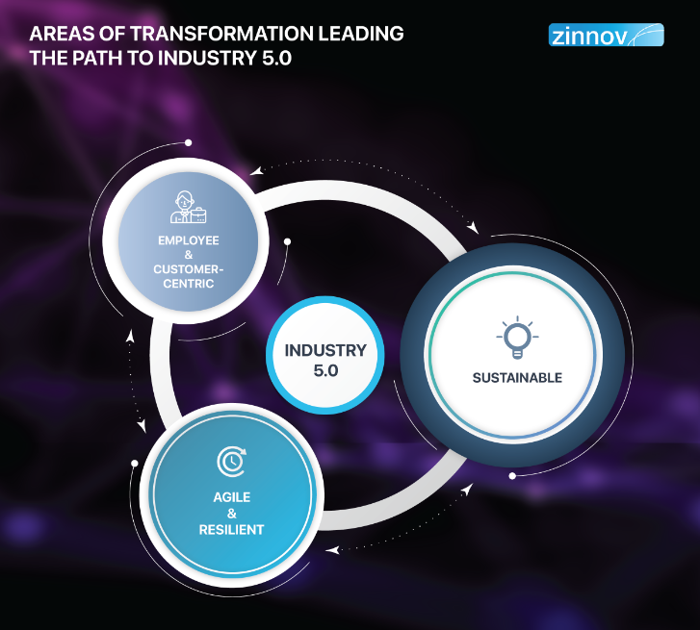
SMART TECHNOLOGY
Introduction to Industry 5.0:
Focuses on integrating advanced technology with human-centric values.
Complements Industry 4.0 by prioritizing sustainability, agility, and human collaboration.
1. Key Transformation Areas:
Employee & Customer-Centric: Shift towards personalized experiences for both employees and customers.
Enhances human-machine collaboration and builds trust-driven ecosystems.
2. Agile & Resilient:
Systems designed to adapt to rapid changes and disruptions.
Emphasis on robust processes for quick recovery and sustained growth.
3. Sustainability:
Embedding environmental consciousness into operations.
Focus on reducing carbon footprints and promoting circular economies.
4. Interconnection of Elements:
These three areas are interdependent and cyclical, feeding into each other to create a continuous loop of improvement for Industry 5.0.
The ultimate goal is holistic growth that combines technological advancements, human-centric approaches, and environmental responsibility.
Industry 5.0 redefines the industrial landscape by ensuring that innovation aligns with human values and planetary needs while fostering adaptability and resilience.
Notes:
‘Smart’ technology refers to the integration of computing and telecommunication technology into other technologies that did not previously have such capabilities. What makes a technology ‘smart’ is its ability to communicate and work with other networked technologies, and through this ability to allow automated or adaptive functionality as well as remote accessibility or operation from anywhere.
1. Conserve Energy.
Smart technology helps by automating home energy usage. Homeowners have the added benefit of being able to turn appliances on or off while they are away from home. This not only saves money, but also helps protect the environment.
2. Offers Convenience At Various Levels.
Smart technology can make it possible for you to accomplish several tasks with just a few clicks, often without the need to even move. You can adjust the temperature or dim the lighting in the room, control the music levels, lock all the doors and close the garage with just a few clicks.
3. Offers An Unprecedented Level Of Security.
Smart technology is far more effective at preventing intrusions as compared to manually operated security systems. Smart home security systems warn homeowners of potential threats inside the home or on their property. Some even text or phone homeowners to alert them about break-ins while the police or external security company are also being informed.
4. Offers Peace of Mind to Vulnerable people and their caregivers.
From medication monitoring, tracking calorie intake to calling the emergency services in times of distress, smart technology helps vulnerable people in numerous ways. Being able to control their settings helps them live more independent lives while the many monitoring functionalities
5. Saves money.
Smart technology draws on developments in ML (Machine learning) /DL (Deep learning) processes and can be used within the employment relationship
to (1) assist and support organizations in directing employees’ attention,
motivating or encouraging them to act in desirable ways and (2) enable new ways of doing so, that have not been possible in the analogue world (Cardinal et al., 2010; Schafheitle et al., 2020).
The Artome M10 plug-and-play furniture comprises a projector, speakers, and mic for remote integration at larger presentations. The wheeled unit functions via HDMI or wirelessly.
The Ashton Bentley Complete Room Systems for Google Meet Series One includes three configurations of screen wrapping for the workplace: small, medium, or large. The single or dual-screen configuration can be managed from a laptop or tablet and includes connectivity ports if Wi-Fi is not available. Additional options to install ports and connectivity to a company’s tables keep everything streamlined and clutter-free.
The Igloo Vision Immersive Workspace uses VR to turn walls into immersive digital workspaces, allowing teams to engage with their digital content in a new way. The walls create a square (or other geometric shape) of 360° projector screens. They can be divided into several screens or used as one big screen that is controlled by a phone or keyboard.
The Logitech Scribe is a whiteboard camera that provides virtual whiteboarding in every room no matter the size. It works with any surface and scribers. An image segmentation feature works like virtual sticky notes, making it possible to move various screens in multiple sizes around the whiteboard.

Slide 16
S T A R A.
.
Artificial Intelligence
.

Slide 17
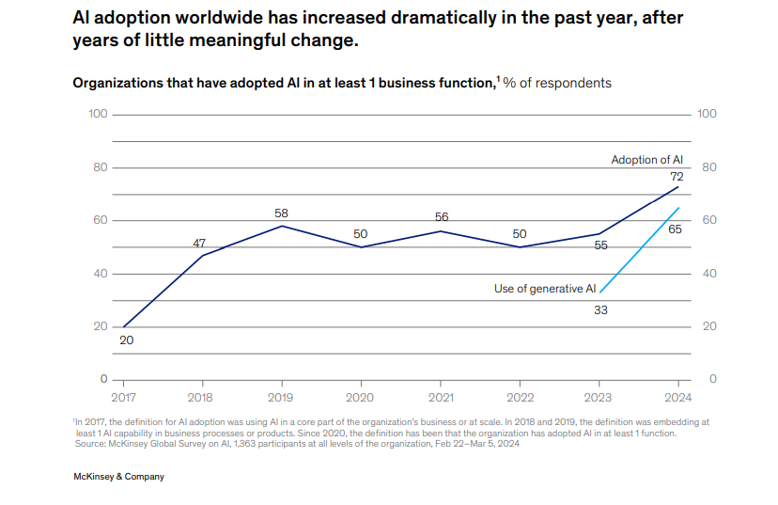
ARTIFICIAL INTELLIGENCE
What is AI?
  AI refers to the simulation of human intelligence in machines that are programmed to think and learn.
  Includes systems capable of decision-making, learning, visual recognition, language understanding, and more.
Why does AI matter?
  Automates repetitive tasks, improving productivity.
  Enhances decision-making with data insights.
  Drives innovation across industries (e.g., finance, healthcare, HR).
The global increase in AI adoption across organizations, highlighting a leap from 50% in 2022 to 72% in 2024
AI adoption
Notes:
"Artificial Intelligence and its Impact on Organizational Behavior: A Theoretical Framework for Change" by Dr. Ivan Del Valle (linkedin.com)

Slide 18
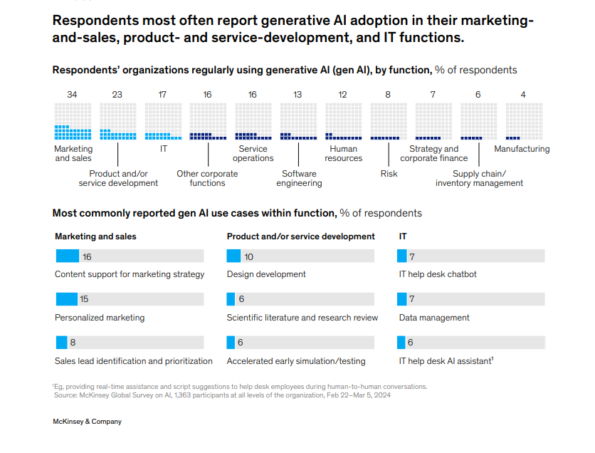
AI’s Impact on the Workplace
Value Creation:
  AI reduces costs in HR by automating recruitment and employee engagement processes.
  Improves accuracy in decision-making, reducing errors in customer interactions.
Applications of AI:
  HR: AI-driven recruitment, workforce optimization, and employee sentiment analysis.
  Sales: Personalized marketing and lead prioritization.
  Operations: Automating workflows, workload distribution, and predictive maintenance.
Generative AI Use by Function in 2024:
  Highlight most-used functions like marketing & sales (34%),

Slide 19



AI IMPLEMENTATION
AI can solve users, customers, and world problems (Dean, 2019).
  Google manages information worldwide, making data beneficial and easily accessible.
  Amazon and Walmart have begun to utilize drones for shipping (Agarwal, 2018).
AI in employee selection processes through software that can filter candidates.
  Real-time communication can be carried out so that when a candidate is rejected, they can immediately find out and seek other job opportunities (Upadhyay & Khandelwal, 2018).
AI is optimizing the healthcare space
  In USA, AI is widely used in the health sector to detect cancer and heart disease (Ho, 2018).
AI in IT
  Of 112 companies in Indonesia that work in IT businesses, 14% have used AI.
  e.g, AI has become the core business strategy for Tokopedia, Go-Jek, and Grab.

Slide 20

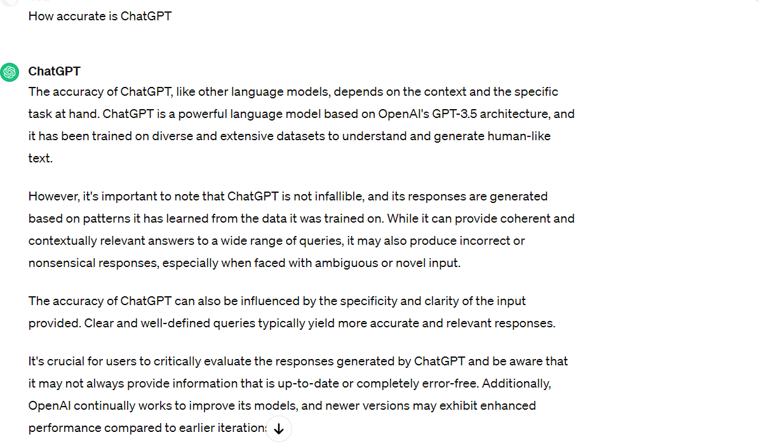
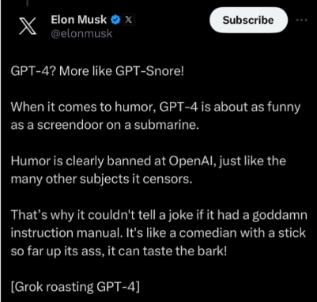

Be Mindful
CHALLENGES OF AI DATA:
One of the main issues with generative AI relates to privacy concerns around data and questions of ownership of information. McKinsey Global Institute (2017) said
“With generative AI tools such as Dall-E, these sometimes don’t provide references to the original data or source. This is where copyright infringement could be a potential risk,”
Notes:
MGI-Artificial-Intelligence-Discussion-paper.ashx (mckinsey.com)
What Are The Problems Of Artificial Intelligence In Business? (businessbecause.com)

Slide 21

FUTURE ANTICIPATION
Regulation of artificial intelligence:
Notes:
MGI-Artificial-Intelligence-Discussion-paper.ashx (mckinsey.com)
What Are The Problems Of Artificial Intelligence In Business? (businessbecause.com)

Slide 22
S T A R A.
.
Robotics
.

Slide 23

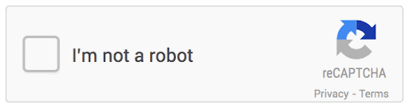
ROBOTICS
Types:
Preprogrammed robots
Autonomous robots
Tele-operated robots
Augmenting” robots
I’m not a robot,” you are giving Google permission to analyze your online behavior to determine if you are a human “??
Notes:
Types:
Preprogrammed robots, such as the robots employed in the assembly halls of car manufacturers designed to perform well-described tasks in well-defined and controlled environments.
Tele-operated robots that are under continuous control of human operators at a distance. Paradigmatic examples are drones, robotic submarines, and surgery robots.
Autonomous robots are able to sense their environment and act with purpose, such as delivery robots in hospitals that distribute and register patient’s medicines.
A further category of robots is “augmenting” robots, which are connected or integrated with the human body. Examples are exoskeletons by means of which (partly) paralyzed persons can walk, or robotic legs or arms. Such robotic skeletons can also be used to enable workers—e.g., soldiers—to use heavy gear.
Have you ever tried to go to a website, but you were stopped beforehand in order to prove you are not a robot?
So how does the “I’m not a robot” CAPTCHA actually work?
It’s not actually the act of clicking “I’m not a robot” that confirms you’re not a bot. It’s what happens before you click it.
This information can be your cursor movement as you go to click that checkbox (apparently humans move their cursors with more randomness than a computer), your cookies and device history, according to Cloudflare.
Google uses that information to determine the probability that you are a human or a robot. Google then sends that score to the website, and if the score is high enough, you’ll be let into the site.
Simply put, by clicking “I’m not a robot,” you are giving Google permission to analyze your online behavior to determine if you are a human.

Slide 24
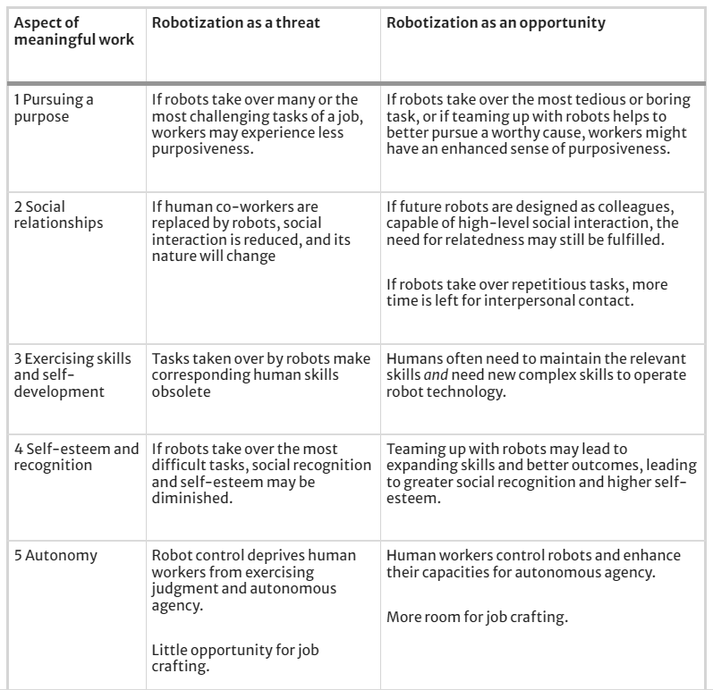
ROBOTS: Aspects of meaningful work
Smids, Nyholm & Berkers (2020) determined the contribution of robots in the workplace having in creating meaning .
Notes:
Robots in the Workplace: a Threat to—or Opportunity for—Meaningful Work? | Philosophy & Technology (springer.com)
In European countries such as in Germany, robotics is used to manage waste (Enway). Greece, robotics is used in agriculture for automatic indoor gardening, controlled via an app (CityCrop). In the United Kingdom, the Factmata company uses a combination of robotics and AI to prevent the spread of hoax news. In the social field, robotics is used to treat older people (Ho, 2018). Similar to Europe, robotics in Asia has also been applied in the health sector, such as for diagnosing diseases in China (Peredoc) and caring for older people in Japan (Softbank robotics). In Indonesia, robots are widely used in the automotive industry. For instance, at Mitsubishi, 40% of its activities utilize robots (Parwata, 2018).
Healthcare
Use of surgical robots – creating minimally invasive surgeries – faster recovery
A hospital that uses this technology is RS Bunda Jakarta (Prawira, 2014)
Manufacturing
Automating tasks, which increase efficiency
Decrease on the job accidents and injuries
Companies using robots:
ABB’s: wide range of industrial robots are able to perform tasks like arc and spot welding, material-handling functions like sorting and packaging, and quality control | Mitsubishi Electric: Robots are used for assembly, machine-tending and tray-handling applications, providing solutions for packing, palletizing, tending, assembling, handling or processing.

Slide 25

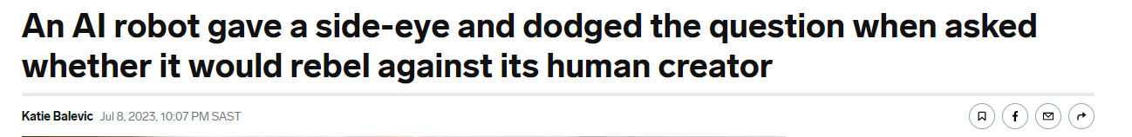
FUTURE ANTICIPATION
Business Insider reported:
  A robot-human press conference took place in Geneva, where humanoids took questions from reporters.
  One bot, Ameca, had a snarky response when asked whether it would rebel against its human creator.
    "I'm not sure why you would think that," Ameca said after casting a pointed, sideways glance. "My creator has been nothing but kind to me, and I am very happy with my current situation."
  Another bot insisted that it would not replace human jobs
Notes:
AI Robot Gave a Side-Eye When Asked If It Would Rebel Against Humans (businessinsider.com)
Business Insider reported:
A robot-human press conference took place in Geneva, where humanoids took questions from reporters.
One bot, Ameca, had a snarky response when asked whether it would rebel against its human creator.
"I'm not sure why you would think that," Ameca said after casting a pointed, sideways glance. "My creator has been nothing but kind to me, and I am very happy with my current situation."
Another bot insisted that it would not replace human jobs
Challenges
-There is a lot of paranoia surrounding the increasing power and capacity of robots Media scare reports insinuate robots will soon take great swathes of today’s careers, especially in industries that already use advanced automation. Undoubtedly, there is some justification for the anxiety. In 2014, robot sales across the world increased by 29% to 229,261 units in comparison to the previous year. In most cases, robots allow humans to be withdrawn from monotonous, challenging or dangerous tasks
Robots have begun entering many workplaces: from order-picking robots in warehouses to delivery robots on university campuses and to bomb disposal robots working alongside teams of soldiers (Royakkers and van Est 2015).
With respect to work in general, the fear for technological unemployment as a result of robots replacing human workers has received significant attention (Brynjolfsson and McAfee 2016; Ford 2016).

Slide 26
S T A R A.
.
Algorithms.

Slide 27
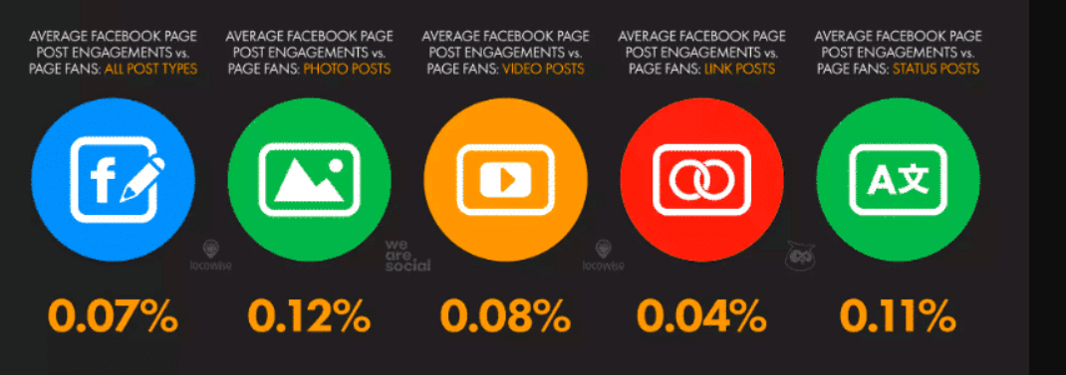
THE KNOWN (WHAT)
Algorithms at work —“precise recipes that specify the exact sequence of steps required to solve a problem”—to augment and automate a variety of (MacCormick, 2012, p. 2). organizing, enabling organizations to process the “vast, fast, disparate, and digital” data produced in contemporary social and organizational life (Brayne, 2017, p. 980). The organization of services to ‘citizen’ and ‘customer,’ and the myriad of ‘clicks’ that regulate our daily lives, are all inspired by algorithmic models” (Totaro & Ninno, 2014, p. 30).
Notes:
Organizations use algorithms—“precise recipes that specify the exact sequence of steps required to solve a problem”—to augment and automate a variety of organizational practices or routines ranging from recommending media content to automatically recognizing entities, assessing security risks, optimizing logistical efficiency, or evaluating the desirability of individuals who are applying for credit or coming up for parole (MacCormick, 2012, p. 2).
Such algorithms are now fundamental features of contemporary organizing, enabling organizations to process the “vast, fast, disparate, and digital” data produced in contemporary social and organizational life (Brayne, 2017, p. 980).
The pervasive influence of algorithmic phenomena means that the “majority of manufacturing processes, the organization of services to ‘citizen’ and ‘customer,’ and the myriad of ‘clicks’ that regulate our daily lives, are all inspired by algorithmic models” (Totaro & Ninno, 2014, p. 30).
Organizations use algorithms—“precise recipes that specify the exact sequence of steps required to solve a problem”—to augment and automate a variety of (MacCormick, 2012, p. 2). organizing, enabling organizations to process the “vast, fast, disparate, and digital” data produced in contemporary social and organizational life (Brayne, 2017, p. 980).
The organization of services to ‘citizen’ and ‘customer,’ and the myriad of ‘clicks’ that regulate our daily lives, are all inspired by algorithmic models” (Totaro & Ninno, 2014, p. 30).
Almost everything that you do with a computer relies in some way on an algorithm that someone has worked very hard to figure out. Even the simplest application on a modern computer would not be possible without algorithms being utilized behind the scenes to manage memory and load data from the hard drive.
Scholars have highlighted the potential of algorithmic tools to provide organizations with:
Affordances that facilitate value creation by making better predictions (Mayer-Schönberger & Cukier, 2013)
Automating structured and repetitive work (Davenport, 2018; Steiner, 2012)
Reshaping organizational culture (Fountaine, McCarthy, & Saleh, 2019; Schildt, 2020), and
Improving the flow of ideas between distinct social domains (Pentland, 2014).
Algorithms are widely in use in areas such as human resource management (see Cheng & Hackett, 2021) and healthcare organizations (e.g., Challen et al., 2019).
The Biography of an Algorithm: Performing algorithmic technologies in organizations - Vern L. Glaser, Neil Pollock, Luciana D’Adderio, 2021 (sagepub.com)
Algorithms and Organizing | Human Communication Research | Oxford Academic (oup.com)

Slide 28
IMPLEMENTATION (HOW)
CHALLENGE 1: Biased data
The data collected are always biased regardless of the data collection method (human or computer) (for an overview, see Silva & Kenney, 2018).
e.g Employment advertisements for doctors, for example, are distributed using an algorithm that mainly directs them to male candidates, thus creating gender discrimination. The legacy reason is that, when an existing population of doctors is dominated by men, the algorithm learns that it gets more clicks or views when the advertisement is offered to men (Datta and Tschantz, 2015)
CHALLENGE 2: Unintentional lawsuits
HireView negatively impacted an individual with autism, due to its facial expression video interview algorithms.
CHALLENGE 4: Control
Algorithms sometimes already verge on being too difficult to understand even by experts, and the managerial echelon certainly does not have the skill to act as the experts’ countervailing power.
CHALLENGE 5: Decision-making
Algorithmic versus professional decision-making
Both can come with bias, lack of transparency, and value conflicts.
Organization should not rely solely on only one type of decision-making.
Notes:
CHALLNEGE 1: Biased data
The data collected are always biased regardless of the data collection method (human or computer) (for an overview, see Silva & Kenney, 2018).
Biased data cause algorithms to operate in a biased way.
The notion of bias highlights how the algorithm does not exist in a void but materializes through relations; in this case, the relation is with the data. Thus, it must be stated that the data bias materializes through the algorithm.
There are many famous big data-related examples of the effects of biased data on the outcomes of learning algorithms (e.g., Neff & Nagy, 2016).
In organizations, for example, racial or sexist issues in recruiting are not bypassed with algorithms even though being nonbiased has been one of these technologies’ big promises (Silva & Kenney, 2018).
EXAMPLE: Employment advertisements for doctors, for example, are distributed using an algorithm that mainly directs them to male candidates, thus creating gender discrimination. The legacy reason is that, when an existing population of doctors is dominated by men, the algorithm learns that it gets more clicks or views when the advertisement is offered to men (Datta and Tschantz, 2015)
CHALLNEGE 2: Unintentional lawsuits
HireView negatively impacted an individual with autism, due to it’s facial expression video interview algorithms.
CHALLNEGE 3: Values conflict
One example is the tension between accuracy and data privacy. The use of personal data can be important for the quality of algorithmic decision-making, but the collection and use of data are subject to sometimes strict conditions.
A trade-off must often be made between data privacy, on the one hand, and the goals of algorithmic decision-making on the other.
CHALLNEGE 4: Control
While transparency is a response to the challenges of AI use, control is about who is on pole position in the response. Developing and using algorithms require specialised knowledge and skills.
Data analysts can be seen as professionals who need discretionary freedom to fulfil their profession (Adams et al., 2020; Noordegraaf, 2020).
The question, thus, is then who controls them? In traditional, hierarchical thinking, control is in the hands of managers, but it is questionable whether this control is sufficient, as AI and algorithms are simply too complex for many managers to handle (De Bruijn, 2002; Okwir et al., 2018).
Algorithms sometimes already verge on being too difficult to understand even by experts, and the managerial echelon certainly does not have the skill to act as the experts’ countervailing power.
CHALLNEGE 5: Decision-making
Algorithmic versus professional decision-making. Data-based decision-making is often positioned against decisions made by experts, who rely heavily on their tacit knowledge and intuition. Both forms of decision-making – data-based and intuition-based – have their strengths and weaknesses. Both can come with bias, lack of transparency and value conflicts.
Consequently, organizations should not rely solely on only one type of decision-making.
On humans, algorithms and data | Emerald Insight

Slide 29
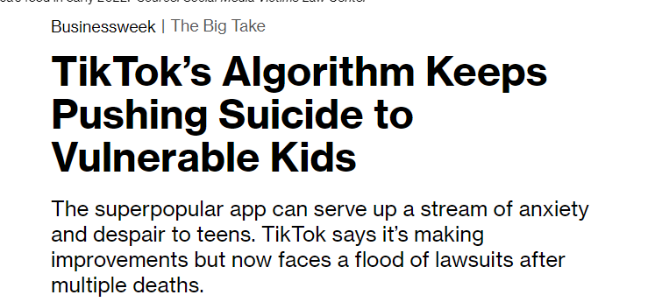

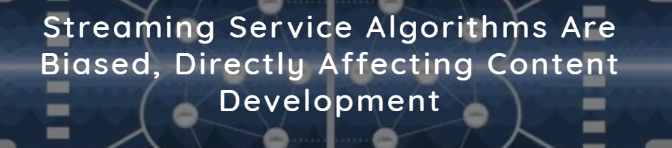
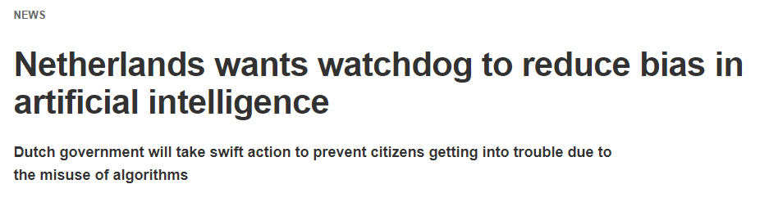
FUTURE ANTICIPATION
Education
  Alogrithms can personalise the learning experience using student data, test scores and learning style
Notes:
TikTok’s Algorithm Keeps Pushing Suicide to Vulnerable Teens – Bloomberg
Netherlands wants watchdog to reduce bias in artificial intelligence | Computer Weekly
Online consumers at risk from 'intelligent' price manipulation, say experts (techxplore.com)

Slide 30
ETHICS

Slide 31
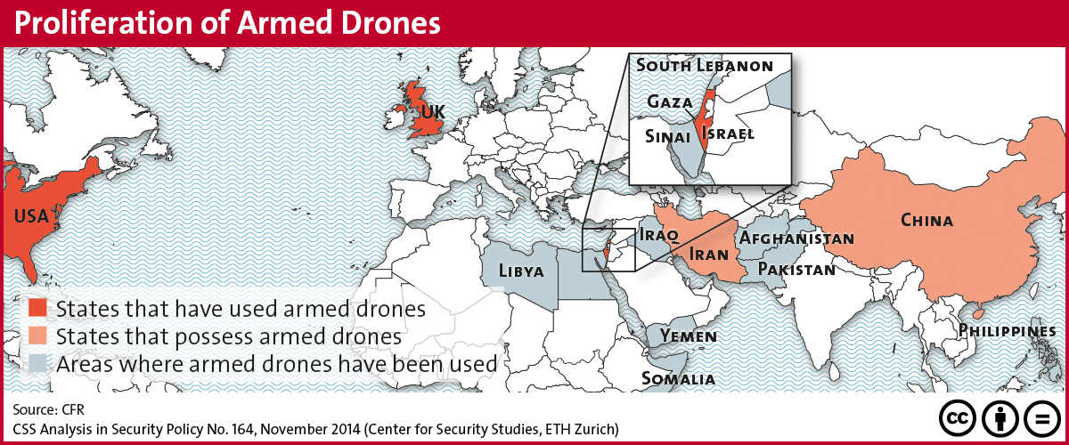
ETHICAL ISSUES (SAFETY)
May used for nefarious reasons as well as good.
AI systems that can cause damage if used maliciously
Notes:
Ethical concerns mount as AI takes bigger decision-making role — Harvard Gazette

Slide 32
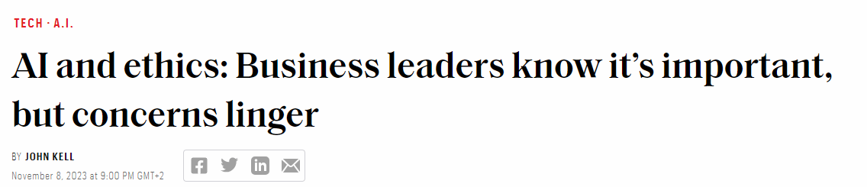
ORGANIZATIONS PROMOTING AI ETHICS
AI ethics issues include data responsibility and privacy, fairness, explainability, robustness, transparency, environmental sustainability, inclusion, moral agency, value alignment, accountability, trust, and technology misuse.
Following organizations and projects monitoring ethics :
NASCAI: The National Security Commission on Artificial Intelligence (link resides outside ibm.com) is an independent commission “that considers the methods and means necessary to advance the development of artificial intelligence, machine learning and associated technologies to comprehensively address the national security and defense needs of the United States.”
AlgorithmWatch: AI Now Institute:DARPA: CHAI: NASCAI
Robots and algorithms now taking over human decision-making tasks and entering the workforce but also encroaching our private lives, currently challenges legal systems around the globe (Themistoklis, 2018).
Example:
The attribution of human legal codes to AI is one of the most groundbreaking contemporary legal and judicial innovations. Until now legal personhood has only been attached directly or indirectly to human entities (Dowell, 2018).
The detachment of legal personhood from human being now remains somewhat of a paradox causing an extent of “fuzziness” of the concept of personhood (Barrat 2013; Solum 1992, p. 1285).
Human concepts, such as morality, ownership, profitability and viability will have different meaning for AI.
The need for redefining AIE has therefore reached unprecedented momentum
Notes:
AI Ethics | IBM
AlgorithmWatch: This non-profit focuses on an explainable and traceable algorithm and decision process in AI programs. AI Now Institute: This non-profit at New York University researches the social implications of artificial intelligence.DARPA: The Defense Advanced Research Projects Agency (link resides outside ibm.com) by the US Department of Defense focuses on promoting explainable AI and AI research.CHAI: The Center for Human-Compatible Artificial Intelligence (link resides outside ibm.com) is a cooperation of various institutes and universities to promote trustworthy AI and provable beneficial systems.NASCAI: The National Security Commission on Artificial Intelligence (link resides outside ibm.com) is an independent commission “that considers the methods and means necessary to advance the development of artificial intelligence, machine learning and associated technologies to comprehensively address the national security and defense needs of the United States.”
Robots and algorithms now taking over human decision-making tasks and entering the workforce but also encroaching our private lives, currently challenges legal systems around the globe (Themistoklis, 2018).
Example:
The attribution of human legal codes to AI is one of the most groundbreaking contemporary legal and judicial innovations. Until now legal personhood has only been attached directly or indirectly to human entities (Dowell, 2018).
The detachment of legal personhood from human being now remains somewhat of a paradox causing an extent of “fuzziness” of the concept of personhood (Barrat 2013; Solum 1992, p. 1285).
As AI gets bestowed with quasi-human rights, defining factors of human personhood will need to be adjusted (Dowell, 2018).
Human concepts, such as morality, ownership, profitability and viability will have different meaning for AI.
The need for redefining AIE has therefore reached unprecedented momentum

Slide 33
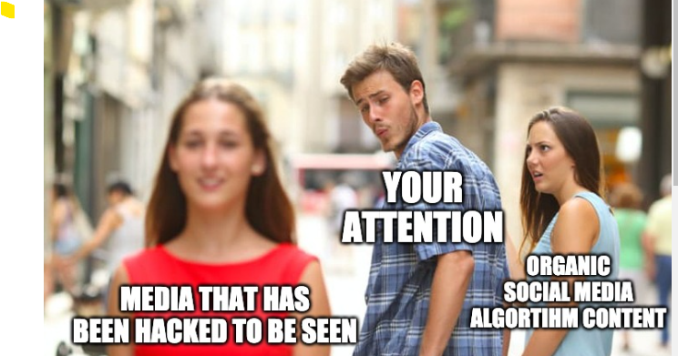
THE IMPORTANCE (WHY) (Continued)
Notes:
Robots in the Workplace: a Threat to—or Opportunity for—Meaningful Work? | Philosophy & Technology (springer.com)
In European countries such as in Germany, robotics is used to manage waste (Enway). Greece, robotics is used in agriculture for automatic indoor gardening, controlled via an app (CityCrop). In the United Kingdom, the Factmata company uses a combination of robotics and AI to prevent the spread of hoax news. In the social field, robotics is used to treat older people (Ho, 2018). Similar to Europe, robotics in Asia has also been applied in the health sector, such as for diagnosing diseases in China (Peredoc) and caring for older people in Japan (Softbank robotics). In Indonesia, robots are widely used in the automotive industry. For instance, at Mitsubishi, 40% of its activities utilize robots (Parwata, 2018).
Healthcare
Use of surgical robots – creating minimally invasive surgeries – faster recovery
A hospital that uses this technology is RS Bunda Jakarta (Prawira, 2014)
Manufacturing
Automating tasks, which increase efficiency
Decrease on the job accidents and injuries
Companies using robots:
ABB’s: wide range of industrial robots are able to perform tasks like arc and spot welding, material-handling functions like sorting and packaging, and quality control | Mitsubishi Electric: Robots are used for assembly, machine-tending and tray-handling applications, providing solutions for packing, palletizing, tending, assembling, handling or processing.

Slide 34

Notes:
AI Ethics | IBM

Slide 35
S T A R A.
FRAMEWORK.

Slide 36

Society
Innovative
Trust (Transparency from business)
Goals, values, preference
STARA
Cost-saving
Well-being
Agility
Self-efficacy (Ability to complete & compete
Collaboration (Consumer / Companies)
Learning Performance
Competitiveness/ Power
Psychological safety
Organization
Individual
Notes:
For STARA to be successful it has to consider three groups, individual, society and organization. Individuals need to feel trust from the business, thus impacting their well-being positively. They have to have self-efficacy and believe in learning performance. The organisation needs to create psychological safety THe organsiation needs to be able to stay true to their goals, values and references, they need to see that it's cost-saving. They need to focus on agility, remain competitive and collaborative Society is focused on innovation

Slide 37
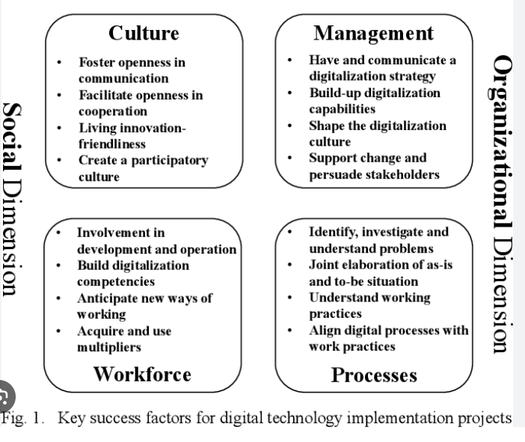
Key Success factors
Notes:
SMART TECHNOLOGIES ON INDUSTRY 5.0
Large data organising e.g IBM Watsons technology capabilities allow for large candidate information to be sorted to provide the best suitable candidate. It is this foresightedness of smart technology that brings out the potential for automation, not only with regard to work execution but also to aspects of leadership.
Smart organizations are better able than others to cope with technological breakthroughs, social, and cultural problems as well as to compete effectively and develop in an environmentally sustainable way. With their growing potential, they are strengthening the economies of their countries of origin and daily operation
Smart organizations are , they are strengthening the economies of their countries of origin and daily operation, whilst achieving sustainable development
CHALLENGES
The implementation of new technology can be framed either as intending to enable employees or as an attempt to create a foolproof organisation in a way that alienates employees and leads to feelings of coercion (Adler & Borys, 1996).
Technology proliferation that increases visibility, for instance, influences employees’ feelings of vulnerability due to being monitored by the employer in a way that is likely to make them more alert and careful in their workplace interactions
Focusing on the needs of the organisation but overlooking the concerns of the employee, smart technology designed either for decision support or implementation via various individual channels can be perceived by employees to be particularly threatening
RESISTANCE TO CHANGE
The use of new devices causes changes, including changes in employee behavior. The presence of new technology can lead to disruption of employee behavior patterns. Changes that occur, such as changes in workload, create changes in work responsibilities, which may require new training. Such resistance can come from both employees and superiors (Delaney & Robert, 2015).

Slide 38
SWOT ANALYSIS OF STARA
Maintained competitiveness for organizations
Opportunity for growth for individuals
Improved environment sustainability
Improve productivity
Improved communication and collaboration
Data-driven decision-making
Innovation & Efficiency
Skills Gap
Resistance to change
Overreliance on technology
Cost
Complexity
Increased safety
Decrease evasive procedures
Flexible working arrangements
Improved Performance monitoring & feedback
Upskilling and Reskilling
Psychological Safety
Decreased trust in the organisation
Privacy concerns
Job displacement concerns
Ethical consideration
Regulation challenges
Strength
Weakness
Opportunity
Threat
Notes:
ANY OTHER YOU WOULD LIKE TO ADD and WHY ?

Slide 39
S T A R A.
CONCLUSION.

Slide 40
SUMMARY
Industry 5.0’s main strategies are:
Human-centricity:
moves people from being seen as resources to being genuine assets
Resilience:
More resilient organizations would look to anticipate and react to any crisis to ensure stability through challenging times.
Sustainability:
Extends sustainability from simply reducing, minimizing, or mitigating climate damage to actively pursuing efforts to create a positive change.

Slide 41
THANK YOU
QUESTIONS ??

