Slide 1
Business Ethics, Corporate Governance
Lecture 10:
Ethics, Corporate Social Responsibility, Corporate Governance
Ondrej Castek
castek@econ.muni.cz

Slide 2
Introduction

Slide 3
Learning outcomes
LO 12-1 Describe the shared value creation framework and its relationship to competitive advantage.
LO 12-2 Explain the role of corporate governance.
LO 12-3 Apply agency theory to explain why and how companies use governance mechanisms to align the interests of principals and agents.
LO 12-4 Evaluate the board of directors as the central governance mechanism for public stock companies.
LO 12-5 Evaluate other governance mechanisms.
LO 12-6 Explain the relationship between strategy and business ethics.

Slide 4
What will the lecture focus at
Introduction
Why business ethics
Business entities
Agency and stewardship theories
Corporate governance and its models (also in non-US settings)
Recap (KvIS)

Slide 5
The business ethics

Slide 6
The business ethics
Staying within the law is a minimum acceptable standard.
Society expects more.
Non-written rules.
Related to brand, image, „license to operate“.

Slide 7
The business ethics
The business of business is business.
„The Social Responsibility of Business Is to Increase Its Profits“
Q: author, year?
Adam Smith, 1759: The Theory of Moral Sentiments (Wealth of Nations: 1776)
„invisible hand of the market“ in both books but extensive use in 20th century by Paul Samuelson.
Noreen Hertz, 2001: The Silent Takeover
Notes:
The Silent Takeover: Global Capitalism and the Death of Democracy

Slide 8
Beyond the shareholder approach
The larger pie: stakeholder view and Corporate Social Responsibility (CSR)
Q: Why did shareholder approach prevail and why is stakeholder approach dominant today?
Q: What is CSR?
Q: What are the three pillars of CSR?

Slide 9
The business ethics
Normative, descriptive, and prescriptive use of stakeholder theory and CSR.
Normative: companies should do this because this is the good thing.
Descriptive: companies are doing this.
Prescriptive: if companies do this, these are the consequences.

Slide 10
The business ethics
How to „do“ the business ethics?
CSR
Codes of conduct (https://www.muni.cz/en/about-us/official-notice-board/mu-code-of-ethics)
Walk the talk!

Slide 11
Business entities, the corporation Owners‘ rights, business entities, IPO, unicorn

Slide 12
Owners: rights, expectations, power
Q: What are the owners‘ rights?

Slide 13
Owners: rights, expectations, power
Company is „the bundle of rights“ (R. Coase, 1960)
Owners are entitled only to residual rights to property and control.
Q: What are the expectations of owners?
Q: How can owners exercise their power?

Slide 14
Owners: rights, expectations, power
The motivation to do business is not always the same.
While for some the main incentive can be the profit, others prefer stability, some want to carry on a family tradition or for some it can be a form of self-realization.

Slide 15
Types of business entities
Sole proprietorship
Limited/unlimited liability
Partnerships/companies/corporations
More at
https://en.wikipedia.org/wiki/List_of_legal_entity_types_by_country#

Slide 16
The corporation
Q: What does mean public versus private company?
Q: What is IPO?
Q: What is an unicorn?
Public stock company:
Limited liability for investors (owners)
Transferability
Legal personality
Separation of ownership and control

Slide 17
Owners: rights, expectations, power
Fully involved in sole proprietorship businesses
Fully involved in companies with unlimited liability, but not necessarily all owners
Markedly less involved in limited liability companies
Rarely involved in corporations
Sometimes we talk about managerial ownership

Slide 18
Corporate governance CG, agency and stewardship theory

Slide 19
The key players
Owners are the statutory and managing body in sole proprietorships and often in unlimited liability companies
Partnership agreement (and law) can determine differently
Corporate governance laws define the distribution of rights and responsibilities among participants in corporations
The ownership and management are definitely separated

Slide 20
Corporate Governance…
…addresses the relationship between owners and management (narrow meaning, based on Berle and Means 1932).
…is "a set of relationships between the company's bodies, its owners, and other stakeholders" (OECD, 1997).
is "the structure and processes by which companies are directed and controlled" (World Bank).

Slide 21
Corporate Governance aims to
protect the interests of owners (Demsetz 1983, p. 386),
ensure the return on investment of finance suppliers (Shleifer and Vishny 1997, p. 737),
reduce agency costs (Mueller 2006),
higher efficiency, better access to capital, lower risk, insurance against poor management/governance (World Bank, cited from International Finance Corporation).

Slide 22
We can define corporate governance as
"the issue of ownership relationships and systems by which owners exercise their ownership rights and control over the management area of the company; at the same time, corporate governance includes processes, structures, and relationships through which the board oversees the activities of its executive officers"
Hučka, Malý, Okruhlica et al., 2007

Slide 23
Why corporate governance?
Still an important and current topic. Milestones:
Cadbury Report
a series of scandals around the turn of the millennium: Enron, Tyco, Global Crossing, WorldCom, Xerox...
in the Czech Republic problematic cases mainly TV Nova, IPB, squeeze outs
The Business Corporation Act of 2012 effective from 2014
currently e.g. ČEZ and other publicly traded Czech companies
Notes:
Great Britain and the former colonies, plus other countries that have voluntarily adopted: USA, Canada, Australia, New Zealand, Africa, Southeast Asia (La Porta et al., 2000).
Relatively homogeneous use.

Slide 24
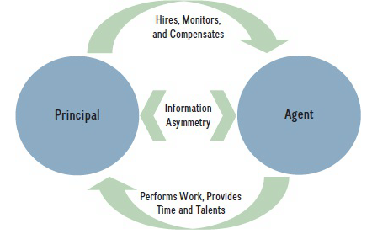
The agency theory
Principal-Agent problem
Information asymmetry
Agency costs
Notes:
Formulated in 1970s in the US

Slide 25
The stewardship theory
Stewardship theory is an alternative to agency theory in corporate governance, emphasizing the role of managers as stewards of the company who act in the best interests of the shareholders.
Managerial Motivation:
Unlike agency theory, which assumes managers are self-interested, stewardship theory posits that managers are motivated by intrinsic rewards such as personal satisfaction, recognition, and the success of the organization.
Managers are seen as trustworthy and committed to the company's goals.
Alignment of Interests:
The theory suggests that the interests of managers and shareholders naturally align, reducing the need for extensive monitoring and control mechanisms.
Managers are viewed as stewards who prioritize long-term organizational success over short-term personal gains.
Notes:
Criticism and Limitations:
Critics argue that stewardship theory may be overly idealistic, assuming that all managers will act as stewards without considering the potential for self-interest.
It may not account for situations where managers' interests diverge from those of shareholders.

Slide 26
The stewardship theory
Corporate Governance Implications:
Governance structures under stewardship theory are less focused on stringent controls and more on enabling and supporting managers.
Boards of directors are seen as partners in governance, working collaboratively with managers to achieve organizational goals.
Performance Outcomes:
Stewardship theory argues that when managers are trusted and empowered, they are more likely to act in the best interests of the company, leading to better performance and higher shareholder value.
It suggests that intrinsic motivation and a sense of duty can drive managers to achieve superior results.
Notes:
Criticism and Limitations:
Critics argue that stewardship theory may be overly idealistic, assuming that all managers will act as stewards without considering the potential for self-interest.
It may not account for situations where managers' interests diverge from those of shareholders.

Slide 27
Corporate governance: the models Anglo-American, Continental, Japanese, comparison

Slide 28
Anglo-american model
So-called one-tier, or external control model
General meeting elects the Board of Directors (BoD)
part of them are insiders (executive directors), part of them outsiders (non-executive or independent directors)
BoD chairman is often also CEO (so-called „duality“)
Required are liquid stock markets and low ownership concentration.
Control is exercised, among others, through the exit system.
Until recently, laws against close connections between companies and their banks in the USA.
Notes:
In these countries, the source of law tends to be common law.
Primarily referred to as single-tier, externally controlled, market-oriented.
Combined decision-making and control functions in one body (board of directors)
Exit system, liquid and large capital markets, low transaction costs of selling, high transaction costs of voting, dispersed ownership - Körner links it to the time and manner of the onset of industrialisation, it is also related to the types of owners - a higher ratio of individual ownership than in the continental model.
It is more about protecting owners from management.

Slide 29
Anglo-american model: ownership patterns
In 1990, institutional investors held approximately 61 percent of the shares of UK corporations, and individuals held approximately 21 percent. (In 1981, individuals held 38 percent.)
In 1990, institutions held 53.3 percent of the shares of US corporations.

Slide 30
Anglo-american model: trends and issues
Growing share of institutional owners, decreasing share of individuals
Voting behavior of institutional owners at AGMs
Concentration of power in the hands of one person or small group of persons
Excessive executive compensation
Regulatory framework reacts

Slide 31
Interactions among key players
Shareholders
Elect
Board of Directors
(Supervisor)
Stakeholders
Appoints and supervises
Officers
(Manager)
Monitors & regulates
Manage
Creditors
Regulatory/
Legal system
Company

Slide 32
Continental model
So-called two-tiered model, or internal control model
General meeting elects supervisory board and management board
in some countries supervisory board names members of management board
it is common that part of the supervisory board is elected by employees (up to 50%, sometimes depends on the firm size)
Management board is the statutory body and is responsible for „daily“ management of the company, supervisory board si responsible for the strategic control.
Control is exercised, among others, through the voting system.
The connection between the company and a bank can be very close.
Notes:
Continental European countries, many Asian systems.
It is not so homogeneous, based on continental law (also civil law or European law), which, according to La Porta, can be divided into Germanic, French and Nordic (sharing the tradition of Roman law). In other countries, it is usually a combination of continental law and local traditions.
At a general level, one could name other important sources of law, such as sharia or post-Soviet republics sharing a socialist past, but these are not relevant from a corporate governance perspective. Although, for example, as far as post-Soviet republics are concerned, commercial law is often "grafted" onto the original legal system and the existence of certain legal institutes does not yet ensure their actual functionality.
Called two-tier, with internal controls, bank-oriented.
The decision-making and control functions are divided into two independent bodies: the Supervisory Board and the Management Board, with the controlling body, the Supervisory Board, usually appointed by the Management Board, the decision-making body.
The voting system, does not require liquid and large capital markets, often there are none. Low transaction costs of voting, high transaction costs of selling, concentrated ownership - Körner relates it to the time and manner of the onset of industrialisation, it is also related to the types of owners - lower ratio of individual ownership than in the continental model. Significant individual ownership through foundations and pyramid ownership.
Rather, it is about protecting minority shareholders from the dominant owner.

Slide 33
Continental model: ownership patterns
Banks 27%
Pension funds 3%
Other companies 41%
Individual owners 4%
Foreign investors 19%

Slide 34
Continental model: trends and issues
The ownership concentration still increases
Capital markets are illiquid
- therefore capital allocation is not perfect
European commission wants to encourage individuals to invest in securities
- however the typical European behavior saved EU from larger impact of 2008 financial crisis

Slide 35
Interactions among key players
Appoint up to 50%
Supervisory Board
Appoint 50%
Appoints and supervises
Employees and Labour unions
Management Board
Shareholder
Manage
Company
Own

Slide 36
Japanese model
So-called Keiretsu. Model with even higher interconnectedness among the key players than the continental model. The key players are:
Main bank (a major inside shareholder)
Affiliated company or affiliated keiretsu (a major inside shareholder)
Management
Government
Outside shareholders
Independent (external) directors
Typical is very high ownership concentration and cross-shareholding

Slide 37
Japanese model: ownership patterns
Banks + insurance companies 43%
Other companies 25%
Foreign investors 3%

Slide 38
Japanese model: trends and issues
Very non-transparent for outsiders
Very rigid
The strong crossholding of equity and debt and strong business relationships can work in favor of competitiveness, but also against it

Slide 39
Japanese model: interaction among key players
Provides monitors and acts in emergencies
Supervisory Board (including President)
Appoint
Provides managers
Ratifies the President’s decision
President
Shareholders
Main bank
Consults
Executive Management (Board of Directors)
Manages
Provides loans
Own
Company
Owns

Slide 40
Japanese model: example of a Keiretsu

Slide 41
A comparison: ownership patterns
Anglo-Saxon System
UK 1990: Institutional ownership 61%
US 1990: Institutional ownership 53%
UK 1981: Individual ownership 38%
UK 1990: Individual ownership 21%
UK 2016:
Foreign ownership 53.9%
Individual ownership 12.3%
Banks 2.5%
Other financial institutions 27.7%
Companies 2.2%
Continental Europe
Banks 27%
Pension funds 3%
Companies 41%
Individual ownership 4%
Foreign ownership 19%
Japan
Banks 43%
Companies 25%
Foreign ownership 3%
Source: Dagala J. C., Statistical Office of Great Britain.

Slide 42
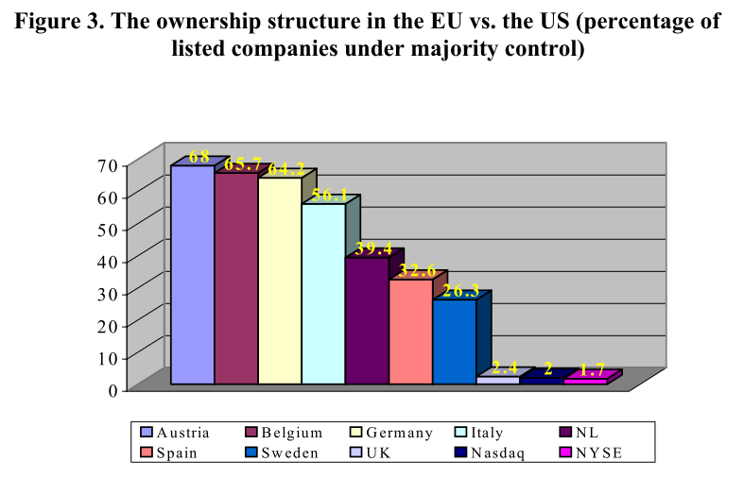
A comparison: ownership patterns
Source: Lannoo K., Khachaturyan A., 2004.

Slide 43
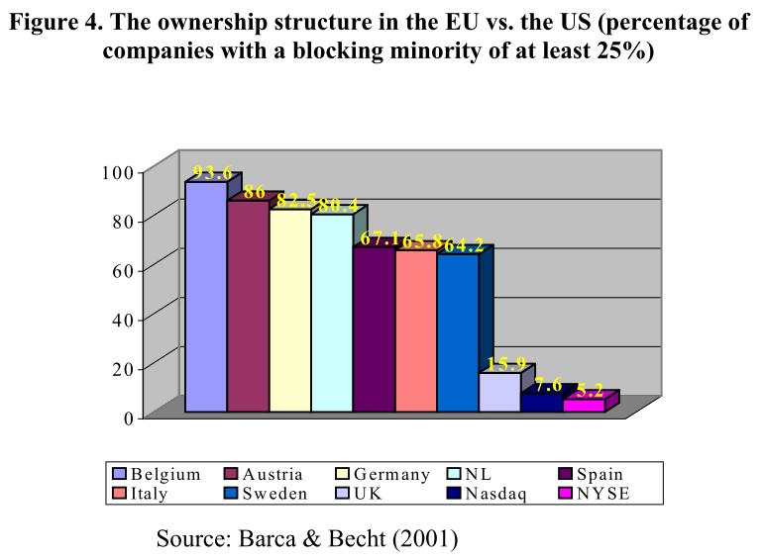
A comparison: ownership patterns

Slide 44
Comparison of systems - governance models
System | Anglo-Saxon | Continental
Check | external | Inside
Model structure of administrative authorities | Single level | two-level
Executive administrative authority | Executive Directors of the Board of Directors | Board of Directors
Controlling administrative authority | external members of the Board of Directors | Supervisory Board
Duality of control and executive roles | Maybe | Impossible
Independence of the supervisory authority | Low | high
Committees of the administrative authorities | mandatory | Recommended
Representation of banks in administrative bodies | low to prohibited | high
Employee representation on the governing bodies | Unusual | usual to compulsory
Influence of political interests | Unwanted | Indirect
Monitoring by owners | indirect, passive | direct, active
Relative costs of monitoring | high | Low
Method of management by owners | exit | vote
Notes:
Internal control - supervisory board and owners' representatives (= owner himself) in it.
Exit vs. Vote: Exit aka the choice with one's feet is too easy, encouraging one to leave society rather than engage (Bhide, 1993). Tends towards speculative ownership while Vote with its high concentration, small and illiquid capital markets tends towards strategic ownership.

Slide 45
Comparison of systems - environment
System | Anglo-Saxon | Continental
Cultural environment | Individual | Collective
Capital markets | large and liquid | small and illiquid
Investment horizon | short-term, speculative | long-term, strategic
Concentration of ownership | Low | high
Representation of institutional investors | high | Low
Prototype of the conflict | principal vs. agent | majority vs. minority owner
Legal system | common law | continental law
Legal protection of owners | high | Low
Cross-ownership | exists | very significant
Risk of hostile takeover | exists | vanishing
Source: Hučka 2007, Körner 2008, Mueller 2006, modified.
Notes:
Individual vs. collective - the US the most individualistic culture in the world,
IDV USA 91 AU 90 UK 89 CAN 80 NZ 79
Market capitalization vs. GDP in 2017 according to the World Bank:
USA 166 % CAN 143 %
Germany 62 % France 106 % Poland 38 %
Czech Republic 2008 17% same as Poland, Germany in 2008 30%
"Euro area" 78 %
https://data.worldbank.org/indicator/CM.MKT.LCAP.GD.ZS?year_high_desc=true
Investment horizon is related to the influence of political interests, cultural environment, concentration of ownership: diversification through portfolio
Instituc. inv. excluding banks
Legal protection:
GMI (1-10) UK, USA, Canada, Ireland, NZ, AU 6.65-7.6 Germany 5.8, France 4.7, emerging 3.9
Antidirector rights (0-5, La Porta, 1997): English-origin 3,39, Fr or. 1,76, Ge or. 2,00.
= de facto protection of minority owners (3 out of 5 index components).
Enforcement of rights (anti-self dealing index Djankov et al. 2008: on a 0-1 average EO countries about 2 times higher than fr. orig. or ge. orig.
Similarly, creditor protection

Slide 46
Comparison of systems - financing
System | Anglo-Saxon | Continental
Main method of financing | share capital | credit
Main source of funding | market | bank
Relations with the bank | free | tight
Accumulation of bank roles | low to prohibited | frequent
Transaction costs of financing | high | Low

Slide 47
Let‘s wrap it up The KvIS is comming

Slide 48
KvIS
Summary of the lecture
Max 1 bonus point (3 questions, 1/3 point for the correct answer)
Remember to submit your answer a few seconds ahead (lag)

Slide 49
Literature
What to study: Rothaermel Ch 12
Literature used for the slides:
Coase R. H. (1960) ‘The Problem of Social Cost’, Journal of Law and Economics 3: 1–44.
Hertz N. (2001) The Silent Takeover: Global Capitalism and the Death of Democracy.
Friedman M. (1970) The Social Responsibility of Business Is to Increase Its Profits.
Graphics (interactions among key players, 3x) borrowed from Dushyant Maheshwari`s lecture Models of Corporate Governance, retrieved from SlideShare.
Ownership patterns data obtained from Joy Clarisse Dagala`s Chapter 4: Models of Corporate Governance, retrieved from SlideShare

