Slide 1
Environmental and Sustainable Development Policy
Tourism Sustainability and Climate Change
MPR_TSCC
Vilém Pařil
Department of Regional Economics
Faculty of Economics and Administration
Masaryk University, Brno, Czech Republic
13th November 2024

Slide 2
Content
Chapters
Introduction
Global Policy
Economic Perspective
EU Policy

Slide 3
Introduction
Environmental policy
policy aimed at guiding the behaviour of society (in the broadest sense) under the objective of preserving conditions of life on Earth
  A set of activities aimed at influencing the decision-making of individual actors following the objectives set in the field of the environment
  the result of knowledge of the adverse effects of human activities on the environment

Slide 4
Introduction
The origins of international environmental policy
1950s/1960s - awareness of the problems of environmental degradation
1962 Rachel Carson - publication Silent Spring
1967 Establishment of the Environmental Protection Fund
1968 Garett Hardin - publication of The Tragedy of the Commons
1968 Founding of the Club of Rome
1972 - United Nations International Conference on Environment in Stockholm

Slide 5
Introduction
1972 - United Nations International Conference on Environment in Stockholm
participation of 113 countries
Consent: economic activity cannot be carried out without regard for the environment
Contradiction: different views of representatives of developed and developing countries
The result:
  Declaration on the Environment
  Limits of Growth (Club of Rome)

Slide 6
Introduction
Declaration on the Environment
"Planet Earth, the only one we have, is seriously threatened by us by ourselves, who are unaware of the vulnerability of its life giving systems and are damaging them by our own reckless actions. Chimneys of our factories and power stations spew huge amounts of air of foreign pollutants into our air, we are producing more and more waste, polluting our waters on land and in the seas with all sorts of harmful substances. Consequences of our actions are affecting nature, human health and the planet's life-support systems are threatened on a global scale."

Slide 7
Introduction
Limits of Growth
Exponential growth in population, production and demand for food will lead to a decline in resource supplies, increased pollution and ultimately catastrophic reversal
Significant publicity, stimulating expert debate
Criticism - failure of not including technological advances
No the term „sustainable development“

Slide 8
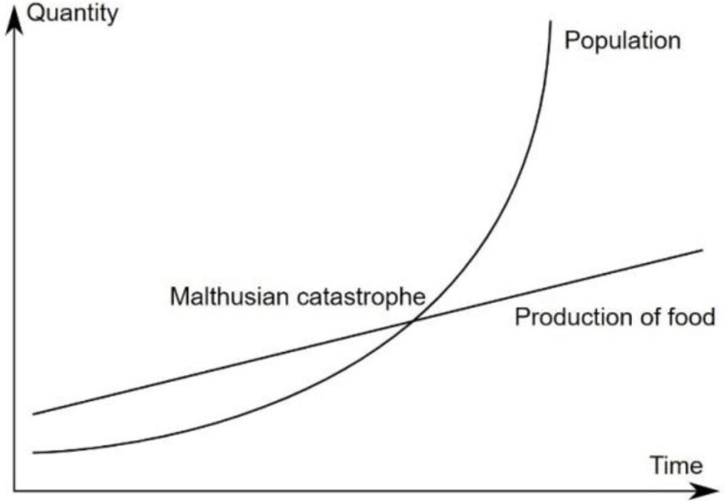
Economic Perspective
Thomas Malthus (1766-1834)
1798 - Essay on the Principle of population: crisis
impact of technological progress

Slide 9
Economic Perspective
Economic sustainability issues before
issues of societal development, economic growth, relationship to the environmentenvironment, natural resources (Nordhaus, Tobin, Solow, Stiglitz)
  the search for consumption levels and acceptable population growth rates (Solow,1974)
  determination of the equilibrium with natural resources, optimal growth of the economy, the optimal level of extraction of natural resources (Stiglitz, 1974)
seeking answers to questions from a development perspective: ECONOMIC x ENVIRONMENTAL x SOCIAL

Slide 10
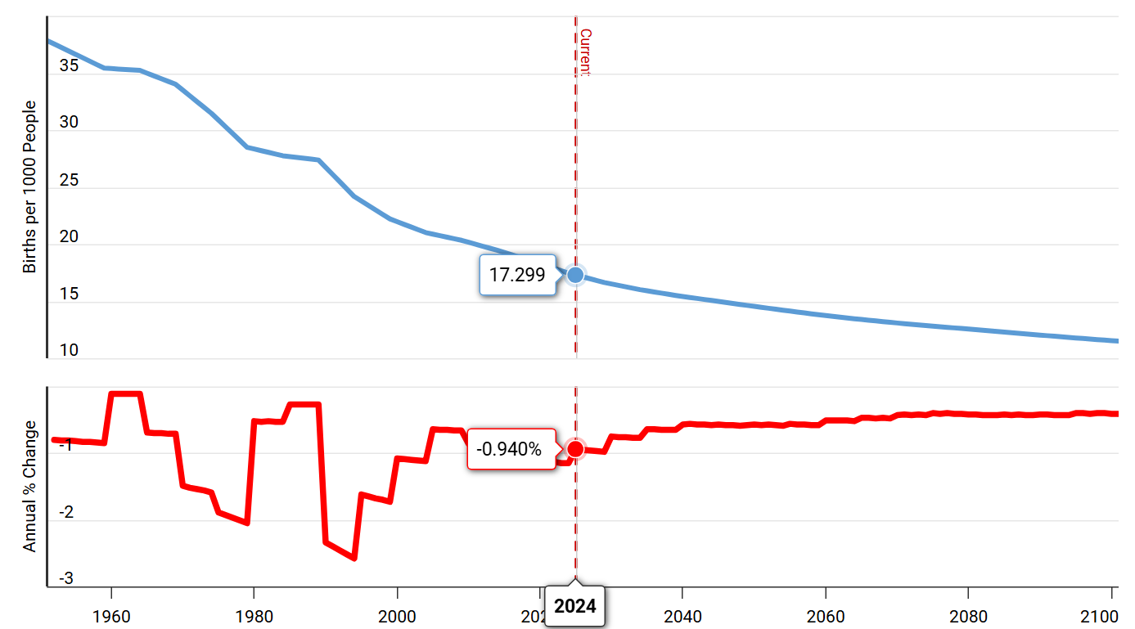
Economic Perspective
Fertility
Change 1960 vs. 2100
    https://www.ined.fr/en/publications/editions/population-and-societies/mapping-the-massive-global-fertility-decline-over-the-last-20-years/

Slide 11
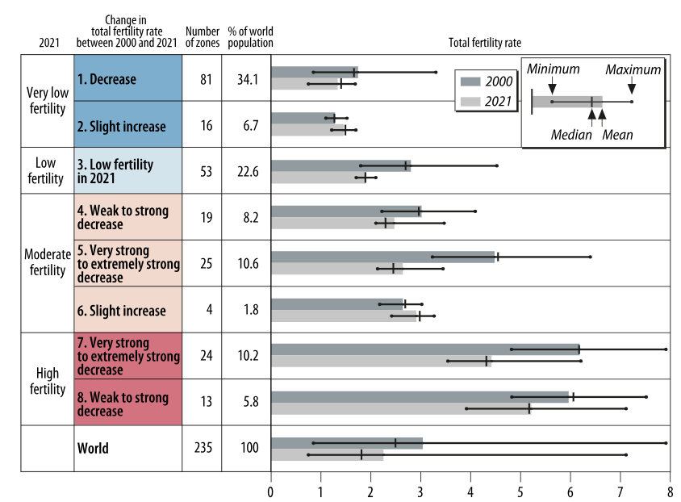
Economic Perspective
Fertility
Change 2000 vs. 2021
    https://www.ined.fr/en/publications/editions/population-and-societies/mapping-the-massive-global-fertility-decline-over-the-last-20-years/

Slide 12
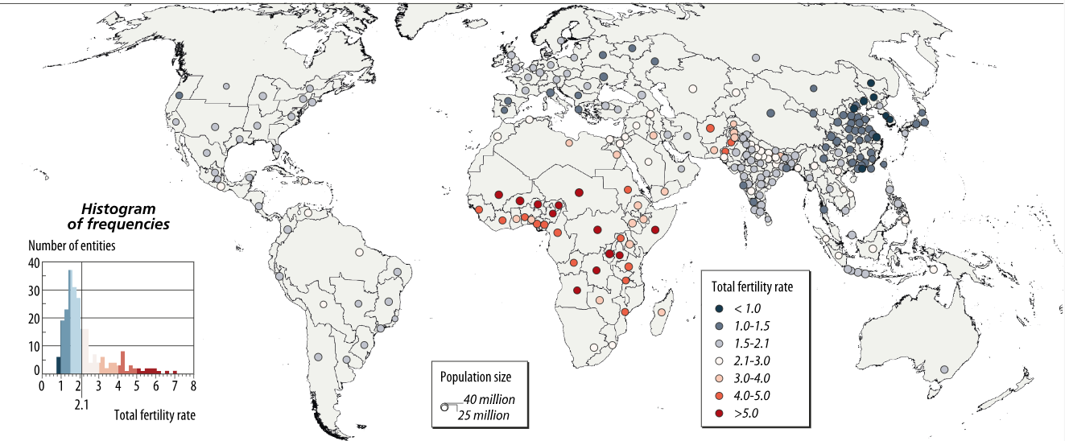
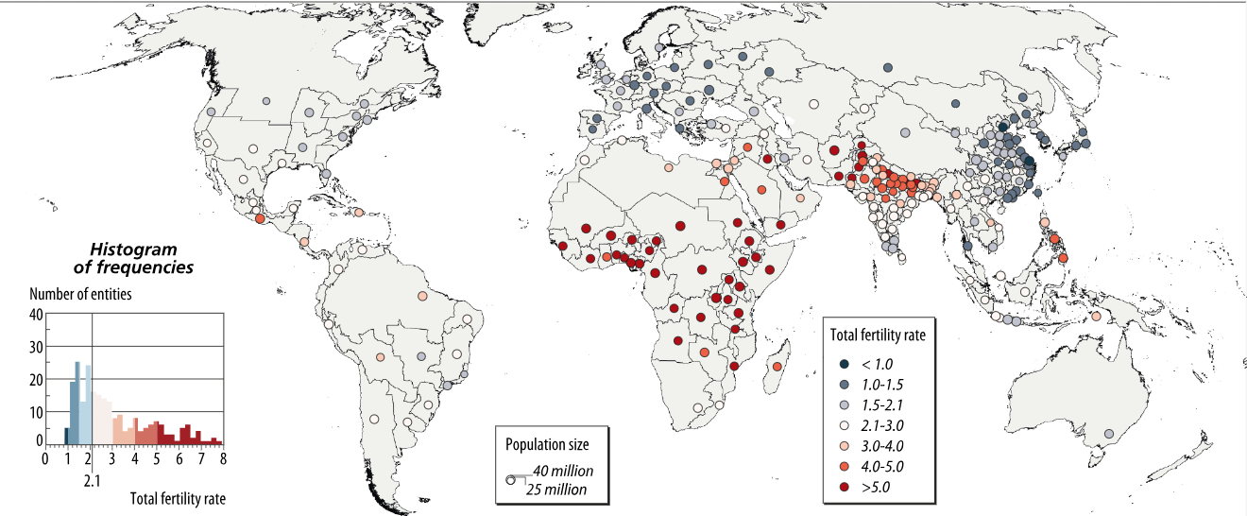
Economic Perspective
Fertility
Change 2000 vs. 2021
    https://www.ined.fr/en/publications/editions/population-and-societies/mapping-the-massive-global-fertility-decline-over-the-last-20-years/

Slide 13
Global Policy
Traditional political paradigm
  Environmental problems addressed from a technocentric perspective
  Environmental problems as unfortunate side effects of economic growth
  Most environmental problems have solutions (technical progress)
  The interdependent relationship among ecosystems and political, economic, social and cultural systems
  Government policies are reactive
  Sectoral approach to environmental protection
  Environmental policy considered as a separate field - 'end-of-pipe' solutions
  A constant emphasis on economic growth

Slide 14
Global Policy
The launch of modern environmental policy
1972 Stockholm UN Conference on the Human Environment
1985 Convention for the Protection of the Ozone Layer
1987 The so-called Montreal Protocol on Substances that Deplete the Ozone Layer
1987 Brundtland Report, Our Common Future
1988 IPCC
1992 UN Conference on Environment and Development (UNCED), also known as the Earth Summit (Rio)
  Agenda 21
  Earth Charter
  United Nations Framework Convention on Climate Change

Slide 15
Global Policy
Sustainable development
Definition
“meeting the needs of the present without compromising the ability of future generations to meet their own needs.”

Slide 16
Global Policy
Intergovernmental Panel on Climate Change (IPCC)
  1988 established by the United Nations Environment Programme (UNEP) and the World Meteorological Organization (WMO)
  provide policymakers with regular scientific assessments on climate change, its implications and potential future risks, as well as to put forward adaptation and mitigation options
  Assessment Reports
  1st 1990
  2nd 1995
  3rd 2001
  4th 2007
  5th 2014
  6th 2021/2022/2023

Slide 17
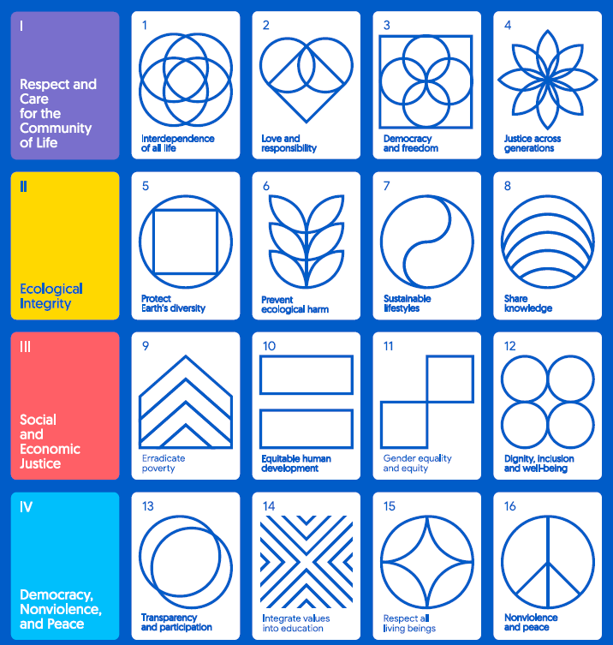
Global Policy
Earth Charter
1992
16 principles

Slide 18
Global Policy
Other international environmental milestones
  1994 Cairo Summit on Population and Development
  The critical importance of environmental conditions
  1995 Copenhagen Social Summit
  Signing up to the ideas of sustainable development
  1997 UN Rio+5 Conference in New York
  Recognition that the environment is deteriorating
  1997 Kyoto Conference - in the context of the UN Framework Convention on climate change
  Kyoto Protocol signed - commitment by developed countries to reduce carbon emissions carbon dioxide and other greenhouse gases
    (2012 – 5,2%; 2020 - 20% decrease x 1990)
  2000 UN Millennium Summit in New York

Slide 19
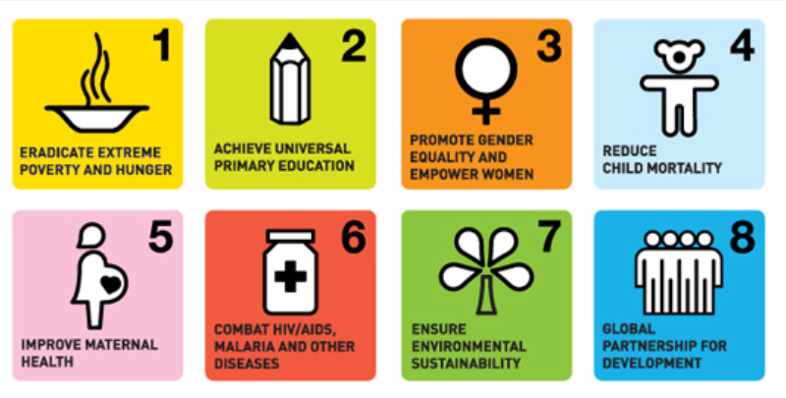
Global Policy
2000 Millennium Summit in New York
UN Summit in New York
Millennium Development Goals (MDGs)
8 goals adopted defining the global human rights agenda development by 2015 (the Millennium Development Goals)

Slide 20
Global Policy
Other international environmental milestones
  2002 UN World Summit on Sustainable Development in Johannesburg (Rio+10)
  Implementation Summit
  2010: UN Millennium Development Goals Summit in New York
  2012: UN Conference on the Environment in Rio de Janeiro(Rio+20)
  Resulting non-binding document Future We Want- the creation of appropriate green jobs and social inclusion
    clean and renewable energy for all
    sustainable cities
    food security and organic agriculture
    sustainable water management, ocean use, disaster preparedness

Slide 21
Global Policy
Other international environmental milestones
  2015 UN Sustainable Development Summit World Summit in New York
  Agenda adopted 2030
  17 Sustainable Development Goals adopted
  169 sub-goals
  A roadmap for the world by the year 2030
  2015 UN Climate Change Conference in Paris
  Adoption of the Paris Agreement (2030 – 40%)
  2017 UN Ocean Conference in New York
  First Global Ocean Conference
  Global agreement to stop marine degradation results
  2019 UN World Summit on Sustainable Development in New York

Slide 22
EU Policy
History of EU Environmental policy
  1972 Paris Summit
    development and approval of action programmes 1st Action Plan (1973 1976)
  1986 (1987) Single European Act
    inserted a chapter on the environmental basic principles, objectives
  1992 (1993) EU Treaty/Maastricht Treaty - environmental policy enshrined
    definition of objectives and targets
  1994 creation of the Cohesion Fund (Cohesion Fund)
  1997 (1999) Amsterdam Treaty
    strengthening of the legal basis
  2007 (2009) Lisbon Treaty
    no significant changes
    emphasis on the fight against climate change
    consideration of the environment also in the field of energy
  2019 European Green Deal
  2021 Fit for 55
    targets a 55% decrease in Greenhouse gas (GHG) emissions by 2030

Slide 23
EU Policy
Principles of environmental policy
Precautionary principle
Prevention principle
Polluter pays principle
Principle of pollution capture at source

Slide 24
EU Policy
EU environmental policy priorities
fighting climate change and pollution
conservation of biological diversity
promoting responsible use of natural resources
sustainable development

Slide 25
EU Policy
EU action programmes on the environment
  Multiannual programmes setting priorities in the field of the environment
  Drivers of legislative developments in the field of the environment
8 action programmes adopted to date
2022: 8th Action Programme adopted by 2030
Other EU Action Plans or strategies
  Circular Economy Action Plan for a Clean and Competitive Europe
  EU Biodiversity Strategy 2030
  the Farmer-to-Consumer Strategy

Slide 26
EU Policy
8th Environmental Action Plan 2030
  6 priority areas:
  achieving the 2030 greenhouse gas reduction target and climate neutrality by 2050
  enhancing adaptive capacity, building resilience and reducing vulnerability to change climate vulnerability
  progress towards a regenerative growth model, decoupling economic growth from resource use and environmental degradation, and accelerating the transition to the circular economy
  striving for zero pollution, including air, water and soil, and protecting the health and well-being of Europeans
  protecting, conserving and restoring biodiversity and enhancing natural capital
  reducing environmental and climate pressures related to production and consumption (in particular in the areas of energy, industry, buildings and infrastructure, mobility, tourism, international trade and the food system)

Slide 27
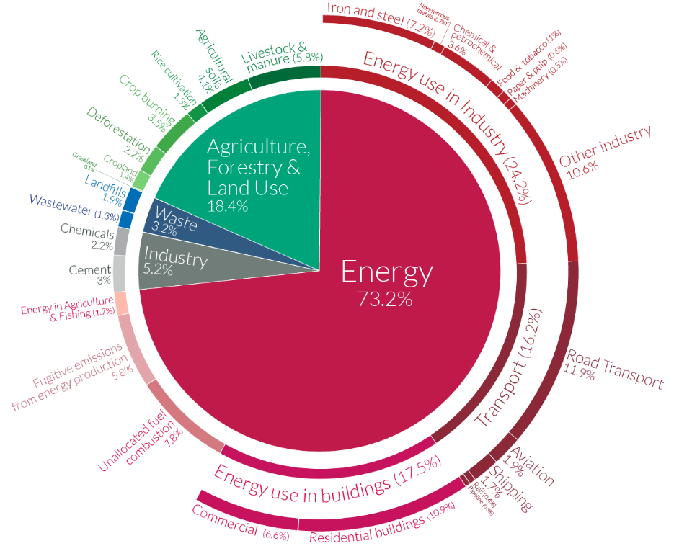
Global Policy
CO2 emissions
  structure

Slide 28
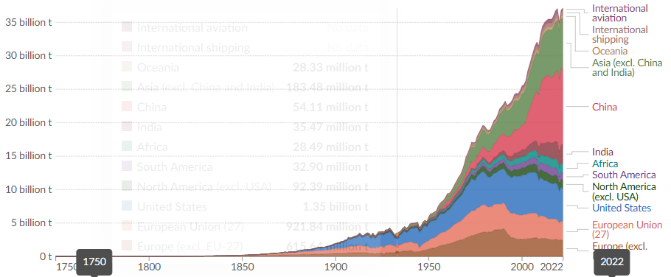
Global Policy
CO2 emissions
  structure

Slide 29
Global Policy
CO2 emissions
  structure

Slide 30
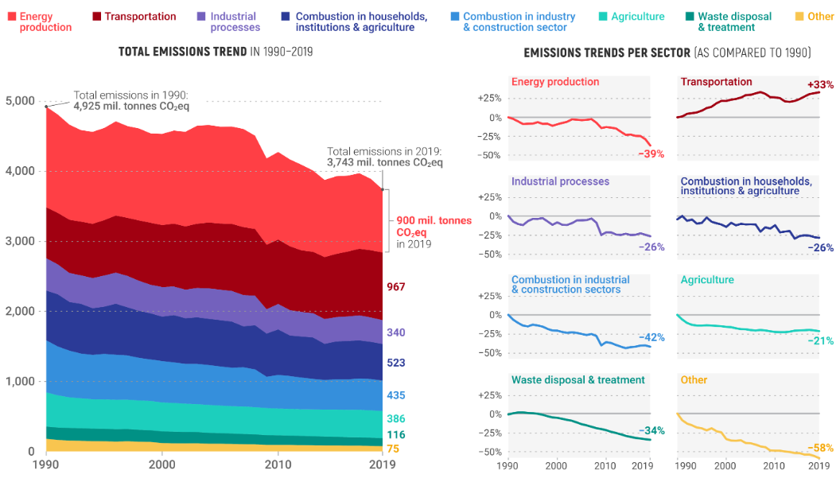
EU Policy
EU CO2 emissions
  Structure
  Change
  1990 x 2021

Slide 31
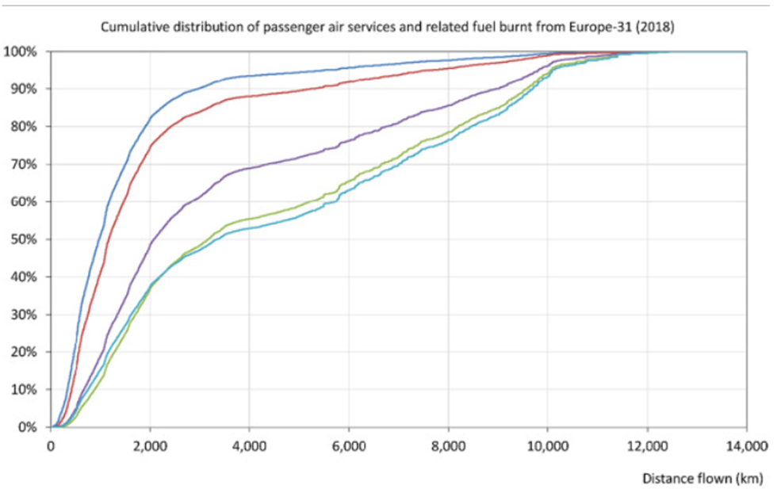
EU Policy
CO2 emissions
  Flights emissions structure
  Dobruszkes, 2022

Slide 32
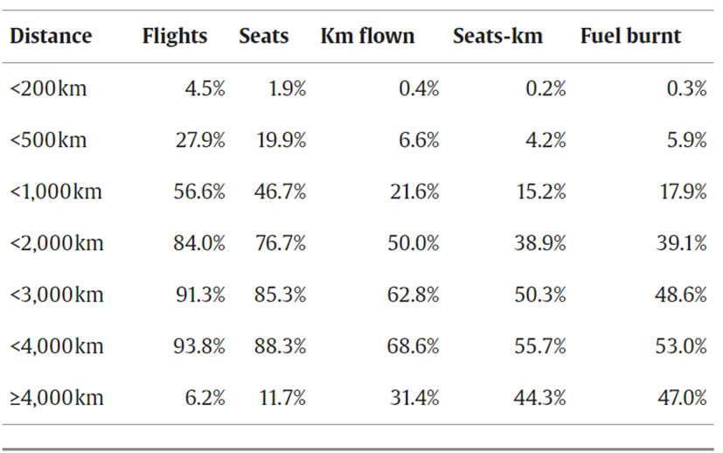
EU Policy
CO2 emissions
  Flights emissions structure
  Dobruszkes, 2022

Slide 33
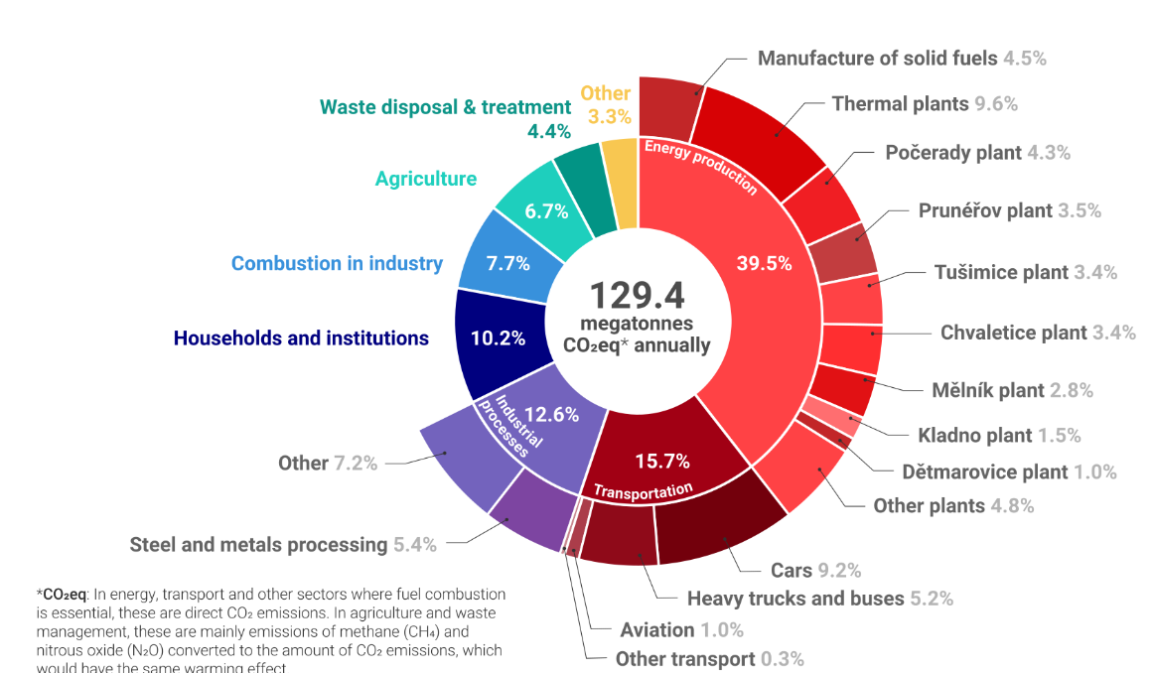
Czech Policy
Czechia CO2 emissions
  Structure

Slide 34
Thank you for your attention
Děkuji za pozornost

