Slide 1
Environmental Protection Measures
Tourism Sustainability and Climate Change
MPR_TSCC
Vilém Pařil
Department of Regional Economics
Faculty of Economics and Administration
Masaryk University, Brno, Czech Republic
13th November 2024

Slide 2
Content
Chapters
Introduction
Administrative measures
Economic measures
Other

Slide 3
Introduction
Objective
to ensure a socially acceptable quality of the environment
  socially optimal environmental quality
  optimal level of environmental pollution
means of achieving environmental policy objectives
  means and methods by which the state achieves its national environmental policy objectives
  means and methods of influencing people's behaviour in relation to the environment
  direct influence on the state of the environment and indirect influence on the state of the environment

Slide 4
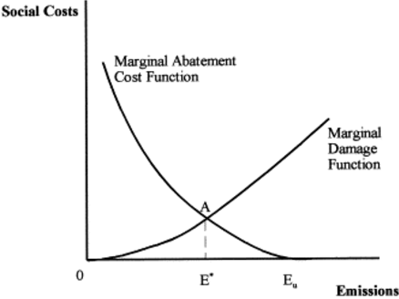
Introduction
Socially acceptable level/quality of environment

Slide 5
Introduction
Microeconomic optimu

Slide 6
Introduction
Different types of instruments
instrument mix
simultaneous effects
  one tool addresses several environmental problems
  e.g. territory protection
contradictory effects
  transfer of pollution between environmental components
  e.g. EV
  conflict with other sectoral policies
  e.g. obligation to blend biofuels into fuel

Slide 7
Introduction
Classification of tools
By form of stimulation
  Positive stimulation tools
  Negative stimulation tools
By mode of action:
  Administrative (normative) / Institutional tools (organisation, regulatory)
  Economic - allow choice
  Other
  Information tools
  Educational, training and awareness-raising tools
  Voluntary tools
  conceptual tools
  spatial planning
  science and research

Slide 8
Introduction
Measures
Characteristics of tools
Objectives
  Efficiency
  Effectiviness
  Prevention
Functions
Fiscal function x incentive/motivation function
Criteria
  Transparency
  Simplicity
  Administrative simplicity

Slide 9
Administrative measures
Administrative tools
Predominant form of environmental regulation
Injunctions and prohibitions
  e.g. activities prohibited in Zone 1 of the NP
Norms and standards
  e.g. technical standards for landfill operation
Limits and quotas
  e.g. emission, immission/concentration limits, recycling quotas
Mandatory procedures
  e.g. EIA
Mandatory technologies
  e.g. BAT (best available techniques)

Slide 10
Administrative measures
Advantages
Certainty of response of regulated entities
The most acceptable solution for the most interest groups
Basic fulfilment of the objectives defined environmental policy
Simplicity, clarity
Ethical perception of the environmental problem by the public
Guaranteeing minimum quality of the environment

Slide 11
Administrative measures
Disadvantages
Demotivation of economic entities to reducing pollution beyond obligation
Limiting decision-making space of enterprises (e.g. in the case of applying BAT)
Negative impact on Innovation
Perverse incentives
Technological pressure
Growing number of instruments – avoidance regulation

Slide 12
Economc measures
Economic measures
Allowing a choice for the economic entity
Using a price mechanism to regulate economic activity
  price fixing - e.g. Fees
  Quantity setting - e.g. tradable emission allowances
Types of economic instruments:
  Taxes and fees
  Subsidies and subsidies
  Tradable emission permits
  Advance payment systems

Slide 13
Economc measures
Taxes and fees
internalisation of negative externalities
Taxes
  Fiscal function - usually budget revenue
  environmental taxes, excise duties
Special levies
  Environmental and fiscal functions - usually a revenue of a special fund
  e.g. fees for exceeding emission limits, wastewater discharge fees
Administrative and user fees
  Coverage of costs for the use of environmental services
  e.g. payments for municipal waste, payment for surface water abstraction
Charges (contributions, levies)
  Coverage of costs for the possibility of using an environmental service
  e.g. contributions to the nuclear account

Slide 14
Case Study
Environmental Policy / Strategic Measures
8th Environment Action Programme (EAP)
  https://environment.ec.europa.eu/strategy/environment-action-programme-2030_en
  create teams based on 2 students
  select 1 (of 6) priority objectives
  set a rate of its fulfilment
  method of determining this rate
  describe the data used
  withdraw the recommendation
  Upload 1 page document – managerial summary:
    https://is.muni.cz/auth/el/econ/podzim2024/MPR_TSCC/ode/2024-11-20_policy_objective_assessment/?strpo=undefined

Slide 15
Thank you for your attention
Děkuji za pozornost

