Slide 1

Writing a Literature Review
Some Tips & Tricks
Chris Rance. rance@phil.muni.cz
Martin Guzi.

Slide 2

Plan for Today
The Most Important Advice
General
  What Writing IS (and Isn’t)
  Tools to Help
Literature Reviews
  Structuring the Literature Review

Slide 3
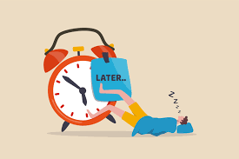
Start yesterday

Slide 4
Plan your writing process
Break the process down into tasks
List all tasks and allocate time
Deadline for drafts (1st , 2nd , 3rd)
Plan for the unforeseen
Long term vs. short term plans
Consider your productivity

Slide 5
Getting the Language Right

Slide 6
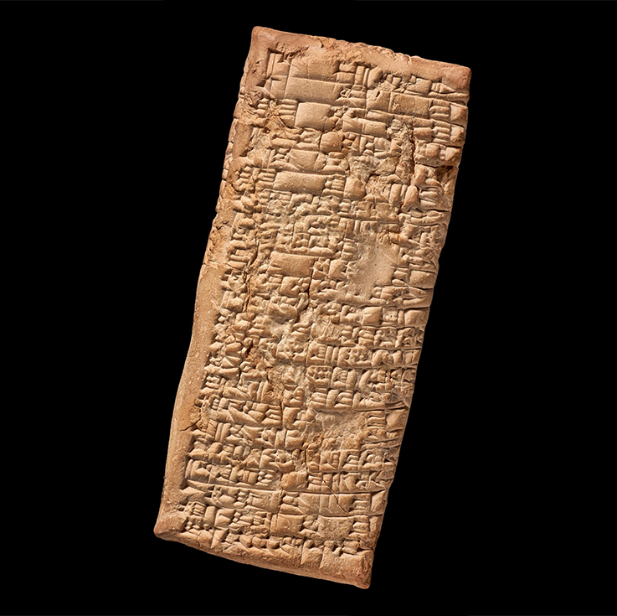
What is This?
Tell Ea-nasir: Nanni sends the following message: ​ When you came, you said to me as follows : "I will give Gimil-Sin (when he comes) fine quality copper ingots." You left then but you did not do what you promised me. You put ingots which were not good before my messenger (Sit-Sin) and said: "If you want to take them, take them; if you do not want to take them, go away!" ​ What do you take me for, that you treat somebody like me with such contempt? I have sent as messengers gentlemen like ourselves to collect the bag with my money (deposited with you) but you have treated me with contempt by sending them back to me empty-handed several times, and that through enemy territory. Is there anyone among the merchants who trade with Telmun who has treated me in this way? You alone treat my messenger with contempt! On account of that one (trifling) mina of silver which I owe(?) you, you feel free to speak in such a way, while I have given to the palace on your behalf 1,080 pounds of copper, and umi-abum has likewise given 1,080 pounds of copper, apart from what we both have had written on a sealed tablet to be kept in the temple of Shamash.
How have you treated me for that copper? You have withheld my money bag from me in enemy territory; it is now up to you to restore (my money) to me in full. ​ Take cognizance that (from now on) I will not accept here any copper from you that is not of fine quality. I shall (from now on) select and take the ingots individually in my own yard, and I shall exercise against you my right of rejection because you have treated me with contempt.
Nanni to Ea-nasir: a letter of complaint (circa 1750 BC).
Writing is transactional.
Keep your readers in mind.
Notes:
𒀀 𒈾 𒂍 𒀀 𒈾 𒍢 𒅕 𒆠 𒉈 𒈠 𒌝 𒈠 𒈾 𒀭 𒉌 𒈠 𒀀 𒉡 𒌑 𒈠 𒋫 𒀠 𒇷 𒆪 𒆠 𒀀 𒄠 𒋫 𒀝 𒁉 𒄠 𒌝 𒈠 𒀜 𒋫 𒀀 𒈠 𒄖 𒁀 𒊑 𒁕 𒄠 𒆪 𒁴 𒀀 𒈾 𒄀 𒅖 𒀭 𒂗𒍪 𒀀 𒈾 𒀜 𒁲 𒅔 𒋫 𒀠 𒇷 𒅅 𒈠 𒋫 𒀝 𒁉 𒀀 𒄠 𒌑 𒆷 𒋼 𒁍 𒍑 𒄖 𒁀 𒊑 𒆷 𒁕 𒄠 𒆪 𒁴 𒀀 𒈾 𒈠 𒅈 𒅆 𒅁 𒊑 𒅀 𒋫 𒀸 𒆪 𒌦 𒈠 𒌝 𒈠 𒀜 𒋫 𒈠 𒋳 𒈠 𒋼 𒇷 𒆠 𒀀 𒇷 𒆠 𒀀 𒋳 𒈠 [𒆷] 𒋼 𒇷 𒆠 𒀀 𒀜 𒆷 𒅗 𒅀 𒋾 𒀀 𒈾 𒆠 𒈠 𒈠 𒀭 𒉌 𒅎 𒌅 𒅆 𒅎 𒈠 𒉌 𒈠 𒆠 𒀀 𒄠 𒋼 𒈨 𒊭 𒀭 𒉌 𒈠 𒊑 𒀀 𒉿 𒇷 𒀀 𒈾 𒆠 𒈠 𒅗 𒋾 𒀀 𒈾 𒆠 𒋛 𒅀 𒈠 𒄩 𒊑 𒅎 𒀸 𒁍 𒊏 𒄠 𒈠 𒌅 𒈨 𒄿 𒊭 𒄠 𒈠 𒄿 𒈾 𒂵 𒂵 𒅈 𒈾 𒀝 𒊑 𒅎
𒅖 𒋾 𒅖 𒋗 𒅇 𒅆 𒉌 𒋗 𒊑 𒆪 𒋢 𒉡 𒌅 𒋼 𒅕 𒊏 𒄠 𒄿 𒈾 𒀀 𒇷 𒅅 𒋼 𒂖 𒈬 𒌦 𒈠 𒀭 𒉡 𒌝 𒊭 𒆠 𒀀 𒄠 𒄿 𒁍 𒊭 𒀭 𒉌 𒄿 𒈠 𒀜 𒋫 𒈠 𒅈 𒅆 𒅁 𒊑 𒅀 𒌅 𒈨 𒂊 𒅖 𒀀 𒈾 𒈠 𒆷 𒅗 𒊍 𒉿 𒅎 𒊭 𒄿 𒈾 𒂵 𒋾 𒅀 𒌅 𒊺 𒍪 𒌑 𒆠 𒀀 𒄠 𒋫 𒁕 𒁍 𒌒 𒅇 𒀸 𒋳 𒄿 𒅗 𒀀 𒈾 𒂍 𒃲 𒇷 𒌋 𒐍 𒄘 𒍏 𒀀 𒈾 𒆪 𒀜 𒁲 𒅔 𒅇 𒋗 𒈪 𒀀 𒁍 𒌝 𒌋 𒐍 𒄘 𒍏 𒄿 𒁲 𒅔 𒂊 𒍣 𒅁 𒊭 𒀀 𒈾 𒂍 𒀭 𒌓 𒆪 𒉡 𒊌 𒅗 𒄠 𒉌 𒍣 𒁍 𒀀 𒈾 𒉿 𒊑 𒅎 𒊭 𒀀 𒋾 𒆠 𒄿 𒋼 𒁍 𒊭 𒀭 𒉌 𒆠 𒋛 𒄿 𒈾 𒂵 𒂵 𒅈 𒈾 𒀝 𒊑 𒌅 𒊌 𒋾 𒅋 𒆠 𒋛 𒀀 𒈾 𒂵 𒋾 𒅀 𒋗 𒇻 𒈠 𒄠 𒂊 𒇷 𒅗 𒄿 𒋗 𒆠 𒈠 𒀭 𒉌 𒆠 𒀀 𒄠 𒉿 𒊑 𒀀 𒄠 𒆷 𒁺 𒈬 𒂵 𒄠 𒆷 𒀀 𒈠 𒄩 𒊒 𒅗 𒋫 𒆷 𒈠 𒀜 𒄿 𒈾 𒆠 𒊓 𒇷 𒅀 𒅖 𒋾 𒈾 𒀀 𒌑 𒈾 𒍝 𒀝 𒈠 𒂊 𒇷 𒆠
𒅇 𒀀 𒈾 𒊭 𒌅 𒈨 𒄿 𒊭 𒀭 𒉌 𒈾 𒋛 𒄴 𒋫 𒄠 𒂊 𒁍 𒍑 𒅗

Slide 7
What is a Paragraph?
A paragraph is a unit of sense within a piece of writing. It makes one clear point (X) and has an introductory sentence and a concluding sentence. A change in paragraph signals a change, or progression, in topic to the reader.
Oxford Brookes University
Unity
Everything in the paragraph is about X
Completeness
Everything about X is in the paragraph
Order
Topic sentence and evidence are placed in a logical order.
Cohesion
The paragraph flows both from sentence to sentence and from preceding to following paragraph

Slide 8
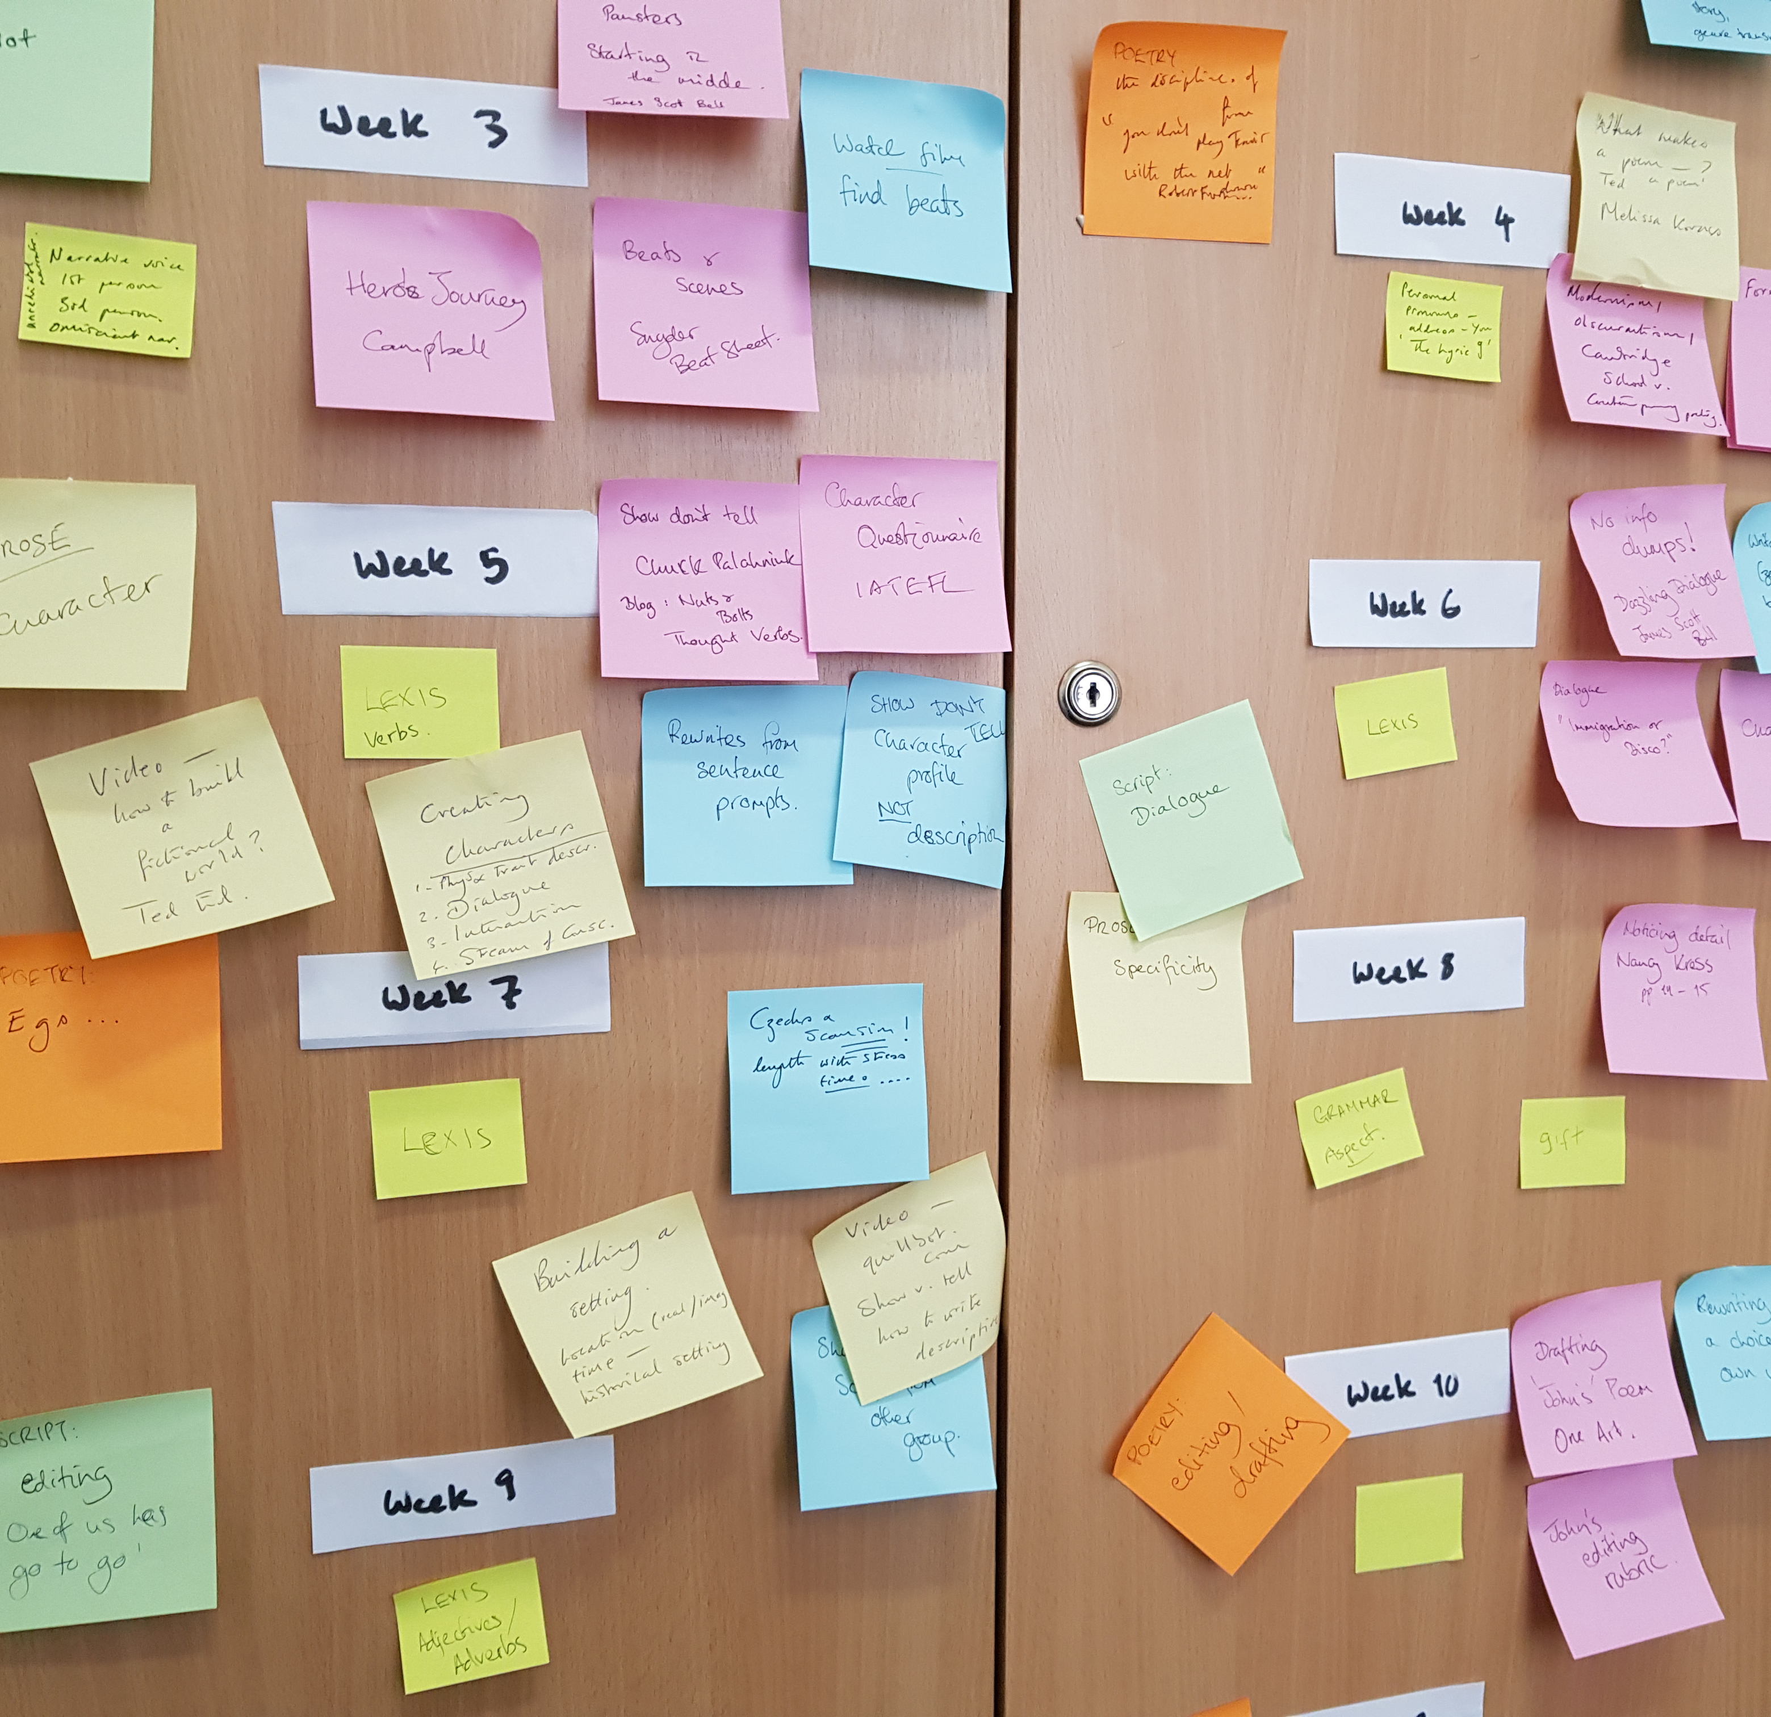
Be flexible
When you plan at first, be flexible.
With research come changing ideas.
Plan in a way that supports rather than hinders them.

Slide 9
Establish a Background
What are you writing for?
  (Claim the importance of the topic)
What are you writing about?
  (Make generalisations)
What do we know so far?
  (Review the literature)
Why then …?

Slide 10


Engage the Audience

Slide 11

Make a Claim for Your Paper
Counter-claim
Indicate a gap
Raise a question
Expand existing research

Slide 12
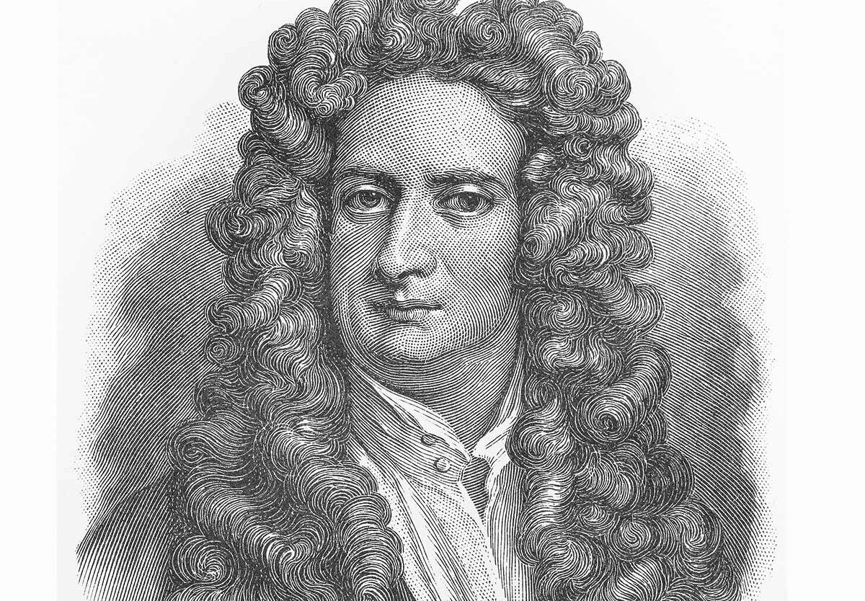
Be Generous
“If I have seen further, it is by standing on the shoulders of Giants”
Position your paper as a response – an addition to the conversation.
“This paper challenges…”

Slide 13
Is this thinking of the reader?
In today's dynamic and competitive marketplace, effective marketing communication holds the key to unlocking brand success. It allows businesses to rise above basic product or service offerings, forging meaningful connections with target audiences and shaping brand perception. However, with an ever-evolving media landscape and an influx of communication channels, crafting a strategic approach to marketing communication has become increasingly complex as such, understanding the intricacies of marketing communication strategy has become imperative for businesses seeking to thrive in competitive landscapes. Innovative marketing communication strategies are essential for businesses to thrive in today's competitive landscape. By embracing creativity, leveraging technology, and remaining sensitive to consumer preferences, businesses can forge stronger connections with their audience, drive growth, and position themselves for long-term success.

Slide 14
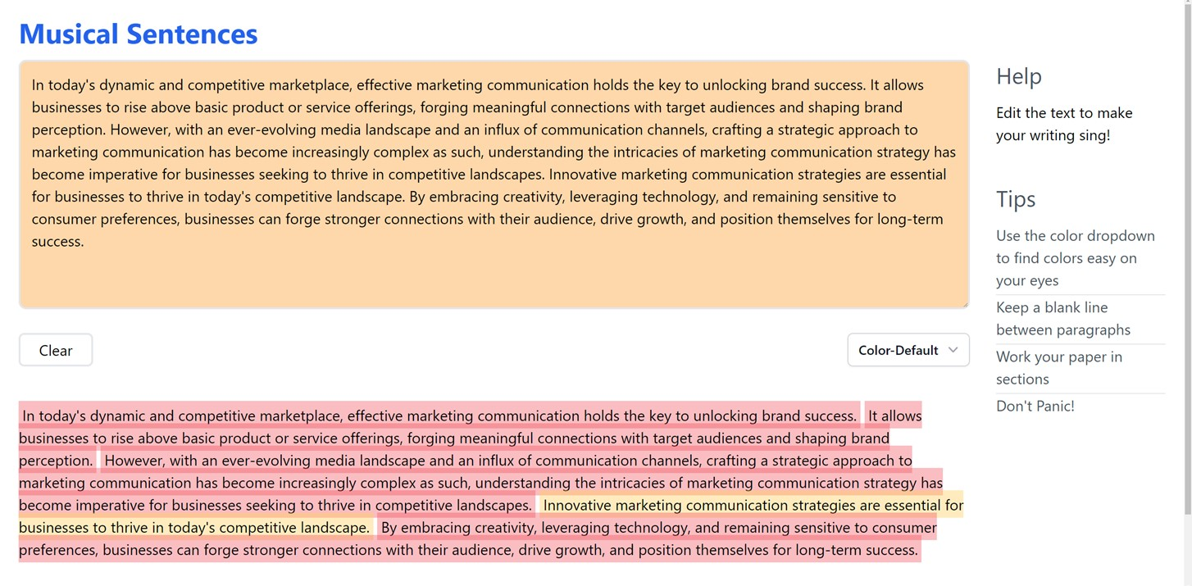
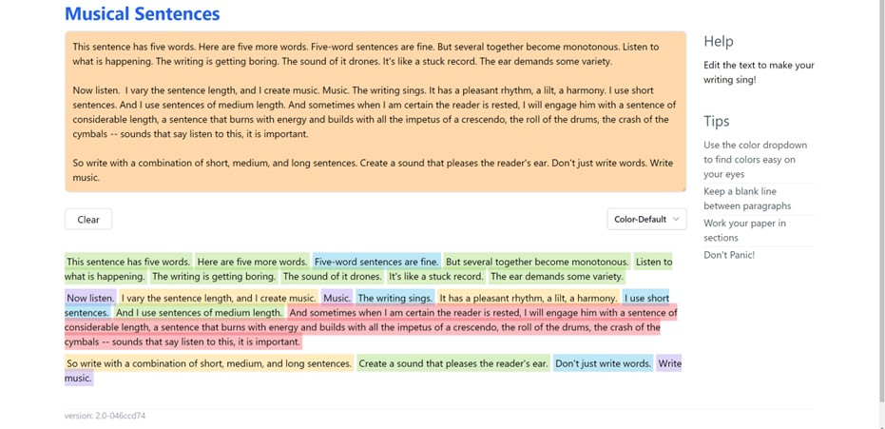
Length
Don’t write walls of text → tl;dr.
Sentence length matters https://www.musical-sentences.com/

Slide 15
Using ChatGPT
ChatGPT is dumb – it needs your help
AI can’t really write papers for you – but it can help make them better.
“I’m writing a paper on [topic] for a leading [discipline] academic journal. What I tried to say in the following section is [specific point]. Please rephrase it for clarity, coherence and conciseness, ensuring each paragraph flows into the next. Remove jargon. Use a professional tone.” Dritjon Gruda
AI writing tools rely on context – the more you give, the better the results.
Be warned – it seems to be getting dumber! Sometimes it just makes things worse…

Slide 16
A closer look at that text
In today's dynamic and competitive marketplace, effective marketing communication holds the key to unlocking brand success. It allows businesses to rise above basic product or service offerings, forging meaningful connections with target audiences and shaping brand perception. However, with an ever-evolving media landscape and an influx of communication channels, crafting a strategic approach to marketing communication has become increasingly complex as such, understanding the intricacies of marketing communication strategy has become imperative for businesses seeking to thrive in competitive landscapes. Innovative marketing communication strategies are essential for businesses to thrive in today's competitive landscape. By embracing creativity, leveraging technology, and remaining sensitive to consumer preferences, businesses can forge stronger connections with their audience, drive growth, and position themselves for long-term success.

Slide 17

A closer look at that text
In today's dynamic and competitive marketplace, effective marketing communication holds the key to unlocking brand success. It allows businesses to rise above basic product or service offerings, forging meaningful connections with target audiences and shaping brand perception. However, with an ever-evolving media landscape and an influx of communication channels, crafting a strategic approach to marketing communication has become increasingly complex as such, understanding the intricacies of marketing communication strategy has become imperative for businesses seeking to thrive in competitive landscapes. Innovative marketing communication strategies are essential for businesses to thrive in today's competitive landscape. By embracing creativity, leveraging technology, and remaining sensitive to consumer preferences, businesses can forge stronger connections with their audience, drive growth, and position themselves for long-term success.
Unlock success
Forge connections
Shape perception
Influx of channels
Thrive in landscapes
Businesses … with their audience

Slide 18
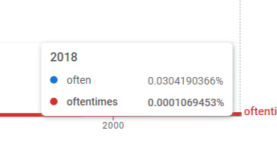
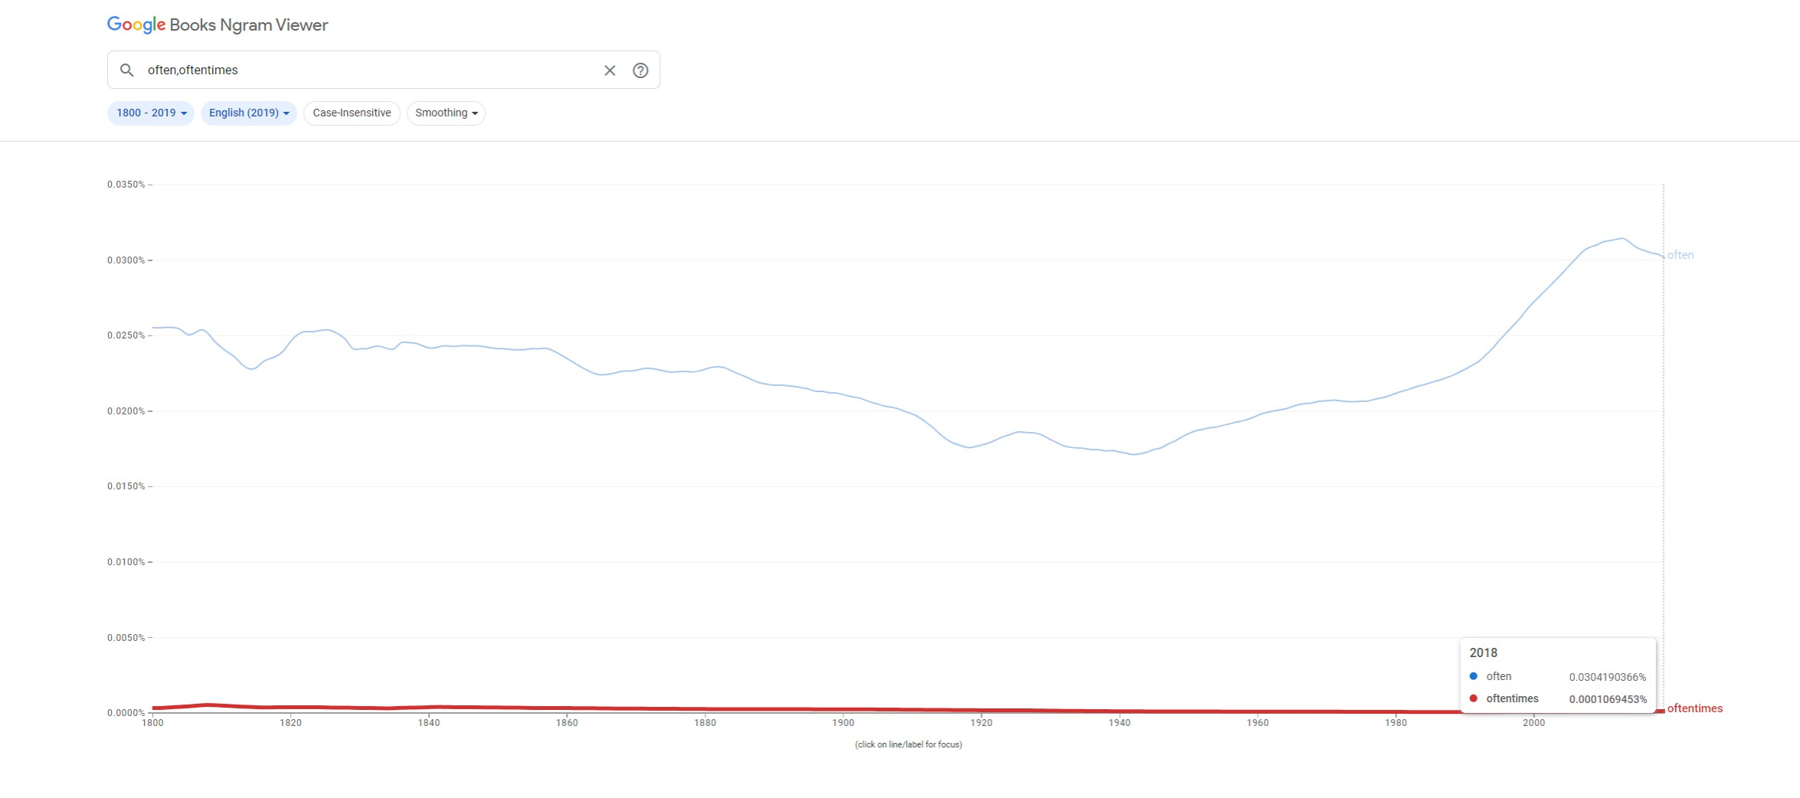
Use the right lexis
Google Ngram for “often, oftentimes”
https://books.google.com/ngrams/

Slide 19
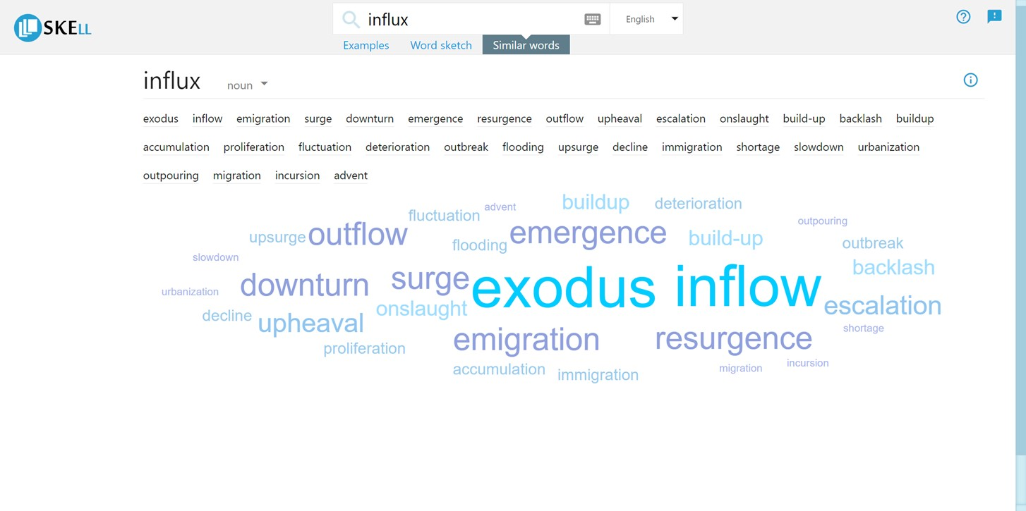
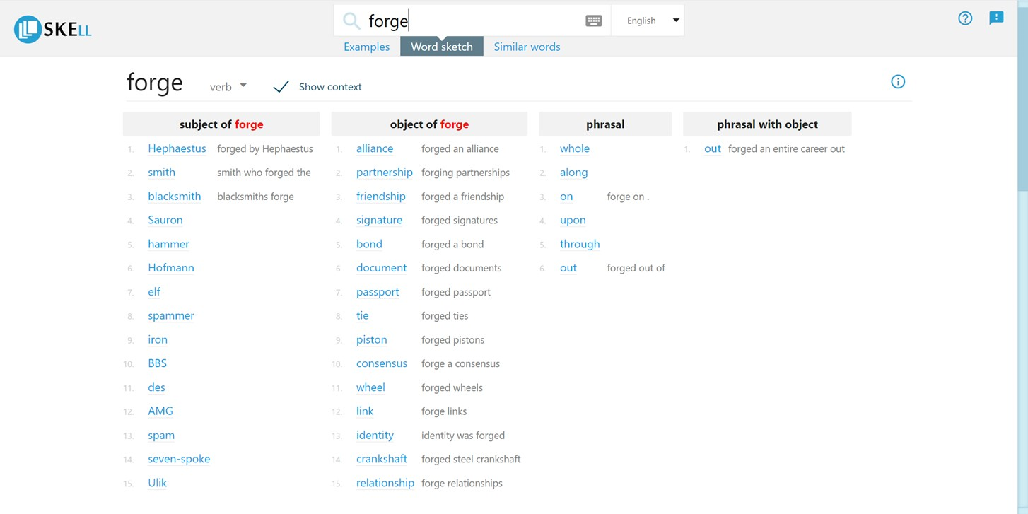
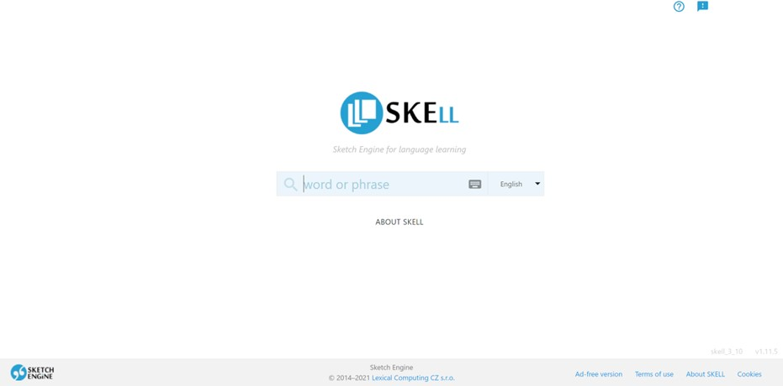
SKELL – corpus linguistics for non-linguists
https://skell.sketchengine.eu/#home?lang=en
Unlock success
Forge connections
Shape perception(s)
Influx of channels
Thrive in landscapes
Business … with their audience

Slide 20
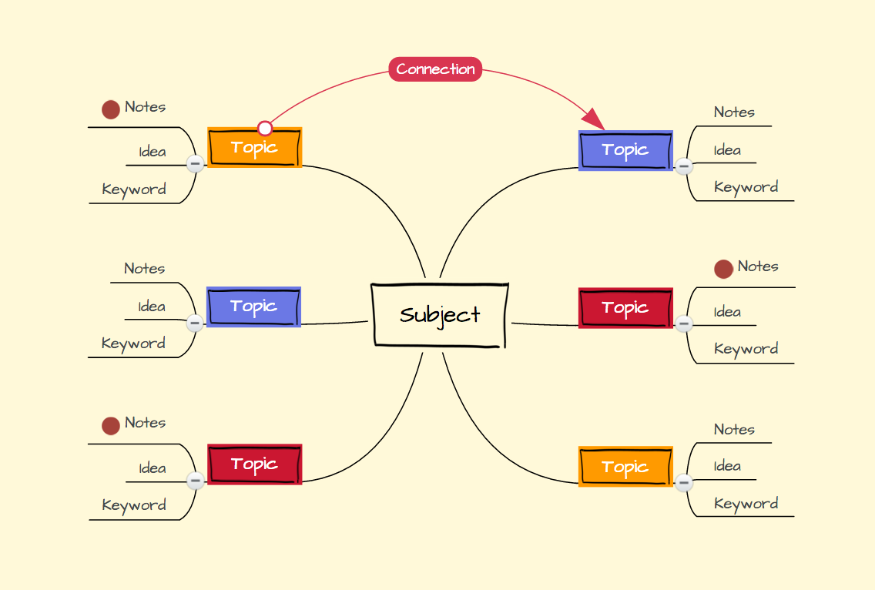
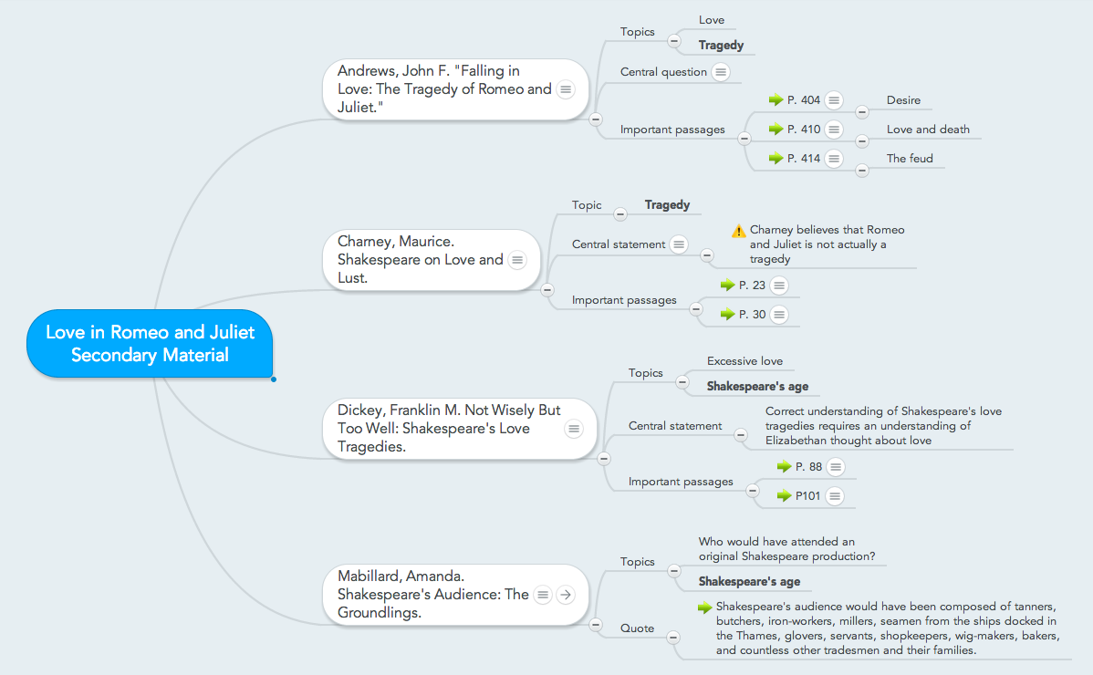
Outline Your Paper in a Mind Map
www.Mindmup.com
www.Coggle.it
www.Mindmeister.com

Slide 21
Literature Review

Slide 22

What a Literature Review Isn’t
a list
a simple summary of other people’s work
a chaotic jumping from point to point
an opportunity to ‘name drop’

Slide 23
Structure
Find Your Literature
  Background & Research Area (limitations etc)
Assess its Relevance
  Finding the Gap / Standing on the Shoulders of Giants
Identify Themes
  What are the Key Themes / Areas of Research Relevant to Your thesis?
Decide on Your Outline
Write the Literature Review

Slide 24
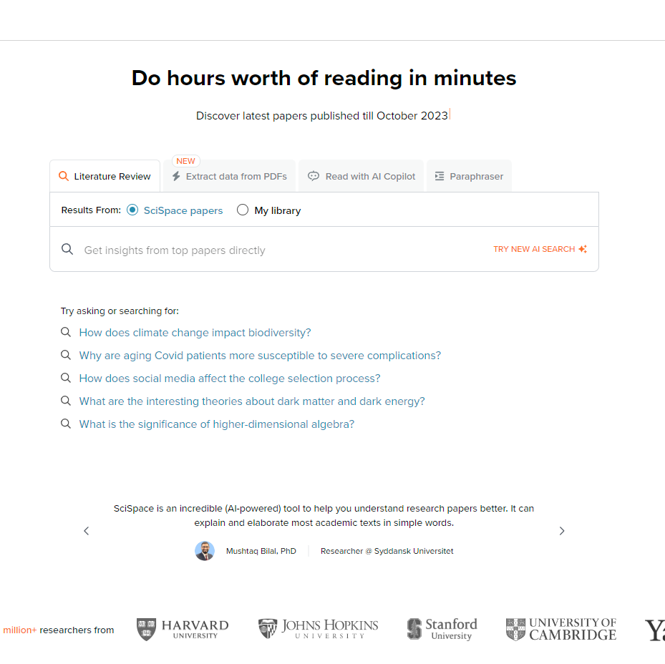
Get an overview - SciSpace
www.typeset.io
Input your question – see what’s out there.
Summarise and review.
Use that to generate your own research question.
Further/future research in conclusions/discussion is a good place to start

Slide 25
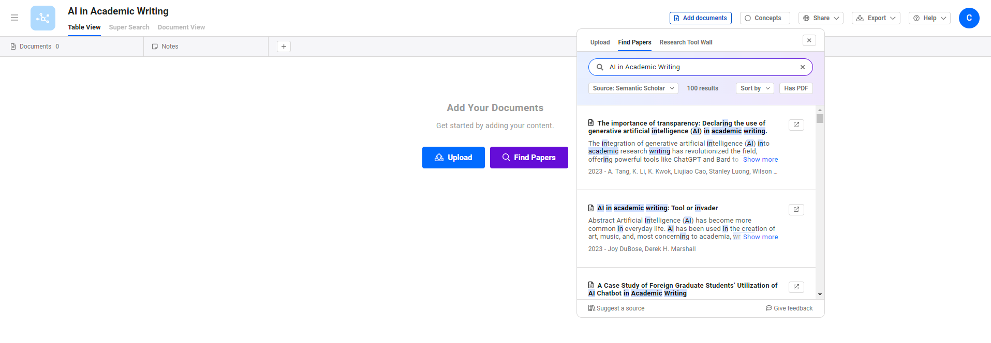
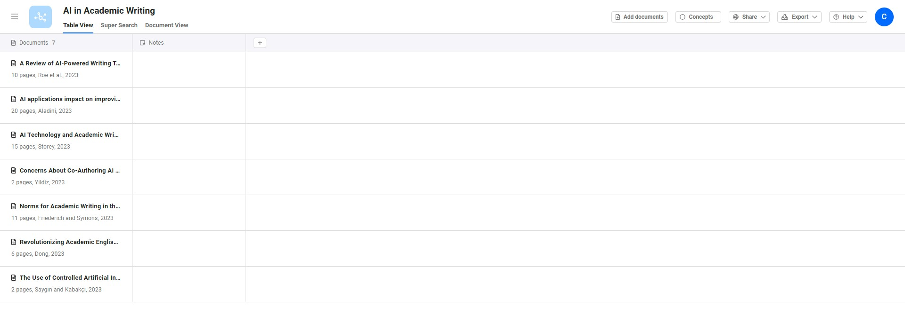
Lateral.io

Slide 26
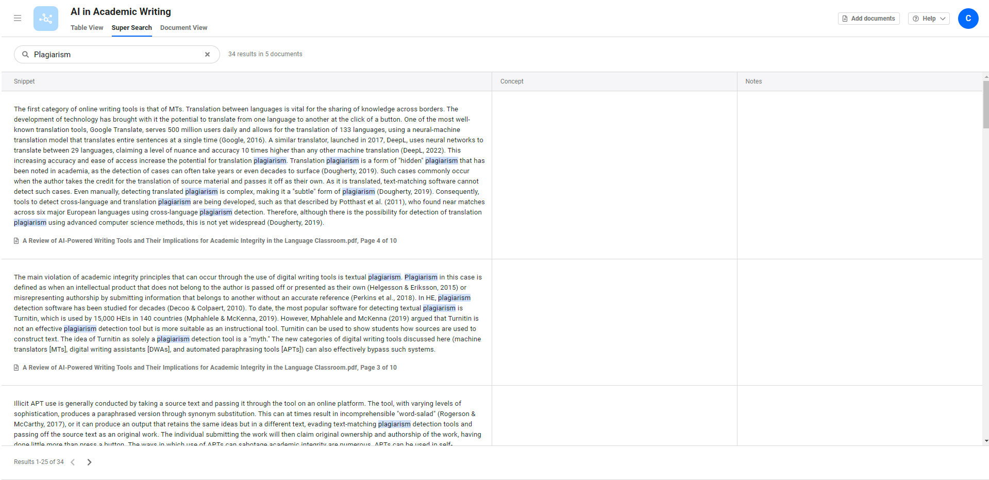
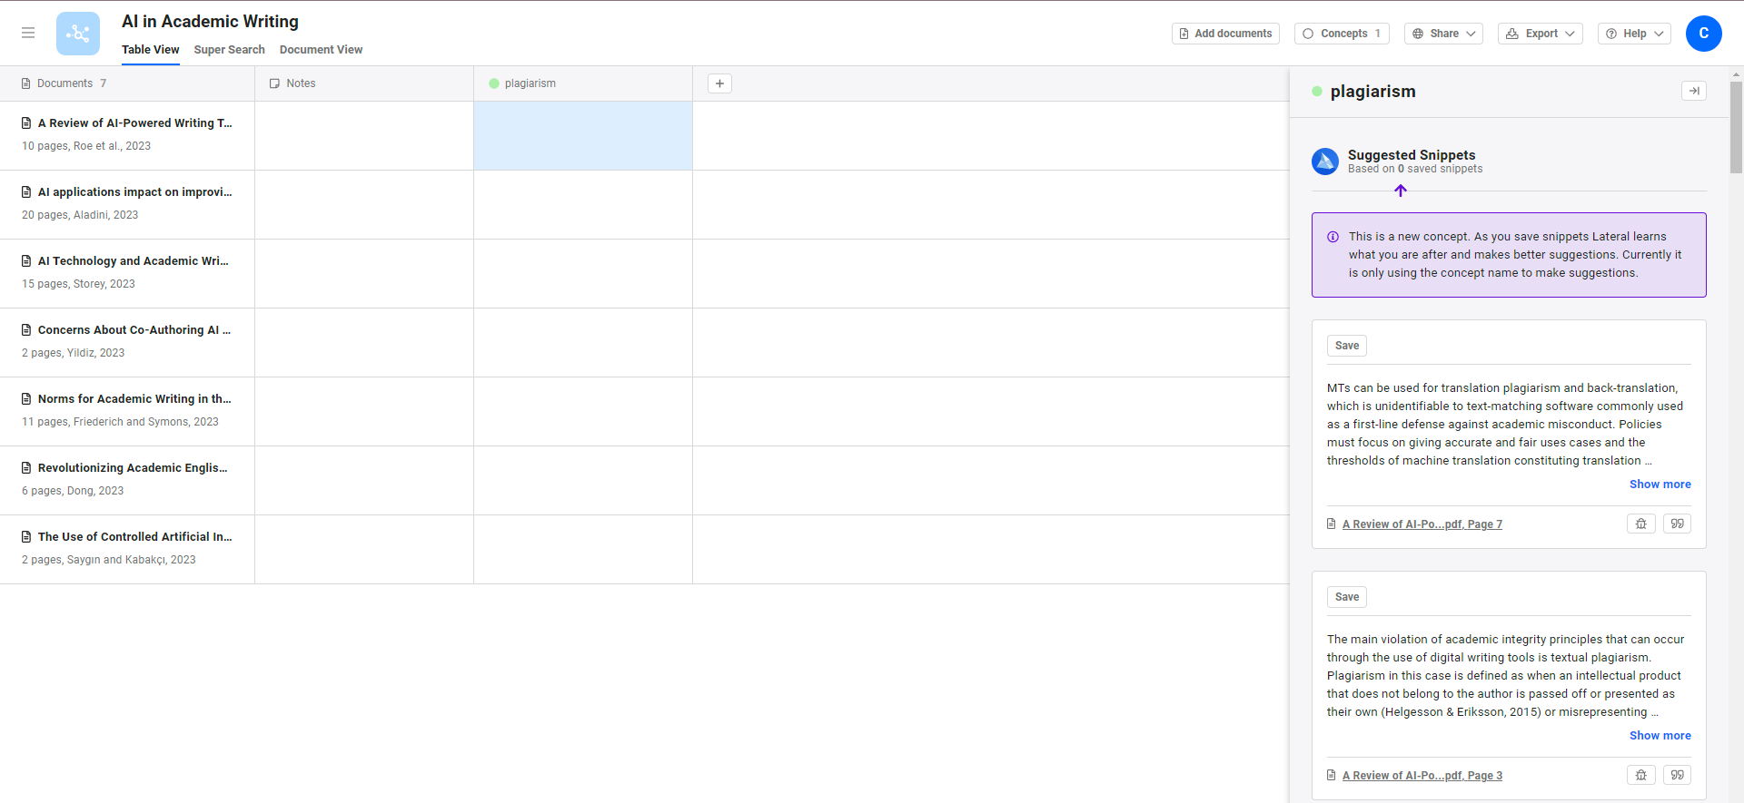
Lateral.io

Slide 27

Other Tools
www.evidencehunt.com
Registration necessary
Will provide an answer to a question and a list of papers from citation
www.researchkick.com
Paid at present (institutional subscription)
Helps find research gaps and questions

Slide 28
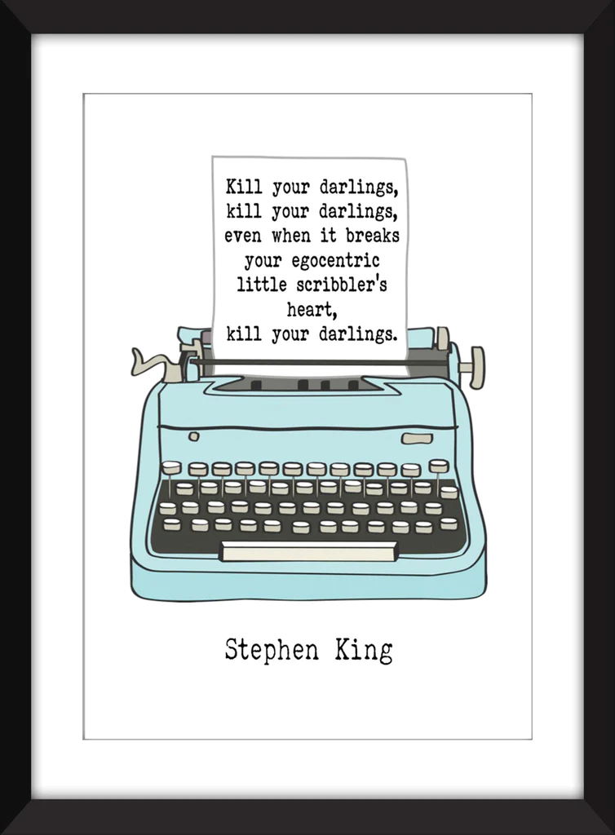
Take a break!
If you’ve just solved all the world’s problems or even some of them
…you probably haven’t.
Don’t become emotionally invested in your topic or argument.
Check your question is acceptable to the faculty/course.

Slide 29

Questions to ask yourself:
How does it relate to my question?
Is it still relevant?
How does it relate to my other sources?
Which outline ‘template’ would be the best choice?

Slide 30

Outline Choices
Chronological
  Easiest for you; easiest to screw (up).
  Make sure you analyse debates and patterns – why did such developments take place?
Methodological
  Compare results using differing research methodologies (qualitative vs quantitative), empirical vs theoretical outlooks, differing source types.
Thematic
  Compare different key areas within your question and organise your paper this way.
  Added advantage on making sure the review is about your topic, not previous literature.
Theoretical
  Identify key concepts and argue how and why different theories provide differing insight. A Keynesian outlook will differ significantly from a Monetarist one.

Slide 31
Write That Review
Introduction
Purpose of the review? Give the context (lots of research on X but not Y, for example).
Body
Synthesise: combine your sources into a cogent basis for your argument.
Analyse, interpret, evaluate. Don’t just paraphrase; relate the sources to your question and mention their strengths/weaknesses.
Conclusion
Emphasise significance of sources and show how you draw on them to construct a framework to answer your question.

Slide 32
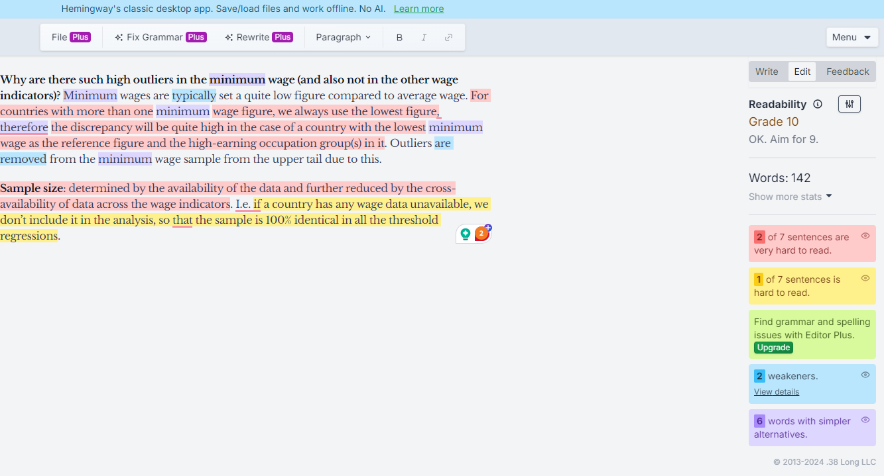
Check your style of writing with Hemmingway
https://hemingwayapp.com/

Slide 33
Finally, Check Your Work
Four Pillars of the Paragraph.
  (Unity / Completeness / Order / Cohesion)
Check for Redundancy / Collocation / Appropriacy.
Get someone else to read your work over.
(Check citations are correct!)

Slide 34
(Re)sources
SciSpace typeset.io
Lateral lateral.io
Musical sentences musical-sentences.com
Google ngram viewer books.google.com/ngrams
Skell skell.sketchengine.eu
ChatGPT chat.openai.com
Evidence Hunt evidencehunt.com
Research Kick researchkick.com
Hemmingway App hemingwayapp.com

Slide 35
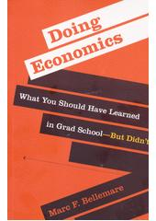
Suggested book
Doing economics : what you should have learned
in grad school-but didn’t (2022), Bellemare, Marc
E-book is available as E-Loan
https://katalog.muni.cz/Record/MUB01006507361
Chapter on Writing Papers is available in pdf
https://is.muni.cz/auth/do/econ/sm/akap/akademicky_text_a_proces_jeho_vzniku/Writting_papers_Bellemare_MIT_2022.pdf

Slide 36

References
Gritjon, Gruda. “Three Ways ChatGPT Helps Me in My Academic Writing.” Nature.com. https://www.nature.com/articles/d41586-024-01042-3
Oxford Brookes University. “Paragraphs.” https://www.brookes.ac.uk/students/academic-development/online-resources/paragraphs
Graff, Gerald, Cathy Birkenstein, and Russel K. Durst. “They Say / I Say”: The Moves that Matter in Academic Writing. New York: W.W. Norton & Company, 2021.

Slide 37

Thank you for listening!

Slide 38
Mindmup.com
Coggle.it
Mindmeister.com
Calmlywriter.com
Ilys.com/welcome
Ommwrite.com
Hemingwayapp.com
Quill.org/tools/grammar

