Slide 1
Paraphrasing
Academic writing
Seminar 2

Slide 2
The text below has some style problems
Many students use poor academic style in their writing, like using I, we and you. A simple way to improve this is to study good examples of academic style and to follow them. Their writing score will go up as a result. And it will be useful at university. Style is always a problem for non-English students, who make lots of mistakes when they start to write academic English, by using, for example, phrasal verbs instead of more formal verbs. This is something that such students need to learn to overcome if they wish to reach a higher grade. What other ways are there for students to improve their style? One way is to ask the teacher for advice. A considerable number of students don't listen to their teachers, and therefore do not improve. This is a terrible situation. It is important for students to remember that they are now adults, not kids. If they do not follow teachers' advice, their writing style will not improve.

Slide 3
Many students use poor academic style in their writing, like using I, we and you. A simple way to improve this is to study good examples of academic style and to follow them. Their writing score will go up as a result. And it will be useful at university. Style is always a problem for non-English students, who make lots of mistakes when they start to write academic English, by using, for example, phrasal verbs instead of more formal verbs. This is something that such students need to learn to overcome if they wish to reach a higher grade. What other ways are there for students to improve their style? One way is to ask the teacher for advice. A considerable number of students don't listen to their teachers, and therefore do not improve. This is a terrible situation. It is important for students to remember that they are now adults, not kids. If they do not follow teachers' advice, their writing style will not improve.

Slide 4
Many students use poor academic style in their writing, for example using I, we and you. A simple way to improve this is to study good examples of academic style and to follow them. Their writing score will increase as a result. In addition it will be useful at university. Style is often a problem for non-English students, who make a considerable number of mistakes when they start to write academic English, by using, for example, phrasal verbs instead of more formal verbs. This is a problem that such students need to learn to overcome if they wish to reach a higher grade. There are other ways in which students can improve their style. One way is to ask the teacher for advice. A considerable number of students do not listen to their teachers, and therefore do not improve. This is a terrible situation. It is important for students to remember that they are now adults, not children. If they do not follow teachers' advice, their writing style is unlikely to improve.

Slide 5
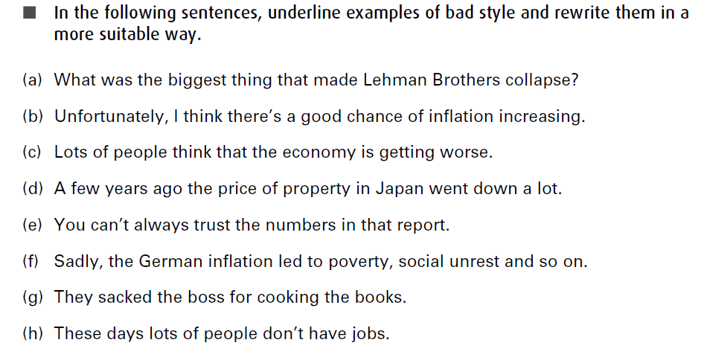

Slide 6
The main factor in the collapse of Lehman Brothers was . . .
There appears to be a significant risk of inflation increasing.
It is commonly believed that the economy is deteriorating.
After 1989, the price of Japanese property fell sharply.
The numbers in that report are unreliable.
The German inflation led to poverty and social unrest.
The manager was dismissed for embezzlement.
Currently there is high unemployment.

Slide 7
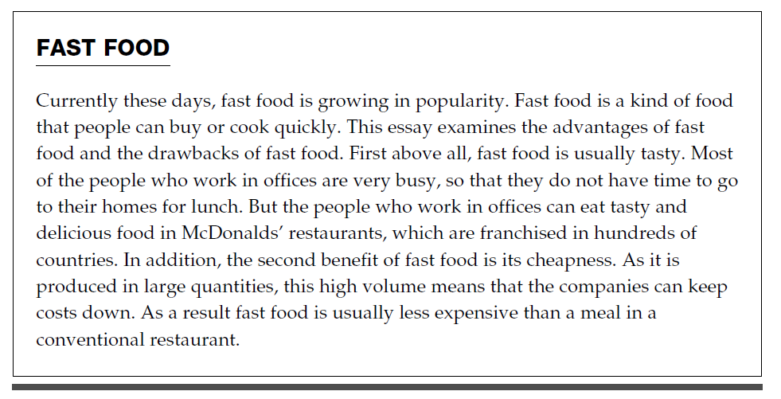
In the following text, remove all repetition and redundancy, rewriting where necessary.

Slide 8
Model answer:
Currently, fast food is growing in popularity. Fast food is food that people can buy or cook quickly. This essay examines the advantages and drawbacks of fast food. First, it is usually tasty. Most people who work in offices are very busy, so they do not have time to go home for lunch. But they can eat tasty food in restaurants such as McDonald’s. The second benefit of fast food is cheapness. As it is produced in large quantities, this means that companies can keep costs down. As a result it is usually less expensive than a meal in a conventional restaurant.

Slide 9
Three ways to use someone’s else work in your own
quotation,
paraphrase
summary.
Paraphrase is the most common of the three.
Materials: https://www.eapfoundation.com/writing/paraphrase/

Slide 10
Using quotation is easier, especially for beginning writers, but you should use quotation sparingly (less than 5% of text).
Paraphrasing is better than quoting, because a quote in your writing only shows your ability to copy from a text but does not demonstrate any understanding of your reading unless you then include an interpretation of the quote.
Paraphrasing is the process of reading a section of text and then re-writing it using your own words. It is necessary in university study as it shows that you have understood the information.

Slide 11
Paraphrasing is different from summarizing. When paraphrasing you need to write more precisely and convey the meaning in as few words as possible.
Paraphrasing is favoured over summary because it allows you to keep the full meaning of the original text, rather than just stating the main points.
Effective paraphrasing is essential in order to avoid plagiarism. Avoiding plagiarism, however, is not the main aim of paraphrasing.

Slide 12
Paraphrasing is a way of showing your understanding of the information you have read but it is a descriptive way of writing. It is a good starting point for developing your academic writing style and learning to understand the need to reference in your first year at university but as you move into later years you will need to develop a more critical approach.

Slide 13
How to paraphrase
Keep the paraphrase as simple as possible.
Express the points concisely.
Use your own words and do not be tempted to copy from the original text unless there is to include technical language.
Three vocabulary techniques:
changing words;
changing word forms;
changing word order.

Slide 14
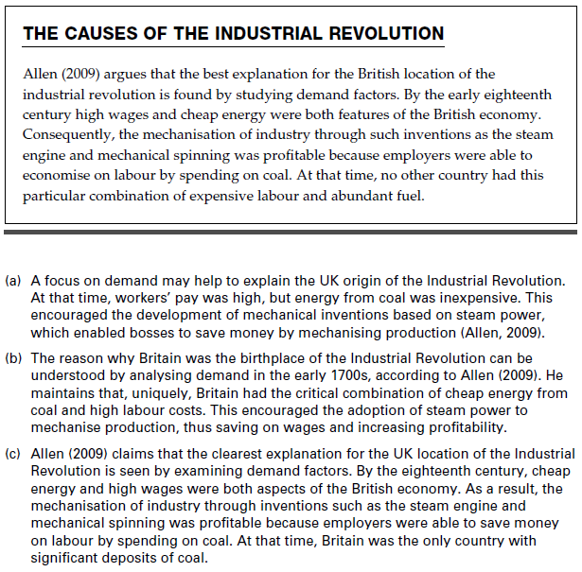
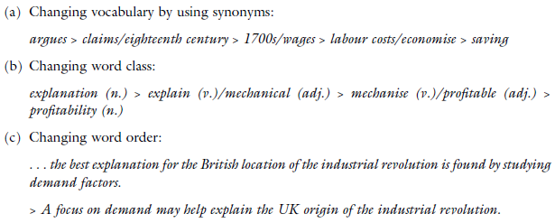
Read the text below and then evaluate the three paraphrases giving reasons
Task 1
Techniques for paraphrasing
Look for
Changing vocabulary by using synonyms
Changing word class:
Changing word order:
Note that in practice, all these three techniques are used at the same time. Do not attempt
to paraphrase every word, since some have no true synonym (e.g. demand, economy).
(a) Quite good, but lack of precision (at that time) and unsuitable register (bosses)
(b) The best paraphrase, with all main points included and a significantly different structure
(c) A poor paraphrase, with only a few words changed and extra and inaccurate information
added (Britain was the only country . . .)

Slide 15
What not to do when paraphrasing:
Use the same sentence structure as the original source: for example, only changing a few words.
Only slightly adapt the original source and then pass this off as your own summary or paraphrase.
Copy useful pieces of the original text and pad it out using your own words.
You must not use bits of the original sentence(s) without referencing these appropriately otherwise you risk being accused of plagiarism.
Change each word to a similar one, a synonym, as you go along a sentence, so technically it is all changed. This it does not demonstrate your understanding of the source read.

Slide 16
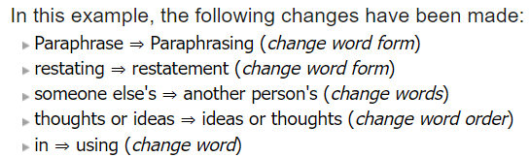
Example 1
Original text from Pears and Shields (2013, p.113)
“Paraphrase: A restating of someone else's thoughts or ideas in your own words.”
Paraphrase
Paraphrasing is a restatement of another person's ideas or thoughts using your own words.

Slide 17
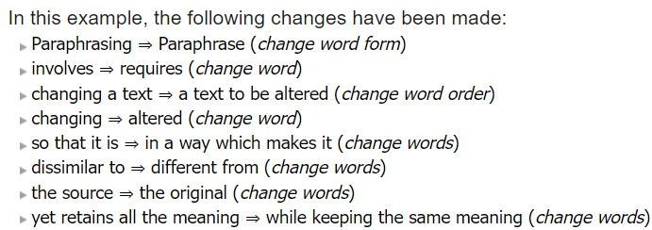
Example 2
Original text from Bailey (2000, p.21)
“Paraphrasing involves changing a text so that it is quite dissimilar to the source yet retains all the meaning.”
Paraphrase
Paraphrase requires a text to be altered in a way which makes it different from the original while keeping the same meaning.

