Slide 1
Referring verbs
Academic writing
Seminar 5

Slide 2
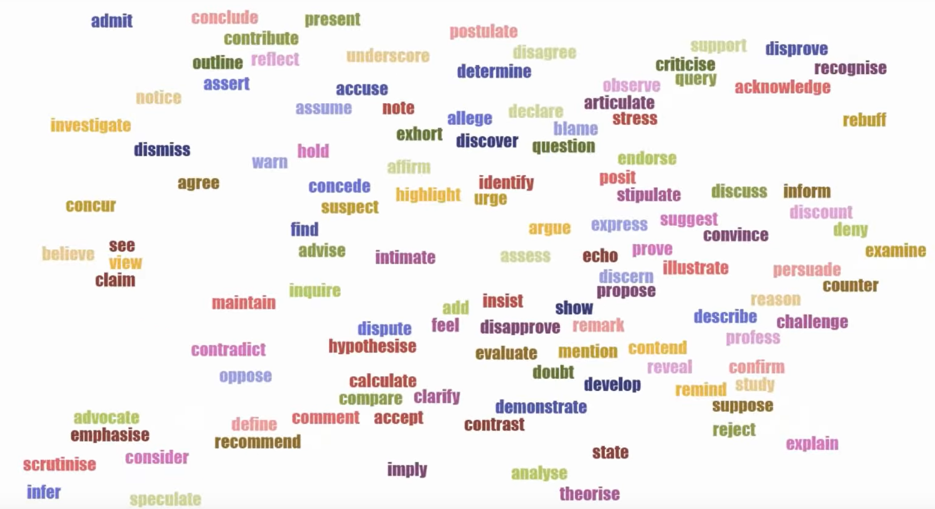

Slide 3
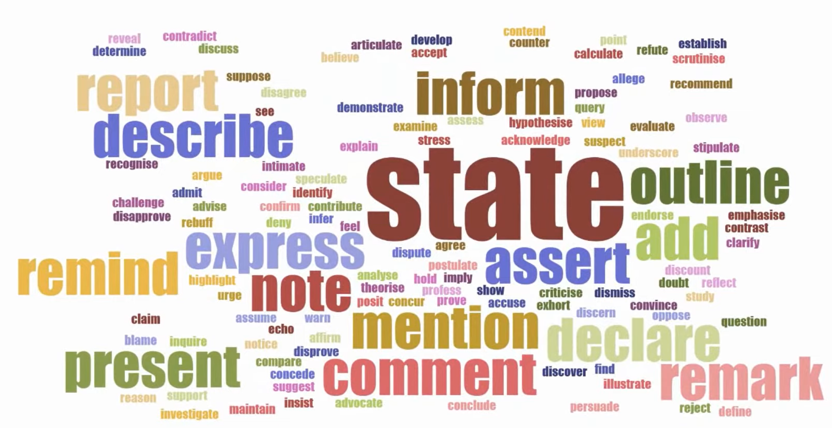

Slide 4
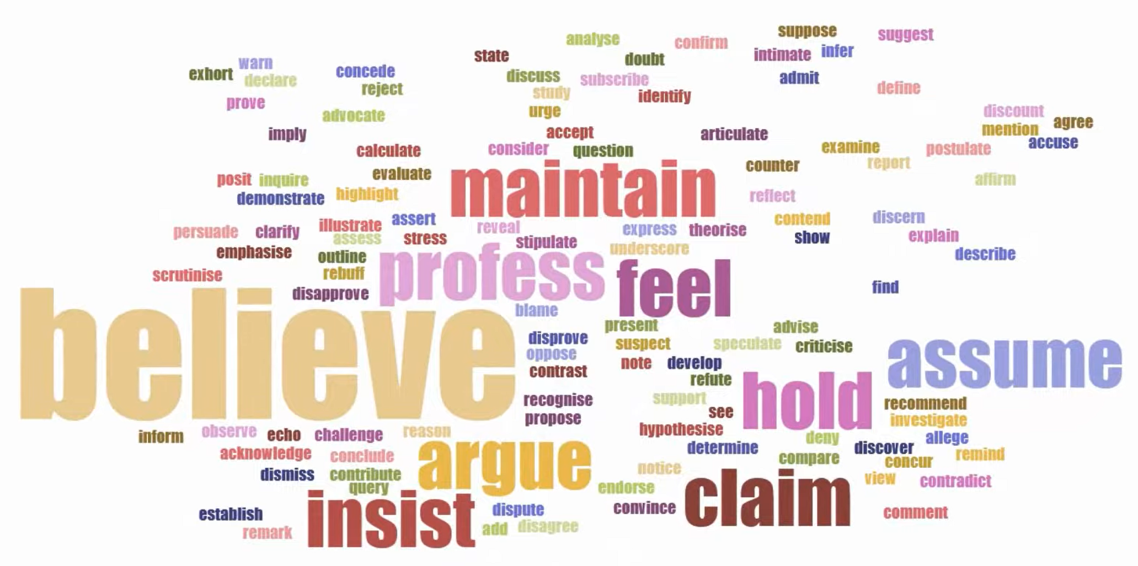

Slide 5
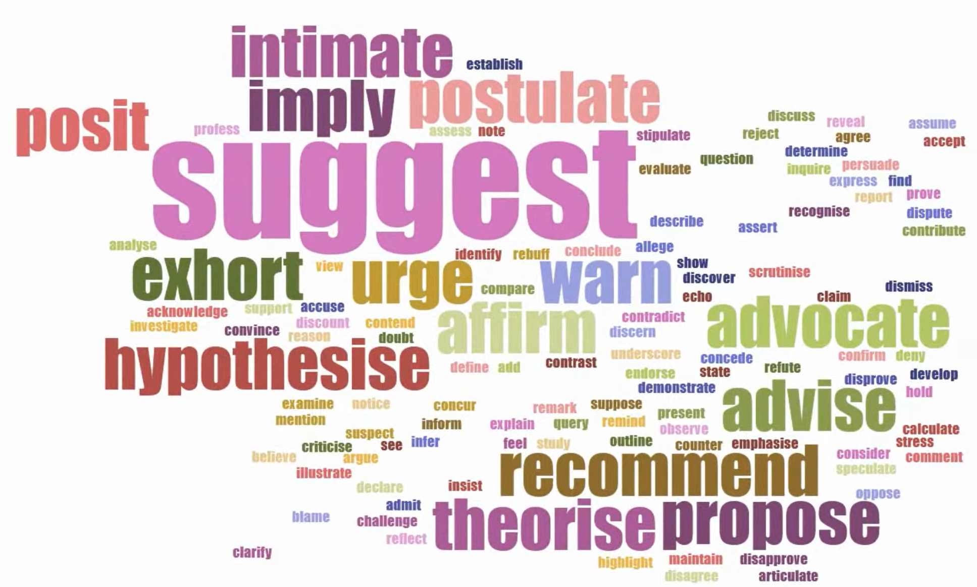

Slide 6
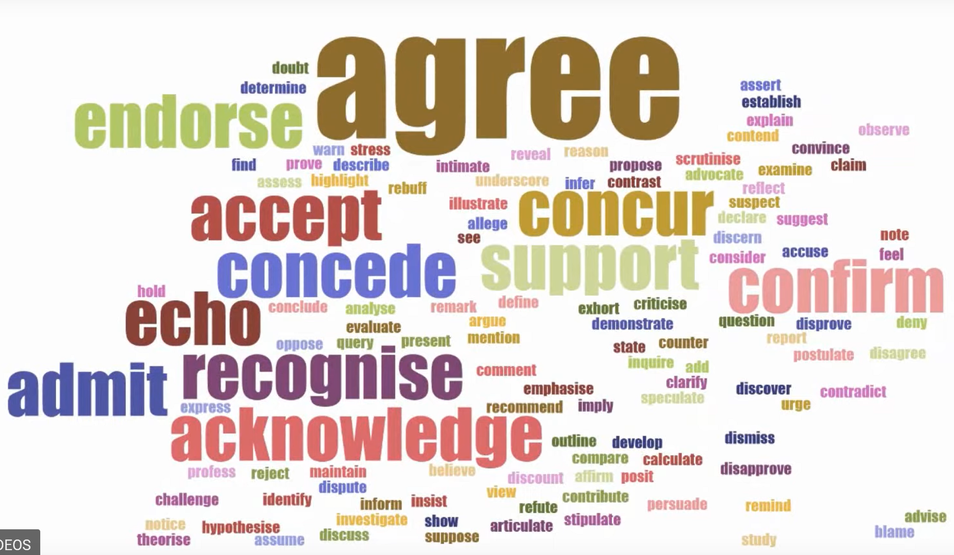
General meaning of agreement

Slide 7
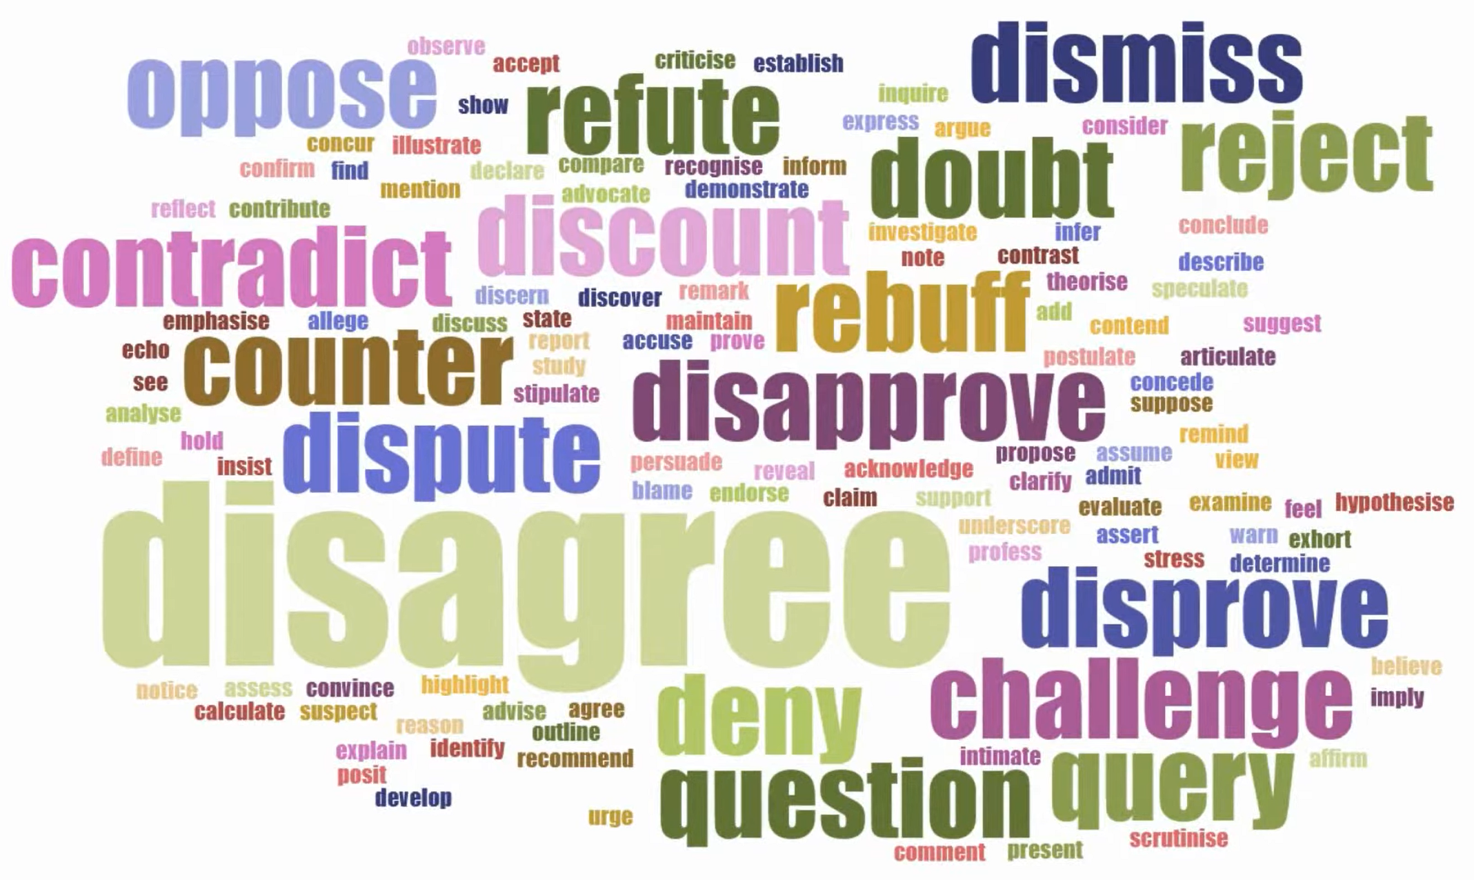
General meaning of disagreement

Slide 8
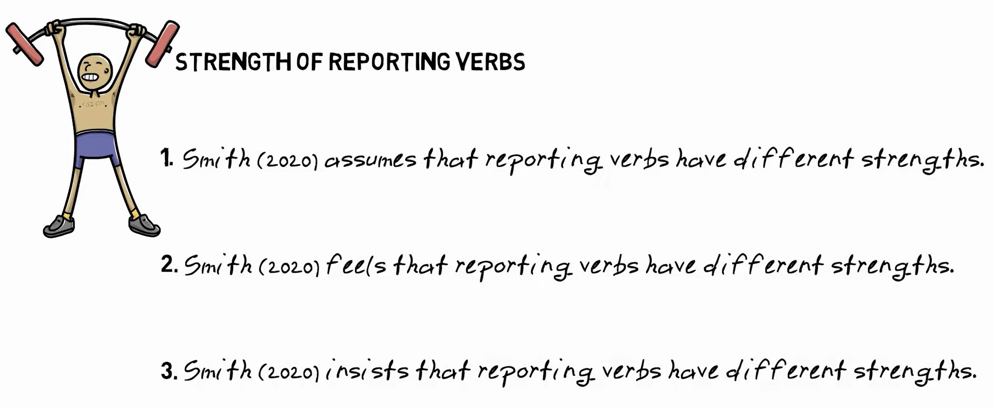

Slide 9
Using referring verbs
Referring verbs are used to summarise another writer’s ideas:
Previn argued that interest rates were too low.
Bakewell (1992) found that most managers tended to use traditional terms . . .
They may also be used to introduce a quotation:
As Scott observed: ‘Comment is free but facts are sacred.’
Most of these verbs are followed by a noun clause beginning with ‘that’.

Slide 10
Using referring verbs
The following mean that the writer is presenting a case:
• argue • claim • consider • hypothesise • suggest • believe • think • state.
Melville (2007) suggested that tax rates should be harmonised.
A second group describe a reaction to a previously stated position:
• accept • admit • agree with • deny • doubt.
Handlesmith doubts Melville’s suggestion that tax rates should be harmonised.
Others include:
• assume • conclude • discover • explain • imply • indicate • maintain • presume • reveal • show.
Patel (2003) assumes that inflation will remain low.

Slide 11
• argue • claim • consider • hypothesise • suggest • believe • think • state
• accept • admit • agree with • deny • doubt
• assume • conclude • discover • explain • imply • indicate • presume • reveal • show.

Slide 12
Further referring verbs
A small group of verbs is followed by the pattern (somebody/thing + for + noun/gerund):
• blame • censure • commend • condemn • criticise.
"Lee (1998) blamed the media for creating uncertainty."
Another group is followed by (somebody/thing + as + noun/gerund):
• assess • characterise • classify • define • describe • evaluate • identify • interpret • portray • present.
"Terry interprets rising oil prices as a result of the Asian recovery."

Slide 13
• blame • censure • commend • condemn • criticise.
• assess • characterise • classify • define • describe • evaluate • identify • interpret • portray • present.

Slide 14
Reporting Verbs
Hard sciences have a more detached reporting style
  The relevant theory was developed by Bruno.
  Stein et al. reported that a typical force..
  Paiva and Venturinit presented an alternative formulation…
Contrasted with soft sciences:
  Baumgarter and Bagozzi (1995) strongly recommend the use of…
  Law and Whitley (1989) argued, for instance, that…..
Plus use of evaluative adverbial comment
  He argues, correctly to my mind, that…
  Churchland justifiably rejects this notion….
  As Stern and Terrell, correctly assert…

Slide 15
Hedges
Hedging, also called caution or cautious language or tentative language or vague language, is a way of softening the language by making the claims or conclusions less absolute.
  Although duration of smoking is also important when considering risk, it is highly correlated with age, which itself is a risk factor, so separating their effects can be difficult; however, large studies tend to show a relation between duration and risk. Because light smoking seems to have dramatic effects on cardiovascular disease, shorter duration might also be associated with a higher than expected risk.

Slide 16
Hedges
  Although duration of smoking is also important when considering risk, it is highly correlated with age, which itself is a risk factor, so separating their effects can be difficult; however, large studies tend to show a relation between duration and risk. Because light smoking seems to have dramatic effects on cardiovascular disease, shorter duration might also be associated with a higher than expected risk.

Slide 17
How to express caution
Introductory verbs
tend to ➞ tendency (n)
assume ➞ assumption (n)
indicate ➞ indication (n)
estimate ➞ estimate (n)
seem to ➞ seemingly (adv)
appear to be ➞ apparently (adv)
doubt ➞ doubtful (adj)
believe
suggest
think
Modal verbs expressing uncertainty instead of more certain modals such as will or would:
may
might
can
could

Slide 18
How to express caution
probably ➞ probable (adj), probability (n)
possibly ➞ possible (adj),
possibility (n)
seemingly ➞ seem to (v)
apparently ➞ appear to be (v)
arguably
perhaps
maybe
presumably
conceivably
sometimes
often
generally
usually
commonly
frequently
occasionally
in general
as a rule
approximately
roughly
about
reasonably
somehow
somewhat

Slide 19
How to write objectively
Use passive
Objective tone is most often connected with the use of passive, which removes the actor from the sentence. For example:
The experiment was conducted.
I conducted the experiment.
The length of the string was measured using a ruler.
I measured the length of the string with a ruler.

Slide 20
Focus on the evidence
Another way to use active voice while remaining objective is to focus on the evidence, and make this the subject of the sentence.
For example:
The findings show...
The data illustrate...
The graph displays...
The literature indicates...
Use evidence from sources
Evidence from sources is a common feature of objective academic writing. This generally uses the third person active. For example:
Newbold (2021) shows that... He further demonstrates the relationship between...
Greene and Atwood (2013) suggest that...

Slide 21
Use impersonal constructions
Impersonal constructions with It and There are common ways to write objectively. These structures are often used with hedges (to soften the information) and boosters (to strengthen it).
It is clear that... (booster)
It appears that... (hedge)
I believe that...
There are three reasons for this.
I have identified three reasons for this.
There are several disadvantages of this approach.
This is a terrible idea.

Slide 22
Personify the writing
Another way to write objectively is to personify the writing (essay, report, etc.) and make this the subject of the sentence.
This essay considers the role of diesel emissions in global warming.
I will discuss the role of diesel emissions in global warming.
This report has shown that...
I have shown that...

Slide 23
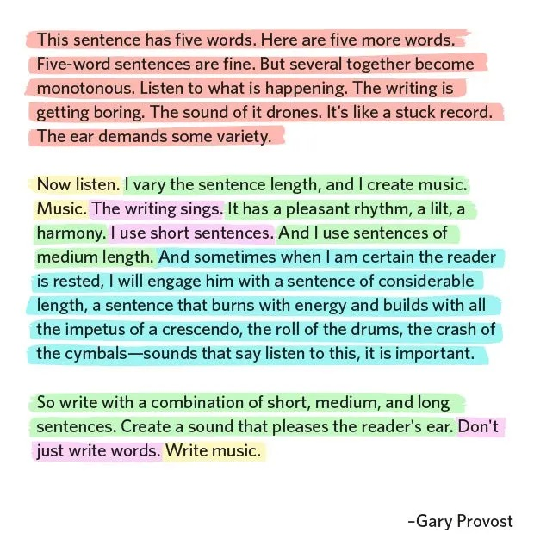

Slide 24
Using adverbs
Adverbs are used in academic writing in a variety of ways.
(a) to provide more detail, with verbs and adjectives:
Reasonably good data are available for only . . .
Economists traditionally argued for import controls.
(b) individually, often at the beginning of sentences, to introduce new points or link sentences together:
Currently, the Earth’s atmosphere appears to be warming up.
Alternatively, the use of non-conventional renewable energies . . .
Note: Adverbs used individually need to be employed with care. It is dangerous to overuse them. Adverbs such as ‘fortunately’ or ‘remarkably’ may be unsuitable

Slide 25
Using adverbs
Adverbs linked to verbs and adjectives usually fall into three groups:
(a) time (when?)
previously published
retrospectively examined
(b) degree (how much?)
declined considerably
contribute substantially
(c) manner (in what way?)
financially complicated
remotely located

Slide 26
Time: recently increasingly originally presently currently traditionally continuously
Degree: clearly particularly broadly highly wholly crucially emphatically
Manner: (un)surprisingly factually politically locally alternatively similarly psychologically
Notes:
(a) particularly
(b) Originally
(c) Alternatively
(d) Recently
(e) locally
(f) Clearly/Crucially

